Slide 1

Data Structure
Level 1
Binary Data Structure

Slide 2

Data Structure
Level 1
Binary Data Structure
Real Examples
2

Slide 3
You can store data in a number using binary
What does this number mean?
79

Slide 4
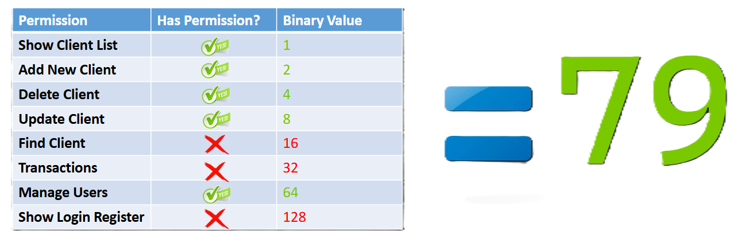
Number 79 means:

Slide 5
What is Time & Space Function of it? O(?)
If
(PermissonToCheck & UserPermissions =
PermissionToCheck)
yes
Else
No
O(1)

Slide 6
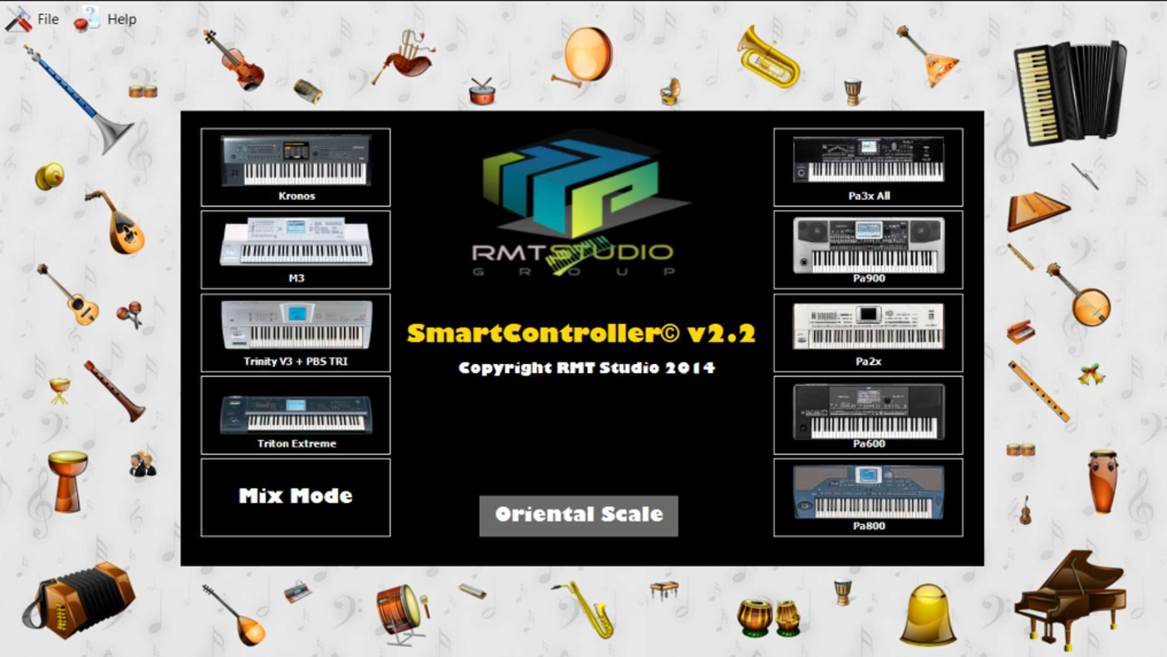
Another Practical Example

Slide 7
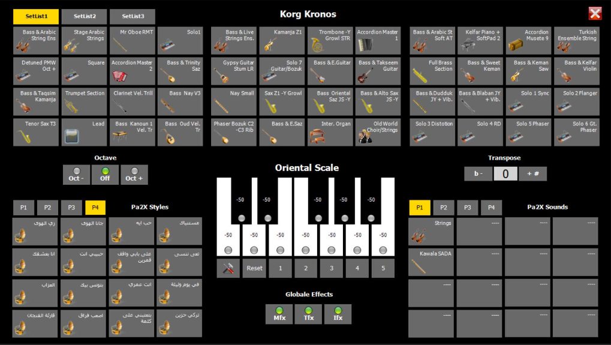
Another Practical Example

Slide 8
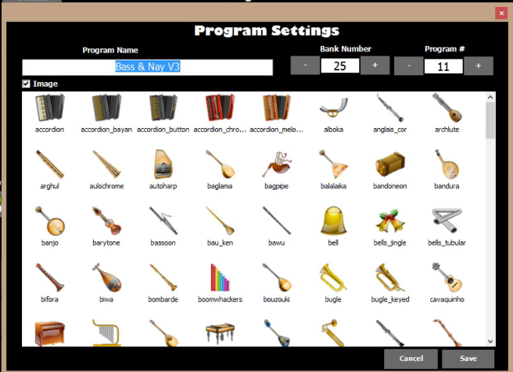
Another Practical Example

Slide 9
Another Practical Example

Slide 10
DKHSF-PYHQ8-58A8P-GRHCB-BV2ZS

Slide 11
Thank you ☺

