Slide 1

Data Structure
Level 1
Array Data Structures

Slide 2

Data Structure
Level 1
Array Data Structures
2

Slide 3
Array Data Structure:
🟨 Array: is a variable that can store multiple values of the same type.
🟨 Array: An array is a collection of data items stored at contiguous memory locations.
🟨 The idea is to store multiple items of the (homogeneous - same type)
together

Slide 4
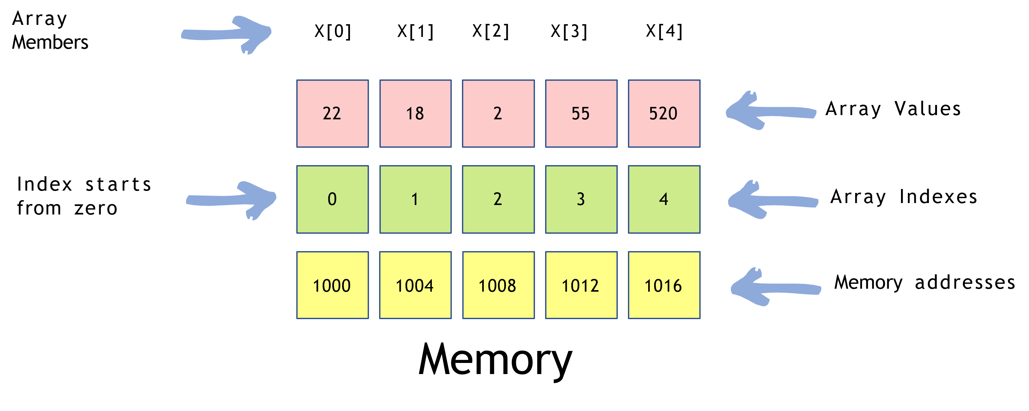
Array Data Structure:
int x[5] = { 22, 18, 2, 55, 520 };

Slide 5
Data Structure
Level 1
Is Array always of fixed size?
2

Slide 6
Is Array always of fixed size?
Depends on they language for example: In C language, the array has a fixed size meaning once the size is given to it, it cannot be changed
i.e. you can’t shrinfi it nor can you expand it.
In C++ you can have dynamic arrays.

Slide 7
Data Structure
Level 1
Operation on the Array
2

Slide 8
Operation on the Array
🟨 Arrays allow random access to elements. This makes accessing elements by position faster.
🟨 Hence operation like searching, insertion, and access becomes really efficient.
🟨 Array elements can be accessed using the loops.

Slide 9
Data Structure
Level 1
Time complexity on the Array
2

Slide 10
Time complexity on the Array
🟨 Insertion: We try to insert a value to a particular array index position, as the array provides random access it can be done easily using the assignment operator.
💡 arr[2] = 10;
🟨 Time Complexity:
O(1) to insert a single element
O(N) to insert all the array elements [where N is the size of the array]

Slide 11
Time complexity on the Array
🟨 Access elements in Array: Accessing array elements become extremely important, in order to perform operations on arrays.
💡 return arr[2];
🟨 Time Complexity:
O(1) to insert a single element
O(N) to insert all the array elements [where N is the size of the array]

Slide 12
Time complexity on the Array
🟨 Searching in Array: We try to find a particular value in the array, in order to do that we need to access all the array elements and look for the particular value.
// searching for value 55 in the array;
Loop from i = 0 to 10:
check if arr[i] = 55:
return true;
🟨 Time Complexity:
O(N) [where is the size of the array]

Slide 13
Data Structure
Level 1
Applications of the Array
2

Slide 14
Applications of the Array
🟨 Array stores data elements of the same data type.
🟨 Arrays are used when the size of the data set is known.
🟨 Used in solving matrix problems.
🟨 Applied as a lookup table in computer.
🟨 Databases records are also implemented by the array.
🟨 Helps in implementing sorting algorithm.
🟨 The different variables of the same type can be saved under one name.
🟨 Arrays can be used for CPU scheduling.
🟨 Used to Implement other data structures like Stacks, Queues, Heaps, Hash tables, etc.

Slide 15
Thank you ☺

