Slide 1

Data Structure
Level 1
Matrix Data Structures

Slide 2

Data Structure
Level 1
Matrix Data Structures
2

Slide 3
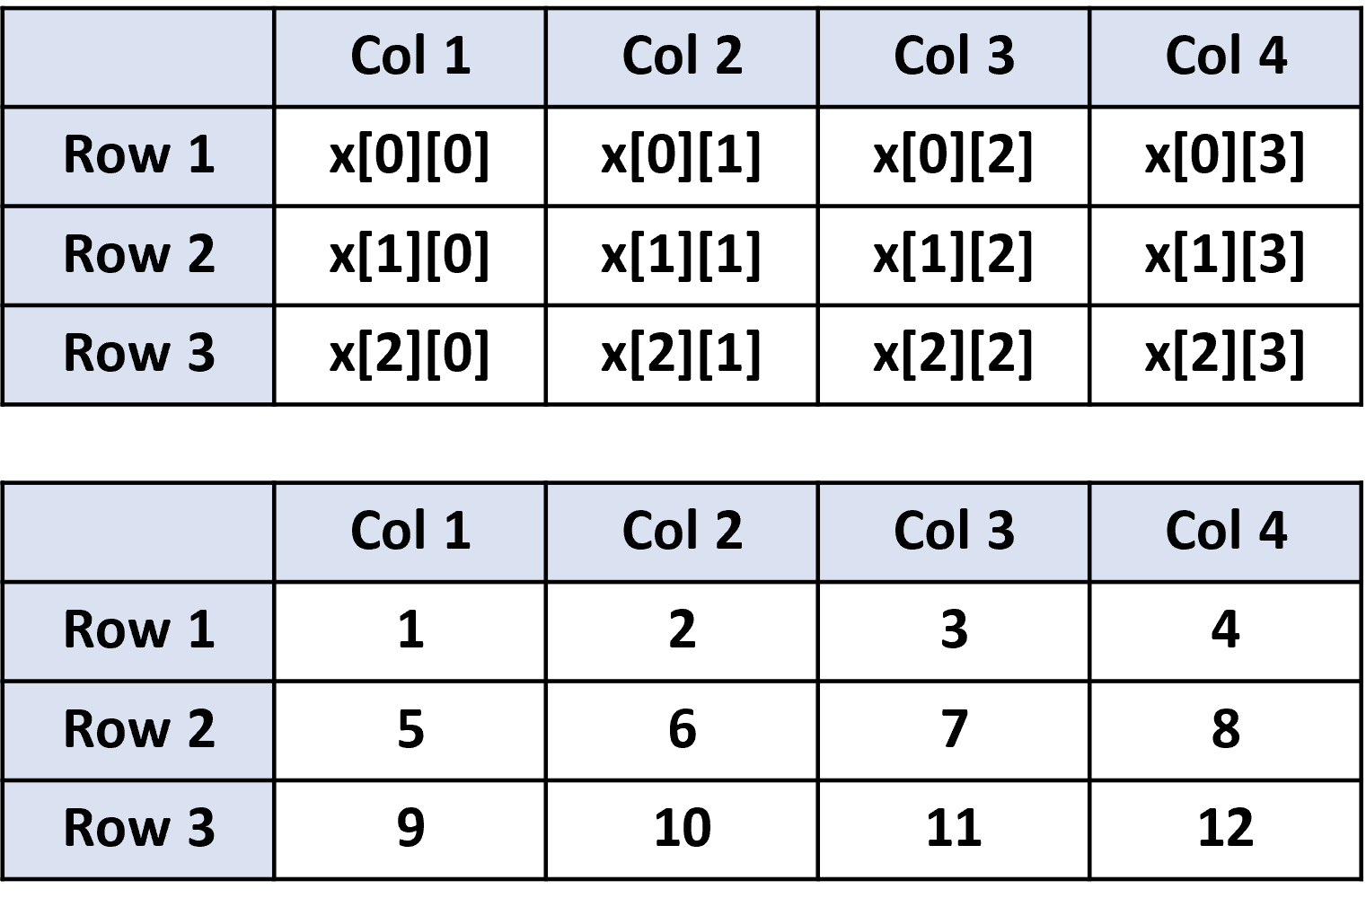
Matrix Data Structure:
🟨 Matrix: A matrix represents a collection of numbers arranged in an order of rows and columns.

Slide 4
Data Structure
Level 1
Time complexity on the Matrix
2

Slide 5
Time complexity on the Matrix
🟨 Insertion: We try to insert a value to a particular array index position, as the array provides random access it can be done easily using the assignment operator.
💡 arr[2][1] = 10;
🟨 Time Complexity:
O(1) to insert a single element
O( 2) to insert all the matrix elements [where N is the size of the array]

Slide 6
Time complexity on the Matrix
🟨 Access elements in Matrix: Accessing Matrix elements become extremely important, in order to perform operations on arrays.
💡 return arr[2][1];
🟨 Time Complexity:
O(1) to insert a single element
O(N^2) to insert all the matrix elements [where N is the size of the array]

Slide 7
Time complexity on the Matrix
🟨 Searching in Array: We try to find a particular value in the matrix, in order
to do that we need to access all the matrix elements and look for the particular value.
// searching for value 55 in the matrix;
Loop from i = 0 to 10:
Loop from j = 0 to 10:
check if arr[i][j] = 55:
return true;
🟨 Time Complexity:
O(N^2) [where N is the size of the array]

Slide 8
Thank you ☺

