Slide 1

Data Structure
Level 1
Stack Data Structures

Slide 2

Data Structure
Level 1
Stack Data Structures
2

Slide 3
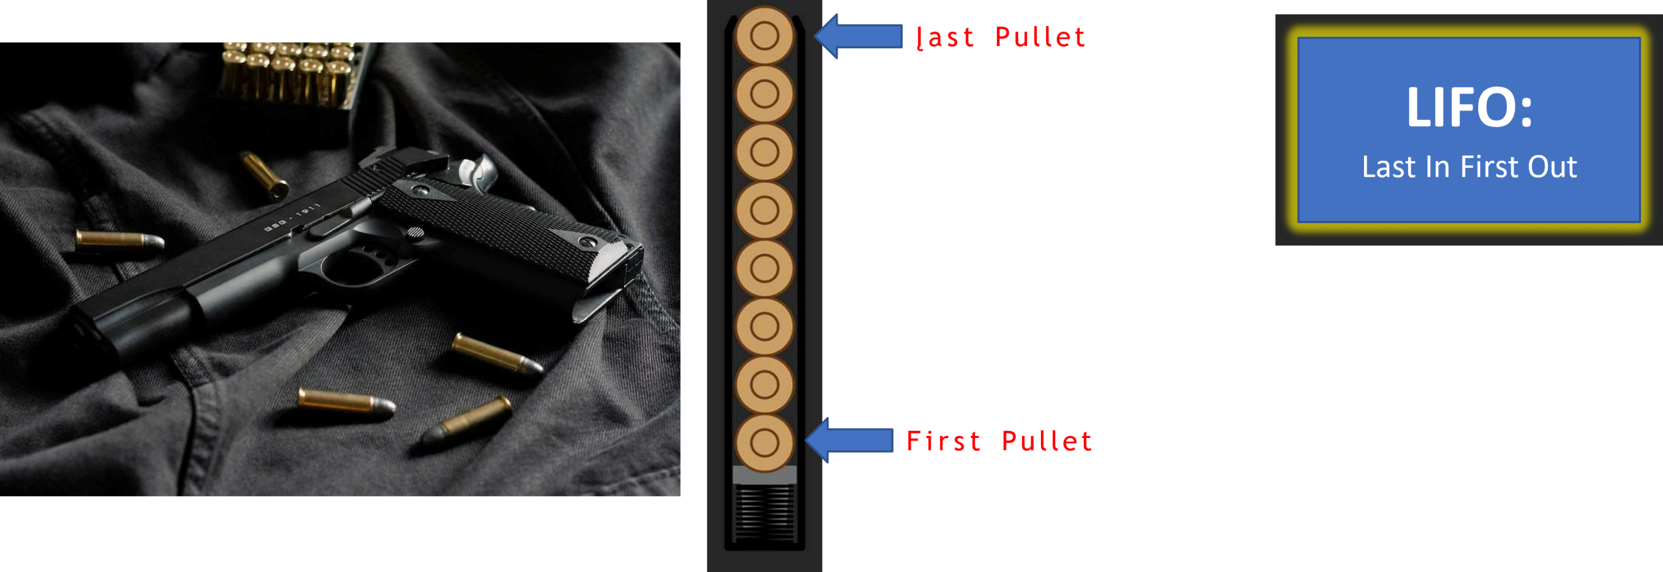
Gun pullet Stack

Slide 4
Stack Push
10
Empty Stack

Slide 5
Stack Push
10

Slide 6
Stack Push
10

Slide 7
Stack Push
20
10

Slide 8
Stack Push
20
10

Slide 9
Stack Push
20
10

Slide 10
Stack Push
30
20
10

Slide 11
Stack Push
30
20
10

Slide 12
Stack Push
30
20
10

Slide 13
Stack Pop
30
20
10

Slide 14
Stack Pop
30
20
10

Slide 15
Stack Pop
30
20
10

Slide 16
Stack Pop
20
10

Slide 17
Stack Pop
20
10

Slide 18
Stack Pop
10

Slide 19
Stack Pop
10

Slide 20
Stack Pop
Empty Stack

Slide 21
Thank you ☺

