Slide 1







Tools: Python • Machine Learning • Power BI
Brazilian E-Commerce Analysis
Dataset: Brazilian E-Commerce Public Dataset (Olist – Kaggle)
Analysis Period: 2016 – 2018
Presented By:
Armia Gamal

Slide 2


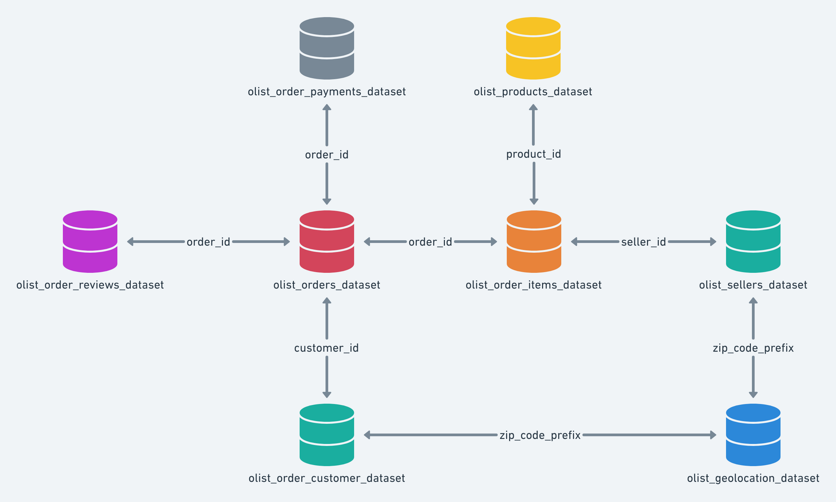
About the Dataset
This project is based on the Brazilian E-Commerce Public Dataset by Olist, available on Kaggle.
The dataset contains approximately 100,000 orders made between 2016 and 2018 across multiple Brazilian marketplaces.
It provides detailed information about orders, payments, products, customers, sellers, reviews, and delivery performance.

Slide 3
Business Context
Olist is one of the largest e-commerce platforms in Brazil.
It connects small businesses to online marketplaces using a single contract.
After a customer places an order, sellers fulfill the order and ship it using Olist logistics partners.
Customers are later invited to provide feedback through satisfaction surveys.

Slide 4
Dataset Structure
The dataset is divided into multiple tables for better organization:
Orders
Payments
Order Items
Products
Customers
Sellers
Reviews
Geolocation
These tables allow analyzing an order from multiple perspectives such as payment behavior, delivery performance, product attributes, and customer satisfaction.

Slide 5
Data Cleaning & Preparation
I performed data cleaning for all datasets individually.
This included handling missing values, removing duplicates, standardizing formats, and preparing the data for analysis.
After cleaning, the datasets were ready for machine learning modeling and business intelligence analysis.

Slide 6
Machine Learning – Classification
After data cleaning, I built a classification model.
The goal was to classify the data into two classes based on customer and order-related features.
The dataset was split into training and testing sets, and the model was evaluated using standard classification metrics.

Slide 7




Classification Results
The classification model achieved the following results on the test set:
Class 0:
Class 1:
Precision = 0.75, Recall = 0.30, F1-score = 0.43
Precision = 0.83, Recall = 0.97, F1-score = 0.89
Overall accuracy reached 82%, indicating good model performance, especially for the majority class.

Slide 8

Power BI Dashboard
After completing the machine learning phase, I loaded the cleaned data into Power BI.
The datasets were connected using proper relationships, and an interactive dashboard was created to analyze the business performance from multiple perspectives.

Slide 9
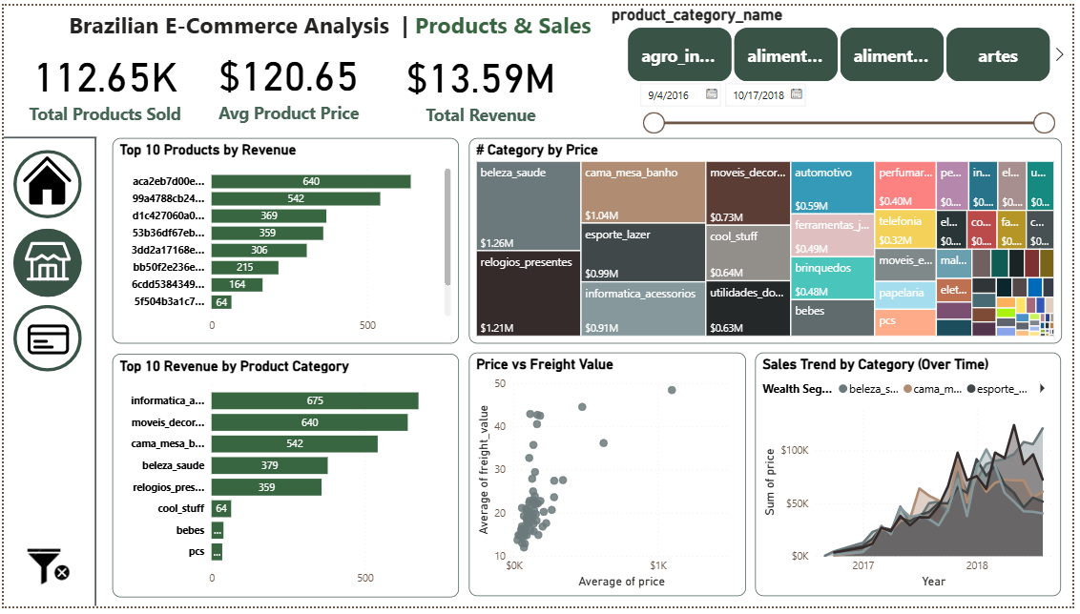
Orders & Payments Analysis
This page focuses on analyzing order behavior and payment performance.
It includes total orders, total revenue, order status distribution, payment methods, and monthly revenue trends.
The analysis highlights how customers place orders and how payments are made.

Slide 10
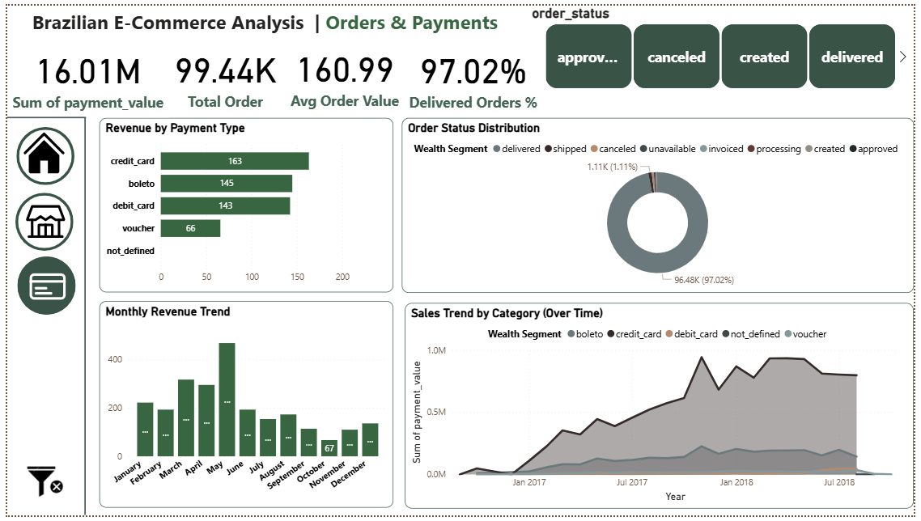
Products & Sales Analysis
This page analyzes product performance and sales behavior.
It shows revenue by product category, top-selling products, sales trends over time, and the relationship between product price and freight cost.
The analysis helps identify the most profitable product categories.

Slide 11
Key Insights
Most customers placed only one order
Credit card is the most common payment method
A small number of product categories generate most of the revenue
The majority of orders were successfully delivered

Slide 12
Conclusion
This project combines data cleaning, machine learning, and business intelligence.
The Power BI dashboard provides clear insights into Brazilian e-commerce behavior.
The results can help businesses improve decision-making, especially in customer retention and product strategy.

Slide 13
Thank you so much

