Slide 1
for me, for you.

Slide 2
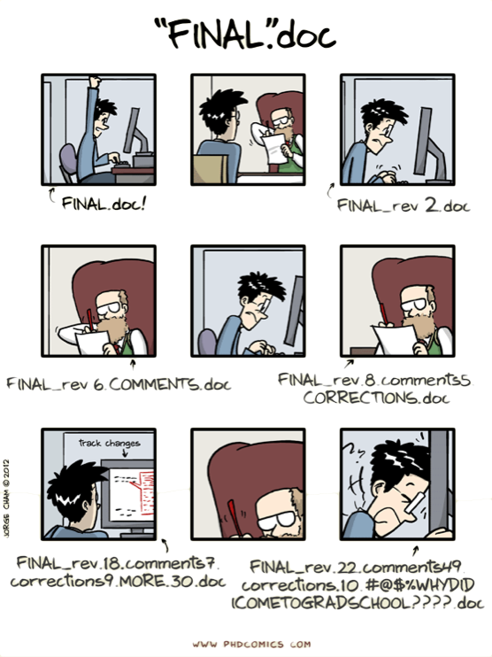
htp://www.phdcomics.com/comics/archive.php?comicid=1531

Slide 3
What is version control?

Slide 4
What Is Version Control?
• A system that keeps records of your changes Allows for collaborative development
• Allows you to know who made what changes and when
• Allows you to revert any changes and go back to a previous state

Slide 5
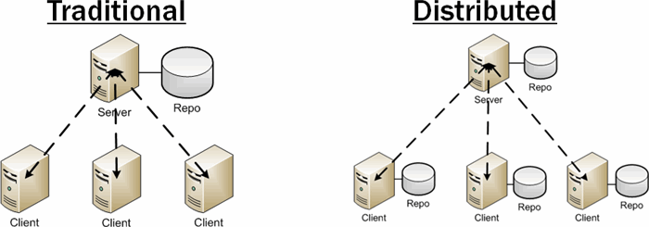
Categories of version control systems

Slide 6
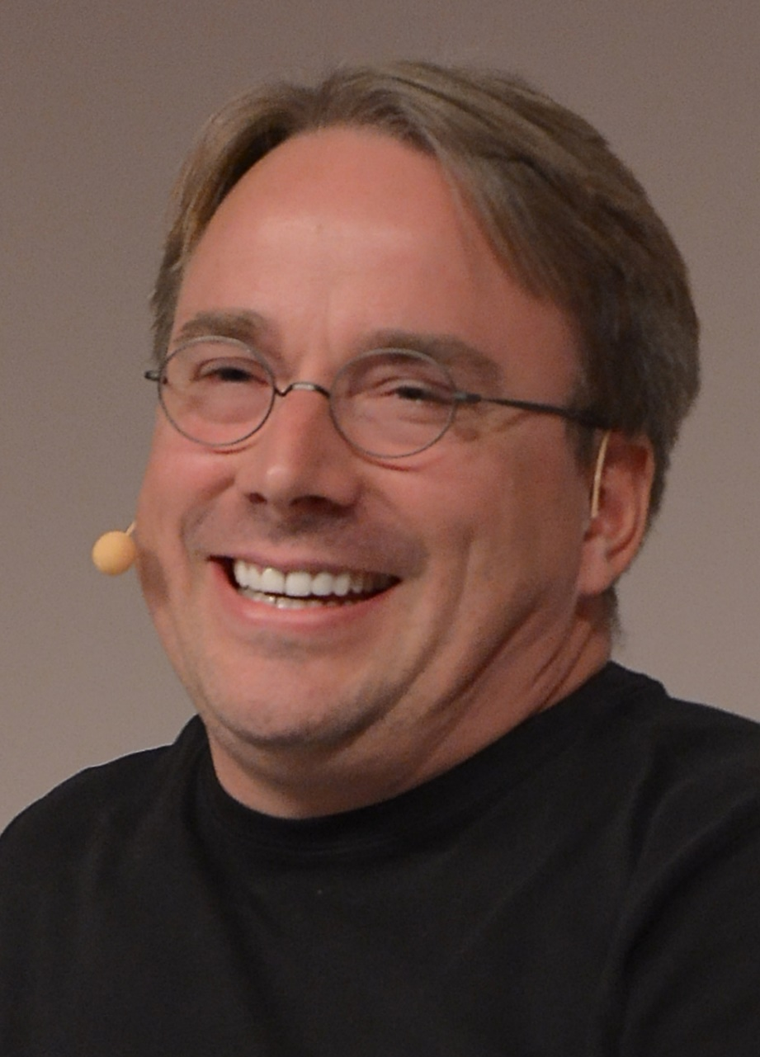
What is git?
• created by Linus Torvalds, April 2005
• a command line version control program
• uses checksums to ensure data integrity
• distributed version control .
• cross-platform (including Windows!)
• open source, free

Slide 7
How does git work?
Can be complicated at first, but there are a few key concepts Important git terminology in following:
Repositories
Commit
Branches

Slide 8
What is a Git Repository?
A Git Repository is a storage of your project files, which makes it possible to save code versions and have access to them.

Slide 9
The Commit—Setting Your Work in Stone
A commit is a snapshot in time, and represents a reproducible
state of your project. The various commits you make during a project constitute the project’s history.

Slide 10
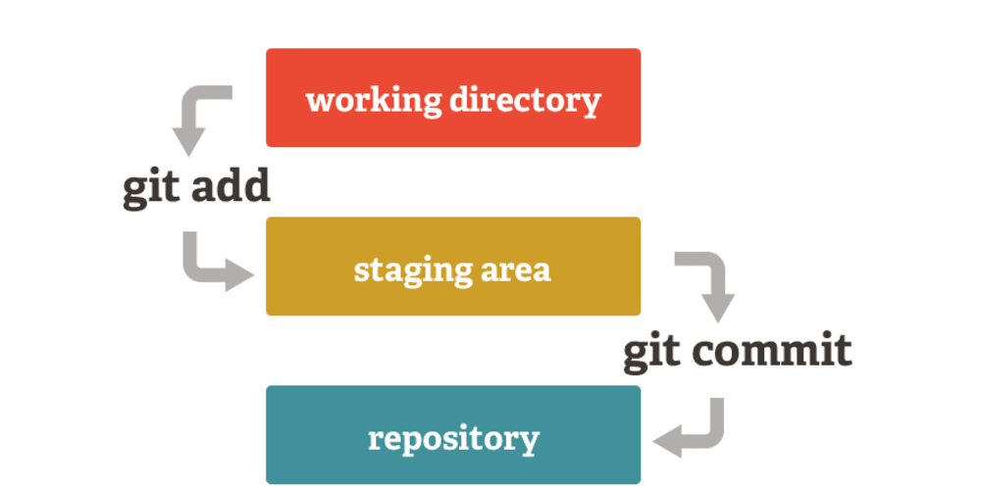
Git uses a three-tree architecture
Unmodified/modified Files
Staged Files
Committed Files
Note: working directory sometimes called the “working tree”, staging area sometimes called the “index”.

Slide 11
Install git
• Linux (Debian)
- Command: sudo apt-get install git!
• Linux (Fedora)
- Command: sudo yum install git!
• Mac
- http://git-scm.com/download/mac
• Windows
- http://git-scm.com/download/win

Slide 12
Lets Start Our Journey

Slide 13
Branches
Branching allows developers to branch out from the original code base and work separately.
master is always the name of the main branch—the one from which you always start. Everything else branches from that.

Slide 14
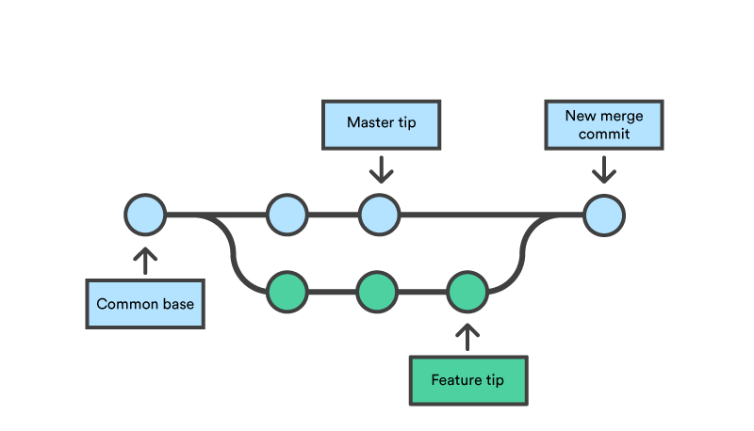
Merging
Once we are finally done with all changes and additions — and everything works* — it’s time to merge.

Slide 15
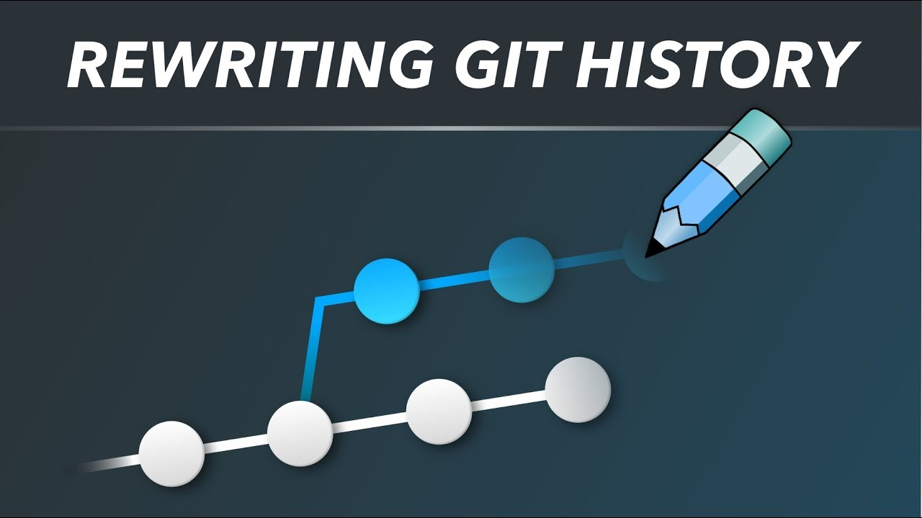

Slide 16


Slide 17
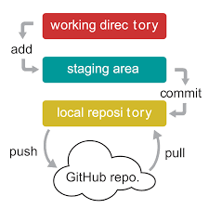
Remotes

Slide 18
DO & DON’T
Do keep the message short.
Do explain what the commit does not How or why .
Don’t use the word “and” that is means doing too many changes. break them into separate commit.
Do not mess with the master.

Slide 19
References
https://www.w3docs.com/learn-git/git-config.html

