Slide 1
Where should yellow cab drivers start their day to maximize daily earnings?
Using data from the NYC Taxi and Limousine Commission (TLC)
Yellow Cab Trips in 2024
Notes:
Cleaned data on:
- Fare amount non-negative, trip distance positive, dropoff time >= pickup time, duration less than 6 hours
Also I limited analysis to zones with more than 100 rides
This is essentially a location choice problem under uncertainty.

Slide 2
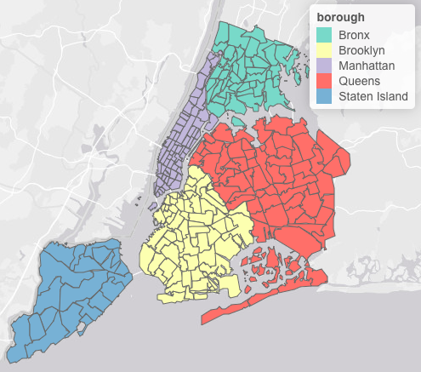
Dataset: 2024 yellow cab rides
Number of rides: 39,694,569
Busiest zone has ~1.8M rides
Avg trip time: 17 mins 28 seconds
Avg revenue per trip: $28.64
Notes:
NYC taxi demand is very dense
Starting location could materially affect earnings

Slide 3
Which zone should a driver start their day in?
Notes:
The answer depends on what other drivers are doing. I don’t observe drivers, I just observe rides
In equilibrium, if drivers mix between zones, their earnings revenue for the day should be equal across zones

Slide 4
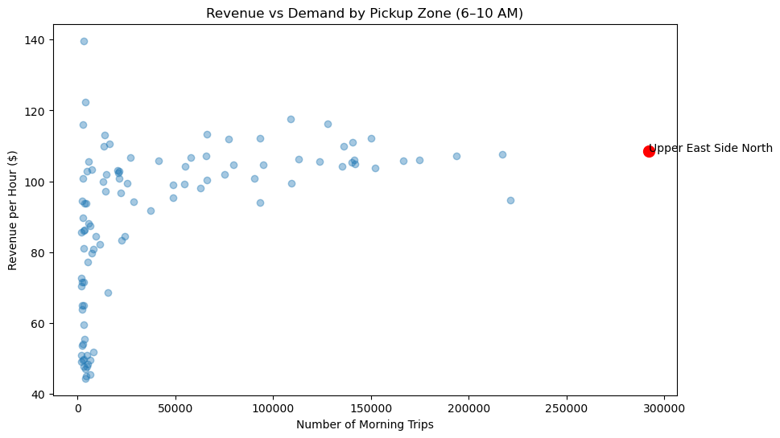
*
*while cab is occupied
Notes:
Revenue per hour = total passenger payments from trips starting in the zone/ total time taxis spent carrying passengers (in hours)
Earnings rate is conditional on having a passenger
I’m measuring earnings conditional on being busy
Revenue per hour isn’t the only thing that matters – how easy it is to get a passenger

Slide 5
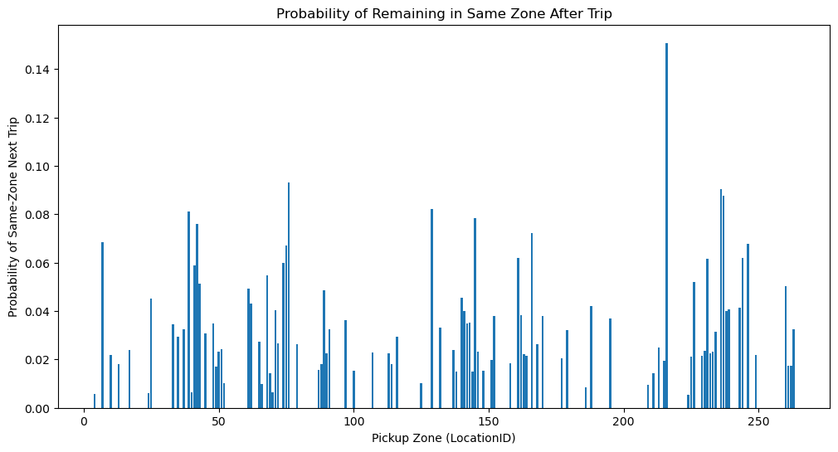
Notes:
Motivation for a more realistic model: drivers don’t stay in the same zone after completing a trip

Slide 6
Next pass:
Maximize expected revenue (from 8am-4pm)
Model captures
Spatial movement of drivers
Variation in trip profitability across zones
Variation in trip durations
Fuel costs
Earnings depends on where the driver moves
during the shift
Notes:
This will be a simulated expected shift value, not an observed driver-level shift, because the TLC data does not identify drivers or actual between-trip waiting times
Conceptually the environment is a Markov process and could be solved with dynamic programming, but my code instead simulates the process directly
Estimate expected net earnings over 8 hours starting at 8am where each trip contributes net trip earnings = total amount – fuel cost per mile * trip_distance and the driver’s next location is drawn from P(next zone j | current zone i)
I assumed 0.20 a mile bc google AI

Slide 7
Taxi Shift Simulation Process
Choose
Start Zone
Add Wait
Time w
Trip Occurs
(Earnings π)
Add Trip
Time τ
Add Wait
Time w
Transition
Next Zone
Repeat until the simulated shift reaches more than 8 hours of total time.

Slide 8
Expected Net Earnings per Hour Model
Goal: Estimate expected net earnings per hour for an 8‑hour taxi shift starting in zone i at time h₀.
Trip-level net earnings:
πᵢ,ₕ = E[ total_amount − cₘᵢₗₑ · distance | zone = i, hour = h ]
Average trip duration:
τᵢ,ₕ = E[ trip_minutes | zone = i, hour = h ]
Expected waiting time (competition proxy):
wᵢ,ₕ = k · (dropoffsᵢ,ₕ / pickupsᵢ,ₕ)
Zone transition probabilities:
Pᵢⱼ(h) = P(next_zone = j | current_zone = i, hour = h)
Total earnings: Σₜ π_{zₜ,hₜ}
Total time: Σₜ (τ_{zₜ,hₜ} + w_{zₜ,hₜ})
Expected net earnings per hour:
V(i, h₀) = E[ Σₜ π_{zₜ,hₜ} / Σₜ (τ_{zₜ,hₜ} + w_{zₜ,hₜ}) ]
Notes:
Expected waiting time: every dropoff means a taxi has just entered that zone. So drop-offs act as a proxy for taxi inflow. If many trips end in a zone, many taxis are suddenly available there. Pickups represent rider demand.
Avg waiting time: about 11.7 mins in simulation
K was set at 5 so if 2x as many drop-offs as pickups, wait time is 10 mins
I estimated expected earnings conditional on starting zone

Slide 9
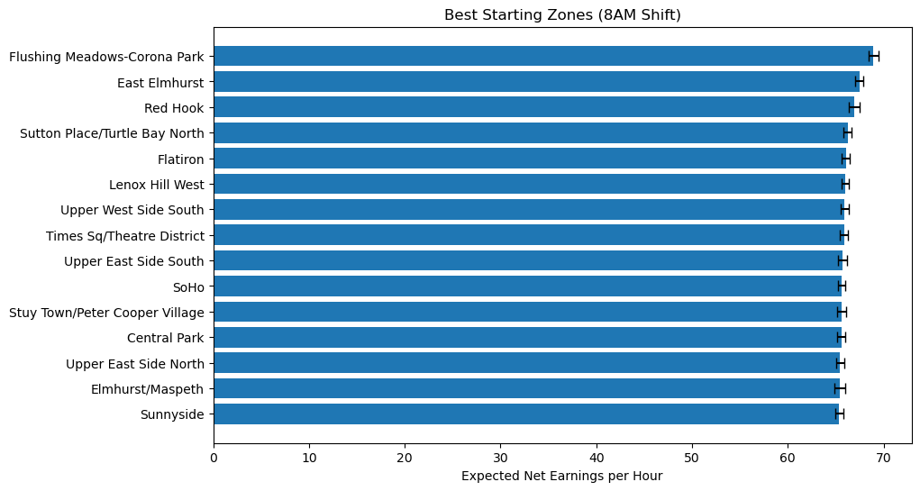
Notes:
Changing time consumed = trip duration
To time consumed = trip duration + expected wait time
Where wait time depends on pickup demand in that zone and hour

Slide 10
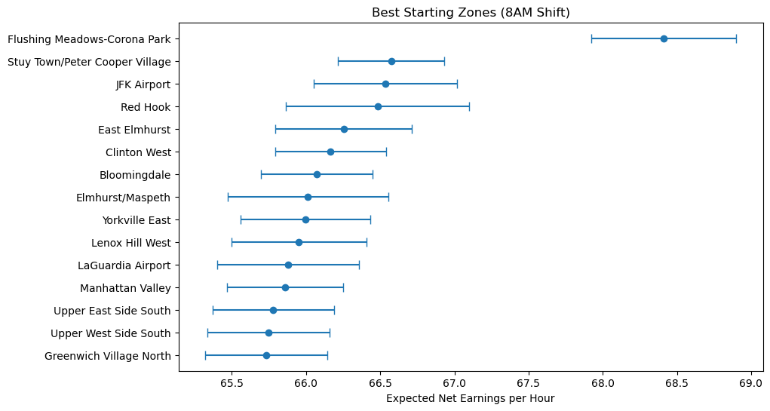

Slide 11
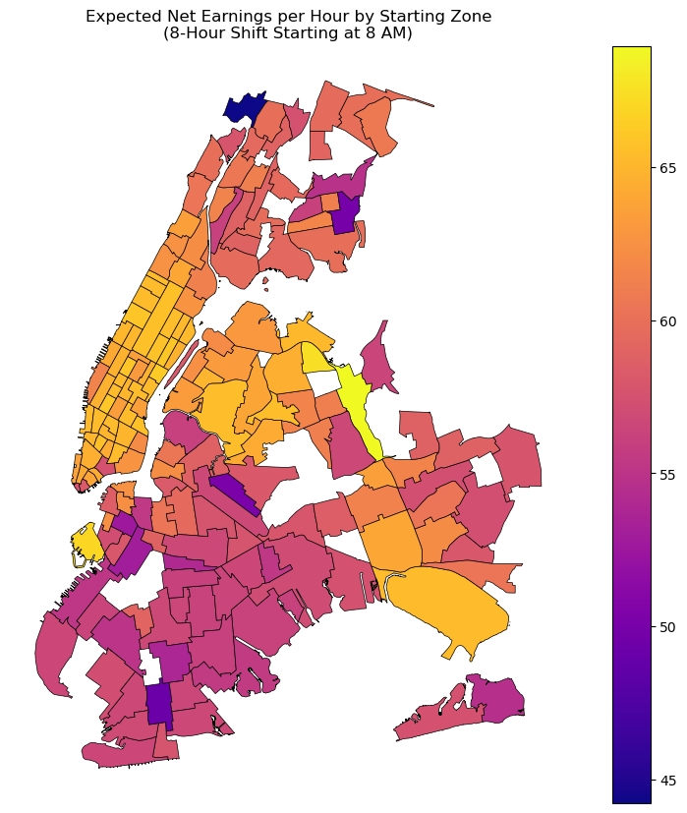
Zone 93:
Flushing Meadows-Corona Park
Queens
Notes:
Now expected wait = k x (drop-offs/pickups)
Mean wait time is 11.2 minutes

Slide 12
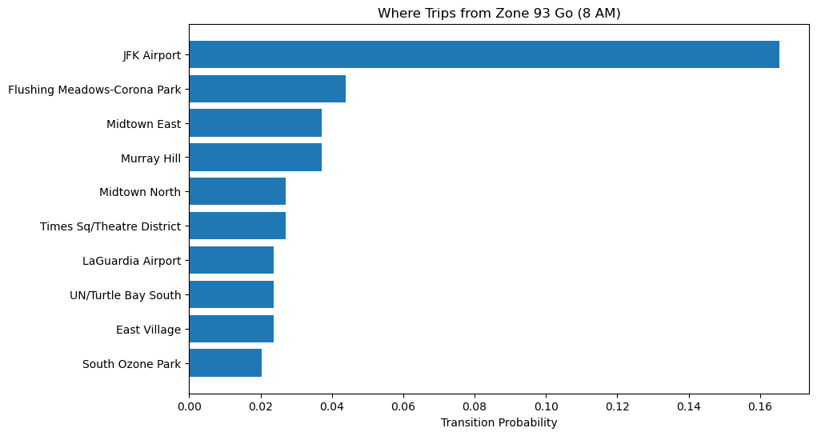

Slide 13
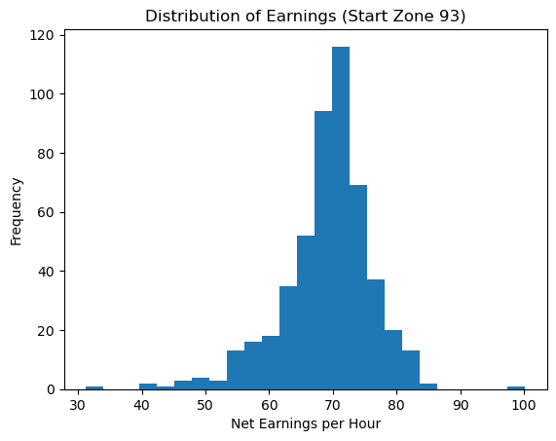

Slide 14
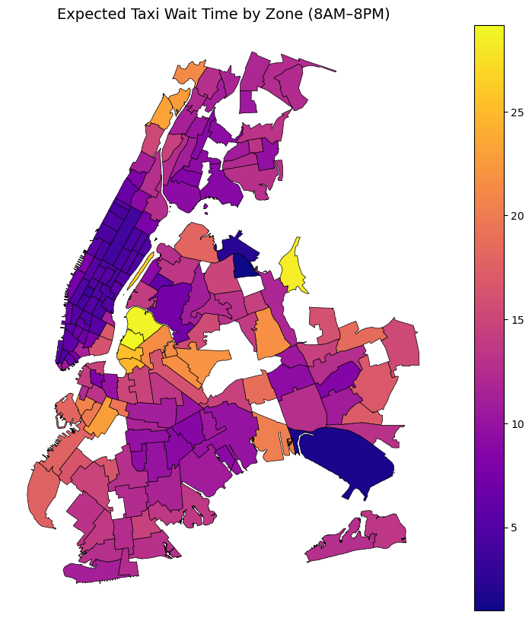
Zone 93:
Flushing Meadows-Corona Park
Queens

Slide 15
Next pass:
What is the optimal zone and hour
in which to maximize the earnings per hour
from an 8 hour shift?

Slide 16
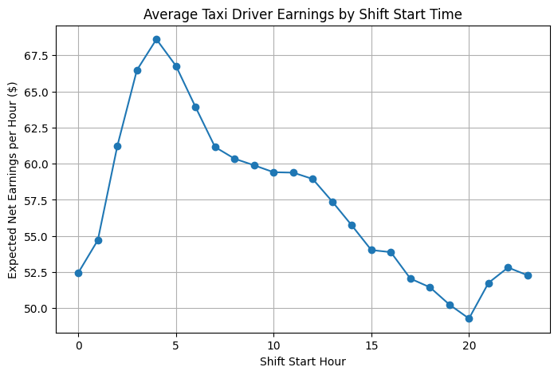

Slide 17
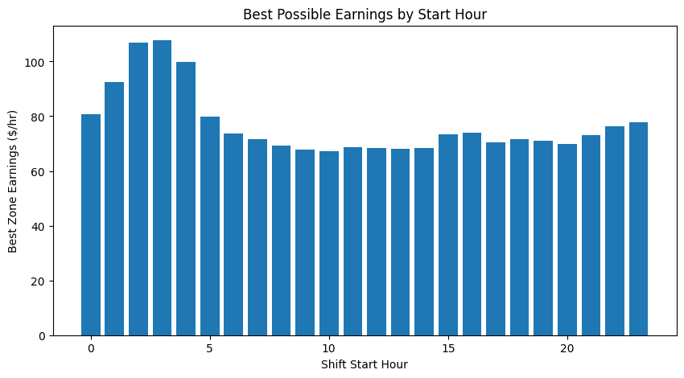

Slide 18
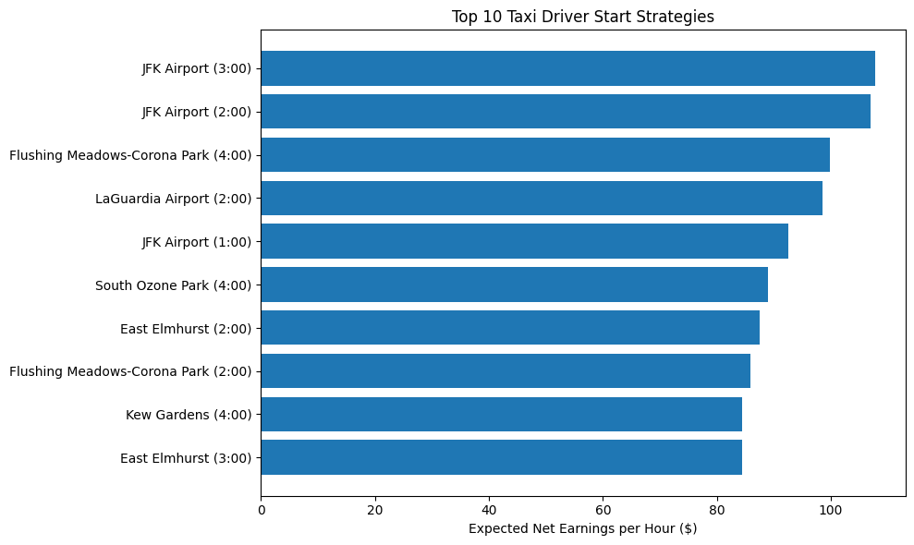

Slide 19
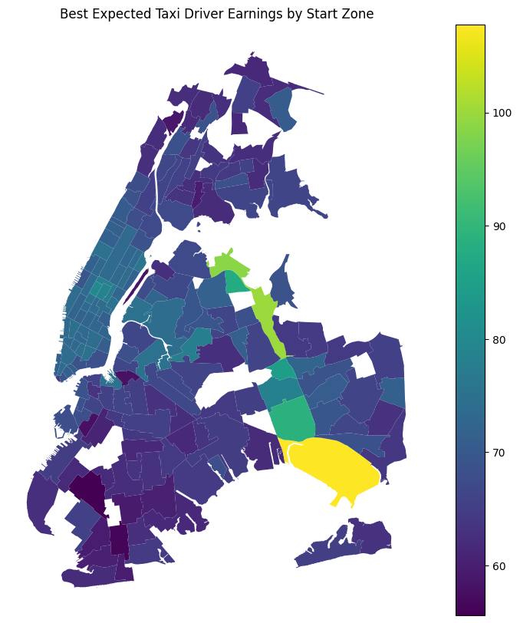
JFK Airport

Slide 20
Next pass:
What is the optimal zone and hour
in which to maximize the earnings per hour
from an 8 hour shift when allowing the driver
the option to reposition themselves in a
different zone after a ride ends?

Slide 21
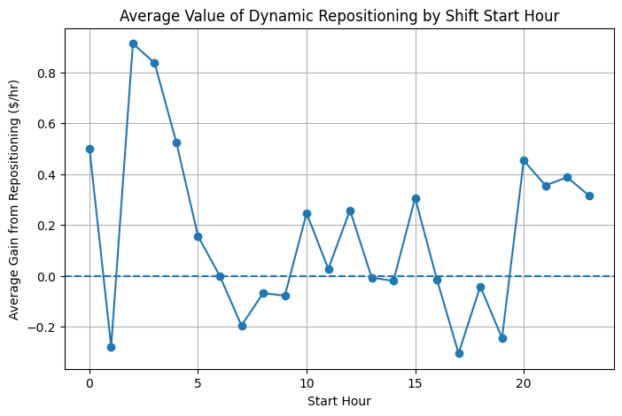

Slide 22
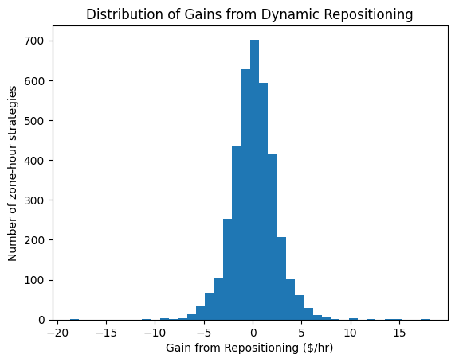
Notes:
Shows for each (start zone, start hour) combo,
Gain = earnings with repositioning strategy – earnings with baseline strategy

Slide 23
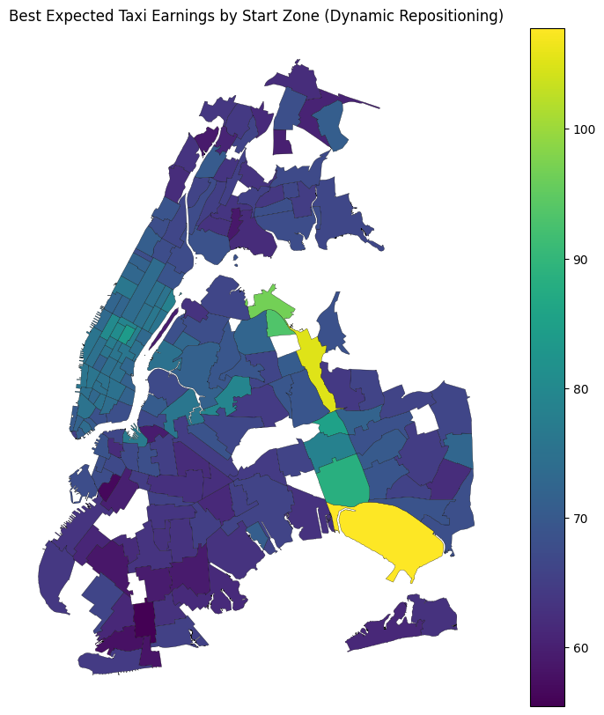
Notes:
JFK and Flushing Meadows still have highest earnings when accounting for dynamic repositioning

Slide 24
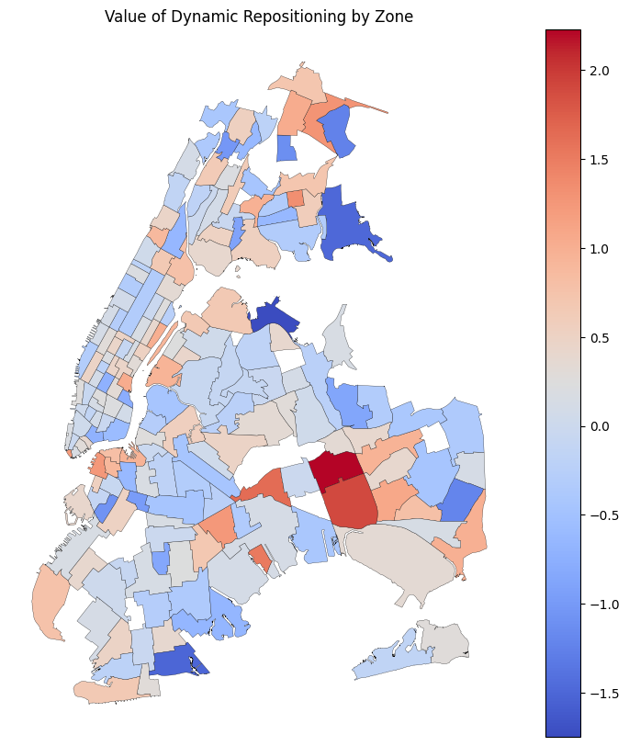
Notes:
Red zones are near JFK

Slide 25
Appendix A

Slide 26
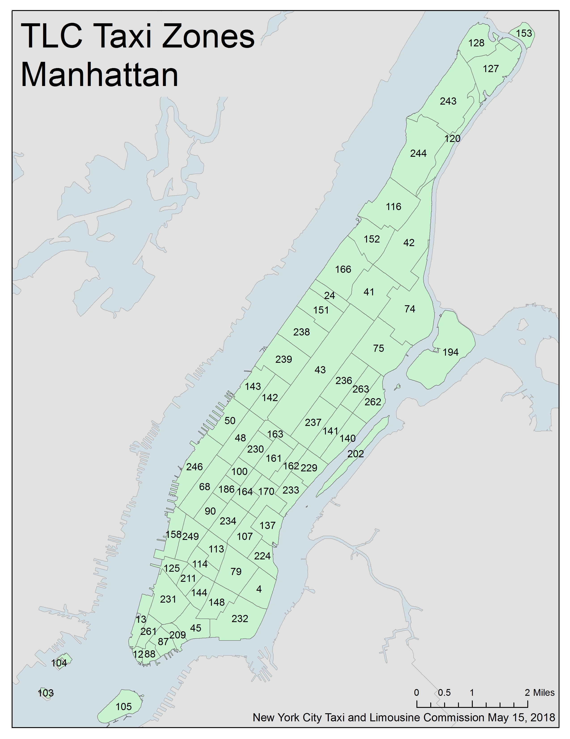
First pass:
Maximize revenue per hour from 6am-10am
Assumptions:
- Costless for driver to start day anywhere
Cab density constant across zones
No waiting time between trips
Next pickup occurs where the last trip ended
Average trip duration and revenue represent future trips
Fuel cost constant across zones
Rides start and end in the same zone
Upper East Side North
Notes:
Zone 236 (Upper East Side North) appears to maximize expected gross revenue per occupied hour during 6–10 AM under the simplifying assumptions:
- Costless for driver to start day anywhere
Cab density constant across zones
No waiting time between trips
Next pickup occurs where the last trip ended
Average trip duration and revenue represent future trips
Fuel cost constant across zones
Rides start and end in the same zone

Slide 27
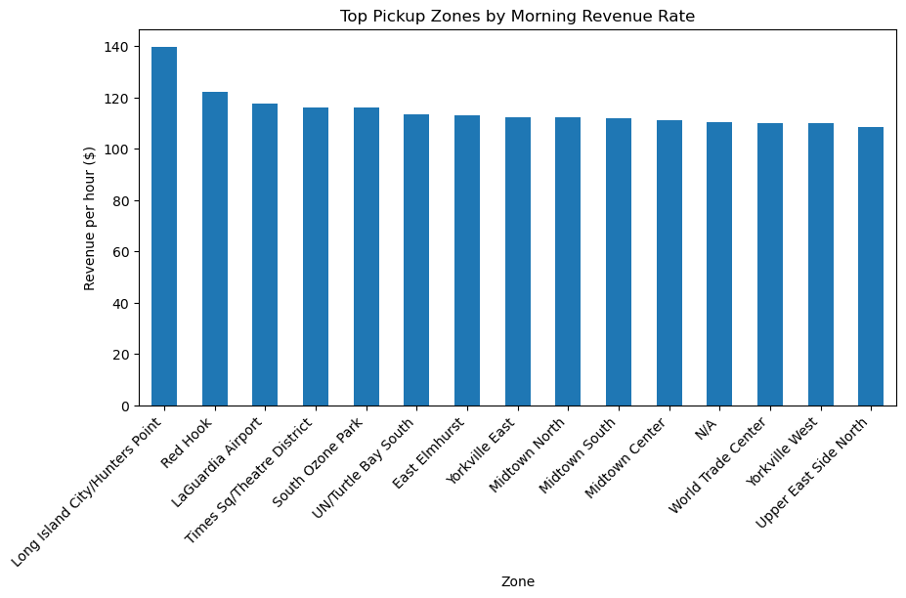

Slide 28
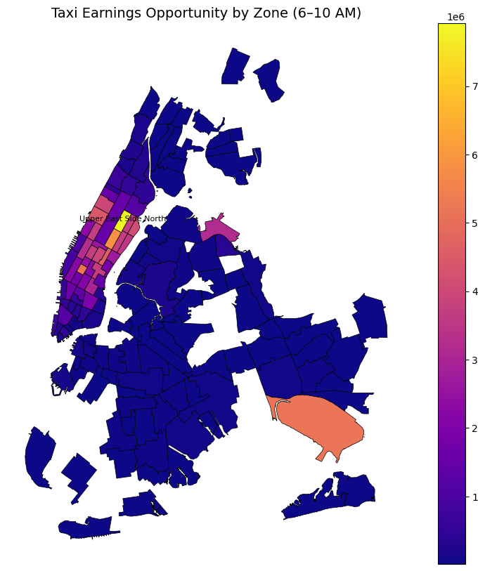
Earnings opportunity:
(revenue per hour) x (trips per hour)
Upper East Side North
Manhattan
Notes:
Earnings opportunity = (revenue per hour) x (trips per hour)
Trips per hour = (number of trips) / 4 This approximates passenger arrival rate
Zone scores are high if they have high-paying trips and many passengers
It’s best interpreted as density of revenue opportunities
Zone 236 appears to maximize expected gross revenue per occupied hour during 6–10 AM under the simplifying assumptions that drivers can start anywhere at zero cost, driver supply is spatially uniform, fuel costs do not vary across zones, and trips do not relocate drivers across zones.
Zones like EWR or with count <= 2000 trips appear not colored because it was excluded from the earnings metric

Slide 29
Appendix B

Slide 30
Economic Interpretation: Driver Opportunity Cost
Drivers choose where to start their shift to maximize expected net earnings per hour.
Key tradeoffs in the model:
• Trip revenue: higher fares increase earnings.
• Trip duration: longer trips reduce earnings per hour.
• Waiting time: idle time between rides represents opportunity cost.
• Taxi competition: more dropoffs relative to pickups increases waiting time.
Zones with strong rider demand and low taxi congestion produce higher expected earnings.
The simulation captures how drivers move across zones and accumulate earnings over time.
Notes:
Model does not observe taxi density directly, but it does approximate taxi competition indirectly using dropoffs

Slide 31
Appendix C

Slide 32
OLS Regression: regress expected net earnings per hour on a constant, avg_trip_revenue, avg_trip_mins, expected_wait_mins, avg_trip_distance, dummy variable for Manhattan note: coefficients will reflect equilibrium relationships, not causal ones

Slide 33
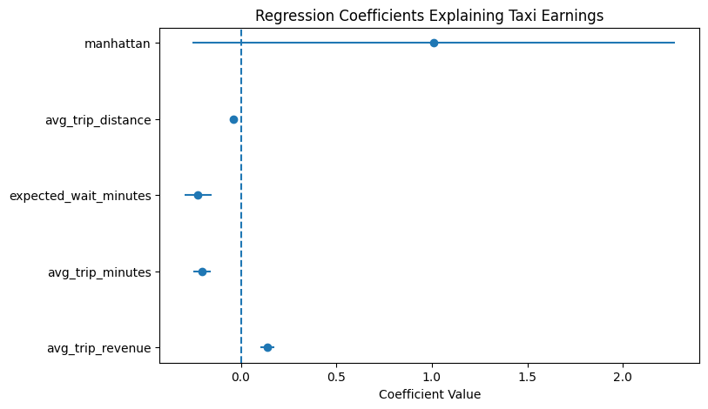
Notes:
Which zone characteristics correlate with earnings?
Zones with shorter trips tend to have higher hourly earnings
Zones with lower wait times tend to have higher earnings

Slide 34
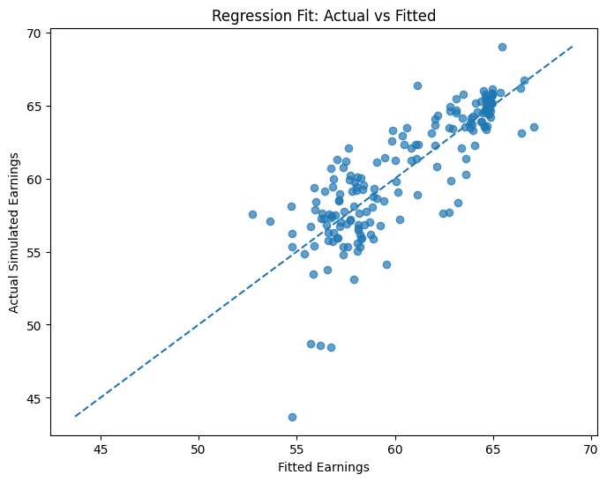

Slide 35
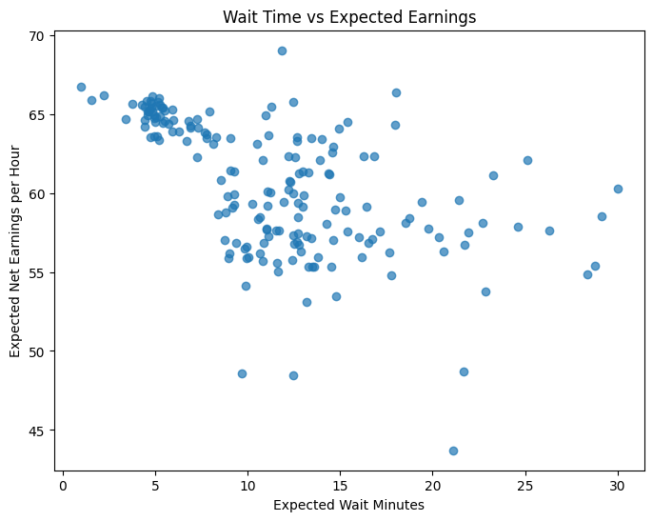
Zone 93:
Flushing Meadows-Corona Park
Queens

Slide 36
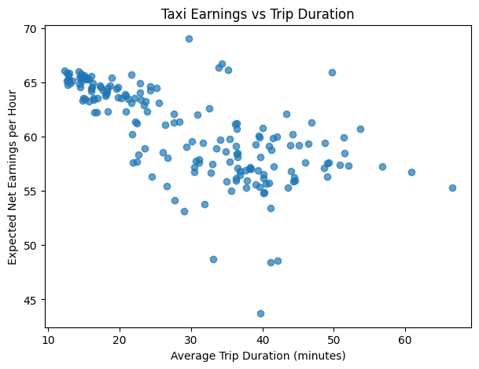
Zone 93:
Flushing Meadows-Corona Park
Queens

