Slide 1
DaTa Archive Infrastructure

Slide 2
Data Archive – Long-term storage
Long-term storage of data
Storage medium: Tape → high latency
Powerful transfer protocols (gridfTp, rsync, scp)
Easy access from HPC services lisa and cartesius via NFS mounts → use archive as yet another directory

Slide 3
Data Archive Infrastructure

Slide 4
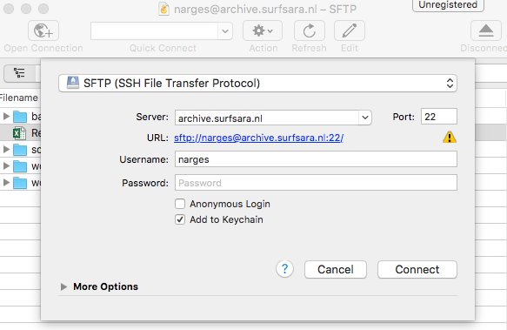
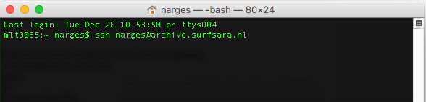
Data Archive Access
Access via graphical user interface (GUI): A transfer client that support SSH File Transfer Protocol (SFTP)
Cyberduck (Mac and Windows)
Filezilla (Linux)
MobaXterm (Windows)
Access via command line interface (CLI)
Terminal (preinstalled on Mac and Linux)
MobaXterm (Windows)
Access via NFS mounts (Also via command line, only possible from compute clusters, Lisa and Cartesius)

Slide 5
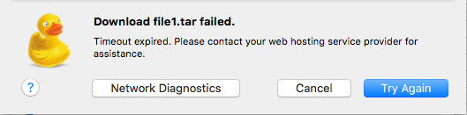
Limitations of GUI Access
The data flows via the user laptop. Therefore the transfer depends on your local storage and connectivity (If the connection is lost, the transfer is lost).
Only for small data files
Does not always work for fetching data (data needs to be staged first)
You can't see the status of the data (i.e. weather the data is on disk or on tape).
Unclear error messages
Data flow
Server 1
( Lisa)
Server 2
(Archive)

Slide 6
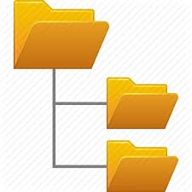



Archiving Workflows on HPC
Login to the HPC system (Lisa / Cartesius)
User’s archive home directory is mounted as folder /archive/<username>
Some data to work with
Retrieve data from the Archive/or copy from any other source
Process and Analyze your Data on HPC
Archive the data
Using tar or “dmftar” tool
Tape
HPC (Lisa/Cartesius)
Staging data
Login
Disk
Copy data

Slide 7
Staging Data
Data on the Archive is stored on Tape
Staging data: copy the data from tape to disk
Always stage the data first from the archive, before you start to work with the data (read/write actions)
Use the dm commands for staging data (“dmget” command)
Tape
HPC (Lisa/Cartesius)
Staging data
Login
Disk
Copy data

Slide 8
Archive Usage – Best practicies
Try to store files of significant size (> 1 GB) as much as possible. Smaller files will always be accepted, but will lower the performance of restoring your files from tape.
If you have many small files, make sure to pack them using a file archiving tool like tar or dmftar.
Try to pack your files before uploading them to the archive.
Organize your files in such a way that in case the files are needed again only parts of the data set need to be restored from tape.
Avoid storing unpacked software packages, these usually contain a lot of small files. Instead pack these as well, or refer to a specific software repository.

Slide 9
Optimal Archiving with dmftar
Wrapper for GNU tar, developed in-house by SURFsara.
Creates archive files of any size (default 10 GB).
Can be used remotely to transfer data to and from the archive file system.
Available on Data Archive, Lisa cluster or Cartesius supercomputer. Also made opensource.
Contains the same information as tarballs, plus more:
Checksum of each tarball (default checksum algorithm is md5, but others are supported as well, i.e sha1, sha224,…)
File index: list of files and directory structure
Understands underlying storage infrastructure: ‘tape-aware’ and automatically stages your archived files

Slide 10
Archiving tools: syntax
Staging data from tape on the archive:
Pushing data to tape on the archive:
dmftar syntax:
(Note: always use the right extension ( ‘.dmftar’ for your archive files!)
dmget –a [file]
dmput [-r] [file]
dmftar [TASK] [OPTIONS] -f <dmftar-archive> <input-files>

Slide 11

Hands-on Archiving Data
Archiving data using dmftar
Login to LISA (command: ssh sdemoXXX@lisa.surfsara.nl)
Explore the environment
Connection to archive
DMF commands
Start an archiving workflow with dmftar
Data Archive
LISA
Disk
Tape
login
Archiving

