Slide 1


Hardware and software features to accelerate deep learning

Slide 2
The three S'
Know your System
What kind of hardware do I have?
What features does my hardware support?
Know your Software
Does my software do what I want to do efficiently?
Does my software support my hardware features?
Know your Stack
What version of software am I running?
Is my stack compiled for my hardware?

Slide 3
System
Which CPUs?
Architectures: X86_64, ARM64
What kind of storage?
SSD, HDD, Tape?
SATA, NVMe or full PCI-E, Network?
What kind of Networking?
Ethernet? InfiniBand (IB)?
IOPs vs Throughput
What kind of RAM?
High Bandwidth Memory (HBM) or Double Data Rate (DDR)?
How much? Enough for a RAMdisk? (/dev/shm)
You (AI person) are always memory limited
Which GPUs?
AMD? Good raw performance, PyTorch support is improving
NVIDIA? Optimized for AI with good PyTorch support.
Intel? Technically supported in PyTorch.
https://servicedesk.surf.nl/wiki/display/WIKI/Snellius+hardware+and+file+systems

Slide 4
System
Goals:
Understand what hardware bottlenecks could be limiting
Understand pro’s and con’s of various hardware
Know how to choose appropriate hardware for you DL task
Know what to do to mitigate bottlenecks

Slide 5

Important System Details
E.g. training a compute intensive network on a single node
Compute (floating point operations per second, FLOPS)
Memory bandwidth
Memory size
I/O
Communication

Slide 6
Important System Details
Compute (floating point operations per second, FLOPS)
Memory bandwidth
Memory size
I/O
Communication
Data needs to get to the processor in time in order to do compute!
Many codes are limited by memory bandwidth

Slide 7
Important System Details
Compute (floating point operations per second, FLOPS)
Memory bandwidth
Memory size
I/O
Communication
(may be) limited by memory:
Deep/wide networks
Networks with very large input/output layers (e.g. high res images)
Not a performance bottleneck, but a no-go!
But: unified memory

Slide 8
Important System Details
Compute (floating point operations per second, FLOPS)
Memory bandwidth
Memory size
I/O
Communication
HPC systems typically have shared file systems
Good bandwitdh
(relatively) low I/O operations per second (IOPS)
Common bottleneck in distributed learning! Many nodes reading from the same filesystem.
Other users (& sysadmins) will dislike you if you do I/O in a naive way!

Slide 9
Important System Details
Compute (floating point operations per second, FLOPS)
Memory bandwidth
Memory size
I/O
Communication
Communication can be limiting in several ways:
Latency (many, small message send between nodes)
Bandwidth (few, large messages send between nodes)
Load imbalance (some workers in distributed job are slower / have more work; others have to wait when synchronization is needed)
CPU <-> GPU sync

Slide 10
Some context
What? | Time | Equivalent to N CPU instructions
CPU instruction | 0.25 ns (@4GHz) | 1
GPU instruction | 1 ns (@1 GHz) | 4
Fetch from L1 CPU cache | 0.5 ns | 2
Fetch from L2 CPU cache | 7 ns | 28
Fetch from main CPU memory | 100 ns | 400
CPU => GPU latency (PCI) | 300 ns | 1200
GPU ⬄ GPU latency (NVLink) | 300 ns | 1200
Infiniband network latency | 1 μs | 4k
Ethernet network latency | 10-1000 μs | 40k-4M
Seek time (NVMe SSD) | 20 μs | 80k
Seek time (Sata SSD) | 200 μs | 800k
Seek time (hard disk) | 2-5 ms | 8-20M
Network File System (NFS) response times | 10-40 ms | 40-120M
Robot Fetch time (Tape) | +- 60 s | 180B

Slide 11
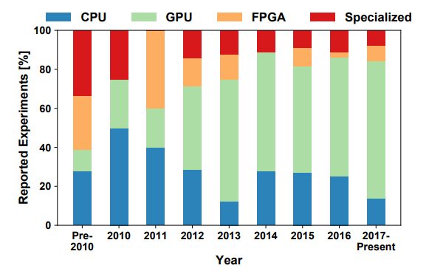
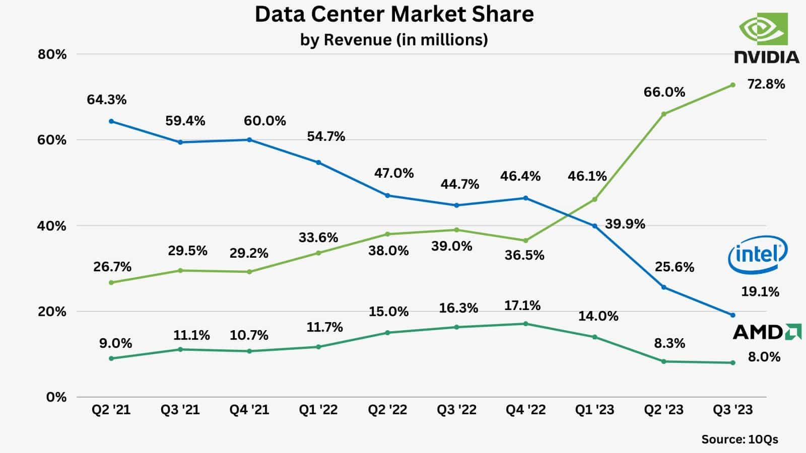
System Hardware Distribution
A look at the hardware, from a DL perspective:
Nvidia is dominant, Volta was a game changer
AMD is catching up
Same for CPUs
Source: Demystifying Parallel and Distributed Deep Learning: An In-Depth Concurrency Analysis, Ben-Nun & Hoefler 2018
Source: AITechInvesting X account

Slide 12
Hardware overview
 | FP4 [TFLOPS] | FP8 [TFLOPS] | INT8 [TOPS] | FP16/BF16 [TFLOPS] | FP32 [TFLOPS] | FP64 [TFLOPS] | Memory [GB] | Memory Bandwidth [GB/s] | PCIe [GB/s] | Power draw [W] | FP16 TFLOP per Watt
AMD MI250 |  |  | 362.1 | 362.1 | 90.5 | 90.5 | 128 | 3276.8 | 31.51 | 560 | 0.64
AMD MI325x |  | 2615 | 2615 | 1307 | 654 | 163 | 256 | 6000 | 128 | 1000 | 1.3
NVIDIA A100 |  |  | 624 | 312 | 156 | 19.5 | 40/80 | 1555-2039 | 64 | 400 | 0.78
NVIDIA H100 |  | 1979 | 1979 | 990 | 495 | 67 | 80/96 | 2000-3900 | 128 | 700 | 1.32
NVIDIA GB200 | 20,000 | 10,000 | 10,000 | 5,000 | 2,500 | 80 | 384 | 16,000 | 256 | 2700 | 1.85
NVIDIA L40S (inference only) |  | 733 | 733 | 362 | 183 | 1.4 | 48 | 864 | 64 | 350 | 1.03
NVIDIA RTX 5090 (consumer) | 1676 | 838 | 838 | 420 | 105 | 1.6 | 24 | 1790 | 128 | 575 | 0.73
AMD EPYC 9334 (per socket) (H100 CPU) | - | - | - | 5.1 | 2.1 | 1.21 | 6000 (max) | 460 (max) | - | 210 | 0.02
Notes:
Add H100, add watt en perf per watt, add a10 inference

Slide 13
Hardware overview
GPUs support reduced precision, has higher performance
 | FP4 [TFLOPS] | FP8 [TFLOPS] | INT8 [TOPS] | FP16/BF16 [TFLOPS] | FP32 [TFLOPS] | FP64 [TFLOPS] | Memory [GB] | Memory Bandwidth [GB/s] | PCIe [GB/s] | Power draw [W] | FP16 TFLOP per Watt
AMD MI250 |  |  | 362.1 | 362.1 | 90.5 | 90.5 | 128 | 3276.8 | 31.51 | 560 | 0.64
AMD MI325x |  | 2615 | 2615 | 1307 | 654 | 163 | 256 | 6000 | 128 | 1000 | 1.3
NVIDIA A100 |  |  | 624 | 312 | 156 | 19.5 | 40/80 | 1555-2039 | 64 | 400 | 0.78
NVIDIA H100 |  | 1979 | 1979 | 990 | 495 | 67 | 80/96 | 2000-3900 | 128 | 700 | 1.32
NVIDIA GB200 | 20,000 | 10,000 | 10,000 | 5,000 | 2,500 | 80 | 384 | 16,000 | 256 | 2700 | 1.85
NVIDIA L40S (inference only) |  | 733 | 733 | 362 | 183 | 1.4 | 48 | 864 | 64 | 350 | 1.03
NVIDIA RTX 5090 (consumer) | 1676 | 838 | 838 | 420 | 105 | 1.6 | 24 | 1790 | 128 | 575 | 0.73
AMD EPYC 9334 (per socket) (H100 CPU) | - | - | - | 5.1 | 2.1 | 1.21 | 6000 (max) | 460 (max) | - | 210 | 0.02
Prace best practice guide – deep learning
https://en.wikipedia.org/wiki/Ampere_(microarchitecture)
Notes:
Add H100, add watt en perf per watt, add a10 inference

Slide 14
Hardware overview
GPUs have a lot of FLOPS
compared to CPUs
 | FP4 [TFLOPS] | FP8 [TFLOPS] | INT8 [TOPS] | FP16/BF16 [TFLOPS] | FP32 [TFLOPS] | FP64 [TFLOPS] | Memory [GB] | Memory Bandwidth [GB/s] | PCIe [GB/s] | Power draw [W] | FP16 TFLOP per Watt
AMD MI250 |  |  | 362.1 | 362.1 | 90.5 | 90.5 | 128 | 3276.8 | 31.51 | 560 | 0.64
AMD MI325x |  | 2615 | 2615 | 1307 | 654 | 163 | 256 | 6000 | 128 | 1000 | 1.3
NVIDIA A100 |  |  | 624 | 312 | 156 | 19.5 | 40/80 | 1555-2039 | 64 | 400 | 0.78
NVIDIA H100 |  | 1979 | 1979 | 990 | 495 | 67 | 80/96 | 2000-3900 | 128 | 700 | 1.32
NVIDIA GB200 | 20,000 | 10,000 | 10,000 | 5,000 | 2,500 | 80 | 384 | 16,000 | 256 | 2700 | 1.85
NVIDIA L40S (inference only) |  | 733 | 733 | 362 | 183 | 1.4 | 48 | 864 | 64 | 350 | 1.03
NVIDIA RTX 5090 (consumer) | 1676 | 838 | 838 | 420 | 105 | 1.6 | 24 | 1790 | 128 | 575 | 0.73
AMD EPYC 9334 (per socket) (H100 CPU) | - | - | - | 5.1 | 2.1 | 1.21 | 6000 (max) | 460 (max) | - | 210 | 0.02
Notes:
Add H100, add watt en perf per watt, add a10 inference

Slide 15
Hardware overview
CPUs have a lot of memory compared to GPUs
 | FP4 [TFLOPS] | FP8 [TFLOPS] | INT8 [TOPS] | FP16/BF16 [TFLOPS] | FP32 [TFLOPS] | FP64 [TFLOPS] | Memory [GB] | Memory Bandwidth [GB/s] | PCIe [GB/s] | Power draw [W] | FP16 TFLOP per Watt
AMD MI250 |  |  | 362.1 | 362.1 | 90.5 | 90.5 | 128 | 3276.8 | 31.51 | 560 | 0.64
AMD MI325x |  | 2615 | 2615 | 1307 | 654 | 163 | 256 | 6000 | 128 | 1000 | 1.3
NVIDIA A100 |  |  | 624 | 312 | 156 | 19.5 | 40/80 | 1555-2039 | 64 | 400 | 0.78
NVIDIA H100 |  | 1979 | 1979 | 990 | 495 | 67 | 80/96 | 2000-3900 | 128 | 700 | 1.32
NVIDIA GB200 | 20,000 | 10,000 | 10,000 | 5,000 | 2,500 | 80 | 384 | 16,000 | 256 | 2700 | 1.85
NVIDIA L40S (inference only) |  | 733 | 733 | 362 | 183 | 1.4 | 48 | 864 | 64 | 350 | 1.03
NVIDIA RTX 5090 (consumer) | 1676 | 838 | 838 | 420 | 105 | 1.6 | 24 | 1790 | 128 | 575 | 0.73
AMD EPYC 9334 (per socket) (H100 CPU) | - | - | - | 5.1 | 2.1 | 1.21 | 6000 (max) | 460 (max) | - | 210 | 0.02
Notes:
Add H100, add watt en perf per watt, add a10 inference

Slide 16
Hardware overview
Memory bandwidth relative to FLOPS is approximately the same
 | FP4 [TFLOPS] | FP8 [TFLOPS] | INT8 [TOPS] | FP16/BF16 [TFLOPS] | FP32 [TFLOPS] | FP64 [TFLOPS] | Memory [GB] | Memory Bandwidth [GB/s] | PCIe [GB/s] | Power draw [W] | FP16 TFLOP per Watt
AMD MI250 |  |  | 362.1 | 362.1 | 90.5 | 90.5 | 128 | 3276.8 | 31.51 | 560 | 0.64
AMD MI325x |  | 2615 | 2615 | 1307 | 654 | 163 | 256 | 6000 | 128 | 1000 | 1.3
NVIDIA A100 |  |  | 624 | 312 | 156 | 19.5 | 40/80 | 1555-2039 | 64 | 400 | 0.78
NVIDIA H100 |  | 1979 | 1979 | 990 | 495 | 67 | 80/96 | 2000-3900 | 128 | 700 | 1.32
NVIDIA GB200 | 20,000 | 10,000 | 10,000 | 5,000 | 2,500 | 80 | 384 | 16,000 | 256 | 2700 | 1.85
NVIDIA L40S (inference only) |  | 733 | 733 | 362 | 183 | 1.4 | 48 | 864 | 64 | 350 | 1.03
NVIDIA RTX 5090 (consumer) | 1676 | 838 | 838 | 420 | 105 | 1.6 | 24 | 1790 | 128 | 575 | 0.73
AMD EPYC 9334 (per socket) (H100 CPU) | - | - | - | 5.1 | 2.1 | 1.21 | 6000 (max) | 460 (max) | - | 210 | 0.02
Notes:
Add H100, add watt en perf per watt, add a10 inference

Slide 17
Hardware overview
GPU price is often irrelevant, but the performance per Watt is.
 | FP4 [TFLOPS] | FP8 [TFLOPS] | INT8 [TOPS] | FP16/BF16 [TFLOPS] | FP32 [TFLOPS] | FP64 [TFLOPS] | Memory [GB] | Memory Bandwidth [GB/s] | PCIe [GB/s] | Power draw [W] | FP16 TFLOP per Watt
AMD MI250 |  |  | 362.1 | 362.1 | 90.5 | 90.5 | 128 | 3276.8 | 31.51 | 560 | 0.64
AMD MI325x |  | 2615 | 2615 | 1307 | 654 | 163 | 256 | 6000 | 128 | 1000 | 1.3
NVIDIA A100 |  |  | 624 | 312 | 156 | 19.5 | 40/80 | 1555-2039 | 64 | 400 | 0.78
NVIDIA H100 |  | 1979 | 1979 | 990 | 495 | 67 | 80/96 | 2000-3900 | 128 | 700 | 1.32
NVIDIA GB200 | 20,000 | 10,000 | 10,000 | 5,000 | 2,500 | 80 | 384 | 16,000 | 256 | 2700 | 1.85
NVIDIA L40S (inference only) |  | 733 | 733 | 362 | 183 | 1.4 | 48 | 864 | 64 | 350 | 1.03
NVIDIA RTX 5090 (consumer) | 1676 | 838 | 838 | 420 | 105 | 1.6 | 24 | 1790 | 128 | 575 | 0.73
AMD EPYC 9334 (per socket) (H100 CPU) | - | - | - | 5.1 | 2.1 | 1.21 | 6000 (max) | 460 (max) | - | 210 | 0.02
Notes:
Add H100, add watt en perf per watt, add a10 inference

Slide 18
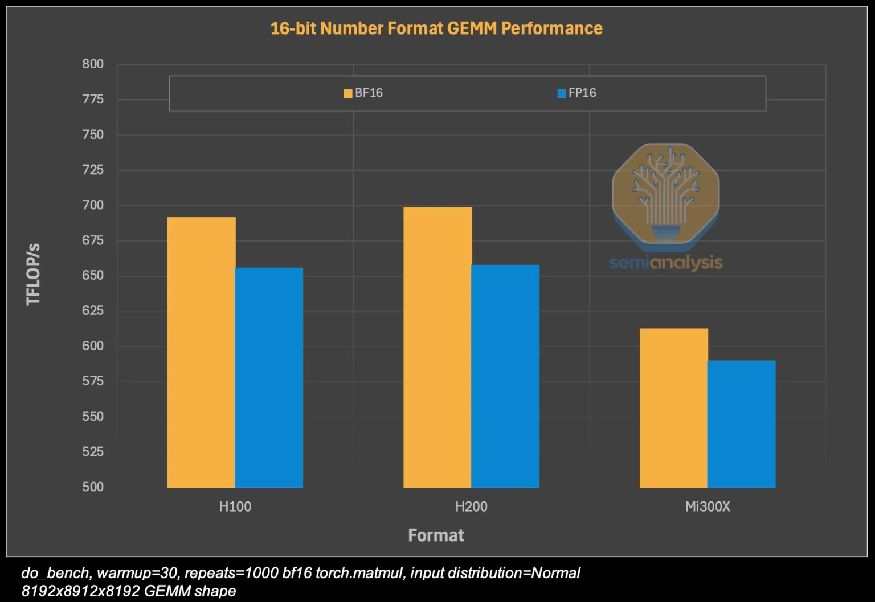
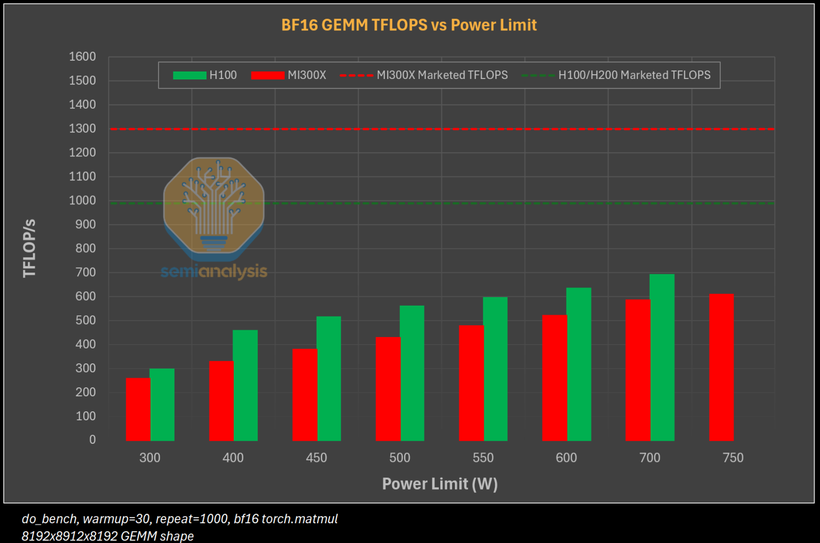
Performance in practice
In practice, the performance can be different (depending on software)
GPUs: observed FLOPS is ~2/3 of theoretical FLOPS

Slide 19
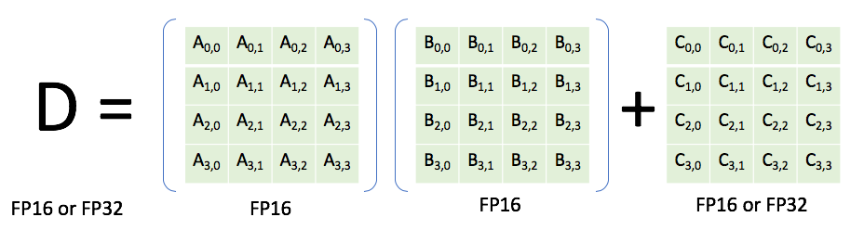
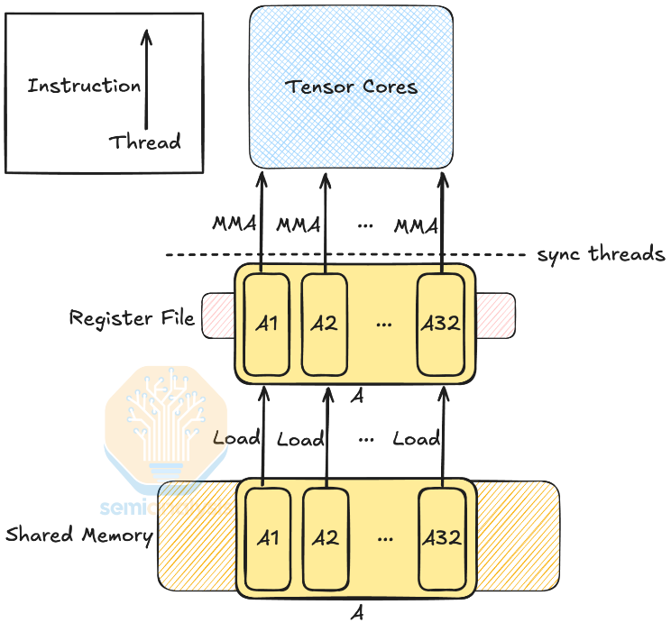
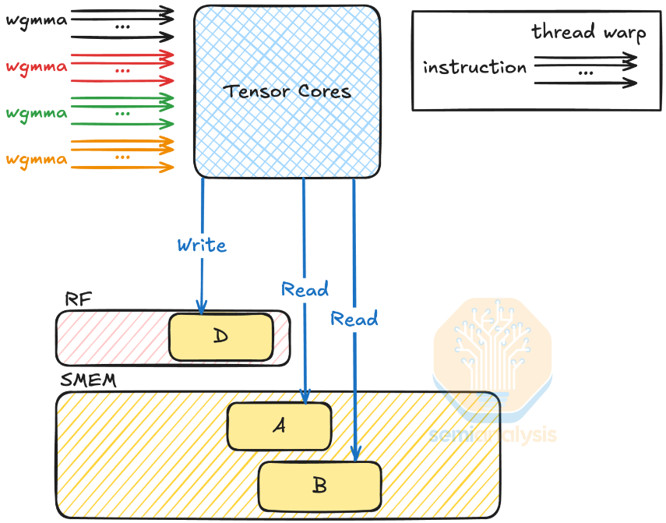
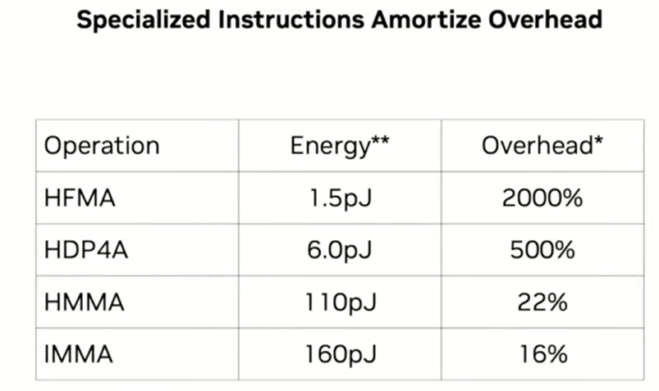
Tensor cores
Lower precision
Increasingly specialized
Pack as many instructions in one go to avoid instruction overhead, & avoid data movement
H=Half, I=Integer, FMA=Fused Multiply Add, DP=Dot Product, MMA = Matrix Multiplication Add
Previously: Now:

Slide 20
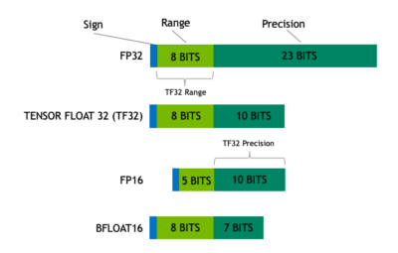
Lower precision for DL
Again: lower precision is a double-whammy of more efficient computation and loading less data
Generally, you are responsible for specifying a reduced precision: DL frameworks don’t do this automatically since it may impact your networks accuracy, convergence, etc
Mixed precision uses FP16. Reduced range causes (potential) need for gradient scaling to prevent underflows

Slide 21
Lower precision for DL
Again: lower precision is a double-whammy of more efficient computation and loading less data
Generally, you are responsible for specifying a reduced precision: DL frameworks don’t do this automatically since it may impact your networks accuracy, convergence, etc
TF32 tries to combine best of both worlds: range of an FP32 (no gradient scaling needed), but with reduced precision (for speedup & less memory)

Slide 22
Lower precision for DL
Again: lower precision is a double-whammy of more efficient computation and loading less data
Generally, you are responsible for specifying a reduced precision: DL frameworks don’t do this automatically since it may impact your networks accuracy, convergence, etc
Automatically used unless
Environment variable NVIDIA_TF32_OVERRIDE=0 is set
torch.backends.cuda.matmul.allow_tf32 = False and torch.backends.cudnn.allow_tf32 = False are set

Slide 23
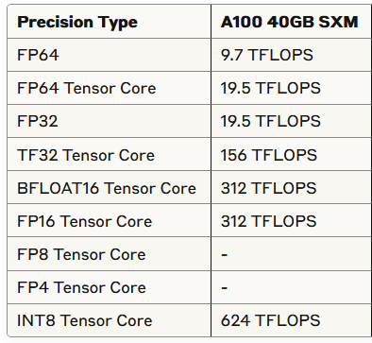
Lower precision for DL
Source: https://servicedesk.surf.nl/wiki/display/WIKI/Deep+Learning+on+A100+GPUs

Slide 24
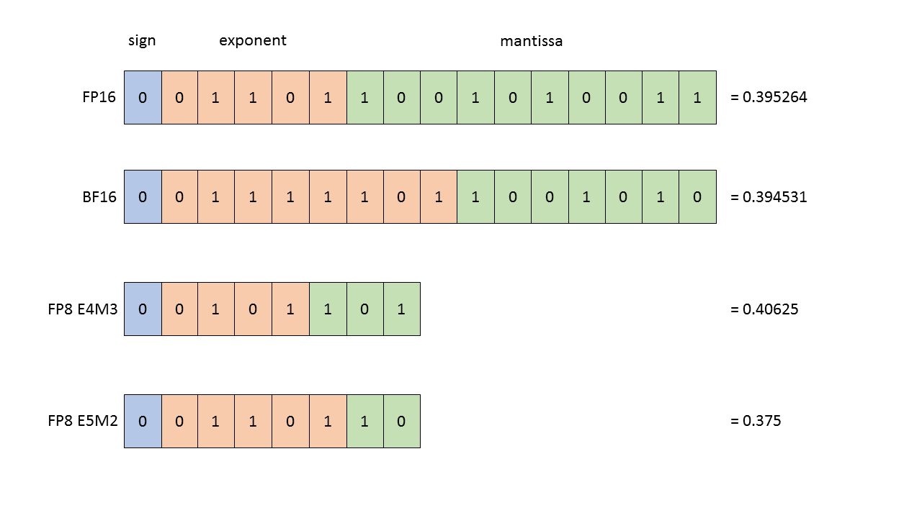
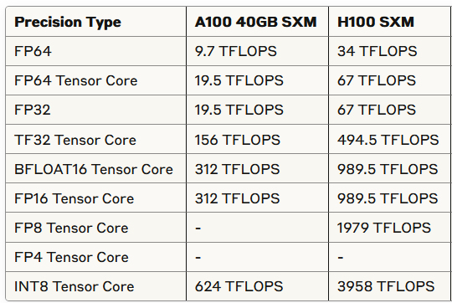
Nvidia Hopper (e.g. H100)
FP8 support
Transformer Engine for transformer specific improvements

Slide 25
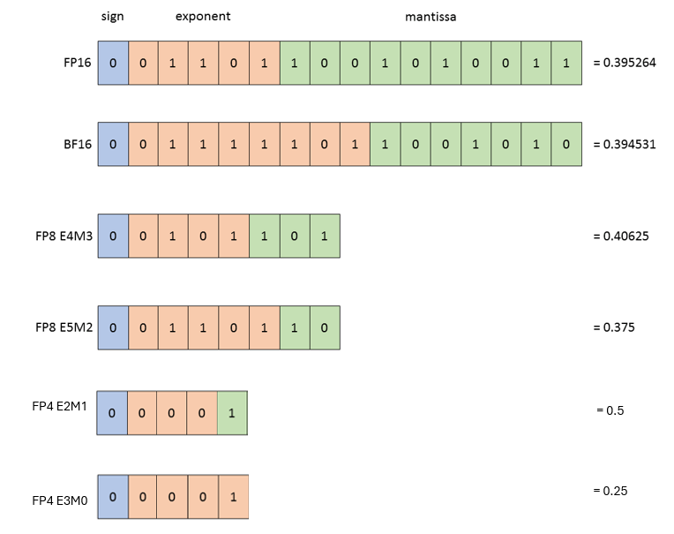
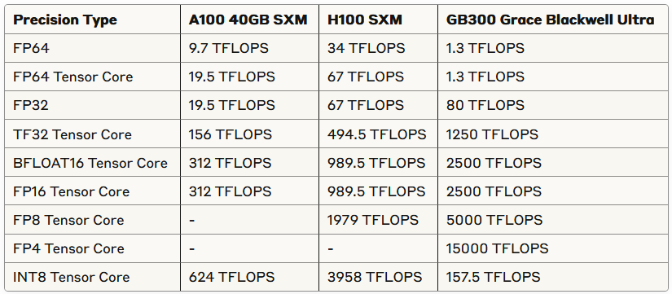
Nvidia Blackwell GPUs (e.g. B300)
FP4 support
Second-generation Transformer Engine

Slide 26
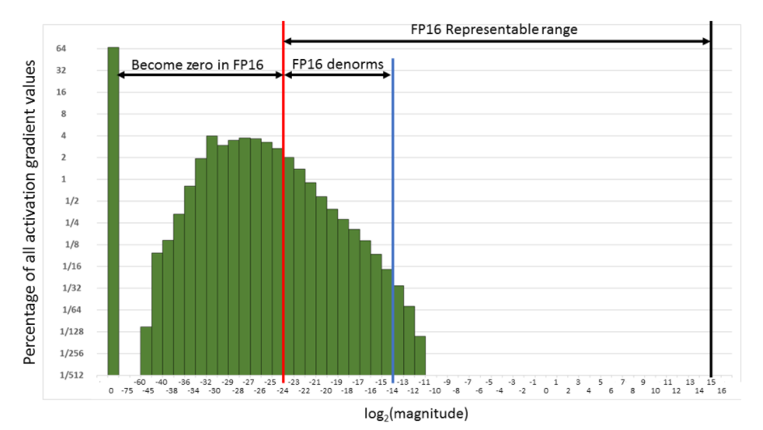
Thinking about the distribution of your data & model becomes even more important

Slide 27
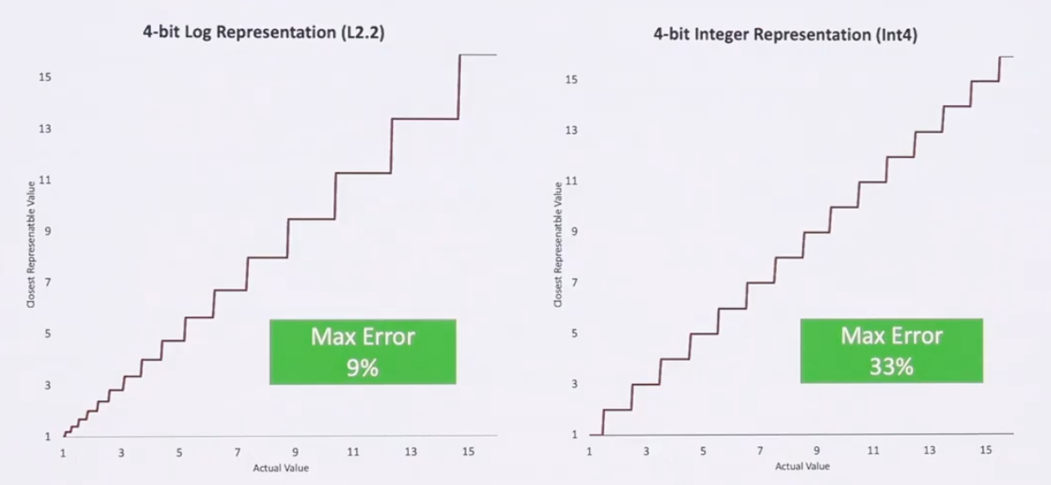
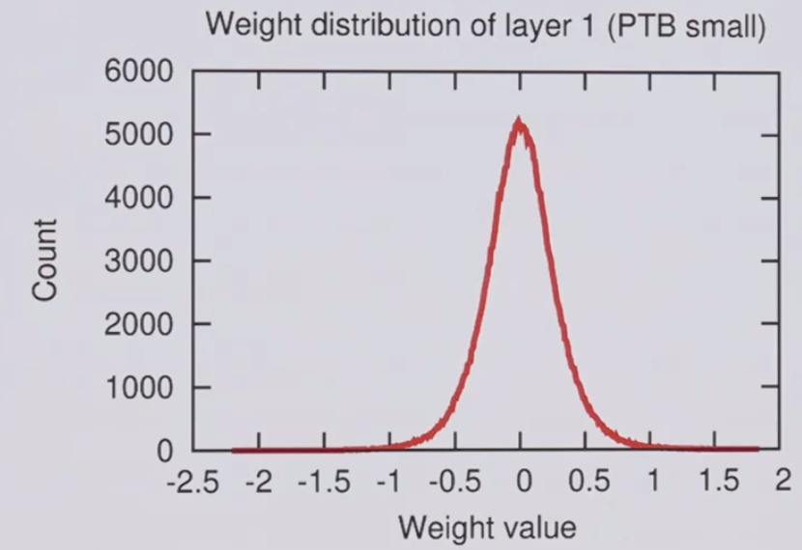
Thinking about the distribution of your data & model becomes even more important

Slide 28
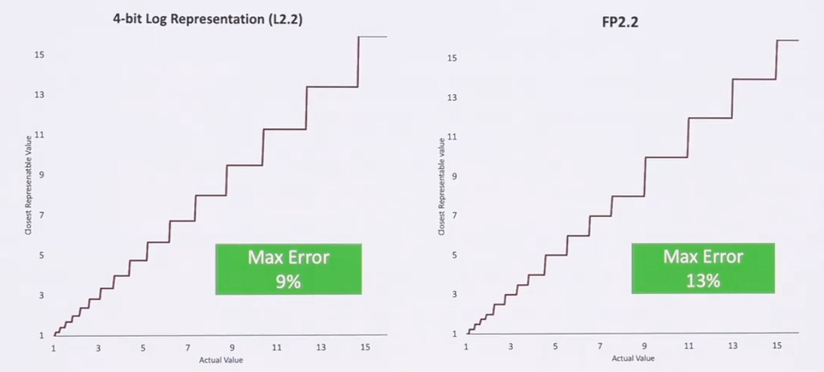
Thinking about the distribution of your data & model becomes even more important

Slide 29
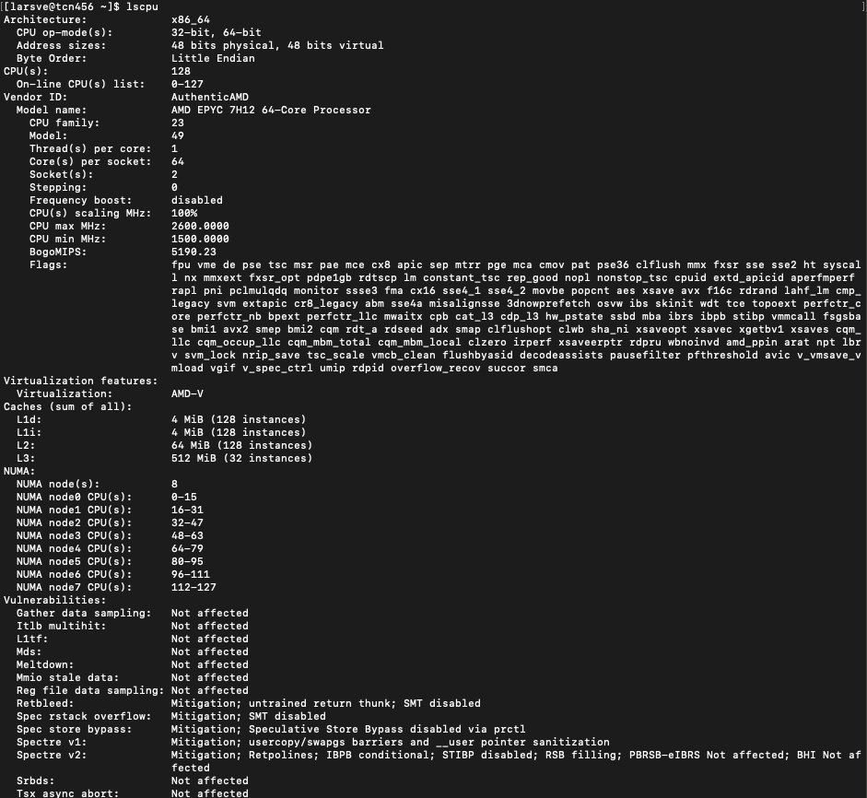
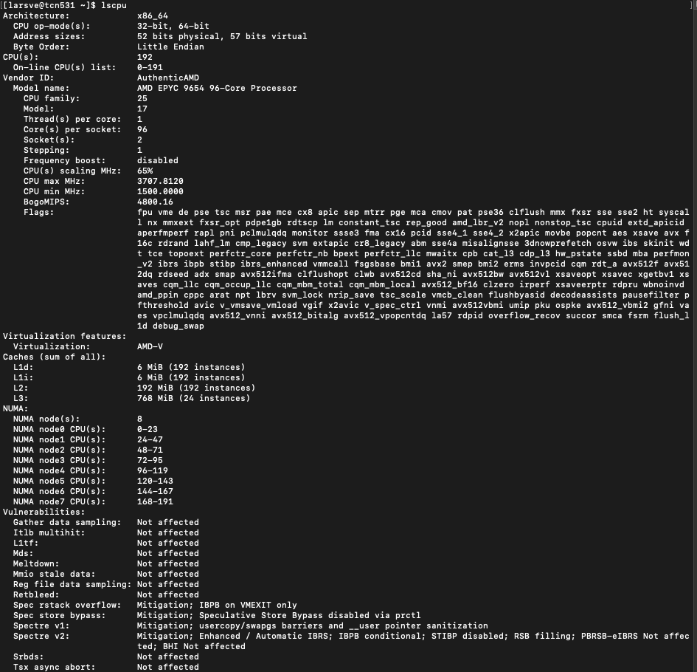
And on CPU:
Rome
Genoa
Notes:
Add new cpus

Slide 30
Second S: Software
PyTorch/TensorFlow vs Numpy
PyTorch and TensorFlow have GPU support, Numpy does not
Support for CUDA (Nvidia), ROCm (AMD), <insert exotic hardware here>?
E.g.: Intel SapphireRapids
IPEX: https://github.com/intel/intel-extension-for-pytorch
LUMI https://www.lumi-supercomputer.eu/
Support for lower precision
BFloat16, Float16? FP8?

Slide 31
Third S: Stack
Is my software compiled for my hardware
Pip install … ?
Module load PyTorch/1.12.0-foss-2022a-CUDA-11.7.0
https://servicedesk.surf.nl/wiki/spaces/WIKI/pages/30660245/Environment+Modules
Again: Consider the hardware/platform that you’re using
GPU: Nvidia/CUDA? AMD/ROCm?
CPUs: AVX512?

Slide 32
Wait ... so what happens?
You call torch
E.g. scatter_add_ -> Message passing in Graph-NNs
(Manual) Dispatching
Torch (python) determines the most appropriate function to call
Dispatching
Torch (C++/CU) calls the CPU/GPU kernel
Dispatching
Low-level C++/CU library performs actual calculation
Dispatching
PyTorch Dispatcher:
http://blog.ezyang.com/2020/09/lets-talk-about-the-pytorch-dispatcher/

Slide 33
In practice: PyTorch + Snellius
We only have NVIDIA GPUs
72x4=288 NVIDIA A100
88x4=352 NVIDIA H100
Makes optimization a bit easier for you
You only need to spend a year sifting through documentation
https://servicedesk.surf.nl/wiki/display/WIKI/Deep+Learning+on+A100+GPUs
Or ask us... :)
Every EINF/NWO small grants has a default of 4 consultancy hours

Slide 34

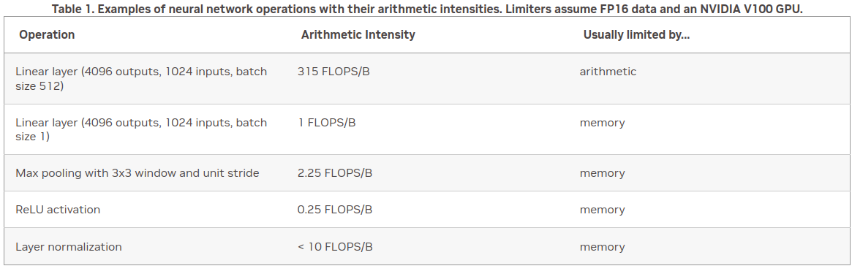
Rapidfire: implementation details
How fast do you want to go?
What is your goal?
Largest model possible?
Best validation performance?
Submit a paper to ISC ‘25?

Slide 35
Rapidfire: implementation details
Some useful resources:
https://pytorch.org/docs/stable/notes/cuda.html
https://docs.nvidia.com/deeplearning/performance/dl-performance-memory-limited/index.html
https://docs.nvidia.com/deeplearning/performance/index.html
Duncan: "You can take any piece of code, spend 6 months optimizing it, and then write a paper about it”

Slide 36
Level 0: "oh my god": torch.autocast
If PyTorch mixed precision isn’t working, probably you are doing something wrong
Gives you a free 2x+ speed boost
BF16 is industry standard
FP8 is coming

Slide 37

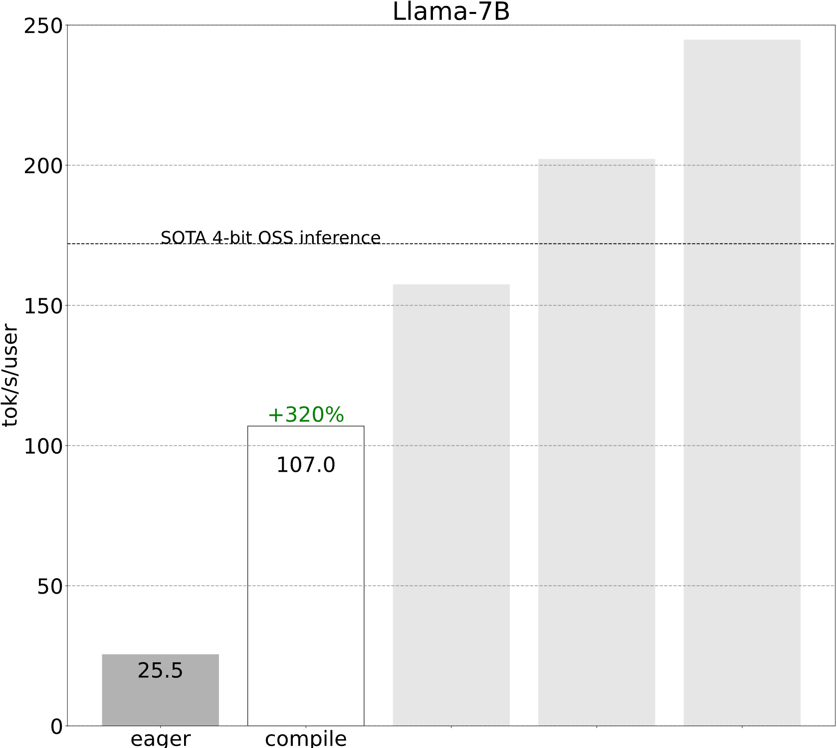
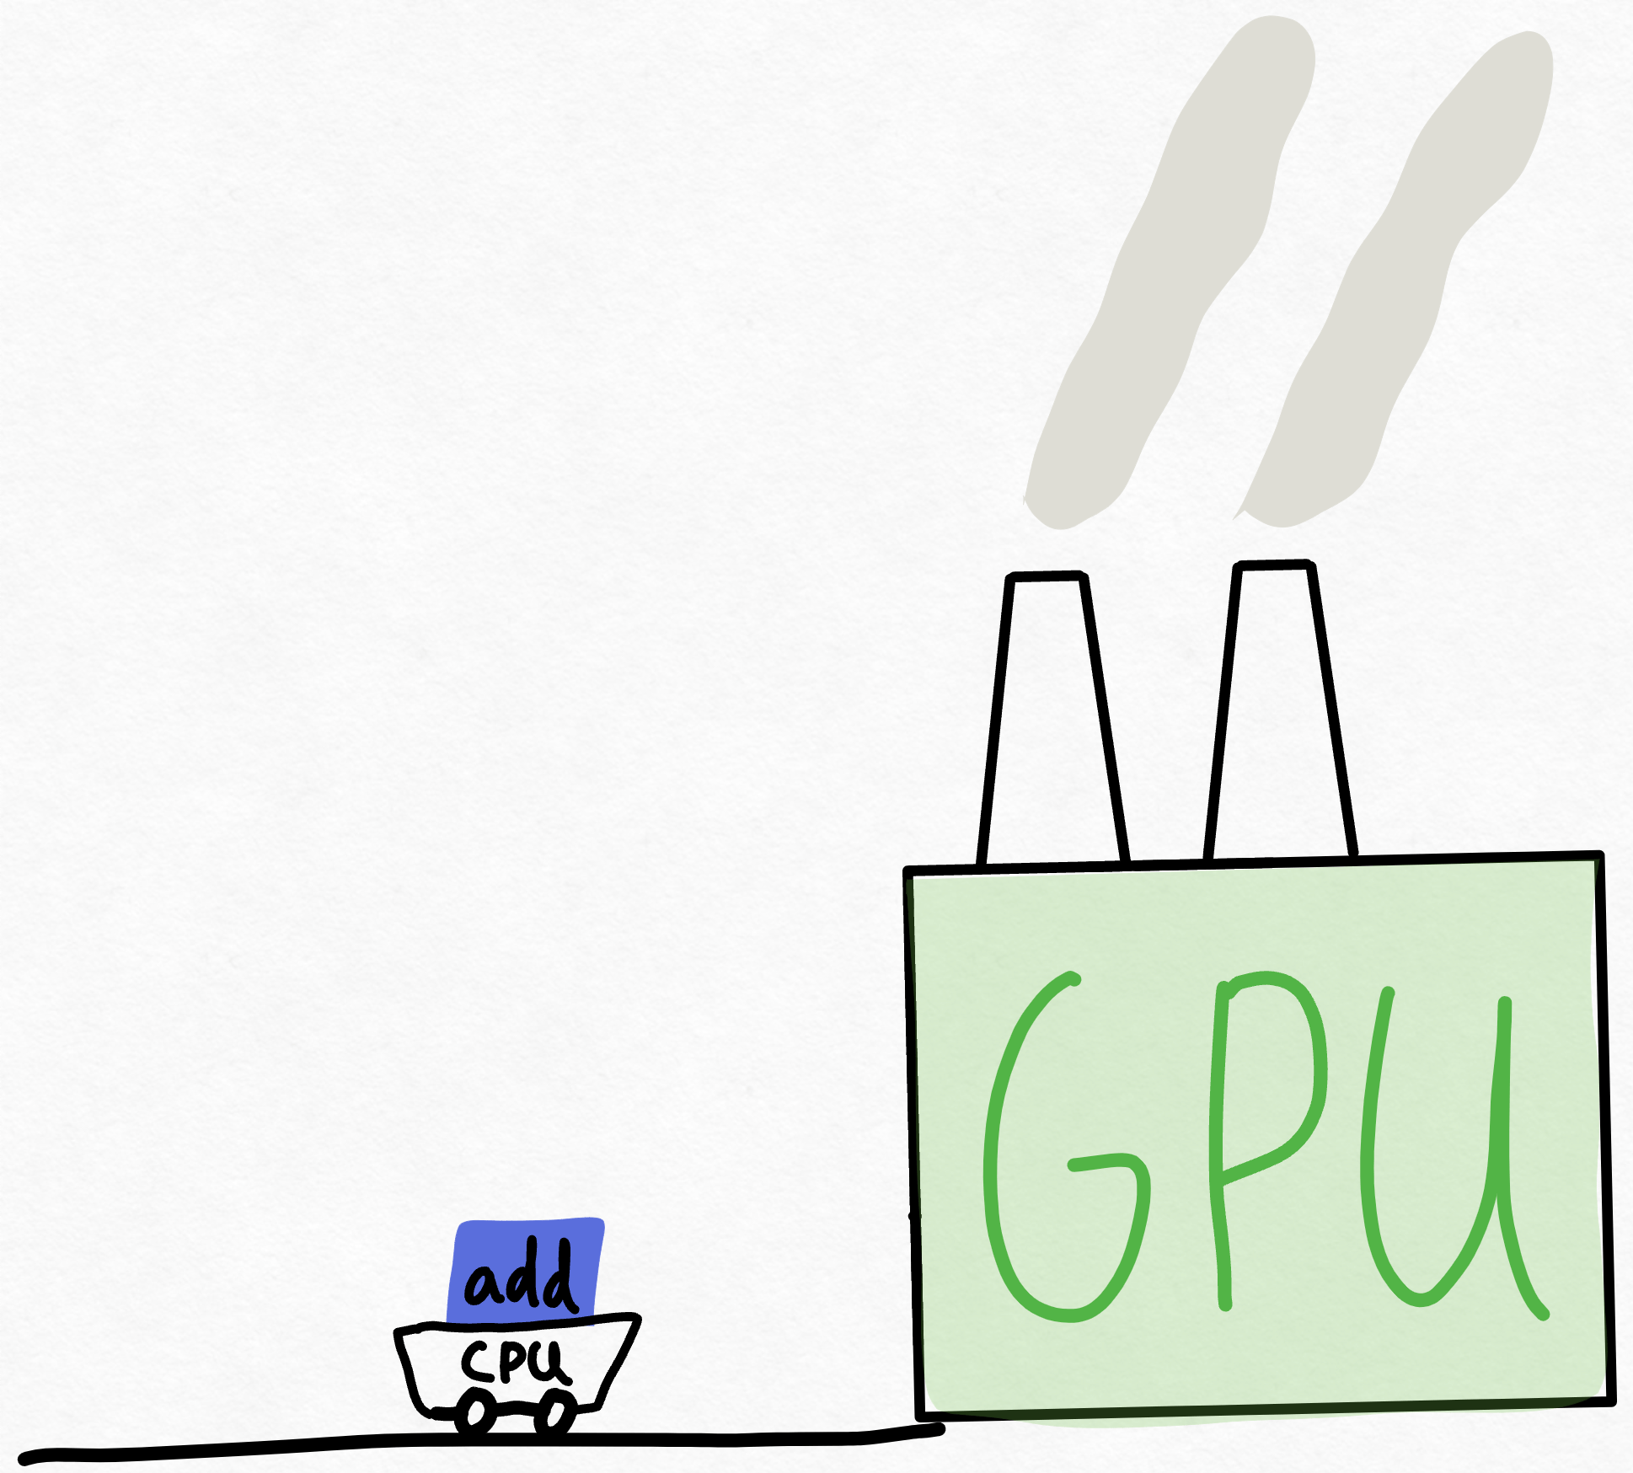
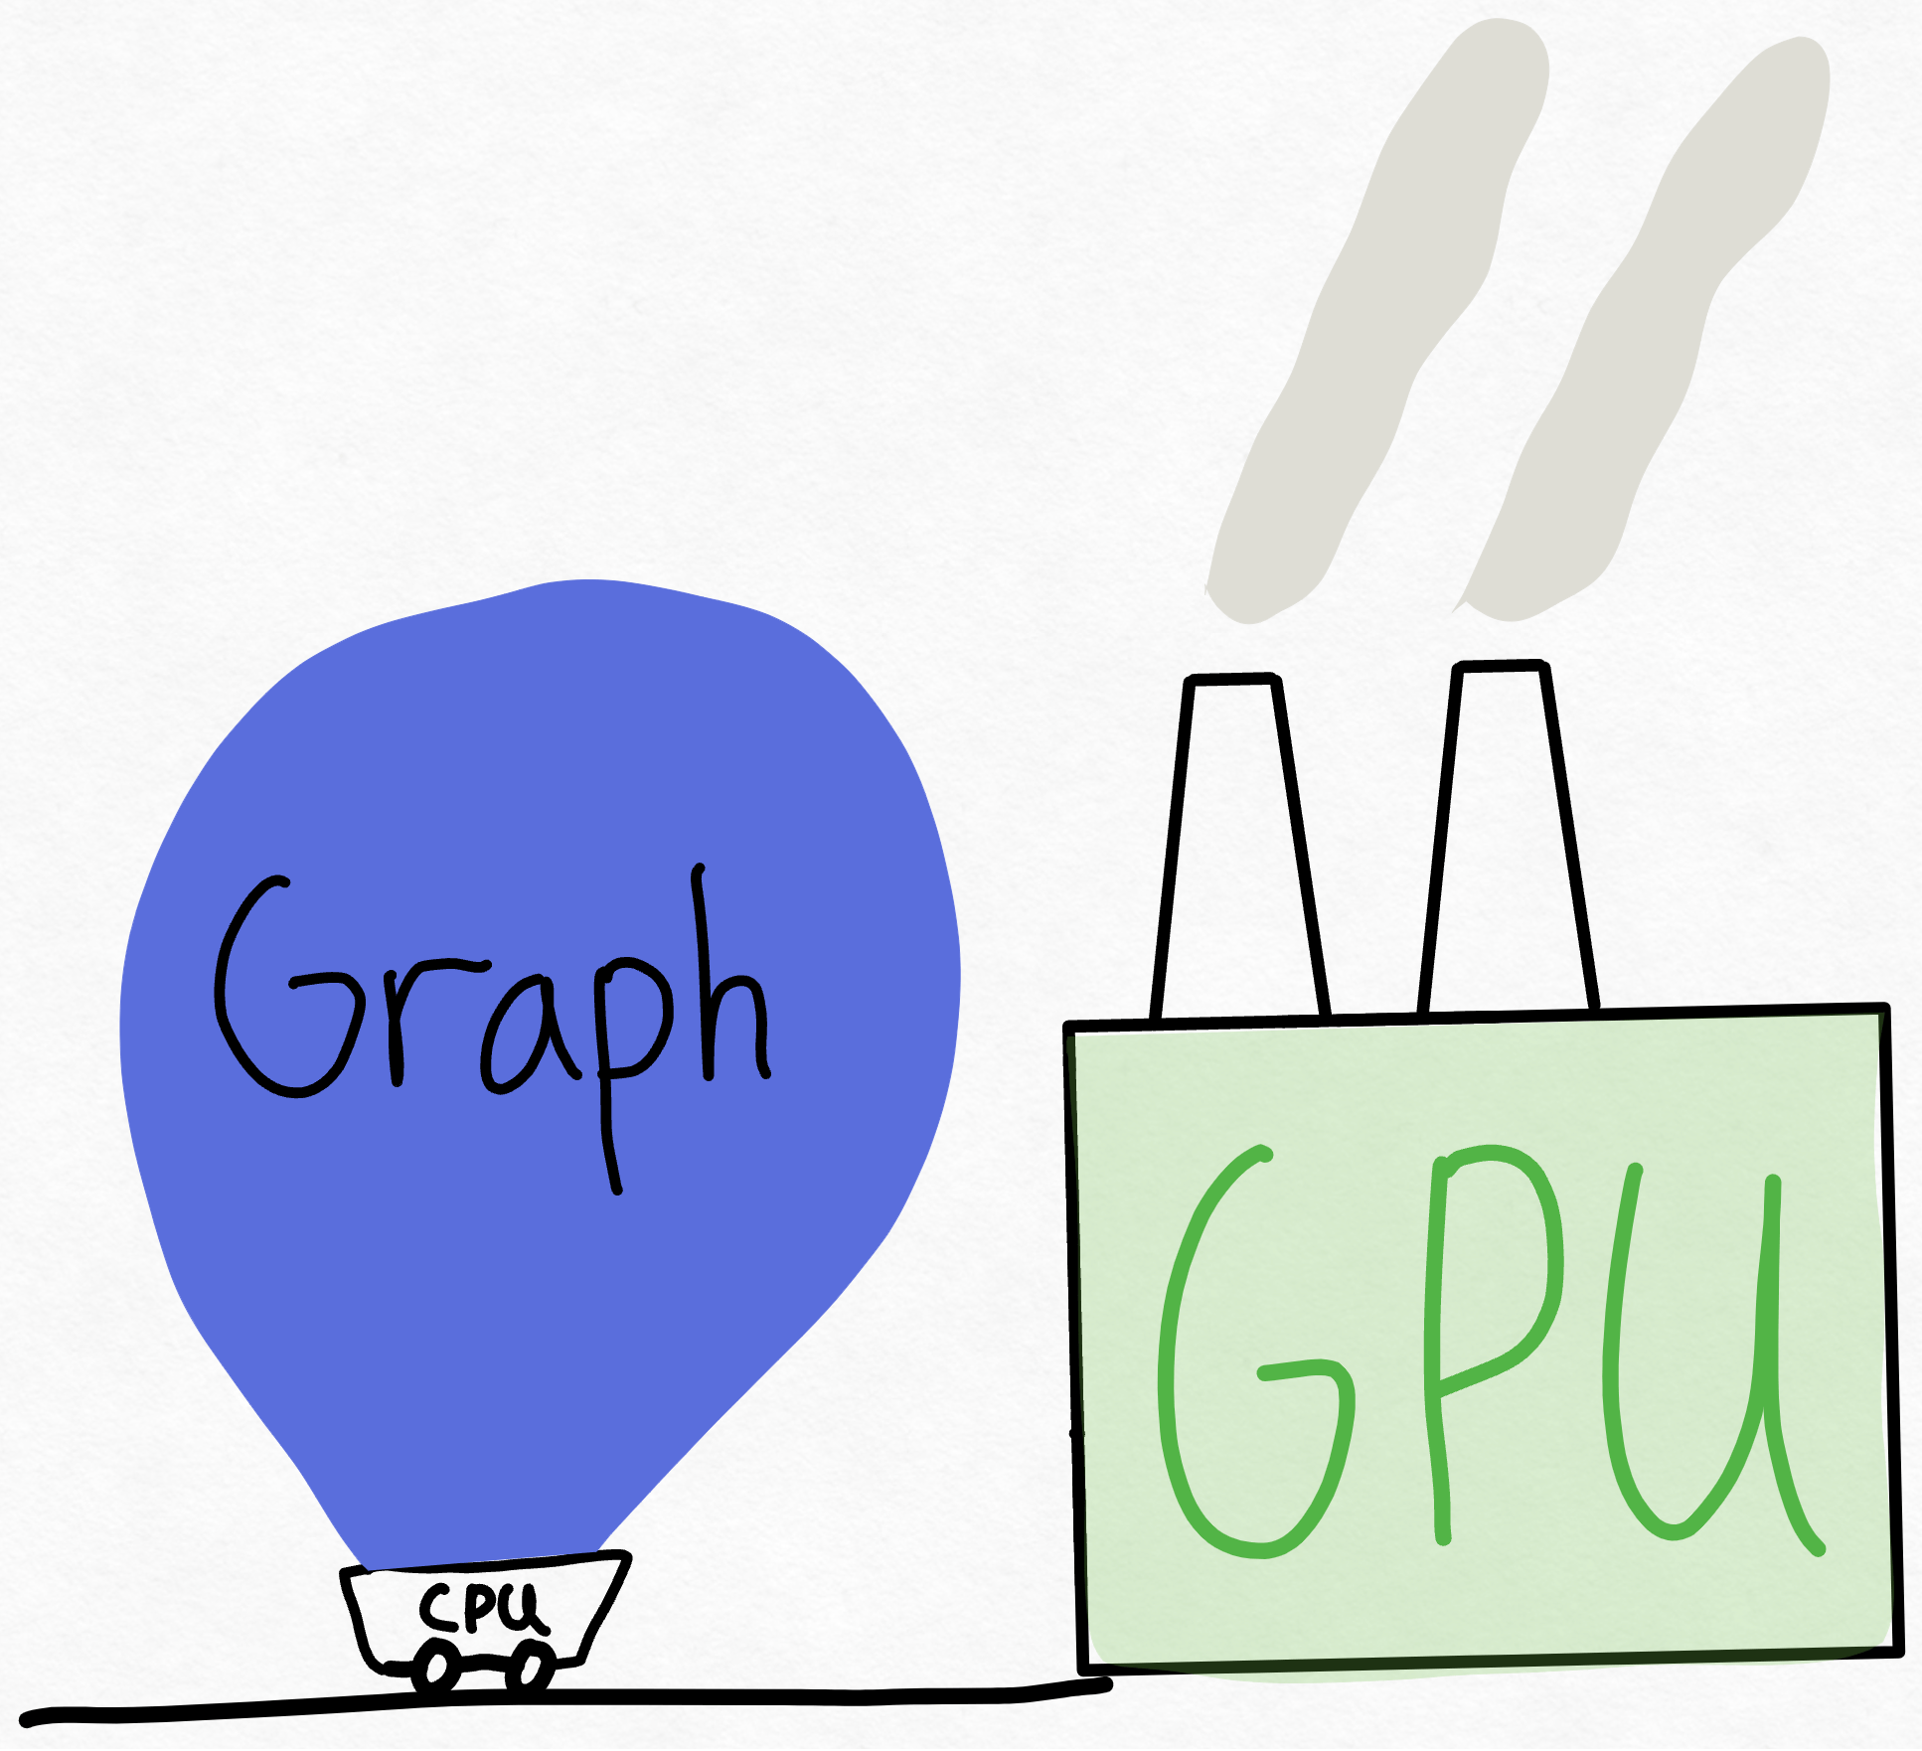
Level 0: "oh my god": torch.compile
1 CPU core is pinned to 1 GPU (used to be worse)
CPU cannot keep up with the giant that is the GPU
Still (somewhat) need to know the magic incantation:

Slide 38
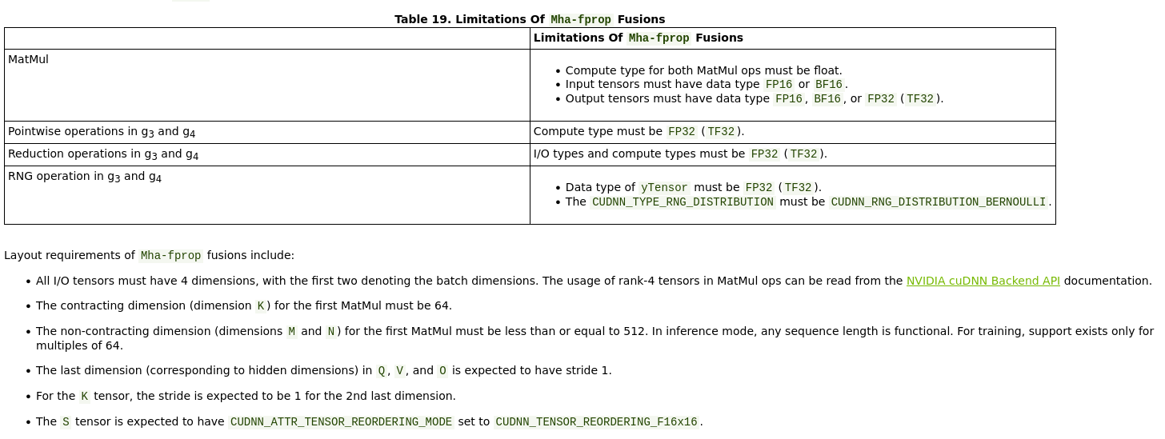
Level 1: Shouldn't impact model convergence:
Make sure every single layer/input/operation is done on multiples of 2, and probably preferable multiples of 8

Slide 39
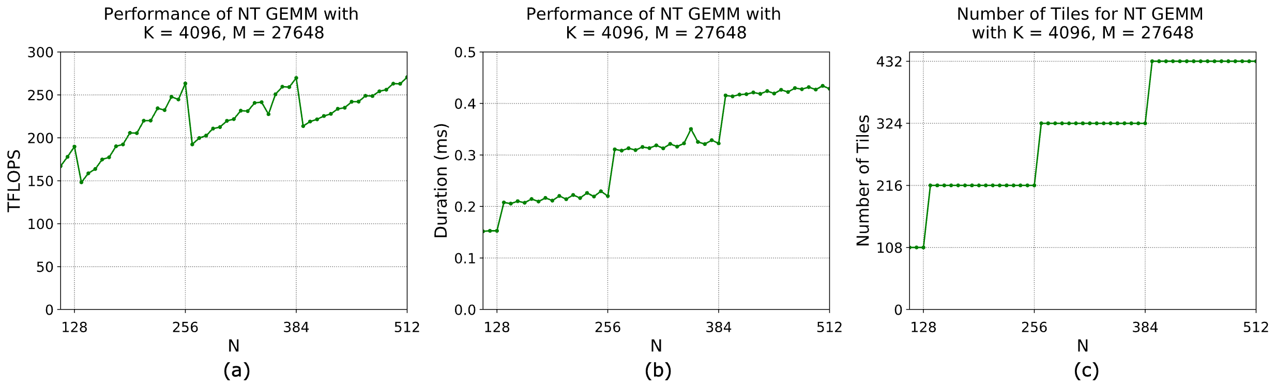
Level 1: Shouldn't impact model convergence:
Make sure every single layer/input/operation is done on multiples of 2, and probably preferable multiples of 8

Slide 40
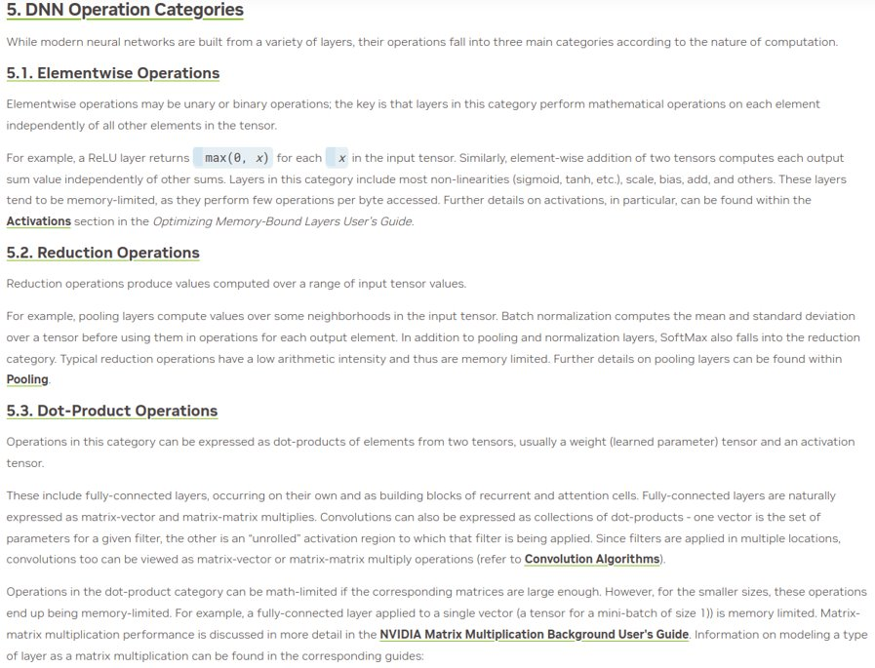
Types of DNN operations

Slide 41
Level 1: Shouldn't impact model convergence:

Slide 42


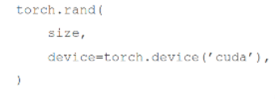
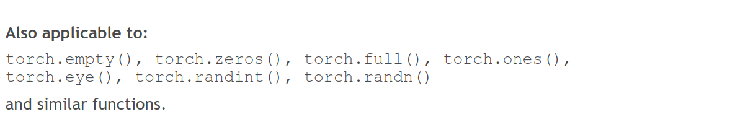
Level 1: Shouldn't impact model convergence:
Avoid CPU-GPU sync
Create tensors directly on the device
✅

Slide 43
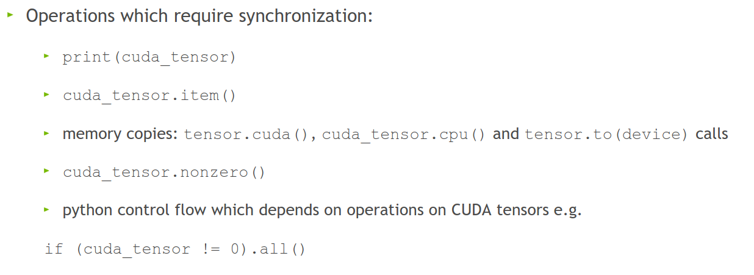
Level 1: Shouldn't impact model convergence:
Avoid doing these inside a training loop if possible:
This forces PyTorch to copy data from GPU to CPU, slowing performance.

Slide 44
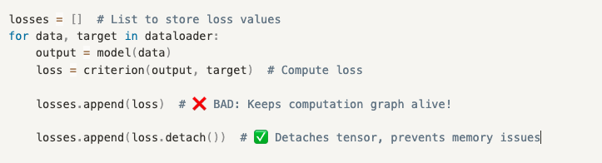
Level 1: Shouldn't impact model convergence:
Don't aggregate tensors which still require grad, e.g.: losses.append(loss) (:o)
instead, detach (loss.detach())
Each loss in losses.append(loss) stores the entire computation graph. PyTorch stores extra gradients unnecessarily!
detach() creates a new tensor with the same values but removes the gradient tracking.

Slide 45
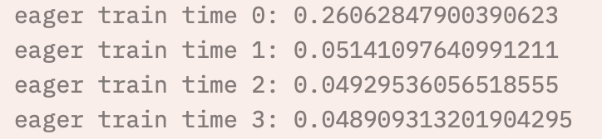
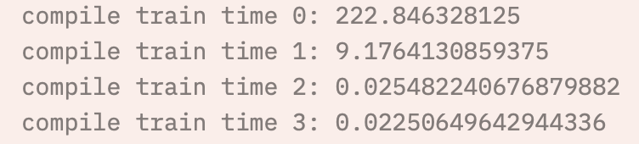
Level 1: Shouldn't impact model convergence:
There is little reason not to use TensorFloat32 ☺
torch.backends.cuda.matmul.allow_tf32 = True
The default in PyTorch (silently)
torch.set_float32_matmul_precision('high')
torch.backends.cudnn.benchmark = True
Empirically benchmarks to find fastest algorithm for some methods, default in PyTorch
Align bytes: multiples of 2, 8, 1024
DNN libraries want nicely aligned memory
torch.channels_last
Helps with memory alignment and reduces cache misses
Compile: PyTorch 2.0
Big speedup, but sensitive to implementation
Helps maintain accuracy in cases where TF32 might introduce minor errors
Stores images in NHWC format instead of NCHW (optimizes GPU cache usage)

Slide 46

Level 2: Danger zone
Lower precision (FP16 or BF16) for matrix reductions instead of higher precision (FP32, advised). Can cause numerical instability!
torch.backends.cuda.matmul.allow_fp16_reduced_precision_reduction = True
Lol:
torch.backends.cuda.matmul.allow_bf16_reduced_precision_reduction = True
Torch.set_float32_matmul_precision('medium')
Cast model and data to (B)Float16 before the forward pass
We're not supposed to...but:
trades some accuracy for faster compute. Can affect model convergence
Forces all computations to use lower precision, instead of letting autocast() to choose

Slide 47
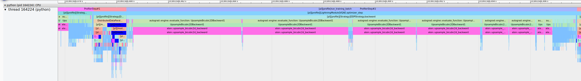
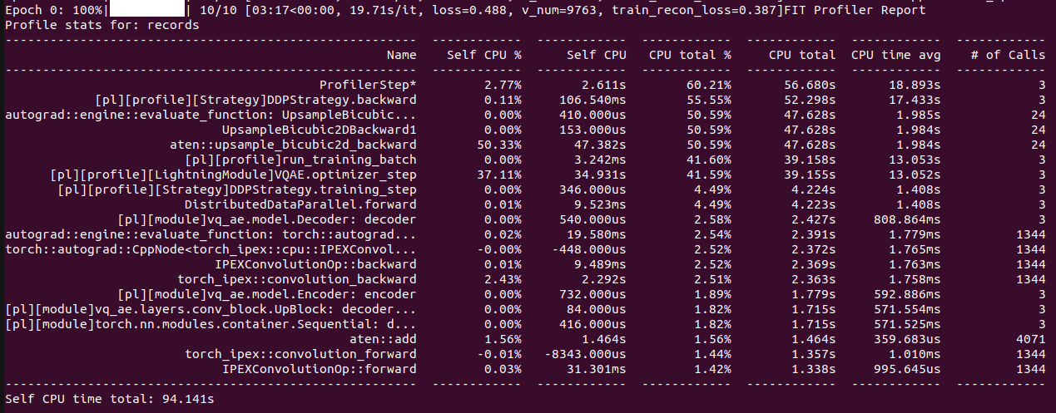
Change your model
Worst case scenario:

Slide 48
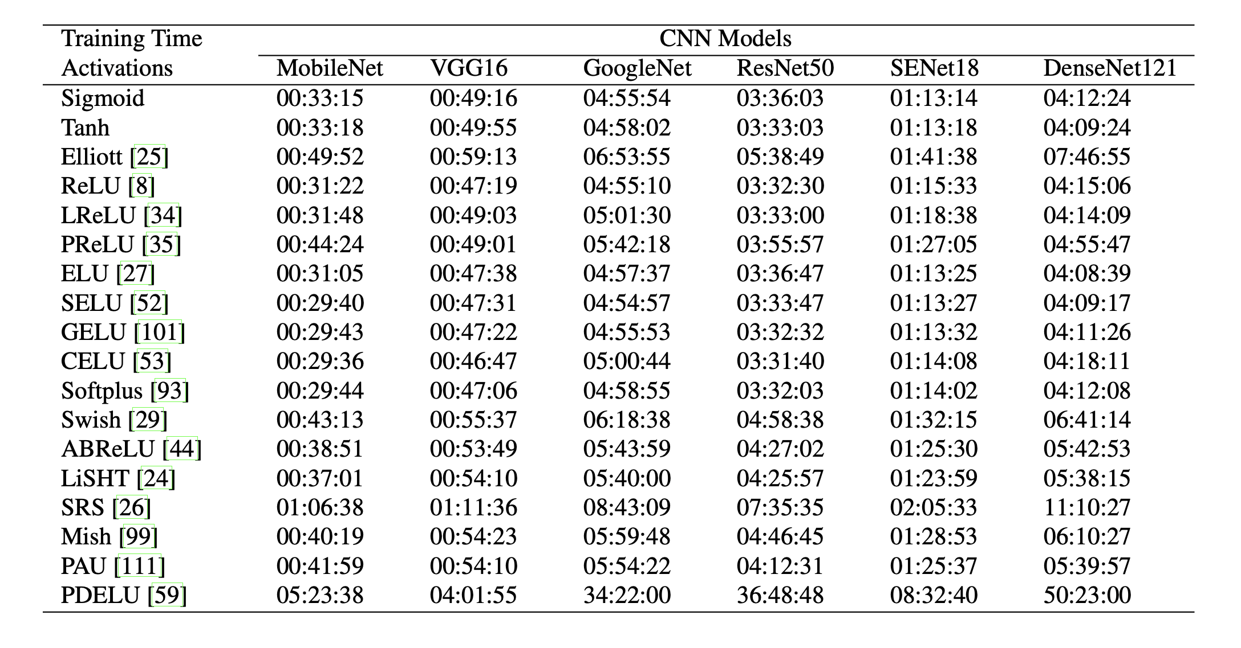
Change your model
Change model architecture to improve performance characteristics, e.g.:
Use LoRA for fine-tuning
Use pre-trained model aka zero shot
E.g. DINOv2
Incorporate dataloading operations into the model instead of CPU pipeline
ViT vs CNN vs GNN
Change non-linearities
Multiples of 2,8,1024
Channels
Hidden size
Vocab size
Batch size
Input resolution/sequence length
Everything
For transformers:
Patching
Masked attention

Slide 49
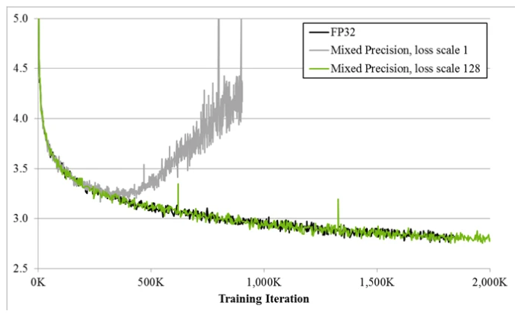
Always
Have a baseline
Check convergence statistics

Slide 50
Monitoring/Profiling
Get a grip on your model’s performance
At least monitor your performance
Preferably, do some form of profiling

Slide 51
Monitoring pyramid
Kernel-level profiling
Nsight compute
Job-level Profiling
PyTorch profiler, nsight systems
Time investment
Performance metric collection
Wandb, Tensorboard perf metric logging (e.g. iterations per second, %watts over time)
Runtime monitoring
Htop, nvtop, nvidia-smi, dcgmi

Slide 52
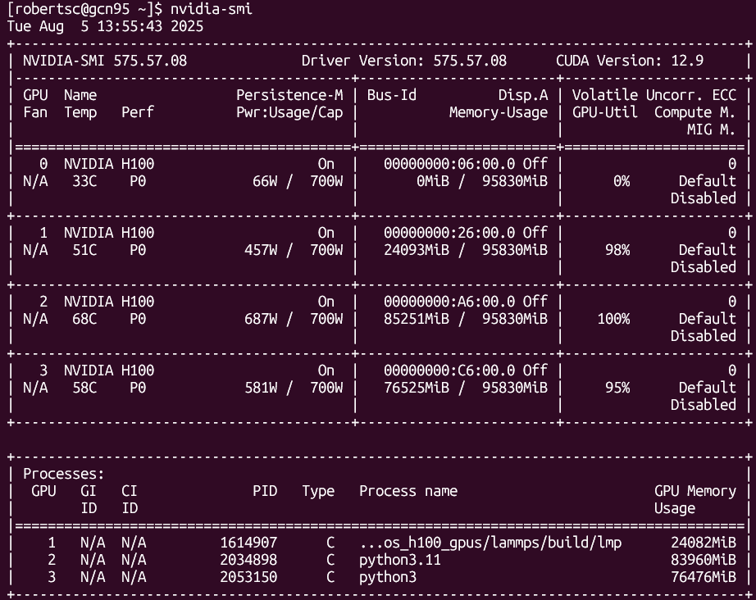
nvidia-smi

Slide 53
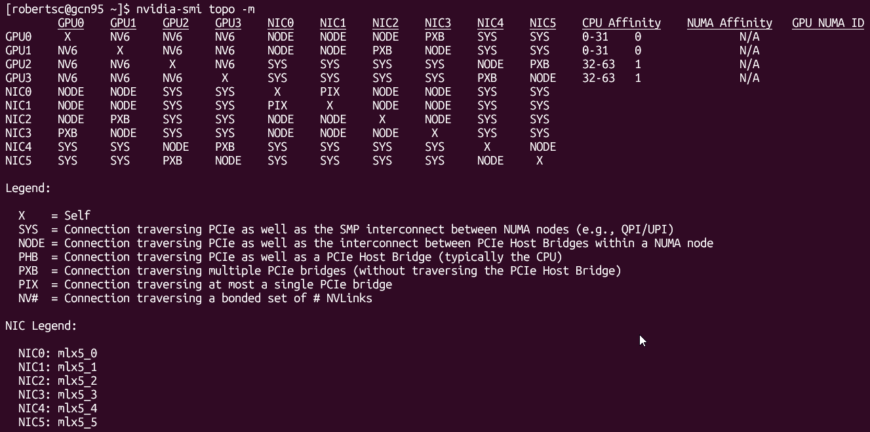
nvidia-smi

Slide 54
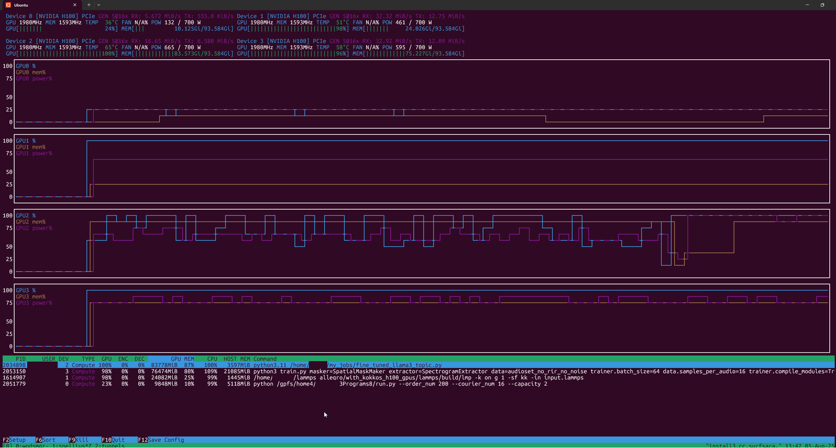
nvtop

Slide 55
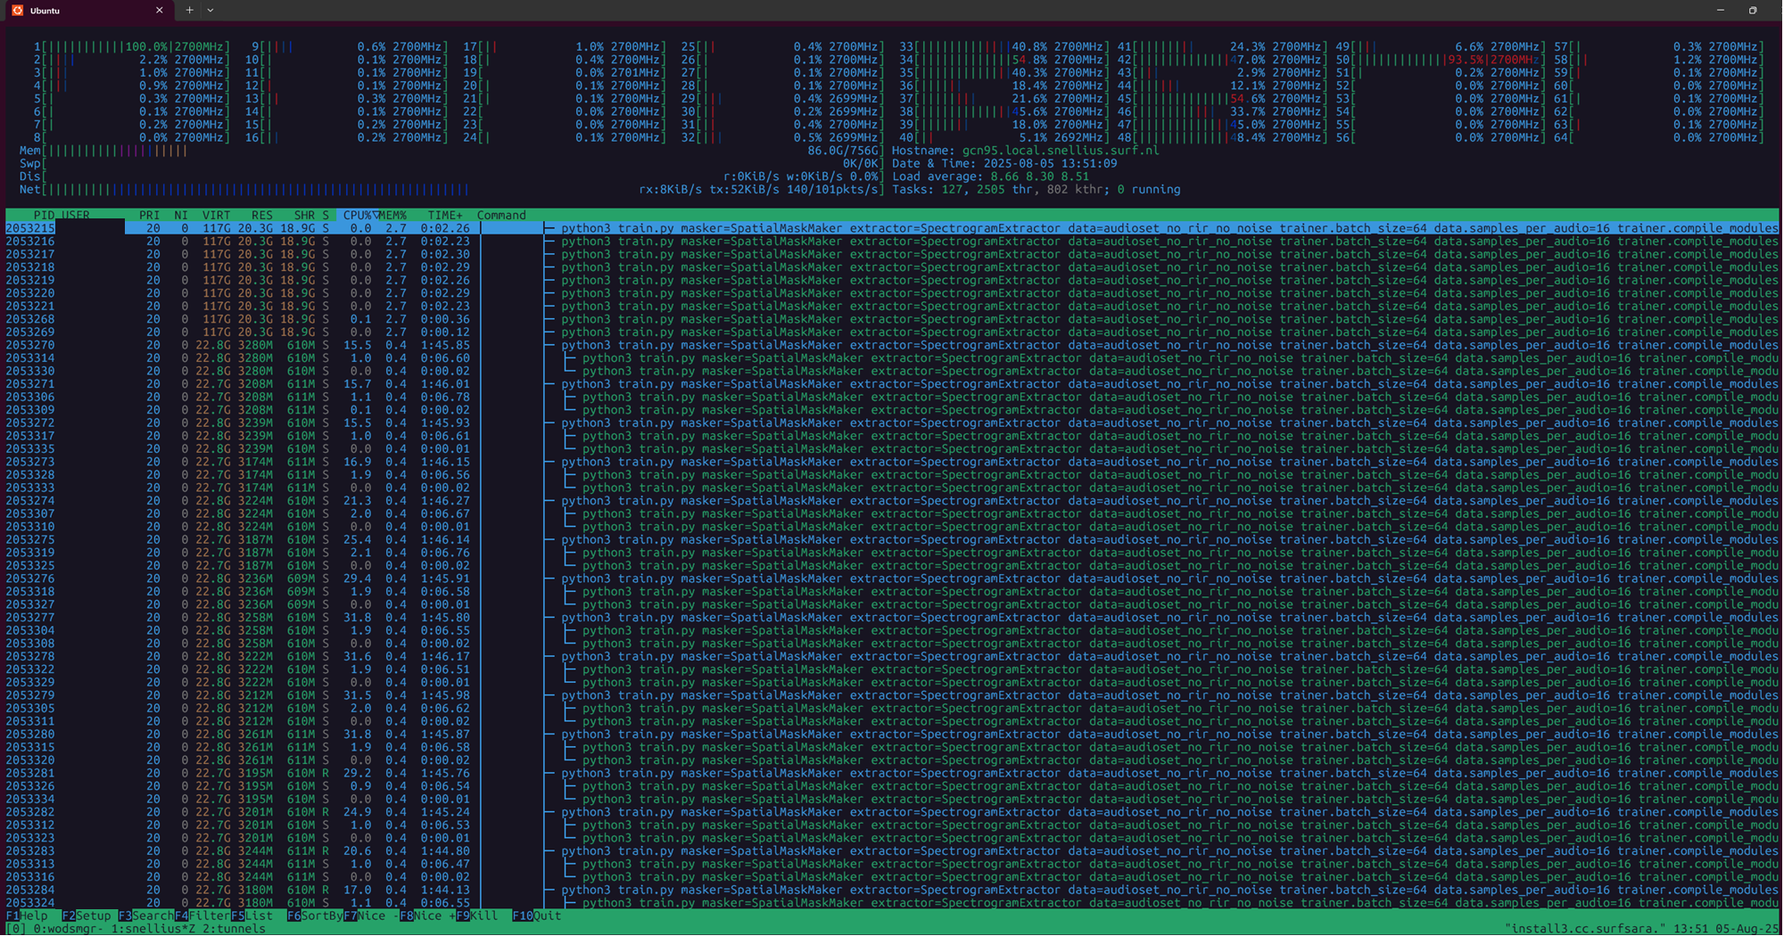
htop

Slide 56
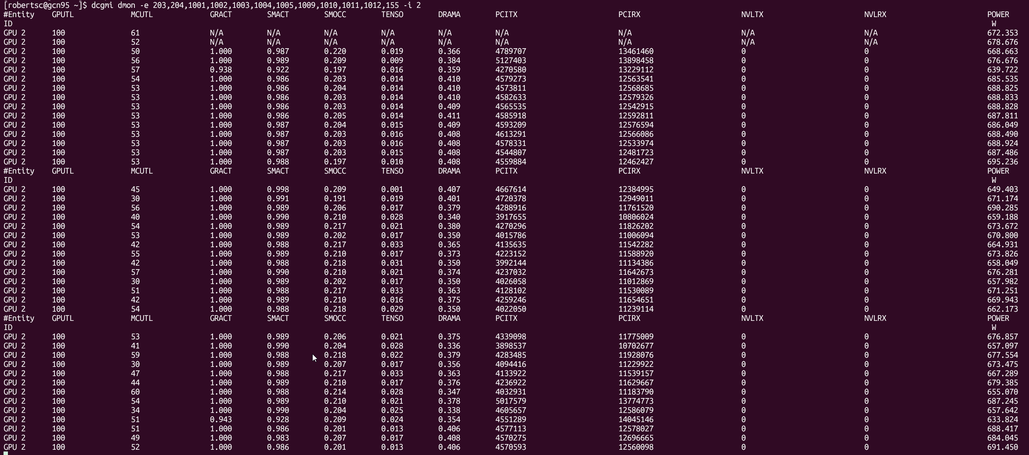
dcgmi

