Slide 1



Machine Learning Tutorial – 5-6 November 2024
Trainers: Simone van Bruggen, Caspar van Leeuwen and Lars Veefkind
Machine Learning Advisors at SURF in HPML Team

Slide 2
Credit where credit is due
Slides stolen from:
SURF colleagues
Caspar van Leeuwen
Monica Rotulo
Bryan Cardenas Guevara
Robert Jan Schlimbach
Erik Bekkers
PyTorch
CUDA/cuDNN

Slide 3
About EuroCC & EuroHPC JU
EuroHPC JU:
joint initiative between EU, EU member states, and private partners to develop a World Class Supercomputing Ecosystem in Europe
https://eurohpc-ju.europa.eu/
EuroCC
A key program in EuroHPC JU
EuroCC acts as gateway for industry and academia to find providers with suitable HPC expertise
EuroCC facilitates HPC-skill oriented trainings (like this one)

Slide 4
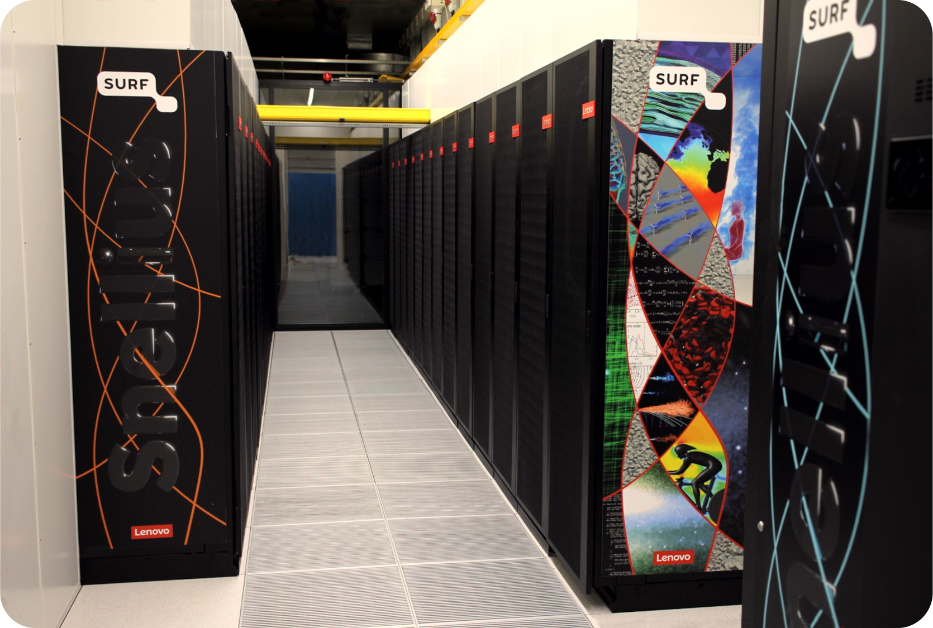
About SURF
Collaborative organization for ICT in Dutch education and research
National Competence Center in EuroCC for The Netherlands
Offers HPC services (and many others, data storage, cloud, networking, etc)

Slide 5
Course plan
Day 1:
Introduction to Deep Learning
Using the PyTorch framework
Fully connected networks, Convolutional networks, Transformers
Day 2:
Software installations on HPC systems
Packed file formats for Machine Learning
Parallel computing for deep learning
Hardware (e.g. Tensor cores) and software features (e.g. low-level libraries for deep learning) for accelerated deep learning
Profiling PyTorch with TensorBoard

Slide 6
Course plan Day 1
9:30 – 9:45 Welcome and course overview (Lars Veefkind)
9:45 – 10:30 Introduction to ML & DL basic principles (Lars Veefkind)
10:30 – 10:50 Introduction to PyTorch (notebook) (Lars Veefkind)
10:50 – 11:05 Coffee break
11:05 – 11:45 Hands-on: Fully connected network (Lars Veefkind)
11:45 – 12:00 Recap Hands-on (Lars Veefkind)
12:00 – 13:00 Lunch Break
13:00 – 14:00 Convolutional neural networks (Lars Veefkind)
14:00 – 14:45 Hands-on: Convolutional neural networks (Lars Veefkind)
14:45 – 15:00 Recap hands-on (Lars Veefkind)
15:00 – 15:15 Coffee Break
15:15 – 16:00 Self-attention / Transformers (Robert Jan Schlimbach)
16:00 – 16:45 Hands-on / demo notebook: Transformers
16:45 – 17:00 Questions, wrap up

Slide 7
Course plan Day 2
9:30 – 10:45 Software installations on HPC systems (Robert Jan Schlimbach)
10:45 – 11:00 Coffee break
11:00 – 11:30 Packed file formats (Robert Jan Schlimbach)
11:30 – 12:15 Hands-on: Packed file formats (Robert Jan Schlimbach)
12:15 – 13:15 Lunch Break
13:15 – 14:45 Parallel Computing for Deep Learning (Lars Veefkind)
14:45 – 15:00 Coffee Break
15:00 – 15:45 Hardware and software features to accelerate deep learning (Lars Veefkind)
15:45 – 16:45 Profiling to understand your neural network’s performance (Robert Jan Schlimbach)
16:45 – 17:00 Questions, wrap up

Slide 8
Logins
Access to the Dutch National Supercomputer (Snellius) for this course
Snellius Supercomputer (CPU-based Jupyter Notebook environment, CPU batch jobs)
Did you get a login ‘scurXXX’?
The e-mail contains a link to choose a password – please do so
Log in to https://portal.cua.surf.nl/ and accept the End User Agreement
Try to login at https://jupyter.snellius.surf.nl/jhssrf010
Select the ‘course hours’ profile, and click ‘spawn’
If you did not receive a login, or starting a notebook server does not work: please let us know so we can resolve it during the first hands-on session.
Notes:
P

