Slide 1


Hardware and software features to accelerate deep learning

Slide 2
The three S'
Know your System
  What kind of hardware do I have?
  What features does my hardware support?
Know your Software
  Does my software do what I want to do efficiently?
  Does my software support my hardware features?
Know your Stack
  What version of software am I running?
  Is my stack compiled for my hardware?

Slide 3
System
Which CPUs?
  Architectures: X86_64, ARM64
What kind of storage?
  SSD, HDD, Tape?
  SATA, NVMe or full PCI-E, Network?
What kind of Networking?
  Ethernet? InfiniBand (IB)?
  IOPs vs Throughput
What kind of RAM?
  High Bandwidth Memory (HBM) or Double Data Rate (DDR)?
  How much? Enough for a RAMdisk? (/dev/shm)
  You (AI person) are always memory limited
Which GPUs?
  AMD? Good raw performance, PyTorch support is improving
  NVIDIA? Optimized for AI with good PyTorch support.
  Intel? Technically supported in PyTorch.
https://servicedesk.surf.nl/wiki/display/WIKI/Snellius+hardware+and+file+systems

Slide 4
System
Goals:
Understand what hardware bottlenecks could be limiting
Understand pro’s and con’s of various hardware
Know how to choose appropriate hardware for you DL task
Know what to do to mitigate bottlenecks

Slide 5

Important System Details
E.g. training a compute intensive network on a single node
Compute (floating point operations per second, FLOPS)
Memory bandwidth
Memory size
I/O
Communication

Slide 6
Important System Details
Compute (floating point operations per second, FLOPS)
Memory bandwidth
Memory size
I/O
Communication
Data needs to get to the processor in time in order to do compute!
Many codes are limited by memory bandwidth

Slide 7
Important System Details
Compute (floating point operations per second, FLOPS)
Memory bandwidth
Memory size
I/O
Communication
(may be) limited by memory:
  Deep/wide networks
  Networks with very large input/output layers (e.g. high res images)
Not a performance bottleneck, but a no-go!
  But: unified memory

Slide 8
Important System Details
Compute (floating point operations per second, FLOPS)
Memory bandwidth
Memory size
I/O
Communication
HPC systems typically have shared file systems
  Good bandwitdh
  (relatively) low I/O operations per second (IOPS)
Common bottleneck in distributed learning! Many nodes reading from the same filesystem.
Other users (& sysadmins) will dislike you if you do I/O in a naive way!

Slide 9
Important System Details
Compute (floating point operations per second, FLOPS)
Memory bandwidth
Memory size
I/O
Communication
Communication can be limiting in several ways:
Latency (many, small message send between nodes)
Bandwidth (few, large messages send between nodes)
Load imbalance (some workers in distributed job are slower / have more work; others have to wait when synchronization is needed)
CPU <-> GPU sync

Slide 10
Some context
What? | Time | Equivalent to N CPU instructions
CPU instruction | 0.25 ns (@4GHz) | 1
GPU instruction | 1 ns (@1 GHz) | 4
Fetch from L1 CPU cache | 0.5 ns | 2
Fetch from L2 CPU cache | 7 ns | 28
Fetch from main CPU memory | 100 ns | 400
CPU => GPU latency (PCI) | 300 ns | 1200
GPU ⬄ GPU latency (NVLink) | 300 ns | 1200
Infiniband network latency | 1 μs | 4k
Ethernet network latency | 10-1000 μs | 40k-4M
Seek time (NVMe SSD) | 20 μs | 80k
Seek time (Sata SSD) | 200 μs | 800k
Seek time (hard disk) | 2-5 ms | 8-20M
Network File System (NFS) response times | 10-40 ms | 40-120M
Robot Fetch time (Tape) | +- 60 s | 180B

Slide 11
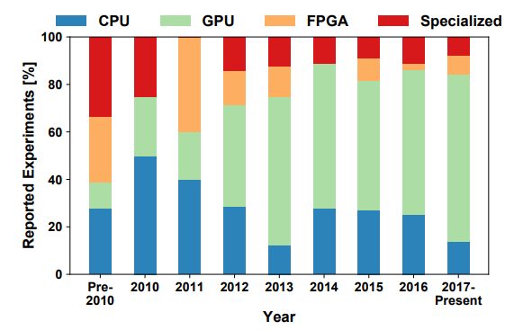
System Hardware Distribution
A look at the hardware, from a DL perspective:
Nvidia is dominant, Volta was a game changer
AMD is slowly catching up
Specialized hardware losing favour
Same for CPUs
Source: Demystifying Parallel and Distributed Deep Learning: An In-Depth Concurrency Analysis, Ben-Nun & Hoefler 2018

Slide 12
Hardware overview
 | FP4 [TFLOPS] | FP8 [TFLOPS] | INT8 [TOPS] | FP16/BF16 [TFLOPS] | FP32 [TFLOPS] | FP64 [TFLOPS] | Memory [GB] | Memory Bandwidth [GB/s] | PCIe [GB/s] | Power draw [W] | FP16 TFLOP per Watt
AMD MI250 |  |  | 362.1 | 362.1 | 90.5 | 90.5 | 128 | 3276.8 | 31.51 | 560 | 0.64
AMD MI325x |  | 2615 | 2615 | 1307 | 654 | 163 | 256 | 6000 | 128 | 1000 | 1.3
NVIDIA A100 |  |  | 624 | 312 | 156 | 19.5 | 40/80 | 1555-2039 | 64 | 400 | 0.78
NVIDIA H100 |  | 1979 | 1979 | 990 | 495 | 67 | 80/96 | 2000-3900 | 128 | 700 | 1.32
NVIDIA GB200 | 20,000 | 10,000 | 10,000 | 5,000 | 2,500 | 90 | 384 | 16,000 | 256 | 2700 | 1.85
NVIDIA L40S (inference only) |  | 733 | 733 | 362 | 183 | 1.4 | 48 | 864 | 64 | 350 | 1.03
NVIDIA RTX 5090 (consumer) | 1676 | 838 | 838 | 420 | 105 | 1.6 | 24 | 1790 | 128 | 575 | 0.73
Intel Xeon Scalable 8180 (per socket) |  |  | - | - | 4.2 | 2.1 | 768 (max) | 119 (max) | 15.75 | 205 | 0.02
AMD EPYC 7601 (per socket) |  |  | - | - | 1.4 | 0.69 | 2000 (max) | 159 (max) | 15.75 | 180 | 0.008
Notes:
Add H100, add watt en perf per watt, add a10 inference

Slide 13
Hardware overview
GPUs support reduced precision, has higher performance
 | FP4 [TFLOPS] | FP8 [TFLOPS] | INT8 [TOPS] | FP16/BF16 [TFLOPS] | FP32 [TFLOPS] | FP64 [TFLOPS] | Memory [GB] | Memory Bandwidth [GB/s] | PCIe [GB/s] | Power draw [W] | FP16 TFLOP per Watt
AMD MI250 |  |  | 362.1 | 362.1 | 90.5 | 90.5 | 128 | 3276.8 | 31.51 | 560 | 0.64
AMD MI325x |  | 2615 | 2615 | 1307 | 654 | 163 | 256 | 6000 | 128 | 1000 | 1.3
NVIDIA A100 |  |  | 624 | 312 | 156 | 19.5 | 40/80 | 1555-2039 | 64 | 400 | 0.78
NVIDIA H100 |  | 1979 | 1979 | 990 | 495 | 67 | 80/96 | 2000-3900 | 128 | 700 | 1.32
NVIDIA GB200 | 20,000 | 10,000 | 10,000 | 5,000 | 2,500 | 90 | 384 | 16,000 | 256 | 2700 | 1.85
NVIDIA L40S (inference only) |  | 733 | 733 | 362 | 183 | 1.4 | 48 | 864 | 64 | 350 | 1.03
NVIDIA RTX 5090 (consumer) | 1676 | 838 | 838 | 420 | 105 | 1.6 | 24 | 1790 | 128 | 575 | 0.73
Intel Xeon Scalable 8180 (per socket) |  |  | - | - | 4.2 | 2.1 | 768 (max) | 119 (max) | 15.75 | 205 | 0.02
AMD EPYC 7601 (per socket) |  |  | - | - | 1.4 | 0.69 | 2000 (max) | 159 (max) | 15.75 | 180 | 0.008
Prace best practice guide – deep learning
https://en.wikipedia.org/wiki/Ampere_(microarchitecture)
Notes:
Add H100, add watt en perf per watt, add a10 inference

Slide 14
Hardware overview
GPUs have a lot of FLOPS
compared to CPUs
 | FP4 [TFLOPS] | FP8 [TFLOPS] | INT8 [TOPS] | FP16/BF16 [TFLOPS] | FP32 [TFLOPS] | FP64 [TFLOPS] | Memory [GB] | Memory Bandwidth [GB/s] | PCIe [GB/s] | Power draw [W] | FP16 TFLOP per Watt
AMD MI250 |  |  | 362.1 | 362.1 | 90.5 | 90.5 | 128 | 3276.8 | 31.51 | 560 | 0.64
AMD MI325x |  | 2615 | 2615 | 1307 | 654 | 163 | 256 | 6000 | 128 | 1000 | 1.3
NVIDIA A100 |  |  | 624 | 312 | 156 | 19.5 | 40/80 | 1555-2039 | 64 | 400 | 0.78
NVIDIA H100 |  | 1979 | 1979 | 990 | 495 | 67 | 80/96 | 2000-3900 | 128 | 700 | 1.32
NVIDIA GB200 | 20,000 | 10,000 | 10,000 | 5,000 | 2,500 | 90 | 384 | 16,000 | 256 | 2700 | 1.85
NVIDIA L40S (inference only) |  | 733 | 733 | 362 | 183 | 1.4 | 48 | 864 | 64 | 350 | 1.03
NVIDIA RTX 5090 (consumer) | 1676 | 838 | 838 | 420 | 105 | 1.6 | 24 | 1790 | 128 | 575 | 0.73
Intel Xeon Scalable 8180 (per socket) |  |  | - | - | 4.2 | 2.1 | 768 (max) | 119 (max) | 15.75 | 205 | 0.02
AMD EPYC 7601 (per socket) |  |  | - | - | 1.4 | 0.69 | 2000 (max) | 159 (max) | 15.75 | 180 | 0.008
Notes:
Add H100, add watt en perf per watt, add a10 inference

Slide 15
Hardware overview
CPUs have a lot of memory compared to GPUs
 | FP4 [TFLOPS] | FP8 [TFLOPS] | INT8 [TOPS] | FP16/BF16 [TFLOPS] | FP32 [TFLOPS] | FP64 [TFLOPS] | Memory [GB] | Memory Bandwidth [GB/s] | PCIe [GB/s] | Power draw [W] | FP16 TFLOP per Watt
AMD MI250 |  |  | 362.1 | 362.1 | 90.5 | 90.5 | 128 | 3276.8 | 31.51 | 560 | 0.64
AMD MI325x |  | 2615 | 2615 | 1307 | 654 | 163 | 256 | 6000 | 128 | 1000 | 1.3
NVIDIA A100 |  |  | 624 | 312 | 156 | 19.5 | 40/80 | 1555-2039 | 64 | 400 | 0.78
NVIDIA H100 |  | 1979 | 1979 | 990 | 495 | 67 | 80/96 | 2000-3900 | 128 | 700 | 1.32
NVIDIA GB200 | 20,000 | 10,000 | 10,000 | 5,000 | 2,500 | 90 | 384 | 16,000 | 256 | 2700 | 1.85
NVIDIA L40S (inference only) |  | 733 | 733 | 362 | 183 | 1.4 | 48 | 864 | 64 | 350 | 1.03
NVIDIA RTX 5090 (consumer) | 1676 | 838 | 838 | 420 | 105 | 1.6 | 24 | 1790 | 128 | 575 | 0.73
Intel Xeon Scalable 8180 (per socket) |  |  | - | - | 4.2 | 2.1 | 768 (max) | 119 (max) | 15.75 | 205 | 0.02
AMD EPYC 7601 (per socket) |  |  | - | - | 1.4 | 0.69 | 2000 (max) | 159 (max) | 15.75 | 180 | 0.008
Notes:
Add H100, add watt en perf per watt, add a10 inference

Slide 16
Hardware overview
Memory bandwidth relative to FLOPS is approximately the same
 | FP4 [TFLOPS] | FP8 [TFLOPS] | INT8 [TOPS] | FP16/BF16 [TFLOPS] | FP32 [TFLOPS] | FP64 [TFLOPS] | Memory [GB] | Memory Bandwidth [GB/s] | PCIe [GB/s] | Power draw [W] | FP16 TFLOP per Watt
AMD MI250 |  |  | 362.1 | 362.1 | 90.5 | 90.5 | 128 | 3276.8 | 31.51 | 560 | 0.64
AMD MI325x |  | 2615 | 2615 | 1307 | 654 | 163 | 256 | 6000 | 128 | 1000 | 1.3
NVIDIA A100 |  |  | 624 | 312 | 156 | 19.5 | 40/80 | 1555-2039 | 64 | 400 | 0.78
NVIDIA H100 |  | 1979 | 1979 | 990 | 495 | 67 | 80/96 | 2000-3900 | 128 | 700 | 1.32
NVIDIA GB200 | 20,000 | 10,000 | 10,000 | 5,000 | 2,500 | 90 | 384 | 16,000 | 256 | 2700 | 1.85
NVIDIA L40S (inference only) |  | 733 | 733 | 362 | 183 | 1.4 | 48 | 864 | 64 | 350 | 1.03
NVIDIA RTX 5090 (consumer) | 1676 | 838 | 838 | 420 | 105 | 1.6 | 24 | 1790 | 128 | 575 | 0.73
Intel Xeon Scalable 8180 (per socket) |  |  | - | - | 4.2 | 2.1 | 768 (max) | 119 (max) | 15.75 | 205 | 0.02
AMD EPYC 7601 (per socket) |  |  | - | - | 1.4 | 0.69 | 2000 (max) | 159 (max) | 15.75 | 180 | 0.008
Notes:
Add H100, add watt en perf per watt, add a10 inference

Slide 17
Hardware overview
GPU price is often irrelevant, but the performance per Watt is.
 | FP4 [TFLOPS] | FP8 [TFLOPS] | INT8 [TOPS] | FP16/BF16 [TFLOPS] | FP32 [TFLOPS] | FP64 [TFLOPS] | Memory [GB] | Memory Bandwidth [GB/s] | PCIe [GB/s] | Power draw [W] | FP16 TFLOP per Watt
AMD MI250 |  |  | 362.1 | 362.1 | 90.5 | 90.5 | 128 | 3276.8 | 31.51 | 560 | 0.64
AMD MI325x |  | 2615 | 2615 | 1307 | 654 | 163 | 256 | 6000 | 128 | 1000 | 1.3
NVIDIA A100 |  |  | 624 | 312 | 156 | 19.5 | 40/80 | 1555-2039 | 64 | 400 | 0.78
NVIDIA H100 |  | 1979 | 1979 | 990 | 495 | 67 | 80/96 | 2000-3900 | 128 | 700 | 1.32
NVIDIA GB200 | 20,000 | 10,000 | 10,000 | 5,000 | 2,500 | 90 | 384 | 16,000 | 256 | 2700 | 1.85
NVIDIA L40S (inference only) |  | 733 | 733 | 362 | 183 | 1.4 | 48 | 864 | 64 | 350 | 1.03
NVIDIA RTX 5090 (consumer) | 1676 | 838 | 838 | 420 | 105 | 1.6 | 24 | 1790 | 128 | 575 | 0.73
Intel Xeon Scalable 8180 (per socket) |  |  | - | - | 4.2 | 2.1 | 768 (max) | 119 (max) | 15.75 | 205 | 0.02
AMD EPYC 7601 (per socket) |  |  | - | - | 1.4 | 0.69 | 2000 (max) | 159 (max) | 15.75 | 180 | 0.008
Notes:
Add H100, add watt en perf per watt, add a10 inference

Slide 18
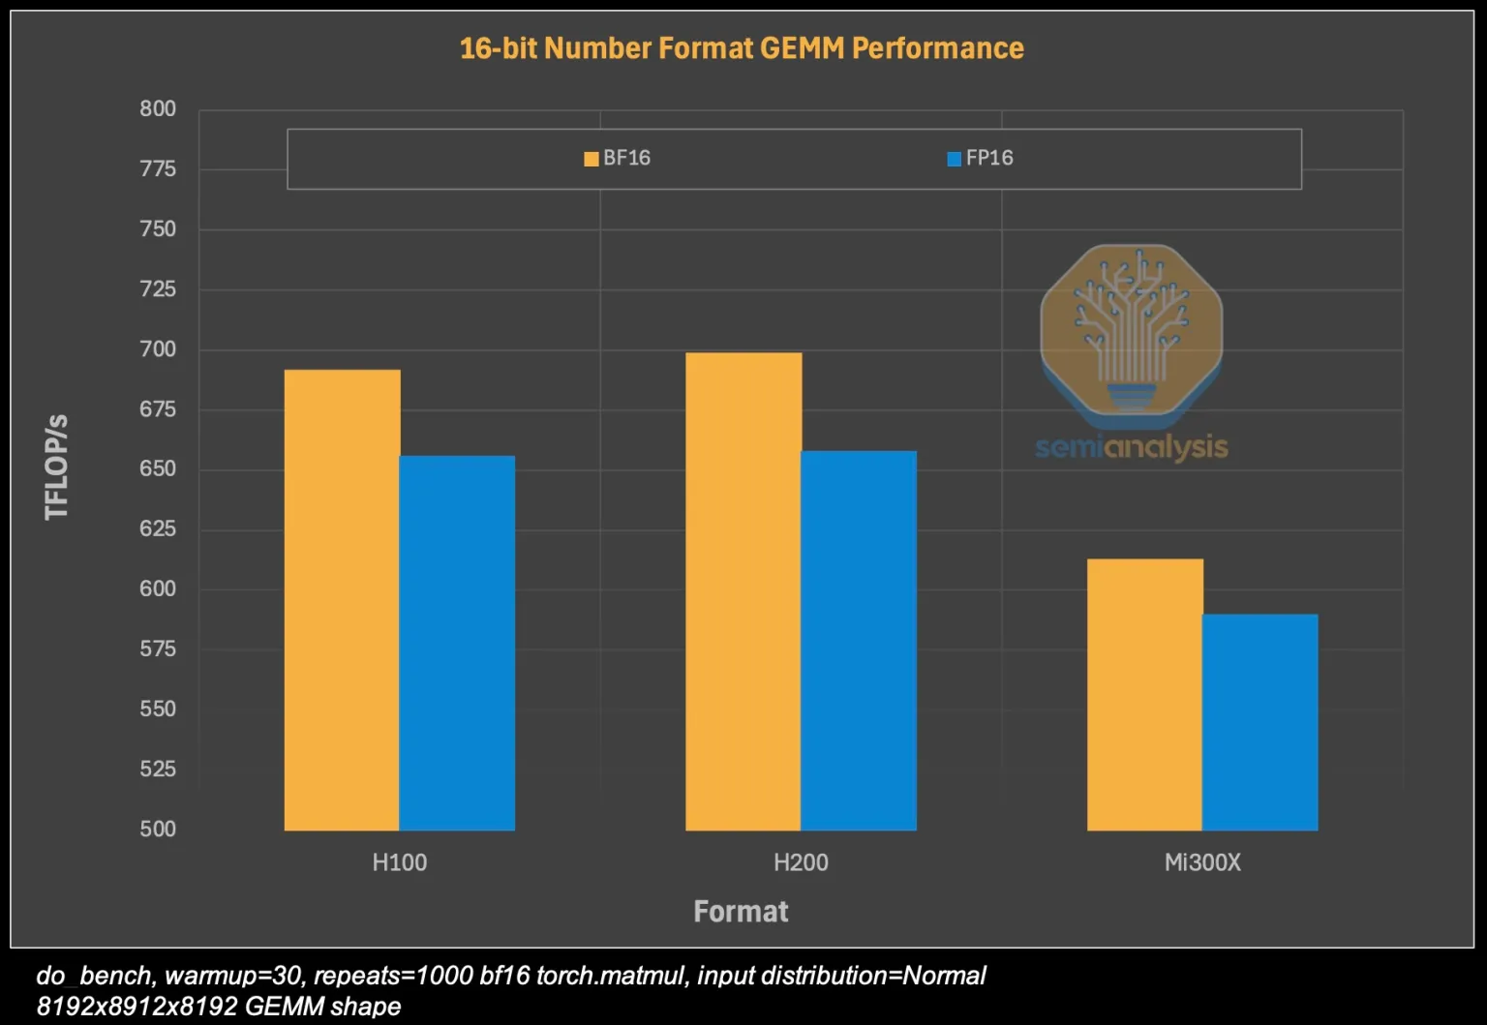
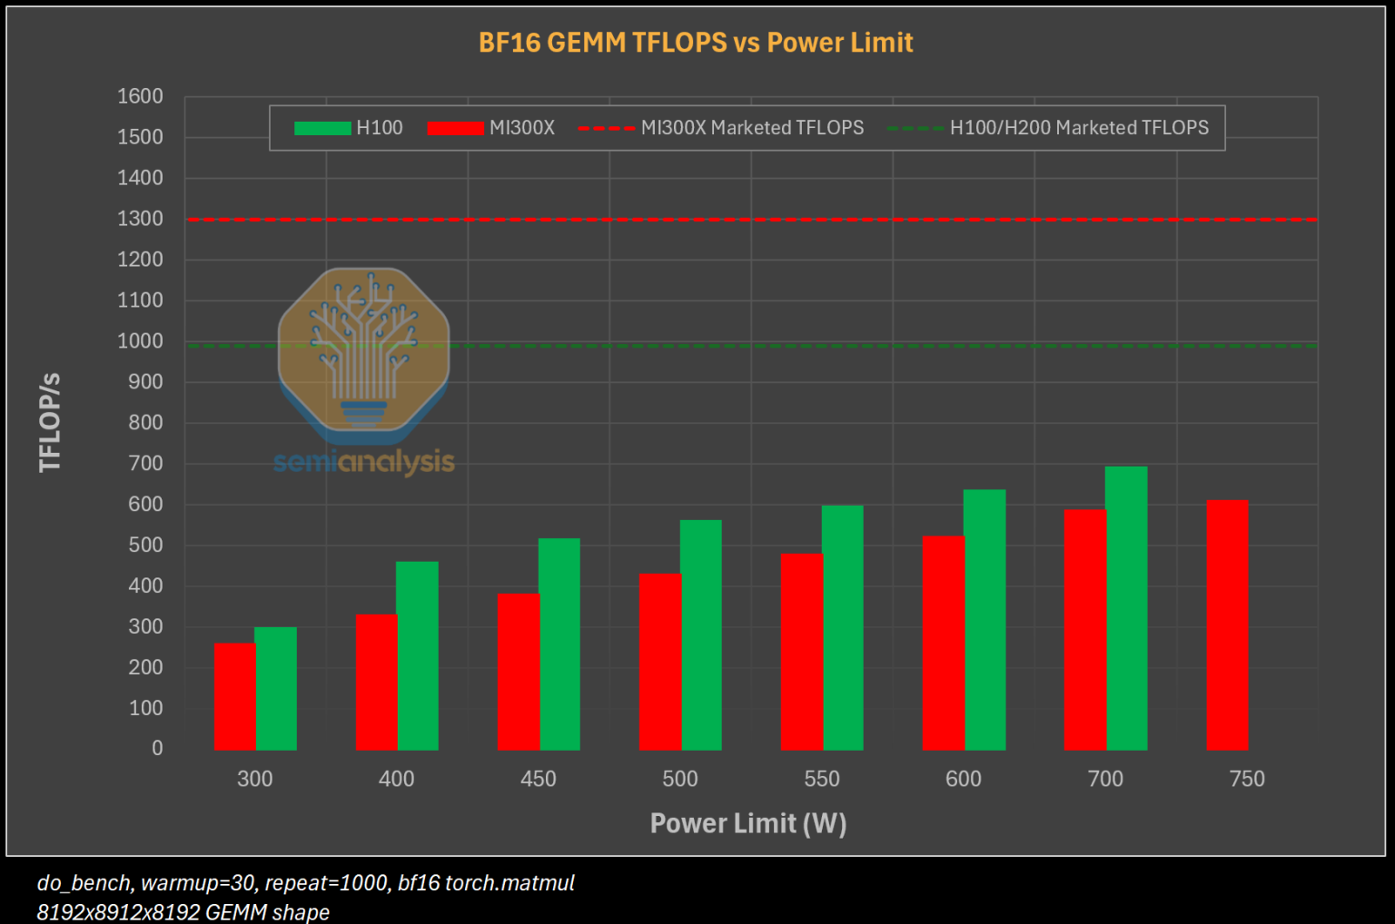
Performance in practice
In practice, the performance can be different (depending on software)

Slide 19
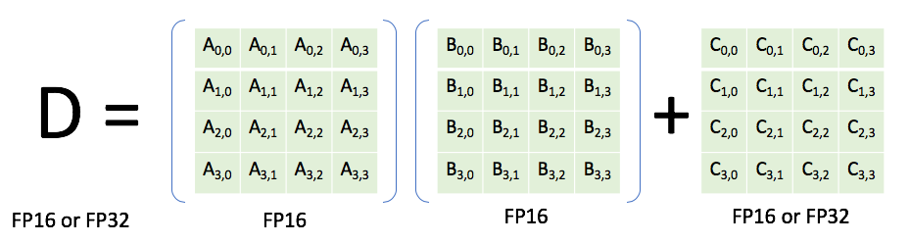
Nvidia Volta/Turing (e.g. V100, TitanRTX, RTX 2080Ti)
Generally, you are responsible for specifying a reduced precision: DL frameworks don’t do this automatically since it may impact your networks accuracy, convergence, etc
Features
INT8 & FP16 support
(Volta) Tensor cores: fused multiply-add units that support mixed precision (multiply in FP16, add in FP32). High performance: 120 TFLOPS (for the time).
High bandwidth memory, 2nd generation (HBM2) (vs. DDR)

Slide 20
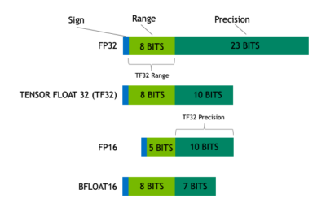
Nvidia Ampere GPUs (e.g. A100, RTX 3090)
Features (see also https://servicedesk.surf.nl/wiki/display/WIKI/Deep+Learning+on+A100+GPUs )
Tensor Cores support more datatypes (FP64, TF32, FP16, BF16, Int8, Int4, Binary)
TensorFloat32 datatype:
Mixed precision uses FP16. Reduced range causes (potential) need for gradient scaling to prevent underflows

Slide 21
Nvidia Ampere GPUs (e.g. A100, RTX 3090)
Features (see also https://servicedesk.surf.nl/wiki/display/WIKI/Deep+Learning+on+A100+GPUs )
Tensor Cores support more datatypes (FP64, TF32, FP16, BF16, Int8, Int4, Binary)
TensorFloat32 datatype:
TF32 tries to combine best of both worlds: range of an FP32 (no gradient scaling needed), but with reduced precision (for speedup & less memory)

Slide 22
Nvidia Ampere GPUs (e.g. A100, RTX 3090)
Features (see also https://servicedesk.surf.nl/wiki/display/WIKI/Deep+Learning+on+A100+GPUs )
Tensor Cores support more datatypes (FP64, TF32, FP16, BF16, Int8, Int4, Binary)
TensorFloat32 datatype:
Automatically used unless
Environment variable NVIDIA_TF32_OVERRIDE=0 is set
torch.backends.cuda.matmul.allow_tf32 = False and torch.backends.cudnn.allow_tf32 = False are set

Slide 23
Nvidia Ampere GPUs (e.g. A100, RTX 3090)
Model | Precision | Throughput (img/s) | Speedup (compared to FP32) | Loss (1st iteration)
ResNet50 | FP32 | 455.9 | 1 | 7.457645893096924
ResNet50 | TF32 | 750.6 | 1.65 | 7.456507205963135
ResNet50 | FP16 (input) + FP32 (accumulator) | 1087.6 | 2.38 | 7.45703125
VGG19 | FP32 | 212.7 | 1 | 6.9077839851379395
VGG19 | TF32 | 550.3 | 2.59 | 6.907783508300781
VGG19 | FP16 (input) + FP32 (accumulator) | 1099.8 | 5.17 | 6.90625
DenseNet121 | FP32 | 391.9 | 1 | 6.96142053604126
DenseNet121 | TF32 | 591.5 | 1.51 | 6.961450576782227
DenseNet121 | FP16 (input) + FP32 (accumulator) | 876.2 | 2.24 | 6.9609375
Source: https://servicedesk.surf.nl/wiki/display/WIKI/Deep+Learning+on+A100+GPUs

Slide 24
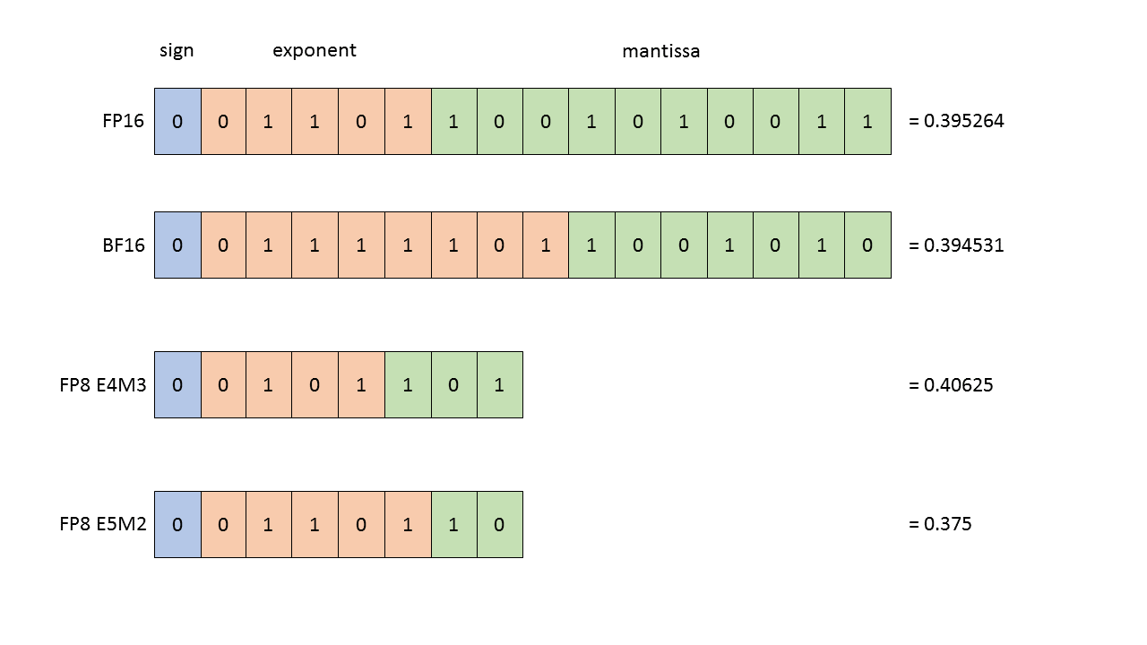
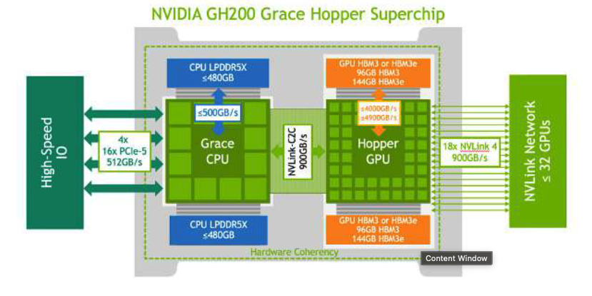
Nvidia Hopper (e.g. H100)
FP8 support
Transformer Engine for transformer specific improvements
Grace Hopper Superchip (GH200)
H200 GPU + Grace Hopper CPU on 1 chip
Faster communication between CPU and GPU
Unified GPU + CPU memory for large models.
(Low Power) LPDDR5x for more efficient inference.

Slide 25
Nvidia Blackwell GPUs (e.g. (G)B200, RTX 5090)
FP4 support
Second-generation Transformer Engine
Grace Blackwell Superchips (e.g. GB200)
2 Blackwell GPUs (B200) with 1 Grace CPU
FP4 E2m1
= 0.5
FP4 E3m0
= 0.25

Slide 26
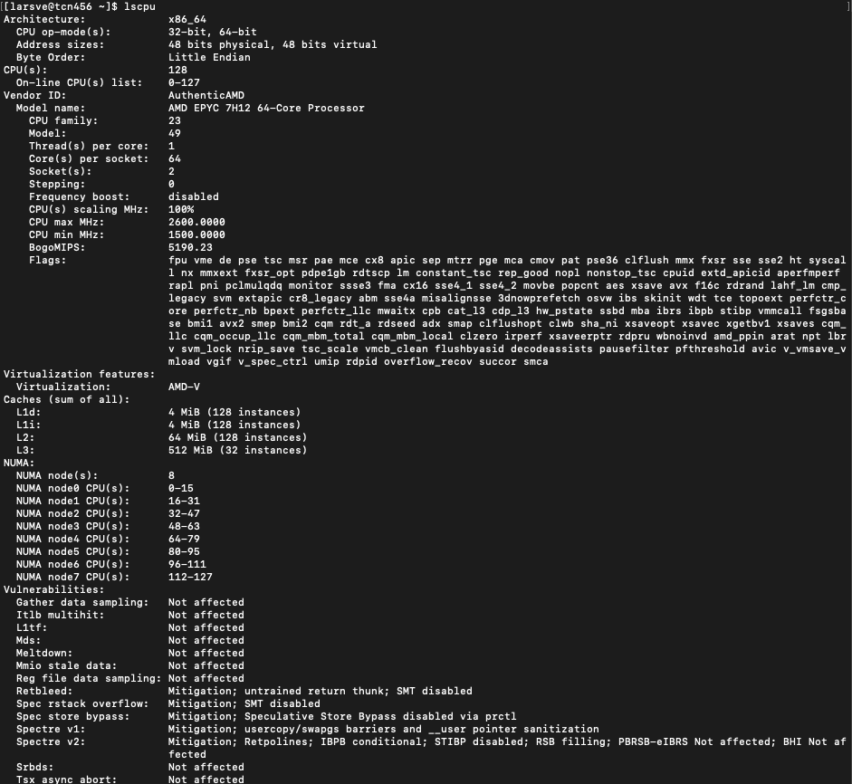
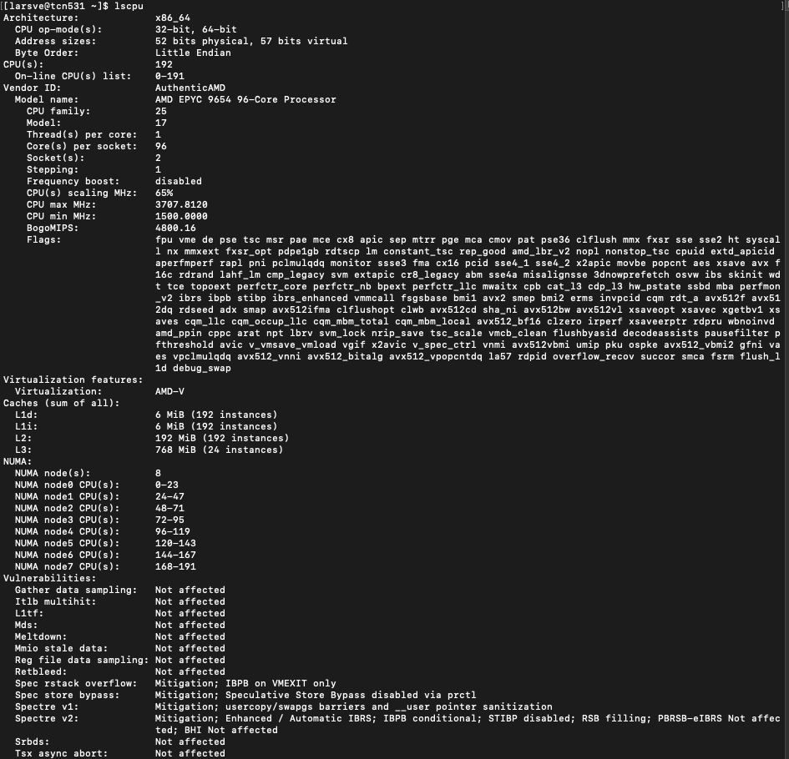
And on CPU:
Rome
Genoa
Notes:
Add new cpus

Slide 27
Second S: Software
PyTorch/TensorFlow vs Numpy
  PyTorch and TensorFlow have GPU support, Numpy does not
Support for CUDA (Nvidia), ROCm (AMD), <insert exotic hardware here>?
  E.g.: Intel SapphireRapids
  IPEX: https://github.com/intel/intel-extension-for-pytorch
  LUMI https://www.lumi-supercomputer.eu/
Support for lower precision
  BFloat16, Float16? FP8?

Slide 28
Third S: Stack
Is my software compiled for my hardware
  Pip install … ?
  Module load PyTorch/1.12.0-foss-2022a-CUDA-11.7.0
  https://servicedesk.surf.nl/wiki/spaces/WIKI/pages/30660245/Environment+Modules
Again: Consider the hardware/platform that you’re using
  GPU: Nvidia/CUDA? AMD/ROCm?
  CPUs: AVX512?

Slide 29
Wait ... so what happens?
You call torch
  E.g. scatter_add_ -> Message passing in Graph-NNs
  (Manual) Dispatching
Torch (python) determines the most appropriate function to call
  Dispatching
Torch (C++/CU) calls the CPU/GPU kernel
  Dispatching
Low-level C++/CU library performs actual calculation
  Dispatching
PyTorch Dispatcher:
http://blog.ezyang.com/2020/09/lets-talk-about-the-pytorch-dispatcher/

Slide 30
In practice: PyTorch + Snellius
We only have NVIDIA GPUs
  72x4=288 NVIDIA A100
  88x4=352 NVIDIA H100
Makes optimization a bit easier for you
You only need to spend a year sifting through documentation
  https://servicedesk.surf.nl/wiki/display/WIKI/Deep+Learning+on+A100+GPUs
  Or ask us... :)
  Every EINF/NWO small grants has a default of 4 consultancy hours

Slide 31

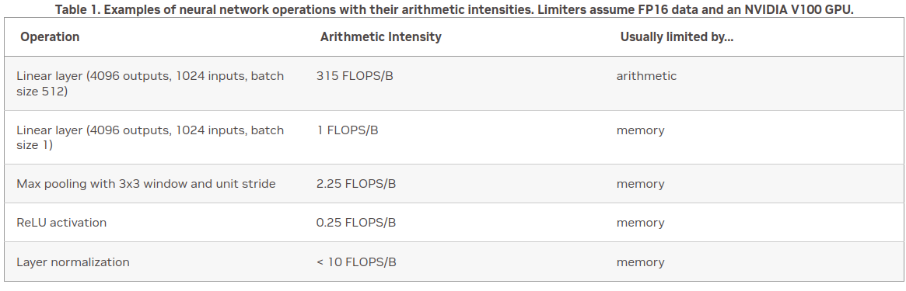
Rapidfire: implementation details
How fast do you want to go?
What is your goal?
  Largest model possible?
  Best validation performance?
  Submit a paper to ISC ‘25?

Slide 32
Rapidfire: implementation details
Some useful resources:
  https://pytorch.org/docs/stable/notes/cuda.html
  https://docs.nvidia.com/deeplearning/performance/dl-performance-memory-limited/index.html
  https://docs.nvidia.com/deeplearning/performance/index.html
Duncan: "You can take any piece of code, spend 6 months optimizing it, and then write a paper about it”

Slide 33
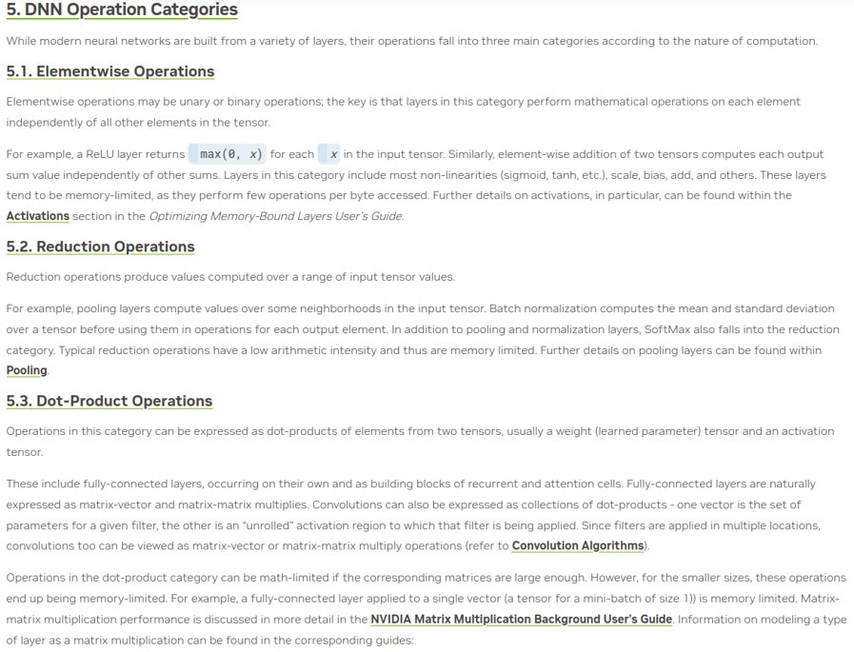
Types of DNN operations

Slide 34
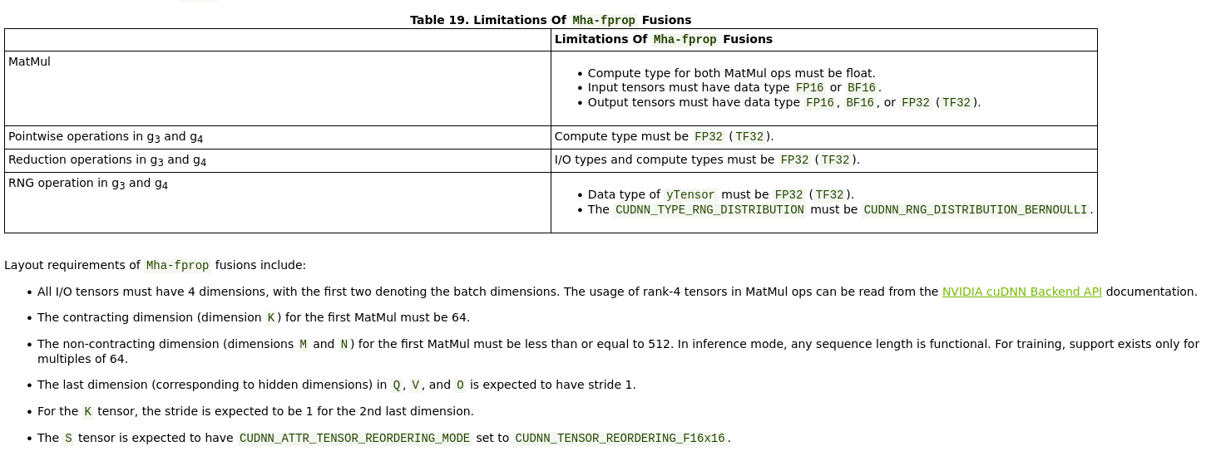
Level 1: Shouldn't impact model convergence:

Slide 35


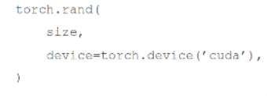
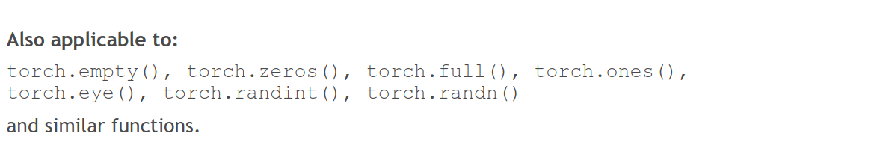
Level 1: Shouldn't impact model convergence:
Avoid CPU-GPU sync
Create tensors directly on the device
✅

Slide 36
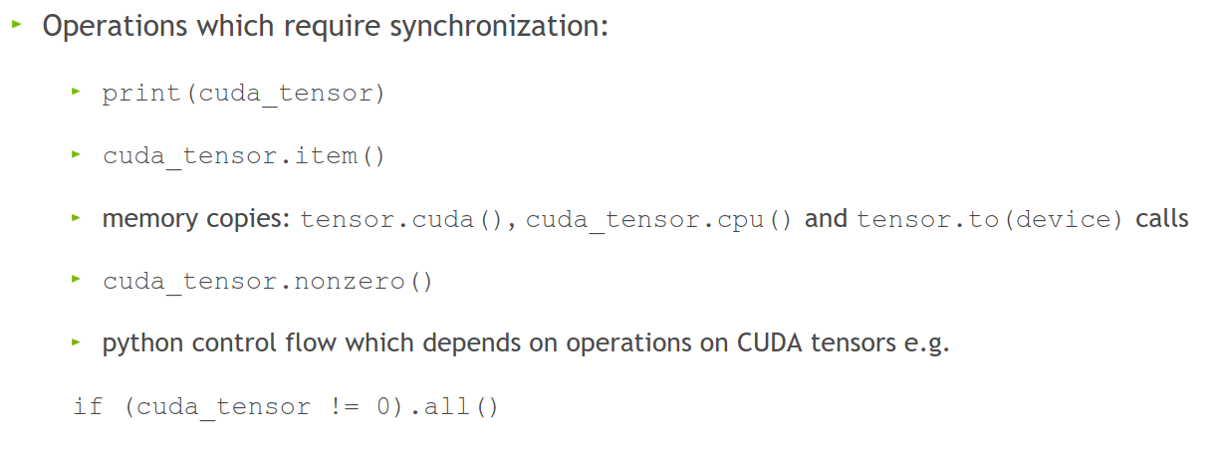
Level 1: Shouldn't impact model convergence:
Avoid doing these inside a training loop if possible:
This forces PyTorch to copy data from GPU to CPU, slowing performance.

Slide 37
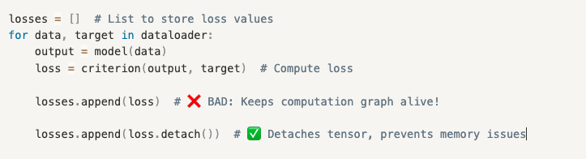
Level 1: Shouldn't impact model convergence:
Don't aggregate tensors which still require grad, e.g.:
losses.append(loss) (:o)
  instead, detach (loss.detach())
Each loss in losses.append(loss) stores the entire computation graph. PyTorch stores extra gradients unnecessarily!
detach() creates a new tensor with the same values but removes the gradient tracking.

Slide 38
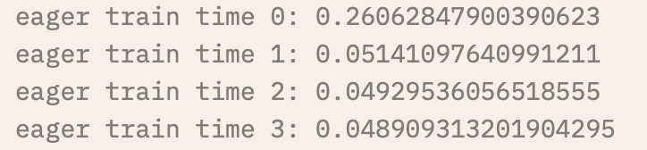
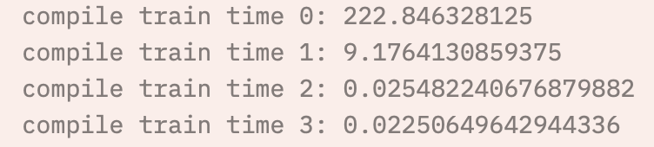
Level 1: Shouldn't impact model convergence:
There is little reason not to use TensorFloat32 ☺
torch.backends.cuda.matmul.allow_tf32 = True
  The default in PyTorch (silently)
torch.set_float32_matmul_precision('high')
torch.backends.cudnn.benchmark = True
  Empirically benchmarks to find fastest algorithm for some methods, default in PyTorch
Align bytes: multiples of 2, 8, 1024
  DNN libraries want nicely aligned memory
torch.channels_last
  Helps with memory alignment and reduces cache misses
Compile: PyTorch 2.0
  Big speedup, but sensitive to implementation
Helps maintain accuracy in cases where TF32 might introduce minor errors
Stores images in NHWC format instead of NCHW (optimizes GPU cache usage)

Slide 39

Level 2: Danger zone
Lower precision (FP16 or BF16) for matrix reductions instead of higher precision (FP32, advised). Can cause numerical instability!
torch.backends.cuda.matmul.allow_fp16_reduced_precision_reduction = True
Lol:
torch.backends.cuda.matmul.allow_bf16_reduced_precision_reduction = True
Torch.set_float32_matmul_precision('medium')
Cast model and data to (B)Float16 before the forward pass
  We're not supposed to...but:
trades some accuracy for faster compute. Can affect model convergence
Forces all computations to use lower precision, instead of letting autocast() to choose

Slide 40
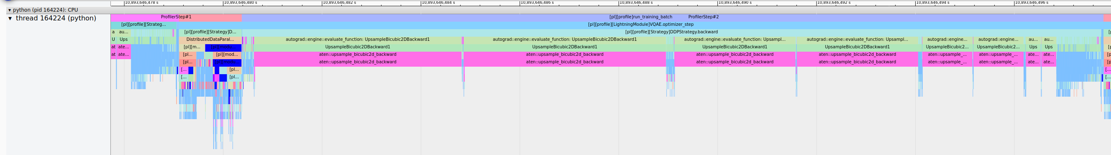
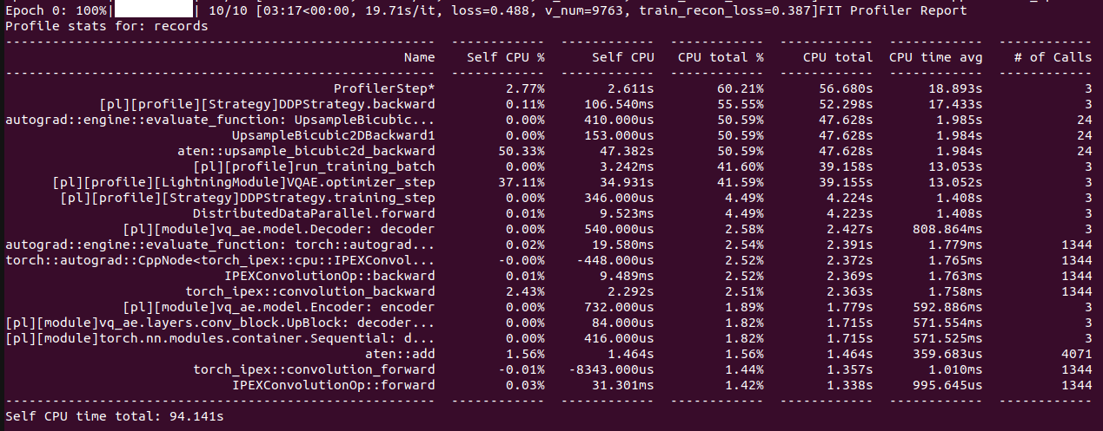
Change your model
  Worst case scenario:

Slide 41
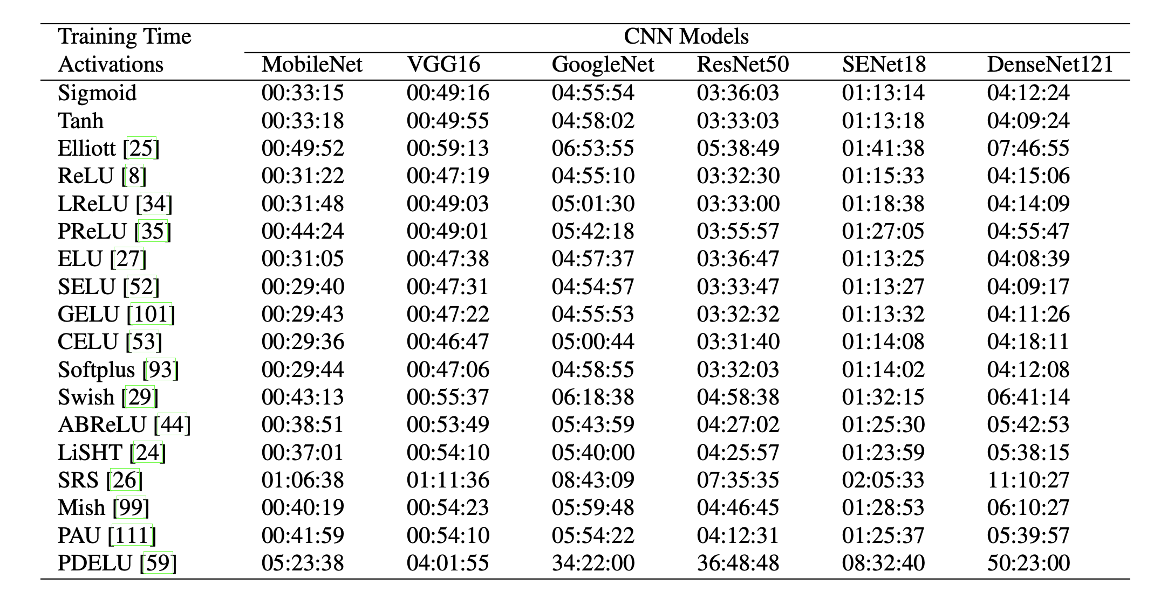
Change your model
Change model architecture to improve performance characteristics, e.g.:
  Use LoRA for fine-tuning
  Use pre-trained model aka zero shot
    E.g. DINOv2
  Incorporate dataloading operations into the model instead of CPU pipeline
  ViT vs CNN vs GNN
  Change non-linearities
  Multiples of 2,8,1024
    Channels
    Hidden size
    Vocab size
    Batch size
    Input resolution/sequence length
    Everything
  For transformers:
    Patching
    Masked attention

Slide 42
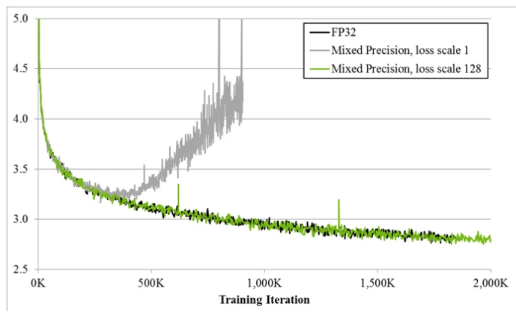
Always
  Have a baseline
  Check convergence statistics

Slide 43

Profile
  Get a grip on your model’s performance
  Profile
  Profile
  Profile

