Slide 1



Intro High Performance Deep Learning – March 2026
GitHub: https://github.com/SURF-ML/HPML-course-materials
Trainers: Lars Veefkind
Machine Learning Advisor at SURF in HPML Team

Slide 2
Credit where credit is due
Slides stolen from:
SURF colleagues
Caspar van Leeuwen
Robert Jan Schlimbach
Bryan Cardenas Guevara
Simone van Bruggen
dr. Erik Bekkers (UvA)
PyTorch
CUDA/cuDNN

Slide 3
About EuroCC & EuroHPC JU
EuroHPC JU:
joint initiative between EU, EU member states, and private partners to develop a World Class Supercomputing Ecosystem in Europe
https://eurohpc-ju.europa.eu/
EuroCC
A key program in EuroHPC JU
EuroCC acts as gateway for industry and academia to find providers with suitable HPC expertise
EuroCC facilitates HPC-skill oriented trainings (like this one)

Slide 4
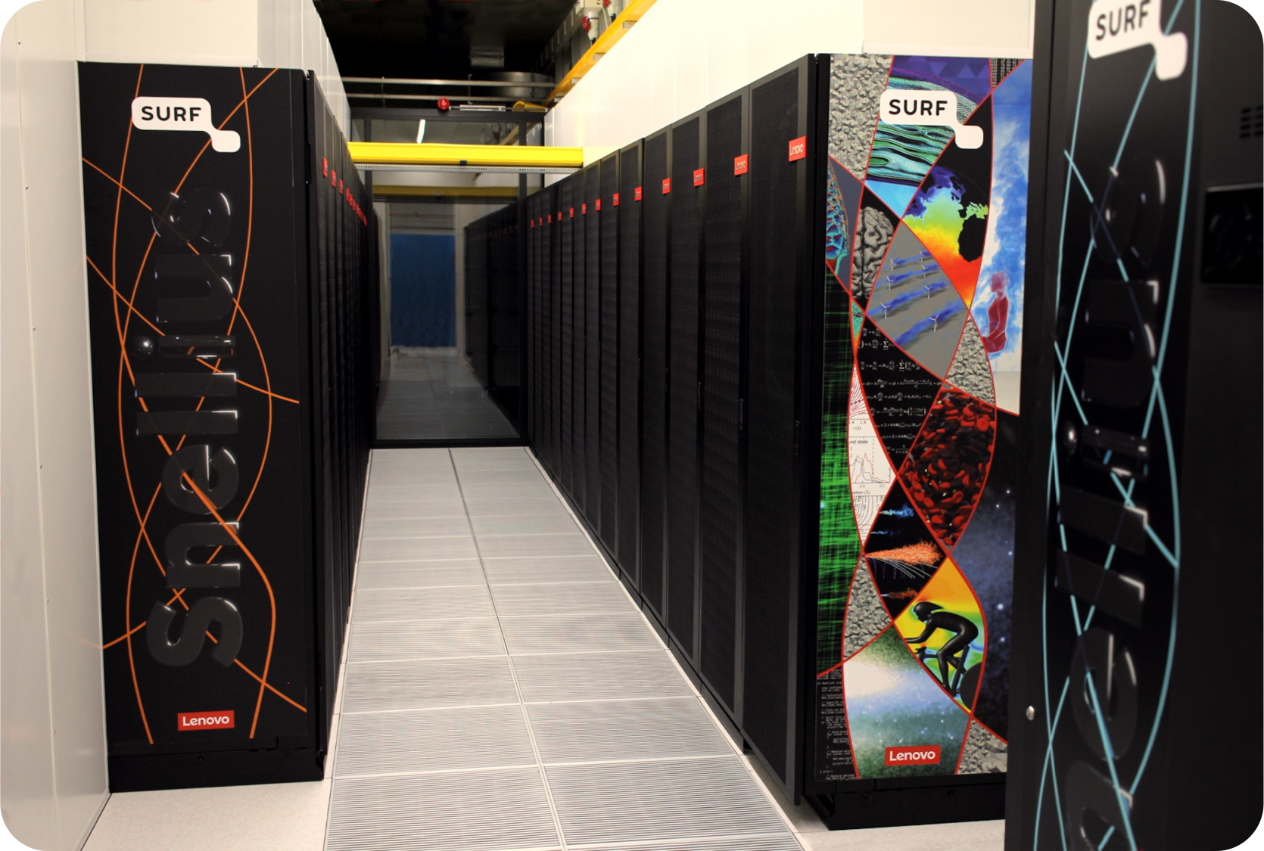
About SURF
Collaborative organization for ICT in Dutch education and research
National Competence Center in EuroCC for The Netherlands
Offers HPC services (and many others, data storage, cloud, networking, etc)

Slide 5
Course plan
Day 1:
Introduction to Deep Learning
Using the PyTorch framework
Fully connected networks, Convolutional networks, Transformers
Day 2:
Parallel computing for deep learning
Software installations on HPC systems
Packed file formats for Machine Learning
Hardware (e.g. Tensor cores) and software features (e.g. low-level libraries for deep learning) for accelerated deep learning
Profiling PyTorch with TensorBoard

Slide 6
Course plan Day 1
13:00 – 13:10 Welcome and course overview
13:10 – 14:00 Introduction to ML & DL basic principles
14:00 – 14:20 Introduction to PyTorch (notebook)
14:20 – 14:30 Coffee break
14:30 – 15:10 Hands-on: Fully connected network
15:10 – 15:30 Recap Hands-on
15:30 – 16:30 Convolutional neural networks
Bonus Hands-on: Convolutional neural networks

Slide 7
Course plan Day 2
9:30 – 10:45 Software installations on HPC systems
10:45 – 11:55 Coffee break
10:55 – 11:10 Packed file formats
11:10 – 11:30 Hands-on: Packed file formats
11:30 – 12:30 Keynote: Vlado Menkovski
12:30 – 13:15 Lunch Break
13:15 – 14:45 Hardware and software features to accelerate deep learning
14:45 – 15:00 Coffee Break
15:00 – 15:45 Parallel Computing for Deep Learning
15:45 – 16:45 Profiling to understand your neural network’s performance
16:45 – 17:00 Questions, wrap up

Slide 8
Logins
Access to the Dutch National Supercomputer (Snellius) for this course
Snellius Supercomputer (CPU-based Jupyter Notebook environment, CPU batch jobs)
Did you get a login ‘scurXXX’?
The e-mail contains a link to choose a password – please do so
Log in to https://portal.cua.surf.nl/ and accept the End User Agreement
Try to login at https://ondemand.snellius.surf.nl
See https://github.com/SURF-ML/HPML-course-materials/README.md for launch instructions
If you did not receive a login, or starting a notebook server does not work: please let us know so we can resolve it during the first hands-on session.
Notes:
P

