Slide 1
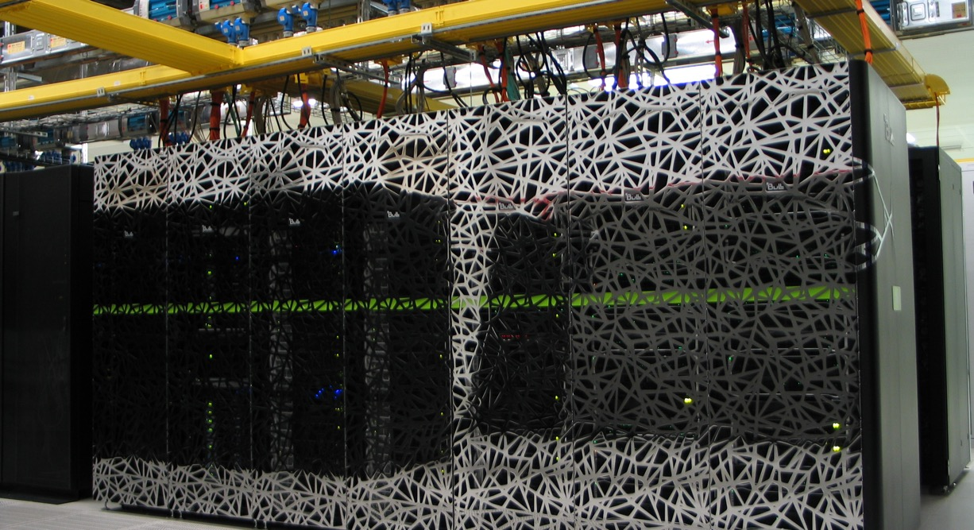
Software management on HPC systems
Caspar van Leeuwen
HPML team SURF

Slide 2
Demos, hands-on
Both demos and hands-on will be done on Snellius: https://jupyter.snellius.surf.nl/jhssrf015
Demos
Throughout this presentation, I will demo a few things. You are welcome to type along, but I’ll go through these.
Hands-on: This is really an exercise meant for you, and I’ll give you time to complete it.

Slide 3
Best practices: software on HPC (1/2)
Use software from the module environment whenever you can
Build on top of the module environment when you have to
Never use system installations of Python/GNU compilers/Perl/etc
If you need additional Python packages: built a virtual environment on top of software from the module environment
Load the modules first, then create / load the virtual environment

Slide 4
Best practices: software on HPC (2/2)
Avoid using conda
But if you do, install everything with conda. Don’t combine with modules.
Expect little support from us
Use containers with care
Optimization usually ok for GPU, but may be poor for CPU
Expect little support from us
Multinode can be tricky (if MPI is used)

Slide 5
Parallel computing for Deep Learning
Content
Software terminology: libraries, binaries, linking, … what does it all mean?
Module environment: what is it, how do I use it, and why?
Python virtual environments
… and how to combine them with the module environment
Conda virtual environments
… and why we think you should avoid them on HPC systems
Containers
… and a word of warning on using them

Slide 6
Software terminology
Some knowledge on terminology is essential to understand issues with software compilations…
Compiled vs interpreted languages
Architecture and micro-architecture
What is a binary file?
What is a library?
What is linking?
What is a dependency?

Slide 7
Compiled vs interpreted languages
We program in a human-readable programming language (Python, C, Fortran, …)
For compiled languages, that human-readable code is translated to machine code (a “binary file”, i.e. ones and zeroes) prior to running it
Binary files are architecture specific. Examples of architectures are X86_64 (your typical AMD and Intel chip are of this type), aarch64 (the ARM-based chip in your phone is of this type). You can not run a program compiled for an X86_64 on an aarch64 based chip.

Slide 8
Compiled vs interpreted languages
We program in a human-readable programming language (Python, C, Fortran, …)
For compiled languages, that human-readable code is translated to machine code (a “binary file”, i.e. ones and zeroes) prior to running it
Binary files are architecture specific. Examples of architectures are X86_64 (your typical AMD and Intel chip are of this type), aarch64 (the ARM-based chip in your phone is of this type). You can not run a program compiled for an X86_64 on an aarch64 based chip.
Interpreted languages are converted to machine instructions on the fly (i.e. while running it), by an interpreter
Interpreted language is portable to other platforms, as long as the interpreter supports that platform
Compiled langauges are often more performant than interpreted languages, because the separate compilation step allows high degree of optimization by the compiler. This is somewhat mitigated by just-in-time (JIT) compilers

Slide 9
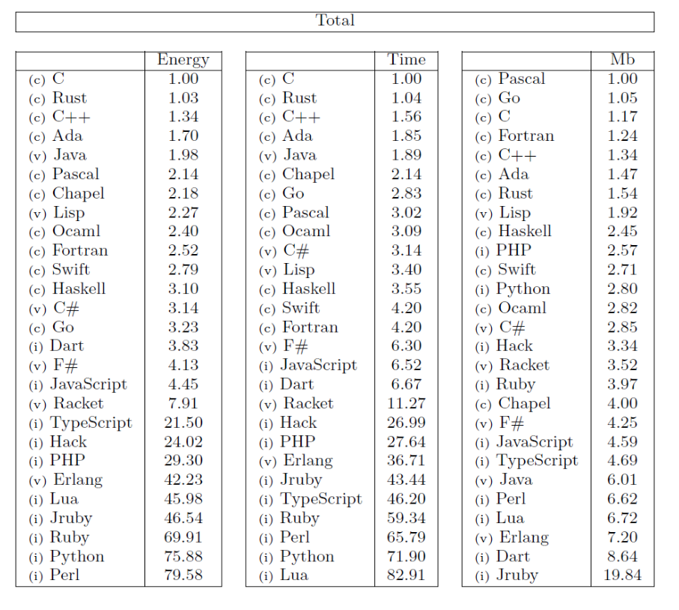
Compiled vs interpreted languages
R. Pereira et al (2017) explored the efficiency of different programming language to solve a fixed set of numerical problems
C = compiled, i = interpreted, v = virtual machine language
https://greenlab.di.uminho.pt/wp-content/uploads/2017/09/paperSLE.pdf

Slide 10
Demo: Compute the square of a number in C
#square.c
#include <stdio.h>
double square(double a) {
return a*a;
}
int main() {
double a, square_a;
printf("Enter one number: ");
scanf("%lf", &a);
// Calculating square
square_a = square(a);
// %.2lf displays number up to 2 decimal point
printf("Square = %.2lf\n", square_a);
return 0;
}
gcc –o square_binary square.c
chmod u+x square_binary
./square_binary

Slide 11
Computer architecture / Instruction Set Architecture (ISA)
Not all processors understand the same instructions
Intel & AMD produce “X86_64 processors”
Your phone contains “aarch64” (or ARM) processors.
An Instruction Set Architecture (ISA) defines things like which registers a processor has, and which operations (instructions) it can do on those registers
A binary compiled for X86_64 will not execute on an aarch64 processor. That processor simply does not support the instructions!
Analogy: Intel and AMD processors speak Dutch, while ARM processors speak English. They won’t understand eachothers instructions!
https://en.wikipedia.org/wiki/Instruction_set_architecture
https://en.wikipedia.org/wiki/X86-64
https://en.wikipedia.org/wiki/AArch64

Slide 12
Micro-architecture
All X86_64 CPUs support the same basic instructions. But they support different extensions to the instruction set:
AMD Zen2: BMI, BMI2, CLWB, F16C, FMA, FSGSBASE, AVX, AVX2, ADCX, RDSEED, MWAITX, SHA, CLZERO, AES, PCLMUL, CX16, MOVBE, MMX, SSE, SSE2, SSE3, SSE4A, SSSE3, SSE4.1, SSE4.2, ABM, XSAVEC, XSAVES, CLFLUSHOPT, POPCNT, RDPID, WBNOINVD
Icelake: MOVBE, MMX, SSE, SSE2, SSE3, SSSE3, SSE4.1, SSE4.2, POPCNT, CX16, SAHF, FXSR, AVX, XSAVE, PCLMUL, FSGSBASE, RDRND, F16C, AVX2, BMI, BMI2, LZCNT, FMA, MOVBE, HLE, RDSEED, ADCX, PREFETCHW, AES, CLFLUSHOPT, XSAVEC, XSAVES, SGX, AVX512F, AVX512VL, AVX512BW, AVX512DQ, AVX512CD, PKU, AVX512VBMI, AVX512IFMA, SHA, AVX512VNNI, GFNI, VAES, AVX512VBMI2 , VPCLMULQDQ, AVX512BITALG, RDPID, AVX512VPOPCNTDQ, PCONFIG, WBNOINVD and CLWB
Analogy: Zen2 CPUs speaks every-day Dutch, Icelake CPUs Dutch including legal jargon. They’ll understand eachother, as long as no legal-specific words are used.
https://en.wikichip.org/wiki/amd/microarchitectures/zen_2
https://en.wikichip.org/wiki/intel/microarchitectures/ice_lake_(client)

Slide 13
Optimizing for micro-architecture
We can ask the compiler to optimize for a certain micro-architecture:
gcc -march=icelake-server -o square_binary square.c
When translating the source code to machine code, the compiler may use instructions that are only supported on AMD-Zen2 chips.
./square_binary
Still works. Why? No icelake-specific instructions (i.e. no “legal jargon”) was used!

Slide 14
Optimizing for micro-architecture
What if I take a vector addition example?*
gcc -march=icelake-server -mprefer-vector-width=512 -O3 -o vectadd vectadd.c
./vectadd
Illegal instruction
This makes sense: icelake-server supports the AVX512 extension, thus, the compiler decided to generate AVX512 instructions. However, the CPU I’m running on (AMD Zen2) does not support these.
Analogy: “Legal jargon” was used, and the common Dutch person (AMD Zen2 CPU) now fails to understand the instructions
*I cheat a little bit here by specifying mprefer-vector-width to convince the compiler that I prefer 512-bit vector operations, if possible. Leaving it to the compiler, it will decide 256-bit vector operations are faster for my dummy code – and those are also support on my AMD Zen2.

Slide 15
What is a library?
A library is a reusable set of functions. Demo: we can put our ‘square’ function in a library
#square_function.c
double square(double a) {
return a*a;
}
We build the shared library:
gcc -shared square_function.c -o libsquare.so
Then, we build the binary and link against our “square” library
gcc -o square_program square_program.c -lsquare -L .

Slide 16
What is a dependency?
$ ldd square_program
linux-vdso.so.1 (0x000014f4faeb7000)
libsquare.so => not found
libc.so.6 => /lib64/libc.so.6 (0x000014f4fa8c6000)
/lib64/ld-linux-x86-64.so.2 (0x000014f4fac8c000)
As you can see, ldd now can tell us against which libraries square_program was linked (libsquare.so, among a few standard libraries).

Slide 17
What is a dependency?
$ ./square_program
./square_program: error while loading shared libraries: libsquare.so: cannot open shared object file: No such file or directory
Why? Because our linker has no idea where to find libsquare.so.
Among many others, the runtime linker searches paths specified on LD_LIBRARY_PATH for libraries used by executables. We can use that to make our runtime linker find libsquare.so:
$ LD_LIBRARY_PATH=.:$LD_LIBRARY_PATH ./square_program
Enter one number: 5
Square = 25.00

Slide 18
What is a dependency?
My square_program can only run if the libsquare.so is there to provide the square() function
libsquare.so is a dependency for square_program
For interpreted langagues (e.g. Python), there is a similar concept of dependencies if one packages uses functions from another package
E.g. PyTorch has a dependency on numpy

Slide 19
How does all this apply to AI?
“Compiled langauges are often more performant than interpreted languages, because the separate compilation step allows high degree of optimization by the compiler”
You might be a bit depressed by now… Does that mean we are doing a bad job in AI, because we typically program in Python with PyTorch or TensorFlow?

Slide 20
How does all this apply to AI?
Performance-critical python packages, such as numpy, PyTorch and TensorFlow, often use compiled backends
End-users program in Python (convenient, easy!)
When executing performance critical functions (e.g. a convolutional layer), PyTorch calls compiled functions in the backend
These functions typically come from deep-learning specific libraries, such as MKL-DNN and cuDNN

Slide 21
How does all this apply to AI?
The AI community has no idea how lucky they are compared to other HPC communities! You get the convenience of programming in Python, with the performance of compiled languages!
Does that mean nothing can go wrong? Well, it can… Let’s try to install PyTorch…

Slide 22
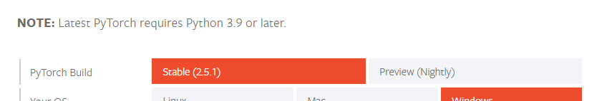
What can happen: PyTorch in a virtual environment with pip
$ module purge # Start with clean environment, I’ll get back to what modules are…
$ python3 –m my_pytorch_venv
$ source my_pytorch_venv/bin/activate
$ pip3 install torch torchvision torchaudio --index-url https://download.pytorch.org/whl/cu124 (instruction from https://pytorch.org/get-started/locally/)
Looking in indexes: https://download.pytorch.org/whl/cu124
ERROR: Could not find a version that satisfies the requirement torch (from versions: none)
ERROR: No matching distribution found for torch
Why? Well, the system python on many HPC clusters is old (04-22-2024: 3.9 on Snellius, 3.6 on Vega, Karolina, Duecalion – three big EuroHPC clusters)!

Slide 23
Do NOT us anything from system paths
On HPC clusters, NEVER use
Python or compilers from /usr/bin or /bin
N.B. using things like text editors etc. from here is fine
Libraries from /usr/lib, /usr/lib64, /lib or /lib64
Use things from the Module environment
But… Why?
Because HPC sysadmins may add / remove / upgrade tools, the OS, etc as they please, without notice. You cannot rely on certain versions to be there! (for text editors, you typically don’t care what exact version they are, hence it’s fine to use those)

Slide 24
Module environment
HPC systems are shared between many users, with different needs. How to offer several versions of the same software?
Module environment
Let’s look what modules we have: module av
We build a module environment every year. Latest one is 2023. Let’s load it: module load 2023
Check the modules again: module av
What Python modules do we have? module av Python
Let’s have a look at one: module show Python/3.11.3-GCCcore-12.3.0
Modules set environment variables like PATH, LD_LIBRARY_PATH, etc. These are used by the Linux OS to find binaries, libaries, etc

Slide 25
How does e.g. PATH work?
$ which python3
/bin/python3
$ module av
$ module load 2023
$ module load Python/3.11.3-GCCcore-12.3.0
$ which python3
/sw/arch/RHEL8/EB_production/2023/software/Python/3.11.3-GCCcore-12.3.0/bin/python3
echo $PATH
/sw/arch/RHEL8/EB_production/2023/software/Python/3.11.3-GCCcore-12.3.0/bin:/sw/arch/RHEL8/EB_production/2023/software/OpenSSL/3/bin:/sw/arch/RHEL8/EB_production/2023/software/XZ/5.4.2-GCCcore-12.3.0/bin:/sw/arch/RHEL8/EB_production/2023/software/SQLite/3.42.0-GCCcore-12.3.0/bin:/sw/arch/RHEL8/EB_production/2023/software/Tcl/8.6.13-GCCcore-12.3.0/bin:/sw/arch/RHEL8/EB_production/2023/software/ncurses/6.4-GCCcore-12.3.0/bin:/sw/arch/RHEL8/EB_production/2023/software/bzip2/1.0.8-GCCcore-12.3.0/bin:/sw/arch/RHEL8/EB_production/2023/software/binutils/2.40-GCCcore-12.3.0/bin:/sw/arch/RHEL8/EB_production/2023/software/GCCcore/12.3.0/bin:/gpfs/admin/hpc/sw/hpc/bin:/gpfs/admin/hpc/sw/hpc/sbin:/usr/local/bin:/usr/bin:/usr/local/sbin:/usr/sbin
The OS finds the python3 from the module environment because PATH includes the directory in which python3 is located

Slide 26
Attempt 2: PyTorch in a virtual environment with pip
# We don’t want it to pick up PYTHON packages from our course environment for this demo
unset PYTHONPATH
source my_pytorch_venv/bin/activate
pip3 install torch torchvision torchaudio --index-url https://download.pytorch.org/whl/cu124 (instruction from https://pytorch.org/get-started/locally/)
Python
>>> import torch
>>> Traceback (most recent call last):
File "<stdin>", line 1, in <module>
File "/gpfs/home5/scur1443/HPML-course-materials/Day2/notebooks/my_pytorch_venv/lib/python3.11/site-packages/torch/__init__.py", line 367, in <module>
from torch._C import * # noqa: F403
^^^^^^^^^^^^^^^^^^^^^^
ImportError: /gpfs/home5/scur1443/HPML-course-materials/Day2/notebooks/my_pytorch_venv/lib/python3.11/site-packages/torch/lib/../../nvidia/cusparse/lib/libcusparse.so.12: undefined symbol: __nvJitLinkComplete_12_4, version libnvJitLink.so.12
Ugh, what now? Where does torch normally find the CUDA installation?

Slide 27
Attempt 2: PyTorch in a virtual environment with pip
ldd /gpfs/home5/scur1443/HPML-course-materials/Day2/notebooks/my_pytorch_venv/lib/python3.11/site-packages/torch/lib/../../nvidia/cusparse/lib/libcusparse.so.12
linux-vdso.so.1 (0x00007ffce2326000)
libnvJitLink.so.12 => /sw/arch/RHEL8/EB_production/2023/software/CUDA/12.1.1/lib/libnvJitLink.so.12 (0x0000146b3ef09000
This library has been linked with lbnvJitLink.so.12 but only works with 12.4 (or newer).

Slide 28
Attempt 2: PyTorch in a virtual environment with pip
How to fix this?
It is now picking up on the CUDA from our module environment. Nowadays, pip can also install CUDA itself (and does so), but the runtime linker picked up on the libnvJiTlink.so from the module environment first. Why?
$ readelf -a /home/scur1443/my_pytorch_venv/lib/python3.11/site-packages/torch/lib/../../nvidia/cusparse/lib/libcusparse.so.12 | grep RUNPATH
0x000000000000001d (RUNPATH) Library runpath: [$ORIGIN:$ORIGIN/../../nvjitlink/lib]
This library exists:
$ ls -al /home/scur1443/my_pytorch_venv/lib/python3.11/site-packages/nvidia/nvjitlink/lib/libnvJitLink.so.12
-rw-rw----+ 1 scur1443 scur1443 53594512 Nov 4 12:14 /home/scur1443/my_pytorch_venv/lib/python3.11/site-packages/nvidia/nvjitlink/lib/libnvJitLink.so.12
But: runtime linker (ld) reads from LD_LIBRARY_PATH before the RUNPATH of any specific library (see man ld)

Slide 29
Attempt 2: PyTorch in a virtual environment with pip
Solution:
Make sure there is no (incompatible) CUDA on LD_LIBRARY_PATH:
$ module unload CUDA
This library exists:
>>> import torch
>>> torch.cuda.is_available()
True
>>> torch.backends.cudnn.version()
90100
>>> torch.backends.cudnn.enabled
True
GPU support works now!

Slide 30
Tensorflow in a virtual environment with pip: the old days
$ python -m venv my_tf_venv
$ source my_tf_venv/bin/activate
$ pip3 install nvidia-cudnn-cu11==8.6.0.163 tensorflow==2.12.* (instructions from https://www.tensorflow.org/install/pip)
$ python3 -c "import tensorflow as tf; print(tf.config.list_physical_devices('GPU'))"
2023-05-12 15:49:48.115916: I tensorflow/tsl/cuda/cudart_stub.cc:28] Could not find cuda drivers on your machine, GPU will not be used.
2023-05-12 15:49:48.222125: I tensorflow/tsl/cuda/cudart_stub.cc:28] Could not find cuda drivers on your machine, GPU will not be used.
2023-05-12 15:49:48.222644: I tensorflow/core/platform/cpu_feature_guard.cc:182] This TensorFlow binary is optimized to use available CPU instructions in performance-critical operations.
To enable the following instructions: AVX2 AVX512F FMA, in other operations, rebuild TensorFlow with the appropriate compiler flags.
2023-05-12 15:49:49.932425: W tensorflow/compiler/tf2tensorrt/utils/py_utils.cc:38] TF-TRT Warning: Could not find TensorRT
2023-05-12 15:49:52.152843: W tensorflow/core/common_runtime/gpu/gpu_device.cc:1956] Cannot dlopen some GPU libraries. Please make sure the missing libraries mentioned above are installed properly if you would like to use GPU. Follow the guide at https://www.tensorflow.org/install/gpu for how to download and setup the required libraries for your platform.
Skipping registering GPU devices...
[]

Slide 31
Tensorflow in a virtual environment with pip: the old days
$ python3 -c "import tensorflow as tf; print(tf.config.list_physical_devices('GPU'))"
2023-05-12 15:49:48.222125: I tensorflow/tsl/cuda/cudart_stub.cc:28] Could not find cuda drivers on your machine, GPU will not be used.
…
2023-05-12 15:49:52.152843: W tensorflow/core/common_runtime/gpu/gpu_device.cc:1956] Cannot dlopen some GPU libraries. Please make sure the missing libraries mentioned above are installed properly if you would like to use GPU. Follow the guide at https://www.tensorflow.org/install/gpu for how to download and setup the required libraries for your platform.
Skipping registering GPU devices...
[]
This TensorFlow installation is not using the GPUs! You wouldn’t believe how many users don’t read these warnings. They allocate (very) expensive GPUs, and then don’t use them… Please make us happy, don’t do this!

Slide 32
Tensorflow in a virtual environment with pip: present day
$ python3 -m pip install tensorflow[and-cuda]
$ python3 -c "import tensorflow as tf; print(tf.config.list_physical_devices('GPU'))"
…
[PhysicalDevice(name='/physical_device:GPU:0', device_type='GPU')]
Yeey, this ‘just works’ now!
Why?
Again: because pip can now be used to install CUDA as well (previously, you’d have to load it from the system – and if you didn’t, you would have no GPU support)

Slide 33
Tensorflow in a virtual environment with pip: present day
$ python3 -m pip install tensorflow[and-cuda]
$ python3 -c "import tensorflow as tf; print(tf.config.list_physical_devices('GPU'))"
…
2023-05-12 15:49:48.222644: I tensorflow/core/platform/cpu_feature_guard.cc:182] This TensorFlow binary is optimized to use available CPU instructions in performance-critical operations.
To enable the following instructions: AVX2 AVX512F FMA, in other operations, rebuild TensorFlow with the appropriate compiler flags.
…
[PhysicalDevice(name='/physical_device:GPU:0', device_type='GPU')]
But it’s not all sunshine and rainbows…
This TensorFlow itself is build without modern extensions to the X86_64 instruction set (AVX2, AVX512 and FMA). This problem is somewhat mitigated by the fact that for performance critical functions, TensorFlow uses low level CPU libraries that are optimized (we will get back to this later today). But, for the last 1% of performance on CPU, one would have to rebuild TensorFlow from sources with these instruction sets enabled
We do this for our TensorFlow module!

Slide 34
Tensorflow in a virtual environment with pip
So, what if supply the necessary cuDNN (version 8.6) and CUDA (version 11.8) at runtime?
$ module load cuDNN/8.9.2.26-CUDA-12.1.1
$ python3 -c "import tensorflow as tf; print(tf.config.list_physical_devices('GPU’))”
2023-05-12 16:00:34.191403: I tensorflow/core/platform/cpu_feature_guard.cc:182] This TensorFlow binary is optimized to use available CPU instructions in performance-critical operations.
To enable the following instructions: AVX2 AVX512F FMA, in other operations, rebuild TensorFlow with the appropriate compiler flags.
2023-05-12 16:00:35.657146: W tensorflow/compiler/tf2tensorrt/utils/py_utils.cc:38] TF-TRT Warning: Could not find TensorRT
[PhysicalDevice(name='/physical_device:GPU:0', device_type='GPU')]
Yes, TensorFlow now sees the GPU in my node!

Slide 35
So, what did we just do…?
We installed TensorFlow and PyTorch from their wheels. That means we are doing a binary installation. Essentially, we are just copying already compiled executables (+ python scripts) and libraries to our system.
That means we have no control over
compiler optimization flags
which versions are used for dependencies
E.g. running on H100 GPUs requires CUDA 12.X. Pulling in an older PyTorch / TensorFlow version compiled against CUDA 11.X will not work on these GPUs.

Slide 36
Doing software installation myself is complicated!
Yes it is! For good performance, you need to make sure
you’re software is optimized for the capabilities of your hardware
all the dependencies your software needs are present (and found!)
Your software is using the hardware you expect, and is giving the performance you expect (is it really using the GPUs?)
What we could have done…
Module load 2023
Module load PyTorch/2.1.2-foss-2023a-CUDA-12.1.1
python3 -c "import torch; print(torch.__file__)"

Slide 37
Module environment
Why using software from the module environment is a good idea
Convenient!
All dependencies are provided by our module environment
Optimized for our specific hardware
Difference is most pronounced for CPU-based codes. CUDA binaries are typically (but not always!) optimized for a wide range of GPU models
One software stack to debug in case of problems (easier to debug then when users each have their own software installations!)
Many users use the same installation => bigger chance of spotting problems. Only have to solve them once, and they’ll be solved for everyone.
Less duplication (save disk space, reduce amount of files)

Slide 38
Reasons to still install your own…
Module environment does not provide my software at all
Module environment does provide my software, but not the version I want
Building PyTorch / TensorFlow from sources is hell. Thus, the HPC community always lags behind a few versions

Slide 39
Combining virtual environment with modules
What do you do if you need additional Python packages?
Load whatever you can/want to use from the module environment
Create a virtual environment with python –m venv <venv-name>
Activate the virtual environment, and pip-install your additional package

Slide 40
Exercise: install PyTorch Lightning on top of the PyTorch module
We’ll use this installation later today!
On Snellius, log in to the JupyterHub at https://jupyter.snellius.surf.nl/jhssrf015
Click ‘New’ => Terminal
Clear the module environment (we have some loaded by default in the Jupyter environment) using module purge
Load the 2023 environment module (module load …)
Load the PyTorch/2.1.2-foss-2023a-CUDA-12.1.1 module
Load the torchvision/0.16.0-foss-2023a-CUDA-12.1.1 module
Create a virtual environment with python -m venv --system-site-packages ~/my_pt_lightning
Activate the virtual environment (source ~/my_pt_lightning/bin/activate)
pip3 install pytorch-lightning
As a check, run python -c "import pytorch_lightning as pt; print(pt.__file__)"

Slide 41
More on the module environment
See https://servicedesk.surf.nl/wiki/display/WIKI/Environment+Modules
module avail / module av: show what modules can be loaded
module spider <modulename>: show what modules can be loaded after other modules (e.g. 2023) are loaded first
module load <modulename>: load a module
module display / module show <modulename>: prints the lua script that a ‘module load’ will execute
module unload <modulename>: unload a module
module list: show currently loaded modules
module purge: unload all modules

Slide 42
Requests for additional modules
See our module policy at https://servicedesk.surf.nl/wiki/display/WIKI/Software+policy+Snellius

Slide 43
Why is conda used so much?
Anaconda is used widely accross scientific domains. Why?
Python virtual environments is limited to managing Python packages. Conda also manages non-Python installations (e.g. CUDA)
This leads to better reproducibility and less issues with missing libraries, particularly for novice users
Many instructions for software installation reference conda
Conda does proper dependency resolution (pip doesn’t) to figure out if all packages in an environment are compatible.
If package A is used as dependency by packages B and C, and those package have version requirements A < 2.0 and A > 2.5, conda will simply error out and tell you it’s impossible to satisfy both requirements. Pip will install A < 2.0 and then overwrite with A > 2.5.

Slide 44
Conda
So, why is conda bad on HPC systems?
Conda uses generically optimized binaries => (potentially) bad for performance
Conda makes incorrect assumption about the location of system libraries => Still issues at runtime
Conda virtual environments produce enormous amounts of files, easily half your file quotum on an HPC system
Many small files are hard to handle for HPC file systems, we’ll get back to this
Conda on LUMI (largest EU system) is only allowed in a container… https://docs.lumi-supercomputer.eu/software/installing/container-wrapper/
Conda modifies the .bashrc file, which can easily cause conflicts or uninteded effects
Conda environments are hard to support
Each conda environment is a full software stack. Each user might have multiple conda environments (i.e. multiple complete stacks). We simply cannot support all of those
See e.g. https://docs.alliancecan.ca/wiki/Anaconda/en

Slide 45
Containers…
https://docs.alliancecan.ca/wiki/Singularity
Containers are ok-ish on HPC systems. Some remarks
Containers are nice for HPC file systems, since they save file I/O
Containers generally have generically optimized binaries, so same performance issues apply as to conda / any binary install (Nvidia GPU performance ok, CPU may or may not be ok)
Like conda, it is a software stack on its own. We can’t help debug.
Very static software environments, hard to add one package => Container rebuild needed
Need to pull in full container to use one small script
Multinode use with MPI applications can be difficult

Slide 46
Why is performance so important on an HPC system?
Questions:
How much power do you think Snellius draws?
How much money do you think Snellius costs?
https://grafana.hpcv.surf.nl/d/dca6ffeb-569a-463e-8340-2424c2bcd6e0/power-usage?orgId=1 (not public)
With more performance we can
Do the same science, for less money / energy
Do more science

Slide 47
Best practices: software on HPC (1/2)
Use software from the module environment whenever you can
Build on top of the module environment when you have to
Never use system installations of Python/GNU compilers/Perl/etc
If you need additional Python packages: built a virtual environment on top of software from the module environment
Load the modules first, then create / load the virtual environment

Slide 48
Best practices: software on HPC (2/2)
Avoid using conda
But if you do, install everything with conda. Don’t combine with modules.
Expect little support from us
Use containers with care
Optimization usually ok for GPU, but may be poor for CPU
Expect little support from us
Multinode can be tricky (if MPI is used)

