Slide 1


Hardware and software features to accelerate deep learning

Slide 2
The three S'
Know your System
What kind of hardware do I have?
What features does my hardware support?
Know your Software
Does my software do what I want to do efficiently?
Does my software support my hardware features?
Know your Stack
What version of software am I running?
Is my stack compiled for my hardware?

Slide 3
System
Which CPUs?
Architectures: X86_64, ARM64
What kind of storage?
SSD, HDD, Tape?
SATA, NVMe or full PCI-E?
What kind of Networking?
Ethernet? InfiniBand (IB)?
IOPs vs Throughput
What kind of RAM?
High Bandwidth Memory (HBM) or Data Double Rate (DDR)?
How much? Enough for a RAMdisk?
You (AI person) are always memory limited
Which GPUs?
AMD? Good raw performance, poor PyTorch support (for now)
NVIDIA? Optimized for AI with good PyTorch support.
https://servicedesk.surf.nl/wiki/display/WIKI/Snellius+hardware+and+file+systems

Slide 4
System
Goals:
Understand what hardware bottlenecks could be limitting
Understand pro’s and con’s of various hardware
Know how to choose appropriate hardware for you DL task
Know what to do to mitigate bottlenecks

Slide 5

System
Compute (floating point operations per second, FLOPS)
Memory bandwidth
Memory size
I/O
Communication

Slide 6
System
E.g. training a compute intensive network on a single node
Compute (floating point operations per second, FLOPS)
Memory bandwidth
Memory size
I/O
Communication

Slide 7
System
Compute (floating point operations per second, FLOPS)
Memory bandwidth
Memory size
I/O
Communication
Data needs to get to the processor in time in order to do compute!
Many codes are limited by memory bandwidth

Slide 8
System
Compute (floating point operations per second, FLOPS)
Memory bandwidth
Memory size
I/O
Communication
Very deep or wide networks, or networks with very large input/output layers (e.g. high resolution images) may be limited by memory size.
Not a performance bottleneck, but a no-go!

Slide 9
System
Compute (floating point operations per second, FLOPS)
Memory bandwidth
Memory size
I/O
Communication
HPC systems typically have shared file systems, usually with good bandwidth, but (relatively) low I/O operations per second (IOPS)
Common bottleneck in distributed learning! Many nodes reading from the same filesystem.
Other users (& sysadmins) will dislike you if you do I/O in a naive way!

Slide 10
System
Compute (floating point operations per second, FLOPS)
Memory bandwidth
Memory size
I/O
Communication
Communication can be limiting in several ways:
Latency (many, small message send between nodes)
Bandwidth (few, large messages send between nodes)
Load imbalance (some workers in distributed job are slower / have more work; others have to wait when synchronization is needed)
CPU <-> GPU

Slide 11
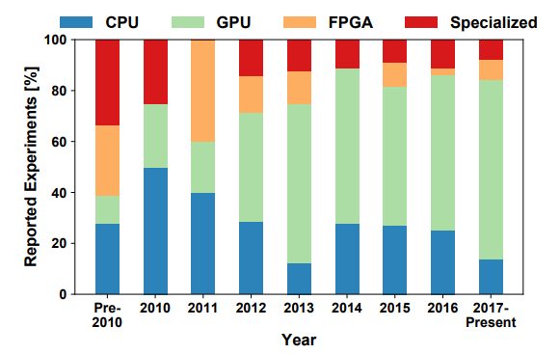
System
A look at the hardware, from a DL perspective:
Nvidia is dominant, Volta was a game changer
AMD is finally catching up
Specialized hardware losing favour
Same for CPUs
Source: Demystifying Parallel and Distributed Deep Learning: An In-Depth Concurrency Analysis, Ben-Nun & Hoefler 2018

Slide 12
Hardware overview
 | FP8 [TFLOPS] | INT8 [TOPS] | FP16 [TFLOPS] | Bloat16 [TFLOPS] | FP32 [TFLOPS] | FP64 [TFLOPS] | Memory [GB] | Memory Bandwidth [GB/s] | PCIe [GB/s] | Power draw [W] | FP16 TFLOP per Watt
AMD MI250 |  | 362.1 | 362.1 | 362.1 | 90.5 | 90.5 | 128 | 3276.8 | 31.51 | 560 | 0.64
AMD MI300x |  | 2615 | 1307 | 1307 | 654 | 163 | 192 | 5300 | 128 | 750 | 1.74
NVIDIA A100 |  | 624 | 312 | 312 | 156 | 19.5 | 40/80 | 1555-2039 | 64 | 400 | 0.78
NVIDIA H100 | 1979 | 1979 | 990 | 990 | 989 | 67 | 80/96 | 2000-3900 | 128 | 700 | 1.32
NVIDIA L40S (inference only) | 733 | 733 | 362 | 362 | 183 | 1.4 | 48 | 864 | 64 | 350 | 1.03
NVIDIA RTX 4090 (consumer) | 330 | 660 | 165 | 165 | 83 | 1.2 | 24 | 1000 | 64 | 400 | 0.41
Intel Xeon Scalable 8180 (per socket) |  | - | - |  | 4.2 | 2.1 | 768 (max) | 119 (max) | 15.75 | 205 | 0.02
AMD EPYC 7601 (per socket) |  | - | - |  | 1.4 | 0.69 | 2000 (max) | 159 (max) | 15.75 | 180 | 0.008
Prace best practice guide – deep learning
https://en.wikipedia.org/wiki/Ampere_(microarchitecture)
Notes:
Add H100, add watt en perf per watt, add a10 inference

Slide 13
Hardware overview
GPUs support reduced precision, has higher performance
 | FP8 [TFLOPS] | INT8 [TOPS] | FP16 [TFLOPS] | Bloat16 [TFLOPS] | FP32 [TFLOPS] | FP64 [TFLOPS] | Memory [GB] | Memory Bandwidth [GB/s] | PCIe [GB/s] | Power draw [W] | FP16 TFLOP per Watt
AMD MI250 |  | 362.1 | 362.1 | 362.1 | 90.5 | 90.5 | 128 | 3276.8 | 31.51 | 560 | 0.64
AMD MI300x |  | 2615 | 1307 | 1307 | 654 | 163 | 192 | 5300 | 128 | 750 | 1.74
NVIDIA A100 |  | 624 | 312 | 312 | 156 | 19.5 | 40/80 | 1555-2039 | 64 | 400 | 0.78
NVIDIA H100 | 1979 | 1979 | 990 | 990 | 989 | 67 | 80/96 | 2000-3900 | 128 | 700 | 1.32
NVIDIA L40S (inference only) | 733 | 733 | 362 | 362 | 183 | 1.4 | 48 | 864 | 64 | 350 | 1.03
NVIDIA RTX 4090 (consumer) | 330 | 660 | 165 | 165 | 83 | 1.2 | 24 | 1000 | 64 | 400 | 0.41
Intel Xeon Scalable 8180 (per socket) |  | - | - |  | 4.2 | 2.1 | 768 (max) | 119 (max) | 15.75 | 205 | 0.02
AMD EPYC 7601 (per socket) |  | - | - |  | 1.4 | 0.69 | 2000 (max) | 159 (max) | 15.75 | 180 | 0.008
Prace best practice guide – deep learning
https://en.wikipedia.org/wiki/Ampere_(microarchitecture)
Notes:
Add H100, add watt en perf per watt, add a10 inference

Slide 14
Hardware overview
GPUs have a lot of FLOPS
compared to CPUs
 | FP8 [TFLOPS] | INT8 [TOPS] | FP16 [TFLOPS] | Bloat16 [TFLOPS] | FP32 [TFLOPS] | FP64 [TFLOPS] | Memory [GB] | Memory Bandwidth [GB/s] | PCIe [GB/s] | Power draw [W] | FP16 TFLOP per Watt
AMD MI250 |  | 362.1 | 362.1 | 362.1 | 90.5 | 90.5 | 128 | 3276.8 | 31.51 | 560 | 0.64
AMD MI300x |  | 2615 | 1307 | 1307 | 654 | 163 | 192 | 5300 | 128 | 750 | 1.74
NVIDIA A100 |  | 624 | 312 | 312 | 156 | 19.5 | 40/80 | 1555-2039 | 64 | 400 | 0.78
NVIDIA H100 | 1979 | 1979 | 990 | 990 | 989 | 67 | 80/96 | 2000-3900 | 128 | 700 | 1.32
NVIDIA L40S (inference only) | 733 | 733 | 362 | 362 | 183 | 1.4 | 48 | 864 | 64 | 350 | 1.03
NVIDIA RTX 4090 (consumer) | 330 | 660 | 165 | 165 | 83 | 1.2 | 24 | 1000 | 64 | 400 | 0.41
Intel Xeon Scalable 8180 (per socket) |  | - | - |  | 4.2 | 2.1 | 768 (max) | 119 (max) | 15.75 | 205 | 0.02
AMD EPYC 7601 (per socket) |  | - | - |  | 1.4 | 0.69 | 2000 (max) | 159 (max) | 15.75 | 180 | 0.008
Prace best practice guide – deep learning
https://en.wikipedia.org/wiki/Ampere_(microarchitecture)
Notes:
Add H100, add watt en perf per watt, add a10 inference

Slide 15
Hardware overview
CPUs have a lot of memory compared to GPUs
 | FP8 [TFLOPS] | INT8 [TOPS] | FP16 [TFLOPS] | Bloat16 [TFLOPS] | FP32 [TFLOPS] | FP64 [TFLOPS] | Memory [GB] | Memory Bandwidth [GB/s] | PCIe [GB/s] | Power draw [W] | FP16 TFLOP per Watt
AMD MI250 |  | 362.1 | 362.1 | 362.1 | 90.5 | 90.5 | 128 | 3276.8 | 31.51 | 560 | 0.64
AMD MI300x |  | 2615 | 1307 | 1307 | 654 | 163 | 192 | 5300 | 128 | 750 | 1.74
NVIDIA A100 |  | 624 | 312 | 312 | 156 | 19.5 | 40/80 | 1555-2039 | 64 | 400 | 0.78
NVIDIA H100 | 1979 | 1979 | 990 | 990 | 989 | 67 | 80/96 | 2000-3900 | 128 | 700 | 1.32
NVIDIA L40S (inference only) | 733 | 733 | 362 | 362 | 183 | 1.4 | 48 | 864 | 64 | 350 | 1.03
NVIDIA RTX 4090 (consumer) | 330 | 660 | 165 | 165 | 83 | 1.2 | 24 | 1000 | 64 | 400 | 0.41
Intel Xeon Scalable 8180 (per socket) |  | - | - |  | 4.2 | 2.1 | 768 (max) | 119 (max) | 15.75 | 205 | 0.02
AMD EPYC 7601 (per socket) |  | - | - |  | 1.4 | 0.69 | 2000 (max) | 159 (max) | 15.75 | 180 | 0.008
Prace best practice guide – deep learning
https://en.wikipedia.org/wiki/Ampere_(microarchitecture)
Notes:
Add H100, add watt en perf per watt, add a10 inference

Slide 16
Hardware overview
Memory bandwidth relative to FLOPS is approximately the same
 | FP8 [TFLOPS] | INT8 [TOPS] | FP16 [TFLOPS] | Bloat16 [TFLOPS] | FP32 [TFLOPS] | FP64 [TFLOPS] | Memory [GB] | Memory Bandwidth [GB/s] | PCIe [GB/s] | Power draw [W] | FP16 TFLOP per Watt
AMD MI250 |  | 362.1 | 362.1 | 362.1 | 90.5 | 90.5 | 128 | 3276.8 | 31.51 | 560 | 0.64
AMD MI300x |  | 2615 | 1307 | 1307 | 654 | 163 | 192 | 5300 | 128 | 750 | 1.74
NVIDIA A100 |  | 624 | 312 | 312 | 156 | 19.5 | 40/80 | 1555-2039 | 64 | 400 | 0.78
NVIDIA H100 | 1979 | 1979 | 990 | 990 | 989 | 67 | 80/96 | 2000-3900 | 128 | 700 | 1.32
NVIDIA L40S (inference only) | 733 | 733 | 362 | 362 | 183 | 1.4 | 48 | 864 | 64 | 350 | 1.03
NVIDIA RTX 4090 (consumer) | 330 | 660 | 165 | 165 | 83 | 1.2 | 24 | 1000 | 64 | 400 | 0.41
Intel Xeon Scalable 8180 (per socket) |  | - | - |  | 4.2 | 2.1 | 768 (max) | 119 (max) | 15.75 | 205 | 0.02
AMD EPYC 7601 (per socket) |  | - | - |  | 1.4 | 0.69 | 2000 (max) | 159 (max) | 15.75 | 180 | 0.008
Prace best practice guide – deep learning
https://en.wikipedia.org/wiki/Ampere_(microarchitecture)
Notes:
Add H100, add watt en perf per watt, add a10 inference

Slide 17
Hardware overview
GPU price is often irrelevant, but the performance per Watt is.
 | FP8 [TFLOPS] | INT8 [TOPS] | FP16 [TFLOPS] | Bloat16 [TFLOPS] | FP32 [TFLOPS] | FP64 [TFLOPS] | Memory [GB] | Memory Bandwidth [GB/s] | PCIe [GB/s] | Power draw [W] | FP16 TFLOP per Watt
AMD MI250 |  | 362.1 | 362.1 | 362.1 | 90.5 | 90.5 | 128 | 3276.8 | 31.51 | 560 | 0.64
AMD MI300x |  | 2615 | 1307 | 1307 | 654 | 163 | 192 | 5300 | 128 | 750 | 1.74
NVIDIA A100 |  | 624 | 312 | 312 | 156 | 19.5 | 40/80 | 1555-2039 | 64 | 400 | 0.78
NVIDIA H100 | 1979 | 1979 | 990 | 990 | 989 | 67 | 80/96 | 2000-3900 | 128 | 700 | 1.32
NVIDIA L40S (inference only) | 733 | 733 | 362 | 362 | 183 | 1.4 | 48 | 864 | 64 | 350 | 1.03
NVIDIA RTX 4090 (consumer) | 330 | 660 | 165 | 165 | 83 | 1.2 | 24 | 1000 | 64 | 400 | 0.41
Intel Xeon Scalable 8180 (per socket) |  | - | - |  | 4.2 | 2.1 | 768 (max) | 119 (max) | 15.75 | 205 | 0.02
AMD EPYC 7601 (per socket) |  | - | - |  | 1.4 | 0.69 | 2000 (max) | 159 (max) | 15.75 | 180 | 0.008
Prace best practice guide – deep learning
https://en.wikipedia.org/wiki/Ampere_(microarchitecture)
Notes:
Add H100, add watt en perf per watt, add a10 inference

Slide 18
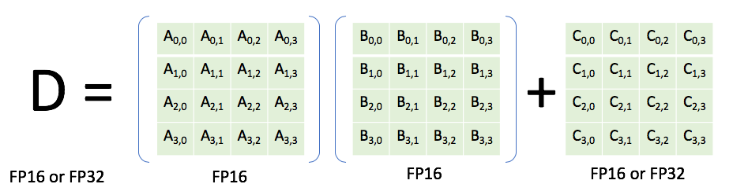
Nvidia Volta (e.g. V100, TitanRTX)
Generally, you are responsible for specifying a reduced precision: DL frameworks don’t do this automatically since it may impact your networks accuracy, convergence, etc
Features
INT8 & FP16 support
(Volta) Tensor cores: fused multiply-add units that support mixed precision (multiply in FP16, add in FP32). High performance: 120 TFLOPS (for the time).
High bandwidth memory, 2nd generation (HBM2) (vs. DDR)

Slide 19
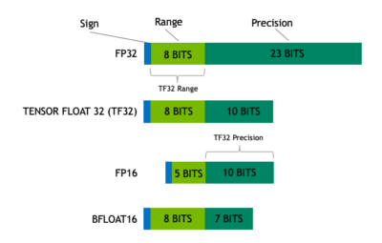
Nvidia Ampere GPUs (e.g. A100)
Features (see also https://servicedesk.surf.nl/wiki/display/WIKI/Deep+Learning+on+A100+GPUs )
Tensor Cores support more datatypes (FP64, TF32, FP16, BF16, Int8, Int4, Binary)
TensorFloat32 datatype:
Mixed precision uses FP16. Reduced range causes (potential) need for gradient scaling to prevent underflows

Slide 20
Nvidia Ampere GPUs (e.g. A100)
Features (see also https://servicedesk.surf.nl/wiki/display/WIKI/Deep+Learning+on+A100+GPUs )
Tensor Cores support more datatypes (FP64, TF32, FP16, BF16, Int8, Int4, Binary)
TensorFloat32 datatype:
TF32 tries to combine best of both worlds: range of an FP32 (no gradient scaling needed), but with reduced precision (for speedup & less memory)

Slide 21
Nvidia Ampere GPUs (e.g. A100)
Features (see also https://servicedesk.surf.nl/wiki/display/WIKI/Deep+Learning+on+A100+GPUs )
Tensor Cores support more datatypes (FP64, TF32, FP16, BF16, Int8, Int4, Binary)
TensorFloat32 datatype:
Automatically used unless
Environment variable NVIDIA_TF32_OVERRIDE=0 is set
torch.backends.cuda.matmul.allow_tf32 = False and torch.backends.cudnn.allow_tf32 = False are set

Slide 22
Nvidia Ampere GPUs (e.g. A100)
Model | Precision | Throughput (img/s) | Speedup (compared to FP32) | Loss (1st iteration)
ResNet50 | FP32 | 455.9 | 1 | 7.457645893096924
ResNet50 | TF32 | 750.6 | 1.65 | 7.456507205963135
ResNet50 | FP16 (input) + FP32 (accumulator) | 1087.6 | 2.38 | 7.45703125
VGG19 | FP32 | 212.7 | 1 | 6.9077839851379395
VGG19 | TF32 | 550.3 | 2.59 | 6.907783508300781
VGG19 | FP16 (input) + FP32 (accumulator) | 1099.8 | 5.17 | 6.90625
DenseNet121 | FP32 | 391.9 | 1 | 6.96142053604126
DenseNet121 | TF32 | 591.5 | 1.51 | 6.961450576782227
DenseNet121 | FP16 (input) + FP32 (accumulator) | 876.2 | 2.24 | 6.9609375
Source: https://servicedesk.surf.nl/wiki/display/WIKI/Deep+Learning+on+A100+GPUs

Slide 23
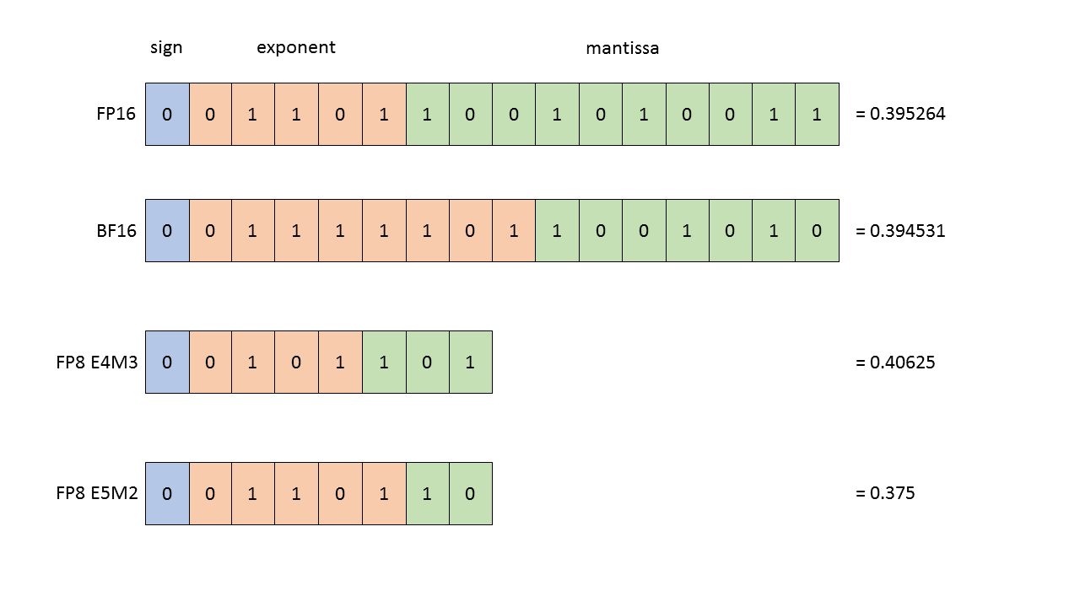
Nvidia Hopper GPUs (e.g. H100)
FP8 support
Transformer-specific optimizations

Slide 24
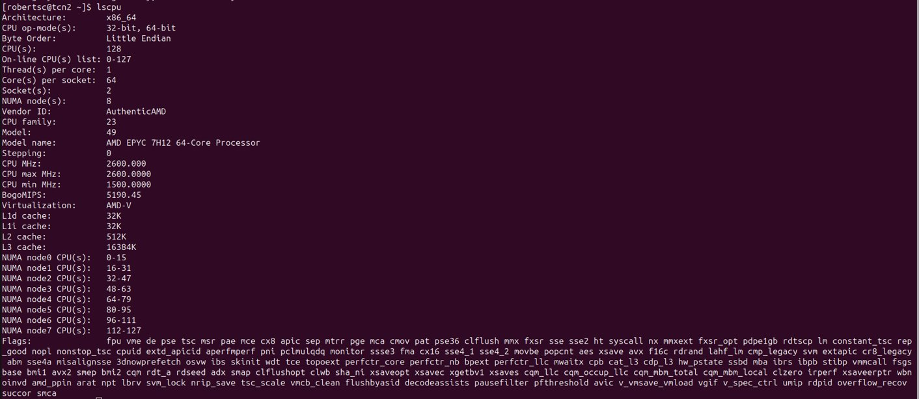
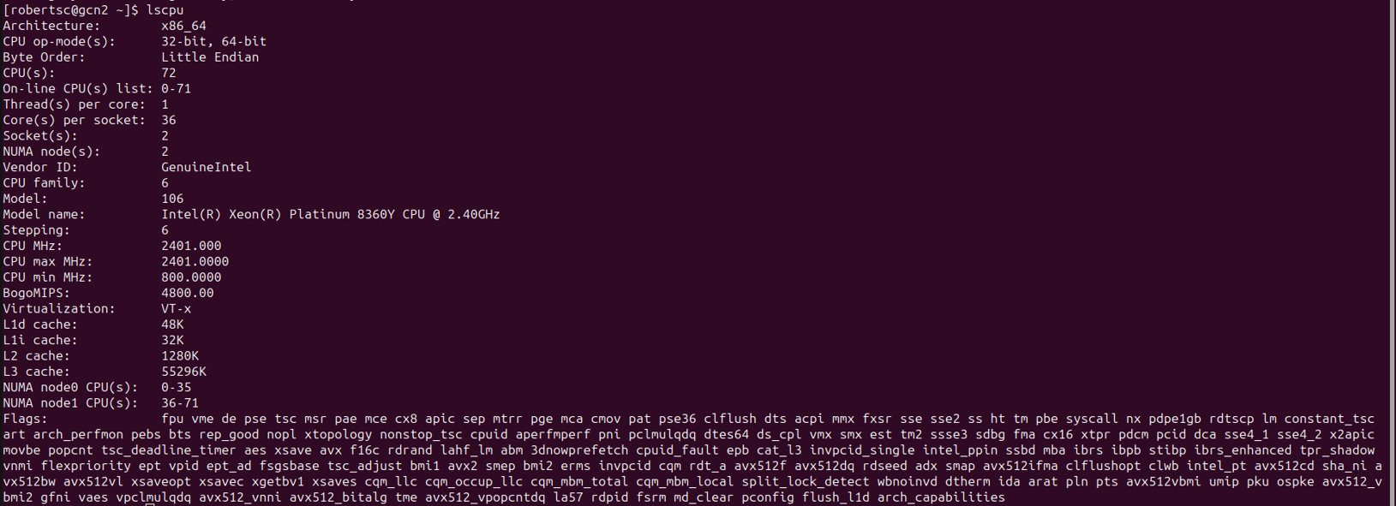
And on CPU:
Notes:
Add new cpus

Slide 25
Second S: Software
PyTorch/TensorFlow vs Numpy
PyTorch and TensorFlow have GPU support, Numpy does not
Numpy on AVX2....brrrr
Support for CUDA (Nvidia), ROCm (AMD), <insert exotic hardware here>?
E.g.: Intel SapphireRapids
IPEX: https://github.com/intel/intel-extension-for-pytorch
LUMI https://www.lumi-supercomputer.eu/
Support for lower precision
BFloat16, Float16?

Slide 26

Third S: Stack
Is my software compiled for my hardware
Pip install … ?
Module load PyTorch/1.12.0-foss-2022a-CUDA-11.7.0
Again: SapphireRapids? ROCm?
PyTorch is crazy: https://github.com/pytorch/pytorch/tree/main/third_party
PyTorch has given up on generic software management
Ptrblck: "

Slide 27
Wait ... so what happens?
You call torch
(Manual) Dispatching
E.g. scatter_add_ -> Message passing in Graph-NNs
Torch (python) determines the most appropriate function to call
Dispatching
Torch (C++/CU) calls the CPU/GPU kernel
Dispatching
Low-level lib performs actual calculation
Dispatching
PyTorch Dispatcher: http://blog.ezyang.com/2020/09/lets-talk-about-the-pytorch-dispatcher/
Your choices matter

Slide 28
In practice: PyTorch + Snellius
We only have NVIDIA GPUs
72x4=288 NVIDIA A100
88x4=352 NVIDIA H100 (added recently)
Makes optimization a bit easier for you
You only need to spend a year sifting through documentation
https://servicedesk.surf.nl/wiki/display/WIKI/Deep+Learning+on+A100+GPUs
Or ask us... :)
Every EINF/NWO small grants has a default of 4 consultancy hours

Slide 29

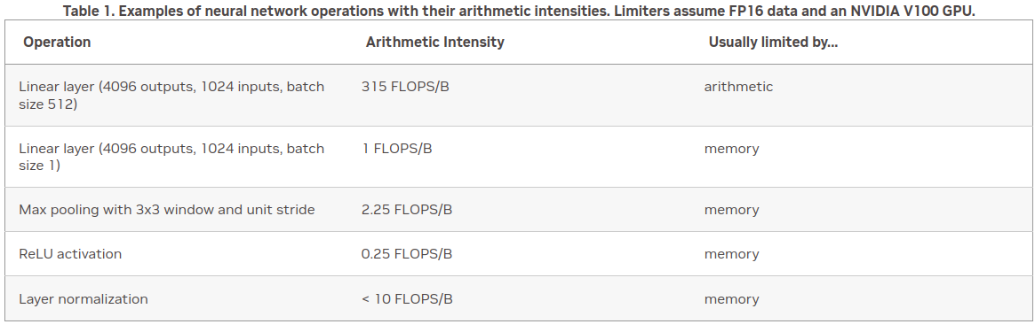
Rapidfire: implementation details
How fast do you want to go?
What is your goal?
Largest model possible?
Best validation performance?
Submit a paper to ISC '23?

Slide 30
Rapidfire: implementation details
How fast do you want to go?
https://pytorch.org/docs/stable/notes/cuda.html
https://docs.nvidia.com/deeplearning/performance/dl-performance-memory-limited/index.html
https://docs.nvidia.com/deeplearning/performance/index.html
Duncan: "You can take any piece of code, spend 6 months optimizing it, and then write a paper about it"

Slide 31
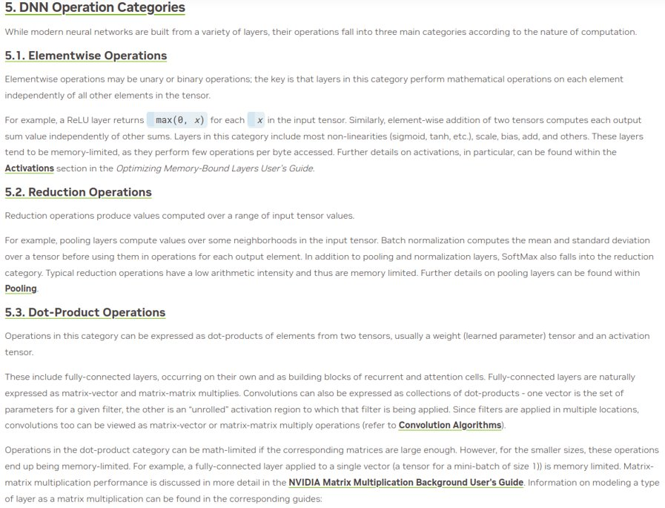
Rapidfire: implementation details

Slide 32
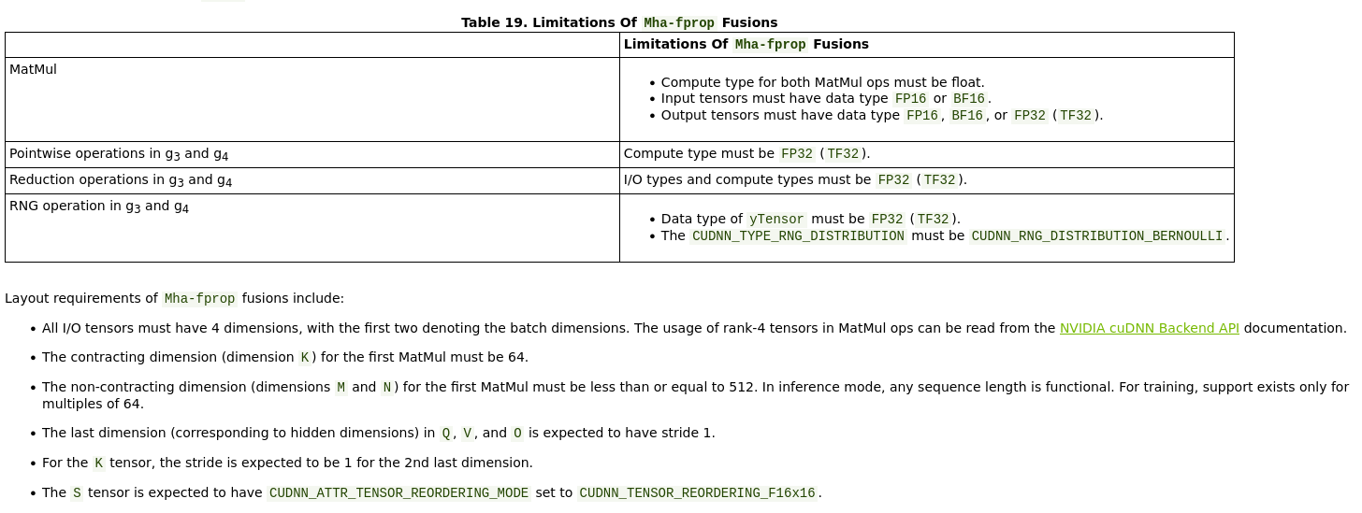
Level 1: Shouldn't impact model convergence:

Slide 33
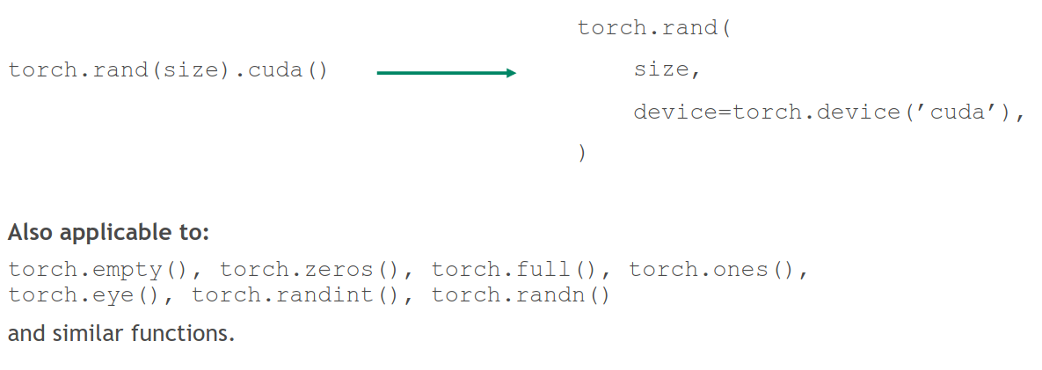
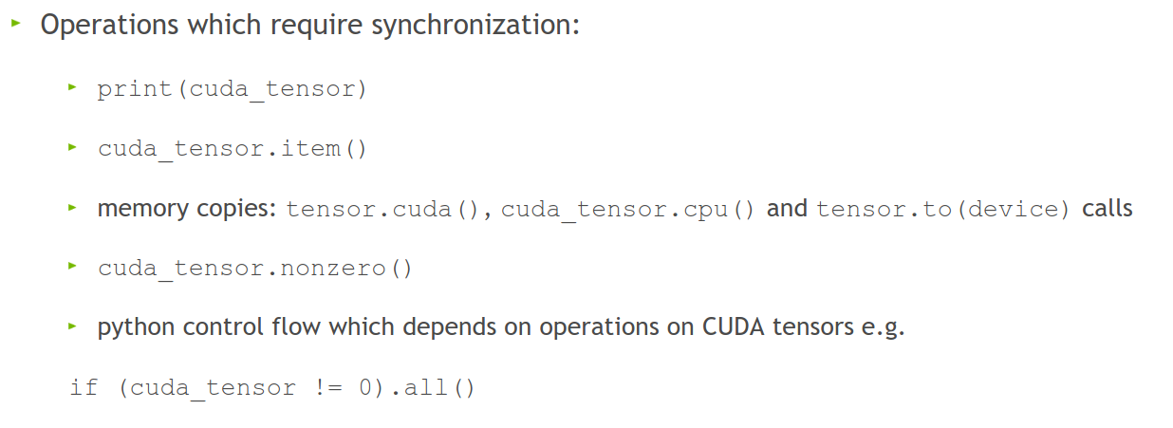
Level 1: Shouldn't impact model convergence:
Avoid CPU-GPU sync
Create tensors directly on the device
Don't aggregate tensors which still require grad, e.g.: losses.append(loss) (:o)
instead, detach (loss.detach())

Slide 34

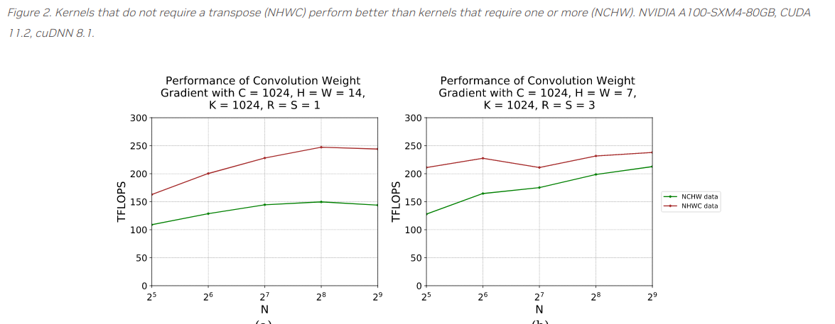
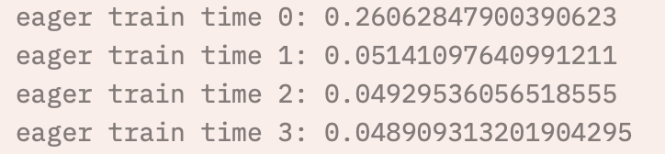
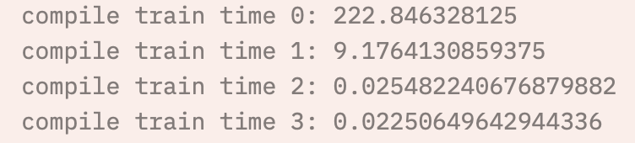
Level 1: Shouldn't impact model convergence:
torch.backends.cuda.matmul.allow_tf32 = True
The default in PyTorch (silently)
torch.set_float32_matmul_precision('high')
torch.backends.cudnn.benchmark = True
Empirically benchmarks to find fastest method
Align bytes: multiples of 2, 8, 1024
DNN libraries want nicely aligned memory
torch.channels_last
Helps with memory alignment and reduces cache misses
Compile: PyTorch 2.0
Big speedup, but sensitive to implementation

Slide 35

Level 2: Danger zone
torch.backends.cuda.matmul.allow_fp16_reduced_precision_reduction = True
Lol:
torch.backends.cuda.matmul.allow_bf16_reduced_precision_reduction
Torch.set_float32_matmul_precision('medium')
Cast model and data to (B)Float16 before the forward pass
We're not supposed to...but:

Slide 36
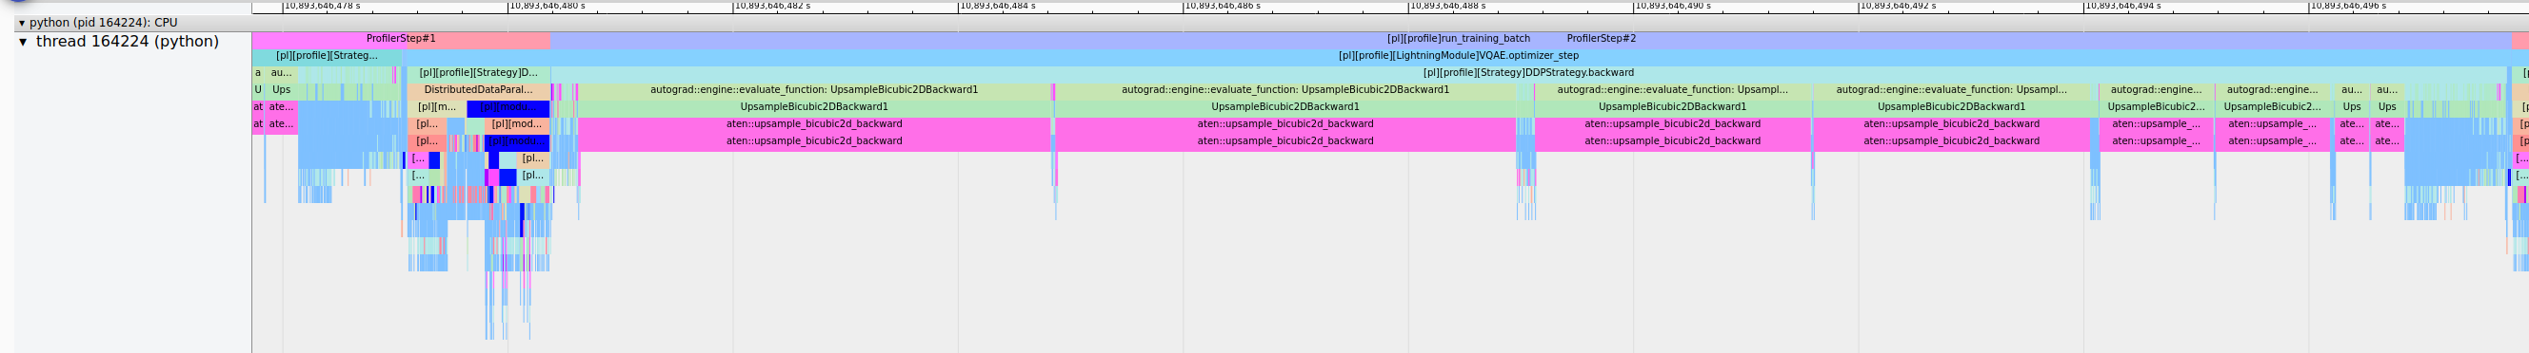
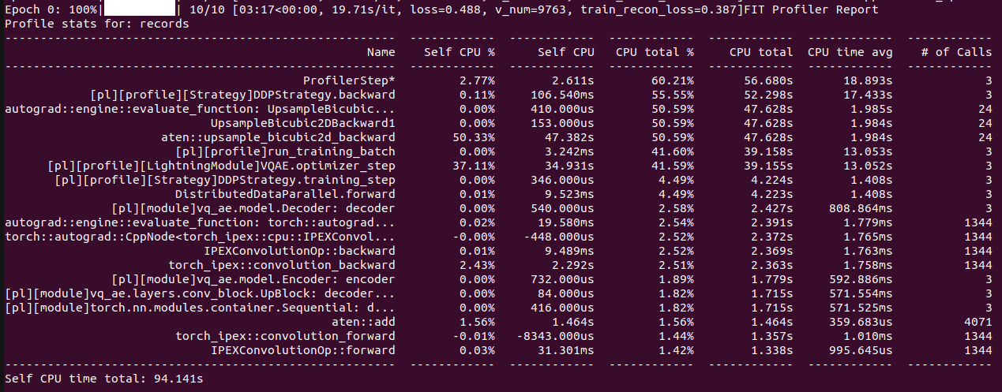
Change your model
Worst case scenario:

Slide 37
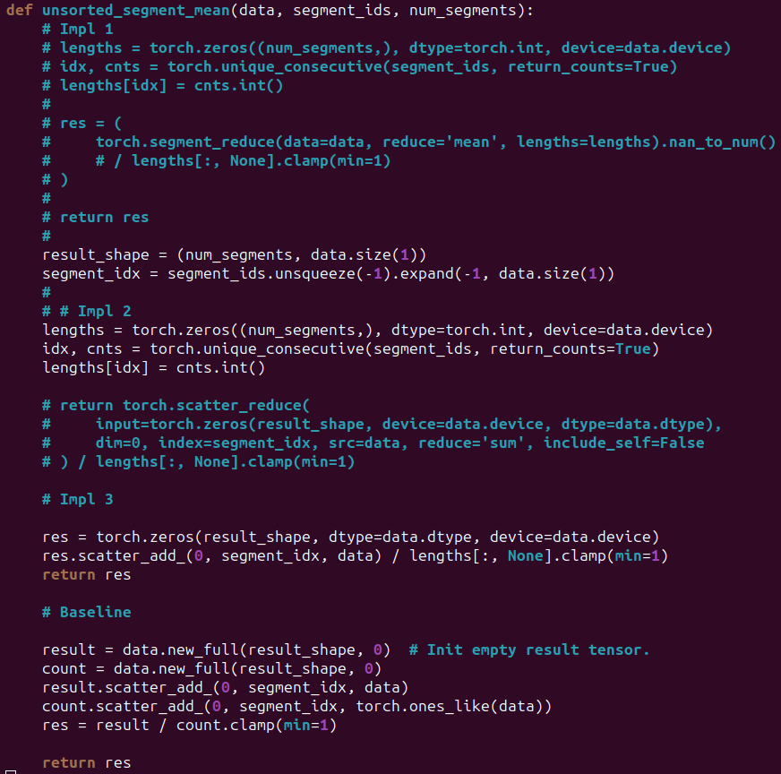

Slide 38
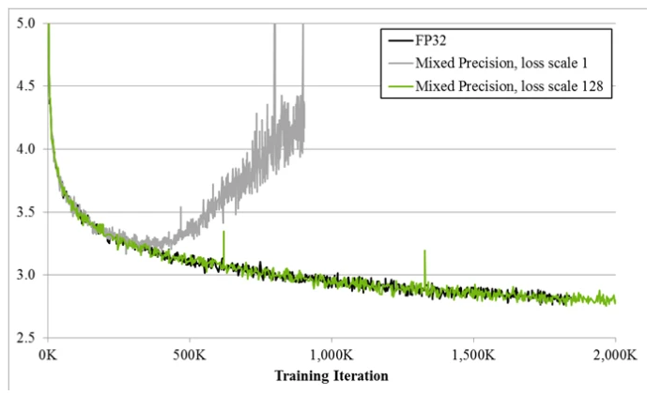
Always
Have a baseline
Check convergence statistics

Slide 39

Profile
Get a grip on your model’s performance
Profile
Profile
Profile
Also important: profile

Slide 40
More generally; listen to Duncan:
Start small
Have a goal
Profile your code

