Slide 1
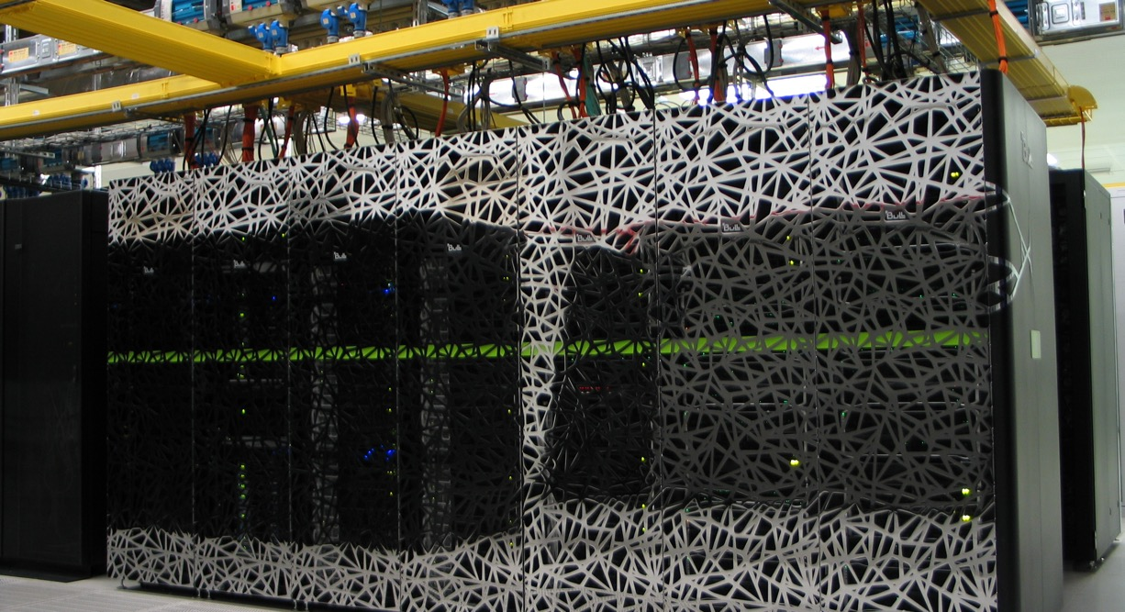
High Performance machine learning
Caspar van Leeuwen
High Performance ML consultant
SURF

Slide 2
Hardware
Goals:
Understand what hardware bottlenecks could be limiting
Understand pro’s and con’s of various hardware
Know how to choose appropriate hardware for you DL task
Know what to do to mitigate bottlenecks

Slide 3
Hardware bottlenecks
Compute (floating point operations per second, FLOPS)
Memory bandwidth
Memory size
I/O
Communication

Slide 4
Hardware bottlenecks
E.g. training a compute intensive network on a single node
Compute (floating point operations per second, FLOPS)
Memory bandwidth
Memory size
I/O
Communication

Slide 5
Hardware bottlenecks
Compute (floating point operations per second, FLOPS)
Memory bandwidth
Memory size
I/O
Communication
Data needs to get to the processor in time in order to do compute!
Many codes are limited by memory bandwidth

Slide 6
Hardware bottlenecks
Compute (floating point operations per second, FLOPS)
Memory bandwidth
Memory size
I/O
Communication
Very deep or wide networks, or networks with very large input/output layers (e.g. high resolution images) may be limited by memory size.
Not a performance bottleneck, but a no-go!

Slide 7
Hardware bottlenecks
Compute (floating point operations per second, FLOPS)
Memory bandwidth
Memory size
I/O
Communication
HPC systems typically have shared file systems, usually with good bandwidth, but (relatively) low IOPS
(Very) common bottleneck in distributed learning! Many nodes reading from the same filesystem.
Other users (& sysadmins) will dislike you if you do I/O in a naive way!

Slide 8
Hardware bottlenecks
Compute (floating point operations per second, FLOPS)
Memory bandwidth
Memory size
I/O
Communication
Communication can be limiting in several ways:
Latency (many, small message send between nodes)
Bandwidth (few, large messages send between nodes)
Load imbalance (some workers in distributed job are slower / have more work; others have to wait when synchronization is needed)
CPU ⬄ GPU

Slide 9
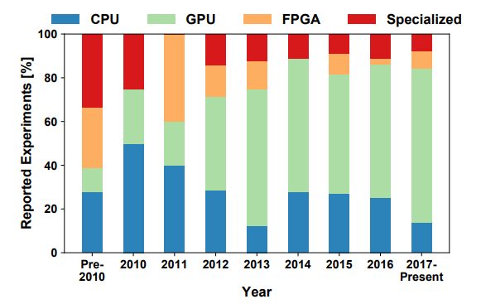
Hardware overview
A look at the hardware, from a DL perspective:
Nvidia Pascal / Volta GPUs
AMD Vega / Vega20
Intel Xeon Scalable
AMD Zen
Specialized hardware
I/O
Interconnects
Source: Demystifying Parallel and Distributed Deep Learning: An In-Depth Concurrency Analysis, Ben-Nun & Hoefler 2018

Slide 10
Hardware overview
 | INT8 [TOPS] | FP16 [TFLOPS] | Bloat16 | FP32 [TFLOPS] | FP64 [TFLOPS] | Memory [GB] | Memory Bandwidth [GB/s] | PCIe [GB/s] | Proprietary Interconnect [GB/s]
AMD MI60 | 58.9 | 29.5 |  | 14.7 | 7.4 | 32 | 1024 | 31.51 | 200 (2 × 100)
AMD MI100 | 184.6 | 184.6 | 92.3 | 23.1 / 46.1 | 11.5 | 32 | 1200 | 31.51 | 300 (3×100)
AMD MI250 | 362.1 | 362.1 | 362.1 | 45.3 / 90.5 | 45.3 / 90.5 | 128 | 3276.8 | 31.51 | 800 (8 × 100)
NVIDIA V100 | 62.8 | 31.4 / 125 |  | 15.7 | 7.8 | 16/32 | 900 | 15.75 | 300 (6 × 50)
NVIDIA A100 | 624 | 78 / 312 | 312 | 19.5 / 156 | 9.7 / 19.5 | 40/80 | 1555/2039 | 64 | 600
Intel Xeon Scalable 8180 (per socket) | - | - |  | 3.0 / 4.2 | 1.5 / 2.1 | 768 (max) | 119 (max) | 15.75 | -
AMD EPYC 7601 (per socket) | - | - |  | 1.1 / 1.4 | 0.56 / 0.69 | 2000 (max) | 159 (max) | 15.75 | -
Source: Prace best practice guide – deep learning
http://www.prace-ri.eu/IMG/pdf/Best-Practice-Guide-Deep-Learning.pdf
https://en.wikipedia.org/wiki/Ampere_(microarchitecture)

Slide 11
Hardware overview
GPUs support reduced precision, has higher performance
 | INT8 [TOPS] | FP16 [TFLOPS] | Bloat16 | FP32 [TFLOPS] | FP64 [TFLOPS] | Memory [GB] | Memory Bandwidth [GB/s] | PCIe [GB/s] | Proprietary Interconnect [GB/s]
AMD MI60 | 58.9 | 29.5 |  | 14.7 | 7.4 | 32 | 1024 | 31.51 | 200 (2 × 100)
AMD MI100 | 184.6 | 184.6 | 92.3 | 23.1 / 46.1 | 11.5 | 32 | 1200 | 31.51 | 300 (3×100)
AMD MI250 | 362.1 | 362.1 | 362.1 | 45.3 / 90.5 | 45.3 / 90.5 | 128 | 3276.8 | 31.51 | 800 (8 × 100)
NVIDIA V100 | 62.8 | 31.4 / 125 |  | 15.7 | 7.8 | 16/32 | 900 | 15.75 | 300 (6 × 50)
NVIDIA A100 | 624 | 78 / 312 | 312 | 19.5 / 156 | 9.7 / 19.5 | 40/80 | 1555/2039 | 64 | 600
Intel Xeon Scalable 8180 (per socket) | - | - |  | 3.0 / 4.2 | 1.5 / 2.1 | 768 (max) | 119 (max) | 15.75 | -
AMD EPYC 7601 (per socket) | - | - |  | 1.1 / 1.4 | 0.56 / 0.69 | 2000 (max) | 159 (max) | 15.75 | -
Source: Prace best practice guide – deep learning
http://www.prace-ri.eu/IMG/pdf/Best-Practice-Guide-Deep-Learning.pdf
https://en.wikipedia.org/wiki/Ampere_(microarchitecture)

Slide 12
Hardware overview
GPUs have a lot of FLOPS
compared to CPUs
 | INT8 [TOPS] | FP16 [TFLOPS] | Bloat16 | FP32 [TFLOPS] | FP64 [TFLOPS] | Memory [GB] | Memory Bandwidth [GB/s] | PCIe [GB/s] | Proprietary Interconnect [GB/s]
AMD MI60 | 58.9 | 29.5 |  | 14.7 | 7.4 | 32 | 1024 | 31.51 | 200 (2 × 100)
AMD MI100 | 184.6 | 184.6 | 92.3 | 23.1 / 46.1 | 11.5 | 32 | 1200 | 31.51 | 300 (3×100)
AMD MI250 | 362.1 | 362.1 | 362.1 | 45.3 / 90.5 | 45.3 / 90.5 | 128 | 3276.8 | 31.51 | 800 (8 × 100)
NVIDIA V100 | 62.8 | 31.4 / 125 |  | 15.7 | 7.8 | 16/32 | 900 | 15.75 | 300 (6 × 50)
NVIDIA A100 | 624 | 78 / 312 | 312 | 19.5 / 156 | 9.7 / 19.5 | 40/80 | 1555/2039 | 64 | 600
Intel Xeon Scalable 8180 (per socket) | - | - |  | 3.0 / 4.2 | 1.5 / 2.1 | 768 (max) | 119 (max) | 15.75 | -
AMD EPYC 7601 (per socket) | - | - |  | 1.1 / 1.4 | 0.56 / 0.69 | 2000 (max) | 159 (max) | 15.75 | -
Source: Prace best practice guide – deep learning
http://www.prace-ri.eu/IMG/pdf/Best-Practice-Guide-Deep-Learning.pdf
https://en.wikipedia.org/wiki/Ampere_(microarchitecture)

Slide 13
Hardware overview
CPUs have a lot of memory compared to GPUs
 | INT8 [TOPS] | FP16 [TFLOPS] | Bloat16 | FP32 [TFLOPS] | FP64 [TFLOPS] | Memory [GB] | Memory Bandwidth [GB/s] | PCIe [GB/s] | Proprietary Interconnect [GB/s]
AMD MI60 | 58.9 | 29.5 |  | 14.7 | 7.4 | 32 | 1024 | 31.51 | 200 (2 × 100)
AMD MI100 | 184.6 | 184.6 | 92.3 | 23.1 / 46.1 | 11.5 | 32 | 1200 | 31.51 | 300 (3×100)
AMD MI250 | 362.1 | 362.1 | 362.1 | 45.3 / 90.5 | 45.3 / 90.5 | 128 | 3276.8 | 31.51 | 800 (8 × 100)
NVIDIA V100 | 62.8 | 31.4 / 125 |  | 15.7 | 7.8 | 16/32 | 900 | 15.75 | 300 (6 × 50)
NVIDIA A100 | 624 | 78 / 312 | 312 | 19.5 / 156 | 9.7 / 19.5 | 40/80 | 1555/2039 | 64 | 600
Intel Xeon Scalable 8180 (per socket) | - | - |  | 3.0 / 4.2 | 1.5 / 2.1 | 768 (max) | 119 (max) | 15.75 | -
AMD EPYC 7601 (per socket) | - | - |  | 1.1 / 1.4 | 0.56 / 0.69 | 2000 (max) | 159 (max) | 15.75 | -
Source: Prace best practice guide – deep learning
http://www.prace-ri.eu/IMG/pdf/Best-Practice-Guide-Deep-Learning.pdf
https://en.wikipedia.org/wiki/Ampere_(microarchitecture)

Slide 14
Hardware overview
Memory bandwidth relative to FLOPS is approximately the same
 | INT8 [TOPS] | FP16 [TFLOPS] | Bloat16 | FP32 [TFLOPS] | FP64 [TFLOPS] | Memory [GB] | Memory Bandwidth [GB/s] | PCIe [GB/s] | Proprietary Interconnect [GB/s]
AMD MI60 | 58.9 | 29.5 |  | 14.7 | 7.4 | 32 | 1024 | 31.51 | 200 (2 × 100)
AMD MI100 | 184.6 | 184.6 | 92.3 | 23.1 / 46.1 | 11.5 | 32 | 1200 | 31.51 | 300 (3×100)
AMD MI250 | 362.1 | 362.1 | 362.1 | 45.3 / 90.5 | 45.3 / 90.5 | 128 | 3276.8 | 31.51 | 800 (8 × 100)
NVIDIA V100 | 62.8 | 31.4 / 125 |  | 15.7 | 7.8 | 16/32 | 900 | 15.75 | 300 (6 × 50)
NVIDIA A100 | 624 | 78 / 312 | 312 | 19.5 / 156 | 9.7 / 19.5 | 40/80 | 1555/2039 | 64 | 600
Intel Xeon Scalable 8180 (per socket) | - | - |  | 3.0 / 4.2 | 1.5 / 2.1 | 768 (max) | 119 (max) | 15.75 | -
AMD EPYC 7601 (per socket) | - | - |  | 1.1 / 1.4 | 0.56 / 0.69 | 2000 (max) | 159 (max) | 15.75 | -
Source: Prace best practice guide – deep learning
http://www.prace-ri.eu/IMG/pdf/Best-Practice-Guide-Deep-Learning.pdf
https://en.wikipedia.org/wiki/Ampere_(microarchitecture)

Slide 15
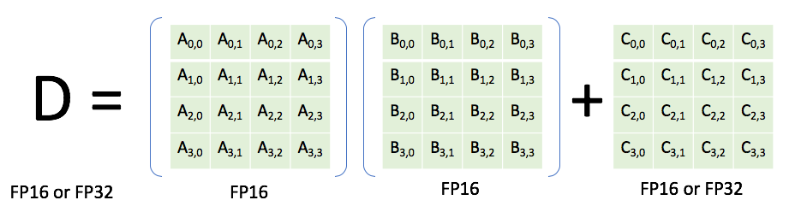
Nvidia Volta (e.g. V100, TitanRTX)
Generally you are responsible for specifying a reduced precision: DL frameworks don’t do this automatically since it may impact your networks accuracy, convergence, etc
Features
INT8 & FP16 support
(Volta) Tensor cores: fused multiply-add units that support mixed precission (multiply in FP16, add in FP32). High performance: 120 TOPS.
High bandwidth memory, 2nd generation (HBM2)
NVLink: allows direct GPU₁ ⬄ GPU₂ communication in a multi-GPU node (much faster than having to go over PCIe)

Slide 16
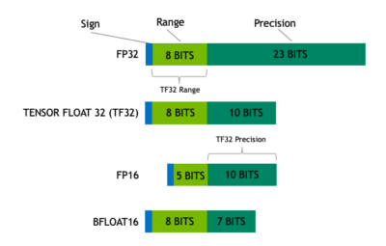
Nvidia Ampere GPUs (e.g. A100)
Features (see also https://servicedesk.surf.nl/wiki/display/WIKI/Deep+Learning+on+A100+GPUs )
Tensor Cores support more datatypes (FP64, TF32, FP16, BF16, Int8, Int4, Binary)
TensorFloat32 datatype:
Mixed precision uses FP16. Reduced range causes (potential) need for gradient scaling to prevent underflows

Slide 17
Nvidia Ampere GPUs (e.g. A100)
Features (see also https://servicedesk.surf.nl/wiki/display/WIKI/Deep+Learning+on+A100+GPUs )
Tensor Cores support more datatypes (FP64, TF32, FP16, BF16, Int8, Int4, Binary)
TensorFloat32 datatype:
TF32 tries to combine best of both worlds: range of an FP32 (no gradient scaling needed), but with reduced precision (for speedup & less memory)

Slide 18
Nvidia Ampere GPUs (e.g. A100)
Features (see also https://servicedesk.surf.nl/wiki/display/WIKI/Deep+Learning+on+A100+GPUs )
Tensor Cores support more datatypes (FP64, TF32, FP16, BF16, Int8, Int4, Binary)
TensorFloat32 datatype:
Automatically used unless
Environment variable NVIDIA_TF32_OVERRIDE=0 is set
torch.backends.cuda.matmul.allow_tf32 = False and torch.backends.cudnn.allow_tf32 = False are set

Slide 19
Nvidia Ampere GPUs (e.g. A100)
Model | Precision | Throughput (img/s) | Speedup (compared to FP32) | Loss (1st iteration)
ResNet50 | FP32 | 455.9 | 1 | 7.457645893096924
ResNet50 | TF32 | 750.6 | 1.65 | 7.456507205963135
ResNet50 | FP16 (input) + FP32 (accumulator) | 1087.6 | 2.38 | 7.45703125
VGG19 | FP32 | 212.7 | 1 | 6.9077839851379395
VGG19 | TF32 | 550.3 | 2.59 | 6.907783508300781
VGG19 | FP16 (input) + FP32 (accumulator) | 1099.8 | 5.17 | 6.90625
DenseNet121 | FP32 | 391.9 | 1 | 6.96142053604126
DenseNet121 | TF32 | 591.5 | 1.51 | 6.961450576782227
DenseNet121 | FP16 (input) + FP32 (accumulator) | 876.2 | 2.24 | 6.9609375
Source: https://servicedesk.surf.nl/wiki/display/WIKI/Deep+Learning+on+A100+GPUs

Slide 20
Nvidia Volta / Ampere GPUs
(Low-level) library support
CUDA
cuBLAS: basic linear algebra
cuSPARSE: sparse matrix algebra
cuDNN: primitives for deep neural networks
NCCL: NVIDIA collective communications library (implements efficient allreduce and supports e.g. NVLink & RDMA)
Efficient low-level libraries are just as important as hardware itself! Otherwise, theoretical hardware specs might be great, but you’ll never get that performance!

Slide 21
AMD Aldebaran
Features
INT8 & FP16 support
High bandwidth memory, 2nd generation (HBM2)
PCIe 4.0 support (large bandwidth CPU ⬄ GPU)
Infinity fabric: proprietary interconnect for high bandwidth GPU ⬄ GPU communication in a multi-GPU node.

Slide 22
AMD Aldebaran
Features
INT8 & FP16 support
High bandwidth memory, 2nd generation (HBM2)
PCIe 4.0 support (large bandwidth CPU ⬄ GPU)
Infinity fabric: proprietary interconnect for high bandwidth GPU ⬄ GPU communication in a multi-GPU node.

Slide 23
AMD AMD
(Low-level) library support
Heterogeneous-computing Interface for Portability (HIP): a C++ dialect that was designed to ease conversion of CUDA applications to portable C++ code
MIOpen: machine learning primitives (based on the OpenCL or HIP)
rocBLAS: basic linear algebra
ROCm: software ecosystem for GPU computing
ROCm: has forks of TensorFlow, Caffe 2, PyTorch, MxNet and CNTK with MIOpen support.
While software stack is ‘young’ compared to NVidia, performance is competitive – provided the ROCm forks of the frameworks are used when computing on AMD hardware!

Slide 24
Intel Xeon Scalable
Pro tip:
Low-end Xeon Scalable processors have only 1 AVX-512 FMA unit. AVX2 may perform better on these processors, because AVX-512 instructions are executed at lower clock speeds!
Supports AVX-512 vector instructions
Supports very large memory (more than 1 TB per node)
Intel Math Kernel Library (MKL): optimized BLAS, LAPACK and FFTW routines
Intel MKL-DNN: primitives for deep learning.

Slide 25
AMD Zen
Supports AVX-2 vector instructions
Supports very large memory (more than 1 TB per node)
BLIS: a BLAS implementation optimized for AMD EPYC processors
libFLAME: portable library for dense matrix multiplications
Note: the Zen processor is not really marketed as a processor for DL task. DL frameworks don’t generally support its low level libraries.
More info: PRACE AMD EPYC best practice guide, http://www.prace-ri.eu/IMG/pdf/Best-Practice-Guide-AMD.pdf

Slide 26
Specialized hardware
Tensor processing units (TPU)
Chip designed specifically for machine learning (tensor operations)
Available only in Google Cloud
Google Cloud TPU v3: 420 TFLOPS, 128 GB HBM. About 8 USD/TPU-hour
Supported in TensorFlow
Field Programmable Gate Arrays (FPGA)
Programmable chips
Can do e.g. compute in any desired accuracy
Very experimental, no framework support
Maybe in the future…

Slide 27
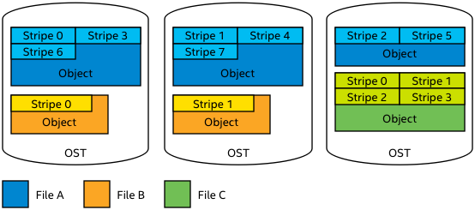
I/O
HPC systems typically use parallel shared file systems.
Parallel file system: one file can be distributed over many physical disks, to increase I/O bandwidth.

Slide 28
I/O
Two main types of parallel filesystems
Lustre
Metadata (filename, size, location, etc) stored on separate server
Object Storage Target (OST) stores actual file
Striping over multiple OSTs can be managed by user
GPFS
Metadata and actual file stored on the same server
Striping is managed automatically, by file system. User has no control.

Slide 29
Mitigate hardware bottlenecks
Use high-FLOP hardware (GPUs, TPUs)
Use specialized vector instructions: AVX, AVX2, AVX-512 (CPUs)
Use reduced precision training (GPUs)
Use distributed learning
Compute (floating point operations per second, FLOPS)
Memory bandwidth
Memory size
I/O
Communication
Pro tip for Tensorflow CPU training
‘Pip install tensorflow’ installs a TensorFlow binary with only AVX support. Ops that are accelerated with MKL-DNN are ok (use newer AVX instructions), but poor performance for ops that are not accelerated by MKL-DNN.
Build from source yourself (tricky, but allows perfect optimization for your system)
Use prebuilt Intel optimized Tensorflow on Intel CPUs: pip install intel-tensorflow, or conda. (easy, but TF versions may lag behind) See https://software.intel.com/en-us/articles/intel-optimization-for-tensorflow-installation-guide

Slide 30
Mitigate hardware bottlenecks
Compute (floating point operations per second, FLOPS)
Memory bandwidth
Memory size
I/O
Communication
Low level libraries (cuDNN, MKL-DNN) have optimized memory access patterns, meaning you get the most out of your memory bandwidth
Make sure your DL framework is build against the appropriate low level libraries
Use a tensors in channels-last memory format on Nvidia GPUs (https://pytorch.org/tutorials/intermediate/memory_format_tutorial.html)

Slide 31
Mitigate hardware bottlenecks
Compute (floating point operations per second, FLOPS)
Memory bandwidth
Memory size
I/O
Communication
Choose different architecture. E.g. TPUs, or CPUs (distributed CPU training can provide as many FLOPS as serial training on GPUs, but much more memory!)
Prune your model, if you can
Model/pipeline parallelism

Slide 32
Mitigate hardware bottlenecks
Compute (floating point operations per second, FLOPS)
Memory bandwidth
Memory size
I/O
Communication
Depends on what’s limiting:
IOPS: pack small files into large files. Many frameworks provide dedicated file formats for this (TensorFlows: TFRecords, Caffe: LMDB), though other packed data formats such as HDF provide similar performance benefits. Particularly important if reading from Lustre filesystem: metadata servers don’t scale!
Bandwidth: exploit parallel filesystems. E.g. use Lustre striping. See PRACE Parallel I/O best practice guide http://www.prace-ri.eu/best-practice-guide-parallel-i-o/
Stage on local disks, if nodes have it. This means read from shared filesystem only occurs once – further reads (each epoch) are done from local filesystem
Stage in RAM (/dev/shm). Only an option for small datasets.

Slide 33
Mitigate hardware bottlenecks
Compute (floating point operations per second, FLOPS)
Memory bandwidth
Memory size
I/O
Communication
Depends on limiting factor:
Latency: bundle small messages into larger ones (e.g. tensor fusion)
Bandwidth: send as little data as possible (efficient reduction operation) using as much of the network between nodes as possible (parameter server = single bottleneck)
Load imbalance: use homogeneous node types, all with same hardware.
SHARP (https://docs.nvidia.com/networking/display/SHARPv200) capable switches can do e.g. reduction operations, substantially reducing the amount of memory sent over the network for MPI_All* operations
More about tensor fusion: https://github.com/horovod/horovod/blob/6f400014b8cb45aa013077aad0060032a4dda713/docs/tensor-fusion.rst

Slide 34
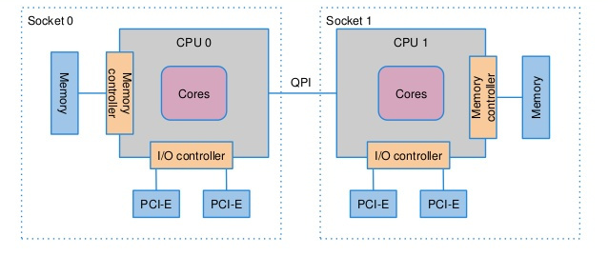
Launching parallel workloads on CPU
NUMA domains
Memory from CPU 0 and CPU 1 is ‘one memory’ from programmers point of view
Cores from CPU 0 can access memory from CPU 1, but is slower!
Dual socket: 2 tasks (data parallel) per node ≈ 20-50% faster than 1 task per node
Dual socket node

Slide 35
Launching parallel workloads on CPU
Problem:
Performance hit if process moves from CPU 0 => CPU 1 (NUMA)
Potential performance hit when multithreading across sockets (NUMA)
Cache misses if thread is moved from one core to another (any multithreading application)
Solution:
Launch 1 worker per socket
Bind (MPI) processes to sockets
Set number of threads to number of cores available per socket
Bind threads to cores

Slide 36
Launching parallel workloads
Binds threads to (hyperthreading)cores
Set nr of threads to nr of cores per socket
Example, 2-socket node, 12 cores per socket
KMP_AFFINITY="granularity=fine,compact,1,0" OMP_NUM_THREADS=12 mpirun -np 2 --map-by ppr:1:socket --bind-to socket python train.py
Tip: specify ‘--report-bindings’ to get verbose output from mpirun on how processes are mapped / bound.
Tip: specify ‘KMP_AFFINITY="granularity=fine,verbose,compact,1,0“ to get verbose output on how threads are bound
Maps one process to each socket
Binds to socket
Launches two processes

Slide 37
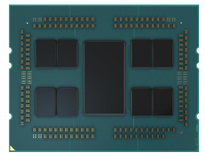
Launching parallel workloads on AMD CPUs
AMD CPUs nowadays have many numa domains, because a single CPU consists of ‘chiplets’
Use ‘lstopo’ command to see number of numa domains
Launch 1 MPI process per numa domain
8 Chiplets on an AMD ZEN3 CPU

Slide 38
Launching parallel workloads on GPU
Depends on the code!
Code designed for multi-GPU node (e.g. uses tf.device(‘/gpu:0’), tf.device(‘/gpu:1’) etc):
Launch a single process per node
Code designed for single-GPU, but parallelized with e.g. Horovod:
Typically: launch one (MPI) process per GPU

Slide 39
Recap
Goals:
Understand what hardware bottlenecks could be limiting
Understand pro’s and con’s of various hardware
Know how to choose appropriate hardware for you DL task
Know what to do to mitigate bottlenecks

