Slide 1


Introduction to high performance Machine Learning
27 / 28 June 2022
Trainers: Robert Jan Schlimbach, Bryan Cardenas Guevara, Caspar van Leeuwen

Slide 2
About PRACE
Prace: partnership for Advanced Computing in Europe
Aims to enable high-impact scientific discovery and engineering research and development across all disciplines to enhance European competitiveness for the benefit of society
26 Member countries
Missions:
Research infrastructure
HPC access
Training and Education
Mark Surveillance

Slide 3
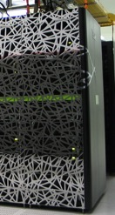
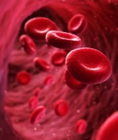

About SURF
Collaborative organization for ICT in Dutch education and research

Slide 4
Course plan until lunch
9:00 – 9:15 Welcome
9:00 – 10:00 Introduction ML & DL, basic principles
10:00 – 10:20 Introduction to PyTorch
10:20 – 11:00 Hands-on 1: fully connected network
11:00 – 11:15 Coffee break
11:15 – 11:30 Recap hands-on
11:30 – 12:30 CNN theory
12:30 – 13:30 Lunch break

Slide 5
Course plan until lunch
12:30 – 13:30 Lunch break
13:30 – 14:30 Hands-on 2: CNN
14:30 – 14:45 Recap hands-on
14:45 – 15:00 Coffee Break
15:00 – 15:45 VAE theory
15:45 – 16:30 Hands-on 3: VAE, ‘demo’ notebook
16:30 – 17:00 Questions & wrap-up day 1

Slide 6
Course plan until lunch
12:05 – 13:15 Lunch break
13:15 – 14:15 CNN theory
14:15 – 15:15 Hands-on 2: CNN
15:15 – 15:30 Coffee Break
15:30 – 15:45 Recap hands-on 2
15:45 – 16:30 VAE theory
16:30 – 17:00 Hands-on 3: VAE, ‘demo’ notebook / Questions & wrap-up day 1

Slide 7
Received logins?
If not, contact me on chat, we’ll figure it out

Slide 8
Polls!

