Slide 1



High Performance Deep Learning
16 & 17 April 2024
Trainers: Robert Jan Schlimbach, Bryan Cardenas Guevara, Monica Rotulo

Slide 2
About EuroCC & EuroHPC JU
EuroHPC JU:
joint initiative between EU, EU member states, and private partners to develop a World Class Supercomputing Ecosystem in Europe
https://eurohpc-ju.europa.eu/
EuroCC
A key program in EuroHPC JU
EuroCC acts as gateway for industry and academia to find providers with suitable HPC expertise
EuroCC facilitates HPC-skill oriented trainings

Slide 3
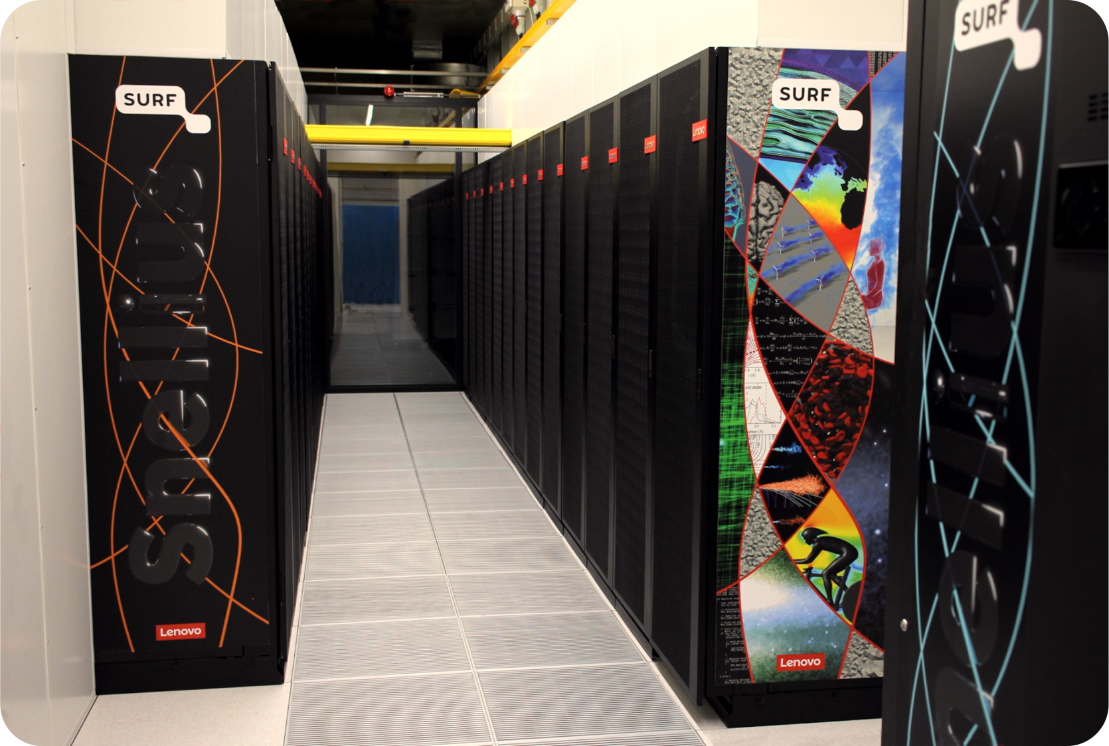
About SURF
Collaborative organization for ICT in Dutch education and research
National Competence Center in EuroCC for The Netherlands
Offers HPC services (and many others, data storage, cloud, networking, etc)

Slide 4
Course plan
Day 1:
Introduction to Deep Learning
Using the PyTorch framework
Fully connected networks, Convolutional networks, Transformers (time permitting)
Day 2:
Software installations on HPC systems
Hardware (e.g. Tensor cores) and software features (e.g. low level libraries for deep learning) to accelerated deep learning
Profiling PyTorch with TensorBoard

Slide 5
Course plan Day 1
Teacher: Bryan Cardenas Guevara
9:30 – 9:45 Welcome and course overview
9:45 – 10:30 Introduction to ML & DL basic principles
10:30 – 10:50 Introduction to PyTorch
10:50 – 11:05 Coffee break
11:05 – 12:00 Convolutional neural networks
12:00 – 13:00 Lunch Break
13:00 – 13:45 Hands-on: Convolutional neural networks
13:45 – 14:00 Recap hands-on, questions

Slide 6
Course plan Day 2
Teacher: Robert Jan Schlimbach
9:30 – 10:45 Software installations on HPC systems
10:45 – 11:00 Coffee break
11:00 – 12:00 Hardware and software features to accelerate deep learning
12:00 – 13:00 Lunch Break
13:00 – 13:45 Profiling to understand your neural network’s performance
13:45 – 14:00 Questions, wrap up

Slide 7
https://github.com/sara-nl/Tue_HPDL_2024

Slide 8
Introductions!
In 3 sentences, tell us
Your name
Your job
Why you’re attending this course

Slide 9
Logins
Access to the Dutch National Supercomputer (Snellius) for this course
Snellius Supercomputer (GPU-based Jupyter Notebook environment, GPU batch jobs)
Did you get a login ‘scurXXX’?
The e-mail contains a link to choose a password – please do so
Log in to https://portal.cua.surf.nl/ and accept the End User Agreement
Try to login at https://jupyter.snellius.surf.nl/jhssrf009
Select the ‘outside course hours’ profile, and click ‘spawn’
If not, did not receive a login, or starting a notebook server does not work: contact us on the chat, so we can resolve it during the next session.

