Slide 1



High Performance Deep Learning
5 & 6 October 2023
Trainers: Robert Jan Schlimbach, Bryan Cardenas Guevara, Monica Rotulo, Caspar van Leeuwen

Slide 2
About EuroCC & EuroHPC JU
EuroHPC JU:
joint initiative between EU, EU member states, and private partners to develop a World Class Supercomputing Ecosystem in Europe
https://eurohpc-ju.europa.eu/
EuroCC
A key program in EuroHPC JU
EuroCC acts as gateway for industry and academia to find providers with suitable HPC expertise
EuroCC facilitates HPC-skill oriented trainings

Slide 3
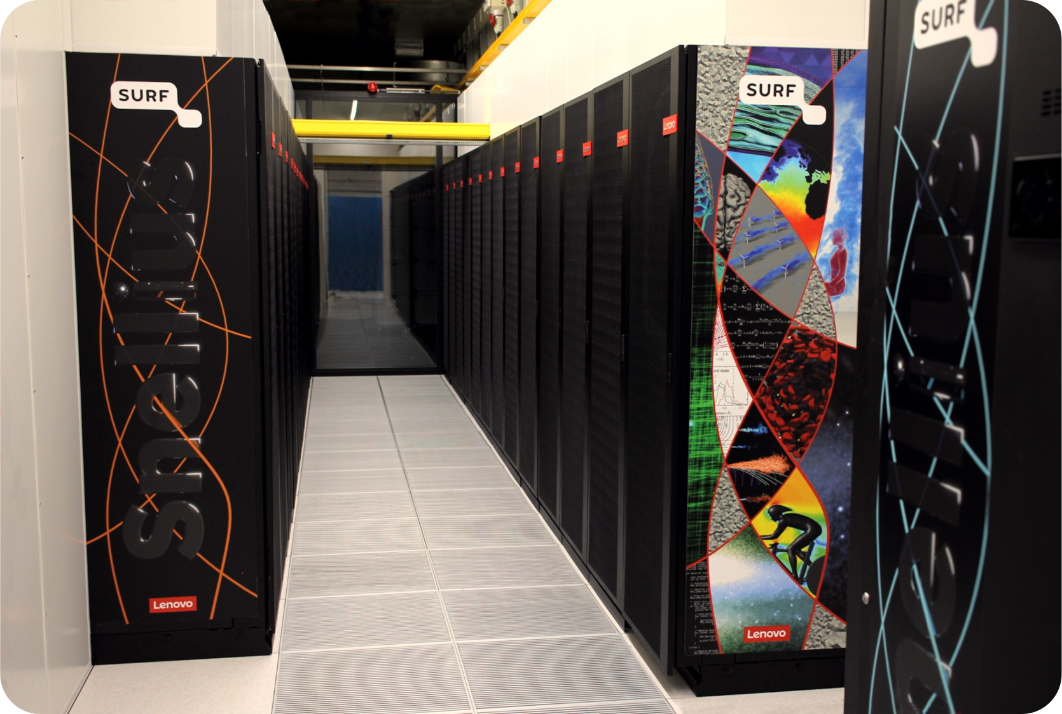
About SURF
Collaborative organization for ICT in Dutch education and research
National Competence Center in EuroCC for The Netherlands
Offers HPC services (and many others, data storage, cloud, networking, etc)

Slide 4
Course plan
Day 1:
Introduction to Deep Learning
Using the PyTorch framework
Fully connected networks, Convolutional networks, Transformers (time permitting)
Day 2:
Software installations on HPC systems
Packed file formats for Machine Learning
Parallel computing for deep learning
Hardware (e.g. Tensor cores) and software features (e.g. low level libraries for deep learning) to accelerated deep learning
Profiling PyTorch with TensorBoard

Slide 5
Course plan Day 1
9:30 – 9:45 Welcome and course overview (Caspar van Leeuwen)
9:45 – 10:30 Introduction to ML & DL basic principles (Bryan Cardenas Guevara)
10:30 – 10:50 Introduction to PyTorch (Bryan Cardenas Guevara)
10:50 – 11:05 Coffee break
11:05 – 11:45 Hands-on: Fully connected network (Robert Jan Schlimbach)
11:45 – 12:00 Recap Hands-on (Robert Jan Schlimbach)
12:00 – 13:00 Lunch Break
13:00 – 14:00 Convolutional neural networks (Bryan Cardenas Guevara)
14:00 – 14:45 Hands-on: Convolutional neural networks (Bryan Cardenas Guevara)
14:45 – 15:00 Recap hands-on (Bryan Cardenas Guevara)
15:00 – 15:15 Coffee Break
15:15 – 16:00 Self-attention / Transformers (Bryan Cardenas Guevara)
16:00 – 16:45 Hands-on / demo notebook: Transformers (Monica Rotulo)
16:45 – 17:00 Questions, wrap up

Slide 6
Course plan Day 2
9:30 – 10:45 Software installations on HPC systems (Caspar van Leeuwen)
10:45 – 11:00 Coffee break
11:00 – 11:30 Packed file formats (Caspar van Leeuwen)
11:30 – 12:15 Hands-on: Packed file formats (Monica Rotulo)
12:15 – 13:15 Lunch Break
13:15 – 14:45 Parallel Computing for Deep Learning (Caspar van Leeuwen & Monica Rotulo)
14:45 – 15:00 Coffee Break
15:00 – 15:45 Hardware and software features to accelerate deep learning (Robert Jan Schlimbach)
15:45 – 16:45 Profiling to understand your neural network’s performance (Robert Jan Schlimbach)
16:45 – 17:00 Questions, wrap up

Slide 7
https://github.com/sara-nl/MLonHPC_2day_Okt2023

Slide 8
Introductions!
In 3 sentences, tell us
Your name
Your job
Why you’re attending this course

Slide 9
Logins
Access to the Dutch National Supercomputer (Snellius) for this course
Snellius Supercomputer (GPU-based Jupyter Notebook environment, GPU batch jobs)
Did you get a login ‘scurXXX’?
The e-mail contains a link to choose a password – please do so
Log in to https://portal.cua.surf.nl/ and accept the End User Agreement
Try to login at https://jupyter.snellius.surf.nl/jhssrf004
Select the ‘outside course hours’ profile, and click ‘spawn’
If not, did not receive a login, or starting a notebook server does not work: contact me on the chat, so I can resolve it during the next session.

