Slide 1
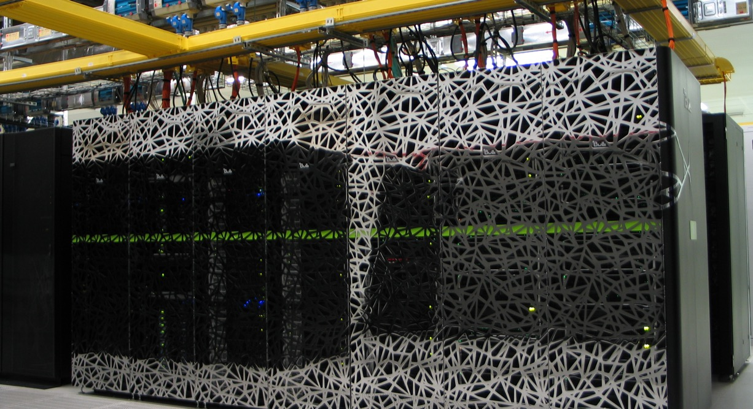
HPC filesystems & packed data formats
Caspar van Leeuwen
High Performance ML consultant
SURF

Slide 2
https://github.com/sara-nl/MLonHPC_2day_Okt2023

Slide 3
Course plan Day 2
9:30 – 10:45 Software installations on HPC systems (Caspar van Leeuwen)
10:45 – 11:00 Coffee break
11:00 – 11:30 Packed file formats (Caspar van Leeuwen)
11:30 – 12:15 Hands-on: Packed file formats (Monica Rotulo)
12:15 – 13:15 Lunch Break
13:15 – 14:45 Parallel Computing for Deep Learning (Caspar van Leeuwen & Monica Rotulo)
14:45 – 15:00 Coffee Break
15:00 – 15:45 Hardware and software features to accelerate deep learning (Robert Jan Schlimbach)
15:45 – 16:45 Profiling to understand your neural network’s performance (Robert Jan Schlimbach)
16:45 – 17:00 Questions, wrap up

Slide 4
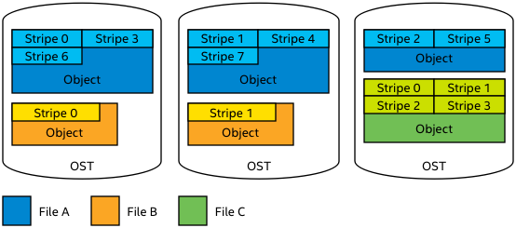
HPC file systems
HPC systems typically use parallel shared file systems.
Parallel file system: one file can be distributed over many physical disks, to increase I/O bandwidth.
https://wiki.lustre.org/

Slide 5
HPC file systems
Two main types of parallel filesystems
Lustre
Metadata (filename, size, location, etc) stored on separate server
Object Storage Target (OST) stores actual file
Striping over multiple OSTs can be managed by user
GPFS
Metadata and actual file stored on the same server
Striping is managed automatically, by file system. User has no control.

Slide 6
HPC file systems
HPC file systems are optimized for bandwidth not I/O operations per second (IOPS)
E.g. Snellius GPFS: up to 10 GB/s write, 20 GB/s read
Important when e.g. a 100 node job needs to start from the same 20 GB input file…
HPC file systems are typically not good at AI / data science workloads
AI workloads are generally: reading lots of small files / parts of a file

Slide 7
Inodes
An inode stores all information about a linux file except its name and data
File size, last change date, file permissions, etc
On most HPC systems, you’ll have an inode quota, in addition to a size quota
Like total size, each filesystem has a (fixed) maximum number of inodes
It is also a way to discourage doing to many IOPS
Seems we’ll run out of inodes before we run out of space on e.g. our home1 filesystem:
$ df -ih /gpfs/home1/
Filesystem Inodes IUsed IFree IUse% Mounted on
home1 287M 69M 218M 24% /gpfs/home1
$ df -h /gpfs/home1/
Filesystem Size Used Avail Use% Mounted on
home1 121T 26T 95T 22% /gpfs/home1

Slide 8
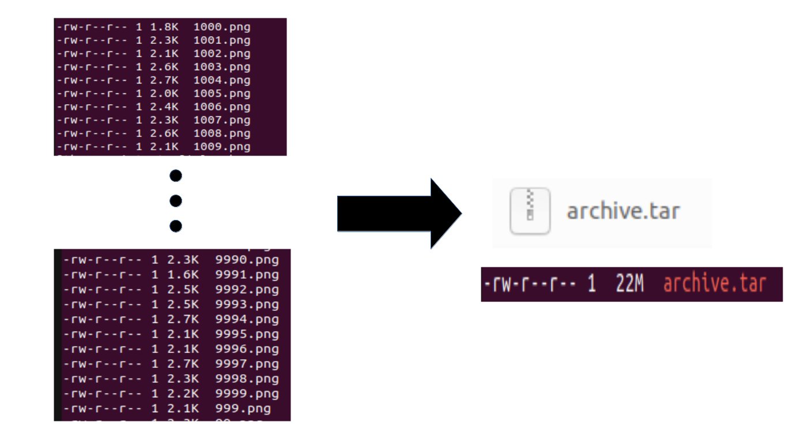
Don’t read individual files in your AI pipelines!
Suppose your dataset is 10k png files of 2k each…
Home1: 121TB, 287M inodes, so 421k per inode
If everyone does this, the filesystem will be full of inodes, with 99.5% / 120 TB (!) storage still available…
If you run 100 epochs, you’ll do 1M I/O operations
Your sysadmin won’t like you
Your fellow users won’t like you: everyone suffers slow I/O because of your job!
You shouldn’t like you: your I/O might be holding back your training performance…

Slide 9
Packed data formats
What is a ‘packed data format’?
Group multiple individual files together in a single ‘packed’/archive file

Slide 10

Packed data formats
What is a ‘packed data format’?
Group multiple individual files together in a single ‘packed’/archive file
Examples of packed data formats → ZIP, TAR, LMDB, HDF5, etc.
Does not necessarily involve compression!
Compression is possible, but often runs on single process, so slow to decompress

Slide 11
Why packed data format?
HPC systems use a shared filesystem. Packed data formats…
Reduces inode consumption
Reduces number of I/O operations/s
Reduces slowdown for yourself and other users

Slide 12
Hands-on: using and benchmarking a packed file format dataloader
See packed_data_formats.ipynb for instructions

Slide 13
Some comments about local scratch disks
Some HPC systems have local disks in the nodes
On Snellius, these can be requested by adding #SBATCH –constraint=scratch-node to your batch script
Note: about half our GPU nodes have local scratch disk. You might be in the queue longer if you request scratch-node, so only do it if you think you benefit from it
Local scratch disks can usually handle much more IOPS
Local scratch disks are shared between all users in a node
Users on the same node may still experience some effects when you ‘hammer’ local scratch with I/O, but it’s way less bad than on a shared filesystem!

Slide 14
Some comments about local scratch disks
Some HPC systems have local disks in the nodes
If you really need to use individual files instead of a packed file format, use local scratch disks
Store zip/tar on shared parallel FS.
At start of job: extract to local scratch dir (for every node, if you use multiple)
Do any further I/O from that local scratch dir

Slide 15
References
More info https://servicedesk.surf.nl/wiki/display/WIKI/Best+Practice+for+Data+Formats+in+Deep+Learning

