Slide 1
Course plan Day 2
9:30 – 10:45 Software installations on HPC systems (Caspar van Leeuwen)
10:45 – 11:00 Coffee break
11:00 – 11:30 Packed file formats (Caspar van Leeuwen)
11:30 – 12:15 Hands-on: Packed file formats (Monica Rotulo)
12:15 – 13:15 Lunch Break
13:15 – 14:45 Parallel Computing for Deep Learning (Caspar van Leeuwen & Monica Rotulo)
14:45 – 15:00 Coffee Break
15:00 – 15:45 Hardware and software features to accelerate deep learning (Robert Jan Schlimbach)
15:45 – 16:45 Profiling to understand your neural network’s performance (Robert Jan Schlimbach)
16:45 – 17:00 Questions, wrap up

Slide 2
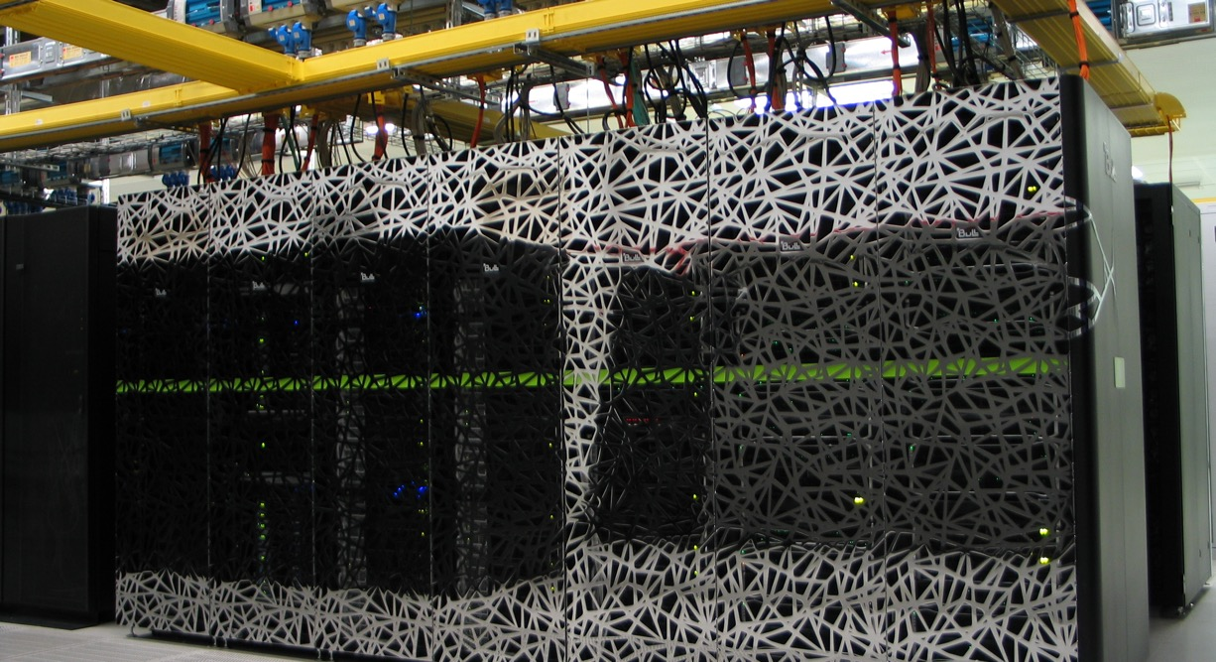
High Performance machine learning
Caspar van Leeuwen
High Performance ML consultant
SURF

Slide 3
https://github.com/sara-nl/MLonHPC_2day_Okt2023

Slide 4
Demos, hands-on
Both demos and hands-on will be done on Snellius: https://jupyter.snellius.surf.nl/jhssrf004
Demos
Throughout this presentation, I will demo a few things. You are welcome to type along, but I’ll go through these.
Hands-on: This is really an exercise meant for you, and I’ll give you time to complete it.

Slide 5
Best practices: software on HPC (1/2)
Use software from the module environment whenever you can
Build on top of the module environment when you have to
Never use system installations of Python/GNU compilers/Perl/etc
If you need additional Python packages: built a virtual environment on top of software from the module environment
Load the modules first, then create / load the virtual environment

Slide 6
Best practices: software on HPC (2/2)
Avoid using conda
But if you do, install everything with conda. Don’t combine with modules.
Expect little support from us
Use containers with care
Optimization usually ok for GPU, but may be poor for CPU
Expect little support from us
Multinode can be tricky (if MPI is used)

Slide 7
Parallel computing for Deep Learning
Content
Software terminology: libraries, binaries, linking, … what does it all mean?
Module environment: what is it, how do I use it, and why?
Python virtual environments
… and how to combine them with the module environment
Conda virtual environments
… and why we think you should avoid them on HPC systems
Containers
… and a word of warning on using them

Slide 8
Software terminology
Some knowledge on terminology is essential to understand issues with software compilations…
Compiled vs interpreted languages
Architecture and micro-architecture
What is a binary file?
What is a library?
What is linking?
What is a dependency?

Slide 9
Compiled vs interpreted languages
We program in a human-readable programming language (Python, C, Fortran, …)
For compiled languages, that human-readable code is translated to machine code (a “binary file”, i.e. ones and zeroes) prior to running it
Binary files are architecture specific. Examples of architectures are X86_64 (your typical AMD and Intel chip are of this type), aarch64 (the ARM-based chip in your phone is of this type). You can not run a program compiled for an X86_64 on an aarch64 based chip.

Slide 10
Compiled vs interpreted languages
We program in a human-readable programming language (Python, C, Fortran, …)
For compiled languages, that human-readable code is translated to machine code (a “binary file”, i.e. ones and zeroes) prior to running it
Binary files are architecture specific. Examples of architectures are X86_64 (your typical AMD and Intel chip are of this type), aarch64 (the ARM-based chip in your phone is of this type). You can not run a program compiled for an X86_64 on an aarch64 based chip.
Interpreted languages are converted to machine instructions on the fly (i.e. while running it), by an interpreter
Interpreted language is portable to other platforms, as long as the interpreter supports that platform
Compiled langauges are often more performant than interpreted languages, because the separate compilation step allows high degree of optimization by the compiler. This is somewhat mitigated by just-in-time compilers

Slide 11
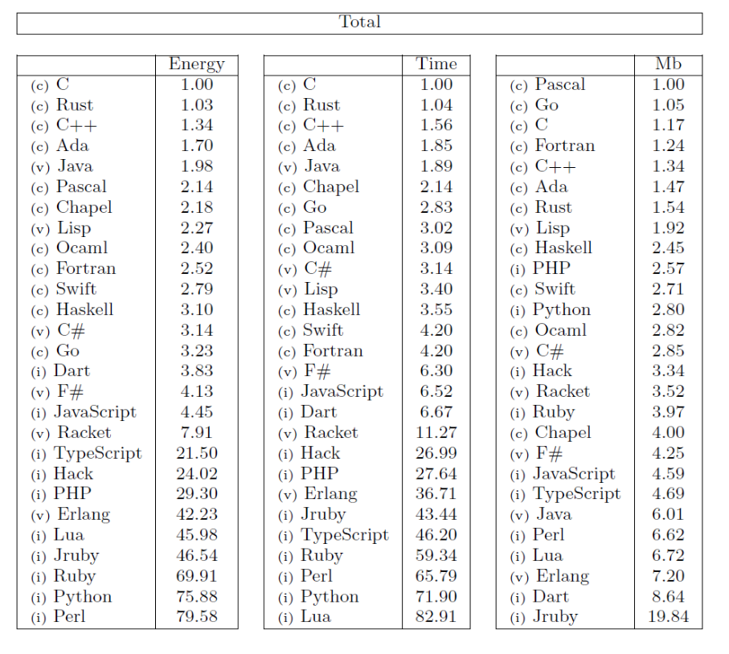
Compiled vs interpreted languages
R. Pereira et al (2017) explored the efficiency of different programming language to solve a fixed set of numerical problems
C = compiled, i = interpreted, v = virtual machine language
https://greenlab.di.uminho.pt/wp-content/uploads/2017/09/paperSLE.pdf

Slide 12
Demo: Compute the square of a number in C
#square.c
#include <stdio.h>
double square(double a) {
return a*a;
}
int main() {
double a, square_a;
printf("Enter one number: ");
scanf("%lf", &a);
// Calculating square
square_a = square(a);
// %.2lf displays number up to 2 decimal point
printf("Square = %.2lf\n", square_a);
return 0;
}
gcc –o square_binary square.c
chmod u+x square_binary
./square_binary

Slide 13
Computer architecture / Instruction Set Architecture (ISA)
Not all processors understand the same instructions
Intel & AMD produce “X86_64 processors”
Your phone contains “aarch64” (or ARM) processors.
An Instruction Set Architecture (ISA) defines things like which registers a processor has, and which operations (instructions) it can do on those registers
A binary compiled for X86_64 will not execute on an aarch64 processor. That processor simply does not support the instructions!
Analogy: Intel and AMD processors speak Dutch, while ARM processors speak English. They won’t understand eachothers instructions!
https://en.wikipedia.org/wiki/Instruction_set_architecture
https://en.wikipedia.org/wiki/X86-64
https://en.wikipedia.org/wiki/AArch64

Slide 14
Micro-architecture
All X86_64 CPUs support the same basic instructions. But they support different extensions to the instruction set:
AMD Zen2: BMI, BMI2, CLWB, F16C, FMA, FSGSBASE, AVX, AVX2, ADCX, RDSEED, MWAITX, SHA, CLZERO, AES, PCLMUL, CX16, MOVBE, MMX, SSE, SSE2, SSE3, SSE4A, SSSE3, SSE4.1, SSE4.2, ABM, XSAVEC, XSAVES, CLFLUSHOPT, POPCNT, RDPID, WBNOINVD
Icelake: MOVBE, MMX, SSE, SSE2, SSE3, SSSE3, SSE4.1, SSE4.2, POPCNT, CX16, SAHF, FXSR, AVX, XSAVE, PCLMUL, FSGSBASE, RDRND, F16C, AVX2, BMI, BMI2, LZCNT, FMA, MOVBE, HLE, RDSEED, ADCX, PREFETCHW, AES, CLFLUSHOPT, XSAVEC, XSAVES, SGX, AVX512F, AVX512VL, AVX512BW, AVX512DQ, AVX512CD, PKU, AVX512VBMI, AVX512IFMA, SHA, AVX512VNNI, GFNI, VAES, AVX512VBMI2 , VPCLMULQDQ, AVX512BITALG, RDPID, AVX512VPOPCNTDQ, PCONFIG, WBNOINVD and CLWB
Analogy: Zen2 CPUs speaks every-day Dutch, Icelake CPUs Dutch including legal jargon. They’ll understand eachother, as long as no legal-specific words are used.
https://en.wikichip.org/wiki/amd/microarchitectures/zen_2
https://en.wikichip.org/wiki/intel/microarchitectures/ice_lake_(client)

Slide 15
Optimizing for micro-architecture
We can ask the compiler to optimize for a certain micro-architecture:
gcc -march=icelake-server -o square_binary square.c
When translating the source code to machine code, the compiler may use instructions that are only supported on AMD-Zen2 chips.
./square_binary
Still works. Why? No icelake-specific instructions (i.e. no “legal jargon”) was used!

Slide 16
Optimizing for micro-architecture
What if I take a vector addition example?*
gcc -march=icelake-server -mprefer-vector-width=512 -O3 -o vectadd vectadd.c
./vectadd
Illegal instruction
This makes sense: icelake-server supports the AVX512 extension, thus, the compiler decided to generate AVX512 instructions. However, the CPU I’m running on (AMD Zen2) does not support these.
Analogy: “Legal jargon” was used, and the common Dutch person (AMD Zen2 CPU) now fails to understand the instructions
*I cheat a little bit here by specifying mprefer-vector-width to convince the compiler that I prefer 512-bit vector operations, if possible. Leaving it to the compiler, it will decide 256-bit vector operations are faster for my dummy code – and those are also support on my AMD Zen2.

Slide 17
What is a library?
A library is a reusable set of functions. Demo: we can put our ‘square’ function in a library
#square_function.c
double square(double a) {
return a*a;
}
We build the shared library:
gcc -shared square_function.c -o libsquare.so
Then, we build the binary and link against our “square” library
gcc -o square_program square_program.c -lsquare -L .

Slide 18
What is a dependency?
$ ldd square_program
linux-vdso.so.1 (0x000014f4faeb7000)
libsquare.so => not found
libc.so.6 => /lib64/libc.so.6 (0x000014f4fa8c6000)
/lib64/ld-linux-x86-64.so.2 (0x000014f4fac8c000)
As you can see, ldd now can tell us against which libraries square_program was linked (libsquare.so, among a few standard libraries).

Slide 19
What is a dependency?
$ ./square_program
./square_program: error while loading shared libraries: libsquare.so: cannot open shared object file: No such file or directory
Why? Because our linker has no idea where to find libsquare.so.
Among many others, the runtime linker searches paths specified on LD_LIBRARY_PATH for libraries used by executables. We can use that to make our runtime linker find libsquare.so:
$ LD_LIBRARY_PATH=.:$LD_LIBRARY_PATH ./square_program
Enter one number: 5
Square = 25.00

Slide 20
What is a dependency?
My square_program can only run if the libsquare.so is there to provide the square() function
libsquare.so is a dependency for square_program
For interpreted langagues (e.g. Python), there is a similar concept of dependencies if one packages uses functions from another package
E.g. PyTorch has a dependency on numpy

Slide 21
How does all this apply to AI?
“Compiled langauges are often more performant than interpreted languages, because the separate compilation step allows high degree of optimization by the compiler”
You might be a bit depressed by now… Does that mean we are doing a bad job in AI, because we typically program in Python with PyTorch or TensorFlow?

Slide 22
How does all this apply to AI?
Performance-critical python packages, such as numpy, PyTorch and TensorFlow, often use compiled backends
End-users program in Python (convenient, easy!)
When executing performance critical functions (e.g. a convolutional layer), PyTorch calls compiled functions in the backend
These functions typically come from deep-learning specific libraries, such as MKL-DNN and cuDNN

Slide 23
How does all this apply to AI?
The AI community has no idea how lucky they are compared to other HPC communities! You get the convenience of programming in Python, with the performance of compiled languages!
Does that mean nothing can go wrong? Well, it can… Let’s try to install PyTorch…

Slide 24
Attempt 1: PyTorch in a virtual environment with pip
$ module purge # Start with clean environment, I’ll get back to what modules are…
$ virtualenv my_pytorch_venv
$ source my_pytorch_venv/bin/activate
$ pip3 install torch torchvision torchaudio --index-url https://download.pytorch.org/whl/cu117 (instruction from https://pytorch.org/get-started/locally/)
Looking in indexes: https://download.pytorch.org/whl/cu117
ERROR: Could not find a version that satisfies the requirement torch (from versions: none)
ERROR: No matching distribution found for torch
Why? Well, our system python is old (3.6)! It is not meant to be used by users – none of the system tools are. Same applies to C compilers, Perl, etc, etc.

Slide 25
Module environment
HPC systems are shared between many users, with different needs. How to offer several versions of the same software?
Module environment
Let’s look what modules we have: module av
We build a module environment every year. Latest on is 2022. Let’s load it: module load 2022
Check the modules again: module av
What Python modules do we have? module av Python
Let’s have a look at one: module show Python/3.10.4-GCCcore-11.3.0
Modules set environment variables like PATH, LD_LIBRARY_PATH, etc. These are used by the Linux OS to find binaries, libaries, etc

Slide 26
How does e.g. PATH work?
$ which python3
/bin/python3
$ module av
$ module load 2022
$ module load Python/3.10.4-GCCcore-11.3.0
$ which python3
/sw/arch/RHEL8/EB_production/2022/software/Python/3.10.4-GCCcore-11.3.0/bin/python3
echo $PATH
/sw/arch/RHEL8/EB_production/2022/software/Python/3.10.4-GCCcore-11.3.0/bin:/sw/arch/RHEL8/EB_production/2022/software/OpenSSL/1.1/bin:…:/home/scur0006/.local/bin:/home/scur0006/bin:/gpfs/admin/hpc/sw/hpc/bin:/gpfs/admin/hpc/sw/hpc/sbin:/projects/0/jhssrf001/JHS_installations/Python/bin:/sbin:/bin:/usr/sbin:/usr/bin
The OS finds the python3 from the module environment because PATH includes the directory in which python3 is located

Slide 27
Attempt 2: PyTorch in a virtual environment with pip
# We don’t want it to pick up PYTHON packages from our course environmen for this demo
unset PYTHONPATH
source my_pytorch_venv/bin/activate
pip3 install torch torchvision torchaudio --index-url https://download.pytorch.org/whl/cu117 (instruction from https://pytorch.org/get-started/locally/)
Python
>>> import torch
>>> torch.__file__
'/gpfs/home4/casparl/Courses/pip_pytorch/my_pytorch_venv/lib/python3.10/site-packages/torch/__init__.py'
>>> torch.cuda.is_available()
True
>>> torch.backends.cudnn.version()
8500
>>> torch.backends.cudnn.enabled
True
Ok, cool, GPU support just works with PyTorch. It is not always that easy though…
BONUS QUESTION: where does torch find the CUDA installation?

Slide 28
Tensorflow in a virtual environment with pip
$ virtualenv my_tf_venv
$ source my_tf_venv/bin/activate
$ python3 -m pip install nvidia-cudnn-cu11==8.6.0.163 tensorflow==2.12.* (instructions from https://www.tensorflow.org/install/pip)
$ python3 -c "import tensorflow as tf; print(tf.config.list_physical_devices('GPU'))"
2023-05-12 15:49:48.115916: I tensorflow/tsl/cuda/cudart_stub.cc:28] Could not find cuda drivers on your machine, GPU will not be used.
2023-05-12 15:49:48.222125: I tensorflow/tsl/cuda/cudart_stub.cc:28] Could not find cuda drivers on your machine, GPU will not be used.
2023-05-12 15:49:48.222644: I tensorflow/core/platform/cpu_feature_guard.cc:182] This TensorFlow binary is optimized to use available CPU instructions in performance-critical operations.
To enable the following instructions: AVX2 AVX512F FMA, in other operations, rebuild TensorFlow with the appropriate compiler flags.
2023-05-12 15:49:49.932425: W tensorflow/compiler/tf2tensorrt/utils/py_utils.cc:38] TF-TRT Warning: Could not find TensorRT
2023-05-12 15:49:52.152843: W tensorflow/core/common_runtime/gpu/gpu_device.cc:1956] Cannot dlopen some GPU libraries. Please make sure the missing libraries mentioned above are installed properly if you would like to use GPU. Follow the guide at https://www.tensorflow.org/install/gpu for how to download and setup the required libraries for your platform.
Skipping registering GPU devices...
[]

Slide 29
Tensorflow in a virtual environment with pip
$ python3 -c "import tensorflow as tf; print(tf.config.list_physical_devices('GPU'))"
2023-05-12 15:49:48.222125: I tensorflow/tsl/cuda/cudart_stub.cc:28] Could not find cuda drivers on your machine, GPU will not be used.
…
2023-05-12 15:49:52.152843: W tensorflow/core/common_runtime/gpu/gpu_device.cc:1956] Cannot dlopen some GPU libraries. Please make sure the missing libraries mentioned above are installed properly if you would like to use GPU. Follow the guide at https://www.tensorflow.org/install/gpu for how to download and setup the required libraries for your platform.
Skipping registering GPU devices...
[]
This TensorFlow installation is not using the GPUs! You wouldn’t believe how many users don’t read these warnings. They allocate (very) expensive GPUs, and then don’t use them… Please make us happy, don’t do this! ☺

Slide 30
Tensorflow in a virtual environment with pip
$ python3 -c "import tensorflow as tf; print(tf.config.list_physical_devices('GPU'))"
…
2023-05-12 15:49:48.222644: I tensorflow/core/platform/cpu_feature_guard.cc:182] This TensorFlow binary is optimized to use available CPU instructions in performance-critical operations.
To enable the following instructions: AVX2 AVX512F FMA, in other operations, rebuild TensorFlow with the appropriate compiler flags.
…
[]
This TensorFlow itself is build without modern extensions to the X86_64 instruction set (AVX2, AVX512 and FMA). This problem is somewhat mitigated by the fact that for performance critical functions, TensorFlow uses low level CPU libraries that are optimized (we will get back to this later today).

Slide 31
Tensorflow in a virtual environment with pip
Why does this happen?
The TensorFlow library (a binary!) is built against a certain version of CUDA
CUDA is a dependency for TensorFlow
Pip installs python dependencies automatically. But it can not do the same for non-python dependencies: you need to provide those yourself!
https://www.tensorflow.org/install/source#tested_build_configurations shows which CUDA/cuDNN versions are used by which TF versions

Slide 32
Tensorflow in a virtual environment with pip
So, what if supply the necessary cuDNN (version 8.6) and CUDA (version 11.8) at runtime?
$ module load cuDNN/8.6.0.163-CUDA-11.8.0
$ python3 -c "import tensorflow as tf; print(tf.config.list_physical_devices('GPU’))”
2023-05-12 16:00:34.191403: I tensorflow/core/platform/cpu_feature_guard.cc:182] This TensorFlow binary is optimized to use available CPU instructions in performance-critical operations.
To enable the following instructions: AVX2 AVX512F FMA, in other operations, rebuild TensorFlow with the appropriate compiler flags.
2023-05-12 16:00:35.657146: W tensorflow/compiler/tf2tensorrt/utils/py_utils.cc:38] TF-TRT Warning: Could not find TensorRT
[PhysicalDevice(name='/physical_device:GPU:0', device_type='GPU')]
Yes, TensorFlow now sees the GPU in my node!

Slide 33
So, what did we just do…?
We installed TensorFlow and PyTorch from their wheels. That means we are doing a binary installation. Essentially, we are just copying already compiled executables (+ python scripts) and libraries to our system.
That means we have no control over
compiler optimization flags
which versions are used for dependencies
Thus, we need to make sure the program can find the right dependencies at runtime that were used at compile time by the TensorFlow team…

Slide 34
Doing software installation myself is complicated!
Yes it is! For good performance, you need to make sure
you’re software is optimized for the capabilities of your hardware
all the dependencies your software needs are present (and found!)
Your software is using the hardware you expect, and is giving the performance you expect (is really using the GPUs?)
What we should have done…
Module load 2022
Module load PyTorch/1.12.0-foss-2022a-CUDA-11.7.0
python3 -c "import torch; print(torch.__file__)"

Slide 35
Module environment
Why using software from the module environment is a good idea
Convenient!
All dependencies are provided by our module environment
Optimized for our specific hardware
Difference is most pronounced for CPU-based codes. CUDA binaries are typically (but not always!) optimized for a wide range of GPU models
One software stack to debug in case of problems (easier to debug then when users each have their own software installations!)
Many users use the same installation => bigger chance of spotting problems. Only have to solve them once, and they’ll be solved for everyone.
Less duplication (save disk space, reduce amount of files)

Slide 36
Reasons to still install your own…
Module environment does not provide my software at all
Module environment does provide my software, but not the version I want

Slide 37
Combining virtual environment with modules
What do you do if you need additional Python packages?
Load whatever you can/want to use from the module environment
Create a virtual environment with virtualenv
Activate the virtual environment, and pip-install your additional package

Slide 38
Exercise: install PyTorch Lightning on top of the PyTorch module
We’ll use this installation later today!
On Snellius, log in to the JupyterHub at https://jupyter.snellius.surf.nl/jhssrf001
Click ‘New’ => Terminal
Clear the module environment (we have some loaded by default in the Jupyter environment) using module purge
Load the 2022 environment module (module load …)
Load the PyTorch/1.12.0-foss-2022a-CUDA-11.7.0 module
Load the torchvision/0.13.1-foss-2022a-CUDA-11.7.0 module
Create a virtual environment with virtualenv --system-site-packages ~/my_pt_lightning
Activate the virtual environment (source ~/my_pt_lightning/bin/activate)
Pip install pytorch-lightning
As a check, run python -c "import pytorch_lightning as pt; print(pt.__file__)"

Slide 39
More on the module environment
See https://servicedesk.surf.nl/wiki/display/WIKI/Environment+Modules
module avail / module av: show what modules can be loaded
module spider <modulename>: show what modules can be loaded after other modules (e.g. 2022) are loaded first
module load <modulename>: load a module
module display / module show <modulename>: prints the lua script that a ‘module load’ will execute
module unload <modulename>: unload a module
module list: show currently loaded modules
module purge: unload all modules

Slide 40
Requests for additional modules
See our module policy at https://servicedesk.surf.nl/wiki/display/WIKI/Software+policy+Snellius+and+Lisa

Slide 41
Why is conda used so much?
Anaconda is used widely accross scientific domains. Why?
Python virtual environments is limited to managing Python packages. Conda also manages non-Python installations (e.g. CUDA)
This leads to better reproducibility and less issues with missing libraries, particularly for novice users
Many instructions for software installation reference conda
Conda does proper dependency resolution (pip doesn’t) to figure out if all packages in an environment are compatible.
If package A is used as dependency by packages B and C, and those package have version requirements A < 2.0 and A > 2.5, conda will simply error out and tell you it’s impossible to satisfy both requirements. Pip will install A < 2.0 and then overwrite with A > 2.5.

Slide 42
Conda
So, why is conda bad on HPC systems?
Conda uses generically optimized binaries => (potentially) bad for performance
Conda makes incorrect assumption about the location of system libraries => Still issues at runtime
Conda virtual environments produce enormous amounts of files, easily half your file quotum on an HPC system
Many small files are hard to handle for HPC file systems, we’ll get back to this
Conda on LUMI (largest EU system) is only allowed in a container… https://docs.lumi-supercomputer.eu/software/installing/container-wrapper/
Conda modifies the .bashrc file, which can easily cause conflicts or uninteded effects
Conda environments are hard to support
Each conda environment is a full software stack. Each user might have multiple conda environments (i.e. multiple complete stacks). We simply cannot support all of those
See e.g. https://docs.alliancecan.ca/wiki/Anaconda/en

Slide 43
Containers…
https://docs.alliancecan.ca/wiki/Singularity
Containers are ok-ish on HPC systems. Some remarks
Containers are nice for HPC file systems, since they save file I/O
Containers generally have generically optimized binaries, so same performance issues apply as to conda / any binary install (Nvidia GPU performance ok, CPU may or may not be ok)
Like conda, it is a software stack on its own. We can’t help debug.
Very static software environments, hard to add one package => Container rebuild needed
Need to pull in full container to use one small script
Multinode use with MPI applications can be difficult

Slide 44
Why is performance so important on an HPC system?
Questions:
How much power do you think Snellius draws?
How much money do you think Snellius costs?
With more performance we can
Do the same science, for less money / energy
Do more science

Slide 45
Best practices: software on HPC (1/2)
Use software from the module environment whenever you can
Build on top of the module environment when you have to
Never use system installations of Python/GNU compilers/Perl/etc
If you need additional Python packages: built a virtual environment on top of software from the module environment
Load the modules first, then create / load the virtual environment

Slide 46
Best practices: software on HPC (2/2)
Avoid using conda
But if you do, install everything with conda. Don’t combine with modules.
Expect little support from us
Use containers with care
Optimization usually ok for GPU, but may be poor for CPU
Expect little support from us
Multinode can be tricky (if MPI is used)

