Slide 1
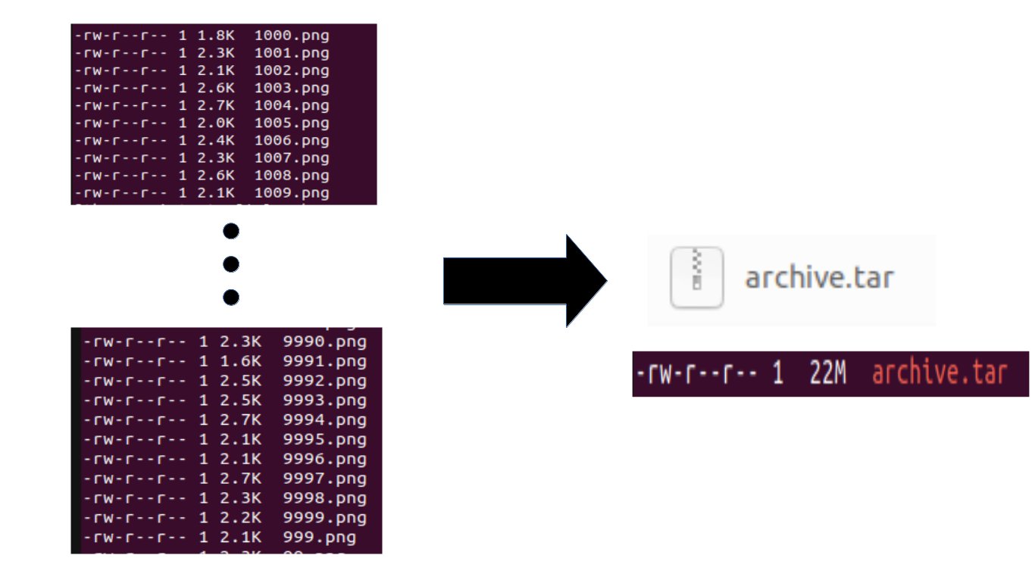

Packed data formats
What is a ‘packed data format’
Group multiple individual files together in a single ‘packed’/archive file

Slide 2
Packed data formats
What is a ‘packed data format’
Group multiple individual files together in a single ‘packed’/archive file
Examples of packed data formats → ZIP, TAR, LMDB, HDF5, etc.
Does not necessarily involve compression!
Compression is possible but often runs on single process so slow to decompress

Slide 3
Why packed data format?
Recall: Snellius (and other supercomputers) use a shared filesystem
Filesystem has limited inodes (structure that holds meta information on a file)
More files → more inodes
Less free space/inodes impacts the speed of the filesystem!
Shared file system, so you may impact others and vice versa
Affects your own data loading pipeline too! → PyTorch hands-on

Slide 4
Extras for packed data formats
Github for custom ZIP/TAR/HDF5/LMDB datasets and benchmark
https://github.com/sara-nl/Packed-Data-Formats
Wiki on benchmark and results for various packed data formats + tips
https://servicedesk.surf.nl/wiki/display/WIKI/Best+Practice+for+Data+Formats+in+Deep+Learning

