Slide 1

Energy Aware Simulations
Benjamin Czaja
HPC Advisor SURF
April 2024

Slide 2
https://ondemand.snellius.surf.nl/

Slide 3
https://github.com/sara-nl/energy-efficient-computing

Slide 4

Energy-aware focus
Dynamic Optimization of Applications
Application Monitoring
Performance
Power usage
3
2
1
System/Architecture
System Monitoring
Energy Accounting

Slide 5
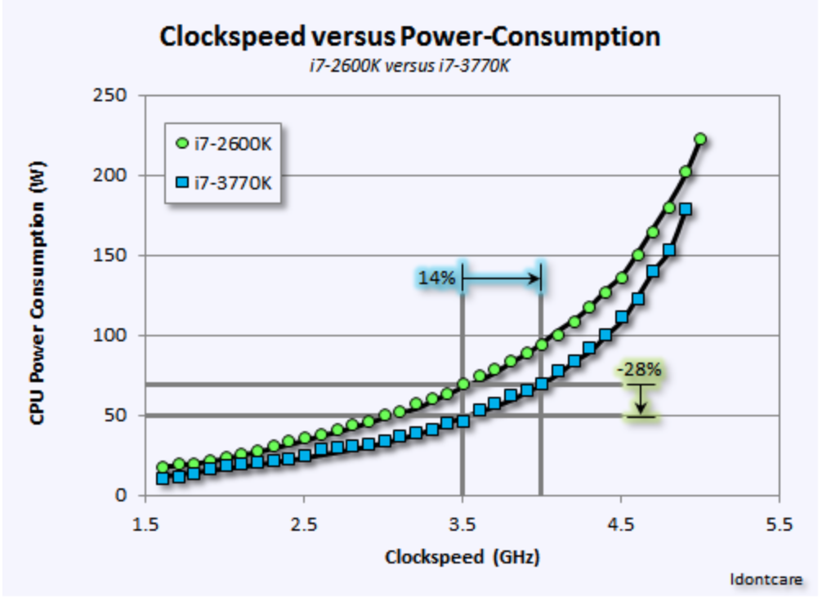
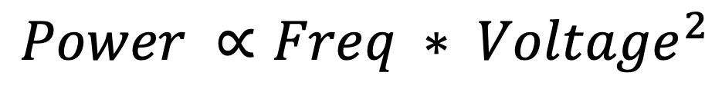
Power scales with CPU Frequency
$$Power ∝Freq {∗ Voltage}^{2}$$
Image credit: “Idontcare” forum member of https://www.anandtech.com

Slide 6
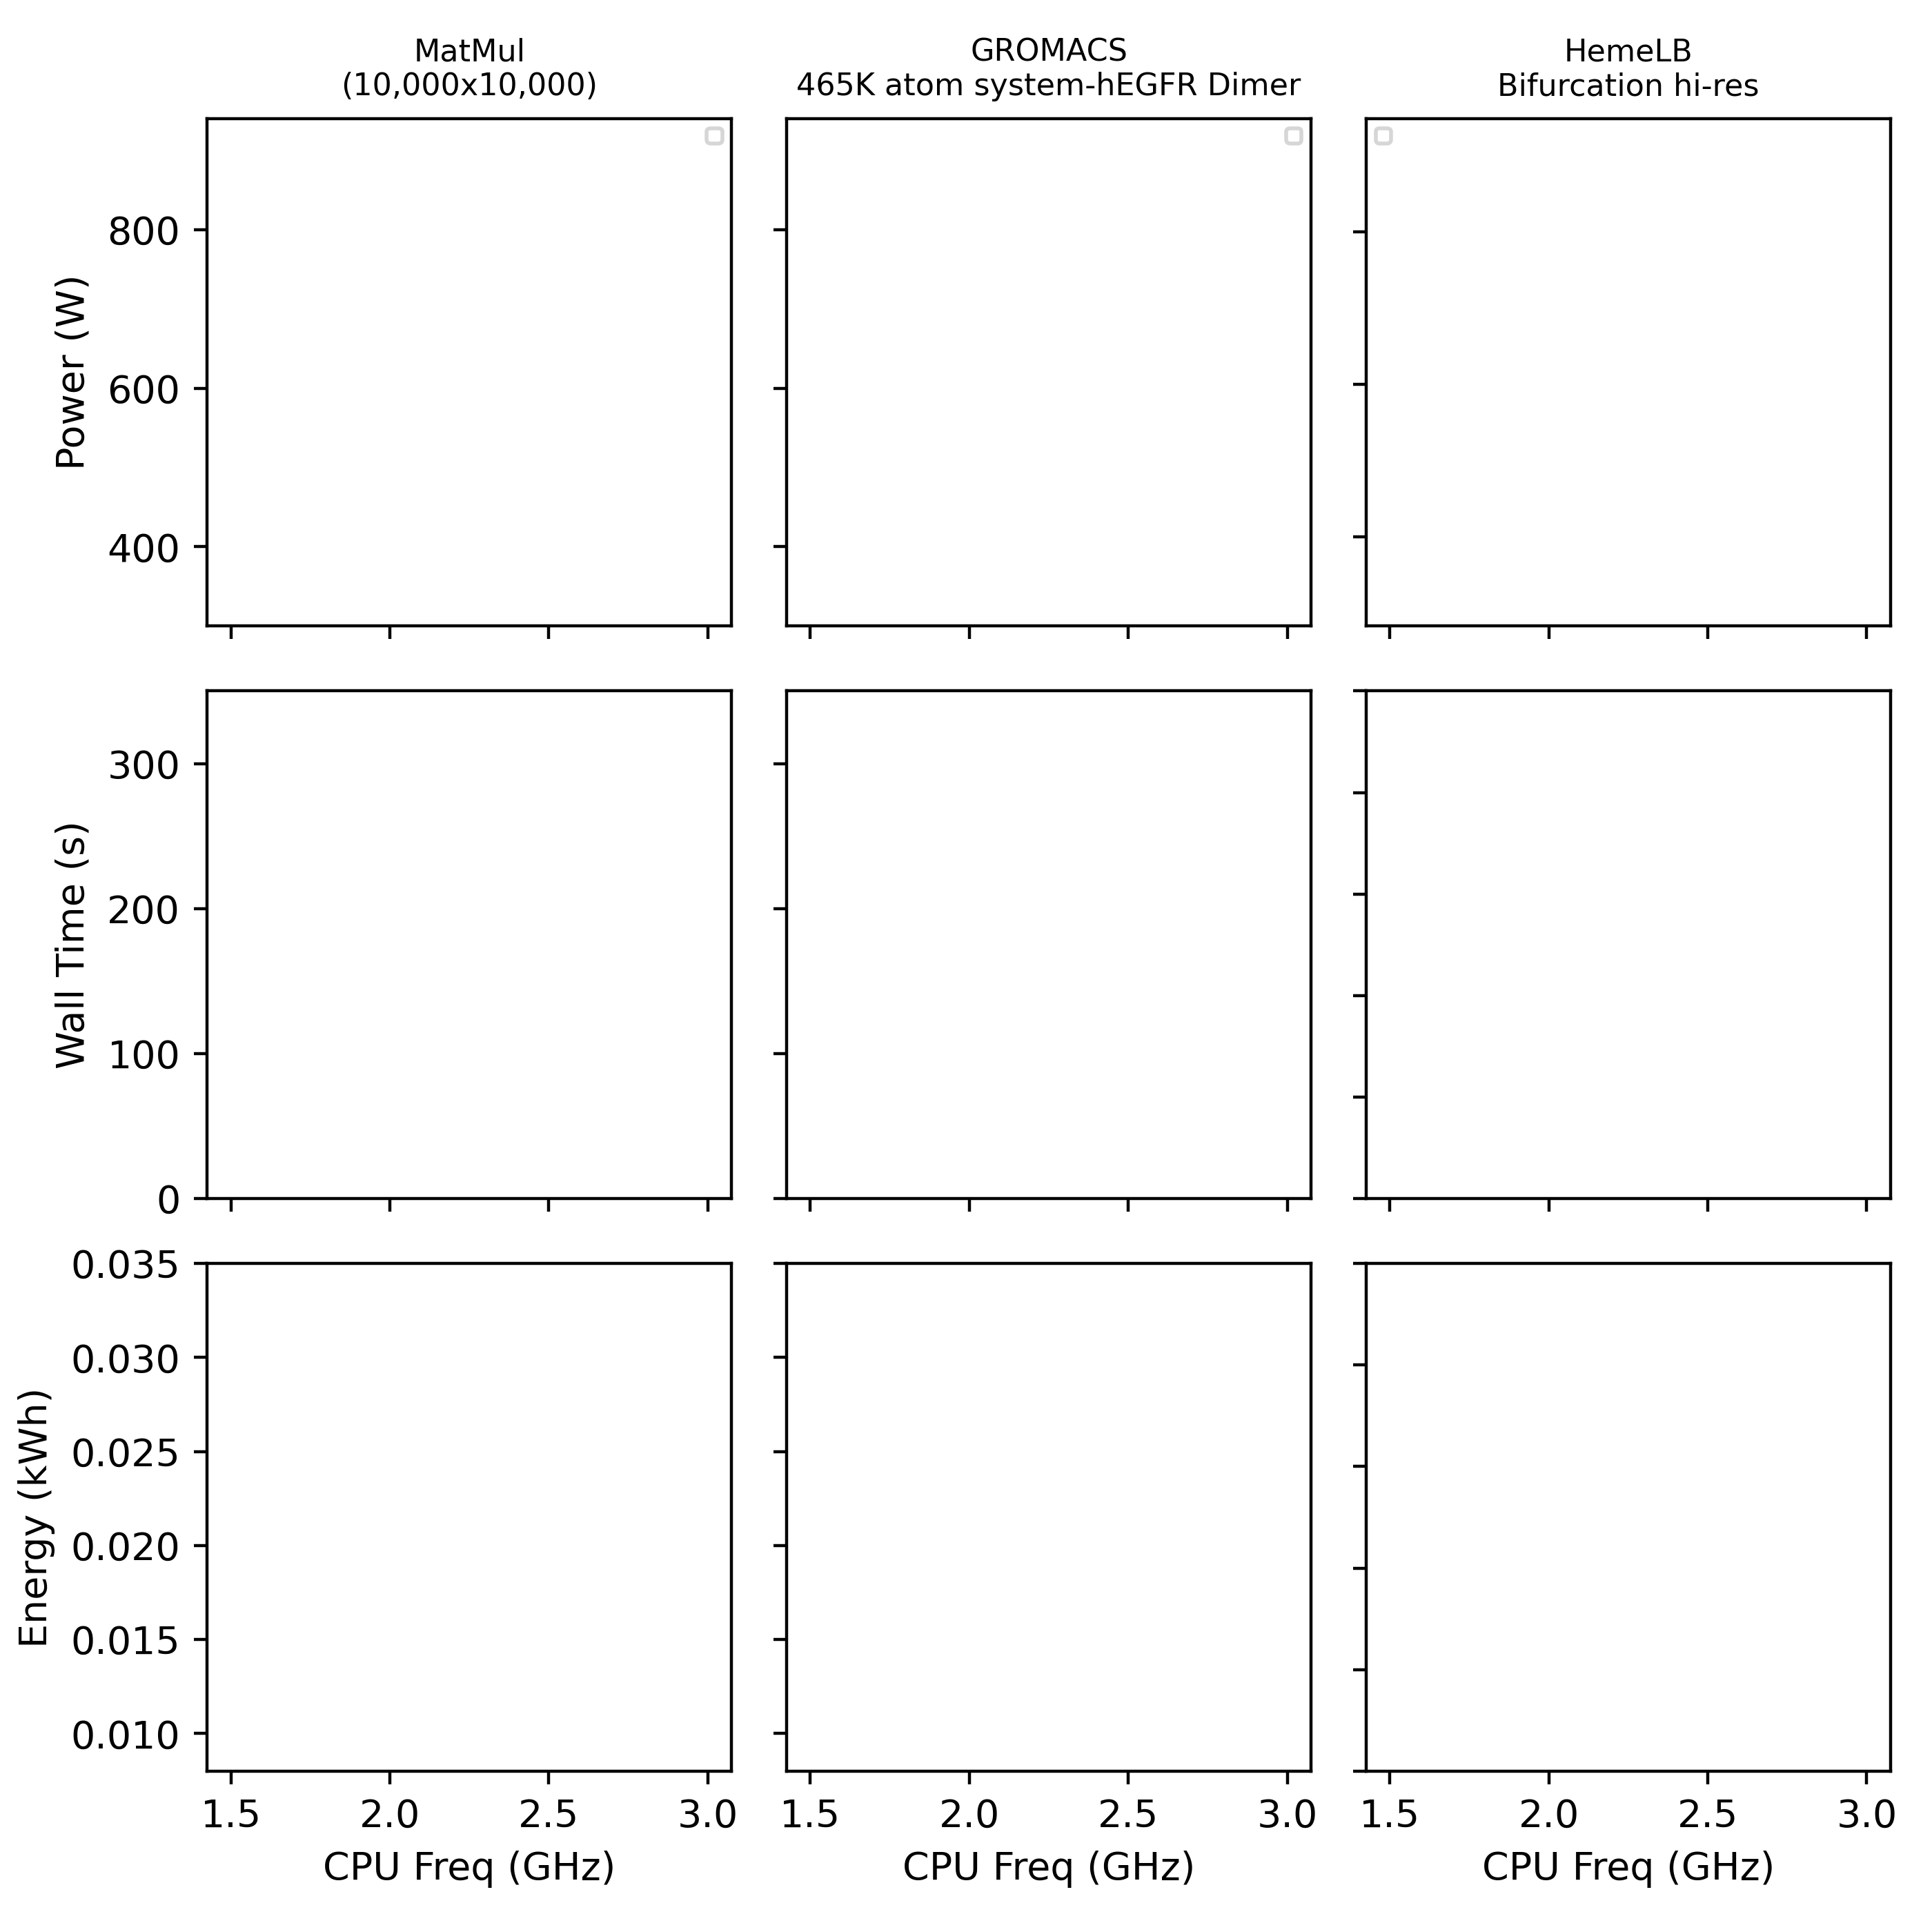
Dynamic Voltage Frequency Scaling on Snellius: To boost, or not too boost, that is the question
Rome “Zen2” Released 07 August 7 2019
Nominal Freq (2.6 Ghz)
Genoa “Zen4” Released 10 November 2022
Nominal Freq (2.4 Ghz)

Slide 7
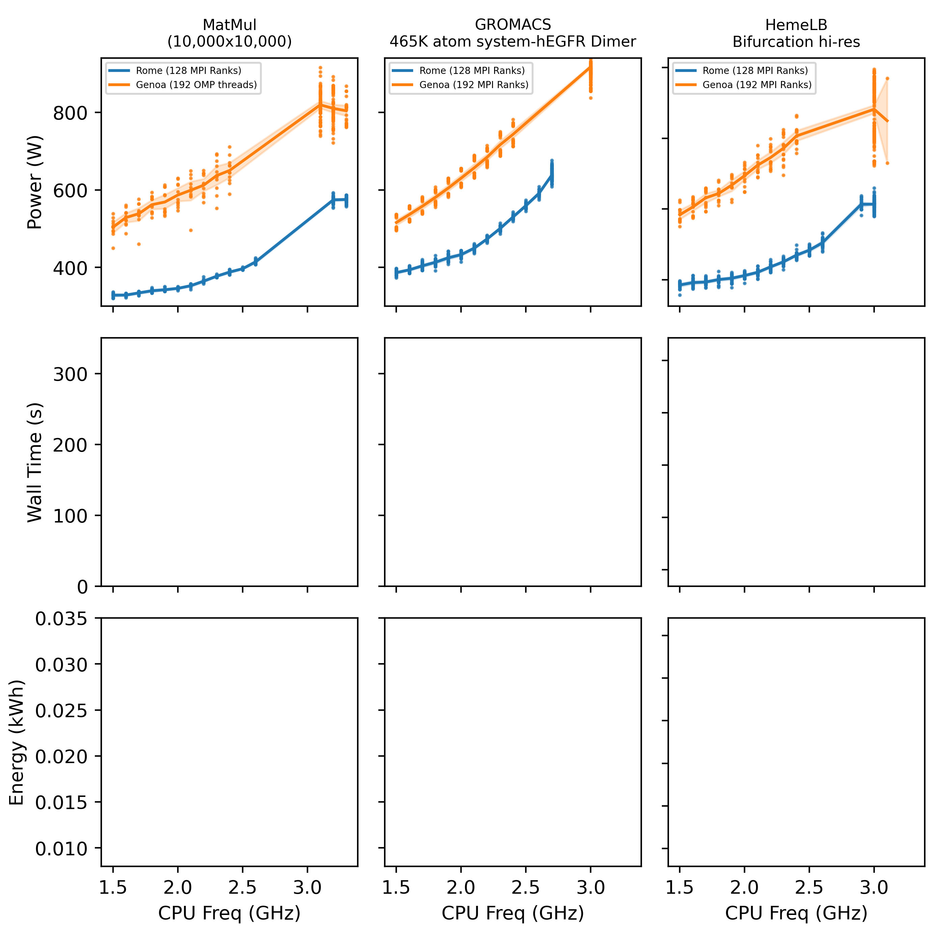
Dynamic Voltage Frequency Scaling on Snellius: To boost, or not too boost, that is the question
Rome “Zen2” Released 07 August 7 2019
Nominal Freq (2.6 Ghz)
Genoa “Zen4” Released 10 November 2022
Nominal Freq (2.4 Ghz)
Observations:
Genoa draws more power
Each application has a different “power draw signature”

Slide 8
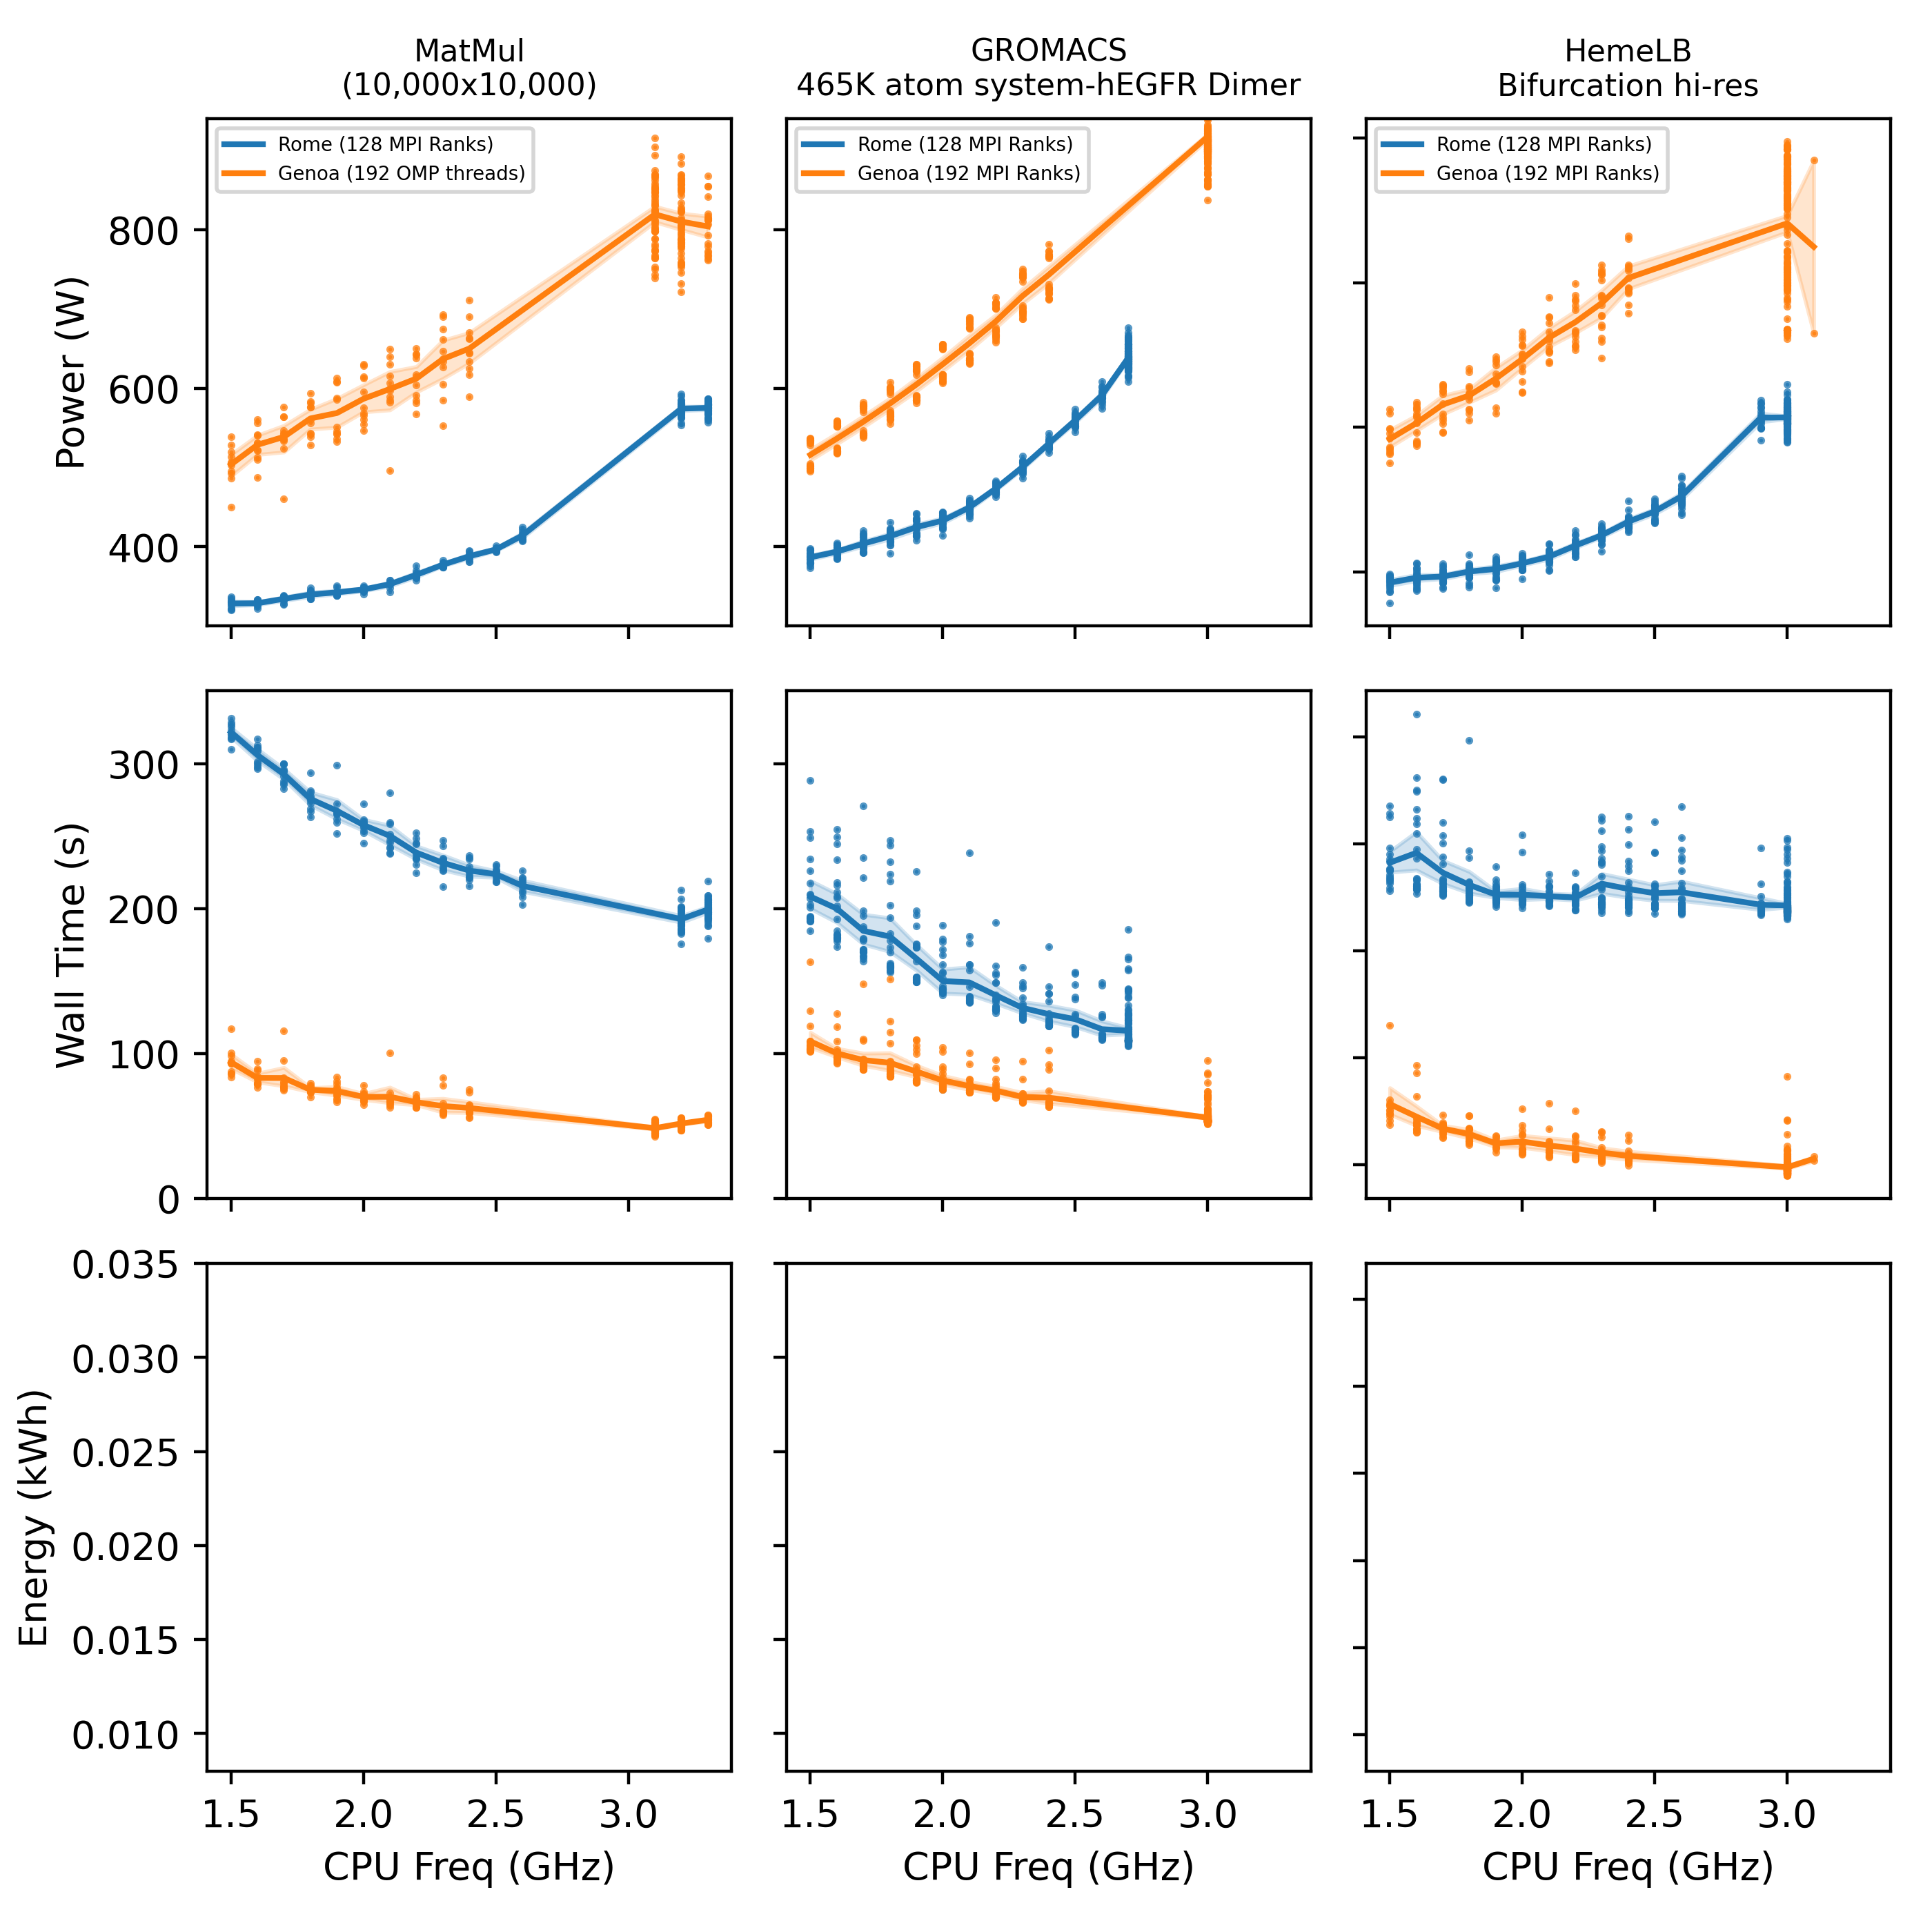
Dynamic Voltage Frequency Scaling on Snellius: To boost, or not too boost, that is the question
Rome “Zen2” Released 07 August 7 2019
Nominal Freq (2.6 Ghz)
Genoa “Zen4” Released 10 November 2022
Nominal Freq (2.4 Ghz)
Observations:
Genoa is more performant
More Logical cores to devote to problem
In the 3 cases, Boost does not have the similar effect in performance vs power draw. i.e. its performance increase is flat as compared to its power draw

Slide 9
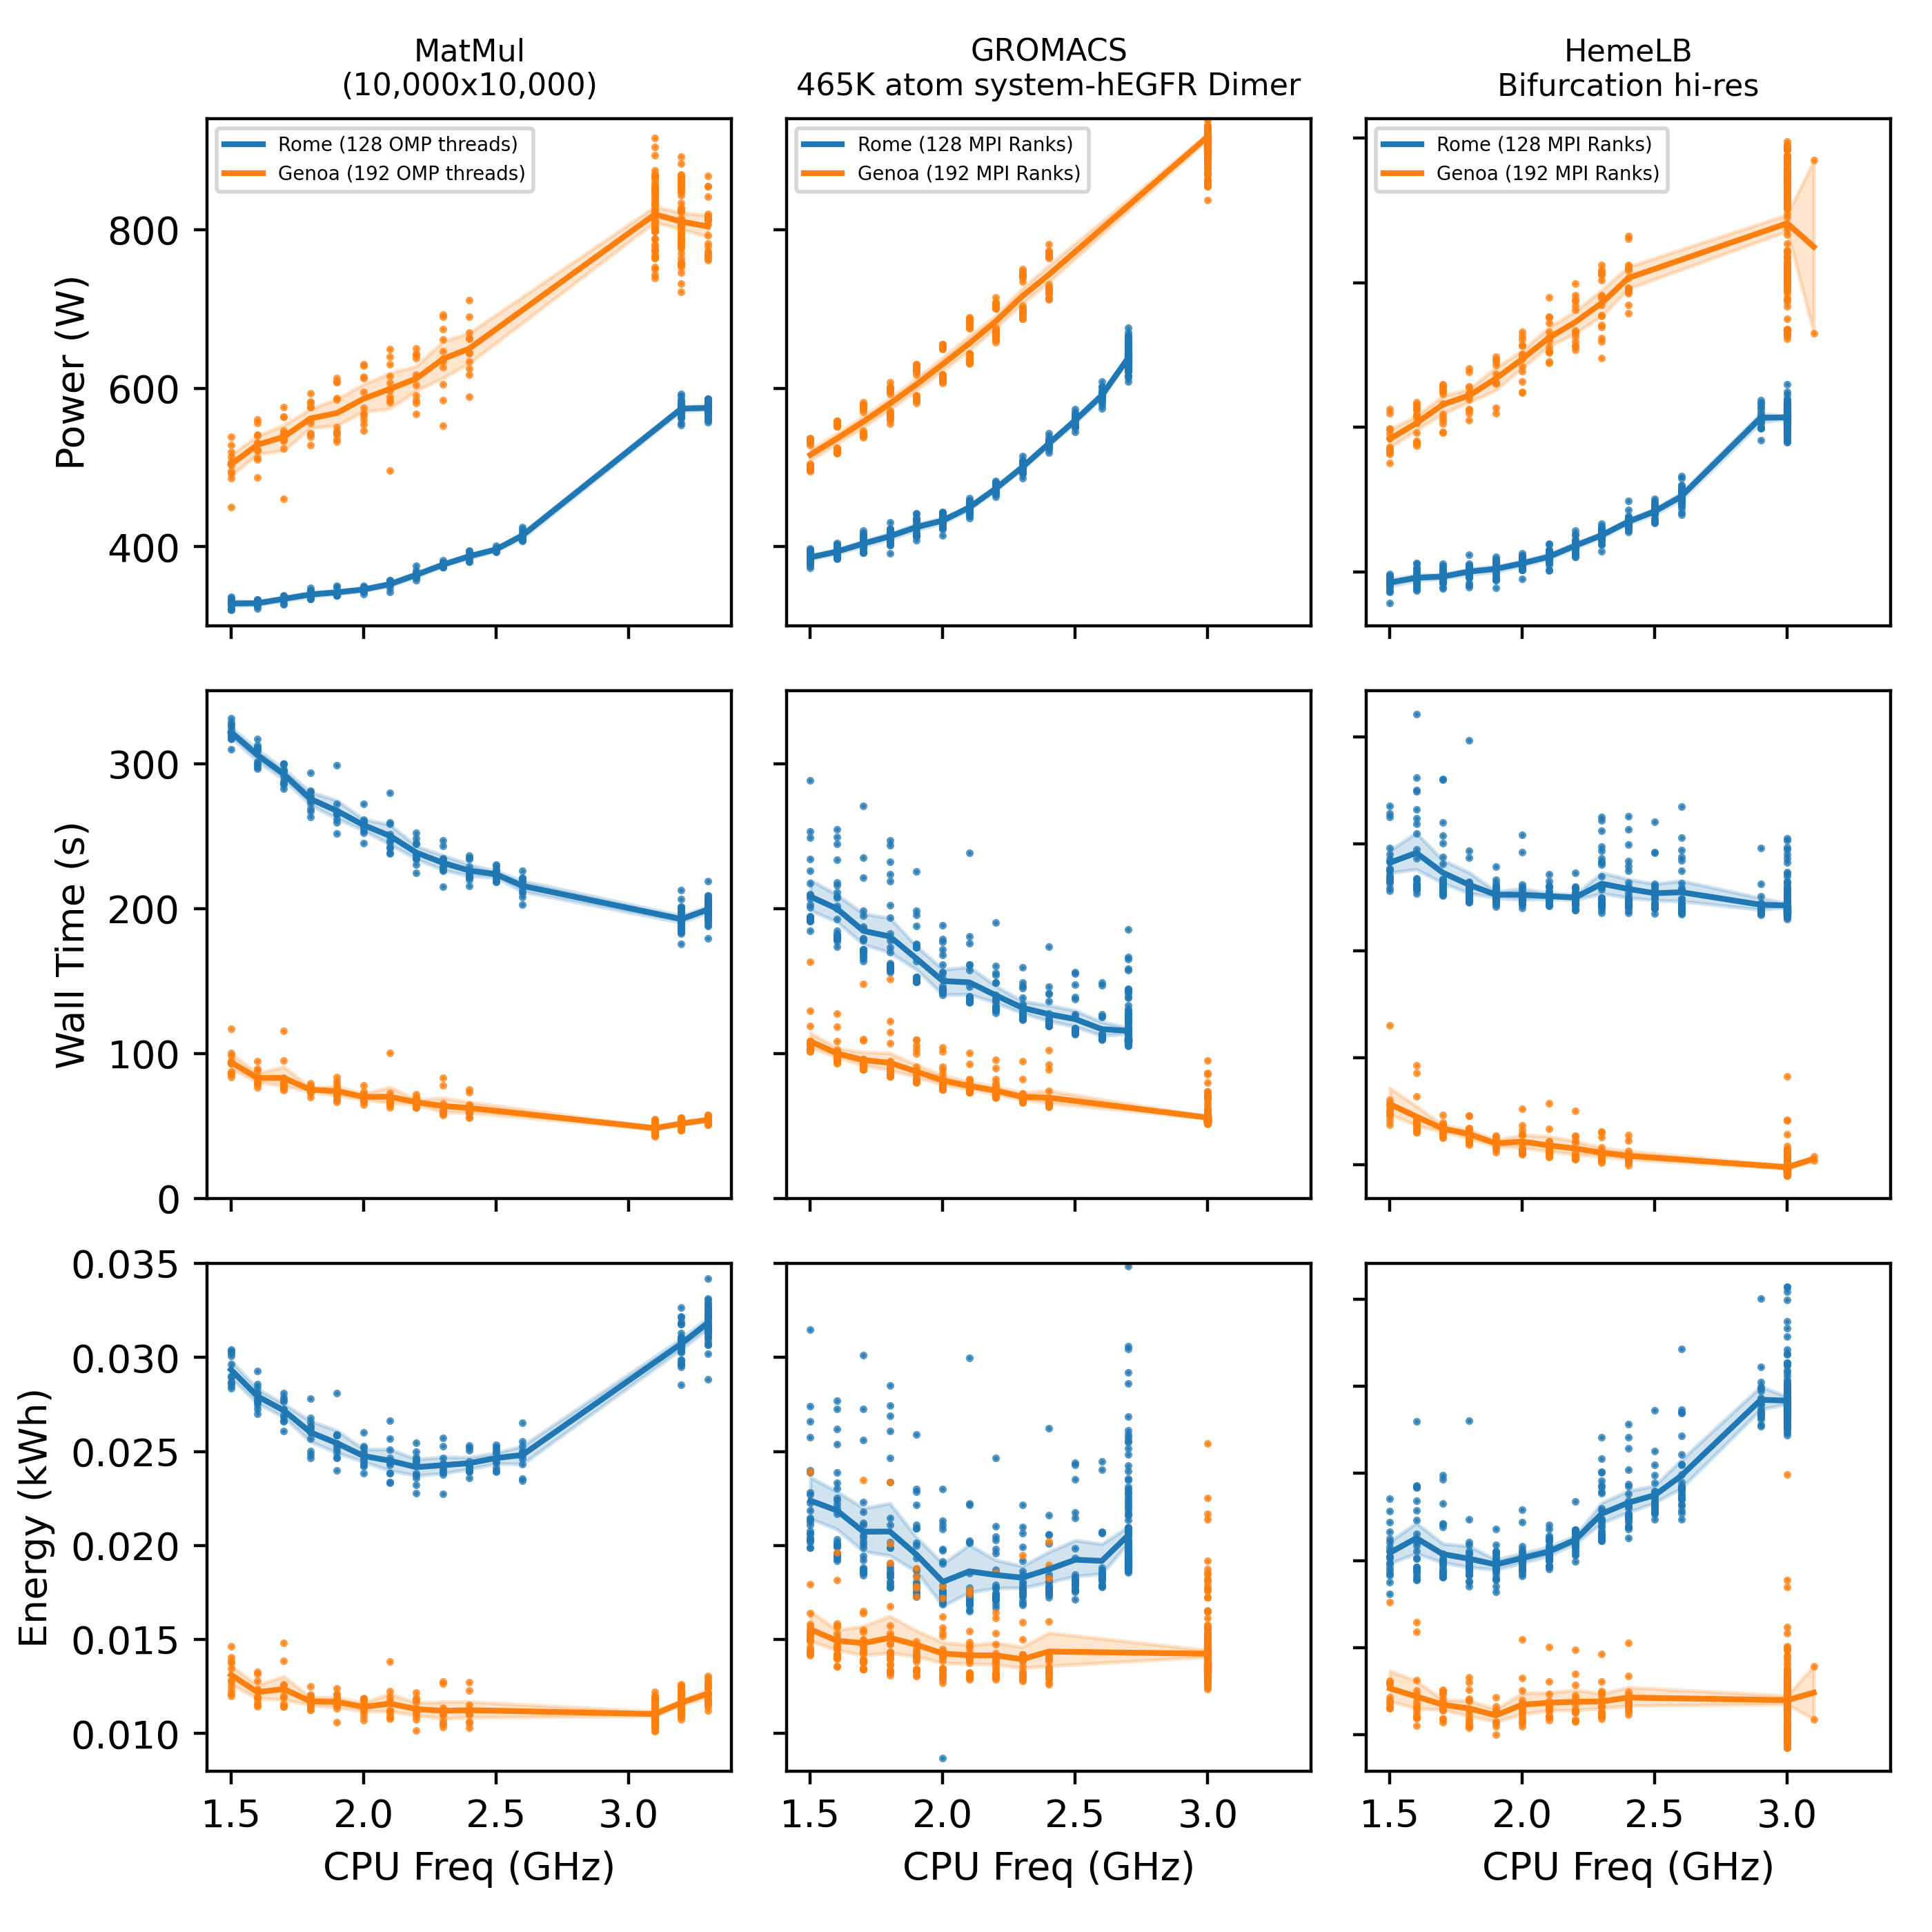
Dynamic Voltage Frequency Scaling on Snellius: To boost, or not too boost, that is the question
Rome “Zen2” Released 07 August 7 2019
Nominal Freq (2.6 Ghz)
Genoa “Zen4” Released 10 November 2022
Nominal Freq (2.4 Ghz)
Observations:
Genoa is more energy efficient.
Each application has its own energy minimum.
DVFS “by hand” is HARD!!!!!!!

Slide 10
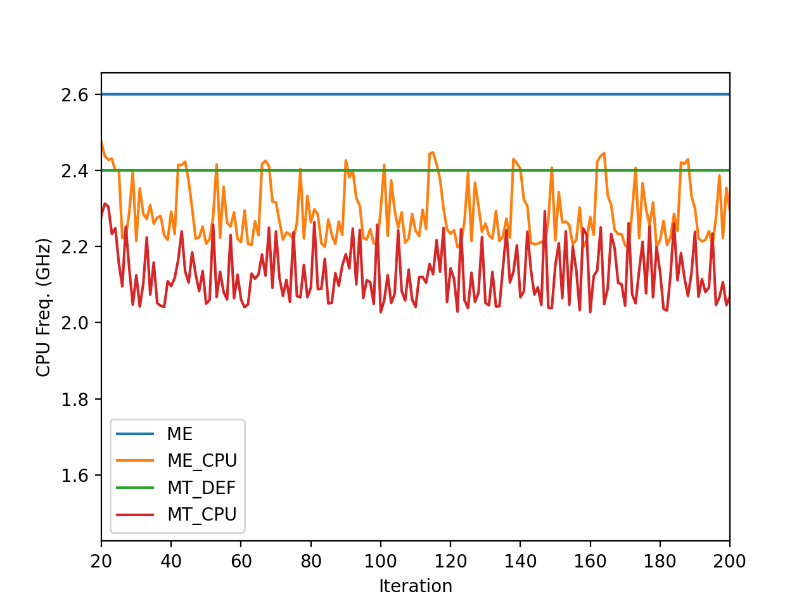

Application Optimization via EAR Policies
monitoring
Does not affect the CPU Freq. Only monitors applications.
min_energy
Memory intensive applications
min_time
CPU intensive applications

Slide 11
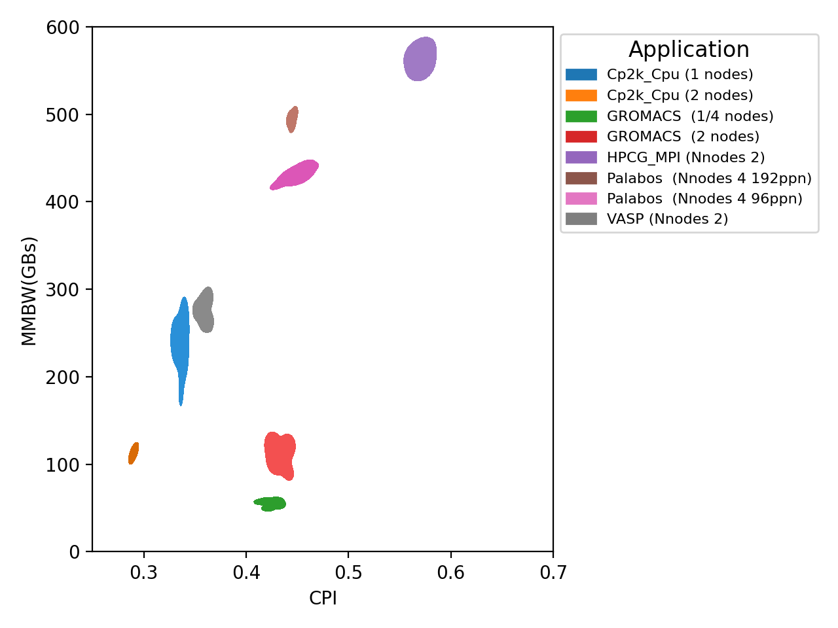
CPU Application characterization
min_energy
min_time
min_energy
min_time

Slide 12
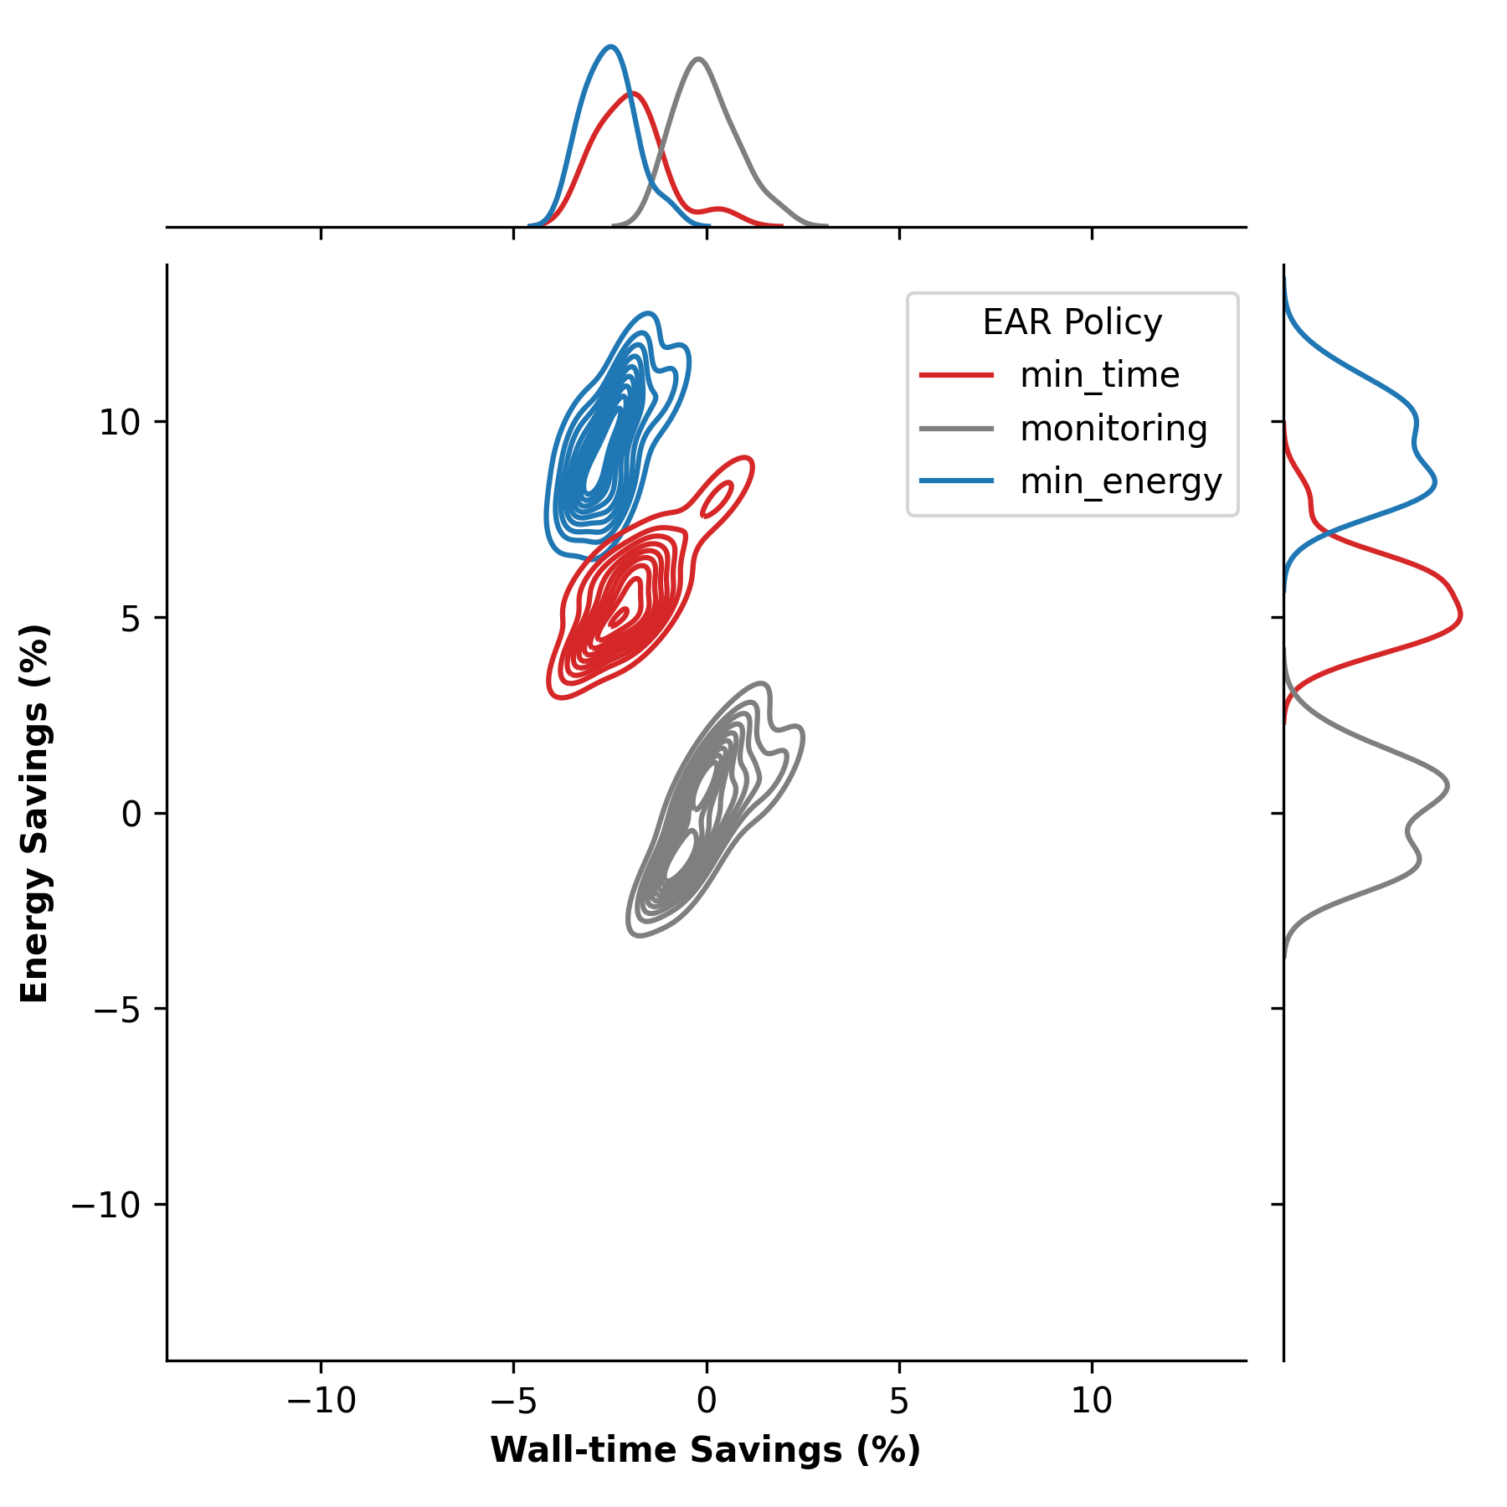
Application characterization/optimization

Slide 13
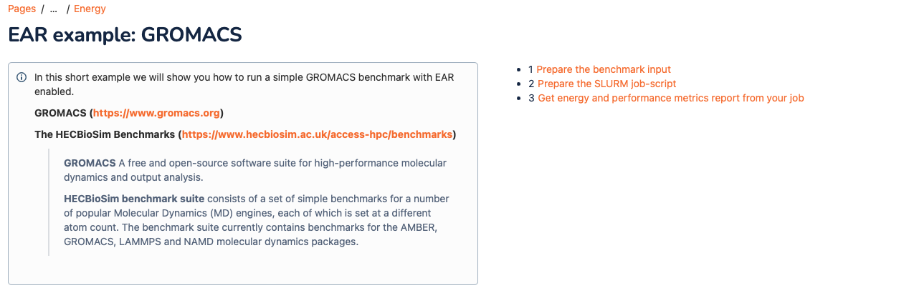
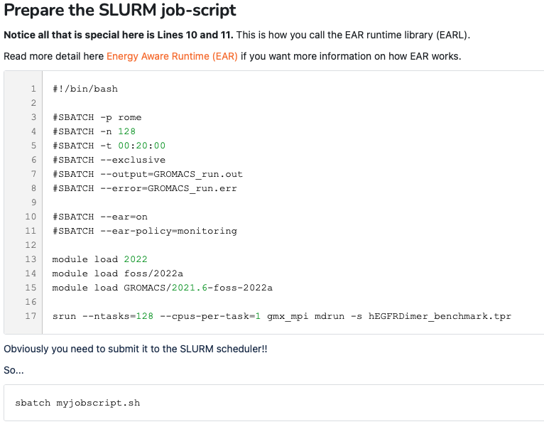
Energy Aware Runtime (EAR) Energy Aware Runtime (EAR) package provides an energy management framework for super computers.
Its Documented and available for use!!!
https://servicedesk.surf.nl/wiki/display/WIKI/Energy

