Slide 1


DATA ANALYST SUITE
ACP • AI • AFC • CYBER
Port Traffic Analytics
PCA • KMeans Clustering • Correspondence Analysis • Anomaly Detection
Sara Naim — Data Analyst (EMSI) • Academic year 2025/2026
Supervisor: Dr. EL MKHALET MOUNA
Tool: “Data Analyst Suite” (Tkinter + Matplotlib + scikit-learn)
Notes:
[Purpose]
Introduce the project and set expectations for a short, clear, and visual presentation.
[Speaker Notes]
Today I present my final Data Analyst project built around an interactive application called “Data Analyst Suite”.
The goal is to analyze port-traffic indicators using PCA, clustering and correspondence analysis, and then apply anomaly detection concepts to a cybersecurity-style module.

Slide 2
DATA ANALYST SUITE
ACP • AI • AFC • CYBER
Agenda
Context & objectives (why analyze port traffic)
Method pipeline: preprocessing → PCA → AI clustering (k=4) → AFC → anomaly detection
Key visuals: correlation heatmap, explained variance, factor maps, correlation circle
Results summary + practical interpretation
How this training/project helped me afterwards (skills & impact)
Notes:
[Speaker Notes]
I will first describe the objectives and the global methodology, then show the key results for each module (ACP/PCA, AI, AFC, Cyber).
I will end with concrete takeaways and answer: how this training and project benefited me and how it helped afterwards.

Slide 3
Data Analyst Suite — Report
Context & Objectives
Context (Morocco)
Objectives
Maritime ports are strategic nodes for Moroccan trade and logistics.
Operational KPIs (time at berth, maneuvers, fuel use, emissions) impact cost and service quality.
Data-driven segmentation helps identify typical vessel profiles and operational risks.
Explore correlations between operational variables (ACP).
Reduce dimensionality to interpret PC1/PC2 structure.
Cluster ships into 4 coherent groups (KMeans) and profile each group.
Illustrate a correspondence analysis view (AFC).
Detect unusual server/traffic patterns using anomaly detection (Cyber).
3
Notes:
[Sources]
- User-provided report and datasets (DOCX + Excel).
[/Sources]

Slide 4
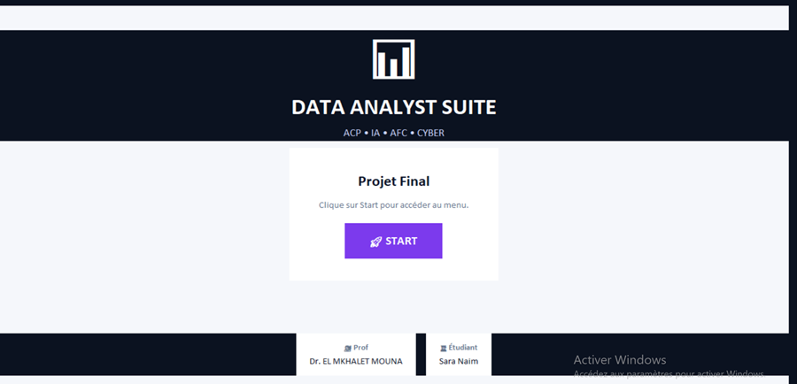
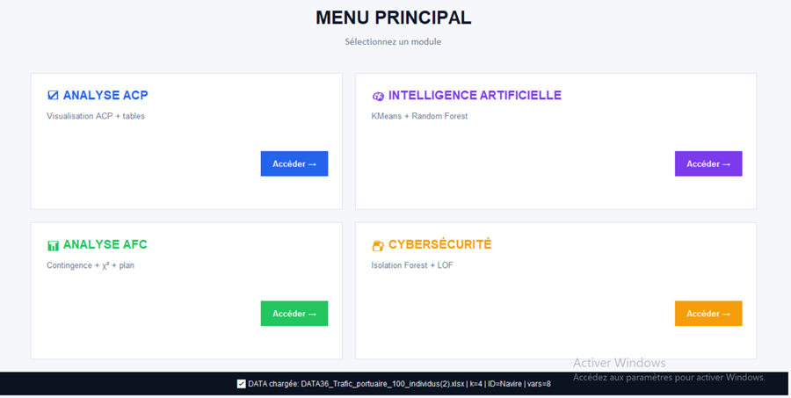
DATA ANALYST SUITE
ACP • AI • AFC • CYBER
Interactive Application (Data Analyst Suite)
Start screen
Module menu
Notes:
[Speaker Notes]
The application is organized into 4 modules: PCA, AI, AFC and Cyber.
All graphs are interactive with zoom/pan (Matplotlib toolbar), and tables can be exported to Excel.
This helps reproduce and present results quickly.

Slide 5
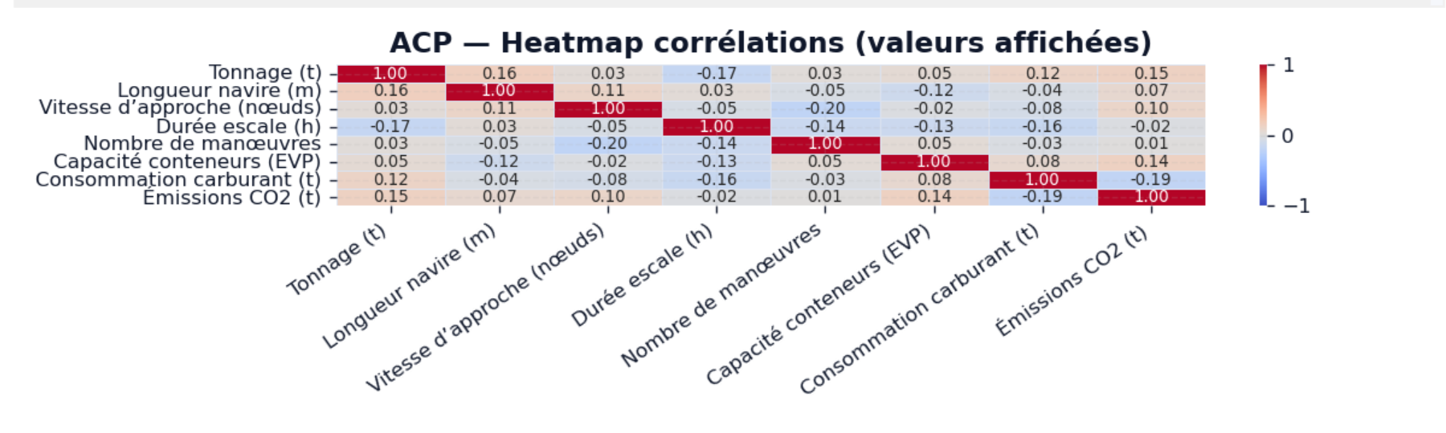
DATA ANALYST SUITE
ACP • AI • AFC • CYBER
PCA — Correlation Heatmap
.
Notes:
[Speaker Notes]
This matrix summarizes relationships between the port-traffic variables.
It is useful to detect redundancy and to justify dimensionality reduction using PCA.

Slide 6
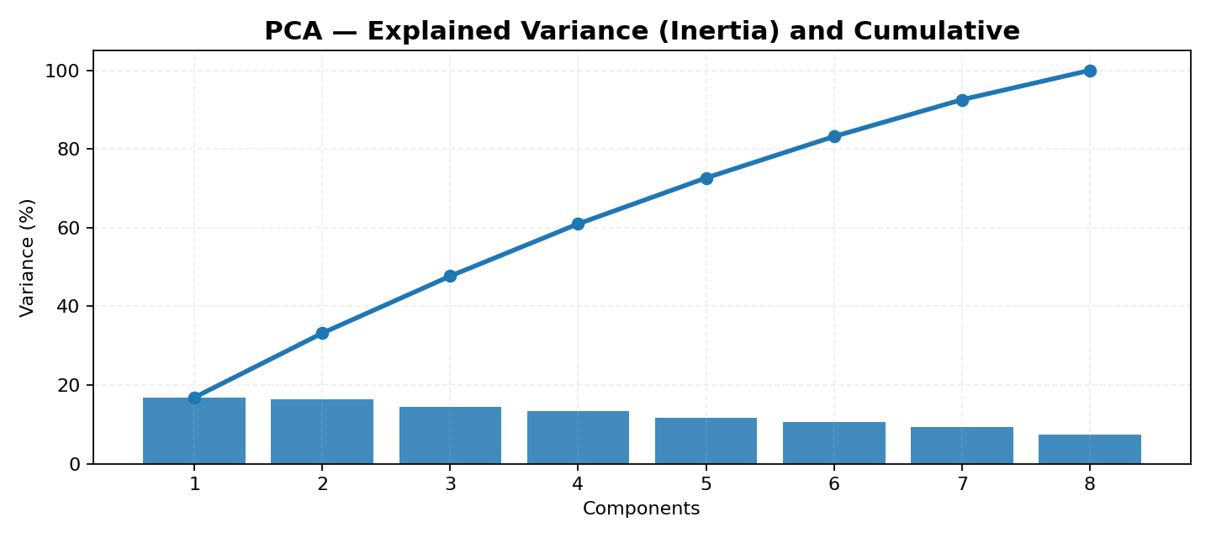
DATA ANALYST SUITE
ACP • AI • AFC • CYBER
PCA — Explained Variance
Key points
PC1 and PC2 summarize the main structure of the data.
The cumulative curve guides how many components are needed.
Interpretation: PC1 ≈ operational/scale effect; PC2 ≈ operational tempo.
We focus on PC1/PC2 for visualization and clustering.
Notes:
[Speaker Notes]
PCA decomposes the variance into orthogonal components.
The bars show explained variance per component and the line shows cumulative variance.
This helps justify focusing on the first two components for a 2D map and for clustering.

Slide 7
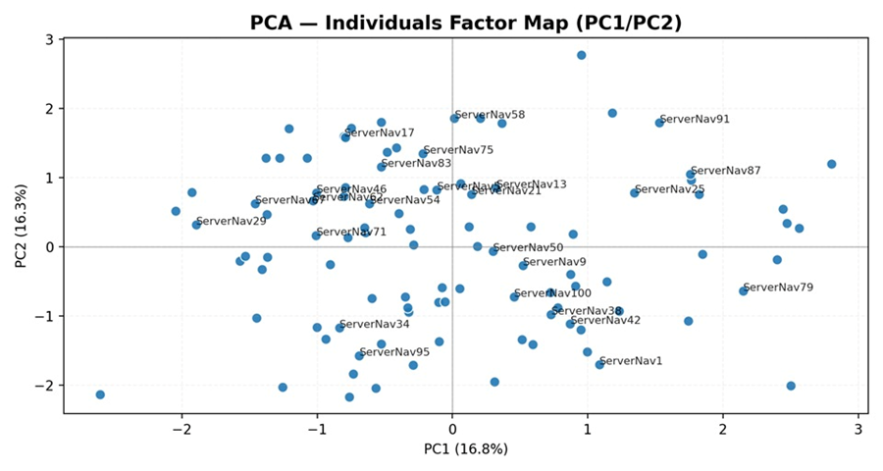
DATA ANALYST SUITE
ACP • AI • AFC • CYBER
PCA — Individuals Factor Map (PC1/PC2)
Notes:
[Speaker Notes]
Each point is one ship/observation projected onto PC1 and PC2.
Distances on this map approximate similarity: close points mean similar profiles.
This projection is the base used in the clustering module.

Slide 8
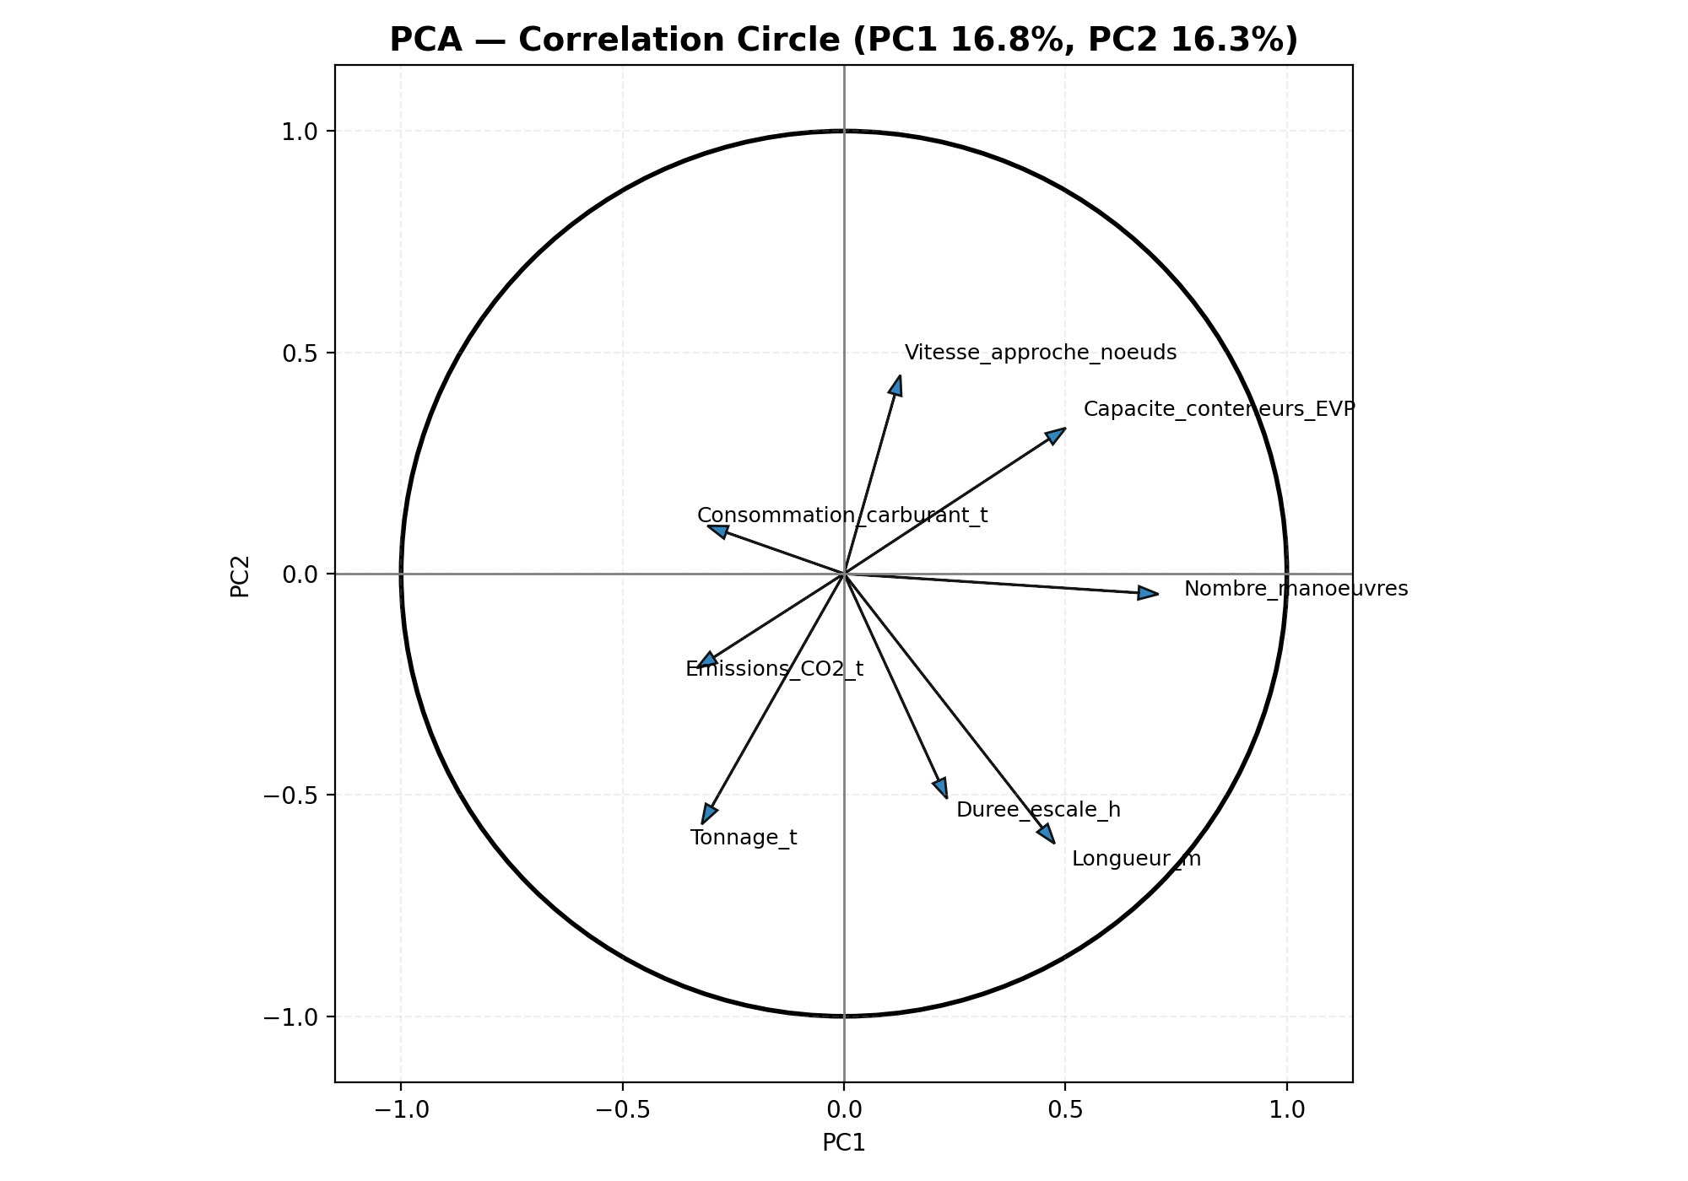
DATA ANALYST SUITE
ACP • AI • AFC • CYBER
PCA — Correlation Circle (Variables)
How to read
Arrow length → quality of representation on PC1/PC2.
Same direction → positive correlation.
Opposite direction → negative correlation.
Near 90° → weak or no linear relation.
PC1 / PC2 meaning (example)
PC1 often captures “scale/size” effects (tonnage, container capacity).
PC2 often captures “tempo/efficiency” (approach speed vs. time at port).
Notes:
[Speaker Notes]
This circle shows how variables relate to the first two components.
It makes PCA interpretable: we can label axes and understand the drivers of separation.
I will reuse this interpretation when describing clusters.

Slide 9
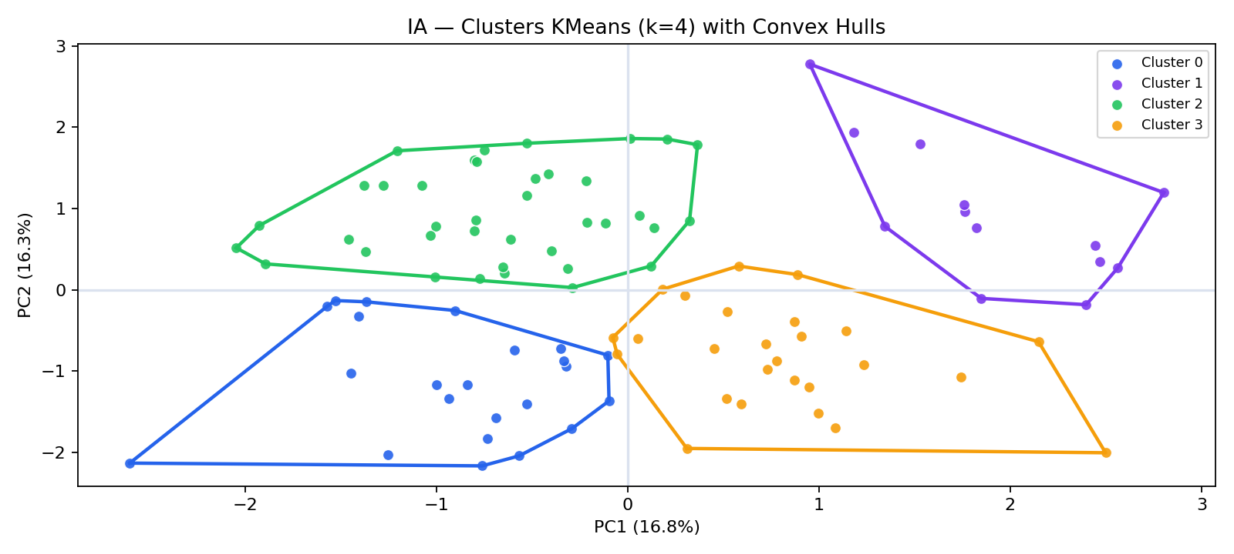
DATA ANALYST SUITE
ACP • AI • AFC • CYBER
AI — KMeans Clustering (k = 4, with hulls)
Interpretation (high-level)
Clusters group ships with similar PCA profiles.
Convex hulls highlight separation and overlap.
k = 4 chosen for a clear, interpretable segmentation.
Operational use
This segmentation can support scheduling and resource allocation
(e.g., similar ships → similar docking time patterns).
Notes:
[Speaker Notes]
Using the PCA coordinates (PC1/PC2), KMeans groups observations into 4 clusters.
This provides an interpretable segmentation of ship profiles.
In practice, such clusters can be linked to operational strategies: berth planning, fuel/CO2 monitoring, etc.

Slide 10
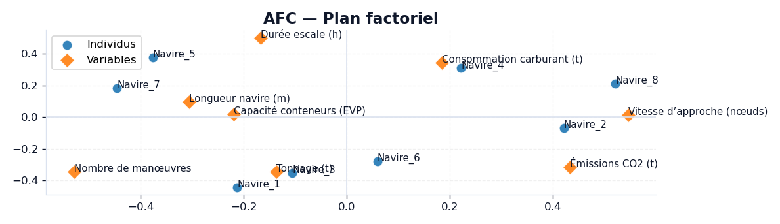
DATA ANALYST SUITE
ACP • AI • AFC • CYBER
AFC — Correspondence Analysis (Factor Map)
AFC visualizes associations between individuals and variables in a joint map.
Notes:
[Speaker Notes]
In this project, AFC is used as a complementary exploratory technique.
It provides a joint representation to interpret potential dependence structures.

Slide 11
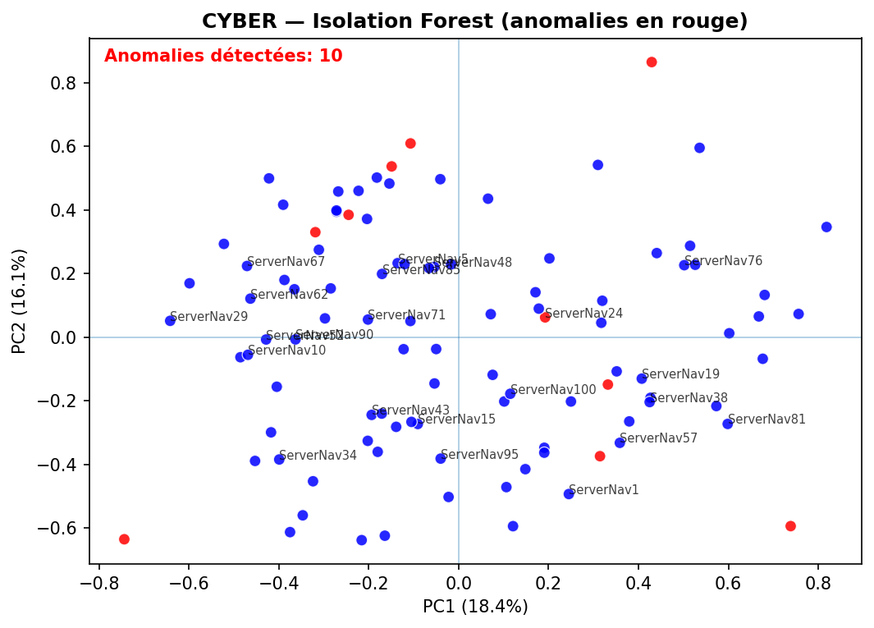
DATA ANALYST SUITE
ACP • AI • AFC • CYBER
CYBER — Isolation Forest (Anomaly Detection)
What it detects
Unusual multivariate patterns (rare combinations).
Outliers flagged in red (here: 10% contamination setting).
Useful for monitoring and early warning.
Cyber analogy
Think “suspicious behavior” → investigate logs / causes.
Notes:
[Speaker Notes]
Isolation Forest isolates observations by random splits; anomalies are isolated faster.
Here, the contamination parameter is 10%, so roughly 10 observations are flagged.
In cybersecurity, this is similar to flagging unusual sessions or traffic that should be investigated.

Slide 12
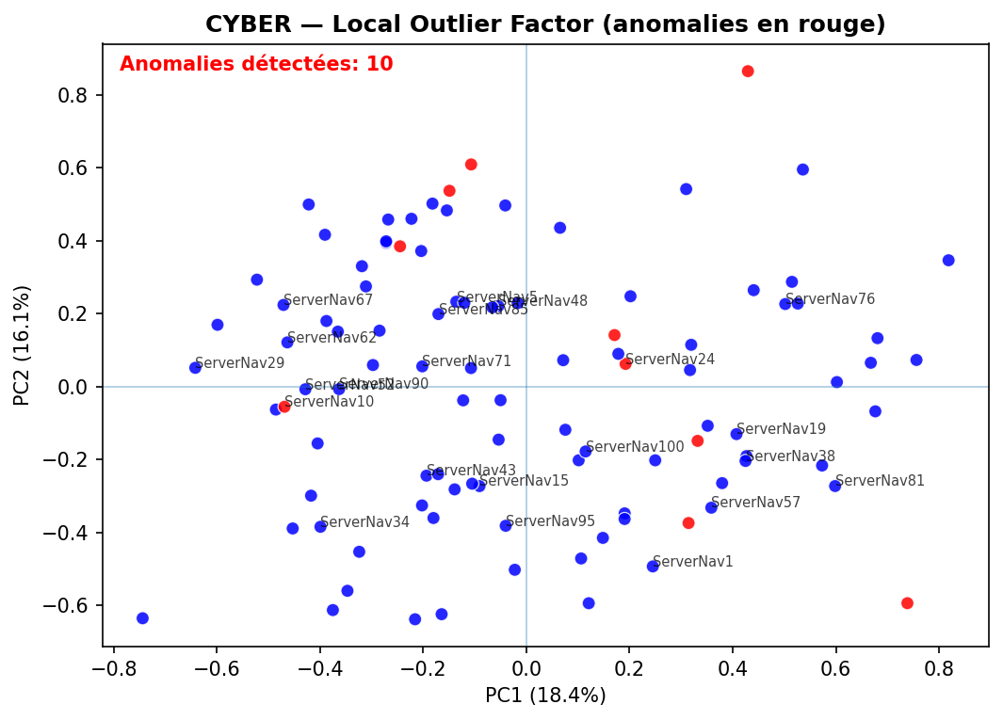
DATA ANALYST SUITE
ACP • AI • AFC • CYBER
CYBER — Local Outlier Factor (LOF)
Difference vs IF
LOF compares local density to neighbors.
Good at detecting “local” anomalies (sparse areas).
Cross-checking IF & LOF increases confidence.
Action
Investigate anomalies: data quality, extreme operations, or suspicious events.
Notes:
[Speaker Notes]
LOF flags observations whose neighborhood density is lower than surrounding points.
It complements Isolation Forest: if both agree, it is a strong signal.

Slide 13
DATA ANALYST SUITE
ACP • AI • AFC • CYBER
Conclusion & Recommendations
Summary of findings
PCA provides an interpretable 2D map (PC1/PC2).
KMeans (k=4) segments ship profiles.
AFC gives additional association insights.
Isolation Forest & LOF highlight unusual patterns.
Anomalies are starting points for investigation.
Interactive app improves reproducibility & communication.
Recommendations (practical)
Use clusters to tailor berth allocation and anticipate service needs.
Track CO₂ and fuel indicators by cluster to target efficiency actions.
Monitor anomalies regularly; validate whether they are data errors or real events.
Notes:
[Speaker Notes]
I summarize the value of each method and translate it into actions.
The main idea: reduce complexity, segment profiles, and monitor risks.

Slide 14
DATA ANALYST SUITE
ACP • AI • AFC • CYBER
How the Data Analyst Program Helped Me
In what way was the program/project beneficial, and how did it help afterwards?
Methodology: framing a question → cleaning data → choosing models → validating results.
Technical skills: PCA, clustering, classification, anomaly detection, visualization.
Tooling: building a reusable app improved speed, repeatability and presentation quality.
Communication: translating graphs into decisions (recommendations for operations & risk).
Afterwards: confidence to tackle new datasets quickly and build dashboards/workflows.
Thank you — Q&A
Notes:
[Speaker Notes — French (you can read this in your recording)]
La formation Data Analyst m’a apporté une méthode complète de travail : partir d’un problème, préparer les données, choisir des techniques adaptées, puis valider et interpréter les résultats.
Dans ce projet, j’ai appliqué l’ACP pour réduire la dimension et interpréter PC1/PC2, le clustering KMeans pour segmenter les profils, l’AFC pour compléter l’analyse, et enfin des méthodes de détection d’anomalies (Isolation Forest, LOF) pour une logique “cyber”.
Le fait de développer une application m’a aussi appris à rendre l’analyse réutilisable : import, graphiques interactifs, export des tableaux — ce qui améliore la qualité de présentation.
Après ce travail, je suis plus autonome : je sais structurer une analyse de bout en bout, expliquer les résultats avec des indicateurs concrets, et proposer des recommandations utiles.

