Slide 1

OBSTACLE AVOIDING ROBOT CAR
Mini Project

Slide 2

Team Composition
Name SRN
TANISH B PES1UG20EC211
GUIDE : Ms. Swetha R

Slide 3
Contents
Problem Statement
Introduction
Literature Survey
Methodology
Block Diagram
Future scope
Results and Discussion
Bibliography

Slide 4
Problem Statement
To develop an obstacle avoiding Robot Car using Arduino.

Slide 5
Literature Survey
Obstacle avoidance is one of the most important aspects of mobile robotics. Without it, robot movement would be very restrictive and fragile. The robot is designed in order to navigate in unknown environment by avoiding collisions
This project proposes robotic vehicle directs itself whenever an obstacle comes in its path so as to protect the robot from any physical damages.
This is achieved with the help of ultrasonic sensors for obstacle detection and a micro-controller (ARDUINO).
The sensor sends a command to the micro-controller. Depending on the input signal received, the micro-controller redirects the robot to move in an alternate direction by actuating the motors which are interfaced to it through a motor driver.

Slide 6
Methodology
NO
Sensor taker reading
(obstacle present)
Stop Moving
Go back
Turn left and take reading
Turn right and take a reading
Turn towards the side of no obstacles Move forward
YES
MICRO-CONTROLLER
BOARD

Slide 7
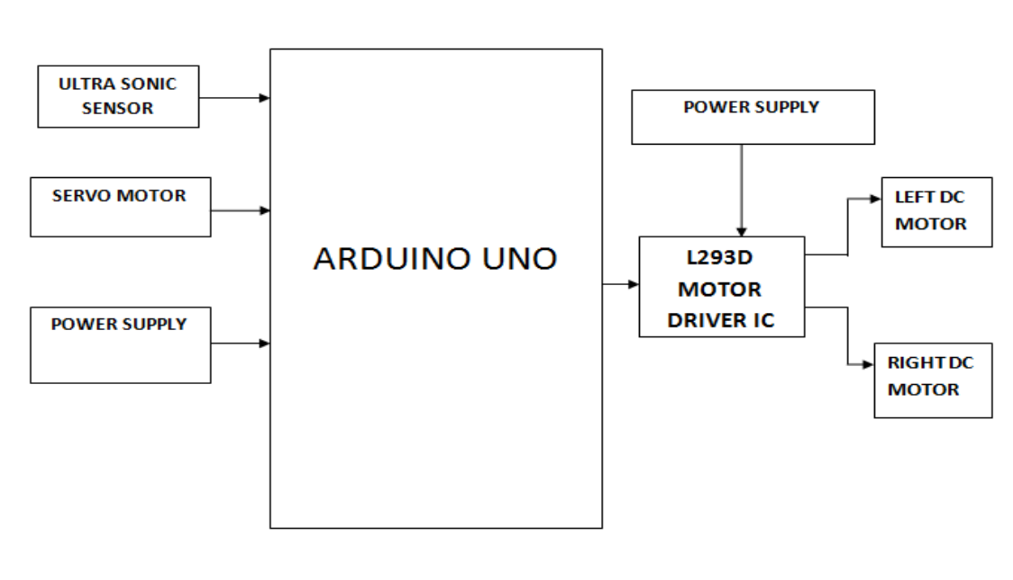
Block Diagram and Contents
1 9v Battery
12v
300 rpm
X 4
1 9v Battery
Small Bread Board for connections

Slide 8
Future scope
As requires no user intervention during its operation it is quite sustainable because ,when placed in unknown environment with obstacles, it moves while avoiding all obstacles with considerable accuracy.
This technology can be used in rovers and also car parking mechanisms to avoid obstacles and damage.

Slide 9
Results and Discussion
Thus the obstacle avoiding robot is built using the above methodology and the Arduino board is coded as per requirement
If the robot moves forward and obstacle is detected, it checks other directions and moves in the direction where there is no obstacles.
It moves in forward direction when no obstacles are detected. To sense the obstacle ultrasonic sensor is used, and a servo motor to rotate the ultrasonic sensor

Slide 10
Bibliography
https://www.arduino.cc/en/software
https://create.arduino.cc/projecthub/sora-jy/obstacles-avoiding-robot-with-servo-motor-719f6b?ref=search&ref_id=obstacle&offset=1
Github
YouTube

Slide 11
THANK YOU

