Slide 1

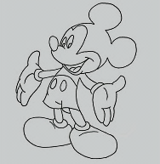
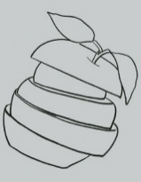
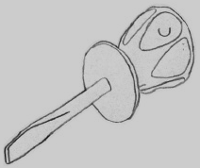
Avg Accuracy % /Random Choice
Random Chance
Level of Sketching Constraints across datasets

Slide 2
Avg Accuracy %
SAR
Manual
Random
Type of Segmentation Algorithm

Slide 3

Avg Accuracy %

