Slide 1

Genex
Genetics Made Practical - Turn diagnoses into daily, doable routines

Slide 2
Problem
Parents leave with a diagnosis—but no Tuesday plan.
Paper handouts don’t translate into daily routines at home or school.
Time-poor caregivers need 5–10 minutes, step-by-step guidance.
Inconsistent IEP/home‑program alignment; language & literacy barriers.
Clinics lack visibility into home adherence and outcomes.

Slide 3
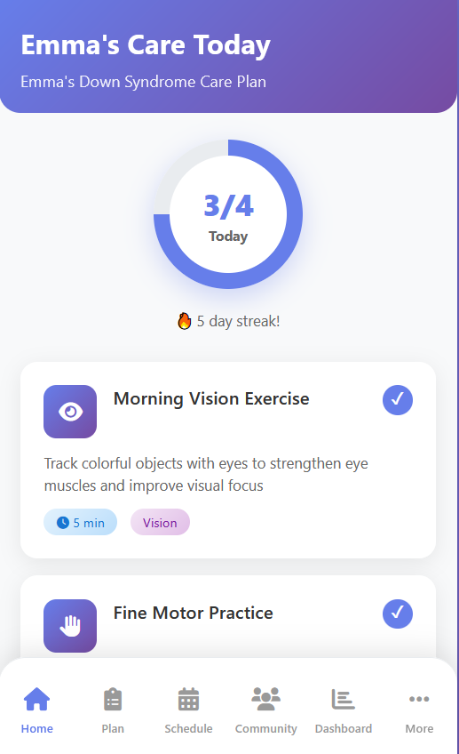
Solution: Genex
Genex app builds daily 5–10‑minute routines aligned to goals and IEPs (Individual Education Plans by school districts).
Transparent knowledge graph: suggestions include sources & confidence level – color schemes.
Reminders, progress loops, and printable EN/ES handouts.
Privacy‑Lite today (no server PHI); Clinical Mode later for providers.
Free for families & public schools; easy clinic/school referrals.

Slide 4
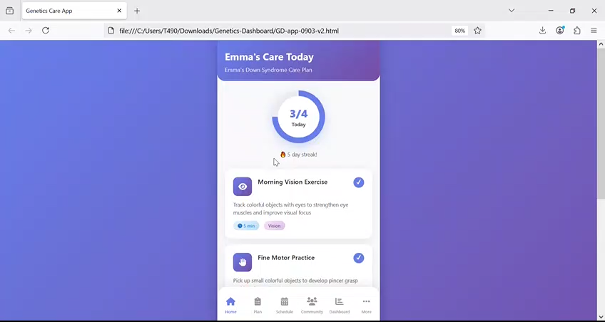
Genex - App

Slide 5
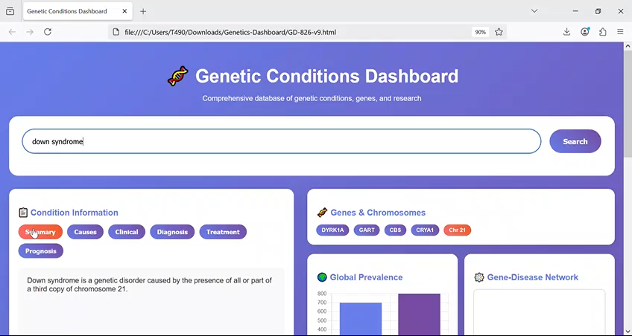
Genex - Dashboard

Slide 6
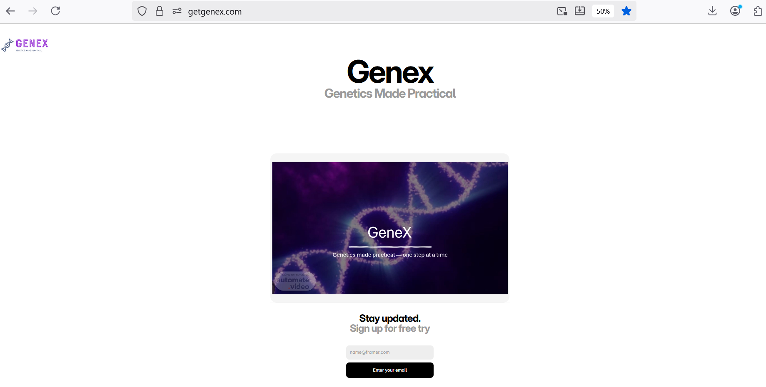
Genex – Landing Page
https://getgenex.com/

Slide 7
Market Opportunity (U.S.)
Children 0–17: ~73.1M; parent‑reported genetic/inherited: 3.9% → ~2.85M.
Service‑seeking families ≈ 60% → ~1.71M annually; IDEA students: ~7.5M.
Free audience fuels MAU (0.51–0.86M at 30–50% of 1.71M).
Monetization on provider + media sides; families/schools stay free.
Go‑to‑market: Down syndrome orgs, pediatric therapy programs, schools.

Slide 8
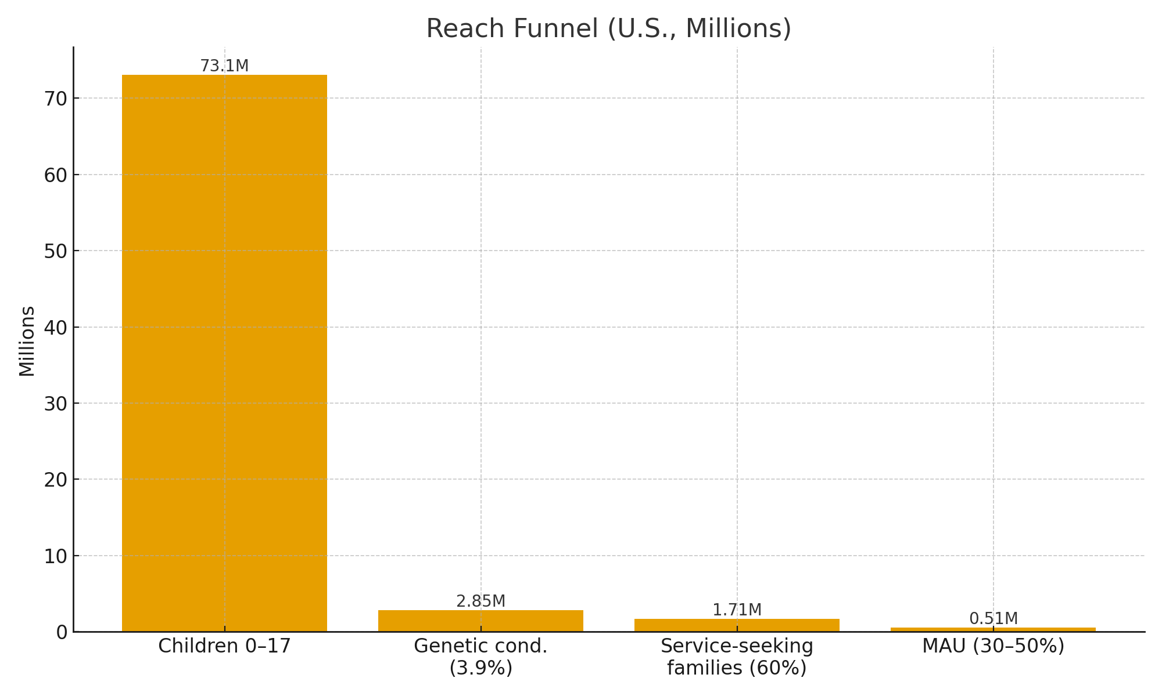
Market Opportunity — Reach Funnel
Sources: NSCH, IDEA; MAU assumption 30–50% of service‑seeking families.

Slide 9
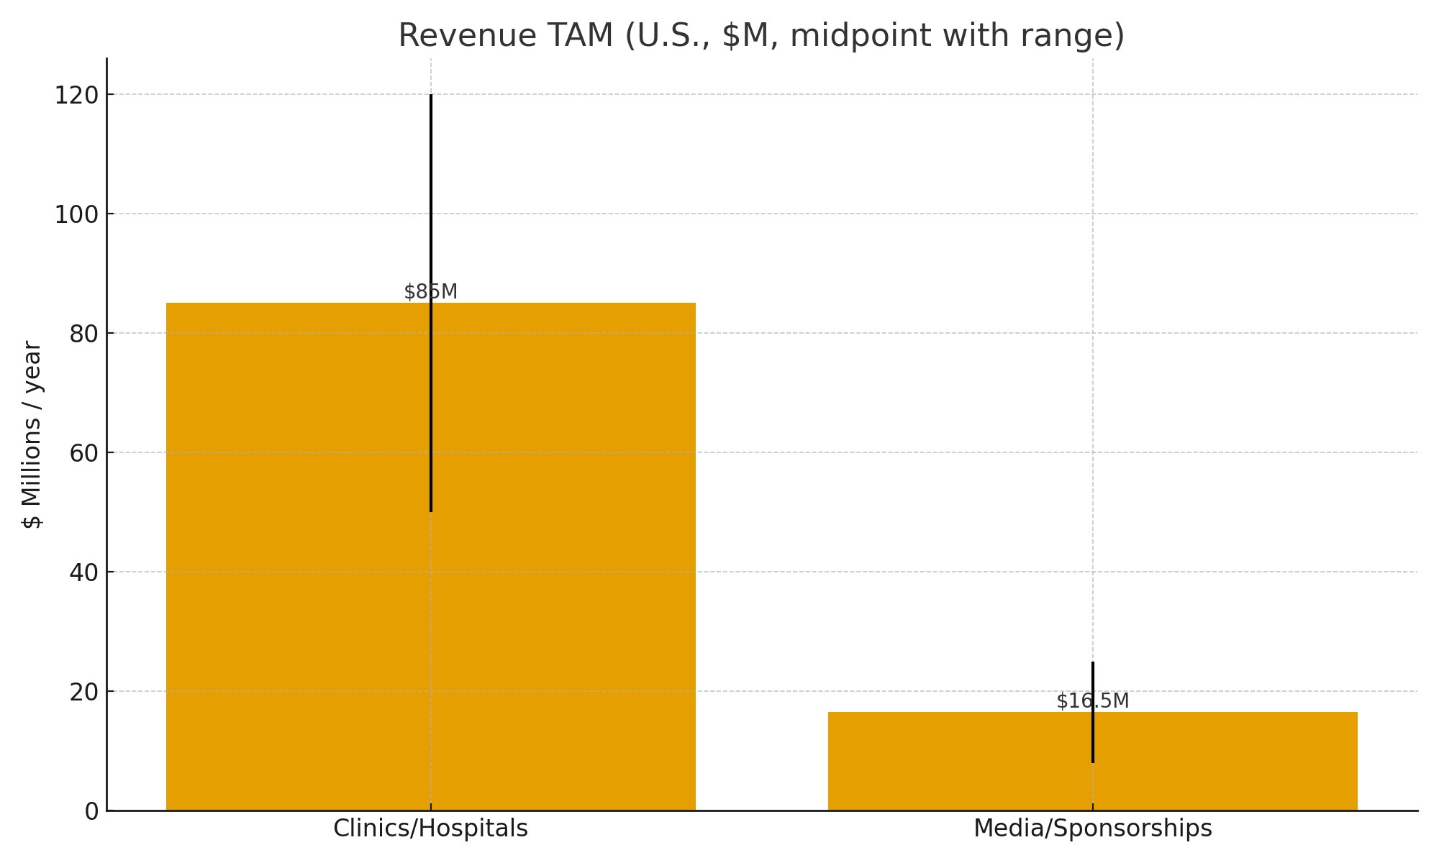
Market Opportunity — Revenue TAM
Ranges shown via error bars; commerce & district services excluded.
Clinics/Hospitals: $25–$60 per clinician/month ($300–$720/yr).
Media & Sponsorships: contextual, privacy‑safe placements (no PHI targeting).

Slide 10
Competition & Genex Edge
Category | Examples | Typical Price | Their Strengths | Our Edge
Milestone/ therapy apps | BabySparks, Joon | $40–$90/yr (B2C) | Broad libraries, habit loops | Free for families/schools; genetics‑aware plans; KG confidence
Condition info sites | GeneReviews, nonprofits | Free | Authoritative reference | Daily routines + plan builder; personalization; school/clinic alignment
Clinic/EHR portals | WebPT, SimplePractice | $70–$100+/mo (B2B) | Scheduling, messaging | Home‑program UX; adherence analytics; parent‑first experience

Slide 11
Business Model
Families & Public Schools: FREE (no paywall).
Clinics/Hospitals: $25–$60 per clinician/month ($300–$720/yr).
Media & Sponsorships: contextual, privacy‑safe placements (no PHI targeting).
Optional District Services: rostering, PD, translation packs, connectors (ala carte).
Unit economics: low CAC via org channels; high gross margin per seat.

Slide 12
The Ask
Introductions: 3–5 pediatric therapy programs/children’s hospitals; 2–3 national org partners.
Funding: [e.g., $1-2M seed] to build content, expand engineering, and run pilots.
Use of funds: content/clinical review, privacy/compliance, GTM pilots, measurement.

Slide 13
Contact
Sara Soltani
sarasz@berkeley.edu • 415‑712‑9981
Genex – Genetics Made Practical

