Slide 1

GeneX
Genetics made practical — one step at a time

Slide 2

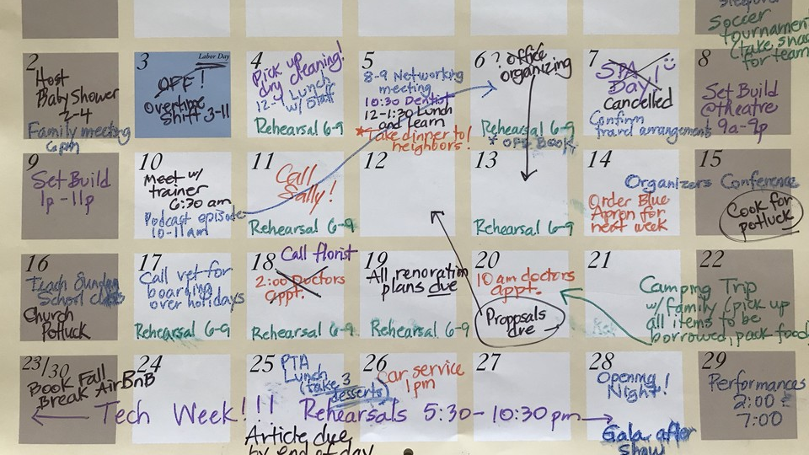
Notes:
For millions of families navigating genetic or developmental conditions, guidance is fragmented, routines are hard to follow, and support often feels out of reach

Slide 3
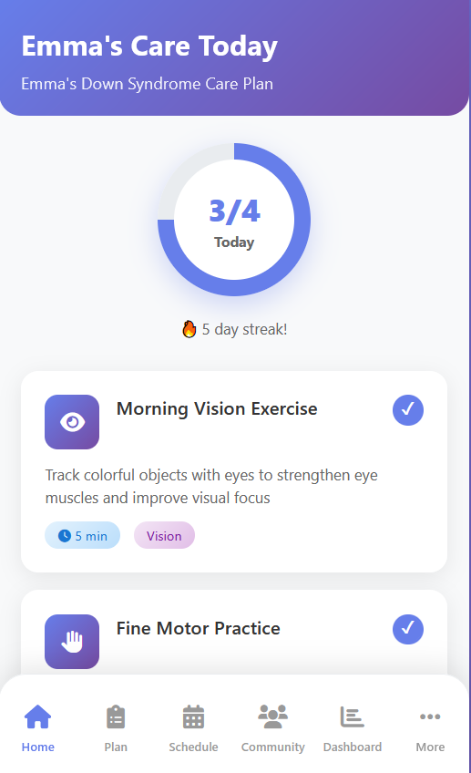

Notes:
That’s why we built a privacy-first app that turns a child’s diagnosis into clear, daily bite-size activities — practical routines you can actually use at home and school.

Slide 4
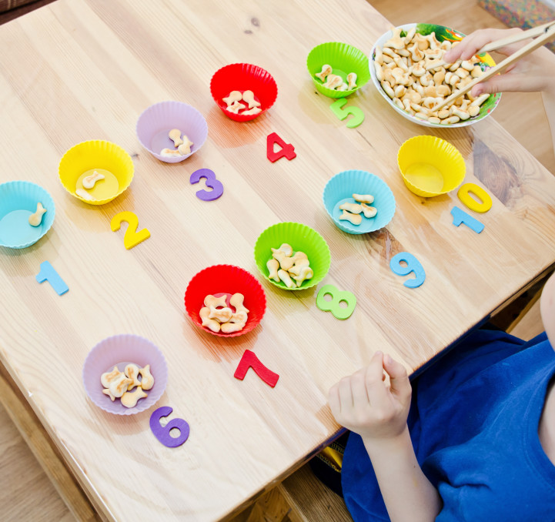

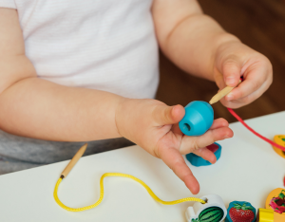

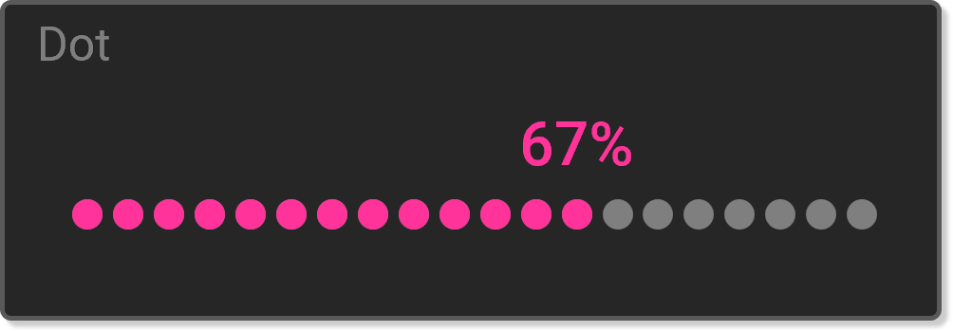
Notes:
With curated 5–10 minute exercises, reminders, progress tracking, and community support, families gain confidence, schools stay aligned, and children get consistent support — every day.

Slide 5





Notes:
"Together, we make care simpler, smarter, and supportive. GeneX — your genetics-aware care companion

