Slide 1
FLOOD RELIEF
FLOOD MANAGEMENT APP
Submitted By,
Sara.E.John
MCA23-155
Guided By,
Prof.Sheera Shamsu

Slide 2
Introduction
This proposed Flood Management App for Kerala’s districts aims to reduce flood impact by facilitating quick and efficient rescue operations using advanced technology. It identifies affected panchayats and taluks, allowing rescue teams to accurately locate and reach victims. Registered users can request rescue, and once safe, they receive a confirmation alert. The app also supports rehabilitation and offers critical lifeline services, including communication, power, water supply, and healthcare, which are essential during floods.

Slide 3
Existing System
Lack of Real time communication and Alerts
Inefficient Rescue Coordination
Poor Resource Allocation and Tracking
Limited Accessibility for Victims
Weak Integration with Lifeline Services

Slide 4
Proposed System
Our app provides online registration facility to the victim and common people.
Our app provide the information about the peoples in rehabilitation center.
Our app provide line of command.
Though our app we can utilize and reduce the time to save the peoples from danger zone
Through our app use we take precaution •
We can identify the number of people are in different camps.
We can identify the commodities for each camp and all people can Sponsor to that camp.

Slide 5
Modules
1.ADMIN :
▪ Register and login
▪ Manage camp
▪ Manage quick response team
▪ Manage members
▪ Display notifications
▪ View details
2. FLOOD MANAGEMENT TEAM (FMT) :
▪ Register and login
▪ Registration of camp and quick response team
▪ View details
▪ Assign request to QRT

Slide 6
3. QUICK RESPONSE TEAM (QRT) :
▪ Register and login
▪ View request from users
▪ Register rescued persons details
▪ View camp details
4.CAMP :
▪ Register and login
▪ Requested for commodities
▪ Member registration
▪ Update profile
▪ View details
5.USER :
▪ Register and login
▪ Request for rescue
▪ Update profile

Slide 7
Software Requirements
• Front end- Flutter
• Back end - Firebase
• IDE - Visual studio ,Android Studio

Slide 8
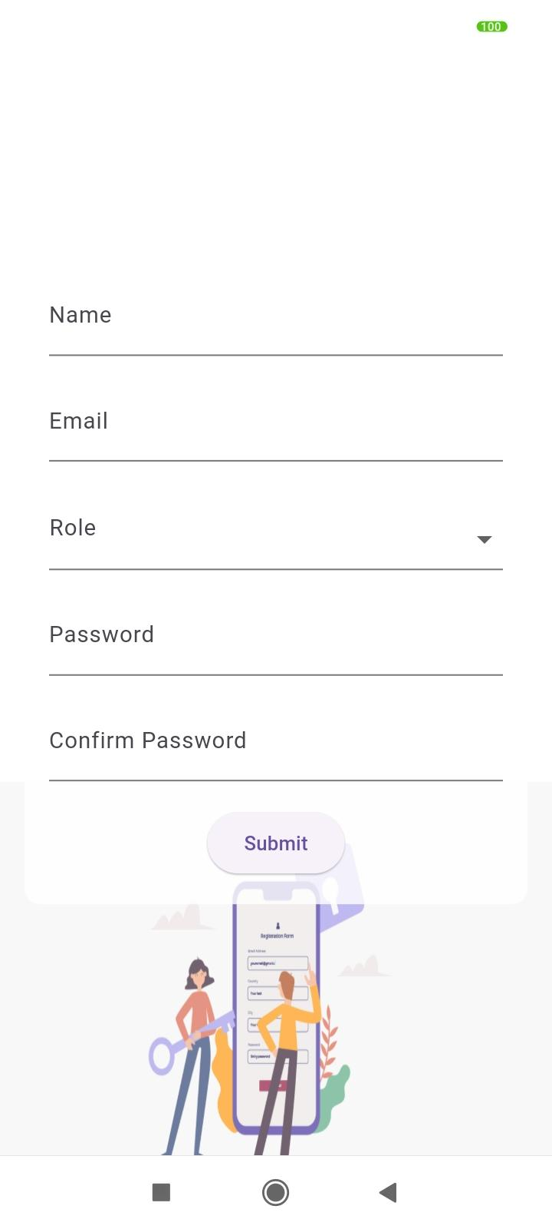
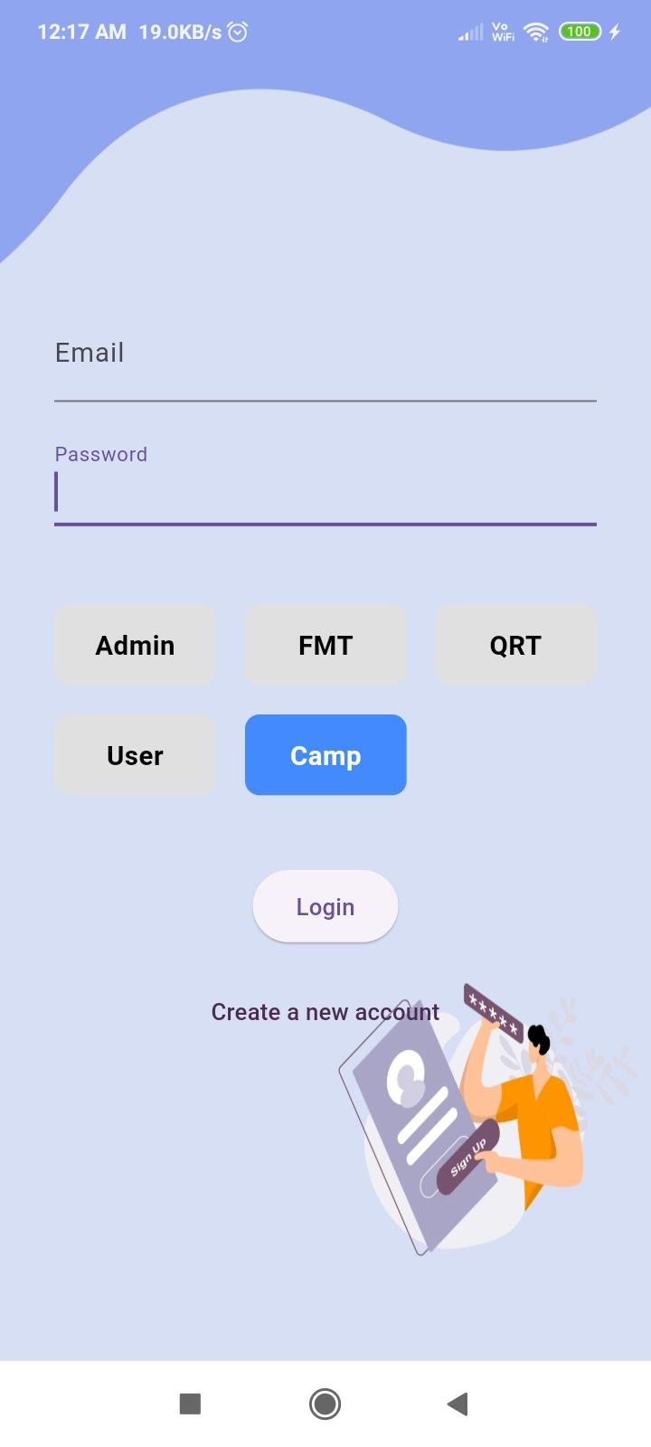

Output
Splash screen
Registration page
Login

Slide 9
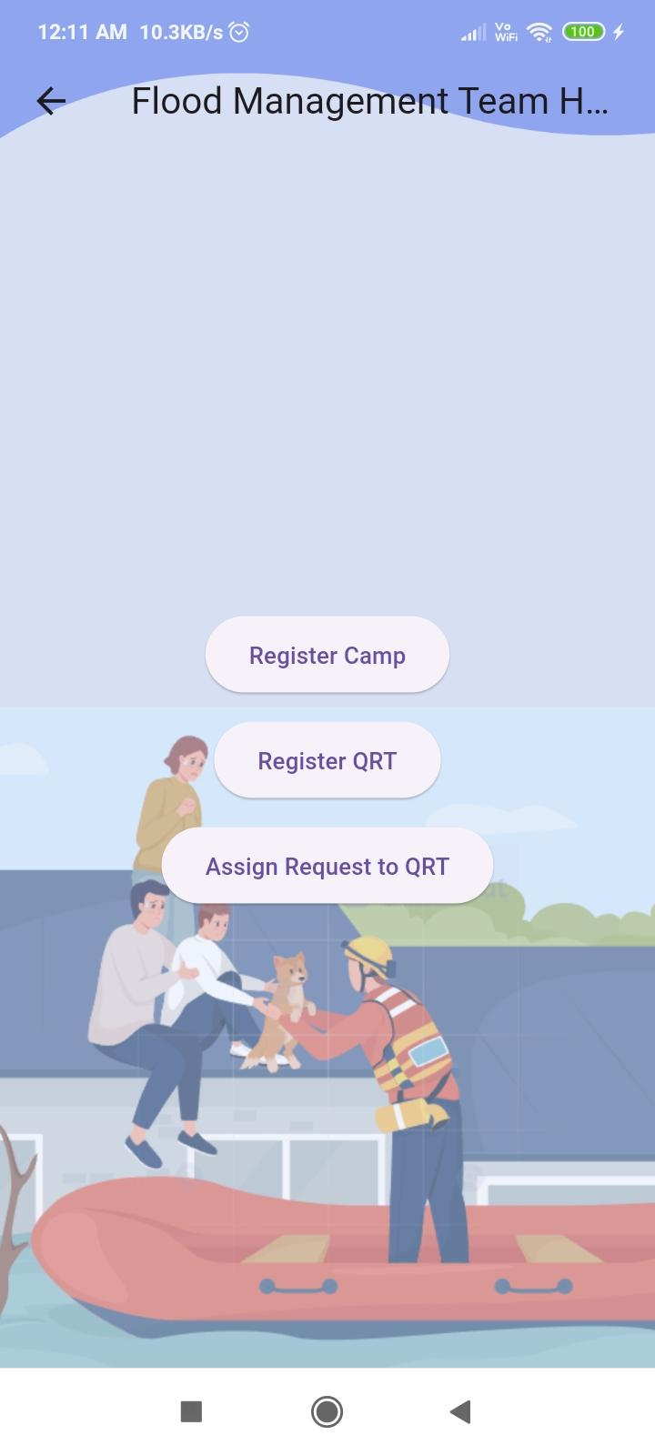
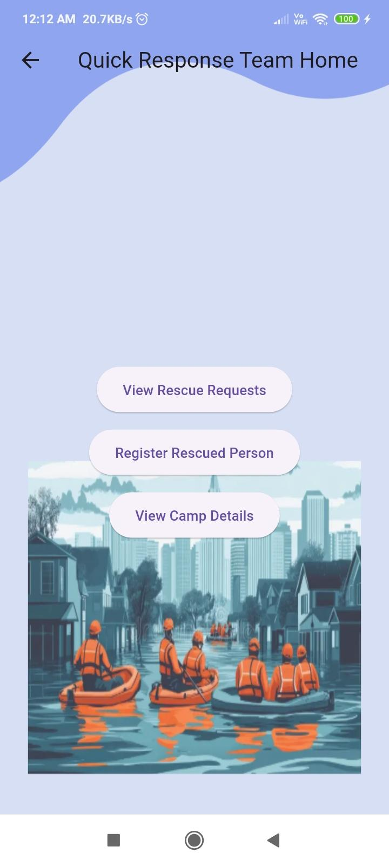
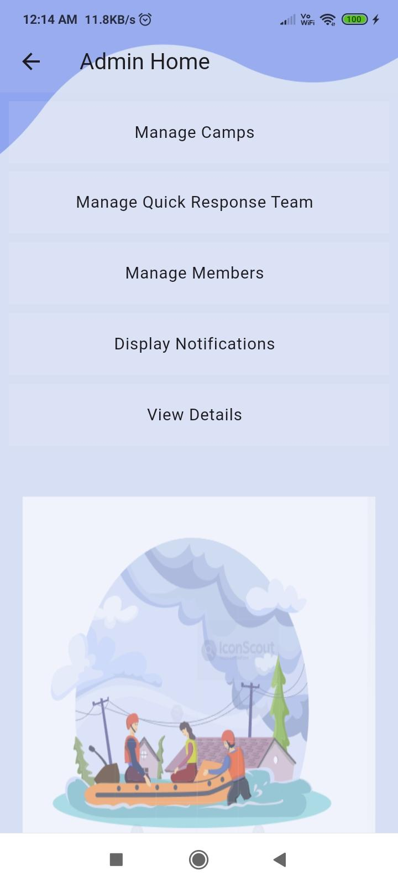
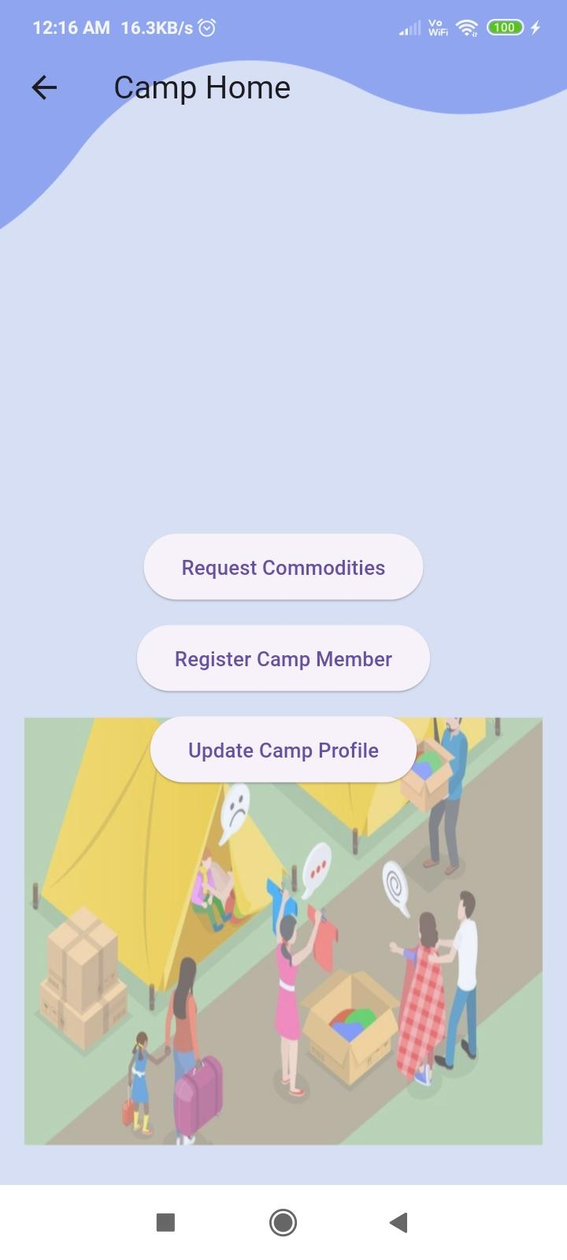

Slide 10
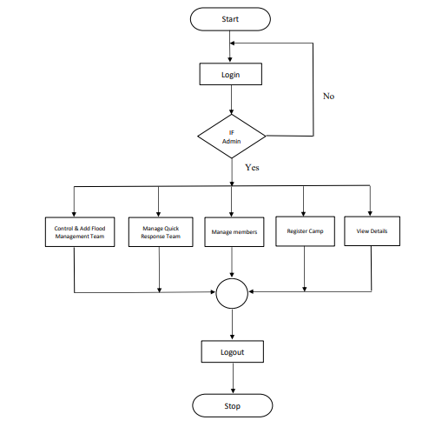
Flowchart-Admin

Slide 11
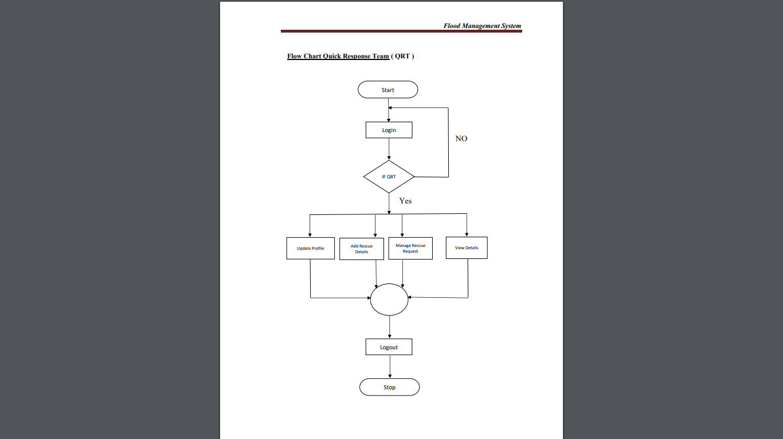
Flowchart-QRT

Slide 12
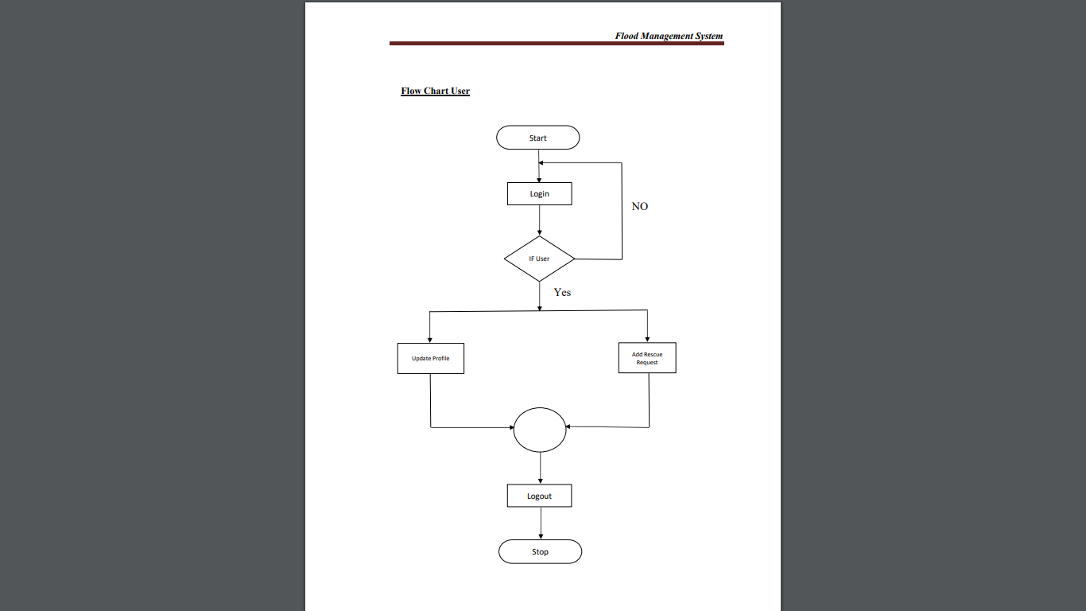
Flowchart-user

Slide 13
Future Enhancement
Enhanced GIS mapping and location-based services
Post-flood rehabilitation and mental health support
Offline map caching and local storage
Automated rescue and assistance with drones and robotic
Data collection and analytics for future planning
Personalized alerts and guidance for residents

Slide 14
THANK YOU

