Slide 1
A CLEAR, VISUAL INTRODUCTION
Sorting Algorithms
Bubble Sort • Selection Sort • Insertion Sort
2 3 4 5 8
Sorting Algorithms
01

Slide 2
FOUNDATIONS
What Is a Sorting Algorithm?
A sorting algorithm is a precise, step-by-step procedure that takes a collection of items and rearranges them into a defined order — typically ascending or descending — based on a comparison rule.
BEFORE
5
3
8
4
2
It doesn’t just move items around — it repeats the same rule (compare, then place) until every element sits in its correct position relative to its neighbors.
AFTER
2
3
4
5
8
Same elements, one rule applied consistently, a new order.
Sorting Algorithms
02

Slide 3
MOTIVATION
Why Do We Use Sorting Algorithms?
1
Faster Searching
2
Efficient Processing
Sorted data lets us use binary search and similar techniques instead of scanning everything.
Many algorithms (merging, deduplication, ranking) assume or run best on sorted input.
3
Clarity for Users
4
A Learning Foundation
Ordered lists, leaderboards, and search results are easier to read and act on.
Sorting teaches core ideas — comparisons, loops, complexity — used across computer science.
Sorting Algorithms
03

Slide 4

ALGORITHM 01
Bubble Sort — Definition
Bubble Sort repeatedly steps through the list, compares each pair of adjacent elements, and swaps them if they are in the wrong order. Larger values “bubble” toward the end with every pass.
HOW IT WORKS
1
Compare each pair of neighboring elements, left to right.
2
Swap them if the left one is bigger than the right one.
3
Reach the end of the list — the largest value is now in place.
4
Repeat for the remaining unsorted portion until no swaps are needed.
Sorting Algorithms
04

Slide 5
ALGORITHM 01 — IN ACTION
Visualizing Bubble Sort
Start
5
3
8
4
2
unsorted array
Pass 1
3
5
4
2
8
largest bubbles up
Pass 2
3
4
2
5
8
Pass 3
3
2
4
5
8
Final
2
3
4
5
8
fully sorted
Placed in final position
Still being compared
Sorting Algorithms
05

Slide 6

ALGORITHM 02
Selection Sort — Definition
Selection Sort divides the list into a sorted and an unsorted part. On every pass, it scans the unsorted part to find the smallest value and moves it to the end of the sorted part.
HOW IT WORKS
1
Search the unsorted portion for the smallest remaining value.
2
Swap it into the next open position at the front.
3
Grow the sorted portion by one element.
4
Repeat until the whole array is sorted.
Sorting Algorithms
06

Slide 7
ALGORITHM 02 — IN ACTION
Visualizing Selection Sort
Start
5
3
8
4
2
unsorted array
Pass 1
2
3
8
4
5
smallest → front
Pass 2
2
3
8
4
5
Pass 3
2
3
4
8
5
Final
2
3
4
5
8
fully sorted
Sorted portion (front)
Unsorted portion
Sorting Algorithms
07

Slide 8

ALGORITHM 03
Insertion Sort — Definition
Insertion Sort builds the sorted list one element at a time. It takes the next unsorted value and inserts it into its correct position among the already-sorted elements, shifting others as needed.
HOW IT WORKS
1
Treat the first element as a sorted list of one.
2
Take the next element and compare it backward through the sorted part.
3
Shift larger elements right to make room.
4
Insert the element into its correct slot; repeat for all remaining items.
Sorting Algorithms
08

Slide 9
ALGORITHM 03 — IN ACTION
Visualizing Insertion Sort
Start
5
3
8
4
2
first element sorted
Insert 3
3
5
8
4
2
Insert 8
3
5
8
4
2
Insert 4
3
4
5
8
2
Insert 2
2
3
4
5
8
fully sorted
Sorted portion (grows left)
Not yet inserted
Sorting Algorithms
09

Slide 10
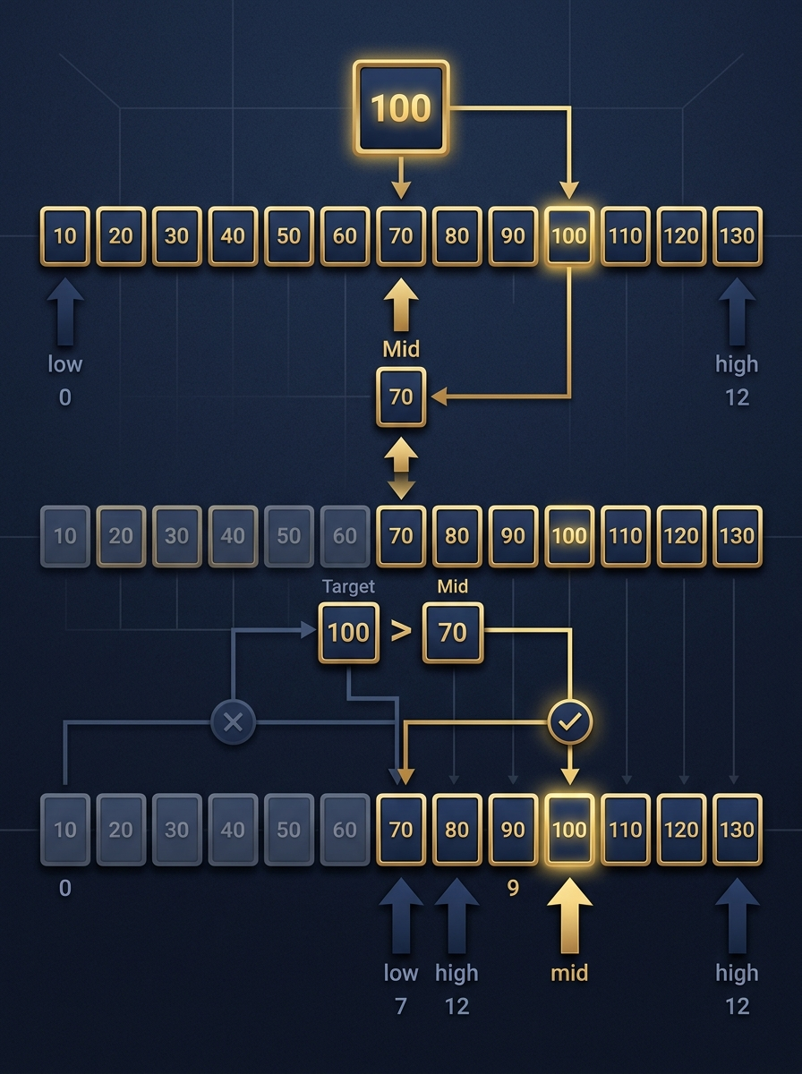
ALGORITHM 04
Binary Search — Definition
Binary Search (or Dichotomous Search) finds a target value in a sorted array by repeatedly splitting the search range in half, discarding the half that cannot contain the target.
HOW IT WORKS
1
Start with the full sorted array; set low and high bounds.
2
Compare the target to the middle element of the current range.
3
If it matches, the search is done — otherwise keep the half that could contain it.
4
Repeat on the smaller range until the target is found or the range is empty.
Sorting Algorithms
10

Slide 11
ALGORITHM 04 — IN ACTION
Visualizing Binary Search
Step 1
1
3
5
7
9
11
13
15
17
15 > 9 → search right half
compare with 9
Step 2
1
3
5
7
9
11
13
15
17
15 > 13 → search right half
compare with 13
Step 3
1
3
5
7
9
11
13
15
17
15 = 15 → target found!
compare with 15
Target: 15 • Array is sorted, length 9 • Found in 3 comparisons (vs. up to 9 for a linear scan)
Found
Currently comparing
Still in range
Eliminated
Sorting Algorithms
11

Slide 12
THANK YOU FOR YOUR ATTENTION
Fin
Questions ?
2 3 4 5 8
Sorting Algorithms
11

