Slide 1
Computer Vision
Day 4
2017, Tanta University
Eng.Sara Hussien

Slide 2
Hough Transform

Slide 3
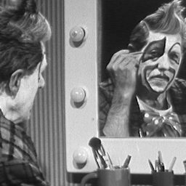

An edge is not a line...
How can we detect lines ?

Slide 4
Edges vs Boundaries
Edges
  Local intensity discontinuities
  Points
  Not dependent on models
Boundaries
  Composed of many points
  May be dependent on model

Slide 5
Finding lines in an image
Option 1:
  Search for the line at every possible position/orientation
  What is the cost of this operation?
Option 2:
  Use a voting scheme: Hough transform

Slide 6
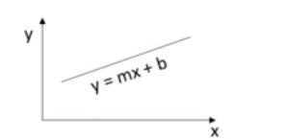
Finding lines via Hough Transform
A line has a two parameters (m,b)

Slide 7
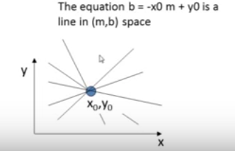


Finding lines via Hough Transform
A line has a two parameters (m,b)
Given a point (x0,y0), the lines that could pass through this points are all (m,b) satisfying
Or

Slide 8
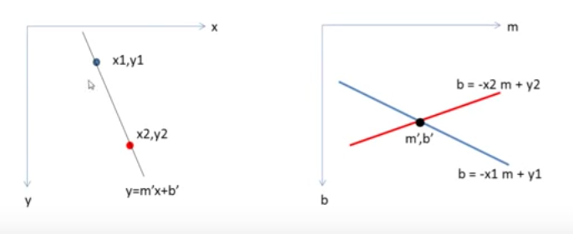
Hough Transform (Continued)
All points on a line in image space, yield lines in parameter space which intersect at a common point
  this point is the (m,b) of the line in image space.

Slide 9
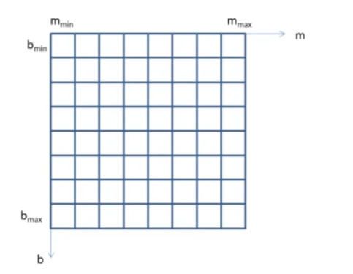
Hough Transform Algorithm
Initialize an accumulator array A(m,b) to zero

Slide 10
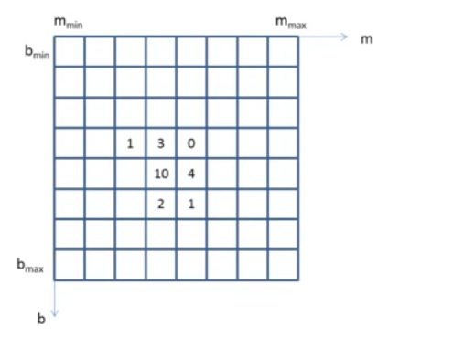
Hough Transform Algorithm
Initialize an accumulator array A(m,b) to zero
For each edge element (x,y), increment all cells that satisfy b = -x m + y

Slide 11
Hough Transform Algorithm
Initialize an accumulator array A(m,b) to zero
For each edge element (x,y), increment all cells that satisfy b = -x m + y
“This representation fails in
case of vertical lines”

Slide 12

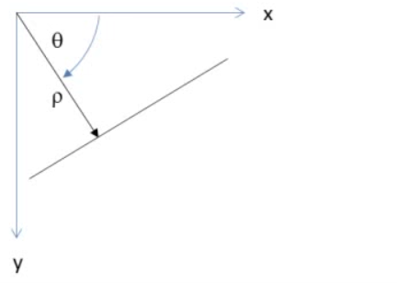
Polar Coordinate Representation of Line
  d is the perpendicular distance from the line to the origin
  θ is the angle this perpendicular makes with the x axis
  Avoids infinite slope

Slide 13
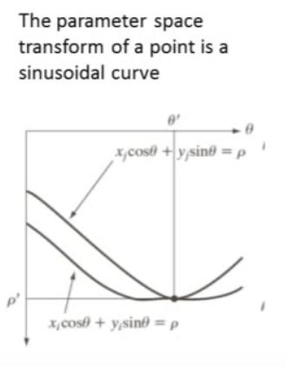
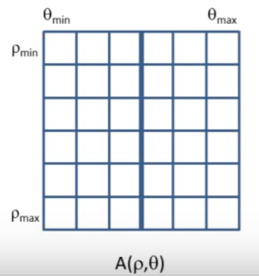
Polar Coordinate Representation of Line
  d is the perpendicular distance from the line to the origin
  θ is the angle this perpendicular makes with the x axis
  Avoids infinite slope

Slide 14

Basic Hough transform algorithm
  Quantize the Hough Transform space: identify the maximum and minimum values of ρ and θ
  Generate an accumulator array H[d, θ]; set all values to zero
  for each edge point I[x,y] in the image
    for θ = 0 to 180
      H[d, θ] += 1
  Find the value(s) of (d, θ) where H[d, θ] is maximum
  Calculate the equation of the line

Slide 15
Extensions
  Extension 1 : Use the image gradient
    To reduce the computational load use Gradient information
  In step 2 : for each edge point I[x,y] in the image
    compute unique (d, θ) based on image gradient at (x,y)
      H[d, θ] += 1
To reduce the effect of noise more than one element (elements in a neighborhood) in the accumulator array are increased

Slide 16
Extensions
  Extension 2 :
    The same procedure can be used with circles, squares, or any other shape

Slide 17
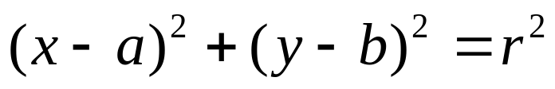
Hough Transform for Detection of Circles
The parametric equation of the circle can be written as
The equation has three parameters – a, b, r
The curve obtained in the Hough Transform space for each edge point will be a right circular cone
Point of intersection of the cones gives the parameters a, b, r

Slide 18
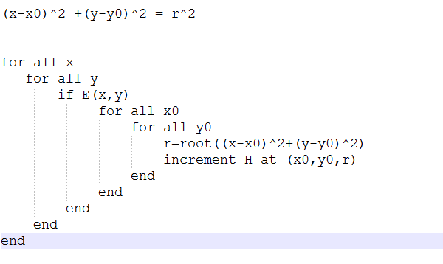
Hough Transform for Detection of Circles
Example- circles (x0,y0,r)
y0
r
x0

Slide 19
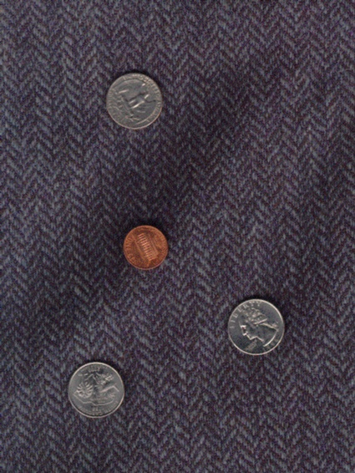
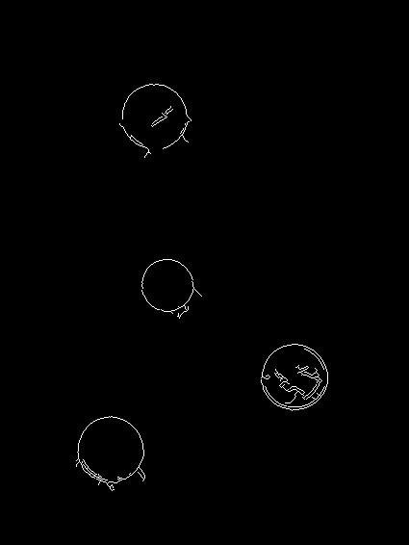
Detection of circle by Hough Transform - example
Original Image Circles detected by Canny Edge Detector

Slide 20

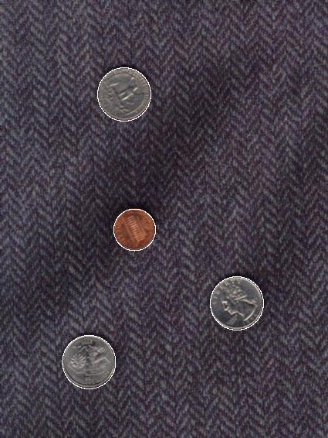
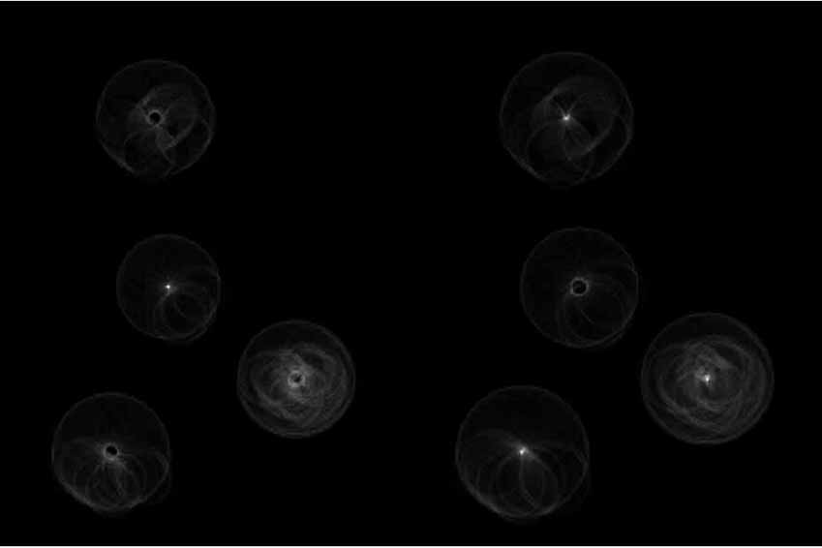
Detection of circle by Hough Transform - contd
Hough Transform of the edge detected image Detected Circles

