Slide 1
Computer Vision
Day 2
2017, Tanta University
Eng.Sara Hussien

Slide 2
Previous Session
Language Used : Python with OpenCV
Tools -setup:
  Install python-2.7.13.msi
  numpy-v1.10
  matplotlib-1.3.0.win32-py2.7.exe
  opencv-3.2.0-vc14.exe ----> extract at c:/opencv
  after extracting Open CV copy file cv2.pyd from C:\opencv\build\python\2.7\x86 and past it to C:\Python27\Lib\site-packages
  class path setup for python
  start menu --> IDLE python --> check installation by write “import cv2”

Slide 3
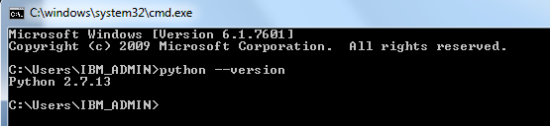
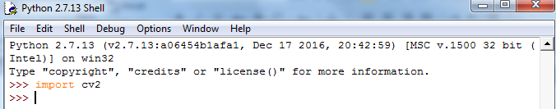
Previous Session
check for python installation
check for OpenCV installation

Slide 4
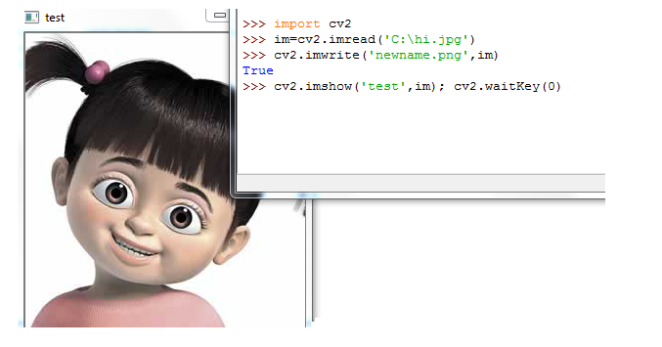
Previous Session
Read / write / display Image
cv2.imread(filename) returns a uint8 image (values 0 to 255) unsigned 8 bit integer for pixel

Slide 5
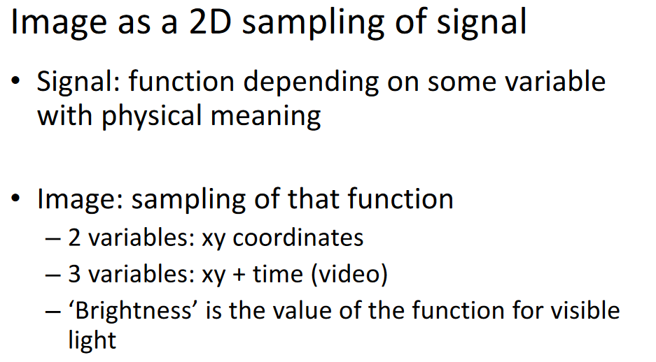
Previous Session

Slide 6
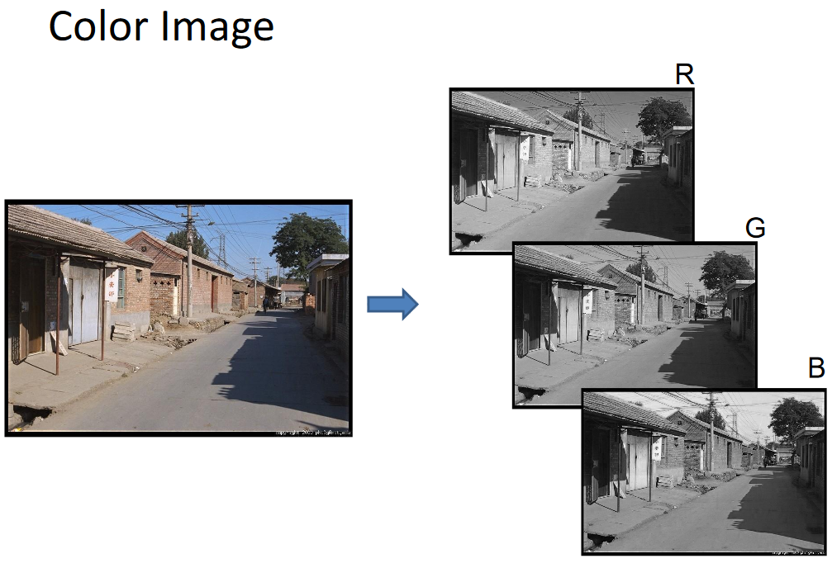
Previous Session

Slide 7
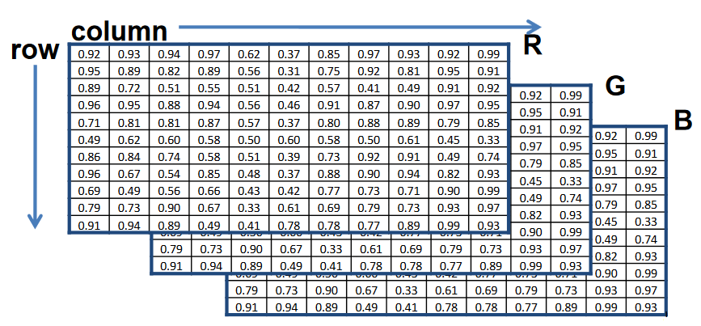
Previous Session
Images represented as a matrix
Suppose we have a NxM RGB image called “im”:
  im[1,1,0] = top-left pixel value in R-channel.
  im[y, x, 1] = y pixels down, x pixels to right in the gth channel
  Im[N, M, 2] = bottom-right pixel in B

Slide 8


Previous Session
Some operations on Image:
  Image.shape
  Crop Image
  Adding /subtracting two images

Slide 9

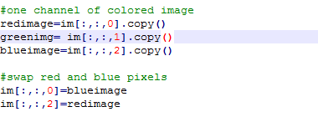
Previous Session
Some operations on Image:
  Display only one channel of colored image
  Swap Colors pixels

Slide 10
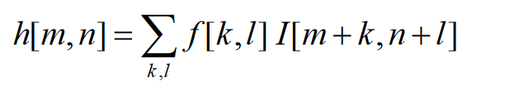
Image Filtering
Image filters in spatial domain:
  Filter is a mathematical operation of a grid of numbers
  Smoothing, sharpening, measuring texture
Image linear Filter :
  Compute function of local neighborhood at each position
F[k,l] :is called the kernel, which is nothing more than the coefficients of the filter.

Slide 11
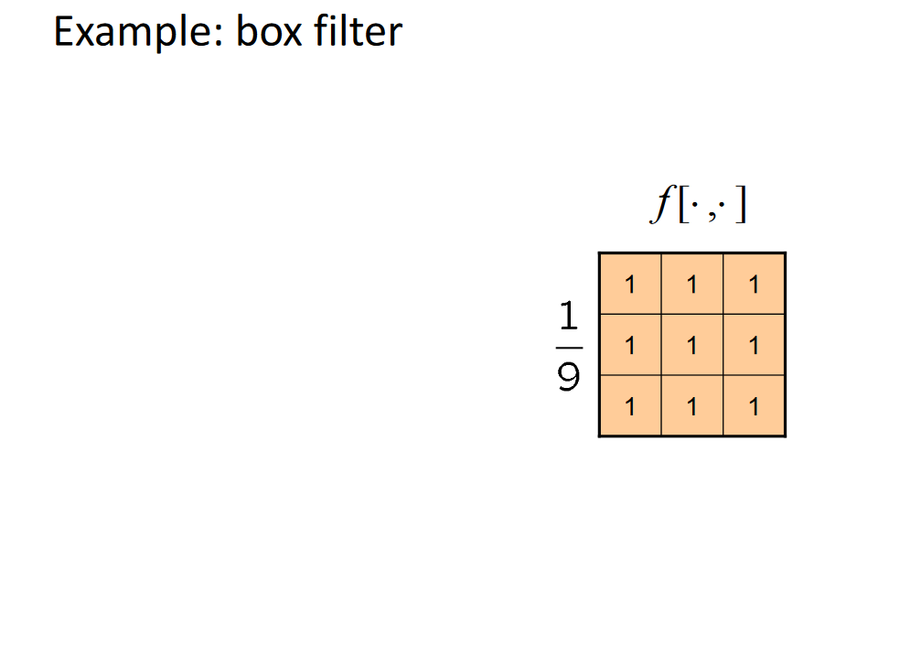
Normalized Box Filter : This filter is the simplest of all! Each output pixel is the mean of its kernel neighbors.

Slide 12
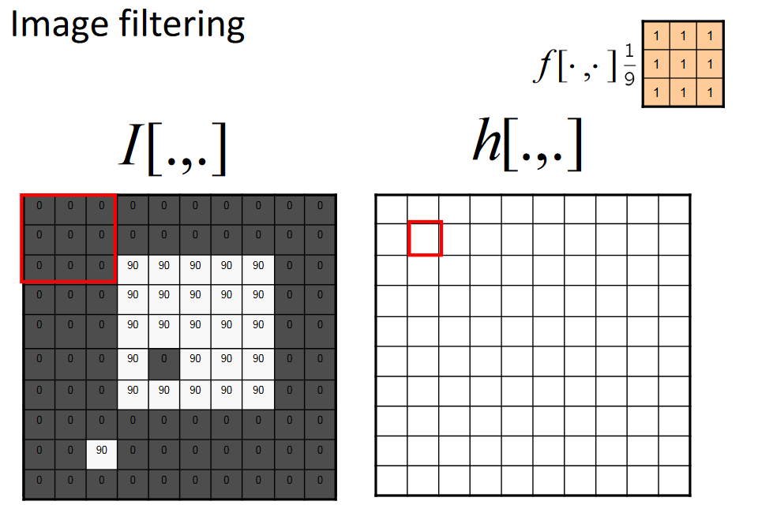

Slide 13
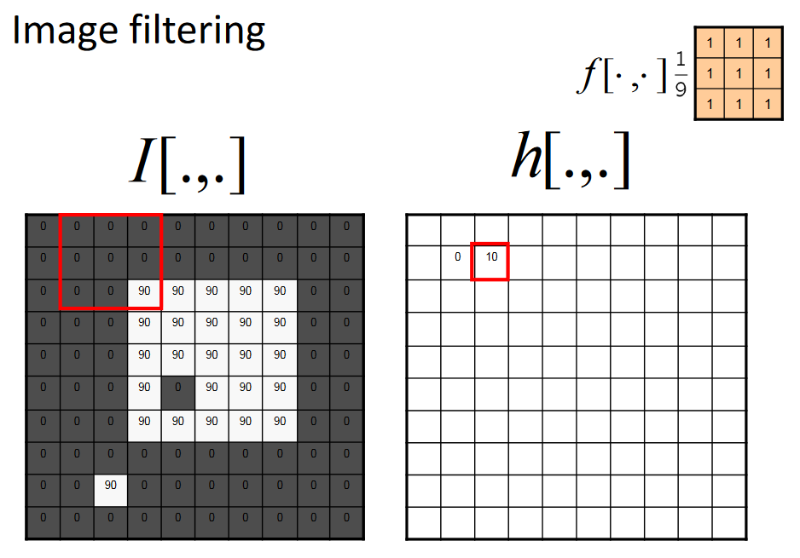

Slide 14
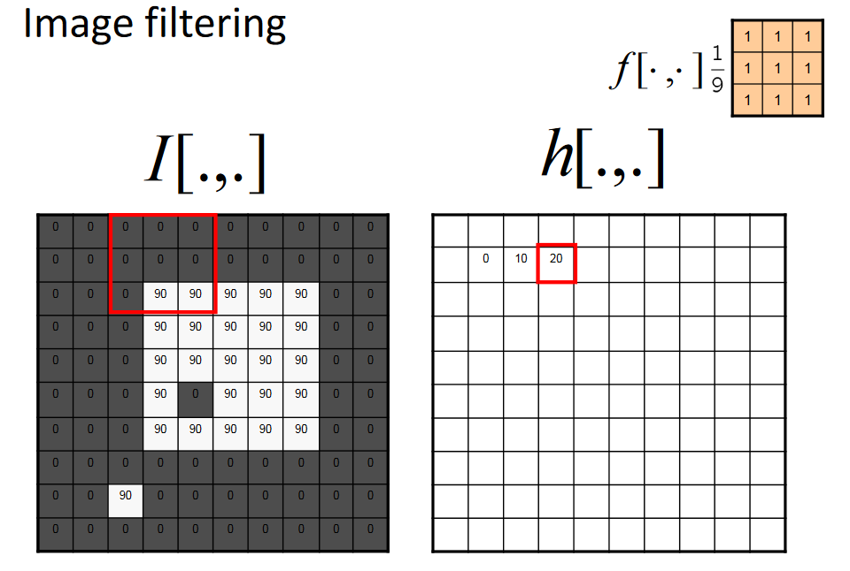

Slide 15
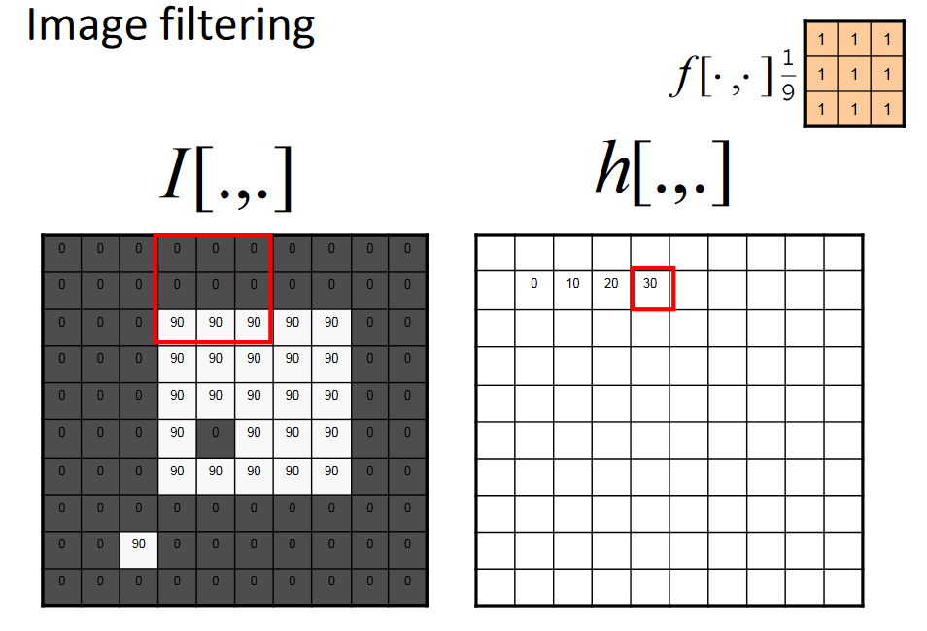

Slide 16
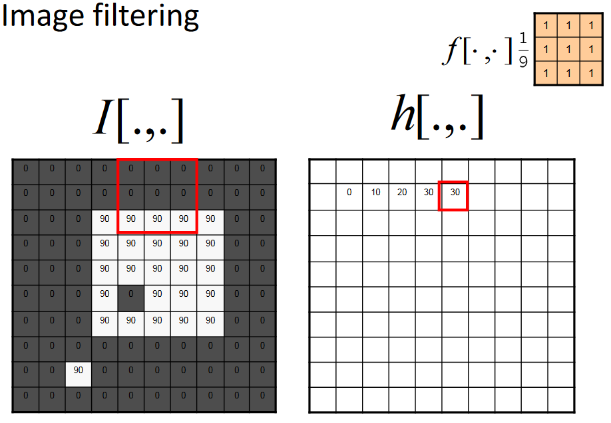

Slide 17
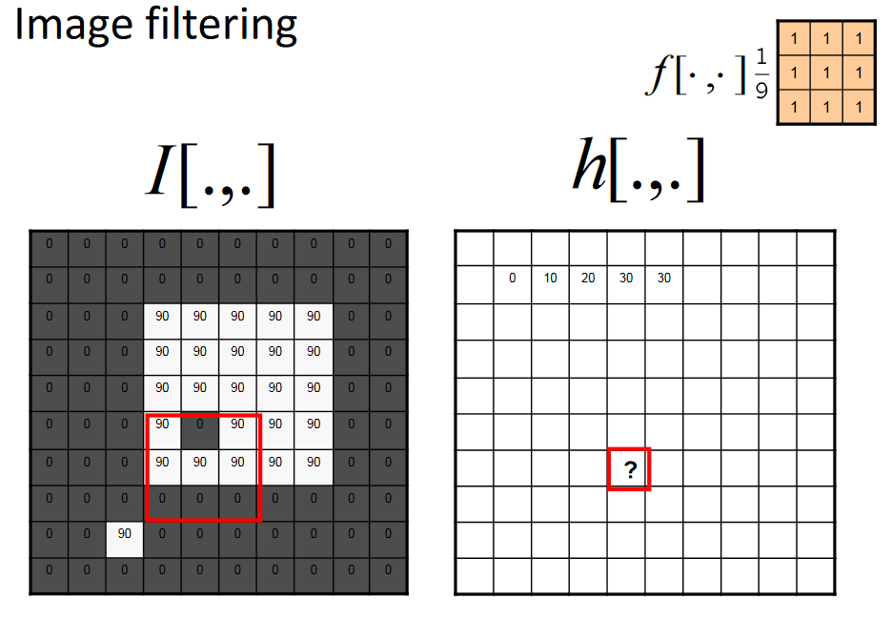

Slide 18
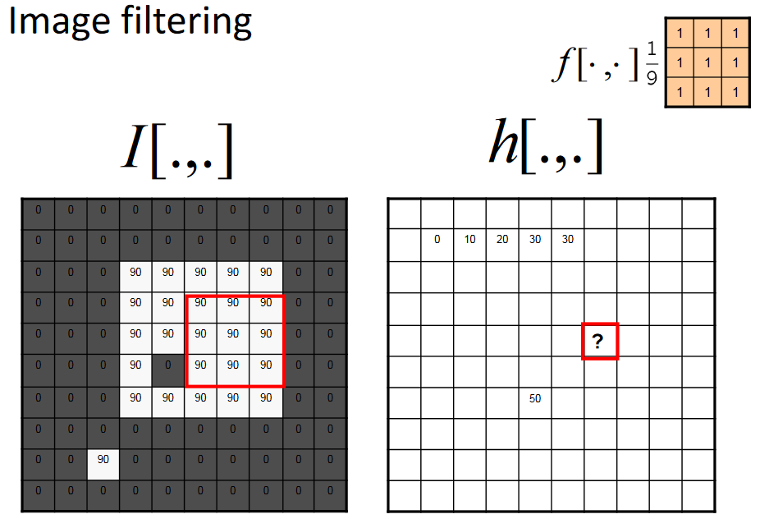

Slide 19
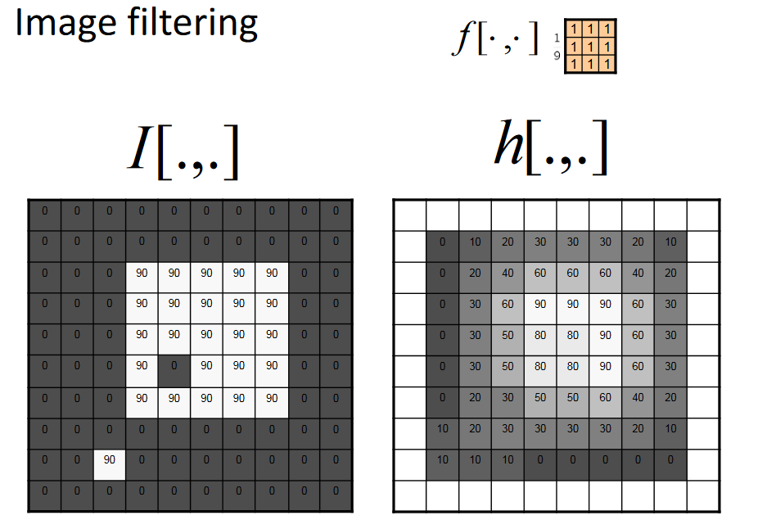

Slide 20
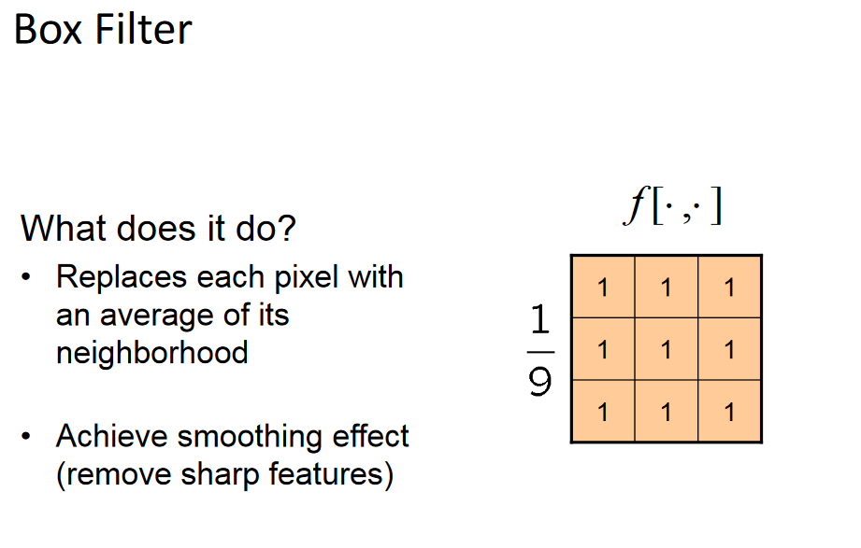

Slide 21
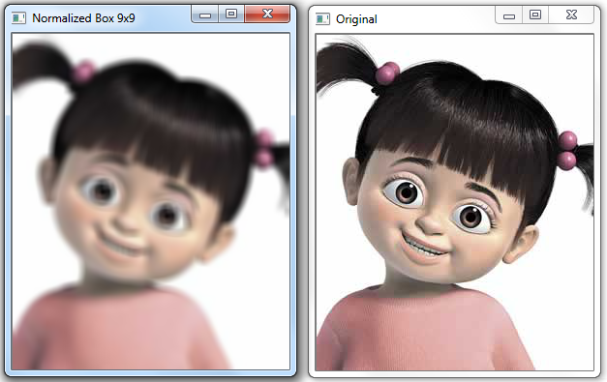
Smoothing with box filter

Slide 22
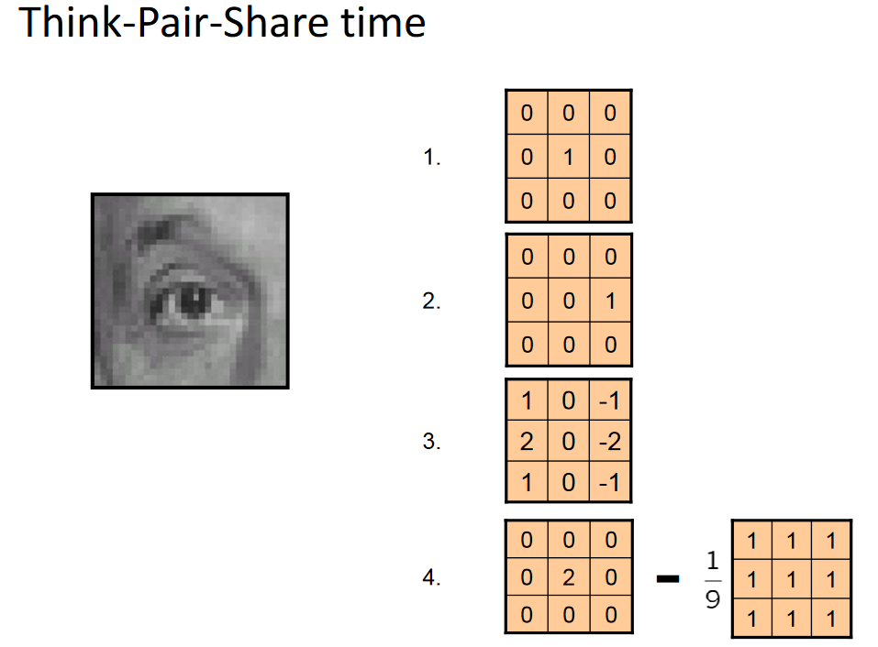

Slide 23
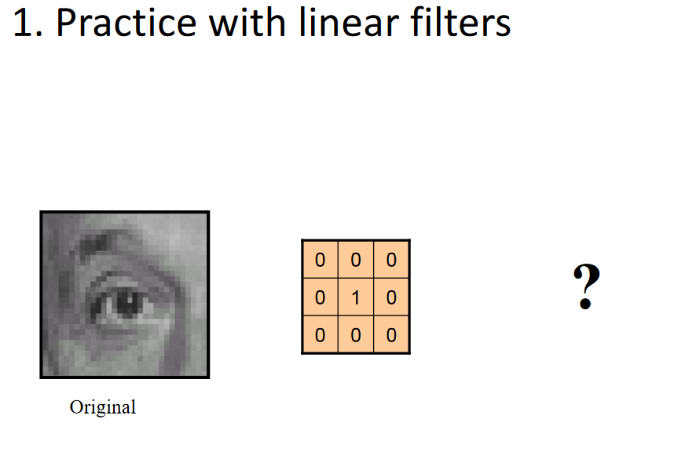

Slide 24
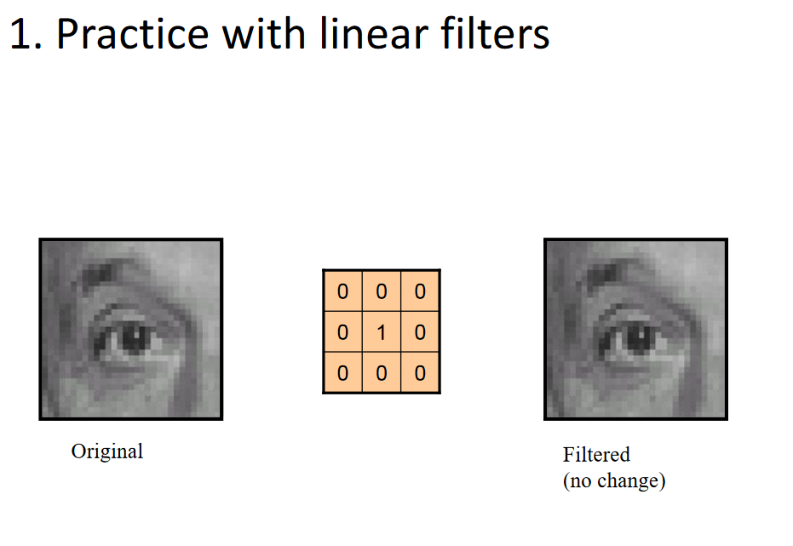

Slide 25
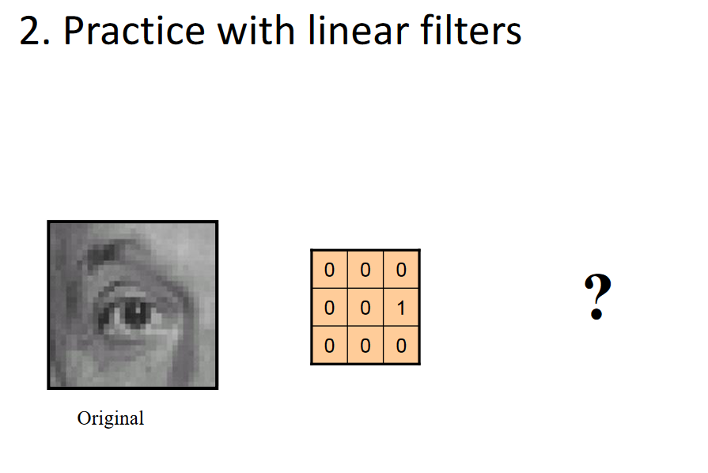

Slide 26
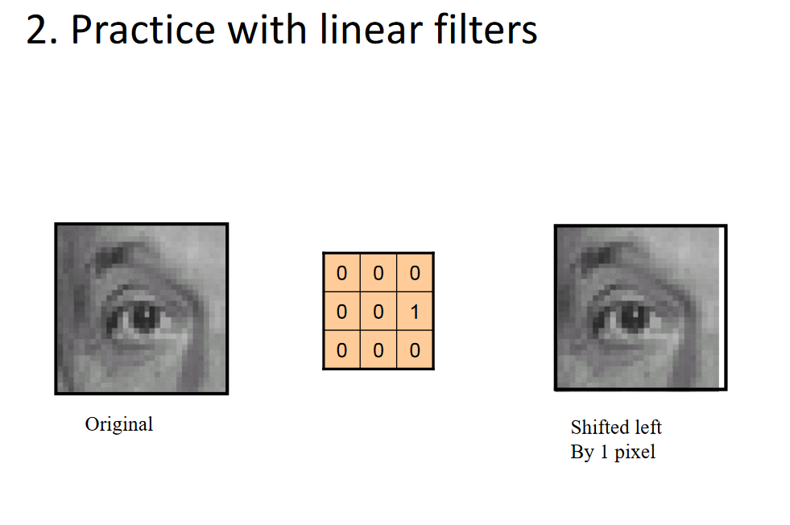

Slide 27
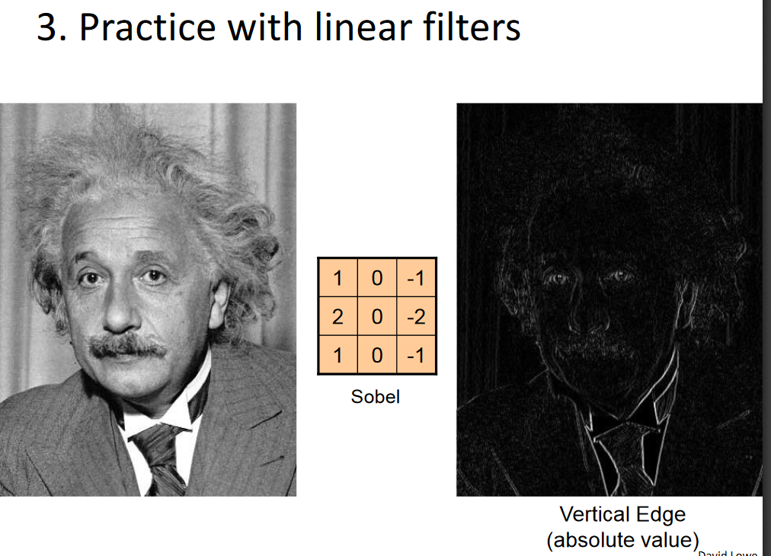

Slide 28
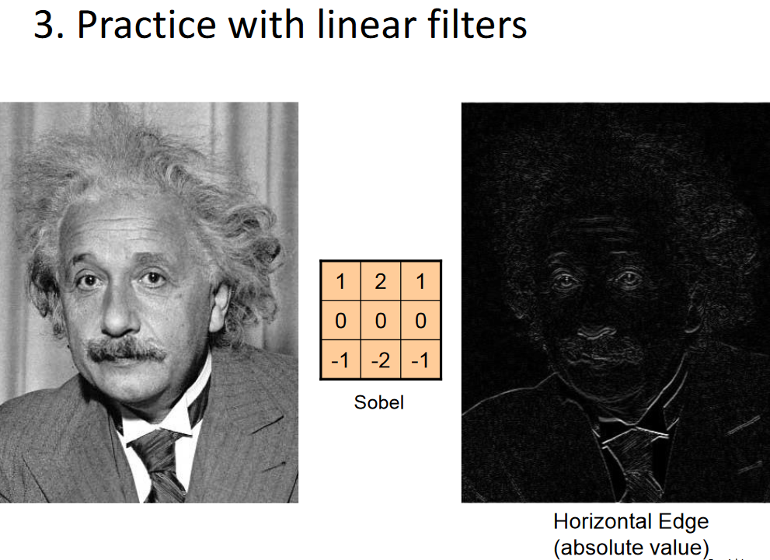

Slide 29
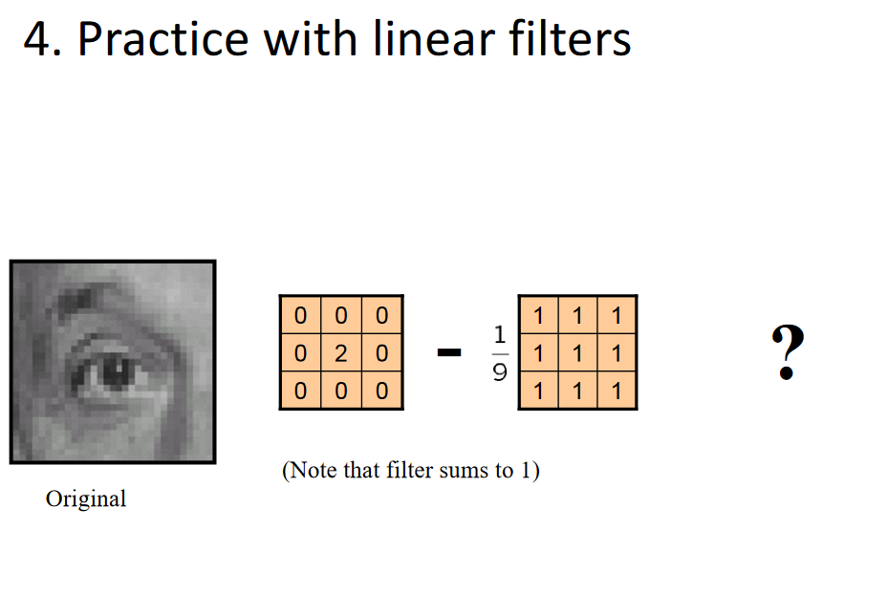

Slide 30
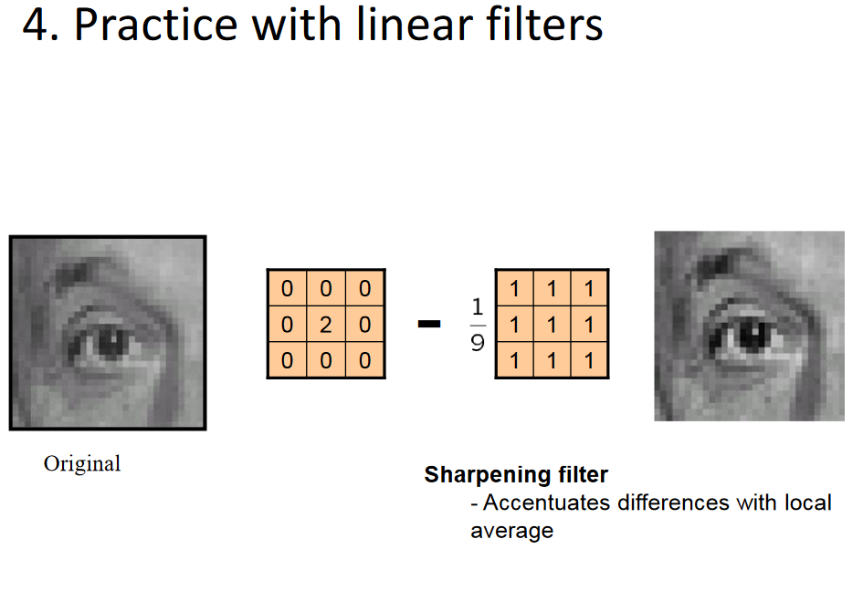

Slide 31
2D Convolution ( Image Filtering )
cv2.filter2D()
Image Blurring (Image Smoothing)
  Averaging
  Gaussian Blurring :Gaussian blurring is highly effective in removing gaussian noise from the image.
  Median Blurring: this is highly effective against salt-and-pepper noise in the images
Code at Github: https://github.com/saraAwaad/ComputerVisionLab

Slide 32
References
http://cs.brown.edu/courses/csci1430/
https://www.udacity.com/course/introduction-to-computer-vision--ud810
http://www.cc.gatech.edu/~afb/classes/CS4495-Fall2014/

