Slide 1
Computer Vision
Day 3
2017, Tanta University
Eng.Sara Hussien

Slide 2
Previous Session
Image Filtering:
  Box Filter cv2.filter2D()
  Averaging
  Gaussian Blurring: Gaussian blurring is highly effective in removing gaussian noise from the image.
  Median Blurring: this is highly effective against salt-and-pepper noise in the images

Slide 3
Edge Detection

Slide 4
Edge Detection?
“The ability to measure gray-level transitions in a meaningful way.”
(R.C. Gonzales & R. E. Woods – Digital Image Processing, 2nd Edition, Prentice-Hall, 2001)

Slide 5

Gray-Level Transition
Ideal
Ramp

Slide 6
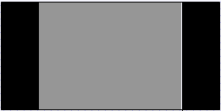
The First Derivative
Ideal
First Derivative

Slide 7
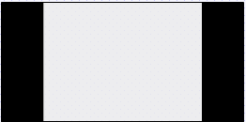


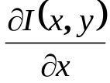
Detecting the Edge
Ideal
First Derivative
TRSH

Slide 8


Detecting the Edge(2)
Ideal
First Derivative
TRSH

Slide 9
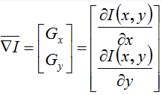


Gradient Operators
The gradient of the image I(x,y) at location (x,y), is the vector:
The magnitude of the gradient:
The direction of the gradient vector:

Slide 10
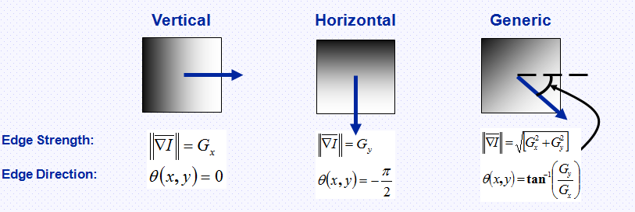
The Meaning of the Gradient
It represents the direction of the strongest variation in intensity

Slide 11
Image Gradients
OpenCV provides three types of gradient filters or High-pass filters, Sobel, Scharr and Laplacian.

Slide 12
The Sobel Edge Detector
-1 | -2 | -1
0 | 0 | 0
1 | 2 | 1
-1 | 0 | 1
-2 | 0 | 2
-1 | 0 | 1
Horizontal Edge
Vertical Edge

Slide 13
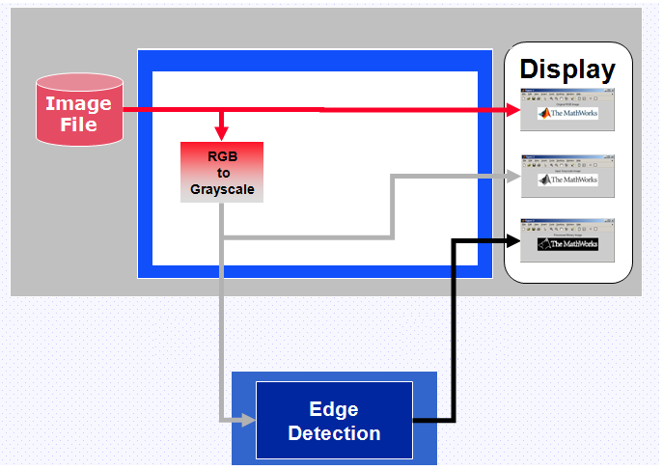
Edge Detection Flow

Slide 14
Image Gradients
Sobel Edge Detection
  void Sobel(InputArray src, OutputArray dst, int ddepth, int dx, int dy, int ksize=3, double scale=1, double delta=0, int borderType=BORDER_DEFAULT )
  Parameters:
  src – input image.
  dst – output image of the same size and the same number of channels as src .
  ddepth – output image depth; the following combinations of src.depth() and ddepth are supported:
    src.depth() = CV_8U, ddepth = -1/CV_16S/CV_32F/CV_64F
    src.depth() = CV_16U/CV_16S, ddepth = -1/CV_32F/CV_64F
    src.depth() = CV_32F, ddepth = -1/CV_32F/CV_64F
    src.depth() = CV_64F, ddepth = -1/CV_64F
  when ddepth=-1, the destination image will have the same depth as the source; in the case of 8-bit input images it will result in truncated derivatives.

Slide 15
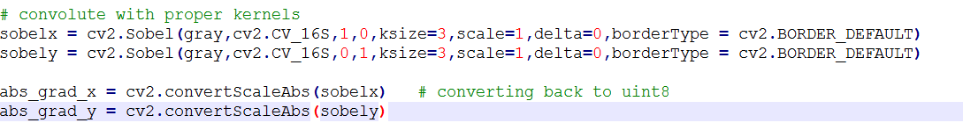
Sobel Edge Detection
  xorder – order of the derivative x.
  yorder – order of the derivative y.
  ksize – size of the extended Sobel kernel; it must be 1, 3, 5, or 7.
  scale – optional scale factor for the computed derivative values; by default, no scaling is applied (see getDerivKernels() for details).
  delta – optional delta value that is added to the results prior to storing them in dst.
  borderType – pixel extrapolation method (see borderInterpolate() for details).

Slide 16
The Canny Method
The Canny method uses two thresholds, and enables the detection of two edge types: strong and weak edge.
If a pixel's magnitude in the gradient image, exceeds the high threshold, then the pixel corresponds to a strong edge.
Any pixel connected to a strong edge and having a magnitude greater than the low threshold corresponds to a weak edge.
Code at Github: https://github.com/saraAwaad/ComputerVisionLab

Slide 17
References
http://cs.brown.edu/courses/csci1430/
https://www.udacity.com/course/introduction-to-computer-vision--ud810
http://www.cc.gatech.edu/~afb/classes/CS4495-Fall2014/

