Slide 1
Introduction to operating system

Slide 2

1. Operating system Overview

Slide 3
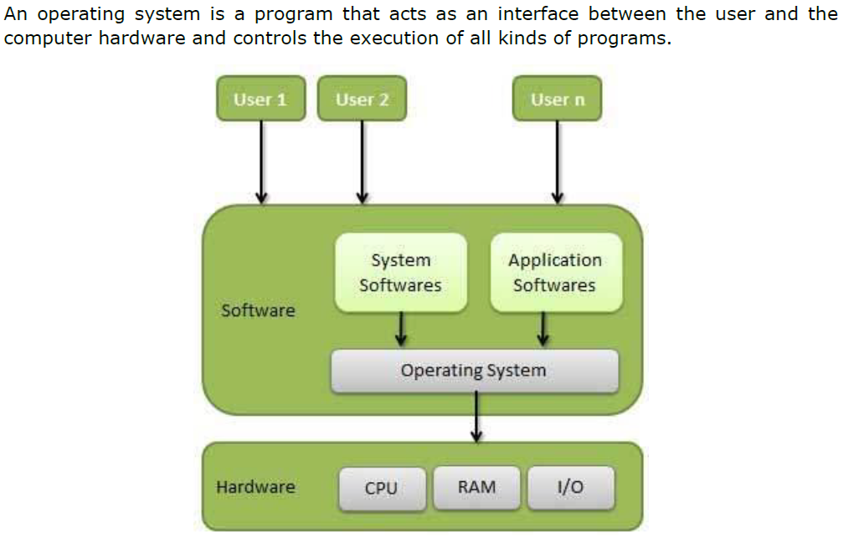
Definition

Slide 4
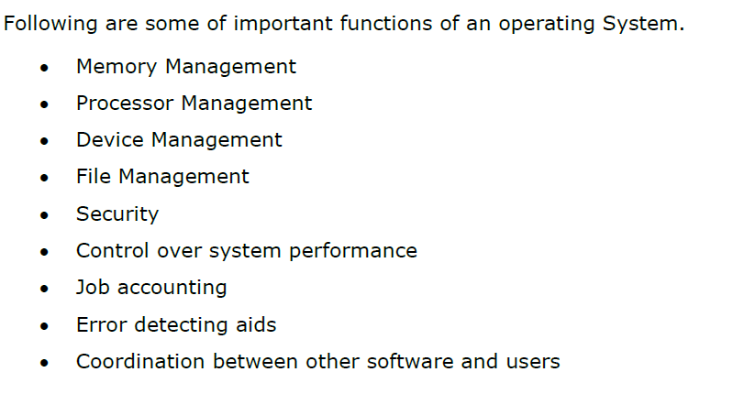
Following are some of important functions of an operating system.

Slide 5
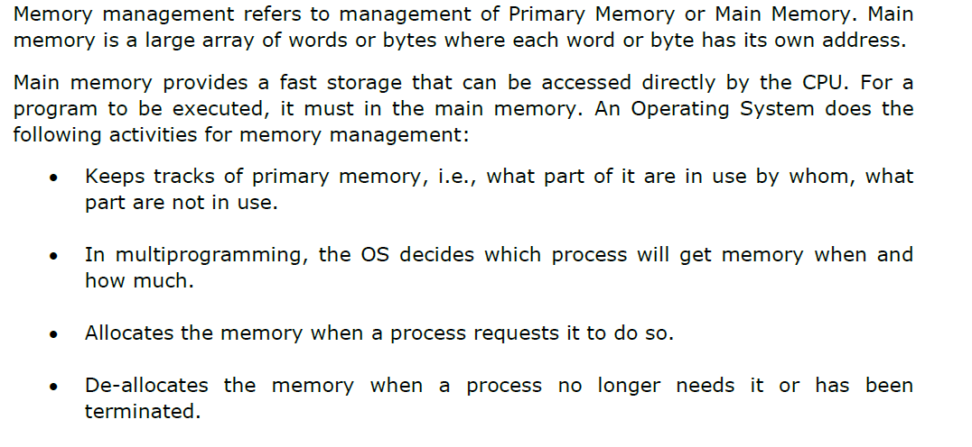
Memory Management

Slide 6

Processor Management

Slide 7

Device Management

Slide 8

File Management

Slide 9
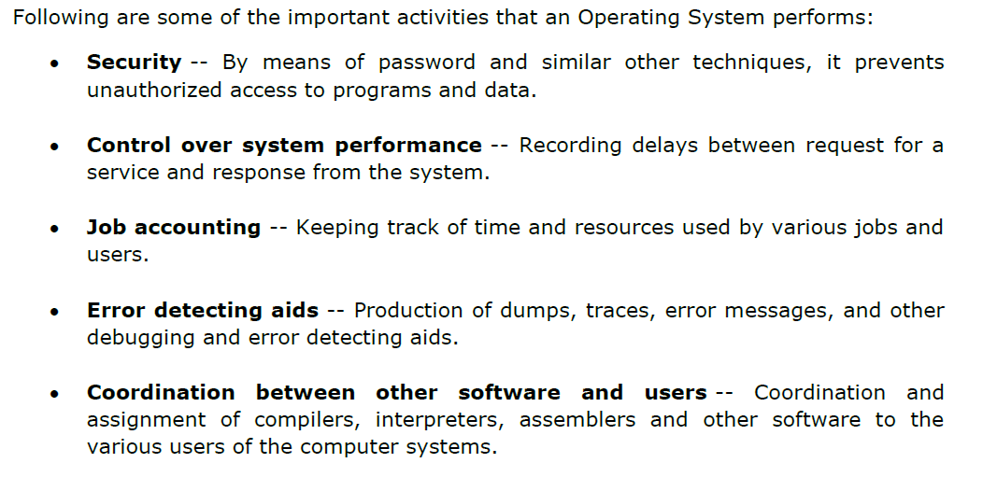
Other Important activities

Slide 10

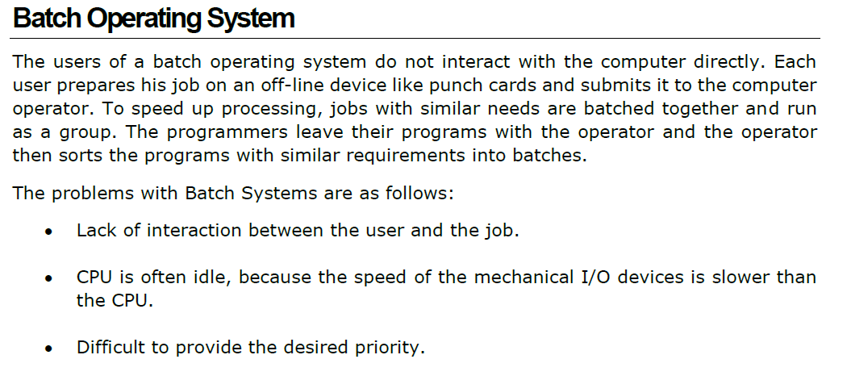
2. Operating system Types

Slide 11


Slide 12
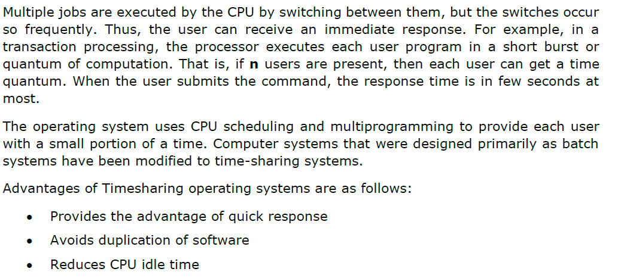

Slide 13



Slide 14
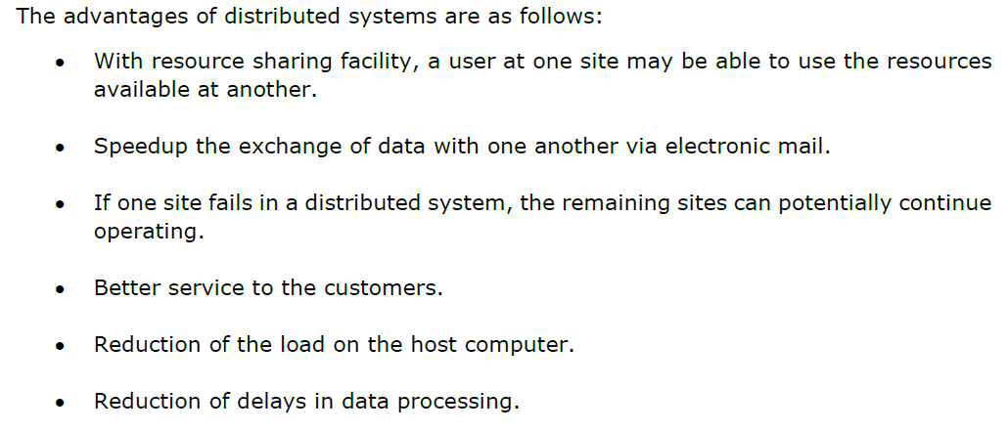

Slide 15
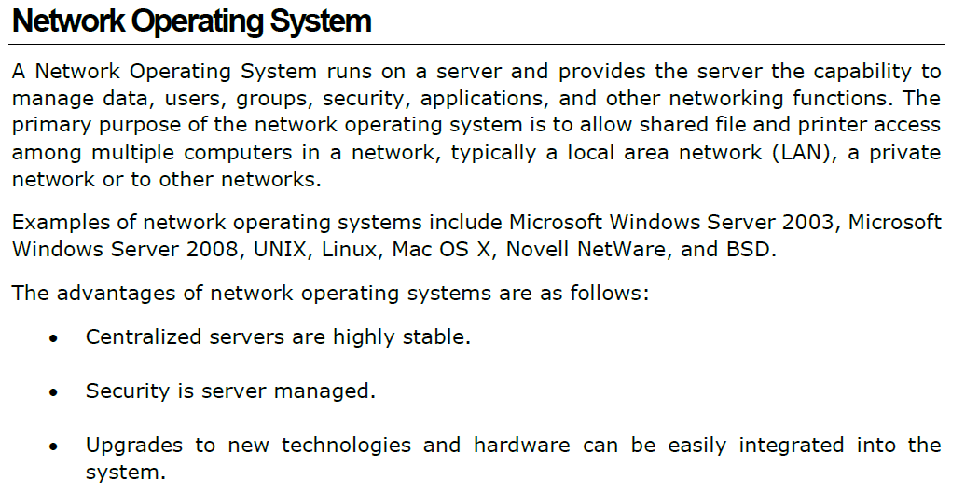

Slide 16



Slide 17
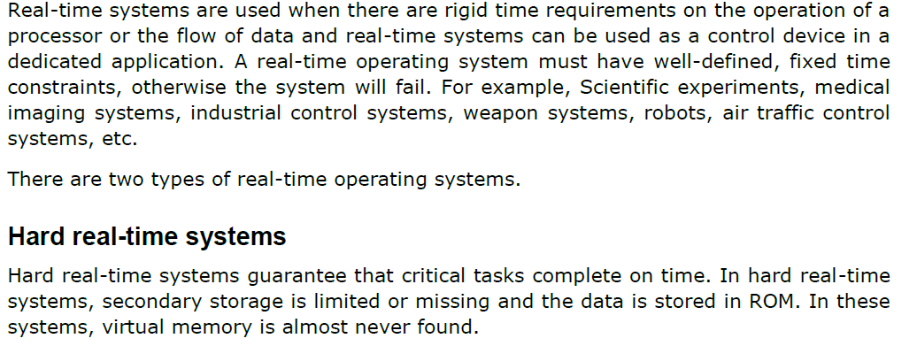

Slide 18


Slide 19
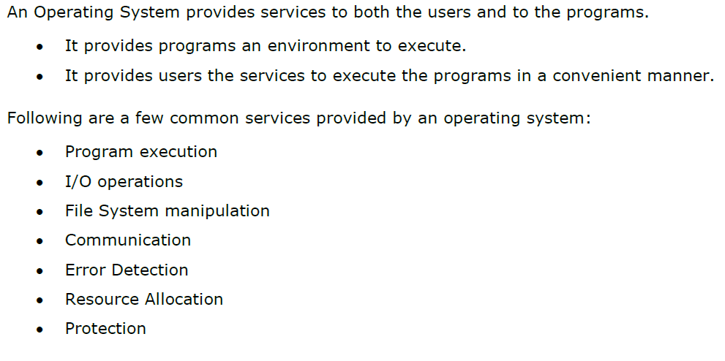
3. Operating system services.

Slide 20
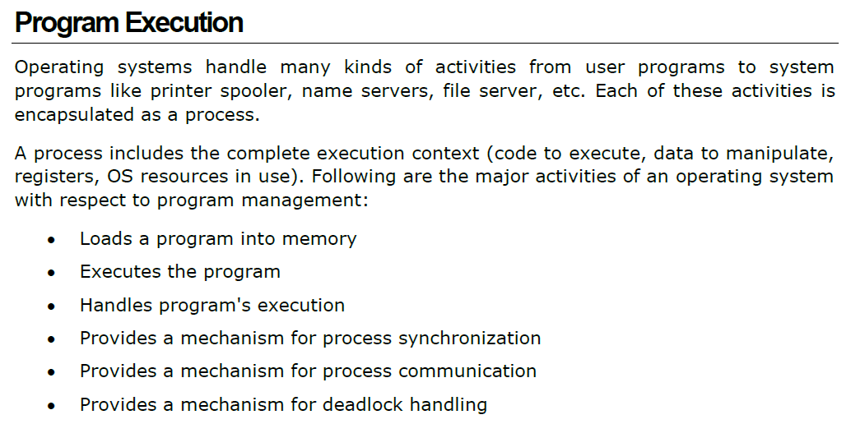

Slide 21


Slide 22
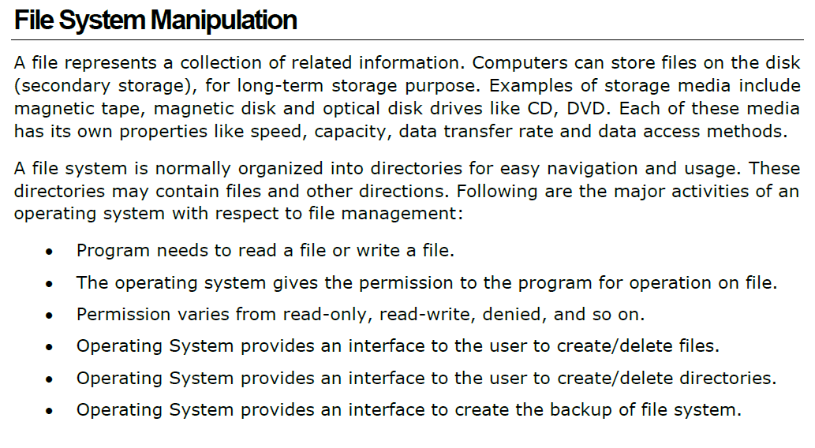

Slide 23
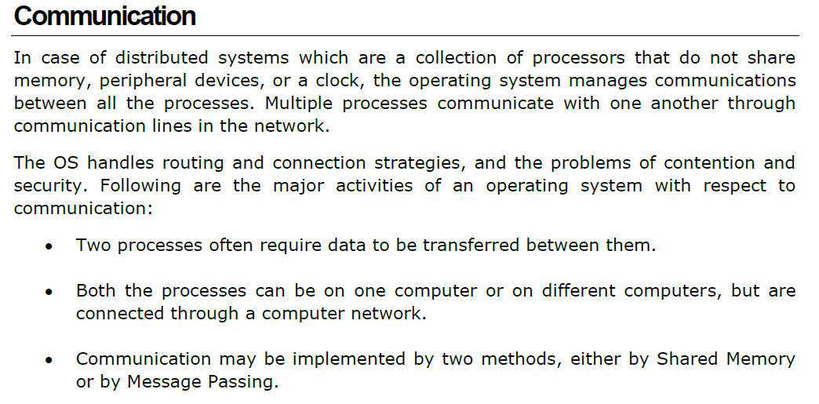

Slide 24



Slide 25
