Slide 1
Software Testing Tools
JIRA FUNDAMENTALS
Defect, Bug, Issue Tracking Tool
By
Q.C. Eng. Rony Rincon
September 16th 2017

Slide 2

Agenda:
What is Jira
Defect tracking tools
Getting Started
JIRA Issue Types
Filters & Dashboards
GreenHopper Extension

Slide 3





Meet JIRA
Project Management and Issue Tracking are not easy tasks
But JIRA makes them easier!
Notes:
Explain to students why do we need to have a system for tracking project activities and why this is so important.
Give examples of Project Management and Issues Tracking tasks

Slide 4

Meet JIRA
What is JIRA?
JIRA is a tool developed by Australian Company Atlassian in 2002.
It is used for bug tracking, issue tracking, and project management functions.
The name "JIRA" is actually inherited from the Japanese word "Gojira" which means "Godzilla". Instead of its competitor "Bugzilla"
Notes:
JIRA is advanced highly customizable issue tracking system.
In JIRA you could customize workflows to any business process and integrate JIRA with existing systems to manage tasks, track activity and ensure you meet your deadlines. You could add as many plug-ins as you need to expand it capabilities.
All this makes JIRA a flexible project management tool whether you can track bugs for a single application, managing software development for several products or running countless projects throughout your entire company.

Slide 5
Meet JIRA
What is JIRA?
The basic use of this tool is to track issue and bugs related to software and Mobile apps.
It is also used for project management.
The JIRA dashboard consists of many useful functions and features which make handling of issues easy.
According to one ranking method, as of June 2017, Jira is the most popular issue management tool
Notes:
JIRA is advanced highly customizable issue tracking system.
In JIRA you could customize workflows to any business process and integrate JIRA with existing systems to manage tasks, track activity and ensure you meet your deadlines. You could add as many plug-ins as you need to expand it capabilities.
All this makes JIRA a flexible project management tool whether you can track bugs for a single application, managing software development for several products or running countless projects throughout your entire company.

Slide 6
Meet JIRA
What is JIRA?
Jira is offered in three packages:
JIRA Software: includes the base software, including agile project management features (previously a separate product: Jira Agile)
JIRA Core: is intended at generic project management
JIRA Service Desk: is intended for use by IT or business service desks.
Let's learn JIRA Defect and Project tracking software with this Training Course.
Notes:
JIRA is advanced highly customizable issue tracking system.
In JIRA you could customize workflows to any business process and integrate JIRA with existing systems to manage tasks, track activity and ensure you meet your deadlines. You could add as many plug-ins as you need to expand it capabilities.
All this makes JIRA a flexible project management tool whether you can track bugs for a single application, managing software development for several products or running countless projects throughout your entire company.

Slide 7
Meet JIRA
JIRA is a Defect Tracking Tool
Tool to Record, Track and Resolve Issues, Bugs, Defects, Improvements and New Feature Requests
In simple terms: “JIRA is an issue tracker”
Comparison of issue-tracking systems
Notes:
JIRA is advanced highly customizable issue tracking system.
In JIRA you could customize workflows to any business process and integrate JIRA with existing systems to manage tasks, track activity and ensure you meet your deadlines. You could add as many plug-ins as you need to expand it capabilities.
All this makes JIRA a flexible project management tool whether you can track bugs for a single application, managing software development for several products or running countless projects throughout your entire company.

Slide 8
Meet JIRA
JIRA is advanced highly customizable issue tracking system
In JIRA you could
customize workflows to any business process
perform integration with existing systems to manage tasks, track activity and deadlines
add lots of plug-ins as you need to expand it capabilities
All this makes JIRA a flexible project management tool where you can:
track bugs for a single application
manage software development for several products
or run countless projects throughout your entire company
Notes:
JIRA is advanced highly customizable issue tracking system.
In JIRA you could customize workflows to any business process and integrate JIRA with existing systems to manage tasks, track activity and ensure you meet your deadlines. You could add as many plug-ins as you need to expand it capabilities.
All this makes JIRA a flexible project management tool whether you can track bugs for a single application, managing software development for several products or running countless projects throughout your entire company.

Slide 9
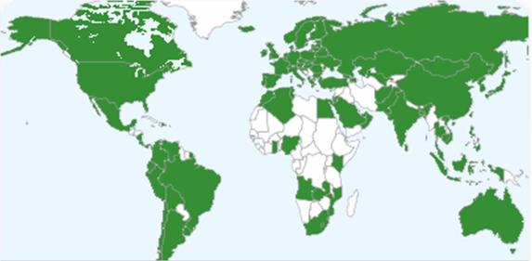
JIRA Over the World
JIRA is used by over customers in countries
89,000
122

Slide 10
Getting Started
JIRA Concepts
JIRA Structure
Issues
Components
Versions
JIRA Menus Overview

Slide 11
Issue Overview
What is an Issue?
Any duty, task that requires an action from a person
A lot of organizations use JIRA to track different kinds of issues. Depending on how your organization is using JIRA, an issue could represent:
a software bug
a project task
a helpdesk ticket
a product improvement
a leave request from client
etc

Slide 12
Project Overview
What is a Project?
Project is an entity in JIRA
A JIRA Project is a collection of issues
Every issue belongs to the Project
Each project has Name and Key
Project Key becomes the first part of that Issue Keys

Slide 13
Project & Issues: Example
Project: Web Design Application
(Key: WEB)
WEB -12
WEB -14
WEB -11
WEB -13
WEB -15

Slide 14
Components
Components are sub-sections of a project, which are used to group issues within a project into smaller parts
Operations with components:
Add — Create a new component under which issues can be classed
Delete — Remove a component from a project
Edit — Update/change the details of a particular component
Select Default Assignee — Set the default assignee for issues created in a particular component
Notes:
Components
Components are sub-sections of a project. They are used to group issues within a project into smaller parts. (A component is the first and most basic way to classify and identify about which part of the software your issue report will be.)
The next operations could be done with components:
Add — Make new components under which issues can be classed.
Delete — Remove a component from a project.
Edit — Update/change the details of a particular component.
Select Default Assignee — Set the default assignee for issues created in a particular component.

Slide 15
Versions
Versions are points-in-time for a project, which help to schedule and organize releases / sprints
E.g.: numbers of application builds, number of Sprints or any other points-in-time etc
Each Version can have the following statuses:
Released — a bundled package
Unreleased — an open package
Archived — a semi-transparent package
Overdue — the release date is highlighted
Notes:
Versions are points-in-time for a project. They help you schedule and organize your releases/sprints .
There are two ways how you could create version:
I. Create version from Administration section:
1. Go to 'Administration' section in Jira, choose project to which you want to add version.
2. You will now see a page displaying the project details. On this page all the configurable actions available on the project are easily accessible. On the lower right, a summary of the versions is displayed along with the link to the version management interface. The summary indicates the version status and the scheduled release date for that version.
3. Click the 'Manage' link to display the 'Manage Versions' screen, which shows a list of versions and each version's status. From here you can perform the operations described below.

Slide 16
JIRA Structure
Project 1
Project 2
…
Project N
Versions
Versions
Components
Components
Issue
Issue
Issue
Issue
Issue
…
…
Issue
…
Issue
Issue
Issue
Notes:
JIRA consist of a set of Projects.
A project component is a logical grouping of issues within a project. Each project may consist of various components (or none), depending on your organization's needs.
For example, a software development project could consist of components called 'Documentation', 'Backend', “UI”, 'Email Subsystem’ etc.
Any issue can belong to one or multiple components within a project or component may not be selected at all.
Versions are points-in-time for a project. They help to schedule and organize releases and sprints. Any issue can belong to one or multiple versions within a project or version may not be selected at all (it will be shown as unresolved by default).
Each issue belongs to a project but may not belong to component or version.

Slide 17
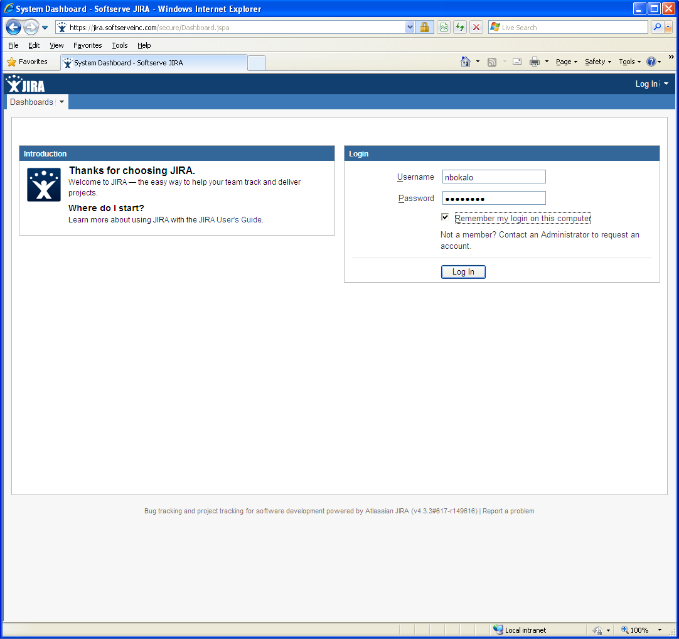
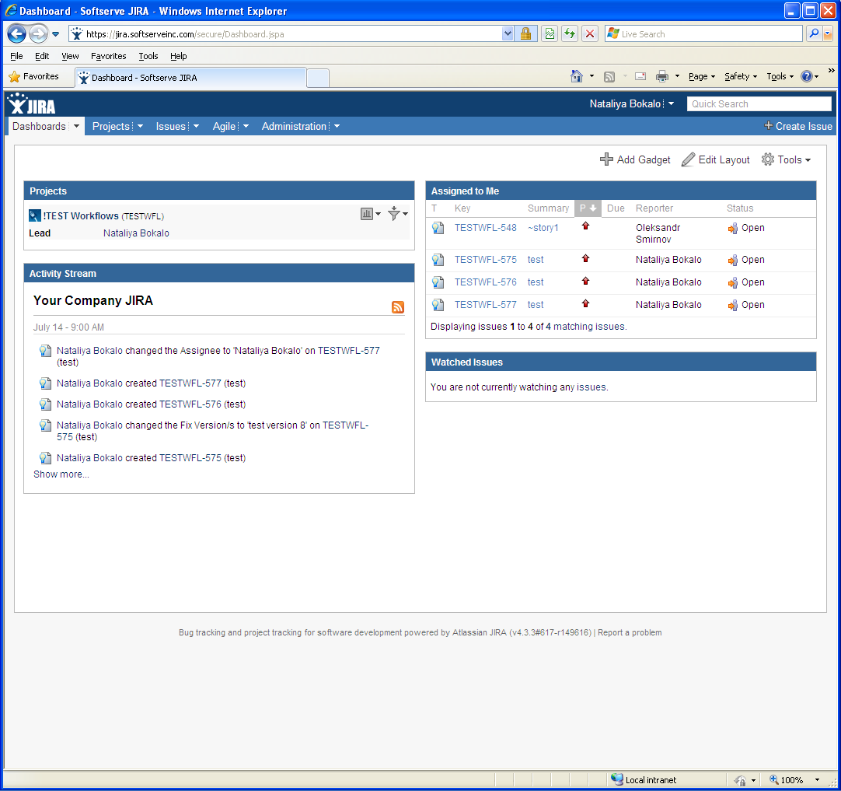
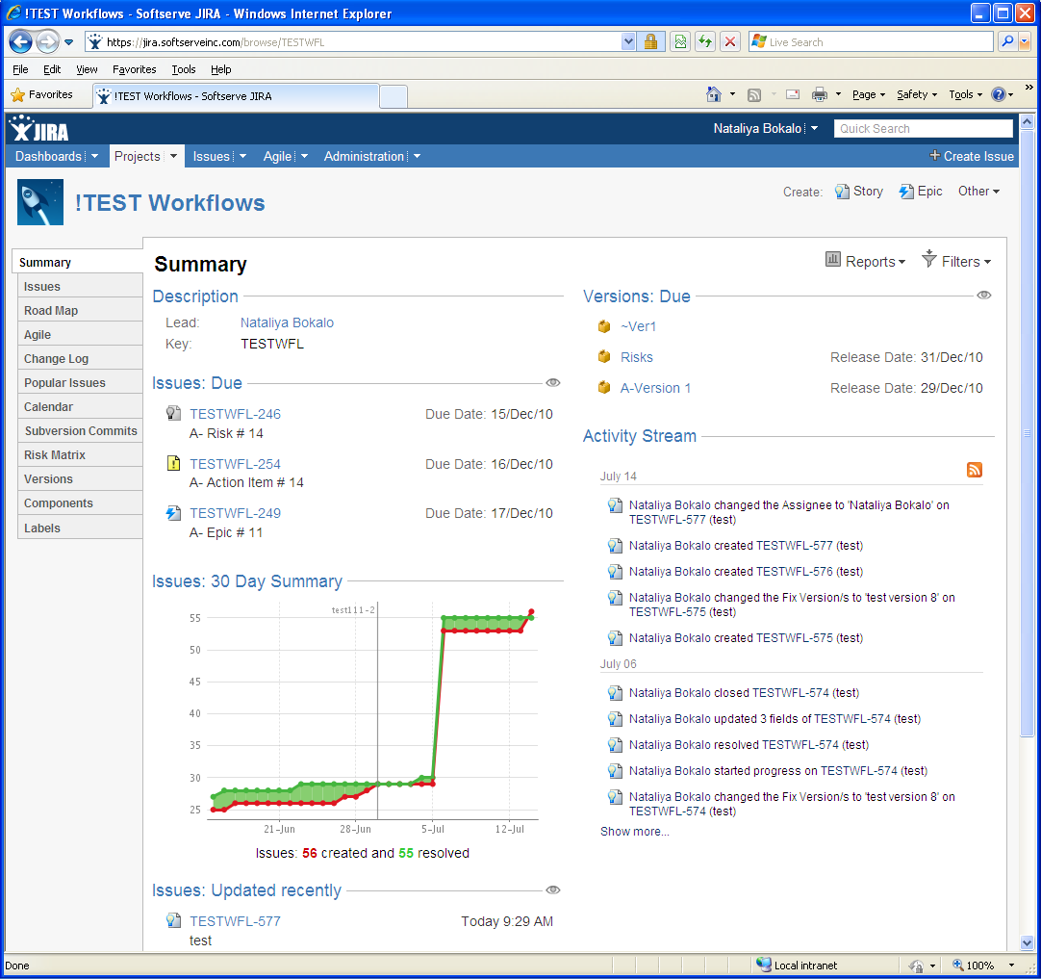
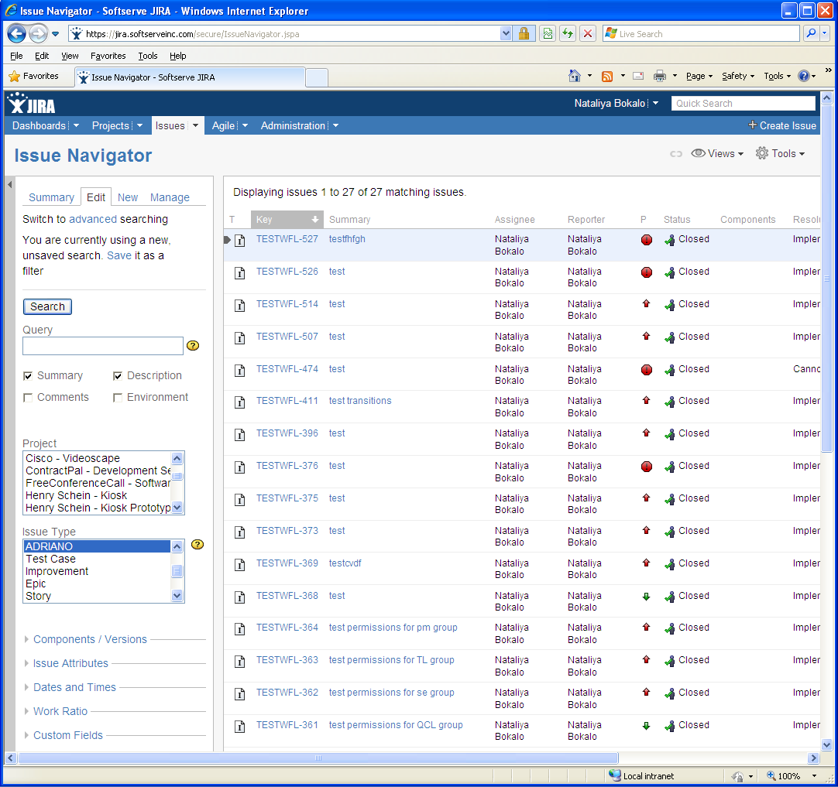
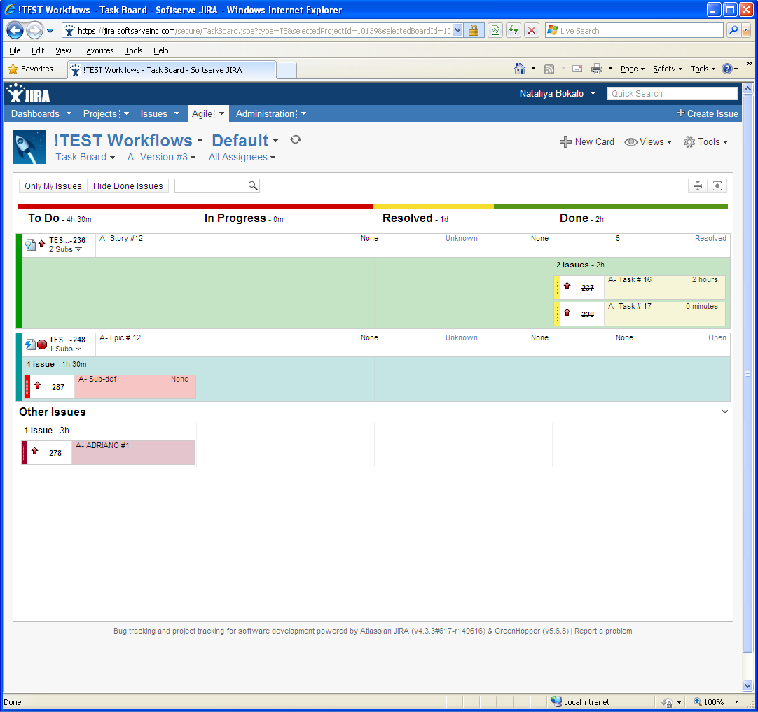
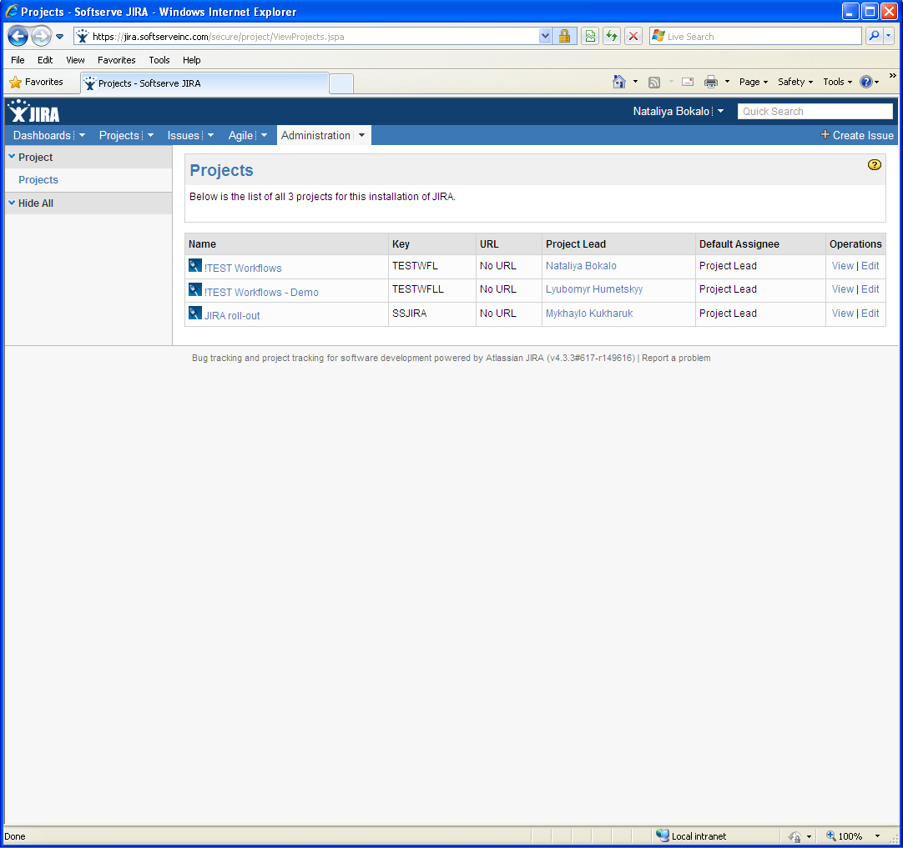
JIRA Menus Overview
Dashboards
Login
Projects
Issues
Agile
Administration
Notes:
In our Jira / Confluence configuration we have single sing-on login (this mean if you are using one browse to enter to your Jira / Confluence, and currently you are already enter to one of them you don’t need to login to another system will automatically log you in).
The Dashboard is the first screen you see when you login to JIRA.
- The navigation bar (at the top of the screen) is the same on every screen in JIRA. It contains links which give you quick access to many of JIRA's most useful functions.
- The white area of the screen, below the top navigation bar, can be customized to display 'gadgets' showing many different types of information, depending on your areas of interest.
Dashboards
The JIRA Dashboards is the first screen you see when you log in to JIRA. It can be configured to display many different types of information, depending on your areas of interest.
If you are anywhere else in JIRA, you can access your JIRA Dashboards view by clicking the 'Dashboards' link in the top left corner of the JIRA interface.
Projects
This screen provides a general overview of your project, with a variety of easily accessible reports for your project's issues, builds and source code reviews, from which you can 'dig down' into further detail.
Issues
JIRA provides a powerful issue search facility. You can search for issues across projects, versions and components using a range of search criteria. If you need to find issues based on time-tracking details, then the standard 'simple search' interface also allows you to search against the work logged on issues. JIRA also makes custom fields available as search criteria, allowing you to refine your searches even further.
Agile
Link to GreenHopper section, you also could choose one of the view: Planning Board, Task Board, Chart Board, Released Board.
Administration
In this section you could find information about your project (Name, Project Key, URL, Project Lead, Default Assignee, Operations View and Edit). Click Edit if you want to edit project info or Project Name link to enter to project info tab.

Slide 18
Jira issue types
Issue Types Overview
Workflow
Bug Issue Type Creation
Typical Actions on Issues

Slide 19
Issue Types
Issues
Epic
Story
Bug
Improvement
Task
New Feature
Risk
Sub-Issues
Technical Task
Sub-Bug
Notes:
JIRA Issue (or entity) represents any distinct logical piece of project scope.
Different organizations use JIRA to track different kinds of issues. Depending on how the organization is using JIRA, an issue could represent a software bug, a project task, a helpdesk ticket, a leave request form, etc.
Technically there are 2 types of issues – parent and child (or sub) issues. It means that sub-issue is the one level down of parent issue and can detail the scope of its parent.
4) Each entity type has its own properties (defined through custom fields) and a lifecycle (defined through the workflows, states and transitions between states)

Slide 20
Issue Type: Epic, Story
Usage
Describes project’s SOW (scope of work) within Requirements Management process
Difference
None (all fields are similar)
Common
States, Transitions and Workflow
Notes:
While User Story describes the distinct piece of functionality, the Epic may reflect the high-level functionality, component, sub-system overview from which user stories might be derived. In simple words, Epic is a big user story that needs to be broken down into smaller pieces.
“Referenced Epic/User Story” - a text field to put ID of Epic that originated given User Story
Usually either Epics or User Stories are used within a project. However, there are cases when project scope is tracked in Epics by non-technical project staff (Product Managers, Sponsors, upper-level managerial staff, etc)

Slide 21
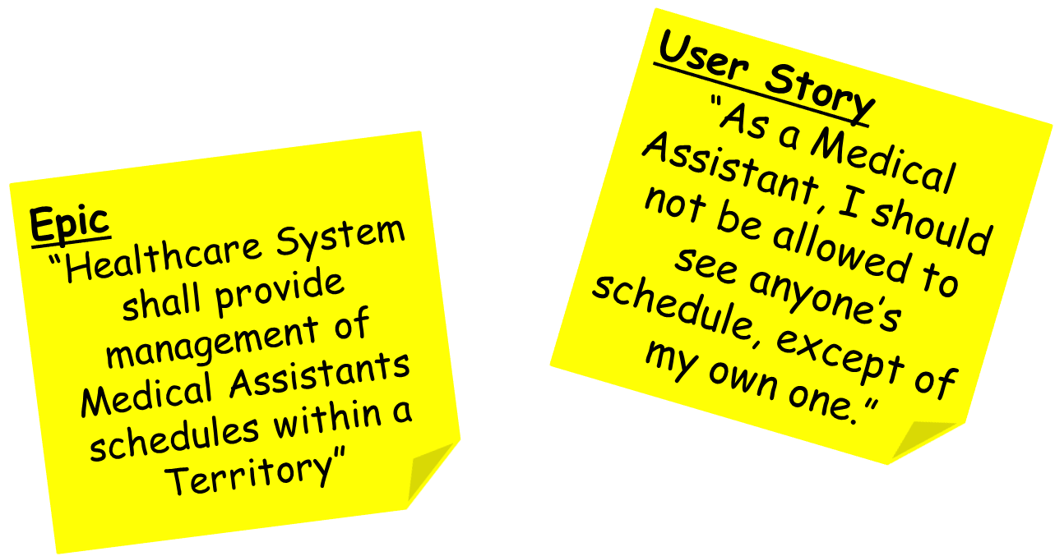

Slide 22
Issue Type: Task, Technical Task
Usage
Communicates the need to do generic work for the project
Specifics
Technical Tasks can be associated with any “parent” JIRA issue type
Task can represents any generic non user story related activity
Recommendation
Makes the most sense when used together with Story issue type
Notes:
1) Sub-Task issue type can not be tracked autonomously, since it’s configured as sub-issue and there is no much benefit of tracking just pieces of work

Slide 23
Technical Task
“Design role-based security approach”
Task
“Re-factor test cases from Functional Test Suite”
Technical Task
“Create test cases for this US”

Slide 24
Issue Type: Bug, Sub-Bug
Usage
Describes the problem which impairs or prevents functionality of the product
Sub-Bug supports Agile best practices on scope management
Difference
None (all fields are similar)
Common
States, Transitions and Workflow

Slide 25
Sub-Bug
“User in Medical Assistant role cannot be logged into Healthcare System”
Bug
“Scheduler role is no more permitted to edit schedules of MA-es within his Territory”

Slide 26
Workflow Overview
What is a Workflow?
Workflow is the movement (or Transition) of an Issue through various Statuses during its lifecycle
Possible statuses:
Open
In Progress
Resolved
Closed
Reopened
Possible transitions:
Start Progress
Stop Progress
Resolve
Re-open
Resolve & Close

Slide 27
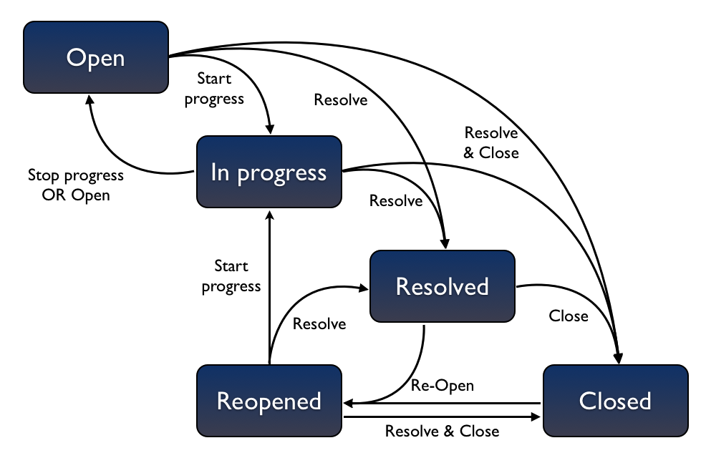
Issues Workflow

Slide 28
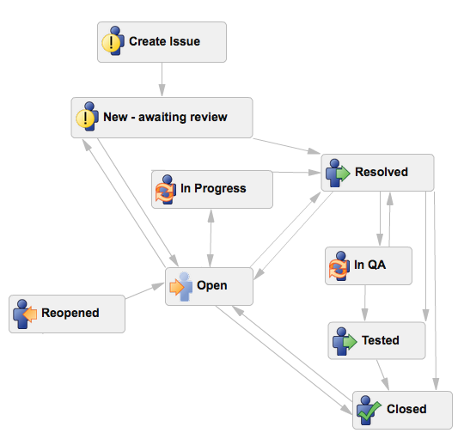
Issues Workflow

Slide 29
Issues Workflow

Slide 30
Issue Type: Improvement
Usage
Communicates any change to
product
product development processes
environment configuration
project documentation, etc
Specifics
Usually is either transformed into Story/Epic or closed after analysis
Improvement
“Need to document application configuration & install processes so that it takes less time for newbie ”

Slide 31
Issue Type: New Feature
Usage
Comparing to the Improvement (which is an enhancement to an existing feature), it’s a completely new feature to the product.
Specifics
Usually is either transformed into Story/Epic for further work
Feature
“Great to have implemented one more role similar to Medical Assistance, but with restricted responsibilities”

Slide 32
Issue Type: Risk
Usage
Concerns potential events of chosen activities/actions (including inactivity too), that can be avoided or mitigated, rather than current ones that must be immediately addressed (issues)
Technically, events might be either Positive or Negative
Specifics
General usage tends to focus only on potential harm that may arise from a future event
Risk workflow is configured to meet risk management process requirements
Risk
“Product scalability metrics do not represent the production load”

Slide 33
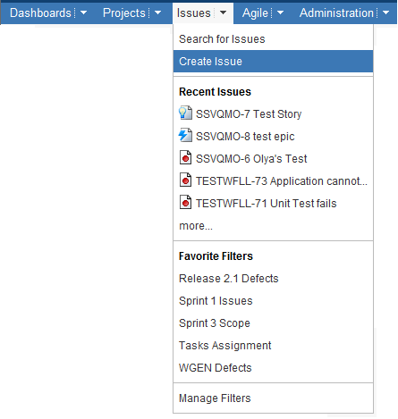
Bug Issue Type: Creation
To create a new issue select
“Issues > Create Issue”

Slide 34
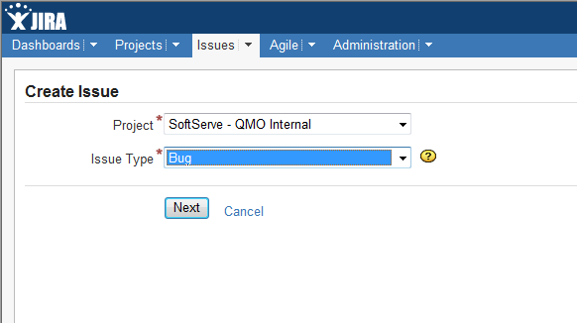
Bug Issue Type: Creation
Project – the 'parent' project to which the issue belongs
Issue Type – selected issue type (e.g.: Story, Bug, Task, etc)

Slide 35
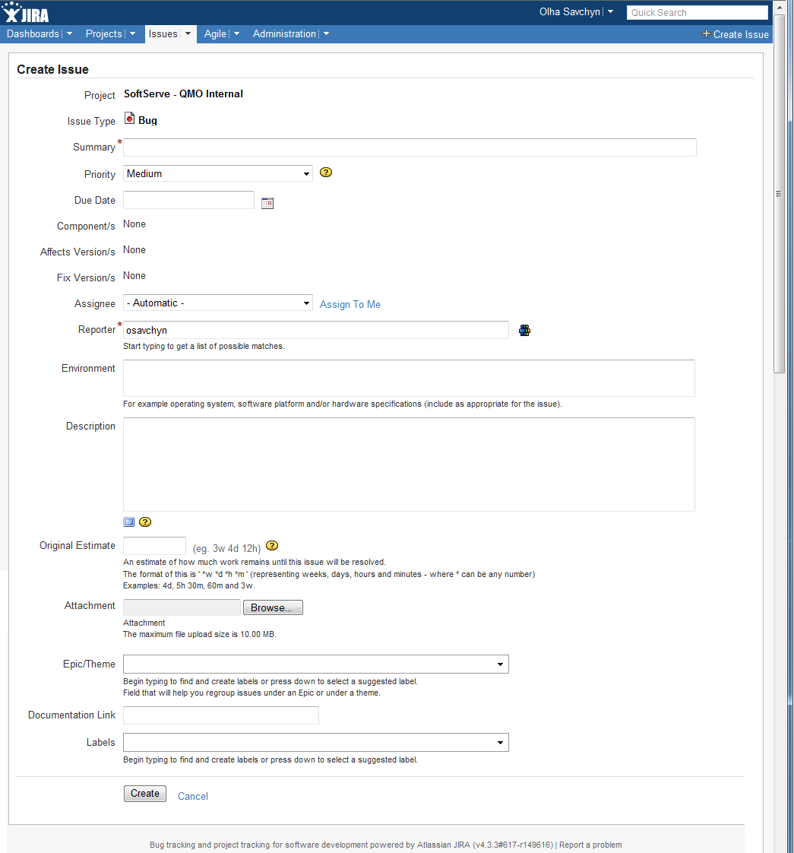
Bug Issue Type: Creation

Slide 36
Bug Issue Type: Fields
Summary – a brief one-line summary of the issue
Example:
“Medical Assistance cannot create an appointment due to exception on the page”
Priority – the importance of the issue in relation to other issues
Example:
Blocker – Indicates that this issue takes precedence over all others
Critical – Indicates that this issue requires urgent attention
Major – Indicates that this issue has a significant impact
Minor – Indicates that this issue has a relatively minor impact
Trivial – Lowest priority (often is not fixed at all)
Due Date – the date by which this issue is scheduled to be completed

Slide 37
Bug Issue Type: Fields
Component/s – project component(s) to which this issue relates
Example: UI, Middleware, Backend
Affects Version/s – project version(s) for which the issue is (or was) manifesting
Example: Sprint 1
Fix Version/s – project version(s) in which the issue was (or will be) fixed
Example: Sprint 2
Assignee – the person to whom the issue is currently assigned

Slide 38
Bug Issue Type: Fields
Reporter – the person who entered the issue into the system.
Environment – the hardware or software environment to which the issue relates
Example: Windows 7, IE 8, JRE 6 update 10
Description – a detailed description of the issue
Example: steps to reproduce for the particular issue
Original Estimate – the estimate of the total amount of time required to resolve the issue, as estimated when the issue was created
Example: 4 hours (will take to fix the issue) – should be set by developer

Slide 39
Bug Issue Type: Fields
Attachment – the attachment which has relation to the issue
Example: screenshot of the application page with highlighted issue
Epic/Theme – epic or theme to which issue belongs
Documentation Link – link to issue related documentation
Labels – allows to categorize issues in more informal way than assigning versions / components

Slide 40
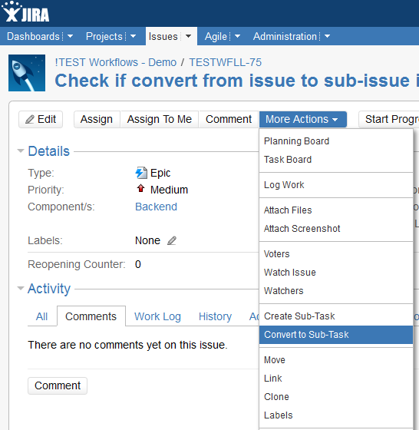
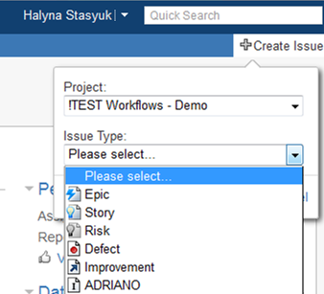
Typical Actions on Issues
Create
Edit
Assign
Comment
Log Work
Attach Files
Move
Link
Clone
Convert

Slide 41
Filters & Dashboards
Searching
Simple
Advanced
Quick
Filtering
Dashboards

Slide 42

JIRA Capabilities
JIRA has the following capabilities:
Simple, Advances & Quick Search
Powerful Predefined and Custom Filters
Issues Bulk Operations
Issues Navigators

Slide 43
JIRA Search
Sometimes you just want to be able to get particular issue
Other times you can’t remember what the issues was
Search
Simple
Advanced
Quick

Slide 44

Simple Search
Performing a Simple Issue Search:
Specifying a Query (searching through descriptive Fields)
Searching particular Projects or Issue Types
Using the 'Components/Versions' section
Using the 'Issue Attributes' section
Using the 'Dates and Times' section
Using the 'Work Ratio' section
Using the 'Custom Fields' section
Notes:
The 'Work Ratio' search is based on the Actual work logged against an issue versus the original Estimated work duration.
Work Ratio Percentage = (Time Spent / Original Estimate) x 100%

Slide 45
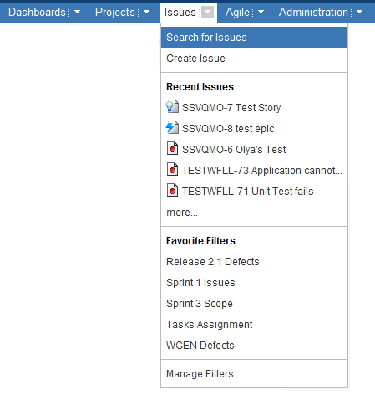
Simple Search
To search for Issues select
“Issues > Search for Issues”
Notes:
The 'Work Ratio' search is based on the Actual work logged against an issue versus the original Estimated work duration.
Work Ratio Percentage = (Time Spent / Original Estimate) x 100%

Slide 46
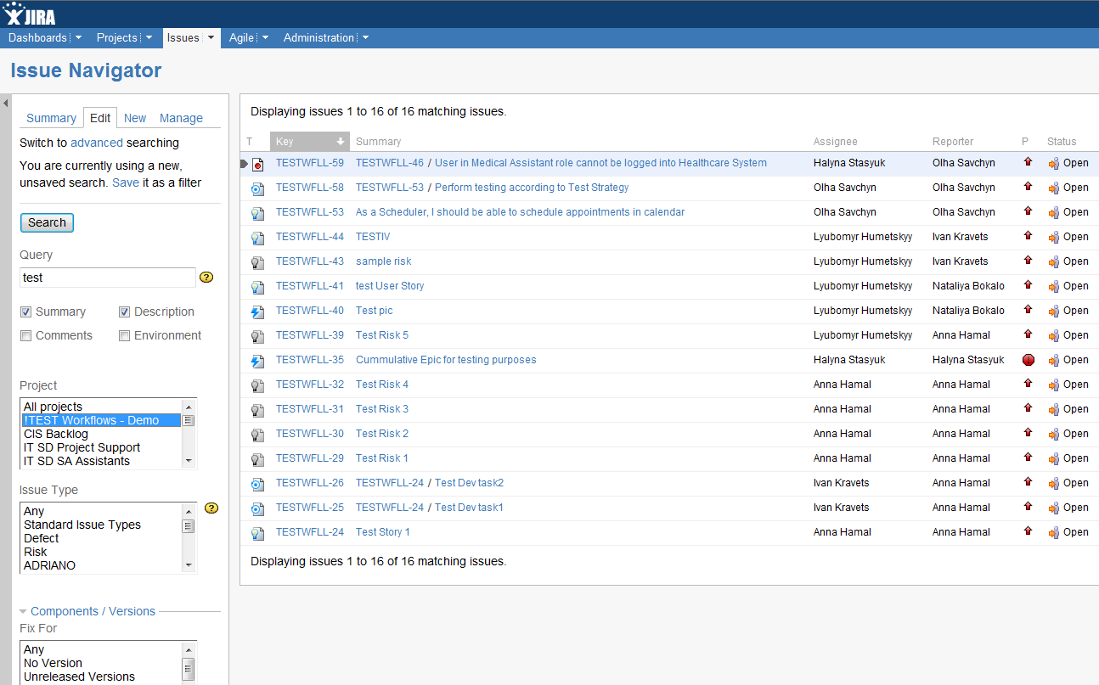
Simple Search
Issue Navigator:
Simple Search
Notes:
The 'Work Ratio' search is based on the Actual work logged against an issue versus the original Estimated work duration.
Work Ratio Percentage = (Time Spent / Original Estimate) x 100%

Slide 47

Advanced Search
Advanced Search allows to use Structured Queries
JIRA Query Language (JQL) gives some SQL-like statements
Examples:
project = "TEST“
status = open and priority = high and assignee = osavchyn
project in (JRA,CONF) and fixVersion = "3.14“
remainingEstimate > 4h order by priority
More details can be found here:
Advanced Search

Slide 48
Advanced Search
Notes:
The 'Work Ratio' search is based on the Actual work logged against an issue versus the original Estimated work duration.
Work Ratio Percentage = (Time Spent / Original Estimate) x 100%

Slide 49
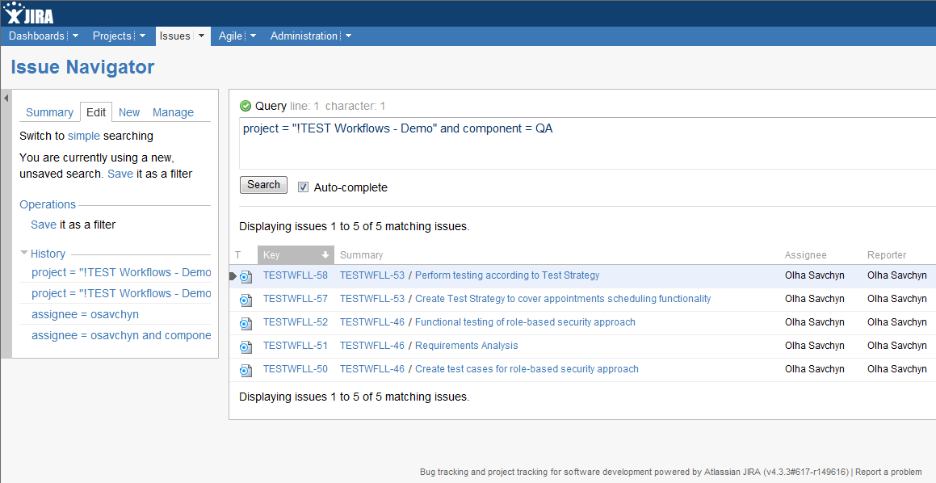
Advanced Search
Advanced Search: Query area
Advanced Search: History

Slide 50

Quick Search
Quick Search box is located at the top right of the screen
Quick Search has:
Jumping to an Issue
‘Smart’ Querying: searches with minimal typing
Free-text searching
More details can be found here:
Quick Search

Slide 51
Issue Filters
A saved Search is called an Issue Filter
With an issue filter you can:
display the search results in the Issue Navigator
display the search results in a report format
display the search results in a Dashboard Gadget
share the search with colleagues
add another user's shared filter as a favorite

Slide 52
Issue Filters
Notes:
The 'Work Ratio' search is based on the Actual work logged against an issue versus the original Estimated work duration.
Work Ratio Percentage = (Time Spent / Original Estimate) x 100%

Slide 53
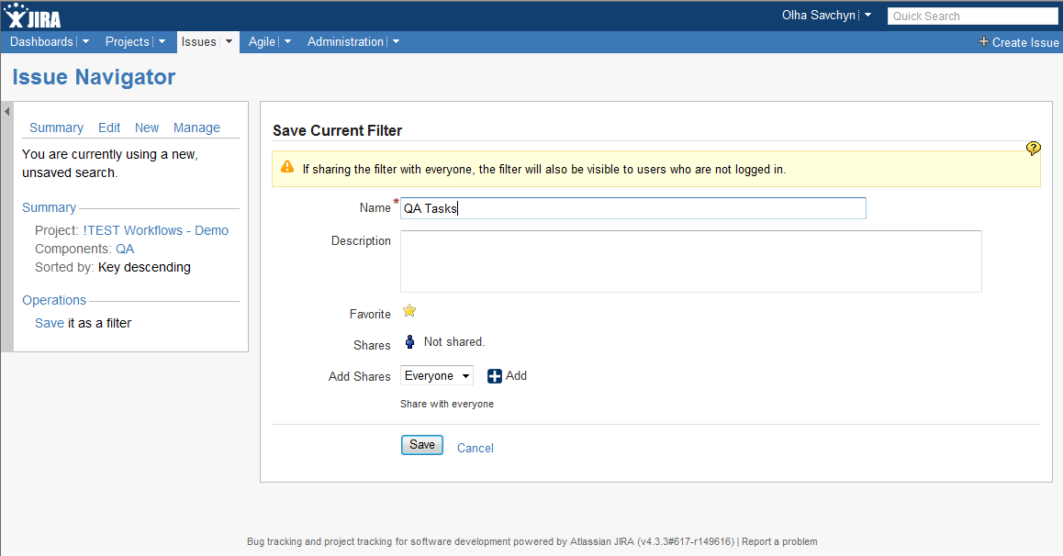
Issue Filters
Saving Filter Details
Filter
Summary
Notes:
Resolved recently- Project: !TEST Workflows - Demo Resolved: From 1 week ago to anytime
Outstanding- project = TESTWFLL AND resolution = Unresolved ORDER BY updated DESC
Most Important -project = TESTWFLL AND resolution = Unresolved ORDER BY priority DESC

Slide 54
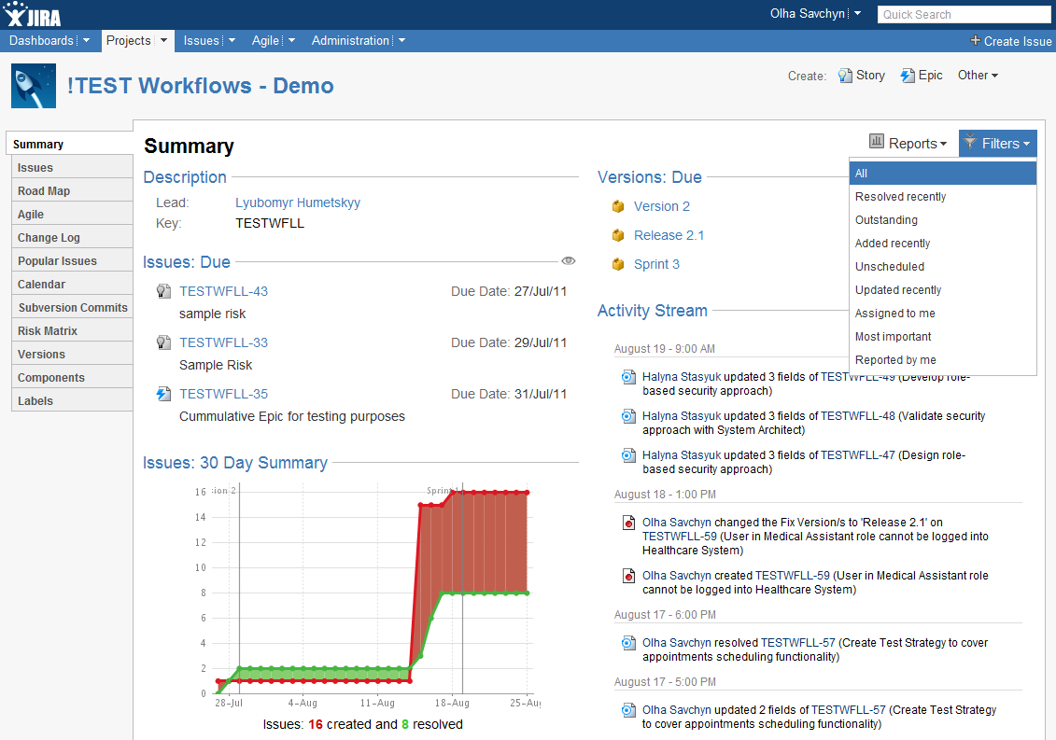

JIRA Predefined Filters
Predefined Filters on ‘Projects’ tab

Slide 55
Recommended Filters
Groups’ Sub-Tasks
Example:
Technical Tasks per each developer
Technical Tasks per each QC Engineer
Bug Status
Example:
Bugs per status and priority
Bugs assigned to particular person
Notes:
QC subtasks: project="!TEST Workflows - Demo" and "Task Type"= "Quality Control“

Slide 56
Issues Bulk Operations
Bulk Operations enable multiple operations to be performed on multiple issues at once
Bulk Operations
Edit
Delete
Move
Workflow Transition
This operation allows multiple fields in multiple issues to be edited at once
This operation allows multiple issues to be deleted at once
This operation allows multiple issues to be moved between projects and/or issue types at once
This operation allows multiple issues to be transitioned through workflow at once
Notes:
Select filter
Tools> Bulk Operation

Slide 57
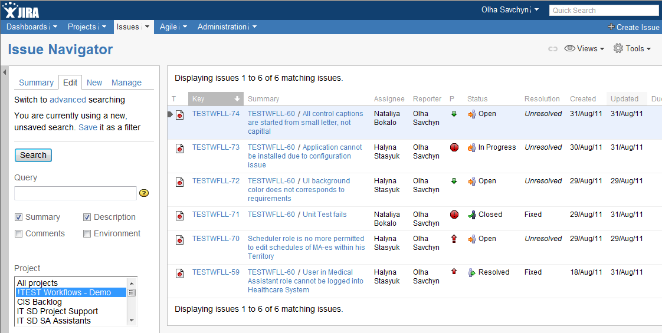
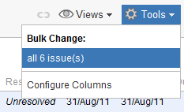
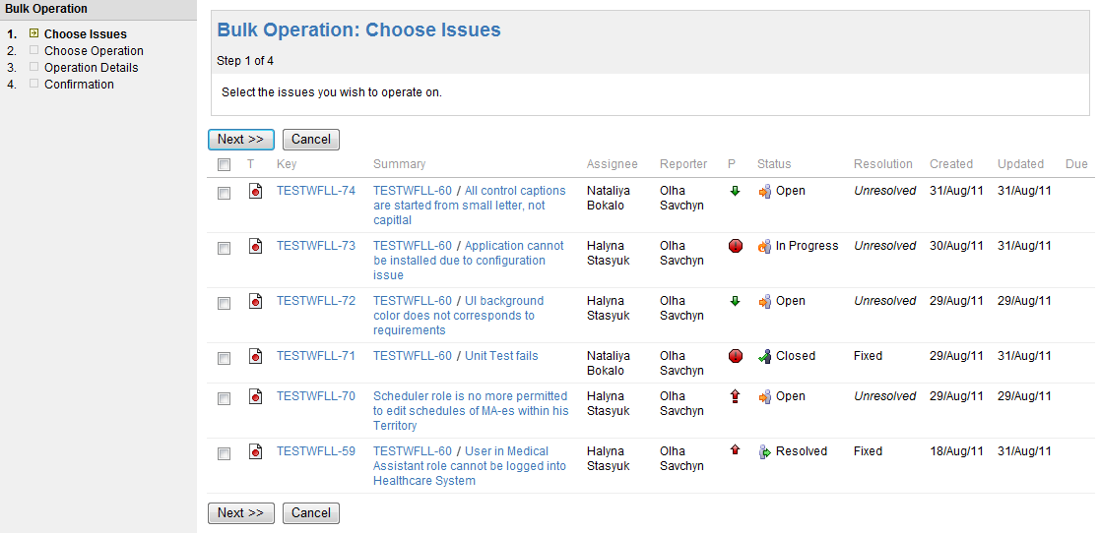
Issues Bulk Operations
4-steps Wizard
Notes:
Select filter
Tools> Bulk Operation

Slide 58
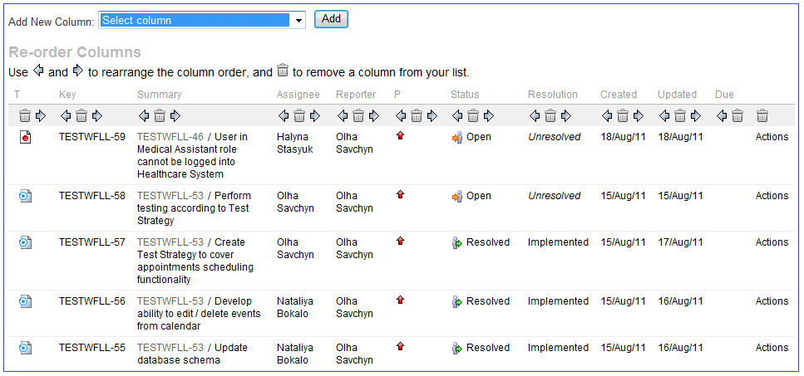
Issue Navigator
Issue Navigator displays the search results from an Issue Filter, Quick Search and Advanced Search
Issue Navigator can be customized:
Notes:
To choose which columns (i.e. issue fields) to display in your Issue Navigator,
Click the 'Issues' link in the navigation bar at the top of the screen. The Issue Navigator will be displayed.
From the 'Tools' menu at the right of the screen (above the search results), select 'Configure Columns'.
To choose how many rows (i.e. issues) to display on each page of your Issue Navigator:
Click your user name at the top-right of the page to open your User Profile.
Click 'Edit Preferences', under 'Operations' in the left-hand column of the screen.
Enter your preferred 'Number of Issues displayed per Issue Navigator page', (The default is 50).
Click the 'Update' button.

Slide 59
Dashboards
'Dashboards' link
In Dashboard you can:
Display different information, depending on interests
Visualize information using charts
Share information with team members and clients

Slide 60
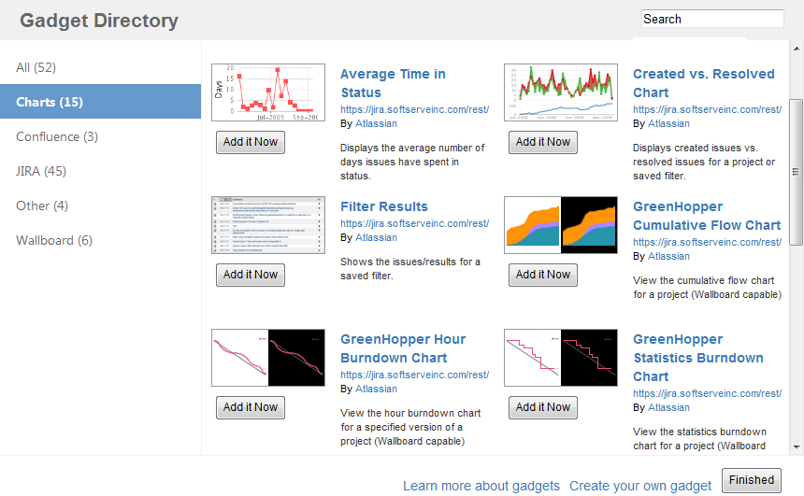
Dashboards: Gadgets
The information boxes on the Dashboard are called Gadgets
Gadgets Categories:
Charts
Confluence
JIRA
Wallboard
Other

Slide 61
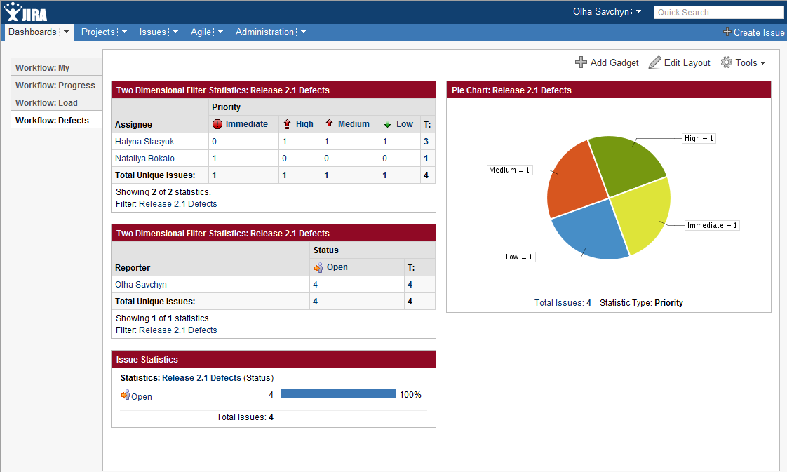
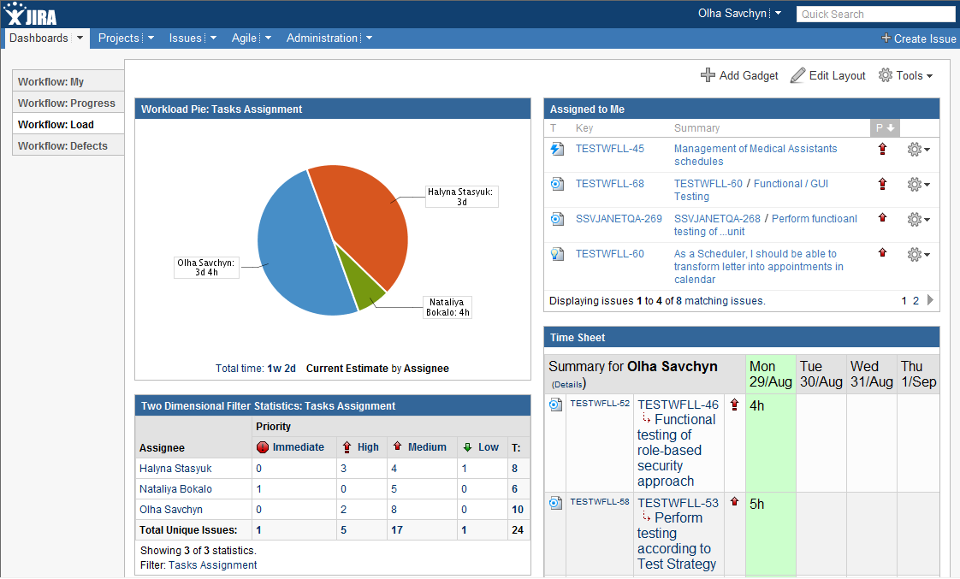
Dashboards: Examples
Notes:
Dashboard> Tools>Create Dashboard
You can now customise your dashboard as follows:
Choosing a Dashboard Layout
Adding a Gadget
Moving a Gadget
Removing a Gadget

Slide 62
Managing Dashboards
Actions you can do managing Dashboards:
Create multiple Dashboards
Customize each Dashboard separately
Edit / Delete / Copy
Share
Notes:
You can also share your dashboard pages with other users, as well as adding dashboards shared by other users as favourites.
Each dashboard page appears as a separate "tab" on the dashboard. You can view a dashboard page by simply clicking its name in the tab list.

Slide 63
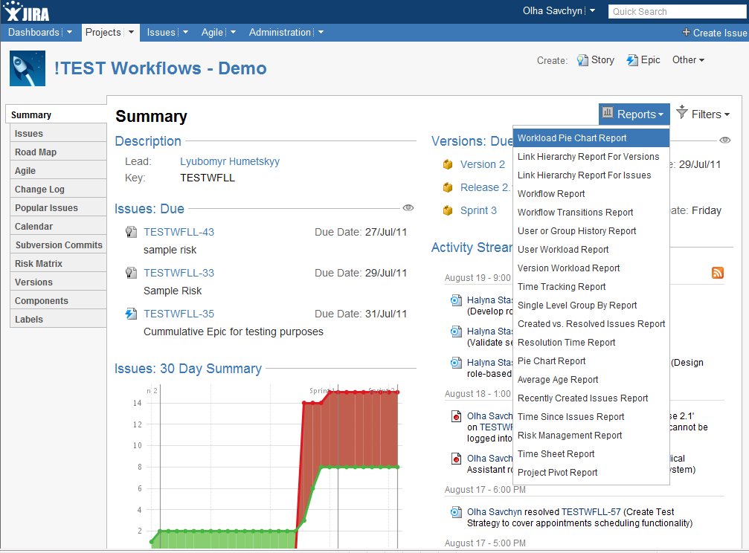
Reports
JIRA Reports display statistical information based on all elements within JIRA – e.g. issues, projects, users, issue types, etc
Reports Examples:
User Work Load report
Version Workload report
Time Tracking report
Pie Chart report
etc

Slide 64
Recommended JIRA Reports
Workload Pie Chart Report | Shows the relative workload for assignees of all issues in a particular project or issue filter
Version Workload Report | Shows how much outstanding work there is (per user and per issue) before a given version is complete
Time Tracking Report | Shows progress towards completing a given version, based on issues' work logs and time estimates
Risk Management Report | Shows risk management matrix with list of risks according to applied filter (per version, project, etc)

Slide 65

Time to Practice

Slide 66

Thank You!

