Slide 1
Inheritance
Diana Buga (5642805) Sara Hacheche (5672186)
Course: Introduction to Object-Oriented Programming (Java)
Matrix College of Management Technology and Healthcare Inc, Montreal, Quebec

Slide 2
In Java, inheritance is a fundamental object-oriented programming (OOP) concept that allows a class to inherit properties and behaviors from another class. The class that is being inherited from is called the superclass or parent class, and the class that inherits from it is called the subclass or child class.
The keyword extends is used by the subclass to inherit the features of superclass.

Slide 3
BASIC SYNTAX:
To implement inheritance in Java, you use the extends keyword to indicate the superclass that the subclass is inheriting from.
class Superclass {
// superclass members
}
class Subclass extends Superclass {
// subclass members
}

Slide 4
THE SUBCLASS CAN INHERIT THE FOLLOWING MEMBERS FROM THE SUPERCLASS:
Fields: The subclass inherits all the fields (variables) declared in the superclass. However, private fields are not directly accessible in the subclass.
Methods: The subclass inherits all the non-private methods defined in the superclass. The subclass can also override these methods to provide its own implementation.
Constructors: The subclass does not inherit constructors from the superclass, but it can call the superclass constructors using the super keyword.
Nested classes: The subclass can inherit nested classes declared within the superclass.

Slide 5
!!! IT'S IMPORTANT TO NOTE THAT JAVA SUPPORTS SINGLE INHERITANCE, WHICH MEANS A CLASS CAN ONLY INHERIT FROM ONE SUPERCLASS. HOWEVER, IT ALLOWS FOR MULTI-LEVEL INHERITANCE, WHERE A SUBCLASS CAN BECOME A SUPERCLASS FOR ANOTHER SUBCLASS.

Slide 6
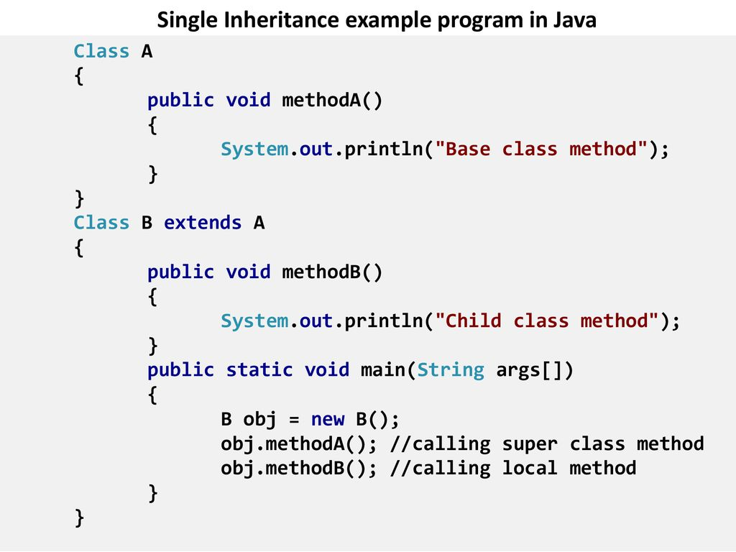
An example to illustrate inheritance in Java:

Slide 7
IMPORTANCE OF JAVA INHERITANCE
Inheritance minimizes the complexity of a code by minimizing duplicate code. If the same code has to be used by another class, it can simply be inherited from that class to its sub-class. Hence, the code is better organized.
The efficiency of execution of a code increases as the code is organized in a simpler form.
The concept of polymorphism can be used along with inheritance.

Slide 8
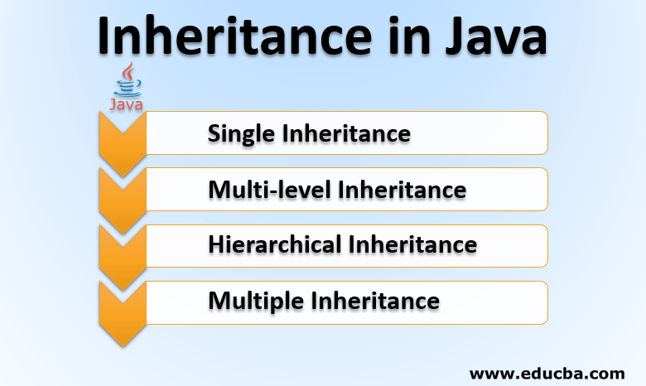

Slide 9
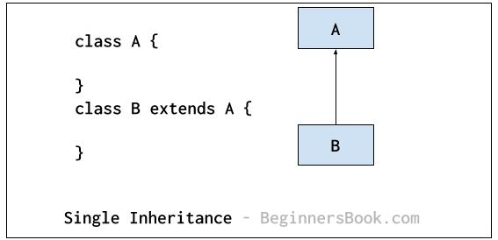
Single level inheritance
As the name suggests, this type of inheritance occurs for only a single class. Only one class is derived from the parent class. In this type of inheritance, the properties are derived from a single parent class and not more than that. As the properties are derived from only a single base class the reusability of a code is facilitated along with the addition of new features.
Two classes Class A and Class B are shown in Figure, where Class B inherits the properties of Class A.

Slide 10
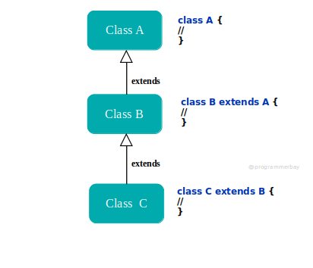
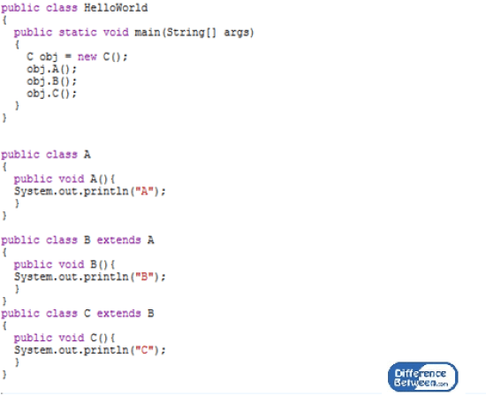
Multi-level Inheritance
The multi-level inheritance includes the involvement of at least two or more than two classes. One class inherits the features from a parent class and the newly created sub-class becomes the base class for another new class.
From the flow diagram in Figure, we can observe that Class B is a derived class from Class A, and Class C is further derived from Class B.

Slide 11
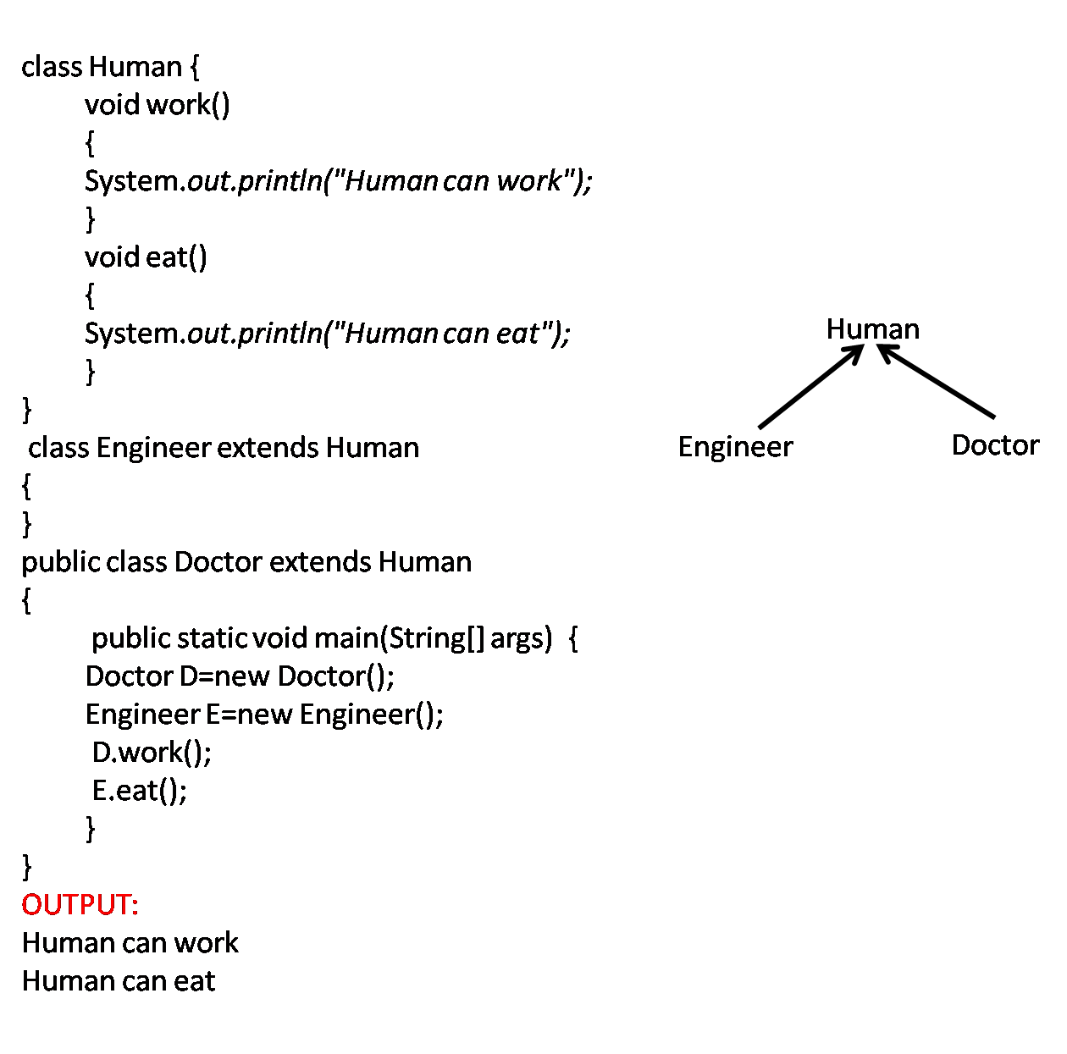
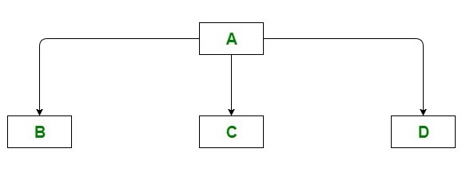
Hierarchical Inheritance
The type of inheritance where many subclasses inherit from one single class is known as Hierarchical Inheritance. It is different from the multilevel inheritance, as the multiple classes are being derived from one superclass. These newly derived classes inherit the features, methods, etc, from this one superclass. This process facilitates the reusability of a code and dynamic polymorphism (method overriding).
In Figure, we can observe that the three classes Class B, Class C, and Class D are inherited from the single Class A. All the child classes have the same parent class in hierarchical inheritance.

Slide 12
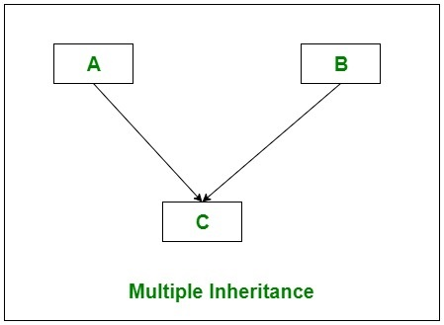
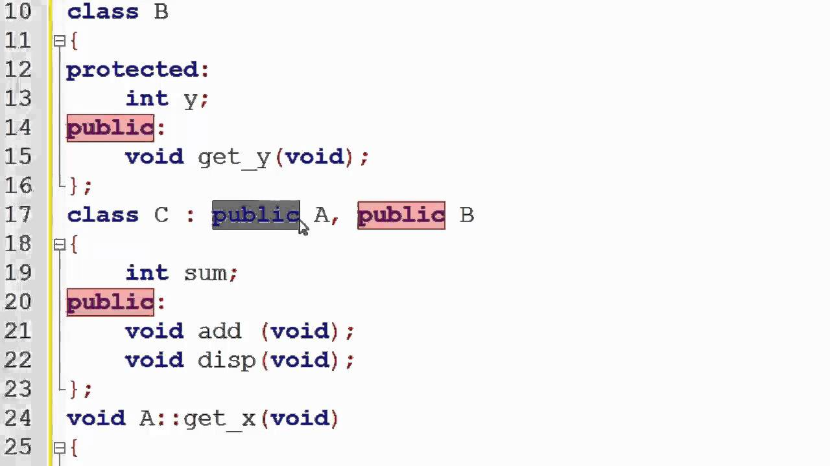
Multiple Inheritance
Multiple inheritances is a type of inheritance where a subclass can inherit features from more than one parent class.
Figure shows that Class C is derived from the two classes Class A and Class B. In other words it can be described that subclass C inherits properties from both Class A and B.

Slide 13
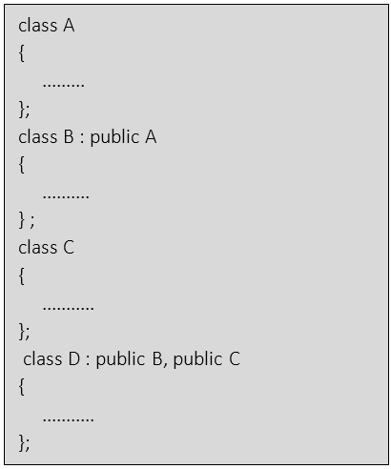
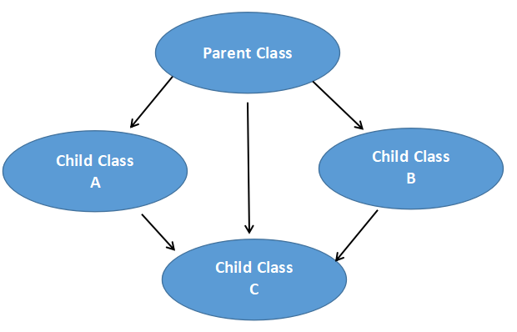
Hybrid Inheritance
Hybrid inheritance is a combination of more than two types of inheritances single and multiple

