Slide 1
Software Testing
Course: MANUAL SOFTWARE TESTING
Diana Buga (5642805)
Sara Hacheche(5672186)
Matrix College of Management Technology and Healthcare Inc, Montreal, Quebec

Slide 2
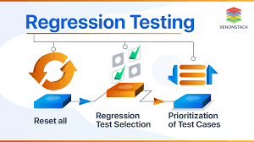
Introduction to Regression Testing
Regression Testing is a type of testing in the software development cycle that runs after every change to ensure that the change introduces no unintended breaks.
Regression testing addresses a common issue that developers face — the emergence of old bugs with the introduction of new changes.

Slide 3
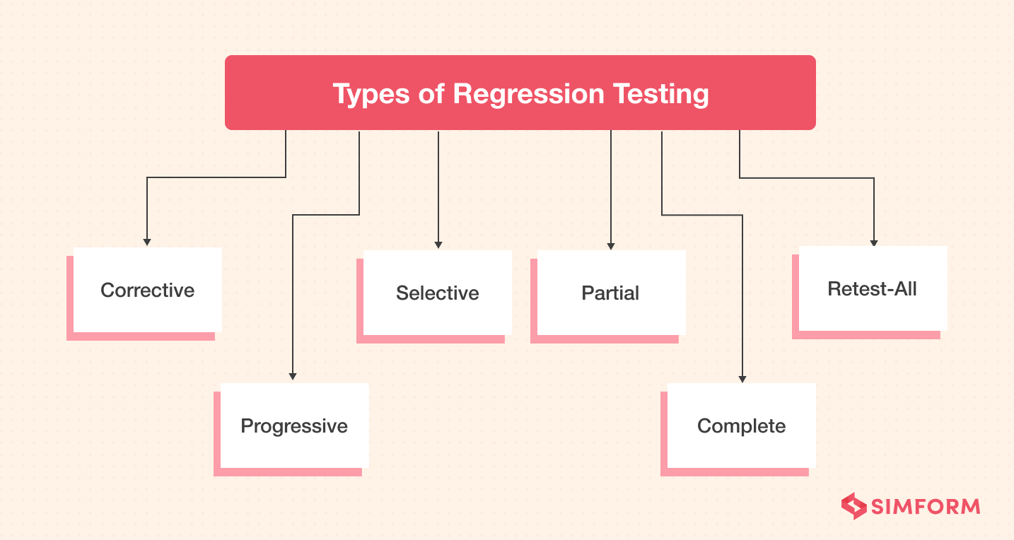
Types of Regression Testing

Slide 4
Types of Regression Testing
Unit Regression Testing: Testing individual components or functions to ensure changes do not disrupt their behavior.
Partial Regression Testing: Testing only the modified parts of the software to verify their integration.
Full Regression Testing: Testing the entire application to ensure new changes do not affect existing functionalities.
Progressive Regression Testing: Testing new changes alongside previously tested features to ensure ongoing integration.
Selective Regression Testing: Testing specific test cases affected by code changes, focusing testing efforts.
Complete Regression Testing: Comprehensive testing of all functionalities after changes, ensuring overall quality.
Smoke Regression Testing: Running essential tests to quickly verify basic functionality after changes.

Slide 5
Unit Regression Testing:
How to Perform?
Isolate the specific unit (function, module, class) that has undergone changes.
Execute test cases that cover the affected unit's functionalities.
Compare the actual outcomes with expected outcomes to ensure consistency.
Examples:
Scenario: Modifying a sorting algorithm in a software application.
Test Cases: Execute test cases to ensure the modified sorting algorithm produces accurate results for different input datasets.
Scenario: Enhancing a function responsible for calculating tax rates.
Test Cases: Verify that the updated tax calculation function correctly computes taxes based on varying income levels and deductions.

Slide 6
Selective Regression Testing:
How to Perform?
Identify the areas of the software that have undergone changes.
Select and execute only those test cases that are related to the modified areas.
Ensure that the core functionality of the application remains intact while testing the affected parts.
Examples:
Scenario: Adding a new payment gateway to an e-commerce platform.
Test Cases: Test the new payment gateway's integration with the checkout process and ensure it functions correctly.
Scenario: Updating a user profile module to accommodate new fields.
Test Cases: Focus on testing the functionality related to user profile updates, making sure the changes do not impact other modules.

Slide 7
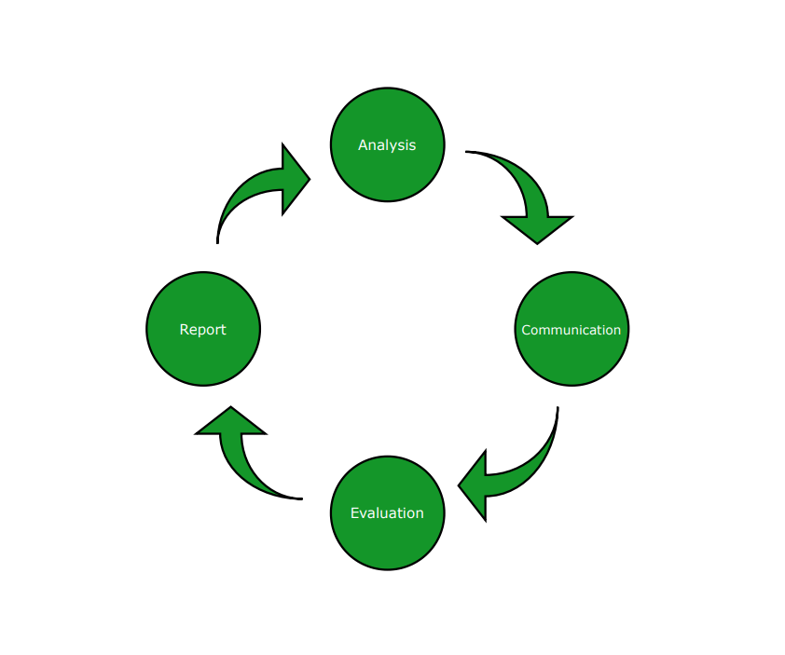
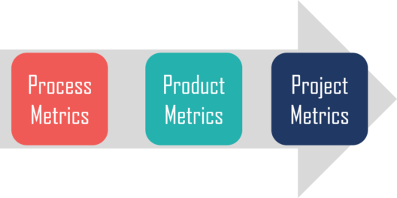
Test metrics
Test metrics are indicators of the efficiency, effectiveness, quality and performance of software testing techniques.
These metrics allow professionals to collect data about various testing procedures and devise ways to make them more efficient.

Slide 8
Types of test metrics:
Defect Density
Test Case Pass Rate
Test Execution Efficiency
Test Coverage
Defect Rejection Rate
Requirement Traceability
Test Effectiveness

Slide 9
Types of Test Metrics:
Defect Density:
Explanation: Defect density measures the number of defects in a specific unit of code or software component.
How to Perform: Calculate the ratio of defects found to the size of the code or component (e.g., defects per KLOC - thousand lines of code).
Example: If a module has 50 defects and 10,000 lines of code, the defect density is 50/10000 = 0.005 defects per line of code.
Test Case Pass Rate:
Explanation: Test case pass rate indicates the percentage of test cases that have passed among those executed.
How to Perform: Divide the number of passed test cases by the total number of executed test cases and multiply by 100 to get the percentage.
Example: If 80 test cases pass out of 100 executed, the pass rate is (80/100) * 100 = 80%.

Slide 10
USER STORY
A user story is an informal, general explanation of a software feature written from the perspective of the end user or customer.
The purpose of a user story is to articulate how a piece of work will deliver a particular value back to the customer.

Slide 11
Where We Can Use User Stories?
User stories are commonly used in Agile methodologies like Scrum and Kanban. They are suitable for defining requirements for software development, enhancements, bug fixes, and any project involving stakeholders' input.
Why We Need User Stories?
User stories help capture user needs, provide clear requirements, and guide the development process. They facilitate effective communication between developers, testers, and stakeholders, ensuring that everyone understands the desired outcome.

Slide 12
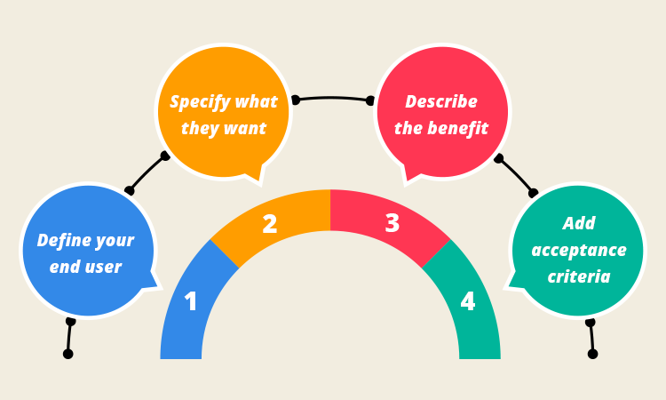
How to write user stories?

Slide 13
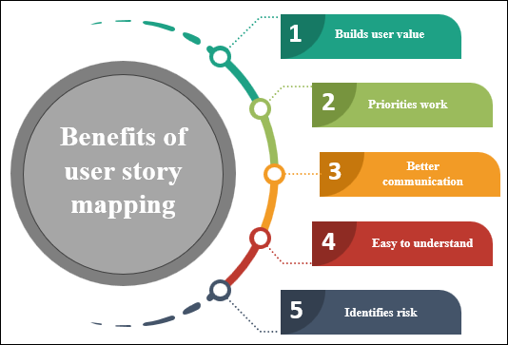

Slide 14
User Story: As a registered user, I want to receive email notifications when my order status changes, so I am informed about the progress of my purchases.
Explanation:
Role: Registered user
Action: Receive email notifications for order status changes
Benefit: Stay informed about the updates in my orders without needing to log in frequently.

Slide 15
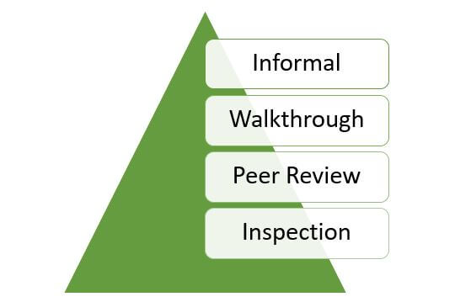
Static testing
Static testing is a type of testing that's performed on a piece of software without executing the actual code.
During testing, we review and validate the product and its supporting documents. In contrast, dynamic testing is a type of testing that's carried out on software during code execution.

Slide 16
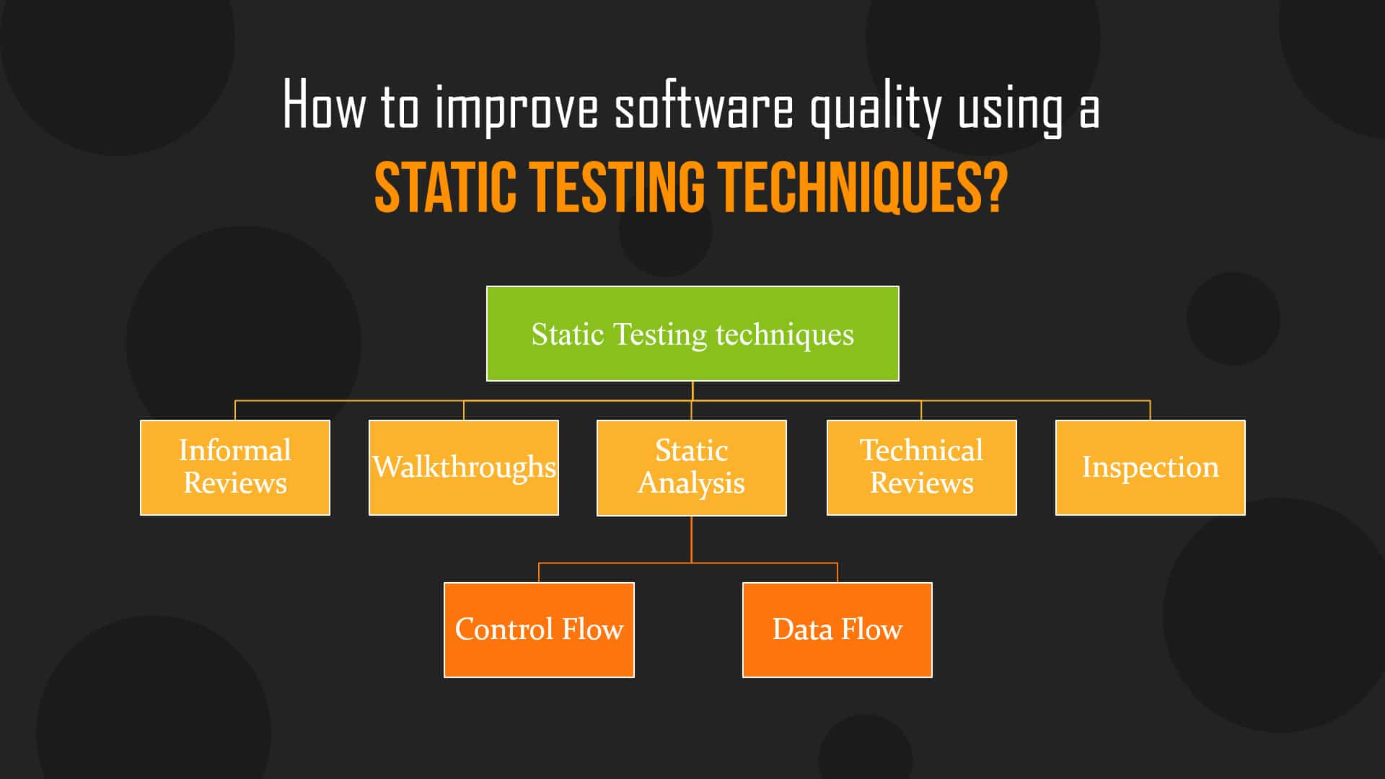

Slide 17
Importance of Static Testing:
Static testing is crucial for several reasons:
Early defect identification and resolution.
Reduced development costs and time by addressing issues before implementation.
Improved software quality and reliability.
Prevention of defects from propagating to later stages of development.
Enhanced collaboration among team members.

Slide 18
Where to Use Static Testing:
Static testing can be applied in various stages of the software development process, including:
Requirement analysis and specification.
Design phase.
Code development.
Documentation preparation.
Reviewing test plans and cases.

Slide 19
Performing Static Testing
To perform static testing, we have to do:
Preparation: Gather the relevant artifacts, such as code, design documents, or requirements.
Review: Examine the artifacts in detail, focusing on correctness, consistency, and adherence to standards.
Identification: Identify defects, errors, or areas of improvement.
Documentation: Document the identified issues, providing clear descriptions and recommendations for resolution.
Feedback: Communicate the findings to the responsible individuals or teams.
Resolution: Address the identified issues by making necessary corrections or adjustments.

Slide 20
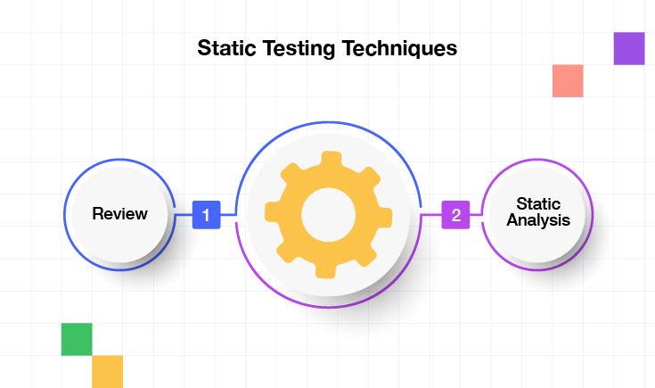
Example: Imagine a software development team is working on an e-commerce website. During a code review, a developer notices that the payment processing module does not handle cases where customers input invalid credit card information. The developer documents this issue and suggests implementing proper validation checks to ensure the accuracy of the credit card data before processing payments. This early identification of a potential flaw can prevent financial losses and customer dissatisfaction once the system is deployed.

Slide 21
References:
https://www.guru99.com/software-testing-metrics-complete-tutorial.html
https://www.geeksforgeeks.org/software-testing-static-testing/
https://katalon.com/resources-center/blog/regression-testing
https://www.scaler.com/topics/software-testing/test-metrics/

