Slide 1
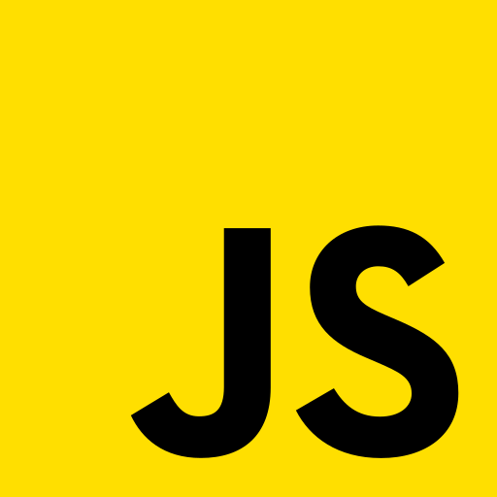
JAVASCRIPT
PRESENTED BY:
SARA NERSISIAN
SHAGHIK ISSAKHANI
JASMINE SINGH
NATE CHEUNG

Slide 2
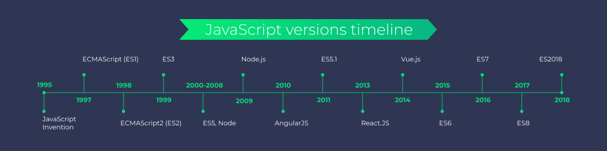
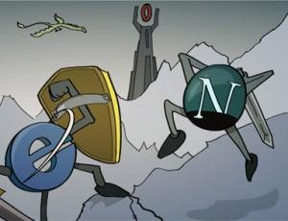

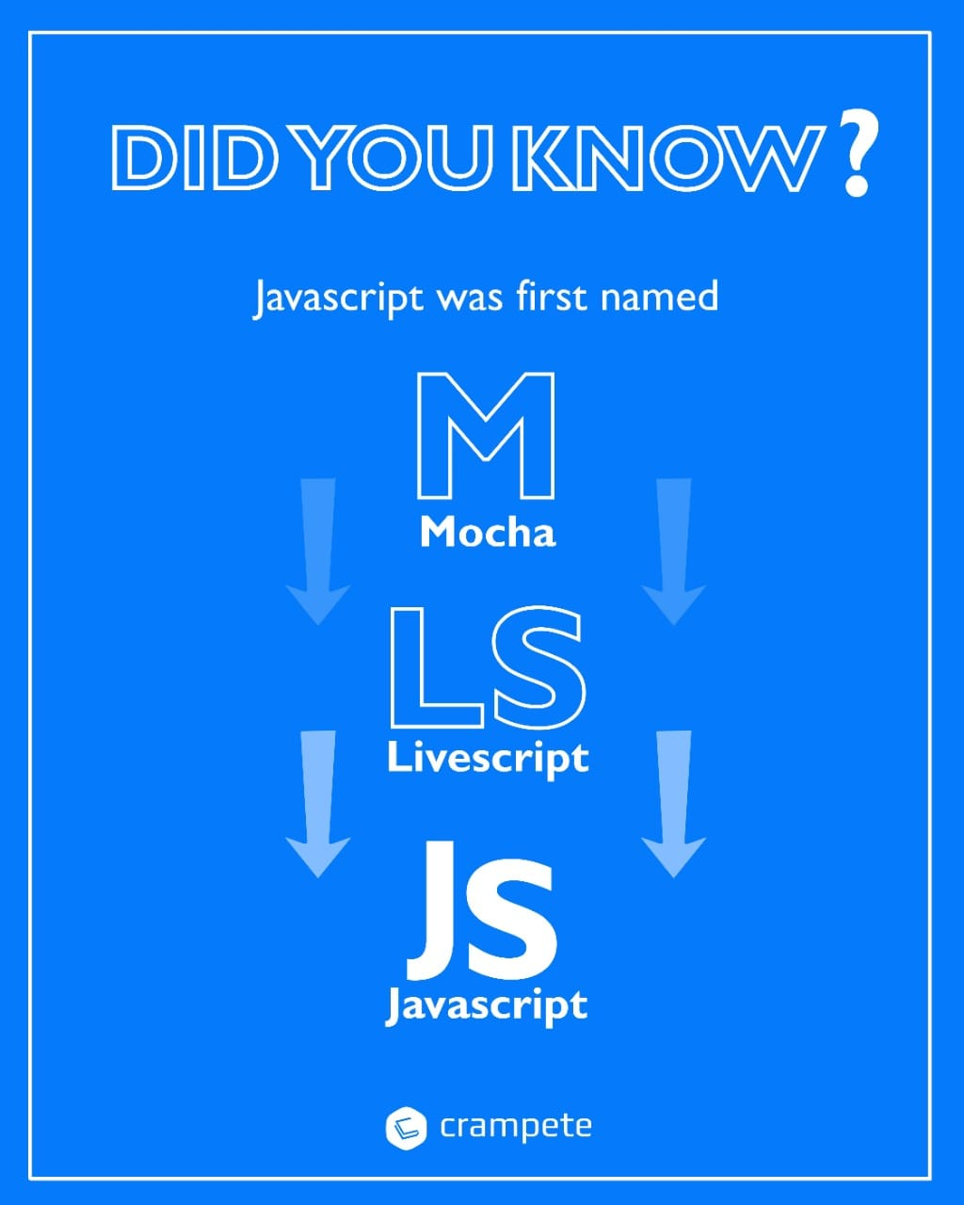
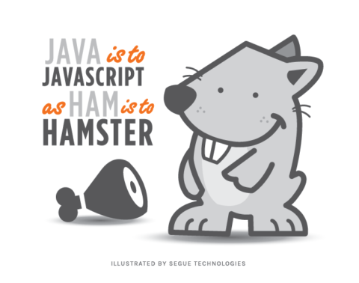
HISTORY
Sparked a significant increase in the usage of JavaScript outside of web browsers
Brendan Eich
(Netscape programmer)
The name JavaScript came from Netscape's support of Java applets within its browser
Notes:
Jasmine
Browser Wars: Competition for Dominance in Shared Web Browser usage
The early to mid-1990s pitted Netscape’s Navigator VS Microsoft’s Internet Explorer
September 1995 - Brendan Eich (Netscape programmer) created scripting language in 10 days
named Mocha -> LiveScript -> JavaScript.
The name JavaScript came from Netscape's support of Java
applets within its browser (Java and JavaScript are not related!)
Creation of Node.js in 2009 by Ryan Dahl
Node.js is a back-end JavaScript runtime environment that executes JavaScript code outside a web browser. It was designed to build scalable network applications
Sparked a significant increase in the usage of JavaScript outside of web browsers
By 2018, Node had been used by millions of developers and npm had the most modules of any package manager in the world

Slide 3
WHAT IS JAVASCRIPT?
01
SCRIPTING LANGUAGE
02
INTERPRETER
BASED
03
04
CLIENT-SIDE
1 OF 3 CORE LANGUAGES FOR WEB
Used in web development
The code is interpreted line by line by the browser interpreter
It runs on you computer within your browser
HTML + CSS + JS
Notes:
(A scripting language is a type of computer programming language used to provide instructions, called scripts, to software. Scripts contain a series of commands that a software, application or scripting engine interprets one at a time within a runtime environment.)
JavaScript is an interpreted language instead of a compiled one. In that sense, it is closer to languages like Ruby and Python. The browser interprets JavaScript’s source code, line by line and runs it. In contrast, a compiled language needs to be compiled into a byte-code code executable. Java and C++ are examples of compiled languages
JavaScript is primarily a client-side language, meaning it runs on your computer within your browser.
one of the three core languages used to develop websites.

Slide 4
HTML VS CSS VS JS
Notes:
Whereas HTML and CSS give a website structure and style, JavaScript lets you add functionality and behaviors to your website, allowing your website’s visitors to interact with content in many imaginative ways.
Since its release, JavaScript has surpassed Java, and other languages because it is relatively easy to learn, has a free and open community, and, most importantly, is incredibly useful, allowing developers to quickly create apps with audiences in the millions.

Slide 5
Syntax - ECMAScript
https://tc39.es/ecma262/
IfStatement :
if ( Expression ) Statement else Statement
if ( Expression ) Statement
if (temperature >= 90) if (isSunny) console.log("Beach"); else
console.log("Game");
Notes:
Ecmascript is most widely used standard for javascript
Implemented in

Slide 6
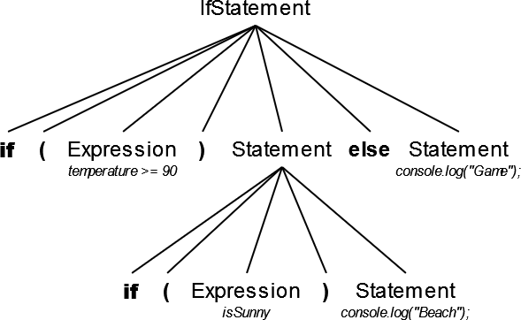
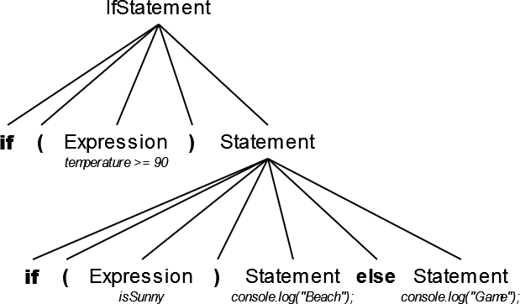
“The lookahead-restriction [lookahead ≠ else] resolves the classic "dangling else" problem in the usual way. That is, when the choice of associated if is otherwise ambiguous, the else is associated with the nearest (innermost) of the candidate ifs“

Slide 7
Interesting Facts
Loosely
typed
Variables are not directly associated with any particular value type, and any variable can be assigned (and re-assigned) values of all types!
Developed in
only 10
days
JavaScript is the most in-demand language
69.7 %
According to Github &
Stackoverflow
Notes:
The set of types in the JavaScript language consists of primitive values and objects

Slide 8
More Interesting Facts
Start with a Semicolon!
;var a = 2
But it is not
recommended
Function Can Execute Themselves
(function() { alert('hello'); })(); //alerts 'hello'
Sum of String and Numbers
Sum of num with string:
'500' + 1; //'5001'
Sum of string with num:
500 + '1'; //501

Slide 9
THANKS
Any questions?

