Slide 1

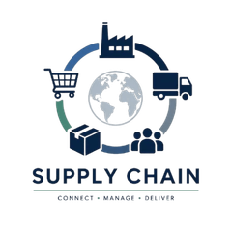
SUPPLY CHAIN PERFORMANCE ANALYSIS
Optimizing Service Levels & Operational Excellence
PROJECT TEAM
Dalia Abu Elmaaref Ibrahim • Reham Ismail Radwan • Sara Abualkhair • Momen Salah • Yousef Zaky

Slide 2



PROJECT OVERVIEW & BUSINESS CHALLENGE
PROJECT SCOPE
THE CORE PROBLEM
End-to-end analysis of global supply chain operations focusing on performance optimization.
Low Service Level Performance: Consistent failure to meet regional delivery benchmarks.
Leveraging Python for advanced data engineering and Power BI for executive-level visualization.
Fill Rate Gaps: Persistent inability to meet customer demand from available inventory.
Objective: Identify root causes and provide data-driven strategies to stabilize delivery performance.
Order Incompleteness: High frequency of partial shipments reducing overall operational efficiency.

Slide 3








THE TECH STACK: PYTHON & POWER BI
DATA ENGINEERING
ADVANCED ANALYTICS
PYTHON (PANDAS)
POWER BI
Robust Data Cleaning
Star Schema Modeling
Handling Missing Values
Complex DAX Measures
ETL Standardization
Interactive Dashboards

Slide 4
Data Cleaning with Python
Handled missing values
Removed duplicates
Fixed inconsistent date formats
Standardized columns
Prepared data for visualization and analysis

Slide 5

Data Description
This dataset contains operational and logistics data used to analyze supply chain performance, delivery efficiency, fulfillment quality, and shipping operations.
My data has 16798 rows and 30 columns
Our data types Numeric, Categorical, Date

Slide 6
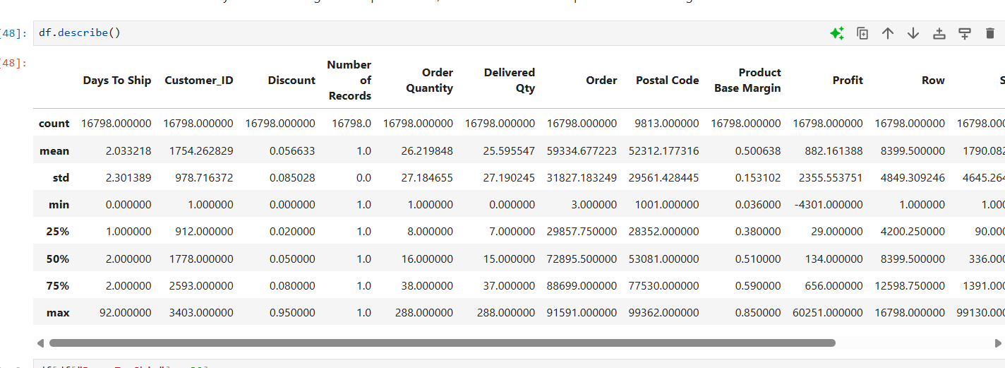
Checking for outliers

Slide 7
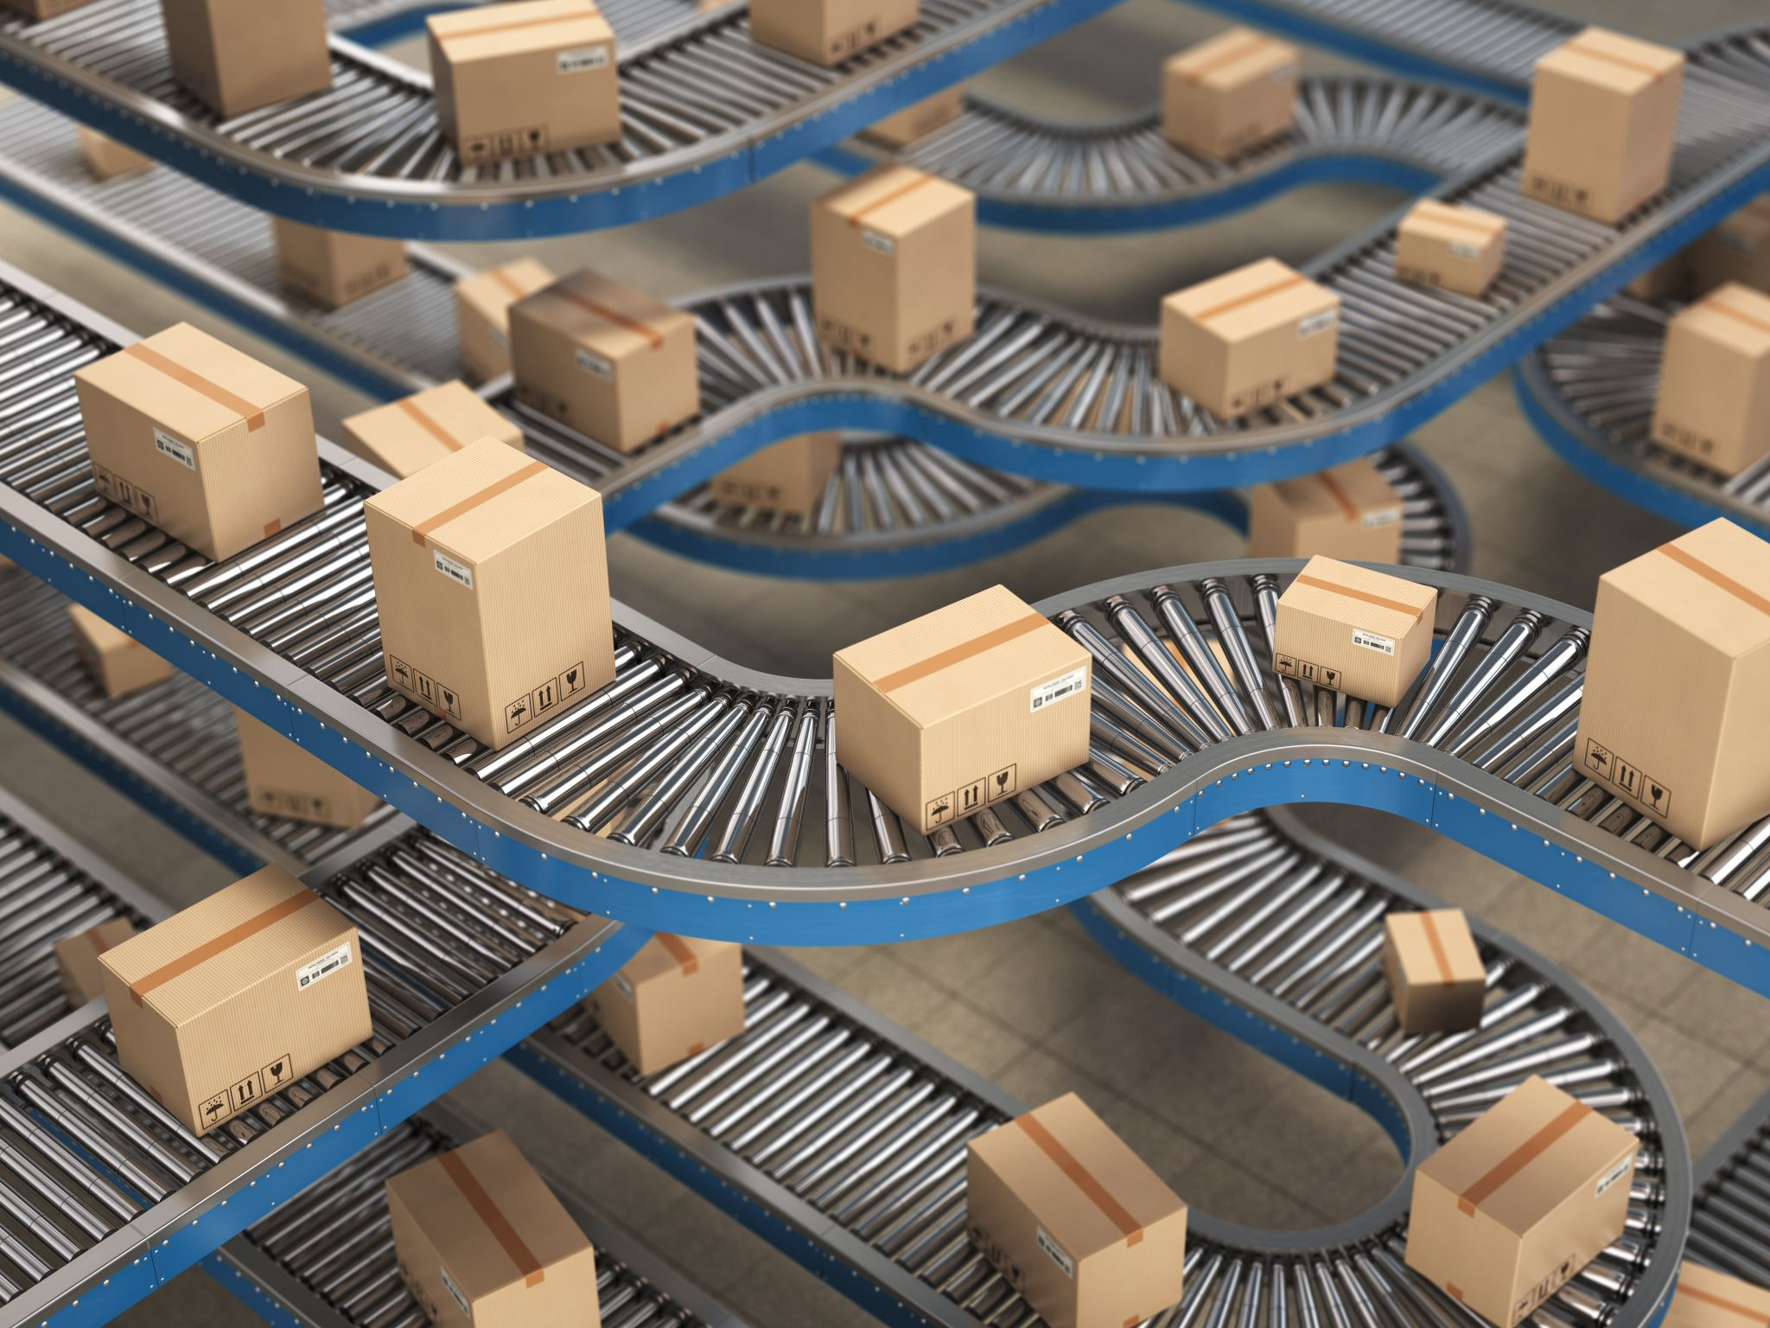
Outlier Analysis — Days To Ship
During data exploration, several records showed unusually high shipping durations exceeding 30 days, while the average shipping time was approximately 2 days. With 6 rows
Further analysis revealed that these shipments:
Achieved the required service level
Delivered the full order quantities
Arrived within the planned due dates
This indicates that the outliers represent planned operational cases such as long-distance or low-priority shipments rather than supply chain inefficiencies.
Key Insight
High shipping duration does not necessarily indicate poor supply chain performance when fulfillment and on-time delivery targets are achieved.

Slide 8

Discount Outlier Analysis
During the discount analysis, approximately 30 records were identified with extremely high discount rates 95%.
Further investigation showed that:
All records belonged to the Furniture category
All of these orders generated negative profits
This suggests that the company may have applied aggressive clearance pricing strategies to dispose of old or low-demand inventory.
Key Insight
Extremely high discounts significantly reduced profitability and were likely used as part of an inventory liquidation strategy rather than normal sales operations.

Slide 9

Negative Profit Orders Analysis
During the analysis, 819 orders were identified with negative profit values, representing approximately 4.9% of total orders.
Further investigation showed that:
30 orders had discounts 95%
Most negative-profit orders belonged to the Office Supplies
These findings suggest that despite financial losses and operational challenges in some cases, the company maintained an almost equal fulfillment performance for negative-profit orders compared to the overall dataset.
Key Insight
Negative profitability did not significantly reduce overall service level performance, indicating that operational fulfillment remained relatively stable despite financial losses.

Slide 10
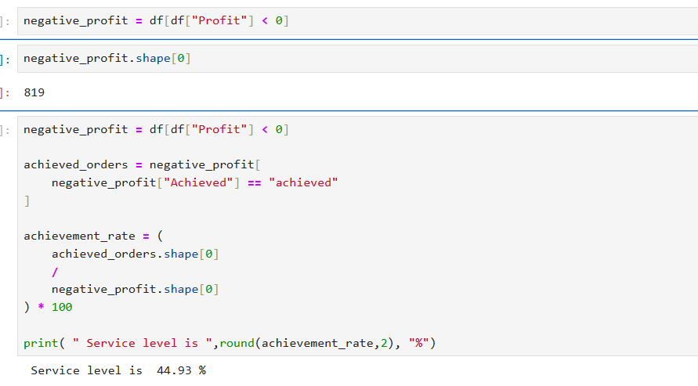

Slide 11



DATA MODELING: THE ANALYTICS FOUNDATION
ETL LAYER
ARCHITECTURE
LOGIC LAYER
POWER QUERY
STAR SCHEMA
MODEL VIEW
Automated data shaping and type conversion.
Centralized Fact tables for transactional data.
One-to-many relationships for data integrity.
Descriptive Dimension tables (Region, Product, Date).
Advanced merging of disparate data sources.
Bi-directional filtering where required for complex analysis.
Creation of custom conditional columns for business logic.
Optimized for high-performance analytical queries.
Established hierarchies for seamless drill-down.

Slide 12






DEFINING SUCCESS: CORE KPIS
SERVICE LEVEL %
FILL RATE %
OTIF %
Measures the percentage of customer orders fulfilled on time and in full against total orders.
Percentage of customer demand met through immediate stock availability without backorders.
On-Time In-Full: Combined metric assessing delivery speed and order completeness.
PRIMARY SUCCESS METRIC
INVENTORY EFFICIENCY
OPERATIONAL EXCELLENCE
TOTAL ORDERS
ON-TIME DEL. %
LATE ORDERS %
Aggregate volume of order requests processed within the analyzed period.
Percentage of orders delivered within the promised timeframe to the customer.
Percentage of orders failing to meet the delivery deadline, indicating logistics friction.
VOLUME BENCHMARK
LOGISTICS RELIABILITY
RISK INDICATOR

Slide 13

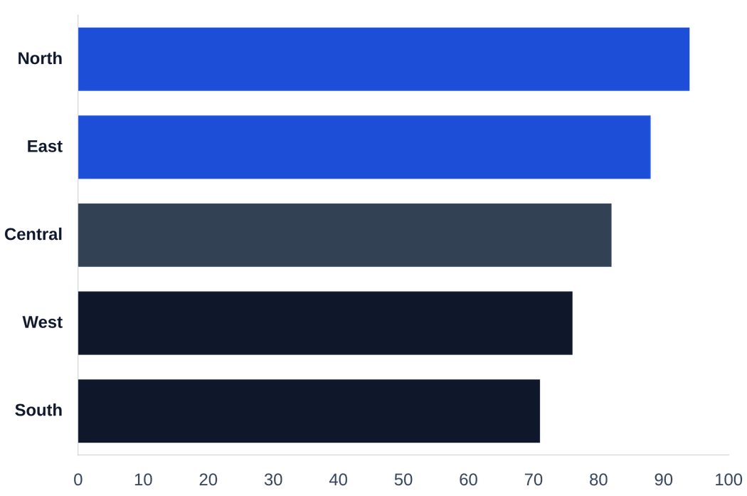
REGIONAL & OPERATIONAL ANALYSIS
SERVICE LEVEL BY REGION (%)
DEPARTMENTAL PERFORMANCE
DEPARTMENT
FILL RATE
STATUS
Electronics
92%
Stable
Apparel
74%
Critical
Home & Kitchen
81%
At Risk
Automotive
88%
Stable
Toys
68%
Critical
Root Cause: Apparel and Toys departments are primary drivers of regional service level failures.
Observation: Significant performance gaps identified between top-performing North and lagging South/West regions.

Slide 14

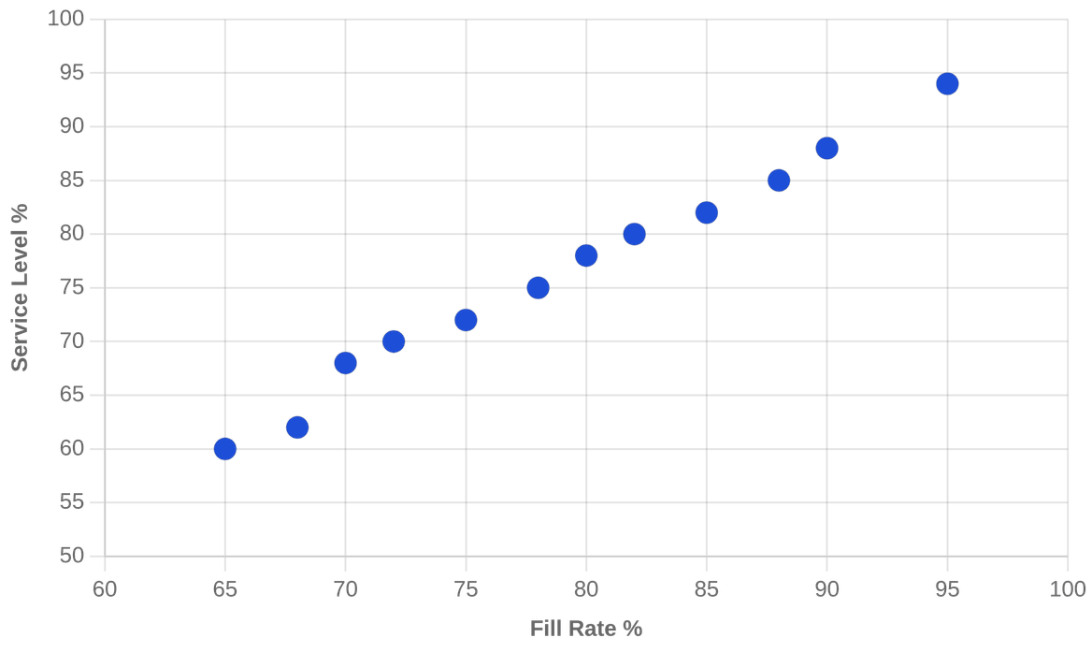

ROOT CAUSE ANALYSIS: FULFILLMENT GAPS
CORRELATION: FILL RATE VS. SERVICE LEVEL
THE FILL RATE LINK
Data confirms that low Fill Rates are the primary predictor of Service Level failure across all regions.
INCOMPLETE ORDERS
High frequency of partial shipments drains operational efficiency and increases logistics costs.
INVENTORY MISMATCH
Misalignment between regional stock levels and actual demand patterns drives fulfillment gaps.
STRONG POSITIVE CORRELATION (R² = 0.89)

Slide 15



KEY INSIGHTS: DATA-DRIVEN FINDINGS
FULFILLMENT QUALITY
REGIONAL STRATEGY
PERFORMANCE METRICS
FULFILLMENT OVER SPEED
REGIONAL DISPARITIES
STABILITY VS. QUALITY
Data reveals a 23% performance gap between top and bottom regions. Certain territories require targeted inventory interventions rather than broad logistical changes to meet baseline KPIs.
Stability in delivery times often masks underlying issues in order accuracy. High on-time delivery rates are currently offset by low fill rates, leading to a net-negative service level impact.
The primary bottleneck is not delivery speed, but the inability to ship orders in full. Incomplete orders are the single largest drain on operational efficiency and customer satisfaction.

Slide 16




STRATEGIC RECOMMENDATIONS
HIGH PRIORITY
OPERATIONAL
INVENTORY & DEMAND
PROCESS IMPROVEMENT
Implement AI-driven demand forecasting to reduce stockouts.
Reduce incomplete orders through better order validation.
Standardize pick-and-pack workflows across all regions.
Optimize safety stock levels based on regional volatility.
Implement real-time order tracking for stakeholders.
Align inventory planning with seasonal demand patterns.
STRATEGIC
EFFICIENCY
SUPPLIER MONITORING
WAREHOUSE OPERATIONS
Establish automated supplier performance scorecards.
Optimize warehouse layout to reduce picking travel time.
Enhance collaboration with low-performing suppliers.
Integrate Power BI dashboards for floor managers.
Diversify supplier base for critical product categories.
Automate inventory cycle counting for higher accuracy.

Slide 17




CONCLUSION & THE PATH FORWARD
PROJECT IMPACT
PHASE 1: MONITOR
Real-time KPI tracking via Power BI.
By transitioning from reactive troubleshooting to proactive, data-driven supply chain management, we establish a foundation for long-term resilience.
PHASE 2: OPTIMIZE
Inventory & warehouse synchronization.
15-20%
TARGETED SERVICE LEVEL IMPROVEMENT
PHASE 3: SCALE
Advanced forecasting integration.

