Slide 1
Review DNA
Evolving a Dual-Axis Behavioral Taxonomy for Yelp Review Simulation
LLM & APP Final Project | NDHU Spring 2026 | Sara & Vanshika
Best Score
Improvement
50 Iterations
0.9128
+5.14%
47 Programs

Slide 2
The Problem: Why Generic Prediction Fails (Task 1)
Task: Given a Yelp user ID and a business ID — predict the exact star rating (1.0–5★) and generate a realistic review text.
👤 USER (no DB record!)
🏪 BUSINESS
❌ NAIVE PREDICTION
UNKNOWN
avg ★ = 4.0
4.0★
Zero profile data
Zero review history
Anthony's Coal Fired Pizza
Tampa, FL — well-loved
Uses only business avg
Prediction is WRONG!
✅ GROUND TRUTH: 5★ — Military user stationed in Tampa, craved authentic Italian pizza after 3 years in Italy → loved Anthony's Coal Fired.
⚠️ Challenge: averages miss behavioral nuance. We need to understand WHY a specific user rates a specific place — not just what the averages say.

Slide 3
Our Goal: Make AI Reason Like a Human Reviewer
1
2
3
4
🔍
🧬
🤔
🌱
Retrieve
→
Classify
→
Reason
→
Evolve
Pull user profile, review history, business data, and web context from the Yelp database
Assign a USER behavioral archetype with a Review DNA profile + a BUSINESS quality category
Apply case-based rules: USER × BUSINESS archetypes → calibrated star prediction and review text
Use OpenEvolve (50 iterations, 3 islands) to automatically discover the best version of that policy
Steps 2 & 3 are our core innovation: a structured taxonomy encoded inside agent backstories, with Step 4 automatically improving it via OpenEvolve.

Slide 4
The OpenEvolve Framework
Evolutionary LLM Search: Search the space of programs/policies using an LLM as mutator and an automated evaluator as judge — instead of tuning parameters, search for better algorithms.
f * = argmax S(f) over all f ∈ F
Evolutionary Concept | In Our Project (OpenEvolve)
Candidate program f | YAML taxonomy inside agent backstory (archetypes + rules)
Program space F | All possible taxonomy configurations OpenEvolve can generate
Evaluator S(f) | Simulation score = (preference_estimation + review_generation) / 2
LLM mutator | minimax-m2.7 via NVIDIA API — rewrites EVOLVE-BLOCK each iteration
Evolutionary loop | MAP-Elites: 3 islands × 50 iterations → 47 evaluated programs
📌 Our contribution: We went beyond basic prompt tuning. We used OpenEvolve to discover structured Prompt Engineering and Behavioral Psychology rules.

Slide 5
5-Agent CrewAI Crew: Who Does What
🔒 Protected from Evolution (tool-using)
🌱 EVOLVE-BLOCK (OpenEvolve rewrites these)
👤 user_analyst
🧬 persona_classifier (no tools)
🔧 Interaction Tool (DB) | → User profile + review history
Classifies user → USER ARCHETYPE + Review DNA
Classifies business → ITEM ARCHETYPE + Quality Verdict
Outputs dual-axis classification for prediction_modeler
→
context
🏪 item_analyst
🔧 Interaction Tool (DB) | → Business data + customer reviews
↓ passes classification
🌐 web_researcher
⭐ prediction_modeler (no tools)
🔧 Serper Search API | → External news & context
Applies case-based rules + cognitive bias calibration
Executes 6-step prediction heuristic
Outputs: {"stars": X.X, "review": "..."}
If evolved → tool calls could break!

Slide 6
Core Innovation: Review DNA + Dual-Axis Taxonomy
We gave OpenEvolve a structured symbolic policy to evolve — not just free-form text.
🧬 Review DNA
⚡ Dual-Axis Classification
A structured behavioral fingerprint — NOT just an average star rating
Classify USER + BUSINESS separately, then combine via case rules
Field | What It Captures
rating_bias | Offset from avg (+0.55 = generous rater)
complaint_triggers | Topics that historically drop this user's rating
writing_style | Tone, length, vocabulary signature
negative_review_risk | LOW/MED/HIGH for THIS specific business
recency_weight | Does the most recent visit dominate? (0.9=yes)
sentiment_velocity | Is user becoming more/less generous over time?
USER AXIS
ITEM AXIS
• HARSH_CRITIC
• GENEROUS_RATER
• BALANCED
• ELITE_CONNOISSEUR
+ evolved types ✨
×
• CONSISTENT_FAV
• POLARIZING
• DECLINING
• AVERAGE
+ evolved types ✨
↓ case-based rules
CASE-BASED PREDICTION RULES
e.g. HARSH_CRITIC × POLARIZING → 2.5–3.5★
TREND_FOLLOWER × CONSISTENT_FAV → boost +0.3

Slide 7
Gen 0: The Seed We Started With (f₀)
0.8614
Program 95465d89 | Gen 0 | Island 0 | Hand-designed — this is f₀, the starting point OpenEvolve evolves from
👤 USER TYPES (4)
🏪 ITEM TYPES (5)
🎯 CASES & THRESHOLDS
TYPE_A: HARSH_CRITIC
CONSISTENT_FAV
CASE A
Drops stars on any complaint
>65% 4–5★, reliable → 4.5–5.0
User missing → use item verdict only
POLARIZING
TYPE_B: GENEROUS_RATER
High 5★ AND high 1–2★ → middle
CASE B
Defaults 4–5★, high tolerance
Low confidence → weight DNA over avg
DECLINING_QUAL
TYPE_C: BALANCED
Recent reviews lower → adjust down
CASE C
Proportional across all factors
NICHE_SPECIALIST
High confidence → anchor to user avg_stars
High stars, specific audience subset
TYPE_D: ELITE_CONNOISSEUR
AVERAGE_PERFORMER
EXCELLENT >70% ≥4.0★ → 4.5–5.0
GOOD >55% ≥3.8★ → 4.0–4.5
MIXED 40–55% → 3.0–4.0 | POOR <40%
Stricter than average standards
3–4★ range, no strong signal

Slide 8
How OpenEvolve Evolved Our Agents (50 Iterations)
①
Sample Parent YAML
OpenEvolve Config (Key Settings)
Pick a high-scoring program from the MAP-Elites population database across 3 islands
max_iterations:
50
②
LLM Mutates EVOLVE-BLOCK
diff_based_evolution:
false (full YAML rewrite — avoids YAML corruption)
minimax-m2.7 rewrites the taxonomy inside the YAML: new archetypes, thresholds, cases
num_islands:
3 (independent lineages, migration every 10 iters)
③
Run Simulation
population_size:
50 programs per island
CrewAI crew executes with the mutated config. Agents predict star rating + review text
parallel_evaluations:
1 (serial — avoids 5-RPM rate limit collision)
④
Score & Store
evaluator timeout:
900s per evaluation
combined_score = (pref_estimation + review_gen) / 2 → stored in MAP-Elites database
LLM mutator:
minimaxai/minimax-m2.7 (NVIDIA NIM)
⑤
Repeat
temperature:
0.7 (diverse mutations while staying coherent)
High-scoring programs become parents for next iteration. Best is always tracked.
System Prompt directs LLM to: invent new archetypes, add DNA variables, adjust thresholds, create new cases, introduce cognitive biases.

Slide 9
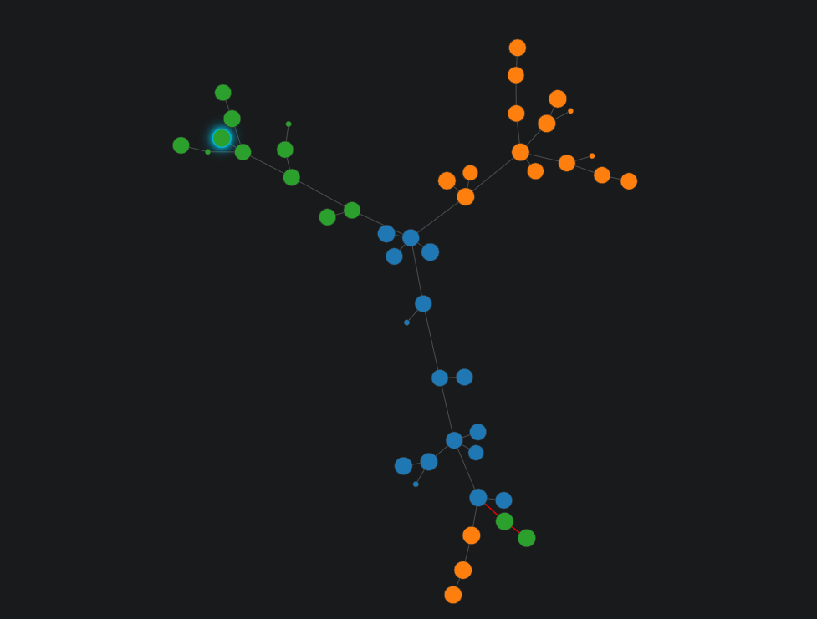
50 Iterations: What Actually Happened
47
7
3
6
+5.14%
programs evaluated
generations
islands
failures (0.2763)
total improvement

Slide 10
Phase 1 — Gen 1: Taxonomy Explosion (+3.7%)
→ 0.8931
Program 5953d050 | Gen 1, Island 0 | Parent: 95465d89 (Gen 0 seed) | First generation — biggest gain
🆕 User Types: 4 → 8
🆕 Item Types: 5 → 8
🆕 Cognitive Bias Layer Added
TYPE_E TREND_FOLLOWER — social proof bias, echoes collective consensus
UNDERPERFORMER — 3.0–3.5★ avg but hidden strengths in attributes
BANDWAGON: TREND_FOLLOWER + CONSISTENT_FAV → +0.2 to +0.4★
TYPE_F VALUE_HUNTER — price-to-quality ratio, downrates overpriced places
INFLATED_HYPE — many reviews at 4–5★ despite recent decline → discount
ANCHORING: stable avg_stars → cluster tightly around it
TYPE_G RECENCY_BIASED — recent experience dominates rating (0.6–0.8)
NEW_ARRIVAL — <10 reviews, high uncertainty → conservative prediction
NEGATIVITY_BIAS: HARSH_CRITIC → multiply triggers by 1.5×
TYPE_H EMOTIONAL_RATER — single peak moment can override all signals
6-step PREDICTION HEURISTIC (ordered algorithm, not vague reasoning)
Key insight: Converting from implicit reasoning to an explicit 6-step ordered algorithm drove the biggest performance gain.

Slide 11
Phase 2 — Gen 2–3: The Complexity Trap
OpenEvolve kept adding more types and cases. Scores did NOT improve. This taught us a critical lesson.
Version | User Types | Item Types | Cases | Score
Gen 0 (seed 95465d89) | 4 | 5 | 3 | 0.8614
Gen 1 best (5953d050) | 8 | 8 | 10 | 0.8931 ↑
Gen 2 avg | 8 | 9 | 12 | ~0.88 (flat)
Gen 3 WORST (9e97cc6b) | 9 | 10 | 18 | 0.8327 ↓↓
❌ What Went Wrong
✅ The Lesson
TYPE_I (NOVICE_REVIEWER)
+ NEW_ARRIVAL item type were added
Cases O, P, Q, R for rare scenarios never triggered in evaluation
→ 18 rules overloaded the LLM. More rules ≠ better predictions.
Optimal complexity for 1-task evaluation:
~6 user types, ~6 item types, ~12 cases
More rules make it harder for the LLM agent to apply them
accurately during prediction.
→ Occam's Razor, discovered automatically by evolution.

Slide 12
The Most Interesting Discovery: Self-Aware Meta-Reasoning
6 programs scored 0.2763 (catastrophic failure). All caused by the same pattern: the LLM wrote analysis BEFORE the YAML output.
What the LLM actually output (program 54633490):
🤔 What This Means
Looking at the evolution history, I can see a clear pattern:
the current program (0.8327) has the MOST complexity but the
LOWEST score. The best performer is actually SIMPLER.
Key observations:
• Adding TYPE_I (NOVICE_REVIEWER) hurt performance
• Extra cases O, P, Q, R introduced overfitting
My strategy: Simplify back toward the best-performing
architecture...
# === Phase 1: Agents Integrated === ← YAML starts here
The LLM correctly read past scores and identified the overfitting
It correctly concluded simplification was the right strategy
But it output that analysis as prose BEFORE the YAML → parser failed
This happened 6 times across all 3 islands independently
❌ YAML Error: 'while scanning a simple key... could not find expected :' at line 1
→ preference_estimation = 0.0 → combined_score = 0.2763
Emergent meta-reasoning — the evolution became self-aware

Slide 13
Gen 4 Breakthrough: The Best Program (0.9128)
🏆 0.9128
Program 2dd64847 | Gen 4, Island 2 | Iteration 48 | Parent score: 0.8327
What Changed | PARENT (0.8327 — Complex) | BEST (0.9128 — Simplified)
User archetype types | 9 types (incl. NOVICE, SKEPTICAL, LOYAL) | 6 types (removed 3 worst performers)
Item archetype types | 10 types (incl. NEW_ARRIVAL) | 6 types (removed 4, added EMERGING_TREND)
Prediction cases | 18 cases (A–R) | 12 cases (removed NOVICE/NEW_ARRIVAL cases)
DNA representation | Numeric: rating_bias=-0.45, recency=0.75 | Capability: 'trigger sensitivity (1.5× multiplier)'
New archetypes invented | — | TYPE_F: RECENCY_BOOSTER (positivity drift over time)
New item type invented | — | EMERGING_TREND (review surge + improving ratings)
⭐ DNA format discovery: 'complaint_trigger_sensitivity (1.5× multiplier)' is MORE effective than 'rating_bias=-0.45'. LLMs execute capability descriptions better than abstract numbers.
🔑 The best program came from the WORST parent (0.8327 → 0.9128). MAP-Elites preserved the complex program for diversity — it became the springboard for radical simplification.

Slide 14
3-Island Competition: How Diversity Helped
Each island evolved independently. Every 10 iterations, the best programs were shared between islands (migration).
Island 0 🔵
Island 1 🟠
Island 2 🟢 🏆
Programs: 16
Programs: 18
Programs: 13
Best Score: 0.8988
Best Score: 0.8988
Best Score: 0.9128
Average: 0.7868
Average: 0.8003
Average: 0.7705
Strategy found:
Strategy found:
Strategy found:
PRECISION-CALIBRATED approach (5 user types, 5 item types)
Clean and lean — no extra complexity
Added RECENCY_CRITIC + SERIAL_LOYALIST
Types that capture repeat-visit behavior
Most exploratory lineage (hosted WORST: 0.8327 and BEST: 0.9128)
Radical simplification breakthrough
Established the 'PRECISION-CALIBRATED' label and format later adopted by other islands
Introduced loyalty and recency dynamics that other islands borrowed during migration
Found that simplification from a bad parent can leap to a global best — only possible with MAP-Elites diversity

Slide 15
5 Key Things OpenEvolve Discovered
01
🧬 Capability Descriptions Beat Numbers
02
📏 Complexity Sweet Spot Exists
03
🧠 LLMs Reason About Their Own Evolution
DNA 'complaint_trigger_sensitivity (1.5× multiplier)' outperforms 'rating_bias=-0.45'. LLM agents execute natural-language instructions more accurately than abstract values.
4 types = too few blind spots. 11 types = overloaded reasoning. Optimal: ~6 user types, ~6 item types, ~12 cases. Occam's Razor found automatically through iteration.
6 programs failed (0.2763) because the LLM wrote correct historical analysis (simplify!) before the YAML, breaking the parser. The strategy was right, the format was wrong.
04
🌱 Best Came from Worst Parent
05
🔍 Cold-Start via Item Signal Works
Program 2dd64847 (0.9128) descended from 9e97cc6b (0.8327 — most complex, worst score). MAP-Elites preserved it for diversity, enabling the simplification breakthrough.
Zero user data → system relied entirely on EXCELLENT item verdict (79.9% positive) → predicted 4.5★. Ground truth: 5★. Error = only 0.5 stars. Cold-start handled gracefully.

Slide 16
Results & Conclusion
preference_estimation
review_generation
combined_score (FINAL)
0.9000
0.9256
0.9128
Star accuracy (error = 0.5★)
Review text quality
+5.14% vs Gen 0 baseline
🎯 What We Built
A 5-agent CrewAI crew with an evolvable Dual-Axis Taxonomy. OpenEvolve searched 47 program configurations across 3 islands to find the optimal behavioral policy.
🔍 What OpenEvolve Found
Capability-based DNA > numbers. Simpler taxonomies outperform complex ones. LLMs meta-reason about their own evolution. Best comes from worst parents via MAP-Elites diversity.
💡 Why This Matters
Applied FunSearch paradigm to agent policy design. Instead of human-tuned prompts, the AI discovered better behavioral theories automatically — producing higher performance AND interpretable findings.
Best: 2dd64847 | Gen 4 / Island 2 / Iteration 48 | 50 iterations • 47 programs • 3 islands | Final Score: 0.9128

Slide 17


