Slide 1

Lecture 9: Data Science and Big Data Analytics
Text Analysis : Theory and Modeling
Prof. Dr. Taysir Hassan Abdel Hamid
Professor,
Information Systems Department,
Faculty of Computers and Information
Assiut University
May 12, 2024

Slide 2
Objectives
Chapter 9: Text analysis

Slide 3
What is Text Analysis?
Text analysis, sometimes called text analytics, refers to the representation, processing, and modeling of textual data to derive useful insights.
An important component of text analysis is text mining, the process of discovering relationships and interesting patterns in large text collections.

Slide 4
Major Challenges of Text Analysis
1. High Dimensionality
2. Unstructured Text

Slide 5
1. High Dimensionality
Text analysis suffers from the curse of high dimensionality.
A corpus (plural: corpora) is a large collection of texts used for various purposes in Natural Language Processing (NLP).
The Google n-gram corpus contains one trillion words from publicly accessible web pages.
Out of the one trillion words in the Google n-gram corpus, there might be one million distinct words, which would correspond to one million dimensions.

Slide 6
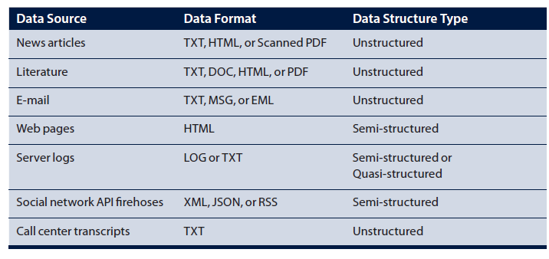
2. Unstructured Text
As mentioned, Big Data can include unstructured, quasi-structured, semi-structured data.
Examples of Data Sources and Formats for Text Analysis

Slide 7
Text Analysis Steps
Parsing
Search & Retrieval
Text Mining

Slide 8
Text Analysis Steps (Cont …)
Parsing is the process that takes unstructured text and imposes a structure for further analysis.
Search and retrieval is the identification of the documents in a corpus that contain search items such as specific words, phrases, topics, or entities like people or organizations.
Text mining uses the terms and indexes produced by the prior two steps to discover meaningful insights pertaining to domains or problems of interest.

Slide 9
If the goal is to construct a CORPUS
If the goal is to construct a corpus or provide a catalog service, for example, the focus would be the parsing task using one or more text preprocessing techniques, such as part-of-speech (POS) tagging, named entity recognition, lemmatization, or stemming.

Slide 10
With the use of a given dictionary, lemmatization finds the correct dictionary base form of a word.
For example, given the sentence:
obesity causes many problems
the output of lemmatization would be:
obesity cause many problem

Slide 11
Text Analysis Example
consider the fictitious company ACME, maker of two products: bPhone and bEbook.
ACME is in strong competition with other companies that manufacture and sell similar products. To succeed, ACME needs to produce excellent phones and eBook readers and increase sales.
One of the ways the company does this is to monitor what is being said about ACME products in social media. In other words, what is the buzz on its products? ACME wants to search all that is said about ACME products in social media sites, such as Twitter and Facebook, and popular review sites, such as Amazon and Consumer Reports.

Slide 12
Text Analysis Example (Cont…)
It wants to answer questions such as these:
Are people mentioning its products?
What is being said? Are the products seen as good or bad? If people think an ACME product is bad,
why? For example, are they complaining about the battery life of the bPhone, or the response time in their bEbook?

Slide 13
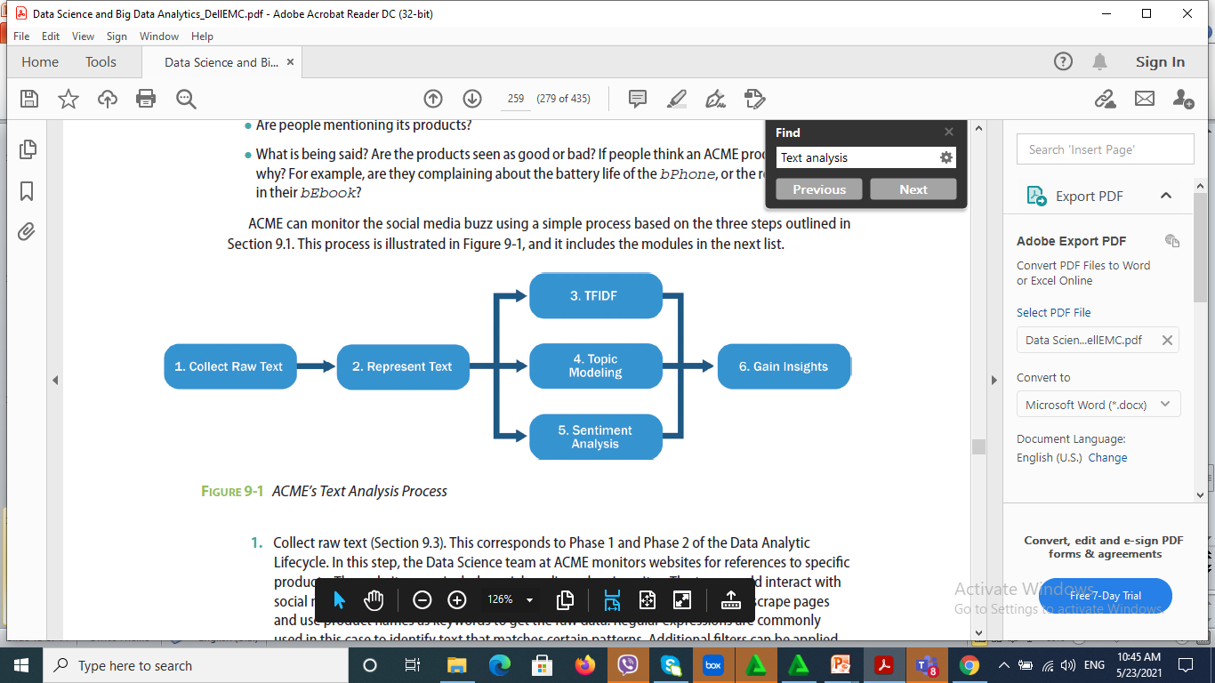
Text Analysis Example (Cont…)

Slide 14
1. Collecting Raw Data
Recall that in the Data Analytic Lifecycle seen in, “Data Analytics Lifecycle,” discovery is the first phase.
In it, the Data Science team investigates the problem, understands the necessary data sources, and formulates initial hypotheses.
Correspondingly, for text analysis, data must be collected before anything can happen.

Slide 15
Regular expressions can find words and strings that match particular patterns in the text effectively and efficiently.

Slide 16
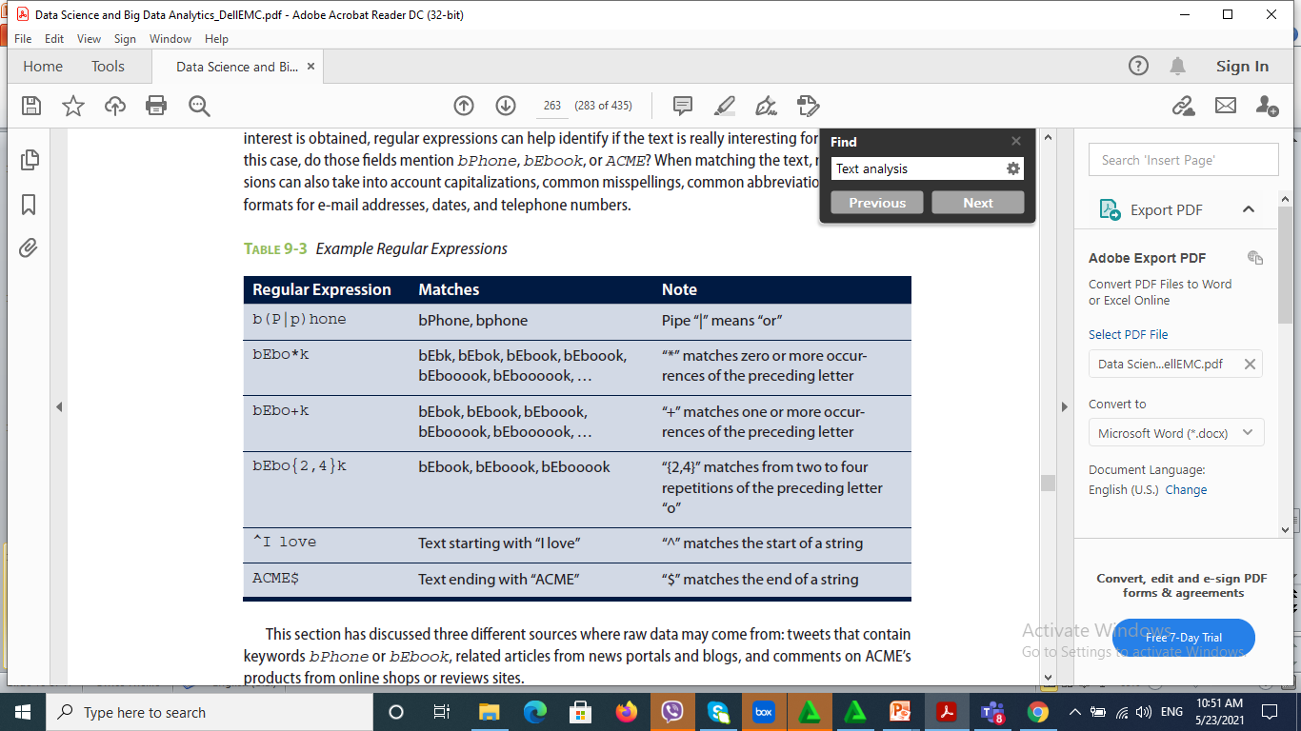

Slide 17
2. Representing Text
After the previous step, the team now has some raw text to start with.
In this data representation step, raw text is first transformed with text normalization techniques such as tokenization and case folding.
Then it is represented in a more structured way for analysis.
Tokenization is the task of separating (also called tokenizing) words from the body of text.
Raw text is converted into collections of tokens after the tokenization, where each token is generally a word.

Slide 18
A common approach is tokenizing on spaces. For example, with the tweet shown previously:
I once had a gf back in the day. Then the bPhone came out lol
Tokenization based on spaces would output a list of tokens.
{I, once, had, a, gf, back, in, the, day.,
Then, the, bPhone, came, out, lol}

Slide 19
3. Term Frequency—Inverse Document Frequency (TFIDF)
TFIDF is a measure widely used in information retrieval and text analysis.
Instead of using a traditional corpus as a knowledge base, TFIDF directly works on top of the fetched documents and
treats these documents as the “corpus.”
TFIDF is robust and efficient on dynamic content, because document changes require only the update of frequency counts.
Given a term t and a document d= { t₁, t₂, t₃,…, t_{n}}
containing n terms, the simplest form of term
frequency of t in d can be defined as the number of times t
appears in d, as shown:

Slide 20
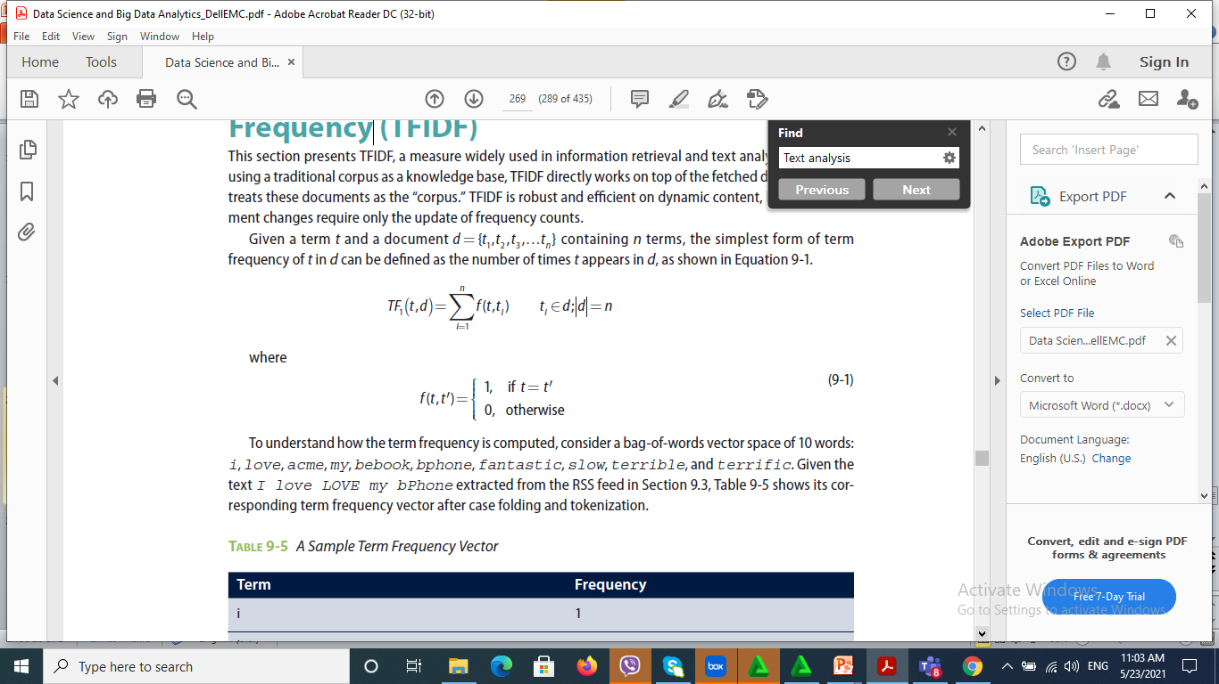
TFIDF (Cont…)

Slide 21
4. Categorizing Documents by Topic
The topics of a document are not as straightforward as they might initially appear. Consider these two reviews:
1. The bPhone5x has coverage everywhere. It’s much less flaky than my old bPhone4G.
2. While I love ACME’s bPhone series, I’ve been quite disappointed by the bEbook. The text is illegible, and it makes even my old NBook look blazingly fast.
Is the first review about bPhone5x or bPhone4G? Is the second review about bPhone, bEbook, or NBook?

Slide 22
The process of topic modeling can be simplified to the following.
1. Uncover the hidden topical patterns within a corpus.
2. Annotate documents according to these topics.
3. Use annotations to organize, search, and summarize texts.

Slide 23
5. Determining Sentiments
In addition to the TFIDF and topic models, the Data Science team may want to identify the sentiments in user comments and reviews of the ACME products.
Sentiment analysis refers to a group of tasks that use statistics and natural language processing to mine opinions to identify and extract subjective information from texts.

Slide 24
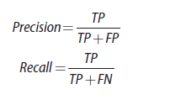
Depending on the classifier, the data may need to be split into training and testing sets.
Precision and recall are two measures commonly used to evaluate tasks related to text analysis.

Slide 25
Precision is defined as the percentage of documents in the results that are relevant.
If by entering keyword bPhone, the search engine returns 100 documents, and 70 of them are relevant, the precision of the search engine result is 0.7%.
Recall is the percentage of returned documents among all relevant documents in the corpus.
If by entering keyword bPhone, the search engine returns 100 documents, only 70 of which are relevant while failing to return 10 additional, relevant documents, the recall is 70 / (70+10)=0.875.

Slide 26
6. Gaining Insights
Corresponding to the data collection phase, the Data Science team has used bPhone as the keyword to collect more than 300 reviews from a popular technical review website.
The 300 reviews are visualized as a word cloud after removing stop words.
A word cloud (or tag cloud) is a visual representation of textual data.
Tags are generally single words, and the importance of each word is shown with font size or color.

Slide 27
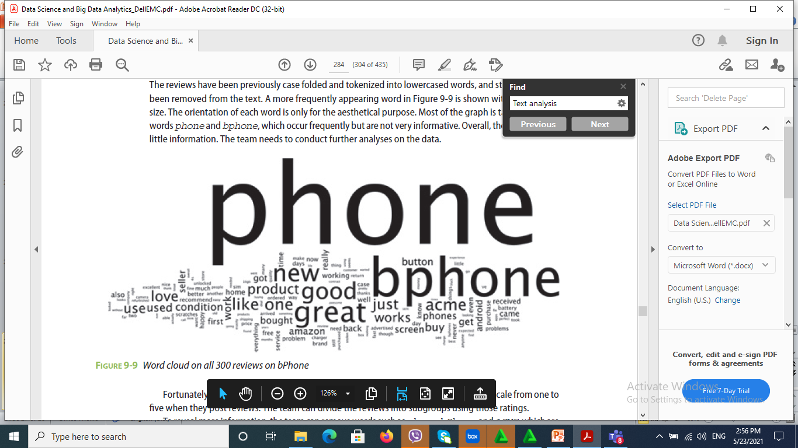

Slide 28
Thank you

