Slide 1
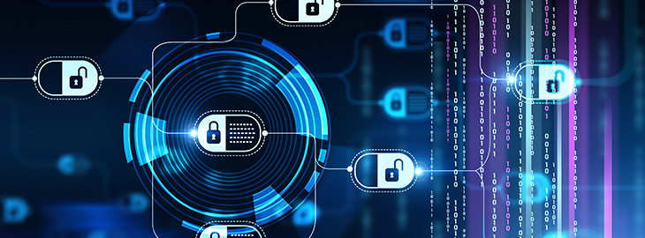
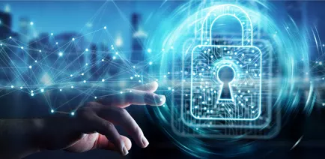
Information Assurance and Security
Dr Dalia Nashat
Associate Professor
IT Department
Faculty of Computer and Information
Assiut University

Slide 2
Part II: Access Control

Slide 3
Access Control
Two parts to access control…
Authentication: Are you who you say you are?
Determine whether access is allowed or not
Authenticate human to machine
Or, possibly, machine to machine
Authorization: Are you allowed to do that?
Once you have access, what can you do?
Enforces limits on actions
Note: “access control” often used as synonym for authorization

Slide 4
Chapter 7: Authentication
Guard: Halt! Who goes there?
Arthur: It is I, Arthur, son of Uther Pendragon,
from the castle of Camelot. King of the Britons,
defeater of the Saxons, sovereign of all England!
⎯ Monty Python and the Holy Grail
Then said they unto him, Say now Shibboleth:
and he said Sibboleth: for he could not frame to pronounce it right.
Then they took him, and slew him at the passages of Jordan:
and there fell at that time of the Ephraimites forty and two thousand.
⎯ Judges 12:6

Slide 5
Are You Who You Say You Are?
Authenticate a human to a machine?
Can be based on…
Something you know
For example, a password
Something you have
For example, a smartcard
Something you are
For example, your fingerprint

Slide 6
Something You Know
Passwords
Lots of things act as passwords!
PIN
Social security number
Mother’s maiden name
Date of birth
Name of your pet, etc.

Slide 7
Trouble with Passwords
“Passwords are one of the biggest practical problems facing security engineers today.”
“Humans are incapable of securely storing high-quality cryptographic keys, and they have unacceptable speed and accuracy when performing cryptographic operations. (They are also large, expensive to maintain, difficult to manage, and they pollute the environment. It is astonishing that these devices continue to be manufactured and deployed.)”

Slide 8
Why Passwords?
Why is “something you know” more popular than “something you have” and “something you are”?
Cost: passwords are free
Convenience: easier for sysadmin to reset pwd than to issue a new thumb

Slide 9
Keys vs Passwords
Crypto keys
Spse key is 64 bits
Then 2⁶⁴ keys
Choose key at random…
…then attacker must try about 2⁶³ keys
Passwords
Spse passwords are 8 characters, and 256 different characters
Then 256⁸ = 2⁶⁴ pwds
Users do not select passwords at random
Attacker has far less than 2⁶³ pwds to try (dictionary attack)

Slide 10
Good and Bad Passwords
Bad passwords
frank
Fido
Password
incorrect
Pikachu
102560
AustinStamp
Good Passwords?
jfIej,43j-EmmL+y
09864376537263
P0kem0N
FSa7Yago
0nceuP0nAt1m8
PokeGCTall150

Slide 11
Password Experiment
Three groups of users ⎯ each group advised to select passwords as follows
Group A: At least 6 chars, 1 non-letter
Group B: Password based on passphrase
Group C: 8 random characters
Results
Group A: About 30% of pwds easy to crack
Group B: About 10% cracked
Passwords easy to remember
Group C: About 10% cracked
Passwords hard to remember
winner →

Slide 12
Password Experiment
User compliance hard to achieve
In each case, 1/3rd did not comply
And about 1/3rd of those easy to crack!
Assigned passwords sometimes best
If passwords not assigned, best advice is…
Choose passwords based on passphrase
Use pwd cracking tool to test for weak pwds
Require periodic password changes?

Slide 13
Attacks on Passwords
Attacker could…
Target one particular account
Target any account on system
Target any account on any system
Attempt denial of service (DoS) attack
Common attack path
Outsider → normal user → administrator
May only require one weak password!

Slide 14
Password Retry
Suppose system locks after 3 bad passwords. How long should it lock?
5 seconds
5 minutes
Until SA restores service
What are +’s and -’s of each?

Slide 15
Password File?
Bad idea to store passwords in a file
But we need to verify passwords
Solution? Hash passwords
Store y = h(password)
Can verify entered password by hashing
If Trudy obtains the password file, she does not (directly) obtain passwords
But Trudy can try a forward search
Guess x and check whether y = h(x)

Slide 16
Dictionary Attack
Trudy pre-computes h(x) for all x in a dictionary of common passwords
Suppose Trudy gets access to password file containing hashed passwords
She only needs to compare hashes to her pre-computed dictionary
After one-time work of computing hashes in dictionary, actual attack is trivial
Can we prevent this forward search attack? Or at least make it more difficult?

Slide 17
Salt
Hash password with salt
Choose random salt s and compute
y = h(password, s)
and store (s,y) in the password file
Note that the salt s is not secret
Analogous to IV
Still easy to verify salted password
But lots more work for Trudy
Why?
Notes:
For salted passwords, Trudy has to re-compute her dictionary of hashes for each specific password.

Slide 18
Password Cracking: Do the Math
Assumptions:
Pwds are 8 chars, 128 choices per character
Then 128⁸ = 2⁵⁶ possible passwords
There is a password file with 2¹⁰ pwds
Attacker has dictionary of 2²⁰ common pwds
Probability 1/4 that password is in dictionary
Work is measured by number of hashes

Slide 19
Password Cracking: Case I
Attack 1 specific password without using a dictionary
E.g., administrator’s password
Must try 2⁵⁶/2 = 2⁵⁵ on average
Like exhaustive key search
Does salt help in this case?

Slide 20
Password Cracking: Case II
Attack 1 specific password with dictionary
With salt
Expected work: 1/4 (2¹⁹) + 3/4 (2⁵⁵) ≈ 2^{54.6}
In practice, try all pwds in dictionary…
…then work is at most 2²⁰ and probability of success is 1/4
What if no salt is used?
One-time work to compute dictionary: 2²⁰
Expected work is of same order as above
But with precomputed dictionary hashes, the “in practice” attack is essentially free…

Slide 21
Password Cracking: Case III
Any of 1024 pwds in file, without dictionary
Assume all 2¹⁰ passwords are distinct
Need 2⁵⁵ comparisons before expect to find pwd
If no salt is used
Each computed hash yields 2¹⁰ comparisons
So expected work (hashes) is 2⁵⁵/2¹⁰ = 2⁴⁵
If salt is used
Expected work is 2⁵⁵
Each comparison requires a hash computation
Notes:
Picture would be useful here

Slide 22
Password Cracking: Case IV
Any of 1024 pwds in file, with dictionary
Prob. one or more pwd in dict.: 1 – (3/4)¹⁰²⁴ ≈ 1
So, we ignore case where no pwd is in dictionary
If salt is used, expected work less than 2²²
See book, or slide notes for details
Work ≈ size of dictionary / P(pwd in dictionary)
What if no salt is used?
If dictionary hashes not precomputed, work is about 2¹⁹/2¹⁰ = 2⁹
Notes:
Calculation for salted case:
Number the passwords in file, pwd1, pwd2, …,pwd1024
Consider checking each pwd in turn. The probability pwd1 is in the dictionary is 1/4 and, if so, expected work (no. of hashes) is 2^19. If pwd1 is not in dictionary but pwd2 is, we do 2^20 hashes (for pwd1) plus an expected 2^19 hashes for pwd2 and so on. We find the expected work factor is
(1/4)*(2^19) + (3/4)*((1/4)*(2^20+2^19) + (3/4)*((1/4)*(2*2^20+2^19)+…+(3/4)((1/4)(1023*2^20+2^19)))…) < 2^22

Slide 23
Other Password Issues
Too many passwords to remember
Results in password reuse
Why is this a problem?
Who suffers from bad password?
Login password vs ATM PIN
Failure to change default passwords
Social engineering
Error logs may contain “almost” passwords
Bugs, keystroke logging, spyware, etc.

Slide 24
Passwords
The bottom line…
Password attacks are too easy
Often, one weak password will break security
Users choose bad passwords
Social engineering attacks, etc.
Trudy has (almost) all of the advantages
All of the math favors bad guys
Passwords are a BIG security problem
And will continue to be a problem

Slide 25
Password Cracking Tools
Popular password cracking tools
Password Crackers
Password Portal
L0phtCrack and LC4 (Windows)
John the Ripper (Unix)
Admins should use these tools to test for weak passwords since attackers will
Good articles on password cracking
Passwords - Conerstone of Computer Security
Passwords revealed by sweet deal

Slide 26
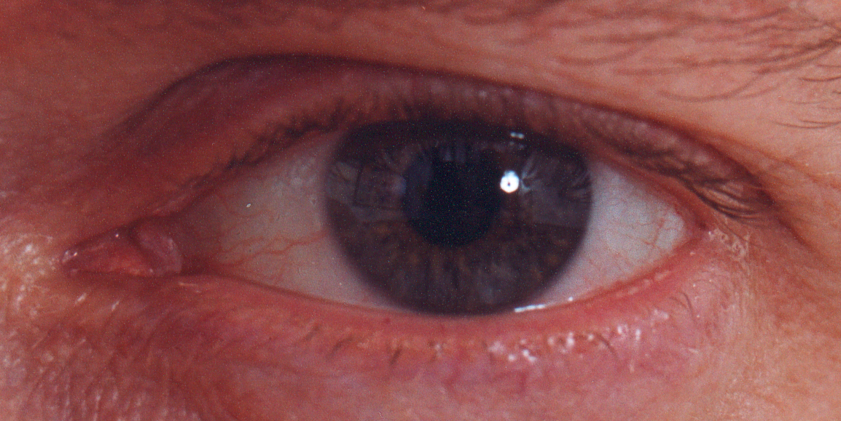
Biometrics

Slide 27
Something You Are
Biometric
“You are your key” ⎯ Schneier
Examples
Fingerprint
Handwritten signature
Facial recognition
Speech recognition
Gait (walking) recognition
“Digital doggie” (odor recognition)
Many more!
Are
Know
Have

Slide 28
Why Biometrics?
May be better than passwords
But, cheap and reliable biometrics needed
Today, an active area of research
Biometrics are used in security today
Thumbprint mouse
Palm print for secure entry
Fingerprint to unlock car door, etc.
But biometrics not really that popular
Has not lived up to its promise/hype (yet?)

Slide 29
Ideal Biometric
Universal ⎯ applies to (almost) everyone
In reality, no biometric applies to everyone
Distinguishing ⎯ distinguish with certainty
In reality, cannot hope for 100% certainty
Permanent ⎯ physical characteristic being measured never changes
In reality, OK if it to remains valid for long time
Collectable ⎯ easy to collect required data
Depends on whether subjects are cooperative
Also, safe, user-friendly, and ???

Slide 30
Identification vs Authentication
Identification ⎯ Who goes there?
Compare one-to-many
Example: FBI fingerprint database
Authentication ⎯ Are you who you say you are?
Compare one-to-one
Example: Thumbprint mouse
Identification problem is more difficult
More “random” matches since more comparisons
We are (mostly) interested in authentication

Slide 31
Enrollment vs Recognition
Enrollment phase
Subject’s biometric info put into database
Must carefully measure the required info
OK if slow and repeated measurement needed
Must be very precise
May be a weak point in real-world use
Recognition phase
Biometric detection, when used in practice
Must be quick and simple
But must be reasonably accurate

Slide 32
Cooperative Subjects?
Authentication ⎯ cooperative subjects
Identification ⎯ uncooperative subjects
For example, facial recognition
Used in Las Vegas casinos to detect known cheaters (also, terrorists in airports, etc.)
Often, less than ideal enrollment conditions
Subject will try to confuse recognition phase
Cooperative subject makes it much easier
We are focused on authentication
So, we can assume subjects are cooperative

Slide 33
Biometric Errors
Fraud rate versus insult rate
Fraud ⎯ Trudy mis-authenticated as Alice
Insult ⎯ Alice not authenticated as Alice
For any biometric, can decrease fraud or insult, but other one will increase
For example
99% voiceprint match ⇒ low fraud, high insult
30% voiceprint match ⇒ high fraud, low insult
Equal error rate: rate where fraud == insult
A way to compare different biometrics

Slide 34
Fingerprint History
1823 ⎯ Professor Johannes Evangelist Purkinje discussed 9 fingerprint patterns
1856 ⎯ Sir William Hershel used fingerprint (in India) on contracts
1880 ⎯ Dr. Henry Faulds article in Nature about fingerprints for ID
1883 ⎯ Mark Twain’s Life on the Mississippi (murderer ID’ed by fingerprint)

Slide 35
Fingerprint History
1888 ⎯ Sir Francis Galton developed classification system
His system of “minutia” can be used today
Also verified that fingerprints do not change
Some countries require fixed number of “points” (minutia) to match in criminal cases
In Britain, at least 15 points
In US, no fixed number of points

Slide 36
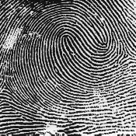
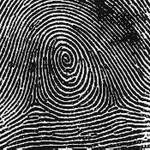
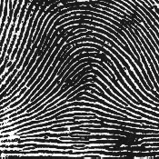
Fingerprint Comparison
Examples of loops, whorls, and arches
Minutia extracted from these features
Loop (double)
Whorl
Arch

Slide 37
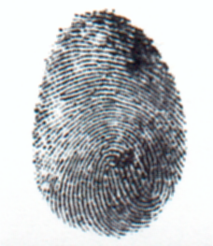
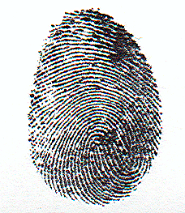
Fingerprint: Enrollment
Capture image of fingerprint
Enhance image
Identify “points”

Slide 38
Fingerprint: Recognition
Extracted points are compared with information stored in a database
Is it a statistical match?
Aside: Do identical twins’ fingerprints differ?

Slide 39
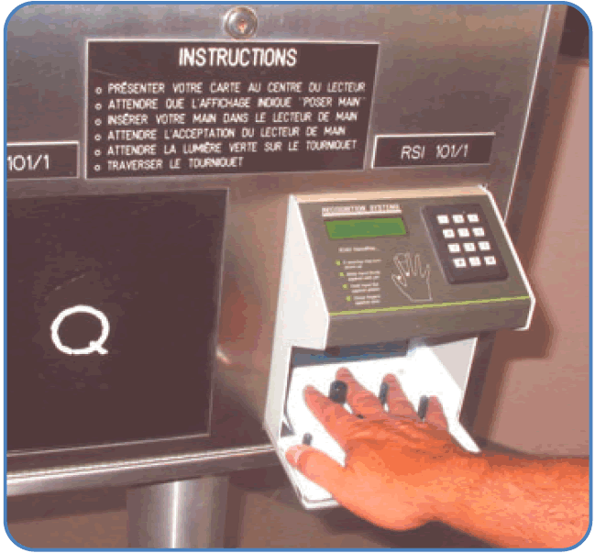
Hand Geometry
A popular biometric
Measures shape of hand
Width of hand, fingers
Length of fingers, etc.
Human hands not so unique
Hand geometry sufficient for many situations
OK for authentication
Not useful for ID problem

Slide 40
Hand Geometry
Advantages
Quick ⎯ 1 minute for enrollment, 5 seconds for recognition
Hands are symmetric ⎯ so what?
Disadvantages
Cannot use on very young or very old
Relatively high equal error rate

Slide 41
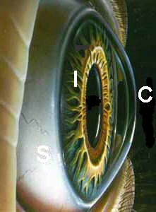

Iris Patterns
Iris pattern development is “chaotic”
Little or no genetic influence
Even for identical twins, uncorrelated
Pattern is stable through lifetime

Slide 42
Iris Recognition: History
1936 ⎯ suggested by ophthalmologist
1980s ⎯ James Bond film(s)
1986 ⎯ first patent appeared
1994 ⎯ John Daugman patents new-and-improved technique
Patents owned by Iridian Technologies
Notes:
The Bond film “Never Say Never Again” prominently features an iris recognition system.

Slide 43

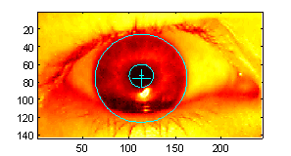
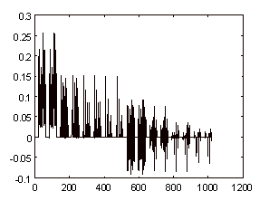
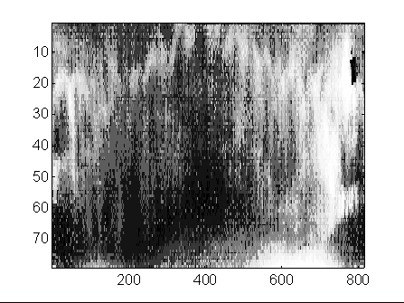
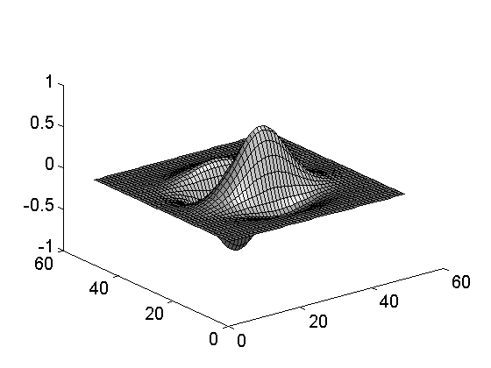
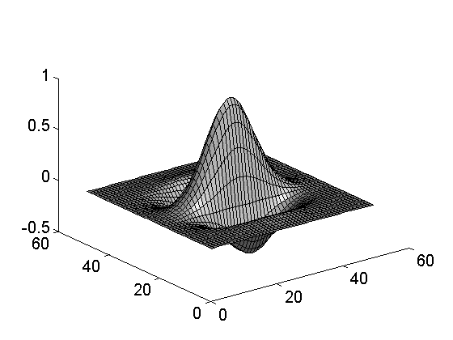
Iris Scan
Scanner locates iris
Take b/w photo
Use polar coordinates…
2-D wavelet transform
Get 256 byte iris code

Slide 44
Measuring Iris Similarity
Based on Hamming distance
Define d(x,y) to be
# of non-match bits / # of bits compared
d(0010,0101) = 3/4 and d(101111,101001) = 1/3
Compute d(x,y) on 2048-bit iris code
Perfect match is d(x,y) = 0
For same iris, expected distance is 0.08
At random, expect distance of 0.50
Accept iris scan as match if distance < 0.32

Slide 45
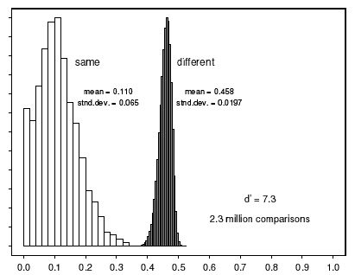

Iris Scan Error Rate
distance
Fraud rate
0.29 | 1 in 1.3∗10¹⁰
0.30 | 1 in 1.5∗10⁹
0.31 | 1 in 1.8∗10⁸
0.32 | 1 in 2.6∗10⁷
0.33 | 1 in 4.0∗10⁶
0.34 | 1 in 6.9∗10⁵
0.35 | 1 in 1.3∗10⁵
== equal error rate
distance

Slide 46
Attack on Iris Scan
Good photo of eye can be scanned
Attacker could use photo of eye
Afghan woman was authenticated by iris scan of old photo
Story can be found here
To prevent attack, scanner could use light to be sure it is a “live” iris

Slide 47
Equal Error Rate Comparison
Equal error rate (EER): fraud == insult rate
Fingerprint biometrics used in practice have EER ranging from about 10⁻³ to as high as 5%
Hand geometry has EER of about 10⁻³
In theory, iris scan has EER of about 10⁻⁶
Enrollment phase may be critical to accuracy
Most biometrics much worse than fingerprint!
Biometrics useful for authentication…
…but for identification, not so impressive today
Notes:
While fingerprints can be highly distinguishing, fingerprint biometrics vary a lot in quality some are really poor

Slide 48
Biometrics: The Bottom Line
Biometrics are hard to forge
But attacker could
Steal Alice’s thumb
Photocopy Bob’s fingerprint, eye, etc.
Subvert software, database, “trusted path” …
And how to revoke a “broken” biometric?
Biometrics are not foolproof
Biometric use is relatively limited today
That should change in the (near?) future

Slide 49
Something You Have
Something in your possession
Examples include following…
Car key
Laptop computer (or MAC address)
Password generator (next)
ATM card, smartcard, etc.

Slide 50
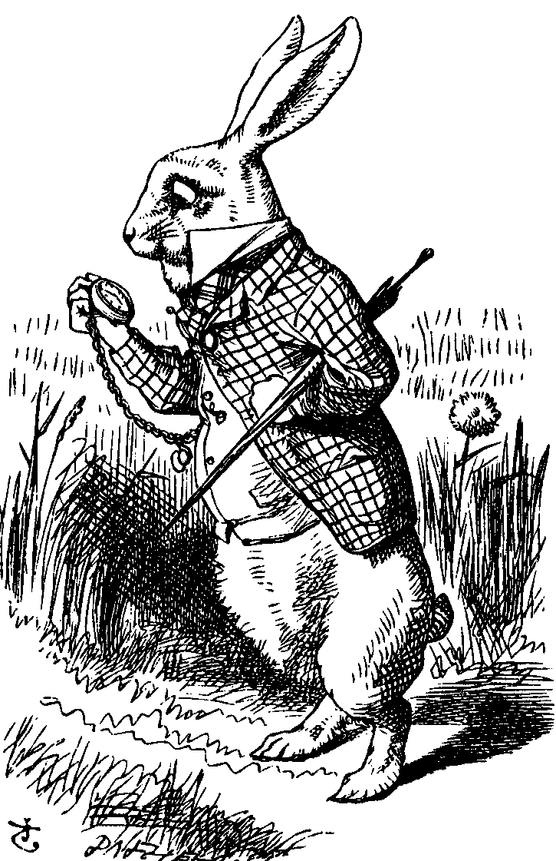
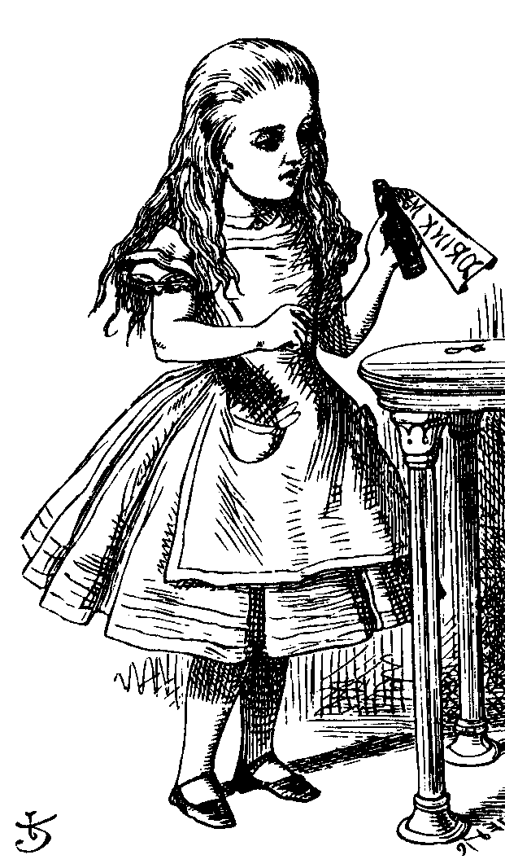

Password Generator
1. “I’m Alice”
3. PIN, R
2. R
4. h(K,R)
password
generator
K
5. h(K,R)
Alice
Bob, K
Alice receives random “challenge” R from Bob
Alice enters PIN and R in password generator
Password generator hashes symmetric key K with R
Alice sends “response” h(K,R) back to Bob
Bob verifies response
Note: Alice has pwd generator and knows PIN

Slide 51
2-factor Authentication
Requires any 2 out of 3 of
Something you know
Something you have
Something you are
Examples
ATM: Card and PIN
Credit card: Card and signature
Password generator: Device and PIN
Smartcard with password/PIN

Slide 52
Single Sign-on
A hassle to enter password(s) repeatedly
Alice would like to authenticate only once
“Credentials” stay with Alice wherever she goes
Subsequent authentications transparent to Alice
Kerberos ⎯ a single sign-on protocol
Single sign-on for the Internet?
Microsoft: Passport
Everybody else: Liberty Alliance
Security Assertion Markup Language (SAML)

Slide 53
Web Cookies
Cookie is provided by a Website and stored on user’s machine
Cookie indexes a database at Website
Cookies maintain state across sessions
Web uses a stateless protocol: HTTP
Cookies also maintain state within a session
Sorta like a single sign-on for a website
But, very, very weak form of authentication
Cookies also create privacy concerns

Slide 54
Authorization

Slide 55
Chapter 8: Authorization
It is easier to exclude harmful passions than to rule them,
and to deny them admittance
than to control them after they have been admitted.
⎯ Seneca
You can always trust the information given to you
by people who are crazy;
they have an access to truth not available through regular channels.
⎯ Sheila Ballantyne

Slide 56
Authentication vs Authorization
Authentication ⎯ Are you who you say you are?
Restrictions on who (or what) can access system
Authorization ⎯ Are you allowed to do that?
Restrictions on actions of authenticated users
Authorization is a form of access control
But first, we look at system certification…

Slide 57
System Certification
Government attempt to certify “security level” of products
Of historical interest
Sorta like a history of authorization
Still important today if you want to sell a product to the government
Tempting to argue it’s a failure since government is so insecure, but…

Slide 58
Orange Book
Trusted Computing System Evaluation Criteria (TCSEC), 1983
Universally known as the “orange book”
Name is due to color of it’s cover
About 115 pages
Developed by U.S. DoD (NSA)
Part of the “rainbow series”
Orange book generated a pseudo-religious fervor among some people
Less and less intensity as time goes by

Slide 59
Orange Book Outline
Goals
Provide way to assess security products
Provide general guidance/philosophy on how to build more secure products
Four divisions labeled D thru A
D is lowest, A is highest
Divisions split into numbered classes

Slide 60
D and C Divisions
D ⎯ minimal protection
Losers that can’t get into higher division
C ⎯ discretionary protection, i.e., don’t enforce security, just have means to detect breaches (audit)
C1 ⎯ discretionary security protection
C2 ⎯ controlled access protection
C2 slightly stronger than C1 (both vague)

Slide 61
B Division
B ⎯ mandatory protection
B is a huge step up from C
C: break security, you might get caught
B: “mandatory”, so you can’t break it
B1 ⎯ labeled security protection
All data labeled, which restricts what can be done with it
This access control cannot be violated

Slide 62
B and A Divisions
B2 ⎯ structured protection
Adds covert channel protection onto B1
B3 ⎯ security domains
On top of B2 protection, adds that code must be tamperproof and “small”
A ⎯ verified protection
Like B3, but proved using formal methods
Such methods still (mostly) impractical

Slide 63
Orange Book: Last Word
Also a 2nd part, discusses rationale
Not very practical or sensible, IMHO
But some people insist we’d be better off if we’d followed it
Others think it was a dead end
And resulted in lots of wasted effort
Aside… people who made the orange book, now set security education standards

Slide 64
Common Criteria
Successor to the orange book (ca. 1998)
Due to inflation, more than 1000 pages
An international government standard
And it reads like it…
Won’t ever stir same passions as orange book
CC is relevant in practice, but usually only if you want to sell to the government
Evaluation Assurance Levels (EALs)
1 thru 7, from lowest to highest security

Slide 65
EAL
Note: product with high EAL may not be more secure than one with lower EAL
Why?
Similarly, product with an EAL may not be any more secure than one without
Why?

Slide 66
EAL 1 thru 7
EAL1 ⎯ functionally tested
EAL2 ⎯ structurally tested
EAL3 ⎯ methodically tested, checked
EAL4 ⎯ designed, tested, reviewed
EAL5 ⎯ semiformally designed, tested
EAL6 ⎯ verified, designed, tested
EAL7 ⎯ formally … (blah blah blah)

Slide 67
Common Criteria
EAL4 is most commonly sought
Minimum needed to sell to government
EAL7 requires formal proofs
Author could only find 2 EAL7 products…
Who performs evaluations?
Government accredited labs, of course (for a hefty fee, like 6 figures)

Slide 68
Authentication vs Authorization
Authentication ⎯ Are you who you say you are?
Restrictions on who (or what) can access system
Authorization ⎯ Are you allowed to do that?
Restrictions on actions of authenticated users
Authorization is a form of access control
Classic view of authorization…
Access Control Lists (ACLs)
Capabilities (C-lists)

Slide 69
Lampson’s Access Control Matrix
Subjects (users) index the rows
Objects (resources) index the columns
Accounting
program
Accounting
data
Insurance
data
Payroll
data
OS
rx | rx | r | ⎯ | ⎯
rx | rx | r | rw | rw
rwx | rwx | r | rw | rw
rx | rx | rw | rw | rw
Bob
Alice
Sam
Accounting
program

Slide 70
Are You Allowed to Do That?
Access control matrix has all relevant info
Could be 100’s of users, 10,000’s of resources
Then matrix has 1,000,000’s of entries
How to manage such a large matrix?
Note: We need to check this matrix before access to any resource by any user
How to make this more efficient/practical?

Slide 71
Access Control Lists (ACLs)
ACL: store access control matrix by column
Example: ACL for insurance data is in blue
Accounting
program
Accounting
data
Insurance
data
Payroll
data
OS
rx | rx | r | ⎯ | ⎯
rx | rx | r | rw | rw
rwx | rwx | r | rw | rw
rx | rx | rw | rw | rw
Bob
Alice
Sam
Accounting
program

Slide 72
Capabilities (or C-Lists)
Store access control matrix by row
Example: Capability for Alice is in red
Accounting
program
Accounting
data
Insurance
data
Payroll
data
OS
rx | rx | r | ⎯ | ⎯
rx | rx | r | rw | rw
rwx | rwx | r | rw | rw
rx | rx | rw | rw | rw
Bob
Alice
Sam
Accounting
program

Slide 73
ACLs vs Capabilities
r
---
r
r
w
rw
Alice
file1
Alice
file1
w
r
---
---
r
r
Bob
file2
Bob
file2
rw
r
r
r
---
r
Fred
file3
Fred
file3
Access Control List
Capability
Note that arrows point in opposite directions…
With ACLs, still need to associate users to files

Slide 74
Confused Deputy
Two resources
Compiler and BILL file (billing info)
Compiler can write file BILL
Alice can invoke compiler with a debug filename
Alice not allowed to write to BILL
Access control matrix
Compiler
BILL
x | ⎯
rx | rw
Alice
Compiler

Slide 75
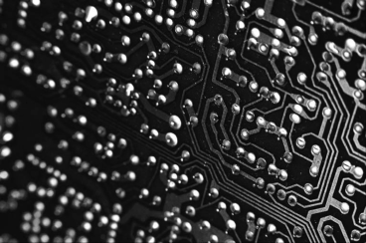
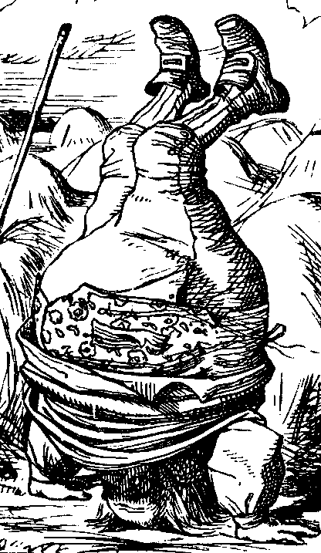
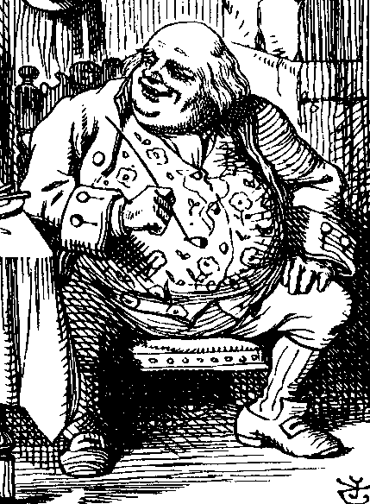
ACL’s and Confused Deputy
debug
BILL
filename BILL
Compiler
Alice
BILL
Compiler is deputy acting on behalf of Alice
Compiler is confused
Alice is not allowed to write BILL
Compiler has confused its rights with Alice’s

Slide 76
Confused Deputy
Compiler acting for Alice is confused
There has been a separation of authority from the purpose for which it is used
With ACLs, more difficult to prevent this
With Capabilities, easier to prevent problem
Must maintain association between authority and intended purpose
Capabilities ⎯ easy to delegate authority

Slide 77
ACLs vs Capabilities
ACLs
Good when users manage their own files
Protection is data-oriented
Easy to change rights to a resource
Capabilities
Easy to delegate ⎯ avoid the confused deputy
Easy to add/delete users
More difficult to implement
The “Zen of information security”
Capabilities loved by academics
Capability Myths Demolished

Slide 78
Multilevel Security (MLS) Models

Slide 79
Classifications and Clearances
Classifications apply to objects
Clearances apply to subjects
US Department of Defense (DoD) uses 4 levels:
TOP SECRET
SECRET
CONFIDENTIAL
UNCLASSIFIED

Slide 80
Clearances and Classification
To obtain a SECRET clearance requires a routine background check
A TOP SECRET clearance requires extensive background check
Practical classification problems
Proper classification not always clear
Level of granularity to apply classifications
Aggregation ⎯ flipside of granularity

Slide 81
Subjects and Objects
Let O be an object, S a subject
O has a classification
S has a clearance
Security level denoted L(O) and L(S)
For DoD levels, we have
TOP SECRET > SECRET >
CONFIDENTIAL > UNCLASSIFIED

Slide 82
Multilevel Security (MLS)
MLS needed when subjects/objects at different levels access same system
MLS is a form of Access Control
Military and government interest in MLS for many decades
Lots of research into MLS
Strengths and weaknesses of MLS well understood (almost entirely theoretical)
Many possible uses of MLS outside military

Slide 83
MLS Applications
Classified government/military systems
Business example: info restricted to
Senior management only, all management, everyone in company, or general public
Network firewall
Confidential medical info, databases, etc.
Usually, MLS not really a technical system
More like part of a legal structure

Slide 84
MLS Security Models
MLS models explain what needs to be done
Models do not tell you how to implement
Models are descriptive, not prescriptive
That is, high-level description, not an algorithm
There are many MLS models
We’ll discuss simplest MLS model
Other models are more realistic
Other models also more complex, more difficult to enforce, harder to verify, etc.

Slide 85
Bell-LaPadula
BLP security model designed to express essential requirements for MLS
BLP deals with confidentiality
To prevent unauthorized reading
Recall that O is an object, S a subject
Object O has a classification
Subject S has a clearance
Security level denoted L(O) and L(S)

Slide 86
Bell-LaPadula
BLP consists of
Simple Security Condition: S can read O if and only if L(O) ≤ L(S)
*-Property (Star Property): S can write O if and only if L(S) ≤ L(O)
No read up, no write down

Slide 87
McLean’s Criticisms of BLP
McLean: BLP is “so trivial that it is hard to imagine a realistic security model for which it does not hold”
McLean’s “system Z” allowed administrator to reclassify object, then “write down”
Is this fair?
Violates spirit of BLP, but not expressly forbidden in statement of BLP
Raises fundamental questions about the nature of (and limits of) modeling

Slide 88
B and LP’s Response
BLP enhanced with tranquility property
Strong tranquility: security labels never change
Weak tranquility: security label can only change if it does not violate “established security policy”
Strong tranquility impractical in real world
Often want to enforce “least privilege”
Give users lowest privilege for current work
Then upgrade as needed (and allowed by policy)
This is known as the high water mark principle
Weak tranquility allows for least privilege (high water mark), but the property is vague

Slide 89
BLP: The Bottom Line
BLP is simple, probably too simple
BLP is one of the few security models that can be used to prove things about systems
BLP has inspired other security models
Most other models try to be more realistic
Other security models are more complex
Models difficult to analyze, apply in practice

Slide 90
Biba’s Model
BLP for confidentiality, Biba for integrity
Biba is to prevent unauthorized writing
Biba is (in a sense) the dual of BLP
Integrity model
Spse you trust the integrity of O but not O
If object O includes O and O then you cannot trust the integrity of O
Integrity level of O is minimum of the integrity of any object in O
Low water mark principle for integrity

Slide 91
Biba
Let I(O) denote the integrity of object O and I(S) denote the integrity of subject S
Biba can be stated as
Write Access Rule: S can write O if and only if I(O) ≤ I(S)
(if S writes O, the integrity of O ≤ that of S)
Biba’s Model: S can read O if and only if I(S) ≤ I(O)
(if S reads O, the integrity of S ≤ that of O)
Often, replace Biba’s Model with
Low Water Mark Policy: If S reads O, then I(S) = min(I(S), I(O))

Slide 92
BLP vs Biba
BLP
Biba
high
high
l
e
v
e
l
L(O)
L(O)
I(O)
l
e
v
e
l
L(O)
I(O)
I(O)
low
Confidentiality
Integrity
low

Slide 93
Compartments

Slide 94
Compartments
Multilevel Security (MLS) enforces access control up and down
Simple hierarchy of security labels is generally not flexible enough
Compartments enforces restrictions across
Suppose TOP SECRET divided into TOP SECRET {CAT} and TOP SECRET {DOG}
Both are TOP SECRET but information flow restricted across the TOP SECRET level

Slide 95
Compartments
Why compartments?
Why not create a new classification level?
May not want either of
TOP SECRET {CAT} ≥ TOP SECRET {DOG}
TOP SECRET {DOG} ≥ TOP SECRET {CAT}
Compartments designed to enforce the need to know principle
Regardless of clearance, you only have access to info that you need to know to do your job

Slide 96
Compartments
Arrows indicate “≥” relationship
TOP SECRET {CAT, DOG}
TOP SECRET {CAT}
TOP SECRET {DOG}
TOP SECRET
SECRET {CAT, DOG}
SECRET {CAT}
SECRET {DOG}
SECRET
Not all classifications are comparable, e.g.,
TOP SECRET {CAT} vs SECRET {CAT, DOG}

Slide 97
MLS vs Compartments
MLS can be used without compartments
And vice-versa
But, MLS almost always uses compartments
Example
MLS mandated for protecting medical records of British Medical Association (BMA)
AIDS was TOP SECRET, prescriptions SECRET
What is the classification of an AIDS drug?
Everything tends toward TOP SECRET
Defeats the purpose of the system!
Compartments-only approach used instead

Slide 98
Covert Channel

Slide 99
Covert Channel
MLS designed to restrict legitimate channels of communication
May be other ways for information to flow
For example, resources shared at different levels could be used to “signal” information
Covert channel: a communication path not intended as such by system’s designers

Slide 100
Covert Channel Example
Alice has TOP SECRET clearance, Bob has CONFIDENTIAL clearance
Suppose the file space shared by all users
Alice creates file FileXYzW to signal “1” to Bob, and removes file to signal “0”
Once per minute Bob lists the files
If file FileXYzW does not exist, Alice sent 0
If file FileXYzW exists, Alice sent 1
Alice can leak TOP SECRET info to Bob

Slide 101
Covert Channel Example
Alice:
Create file
Delete file
Create file
Delete file
Bob:
Check file
Check file
Check file
Check file
Check file
Data:
1
0
1
1
0
Time:

Slide 102
Covert Channel
Other possible covert channels?
Print queue
ACK messages
Network traffic, etc.
When does covert channel exist?
Sender and receiver have a shared resource
Sender able to vary some property of resource that receiver can observe
“Communication” between sender and receiver can be synchronized

Slide 103
Covert Channel
Potential covert channels are everywhere
But, it’s easy to eliminate covert channels:
“Just” eliminate all shared resources and all communication!
Virtually impossible to eliminate covert channels in any useful information system
DoD guidelines: reduce covert channel capacity to no more than 1 bit/second
Implication? DoD has given up on eliminating covert channels

Slide 104
Covert Channel
Consider 100MB TOP SECRET file
Plaintext stored in TOP SECRET location
Ciphertext ⎯ encrypted with AES using 256-bit key ⎯ stored in UNCLASSIFIED location
Suppose we reduce covert channel capacity to 1 bit per second
It would take more than 25 years to leak entire document thru a covert channel
But it would take less than 5 minutes to leak 256-bit AES key thru covert channel!

Slide 105
Real-World Covert Channel
bits
0
8
16
24
31
Source Port
Destination Port
Sequence Number
Acknowledgement Number
Offset
reserved
U
A
P
R
S
F
Window
Checksum
Urgent Pointer
Options
Padding
Data (variable length)
Hide data in TCP header “reserved” field
Or use covert_TCP, tool to hide data in
Sequence number
ACK number

Slide 106

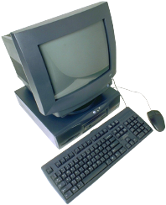
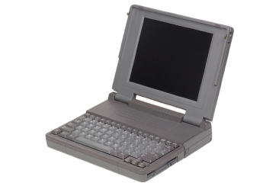
Real-World Covert Channel
Hide data in TCP sequence numbers
Tool: covert_TCP
Sequence number X contains covert info
ACK (or RST)
Source: B
Destination: C
ACK: X
SYN
Spoofed source: C
Destination: B
SEQ: X
B. Innocent
server
A. Covert_TCP
sender
C. Covert_TCP
receiver

Slide 107
Inference Control

Slide 108
Inference Control Example
Suppose we query a database
Question: What is average salary of female CS professors at SJSU?
Answer: $95,000
Question: How many female CS professors at SJSU?
Answer: 1
Specific information has leaked from responses to general questions!

Slide 109
Inference Control & Research
For example, medical records are private but valuable for research
How to make info available for research and protect privacy?
How to allow access to such data without leaking specific information?

Slide 110
Naïve Inference Control
Remove names from medical records?
Still may be easy to get specific info from such “anonymous” data
Removing names is not enough
As seen in previous example
What more can be done?

Slide 111
Less-naïve Inference Control
Query set size control
Don’t return an answer if set size is too small
N-respondent, k% dominance rule
Do not release statistic if k% or more contributed by N or fewer
Example: Avg salary in Bill Gates’ neighborhood
This approach used by US Census Bureau
Randomization
Add small amount of random noise to data
Many other methods ⎯ none satisfactory

Slide 112
Netflix Example
Netflix prize ⎯ $1M to first to improve recommendation system by 10% or more
Netflix created dataset for contest
Movie preferences of real users
Usernames removed, some “noise” added
Insufficient inference control
Researchers able to correlate IMDB reviews with those in Netflix dataset
Notes:
“Recommendation system” consists of predicting user reviews based on previous reviews.
Since this happened in the USA, it goes without saying that this breach of privacy resulted in a lawsuit against Netflix.
Also, Netflix never implemented the winning algorithm!

Slide 113
Something Better Than Nothing?
Robust inference control may be impossible
Is weak inference control better than nothing?
Yes: Reduces amount of information that leaks
Is weak covert channel protection better than nothing?
Yes: Reduces amount of information that leaks
Is weak crypto better than no crypto?
Probably not: Encryption indicates important data
May be easier to filter encrypted data

Slide 114
CAPTCHA

Slide 115
Turing Test
Proposed by Alan Turing in 1950
Human asks questions to a human and a computer, without seeing either
If questioner cannot distinguish human from computer, computer passes
This is the gold standard in AI
No computer can pass this today
But some claim they are close to passing

Slide 116
CAPTCHA
CAPTCHA
Completely Automated Public Turing test to tell Computers and Humans Apart
Completely Automated ⎯ test is generated and scored by a computer
Public ⎯ program and data are public
Turing test to tell… ⎯ humans can pass the test, but machines cannot
Also known as HIP == Human Interactive Proof
Like an inverse Turing test (sort of…)
Notes:
CAPTCHA == worst acronym in the history of acronyms

Slide 117
CAPTCHA Paradox?
“…CAPTCHA is a program that can generate and grade tests that it itself cannot pass…”
“…much like some professors…”
Paradox ⎯ computer creates and scores test that it itself cannot pass!
CAPTCHA purpose?
Only humans get access (not bots/computers)
So, CAPTCHA is for access control

Slide 118
CAPTCHA Uses?
Original motivation?
Automated bots stuffed ballot box in vote for best CS grad school
SJSU vs Stanford? No, it was MIT vs CMU
Free email services ⎯ spammers like to use bots to sign up for 1000s of email accounts
CAPTCHA employed so only humans get accounts
Sites that do not want to be automatically indexed by search engines
CAPTCHA would force human intervention

Slide 119
CAPTCHA: Rules of the Game
Easy for most humans to pass
Difficult or impossible for machines to pass
Even with access to CAPTCHA software
From Trudy’s perspective, the only unknown is a random number
Similar to Kerckhoffs’ Principle
Good to have different CAPTCHAs in case someone cannot pass one type
E.g., blind person could not pass visual CAPTCHA

Slide 120
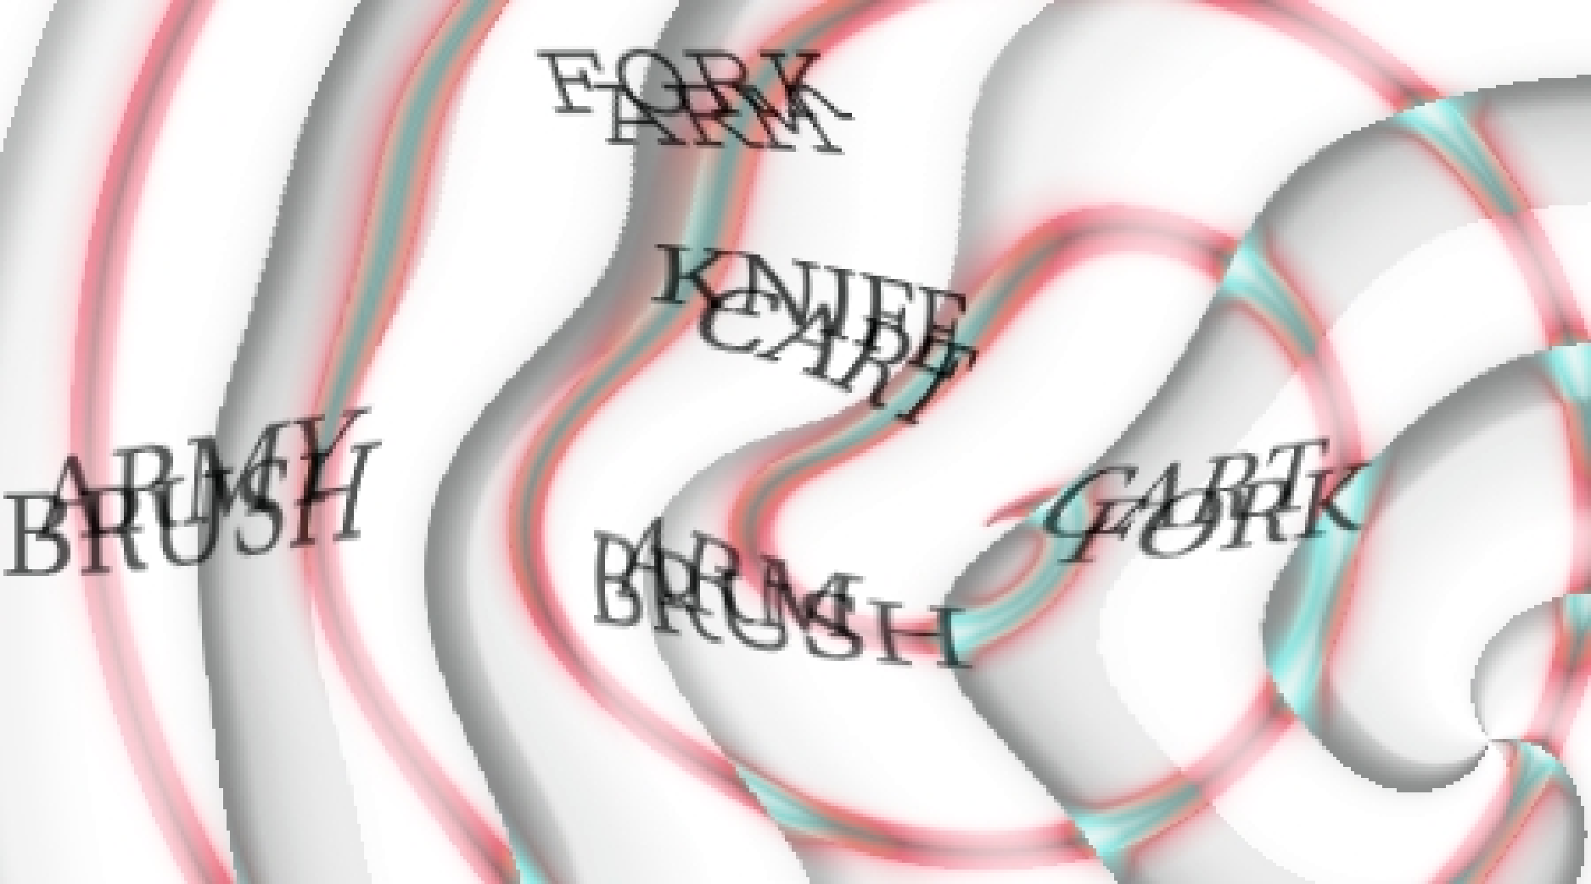
Do CAPTCHAs Exist?
Test: Find 2 words in the following
Easy for most humans
A (difficult?) OCR problem for computer
OCR ⎯ Optical Character Recognition

Slide 121
CAPTCHAs
Current types of CAPTCHAs
Visual ⎯ like previous example
Audio ⎯ distorted words or music
No text-based CAPTCHAs
Maybe this is impossible…

Slide 122
CAPTCHA’s and AI
OCR is a challenging AI problem
Hardest part is the segmentation problem
Humans good at solving this problem
Distorted sound makes good CAPTCHA
Humans also good at solving this
Hackers who break CAPTCHA have solved a hard AI problem (such as OCR)
So, putting hacker’s effort to good use!
Other ways to defeat CAPTCHAs???
Notes:
See the excellent paper, Telling Humans and Computers Apart: How Lazy Cryptographers do AI
http://www.captcha.net/captcha_cacm.pdf

Slide 123

Firewalls

Slide 124
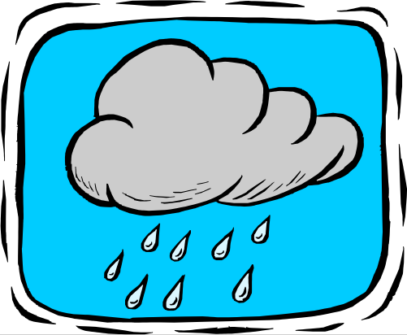

Firewalls
Internal
network
Internet
Firewall
Firewall decides what to let in to internal network and/or what to let out
Access control for the network

Slide 125
Firewall as Secretary
A firewall is like a secretary
To meet with an executive
First contact the secretary
Secretary decides if meeting is important
So, secretary filters out many requests
You want to meet chair of CS department?
Secretary does some filtering
You want to meet POTUS?
Secretary does lots of filtering

Slide 126
Firewall Terminology
No standard firewall terminology
Types of firewalls
Packet filter ⎯ works at network layer
Stateful packet filter ⎯ transport layer
Application proxy ⎯ application layer
Lots of other terms often used
E.g., “deep packet inspection”

Slide 127
Packet Filter
Operates at network layer
Can filters based on…
Source IP address
Destination IP address
Source Port
Destination Port
Flag bits (SYN, ACK, etc.)
Egress or ingress
application
transport
network
link
physical

Slide 128
Packet Filter
Advantages?
Speed
Disadvantages?
No concept of state
Cannot see TCP connections
Blind to application data
application
transport
network
link
physical

Slide 129
Packet Filter
Configured via Access Control Lists (ACLs)
Different meaning than at start of Chapter 8
Source
IP
Dest
IP
Source
Port
Dest
Port
Flag
Bits
Action
Protocol
Allow | Inside | Outside | Any | 80 | HTTP
Allow | Outside | Inside | 80 | > 1023 | HTTP
Deny | All | All | All | All | All
Any
ACK
All
Q: Intention?
A: Restrict traffic to Web browsing

Slide 130
TCP ACK Scan
Attacker scans for open ports thru firewall
Port scanning often first step in network attack
Attacker sends packet with ACK bit set, without prior 3-way handshake
Violates TCP/IP protocol
ACK packet pass thru packet filter firewall
Appears to be part of an ongoing connection
RST sent by recipient of such packet

Slide 131
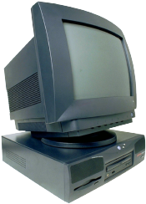

TCP ACK Scan
ACK dest port 1207
ACK dest port 1208
ACK dest port 1209
Trudy
RST
Internal
Network
Packet
Filter
Attacker knows port 1209 open thru firewall
A stateful packet filter can prevent this
Since scans not part of established connections

Slide 132
Stateful Packet Filter
Adds state to packet filter
Operates at transport layer
Remembers TCP connections, flag bits, etc.
Can even remember UDP packets (e.g., DNS requests)
application
transport
network
link
physical

Slide 133
Stateful Packet Filter
Advantages?
Can do everything a packet filter can do plus...
Keep track of ongoing connections (e.g., prevents TCP ACK scan)
Disadvantages?
Cannot see application data
Slower than packet filtering
application
transport
network
link
physical

Slide 134
Application Proxy
A proxy is something that acts on your behalf
Application proxy looks at incoming application data
Verifies that data is safe before letting it in
application
transport
network
link
physical

Slide 135
Application Proxy
Advantages?
Complete view of connections and applications data
Filter bad data at application layer (viruses, Word macros)
Disadvantages?
Speed
application
transport
network
link
physical

Slide 136
Application Proxy
Creates a new packet before sending it thru to internal network
Attacker must talk to proxy and convince it to forward message
Proxy has complete view of connection
Can prevent some scans stateful packet filter cannot ⎯ next slides

Slide 137
Firewalk
Tool to scan for open ports thru firewall
Attacker knows IP address of firewall and IP address of one system inside firewall
Set TTL to 1 more than number of hops to firewall, and set destination port to N
If firewall allows data on port N thru firewall, get time exceeded error message
Otherwise, no response

Slide 138
Firewalk and Proxy Firewall
Packet
filter
Trudy
Router
Router
Router
Dest port 12343, TTL=4
Dest port 12344, TTL=4
Dest port 12345, TTL=4
Time exceeded
This will not work thru an application proxy (why?)
The proxy creates a new packet, destroys old TTL

Slide 139
Deep Packet Inspection
Many buzzwords used for firewalls
One example: deep packet inspection
What could this mean?
Look into packets, but don’t really “process” the packets
Like an application proxy, but faster

Slide 140

Firewalls and Defense in Depth
Typical network security architecture
DMZ
FTP server
Web server
DNS server
Intranet with
additional
defense
Packet
Filter
Application
Proxy
Internet

Slide 141
Intrusion Detection Systems

Slide 142
Intrusion Prevention
Want to keep bad guys out
Intrusion prevention is a traditional focus of computer security
Authentication is to prevent intrusions
Firewalls a form of intrusion prevention
Virus defenses aimed at intrusion prevention
Like locking the door on your car

Slide 143
Intrusion Detection
In spite of intrusion prevention, bad guys will sometime get in
Intrusion detection systems (IDS)
Detect attacks in progress (or soon after)
Look for unusual or suspicious activity
IDS evolved from log file analysis
IDS is currently a hot research topic
How to respond when intrusion detected?
We don’t deal with this topic here…

Slide 144
Intrusion Detection Systems
Who is likely intruder?
May be outsider who got thru firewall
May be evil insider
What do intruders do?
Launch well-known attacks
Launch variations on well-known attacks
Launch new/little-known attacks
“Borrow” system resources
Use compromised system to attack others. etc.

Slide 145
IDS
Intrusion detection approaches
Signature-based IDS
Anomaly-based IDS
Intrusion detection architectures
Host-based IDS
Network-based IDS
Any IDS can be classified as above
In spite of marketing claims to the contrary!

Slide 146
Host-Based IDS
Monitor activities on hosts for
Known attacks
Suspicious behavior
Designed to detect attacks such as
Buffer overflow
Escalation of privilege, …
Little or no view of network activities

Slide 147
Network-Based IDS
Monitor activity on the network for…
Known attacks
Suspicious network activity
Designed to detect attacks such as
Denial of service
Network probes
Malformed packets, etc.
Some overlap with firewall
Little or no view of host-base attacks
Can have both host and network IDS

Slide 148
Signature Detection Example
Failed login attempts may indicate password cracking attack
IDS could use the rule “N failed login attempts in M seconds” as signature
If N or more failed login attempts in M seconds, IDS warns of attack
Note that such a warning is specific
Admin knows what attack is suspected
Easy to verify attack (or false alarm)

Slide 149
Signature Detection
Suppose IDS warns whenever N or more failed logins in M seconds
Set N and M so false alarms not common
Can do this based on “normal” behavior
But, if Trudy knows the signature, she can try N − 1 logins every M seconds…
Then signature detection slows down Trudy, but might not stop her

Slide 150
Signature Detection
Many techniques used to make signature detection more robust
Goal is to detect “almost” signatures
For example, if “about” N login attempts in “about” M seconds
Warn of possible password cracking attempt
What are reasonable values for “about”?
Can use statistical analysis, heuristics, etc.
Must not increase false alarm rate too much

Slide 151
Signature Detection
Advantages of signature detection
Simple
Detect known attacks
Know which attack at time of detection
Efficient (if reasonable number of signatures)
Disadvantages of signature detection
Signature files must be kept up to date
Number of signatures may become large
Can only detect known attacks
Variation on known attack may not be detected

Slide 152
Anomaly Detection
Anomaly detection systems look for unusual or abnormal behavior
There are (at least) two challenges
What is normal for this system?
How “far” from normal is abnormal?
No avoiding statistics here!
mean defines normal
variance gives distance from normal to abnormal

Slide 153
How to Measure Normal?
How to measure normal?
Must measure during “representative” behavior
Must not measure during an attack…
…or else attack will seem normal!
Normal is statistical mean
Must also compute variance to have any reasonable idea of abnormal

Slide 154
How to Measure Abnormal?
Abnormal is relative to some “normal”
Abnormal indicates possible attack
Statistical discrimination techniques include
Bayesian statistics
Linear discriminant analysis (LDA)
Quadratic discriminant analysis (QDA)
Neural nets, hidden Markov models (HMMs), etc.
Fancy modeling techniques also used
Artificial intelligence
Artificial immune system principles
Many, many, many others

Slide 155
Anomaly Detection (1)
Spse we monitor use of three commands:
open, read, close
Under normal use we observe Alice:
open, read, close, open, open, read, close, …
Of the six possible ordered pairs, we see four pairs are normal for Alice,
(open,read), (read,close), (close,open), (open,open)
Can we use this to identify unusual activity?

Slide 156
Anomaly Detection (1)
We monitor use of the three commands
open, read, close
If the ratio of abnormal to normal pairs is “too high”, warn of possible attack
Could improve this approach by
Also use expected frequency of each pair
Use more than two consecutive commands
Include more commands/behavior in the model
More sophisticated statistical discrimination

Slide 157
Anomaly Detection (2)
Over time, Alice has accessed file F_{n} at rate H_{n}
Recently, “Alice” has accessed F_{n} at rate A_{n}
H₀ | H₁ | H₂ | H₃
.10 | .40 | .40 | .10
A₀ | A₁ | A₂ | A₃
.10 | .40 | .30 | .20
Is this normal use for Alice?
We compute S = (H₀−A₀)²+(H₁−A₁)²+…+(H₃−A₃)² = .02
We consider S < 0.1 to be normal, so this is normal
How to account for use that varies over time?

Slide 158
Anomaly Detection (2)
To allow “normal” to adapt to new use, we update averages: H_{n} = 0.2A_{n} + 0.8H_{n}
In this example, H_{n} are updated… H₂=.2∗.3+.8∗.4=.38 and H₃=.2∗.2+.8∗.1=.12
And we now have
H₀ | H₁ | H₂ | H₃
.10 | .40 | .38 | .12

Slide 159
Anomaly Detection (2)
The updated long term average is
Suppose new observed rates…
H₀ | H₁ | H₂ | H₃
.10 | .40 | .38 | .12
A₀ | A₁ | A₂ | A₃
.10 | .30 | .30 | .30
Is this normal use?
Compute S = (H₀−A₀)²+…+(H₃−A₃)² = .0488
Since S = .0488 < 0.1 we consider this normal
And we again update the long term averages:
H_{n} = 0.2A_{n} + 0.8H_{n}

Slide 160
Anomaly Detection (2)
The starting averages were:
After 2 iterations, averages are:
H₀ | H₁ | H₂ | H₃
.10 | .40 | .40 | .10
H₀ | H₁ | H₂ | H₃
.10 | .38 | .364 | .156
Statistics slowly evolve to match behavior
This reduces false alarms for SA
But also opens an avenue for attack…
Suppose Trudy always wants to access F₃
Can she convince IDS this is normal for Alice?

Slide 161
Anomaly Detection (2)
To make this approach more robust, must incorporate the variance
Can also combine N stats S_{i} as, say,
T = (S₁ + S₂ + S₃ + … + S_{N}) / N
to obtain a more complete view of “normal”
Similar (but more sophisticated) approach is used in an IDS known as NIDES
NIDES combines anomaly & signature IDS

Slide 162
Anomaly Detection Issues
Systems constantly evolve and so must IDS
Static system would place huge burden on admin
But evolving IDS makes it possible for attacker to (slowly) convince IDS that an attack is normal
Attacker may win simply by “going slow”
What does “abnormal” really mean?
Indicates there may be an attack
Might not be any specific info about “attack”
How to respond to such vague information?
In contrast, signature detection is very specific

Slide 163
Anomaly Detection
Advantages?
Chance of detecting unknown attacks
Disadvantages?
Cannot use anomaly detection alone…
…must be used with signature detection
Reliability is unclear
May be subject to attack
Anomaly detection indicates “something unusual”, but lacks specific info on possible attack

Slide 164
Anomaly Detection: The Bottom Line
Anomaly-based IDS is active research topic
Many security experts have high hopes for its ultimate success
Often cited as key future security technology
Hackers are not convinced!
Title of a talk at Defcon: “Why Anomaly-based IDS is an Attacker’s Best Friend”
Anomaly detection is difficult and tricky
As hard as AI?

Slide 165
Access Control Summary
Authentication and authorization
Authentication ⎯ who goes there?
Passwords ⎯ something you know
Biometrics ⎯ something you are (you are your key)
Something you have

Slide 166
Access Control Summary
Authorization ⎯ are you allowed to do that?
Access control matrix/ACLs/Capabilities
MLS/Multilateral security
BLP/Biba
Covert channel
Inference control
CAPTCHA
Firewalls
IDS

Slide 167
Coming Attractions…
Security protocols
Generic authentication protocols
SSH
SSL
IPSec
Kerberos
WEP
GSM
We’ll see lots of crypto applications in the protocol chapters

