Slide 1
Classifying Waste

Slide 2
CONTENTS
INTRODUCTION
Solution
Problem statement
Experiments
Data
Conclusion

Slide 3
INTRODUCTION
We will classify the waste into organic waste and recyclable waste

Slide 4
Problem statement
With the amount of waste produced daily in Saudi Arabia, waste management is a huge problem. A big part of this issue is waste classification.

Slide 5
Data

Slide 6
This dataset contains 22500 images of organic and recyclable objects

Slide 7
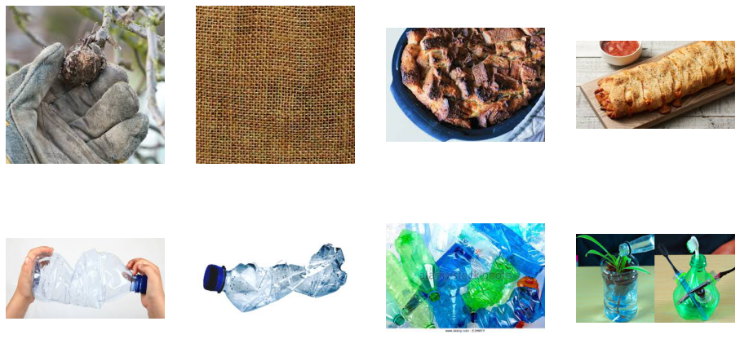
image samples

Slide 8
Solution

Slide 9
the solution is to build machine learning models that can classify waste as organic or recyclable from images., I will do this using a convolutional neural network.

Slide 10
Experiments

Slide 11
EXP1
VENUS
Input layer
Convolutional
Layer
(16,3)
MaxPooling
layer
Convolutional
Layer
(32,3)
MaxPooling
layer
Convolutional
Layer
(64,3)
MaxPooling
layer
JUPITER
Dense
Layer
Flattened
MARS
Dropout
layer
Output
layer

Slide 12
Accuracy/Loss
Epoch | loss | acc | val_loss | val_acc
1 | 0.5170 | 0.7892 | 0.4714 | 0.7955
2 | 0.3920 | 0.8368 | 0.3694 | 0.8687
3 | 0.3614 | 0.8546 | 0.8273 | 0.8273
4 | 0.3475 | 0.8601 | 0.4451 | 0.8464
5 | 0.3375 | 0.3431 | 0.3431 | 0.8786
6 | 0.3320 | 0.8686 | 0.2671 | 0.8961
7 | 0.3252 | 0.8736 | 0.3277 | 0.8679
8 | 0.3179 | 0.8774 | 0.2910 | 0.8890

Slide 13
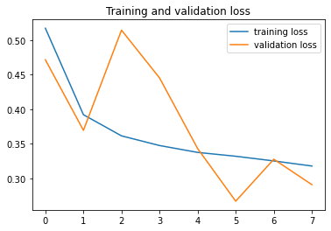
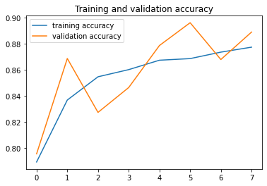
Accuracy/Loss

Slide 14
EXP2: Inception v3 model
VENUS
Inception
Flattened
Dense
layer
Dropout
layer
Output
layer
JUPITER

Slide 15
Accuracy/Loss
Epoch | loss | acc | val_loss | val_acc
1 | 0.6763 | 0.6056 | 0.6944 | 0.4431
2 | 0.5858 | 0.7100 | 0.6932 | 0.4569
3 | 0.5568 | 0.7184 | 0.6889 | 0.5625
4 | 0.5400 | 0.7300 | 0.6831 | 0.5581
5 | 0.5140 | 0.7550 | 0.6653 | 0.5544
6 | 0.5083 | 0.7703 | 0.6122 | 0.6194
7 | 0.5099 | 0.7559 | 0.5306 | 0.7513
8 | 0.4893 | 0.7703 | 0.4372 | 0.8256

Slide 16
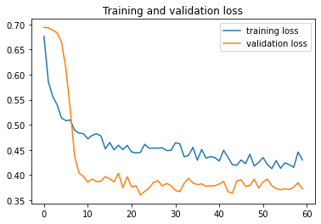
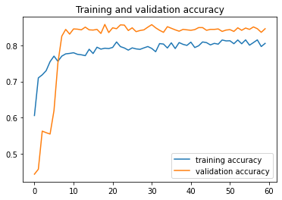
Accuracy/Loss

Slide 17
Conclusion

Slide 18
90%
CNN
learning transfer model

Slide 19
CNN from scratch achieved a slightly higher accuracy in the learning transfer model, so I'm going to visualize and evaluate its performance!

Slide 20
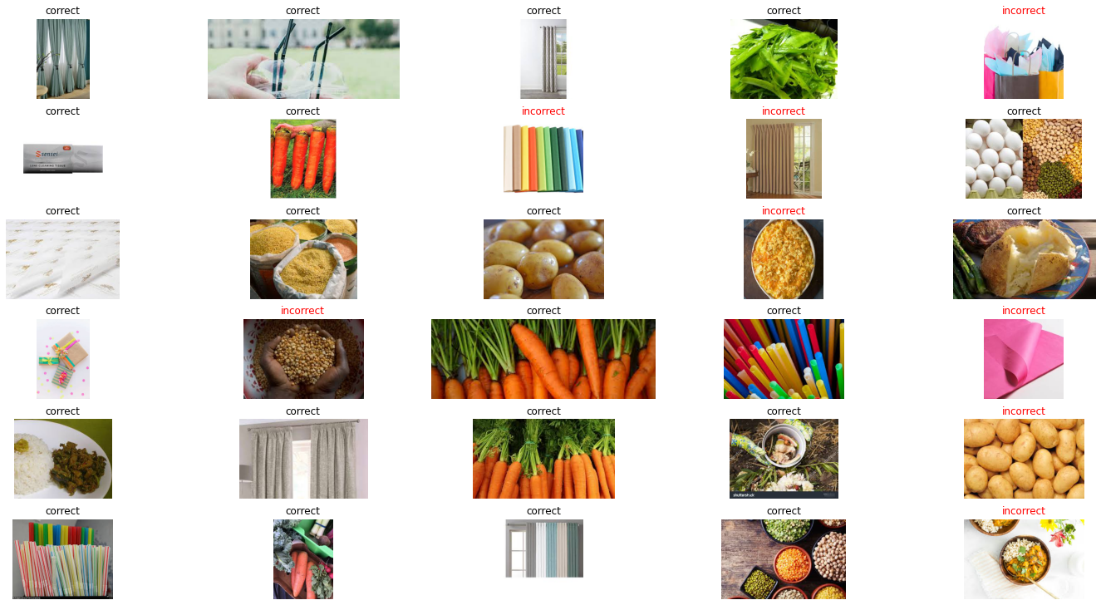
visualize these results, let’s output the images of the classified waste along with correctness

Slide 21
You have successfully created a classifier that can differentiate between images of organic waste and images of recyclable waste! But we still have a long way to go before the waste crisis is resolved.

Slide 22
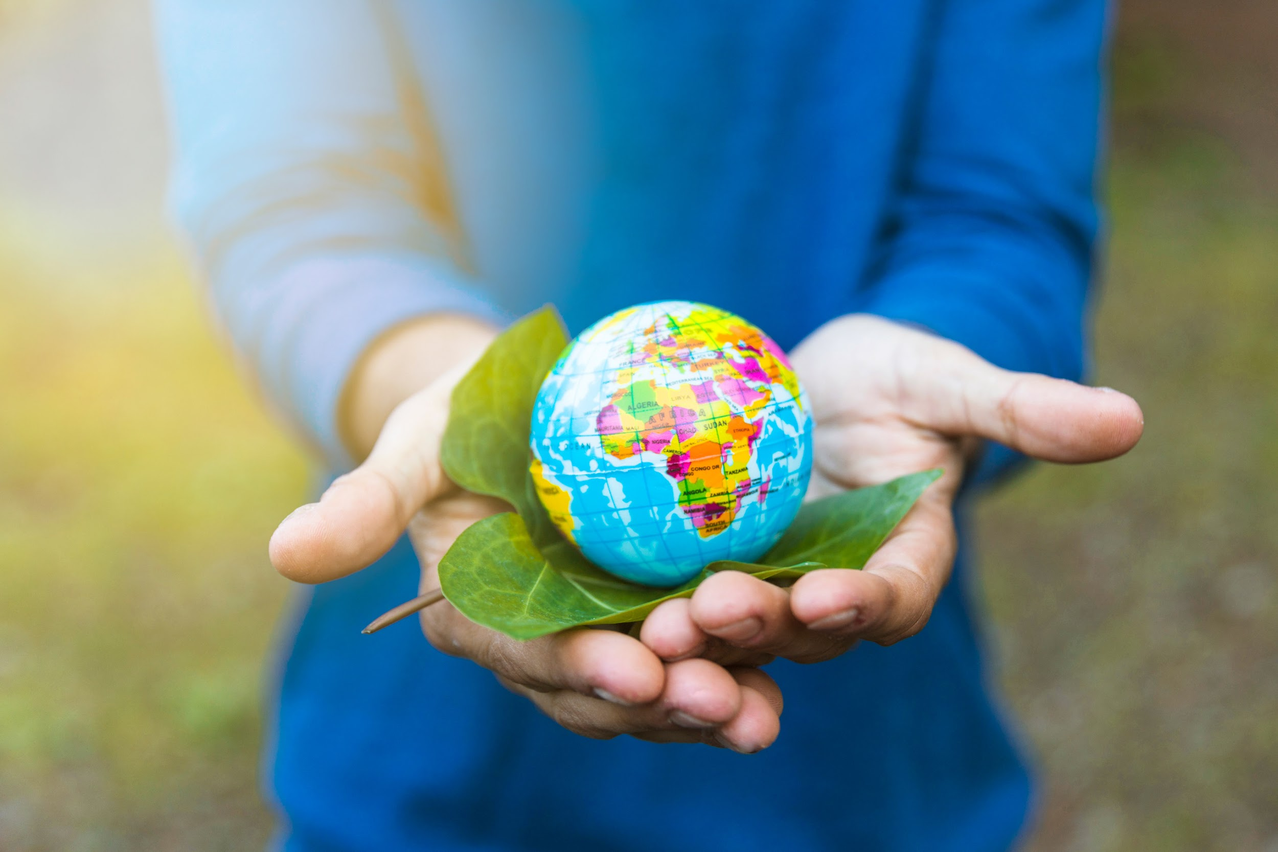
Thanks! Do you have any questions?

