Slide 1
GSG × PSSAR — Advanced Training CAPSTONE
AI-Based Customer
Behavior Shift Detection
Spotting early signals of customer disengagement from transaction data —
before the customer is already gone.
Prepared by
Sara Alwadia & Rana Almadhoun
Online Retail II Dataset • Python, Scikit-learn, XGBoost, SHAP

Slide 2
The Problem We Set Out to Solve
In e-commerce, customers rarely announce they're leaving — they simply order less, spend less, and fade out quietly. By the time a business notices, the relationship is often already lost.
1
2
3
Silent disengagement
Detected too late
Retention opportunity lost
Behavior changes gradually, with no explicit signal like a cancellation.
Traditional reporting shows the drop only after it has already happened.
Without an early flag, there's no window to re-engage the customer.
Our Goal
Build a machine learning pipeline that flags customers likely to reduce their purchasing activity in the next observation window — early enough, and clearly enough, to act on it.
AI-Based Customer Behavior Shift Detection
2

Slide 3
The Dataset — Online Retail II
A real-world transaction log from a UK-based online gift retailer, spanning two full years. Each row is a single line item on a customer invoice.
UK-Based Online Retailer
Fields: Invoice, StockCode, Description, Quantity, Price, Customer ID, Country, InvoiceDate
Time span: December 2009 – December 2011
Granularity: individual purchase line items, rolled up per customer
Engineered value: Quantity × Price → TotalPrice per transaction
2 yrs
of continuous transaction history
1,000s
of unique customers tracked over time
30 / 60 / 90
day observation windows tested
AI-Based Customer Behavior Shift Detection
3

Slide 4
Dataset Inspection & Cleaning
Before any feature engineering, the raw dataset was inspected for quality issues that could distort behavioral measurements.
!
Missing Customer IDs
!
Missing descriptions
Key Observations
Duplicate records
Negative quantities
1,067,371
!
!
rows in the combined raw dataset
824,364
!
Negative prices
!
Zero prices
transactions with a valid Customer ID
243,007
Cancellation transactions
Non-commercial transactions
transactions without a Customer ID
!
!
5,942
unique customers identified
Decision
Lesson
Modeling was restricted to transactions with a valid Customer ID — reliable behavioral history requires a stable identifier. Cancellations and non-commercial transactions were removed per the project's cleaning rules.
Cleaning has to happen before temporal feature construction — invalid or duplicate transactions directly distort behavioral measurements like order counts and spend.
AI-Based Customer Behavior Shift Detection
4

Slide 5
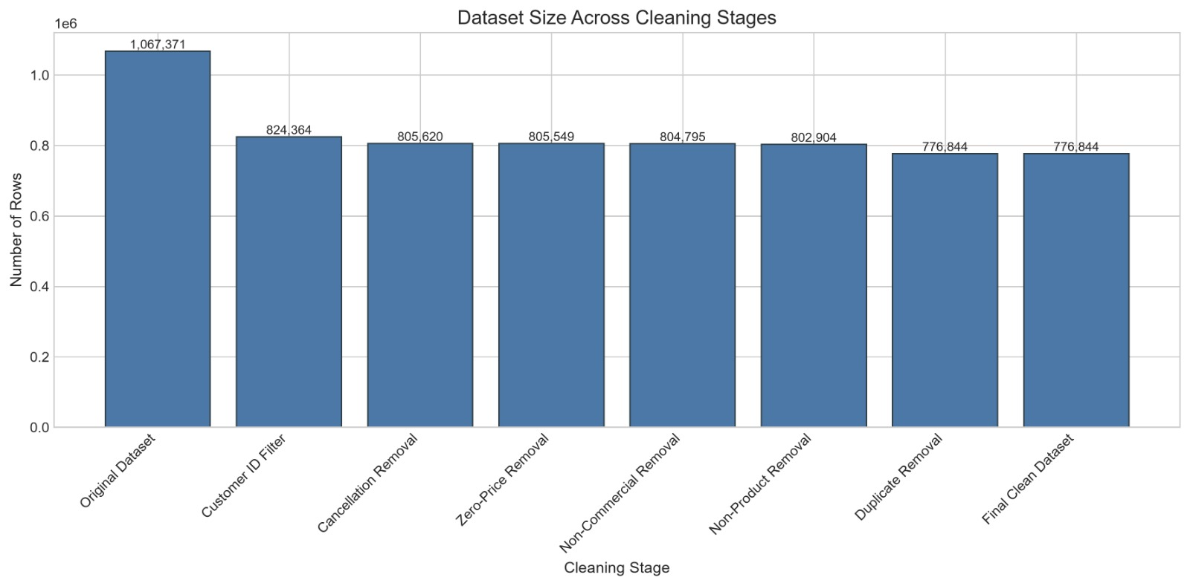
Dataset Inspection & Cleaning

Slide 6
Our Pipeline, End to End
1
→
2
→
3
→
4
→
5
→
6
Data Cleaning
Feature
Engineering
Labeling
Modeling
Evaluation
Interpretation
Remove cancellations,
nulls & invalid rows
Aggregate activity per
customer & time window
Define & flag
Behavior Shift
Train & compare
classification models
Time-based CV &
hyperparameter tuning
Explain predictions
with SHAP
Every stage was built as its own notebook — with strict guardrails against data leakage carried through the whole chain.
AI-Based Customer Behavior Shift Detection
5

Slide 7
Feature Engineering
Transactions were rolled up per customer into fixed-length observation windows (30 / 60 / 90 days), producing three feature families:
Current Activity
Previous Window (prev_)
Change (% delta)
orders, spend, quantity
unique products, active days
average order value
items per order
same metrics, shifted
one window back
per customer, sorted
by window order
(current − previous) / previous
captures direction & size
of behavior change
core signal for the model
AI-Based Customer Behavior Shift Detection
6

Slide 8
Defining “Behavior Shift”
For each customer-window, we looked one window into the future and measured how much orders and spend changed:
BehaviorShift = 1 if future_orders_change ≤ -T OR future_spend_change ≤ -T
next_orders and next_spend are computed with a per-customer shift(-1) — strictly future values
Change is a percentage: (next − current) / current
T is a tunable threshold — how large a drop counts as a real ‘shift’
These future-only columns are excluded from the model inputs to prevent data leakage
AI-Based Customer Behavior Shift Detection
7

Slide 9
Choosing the Right Threshold
We tested five candidate thresholds. A higher threshold means a stricter definition of ‘shift’ — fewer positive cases, but a stronger signal.
Threshold | % Positive Class | Customers Flagged
30% | 27.9% | 2,235
40% | 23.3% | 2,050
50% | 20.0% | 1,887
60% | 10.0% | 1,246
70% | 5.1% | 749
Our Choice: 30%
Balanced enough for stable training (~28% positive)
Highest F1 and PR-AUC lift over the random baseline
Confirmed stable across 5-fold time-series CV
Still captures meaningful, real behavior change
AI-Based Customer Behavior Shift Detection
8

Slide 10
Guarding Against Data Leakage
✕
✕
✕
No future information
No identity shortcuts
Time-based split
next_orders, next_spend and their % changes are dropped from the model inputs — the model never sees the answer.
CustomerID, window dates and other identifiers are excluded, so the model learns behavior patterns, not who the customer is.
Train/test split follows window_id chronologically (80/20) — never a random shuffle across time.
Why it matters
A model that leaks the future — or memorizes customer IDs — looks great on paper and fails completely on real, unseen customers. Every guardrail here exists so the reported metrics reflect what the model would actually do in production.
AI-Based Customer Behavior Shift Detection
9

Slide 11
Comparing Four Models (30% Threshold)
Metric | Logistic Regression | Random Forest | XGBoost | LightGBM
Precision (class 1) | 0.64 | 0.61 | 0.60 | 0.61
Recall (class 1) | 0.61 | 0.70 | 0.70 | 0.71
F1 (class 1) | 0.63 | 0.65 | 0.65 | 0.65
ROC-AUC | 0.780 | 0.798 | 0.791 | 0.795
PR-AUC | 0.658 | 0.652 | 0.660 | 0.654
XGBoost and LightGBM led on Recall — catching more true behavior shifts — while all tree-based models clearly outperformed the linear baseline.
AI-Based Customer Behavior Shift Detection
10

Slide 12
Validating Stability Over Time
Random shuffling would let the model peek at the future. Instead, we used TimeSeriesSplit (5 folds, expanding window) to confirm performance holds up chronologically.
0.806
0.681
0.677
0.666
± 0.012
± 0.028
± 0.026
± 0.022
ROC-AUC
PR-AUC
Recall (class 1)
F1 (class 1)
Takeaway
Low standard deviations across every metric (≤ 0.03) show the model's performance is consistent from one time period to the next — not a lucky single split.
AI-Based Customer Behavior Shift Detection
11

Slide 13
Final Model — Tuned XGBoost
Selected configuration
Held-out Test Performance
Threshold: 30% (orders/spend drop)
n_estimators: 200 | max_depth: 6
learning_rate: 0.01
subsample: 1.0 | colsample_bytree: 0.9
scale_pos_weight ≈ 1.84 (class imbalance)
'orders' (raw) dropped — redundant, low-signal feature
Recall (class 1)
0.72
F1 (class 1)
0.66
ROC-AUC
0.811
PR-AUC
0.684
AI-Based Customer Behavior Shift Detection
12

Slide 14
Explainability — What Drives the Prediction?
SHAP values show not just which features matter, but how each one pushes a prediction toward or away from a Behavior Shift.
orders_change_pct
Fewer orders than last window → strongest signal of a shift
spend
Lower current spend → higher shift probability
active_days
Fewer active days in the window adds risk
avargeOrderValue
Lower average order value pushes risk up
The model's top signals — a drop in order frequency and current spend — line up with real business intuition, not statistical artifacts.
AI-Based Customer Behavior Shift Detection
13

Slide 15
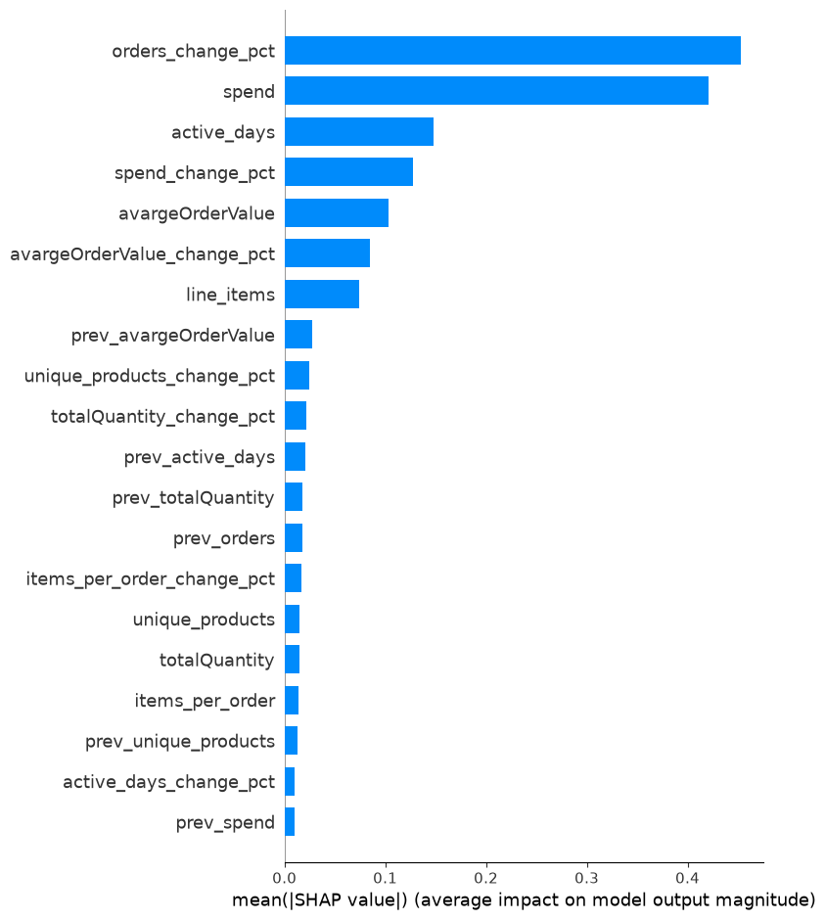
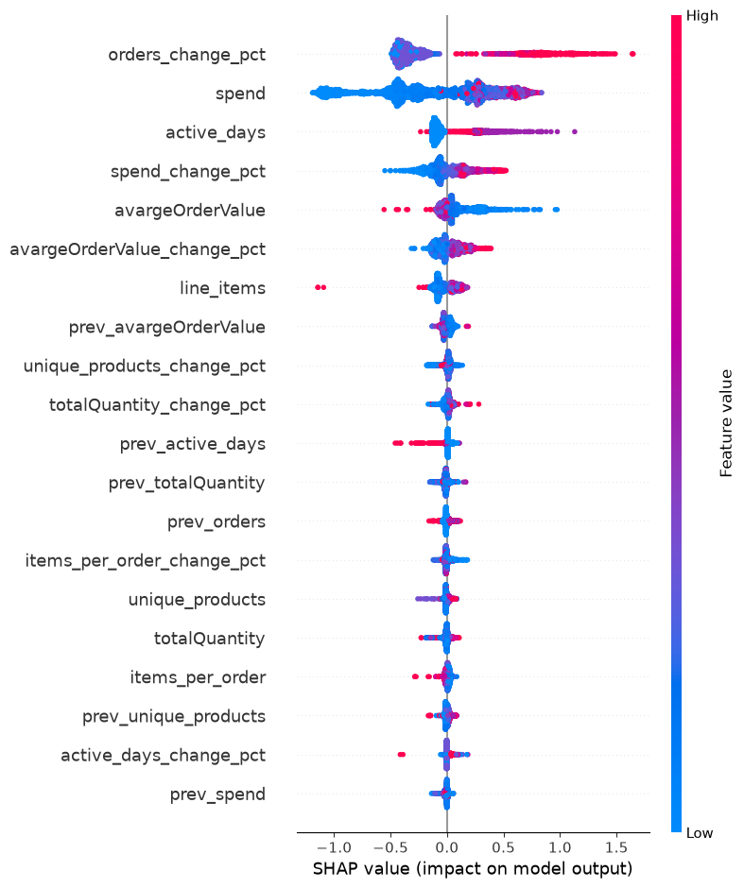
Explainability — What Drives the Prediction?
SHAP values show not just which features matter, but how each one pushes a prediction toward or away from a Behavior Shift.
AI-Based Customer Behavior Shift Detection
13

Slide 16
From Notebook to Production — REST API
The final tuned XGBoost model was wrapped in a FastAPI REST service so predictions can be requested outside the notebook.
GET /health
GET /metadata
GET /versions
POST /predict
Confirms the API and model are live
Model info & feature schema
Deployed model version
Customer features → prediction
Threshold = 0.30
Notebook vs. API — Identical Output
The API applies the same threshold chosen during validation — not re-tuned on the test set — keeping the decision boundary honest.
Probability: 0.14842 = 0.14842 Prediction: 0 = 0
✓ Deployment verified — same result as the notebook
Input Validation
Automated Test Suite
Missing feature (e.g. months_since_previous) → 422 Unprocessable Wrong type (text instead of number) → 422 Unprocessable
pytest -v → 6 passed
health · metadata · versions · valid_prediction · missing_feature · invalid_type
AI-Based Customer Behavior Shift Detection
14

Slide 17
Key Takeaways
1
Recall over precision
2
Recent change beats history
Missing a real shift costs more than a false alarm — we optimized to catch as many true shifts as possible.
How behavior changed this window matters far more than raw past totals.
3
Interpretability matters
4
A validated, stable model
SHAP turns the model from a black box into a tool the business can act on and trust.
Time-based CV confirms the results generalize across periods, not just one lucky split.
AI-Based Customer Behavior Shift Detection
15

Slide 18
Challenges & Future Work
Challenges We Navigated
What's Next
Class imbalance across every threshold tested
Avoiding subtle data leakage (future columns, IDs, near-duplicate targets)
A feature (raw ‘orders’) dominating importance for the wrong reason
Choosing a threshold that is both statistically sound and business-meaningful
Per-customer SHAP explanations for account-level retention actions
Testing 60/90-day windows for longer-cycle customers
A lightweight dashboard to surface at-risk customers weekly
Retraining pipeline as new transaction data arrives
AI-Based Customer Behavior Shift Detection
16

Slide 19
Live Demo-Testing the API!
{
"spend": 84.65,
"totalQuantity": 25,
"unique_products": 4,
"active_days": 1,
"line_items": 4,
"avargeOrderValue": 84.65,
"items_per_order": 4.0,
"window_days": 30,
"prev_orders": 1.0,
"prev_spend": 425.25,
"prev_totalQuantity": 177.0,
"prev_avargeOrderValue": 425.25,
"prev_unique_products": 23.0,
"prev_active_days": 1.0,
"prev_items_per_order": 23.0,
"orders_change_pct": 0.0,
"spend_change_pct": -0.8009406231628454,
"totalQuantity_change_pct": -0.8587570621468926,
"avargeOrderValue_change_pct": -0.8009406231628454,
"unique_products_change_pct": -0.8260869565217391,
"active_days_change_pct": 0.0,
"items_per_order_change_pct": -0.8260869565217391
}
{
"spend": 1294.32,
"totalQuantity": 676,
"unique_products": 47,
"active_days": 1,
"line_items": 47,
"avargeOrderValue": 1294.32,
"items_per_order": 47.0,
"window_days": 30,
"prev_orders": 1.0,
"prev_spend": 584.91,
"prev_totalQuantity": 277,
"prev_avargeOrderValue": 584.91,
"prev_unique_products": 22.0,
"prev_active_days": 1.0,
"prev_items_per_order": 22.0,
"orders_change_pct": 0.0,
"spend_change_pct": 1.212853,
"totalQuantity_change_pct": 1.440433,
"avargeOrderValue_change_pct": 1.212853,
"unique_products_change_pct": 1.136364,
"active_days_change_pct": 0.0,
"items_per_order_change_pct": 1.136364
}
AI-Based Customer Behavior Shift Detection
10

Slide 20
Thank You
Questions & discussion welcome.
Sara Alwadia & Rana Almadhoun
GSG × PSSAR Advanced Training• Capstone Project
AI-Based Customer Behavior Shift Detection
17

