Slide 1

This lecture is being recorded If you feel uncomfortable, you can turn off your camera and microphone
Lund University | Master's programme in Bioinformatics| BINP16 Bioinformatics: Programming in Python | Dr. Sara Behnamian| October 2021

Slide 2
LEARNING OBJECTIVES
Jupyter Notebook
Getting started
Installation
Starting the Jupyter Notebook Server
Creating a Notebook
Naming
Running cells
Introduction
Getting started
Installation
pandas data structures
GFF file format – Definition
The Jupyter file (Working with a GFF DataFrames, Reading a Tabular Data, Selecting a Subset of a Table, Filtering a Table, Creating Plots, doing some statistics, sharing the code, etc.)
Pandas

Slide 3

What is Jupyter Notebook?
The Jupyter Notebook is an open source web application that you can use to create and share documents that contain live code, equations, visualizations, and text.
Jupyter Notebooks are a spin-off project from the IPython project, which used to have an IPython Notebook project itself.
The name, Jupyter, comes from the core supported programming languages that it supports: Julia, Python, and R.

Slide 4

Getting Up and Running With Jupyter Notebook The Jupyter Notebook is not included with Python, so if you want to try it out, you will need to install Jupyter. There are many distributions of the Python language. Here we will focus on just two of them for the purposes of installing Jupyter Notebook. You can find other ways here.

Slide 5

Installation
You can use a handy tool that comes with Python called pip to install Jupyter Notebook like this:
The next most popular distribution of Python is Anaconda. Anaconda has its own installer tool called conda that you could use for installing a third-party package. However, Anaconda comes with many scientific libraries preinstalled, including the Jupyter Notebook, so you don’t actually need to do anything other than install Anaconda itself

Slide 6

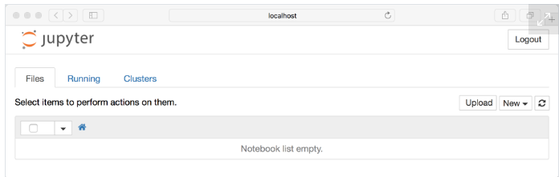
Starting the Jupyter Notebook Server
Now that you have Jupyter installed, let’s learn how to use it. To get started, all you need to do is open up your terminal application and go to a folder of your choice.
Then just go to that location in your terminal and run the following command:
This will start up Jupyter and your default browser should start (or open a new tab) to the following URL: http://localhost:8888/tree
Your browser should now look like this:

Slide 7
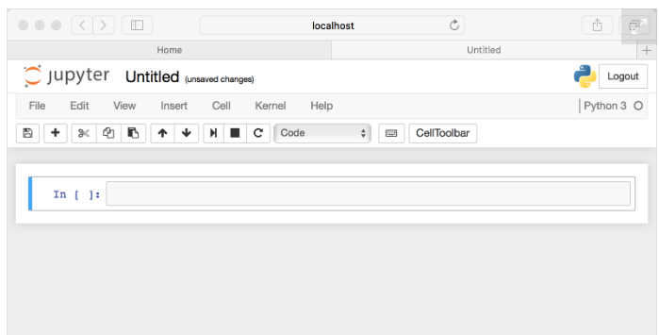
Creating a Notebook
Let’s create a Notebook now!
All you need to do is click on the New button (upper right, File -> New->Notebook), and it will open up a list of choices.
Your web page should now look like this:

Slide 8
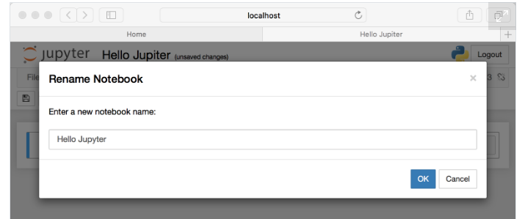
Naming
You will notice that at the top of the page is the word Untitled. This is the title for the page and the name of your Notebook. Since that isn’t a very descriptive name, let’s change it!
Just move your mouse over the word Untitled and click on the text. You should now see an in-browser dialog titled Rename Notebook. Let’s rename this one to Hello Jupyter:

Slide 9
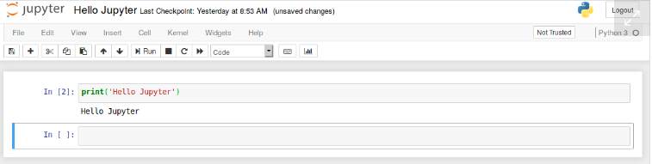
Running Cells
A Notebook’s cell defaults to using code whenever you first create one, and that cell uses the kernel that you chose when you started your Notebook.
I recommend that you start yours with Python 3 as your kernel, so that means you can write Python code in your code cells.
Running a cell means that you will execute the cell’s contents. To execute a cell, you can just select the cell and click the Run button that is in the row of buttons along the top. It’s towards the middle. If you prefer using your keyboard, you can just press Shift + Enter:

Slide 10

Want to share your code with your friends?
Colaboratory, or Colab for short allows you to write and execute Python code through your browser.
It is a hosted Jupyter notebook that requires no setup and has an excellent free version, which gives free access to Google computing resources such as GPUs and TPUs.
Another great feature that Google Colab offers is the collaboration feature. If you are working with your friends on a project, it is great to use a Google Colab notebook. You can co-code together using a Google Colab notebook.
Today, after learning about Pandas and GFF file format, we will go to Google Colab to learn more about Jupyter and its features through a project using Pandas (I will share the file “Example(gff).ipynb”).

Slide 11
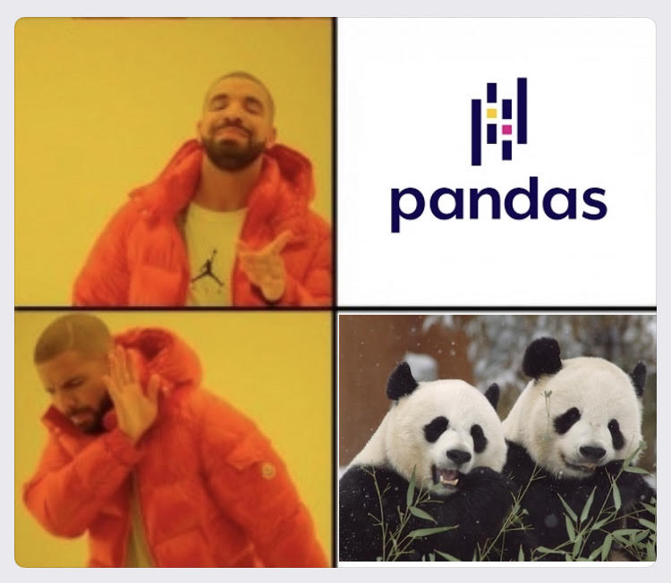
What is Pandas?
Pandas is a software library written for the Python programming language for data manipulation and analysis.
It contains data structures and data manipulation tools designed to make data cleaning and analysis fast and easy in Python.
Pandas is often used in tandem with numerical computing tools like NumPy and SciPy, analytical libraries like statsmodels and scikit-learn, and data visualization libraries like matplotlib.

Slide 12

Getting started Installation
Working with conda?
pandas is part of the Anaconda distribution and can be installed with Anaconda or Miniconda:
Prefer pip?
pandas can be installed via pip from PyPI.
Other installation options can be found here.
conda install pandas
pip install pandas

Slide 13
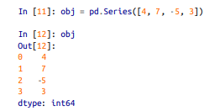
Introduction to pandas Data Structures
To get started with pandas, you will need to get comfortable with its two workhorse data structures,
Series and DataFrame.
Series
Pandas Series is a one-dimensional labeled array capable of holding any data type (integers, strings, floating-point numbers, Python objects, etc.). The simplest Series is formed from only an array of data:
Compared with NumPy arrays, you can use labels in the index when selecting single values or a set of values, for example, obj[1] = 7.
More information on the Pandas series can be accessed here.

Slide 14
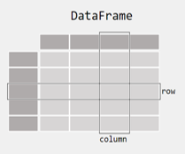
DataFrame
A DataFrame represents a rectangular table of data and contains an ordered collection of columns, each of which can be a different value type (numeric, string, boolean, etc.).
The DataFrame has both a row and column index; it can be thought of as a dict of Series all sharing the same index. Under the hood, the data is stored as one or more two-dimensional blocks rather than a list, dict, or some other collection of one-dimensional arrays.
For getting started with pandas, let’s study and work on an example with real-world data together.
I wrote the explanations in the markdown sections (which I will share and show you in a few minutes). We’ll open it in Google Colab and we'll go over it cell by cell. Let's start by clarifying what a GFF file is.

Slide 15
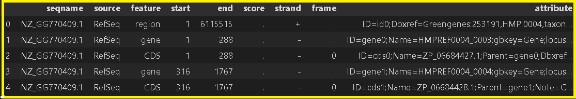

GFF/GTF File Format - Definition and supported options
The GF$F^{\text{∗}}$ format consists of one line per feature, each containing nine columns of data, plus optional track definition lines.
GFF2 is a supported format in GMO$D^{\text{†}}$, but it is now deprecated and if you have a choice you should use GFF3.
The GT$F^{\text{‡}}$ is identical to GFF version 2.
Genome annotation files are provided in GFF3 format for all annotated assemblies included in NCBI's genomes FTP resource. GFF3 files are formatted according to the specifications described at Sequence Ontology .
The following is a gff file with five rows. Fields must be tab-separated. Also, all but the final field in each feature line must contain a value; "empty" columns should be denoted with a '.‘.
Before we learn how to read and manipulate it in Pandas, let's take a brief look at its columns.

Slide 16
COLUMN SPECIFICATIONS
seqname - name of the chromosome or scaffold; chromosome names can be given with or without the 'chr' prefix.
source - name of the program that generated this feature, or the data source (database or project name).
feature - feature type name, e.g. Gene, Variation, Similarity.
start - Start position of the feature, with sequence numbering starting at 1.
end - End position of the feature, with sequence numbering starting at 1.
score - A floating point value.
strand - defined as + (forward) or - (reverse).
frame - One of '0', '1' or '2'. '0' indicates that the first base of the feature is the first base of a codon, '1' that the second base is the first base of a codon, and so on.
attribute - A semicolon-separated list of tag-value pairs, providing additional information about each feature.

Slide 17
Supporting Materials: Please click on the topics to be directed to the websites or book that were used in this Powerpoint (they are hyperlinks). Jupyter Notebook Pandas Introduction, Series Pandas DataFrame Google Colab GFF File Format Example

