Slide 1

This lecture is being recorded If you feel uncomfortable, you can turn off your camera and microphone
Lund University | Master's programme in Bioinformatics| BINP16 Bioinformatics: Programming in Python | Dr. Sara Behnamian| October 2021

Slide 2
LEARNING OBJECTIVES
1. Module
1. Module-Definition
2. Function-Definition
3. Class-Definition
4. Methods for Importing a Module
5. List of Some Useful Built-in Python Modules 6. Random Module 2. Package
1. Definition 2. Biopython Package
3. Create Your Own Package 3. Library
1. Definition 2. Some Python Libraries for Data Science You Should Know

Slide 3
Modules Why do we need modules? What is a module? In the simplest case, we write codes in a single Python file (the file name ends with .py). As your program gets longer, you may want to split it into several files for easier maintenance. You may also want to use a handy function that you’ve written in several programs without copying its definition into each program. To support this, Python has a way to put definitions in a file and use them in a script or in an interactive instance of the interpreter. Such a file is called a module; definitions from a module can be imported into other modules or into the main module. A module is a file containing Statements Functions Classes. The file name is the module name with the suffix .py appended. Within a module, the module’s name (as a string) is available as the value of the global variable __name__.
Modules
User- defined
Built-in

Slide 4
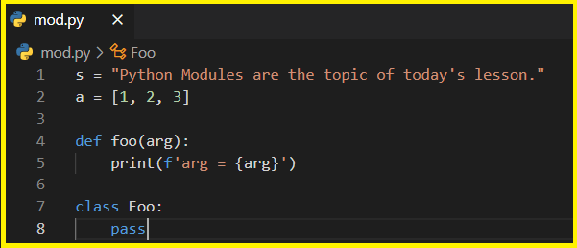

For example, suppose you have created a file called mod.py containing the following:
Several objects are defined in mod.py:
s (a string)
a (a list)
foo() (a function)
Foo (a class)
Assuming mod.py is in an appropriate location, which you will learn more about shortly, these objects can be
accessed by importing the module as follows:

Slide 5



2. Variables that are created outside of a function are known as global variables. If you create a variable with the same name inside a function, this variable will be local, and can only be used inside the function. In our example, the list “a” is a global list. Here, we import the mod module and print the list a from it:
3. Function: A function is a block of organized, reusable code that is used to perform a single, related action. Functions provide better modularity for your application and a high degree of code reusing.
As you already know, Python gives you many built-in functions like print(), etc. But you can also create your own functions.
Defining a Function
Here are simple rules to define a function in Python.
Function blocks begin with the keyword def followed by the function name and parentheses.
Any input parameters or arguments should be placed within these parentheses. You can also define parameters inside these parentheses.
The code block within every function starts with a colon (:) and is indented.
The statement return [expression] exits a function, optionally passing back an expression to the caller. A return statement with no arguments is the same as return None.

Slide 6



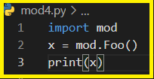

4. Class : Python is an object oriented programming language. Almost everything in Python is an object, with its properties and methods. A Class is like an object constructor, or a "blueprint" for creating objects. Defining a Class The class statement creates a new class definition. The name of the class immediately follows the keyword class followed by a colon as follows. Our Object-oriented programming lecture will cover classes in more detail. We import the mod module and call the class Foo here:
We import the mod module and call the foo function here:

Slide 7
Now, it’s your turn. Please write a piece of code that displays the Fibonacci sequence using a recursive function and save it as fibo.py.
Our goal is to test various import methods using the fibo module.
In the Fibonacci sequence, each number is the sum of two numbers that precede it.
Default
def recurse():
…
0 1 1 2 3 5 … n recurse()
0+1=1 …
1+1=2 recurse()
1+2=3
2+3=5
…
Recursive call

Slide 8
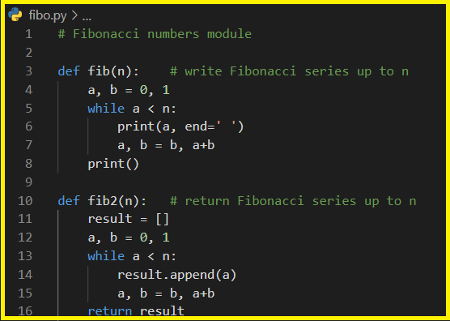



Now enter the Python interpreter and import this module with the following command:
Import fibo
Note: You must put all following files in the same directory as fibo.py.

Slide 9



If you intend to use a function often you can assign it to a local name:
There is a variant of the import statement that imports names from a module directly into the importing module’s symbol table; For example:
This does not introduce the module name from which the imports are taken in the local symbol table (so in the example, fibo is not defined).
There is even a variant to import all names that a module defines:
This imports all names except those beginning with an underscore (_). In most cases Python programmers do not use this facility since it introduces an unknown set of names into the interpreter, possibly hiding some things you have already defined.

Slide 10


If the module name is followed by as, then the name following as is bound directly to the imported module.
This is effectively importing the module in the same way that import fibo will do, with the only difference of it being available as fib. It can also be used when utilizing from with similar effects:
Note: For efficiency reasons, each module is only imported once per interpreter session. Therefore, if you change your modules, you must restart the interpreter.

Slide 11
In summary, there are a variety of methods for importing a module
import module_name
module_name.statement
module_name.global variable_name
module_name.function_name()
module_name.class_name()
from module_name import this, that, the other
this()
import module_name as alt _name
alt_name.this()
from module _name import *
This()

Slide 12
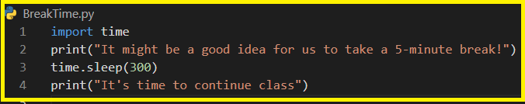

List of Some Useful Built-in Python Modules
re — Regular expression operations
Collections — Container data types
time — Time access and conversions
multiprocessing — Run multiple functions at the same time
CSV — Managing CSV files
copy — Shallow and deep copy operations
Random — Generate pseudo-random numbers
If you want to learn more about them or other modules, follow these links, 1, 2.
(300 seconds) five minutes later

Slide 13
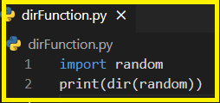
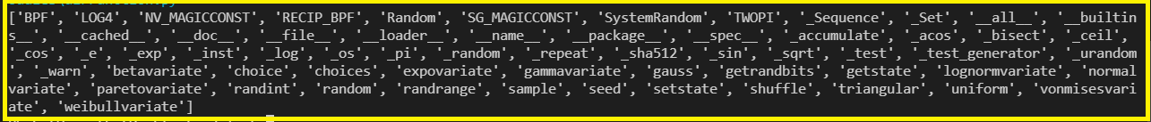
Random Module Python has some built-in modules that you can use. One useful module is random, which provides various ways to generate random numbers. The random module has a set of methods, some of which are shown here.
Method | Description
seed() | Initialize the random number generator
getstate() | Returns the current internal state of the random number generator
setstate() | Restores the internal state of the random number generator
Randint() | Returns a random number between the given range
shuffle() | Takes a sequence and returns the sequence in a random order
The dir( ) Function
The dir() built-in function returns a sorted list of strings containing the names defined by a module.
The list contains the names of all the modules, variables and functions that are defined in a module. Following is a simple example.

Slide 14
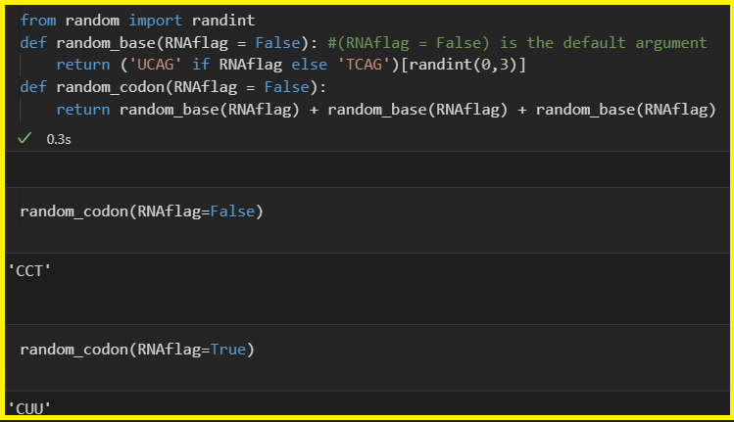
The function random.randint takes two integer arguments and returns a random integer in the range of the first to the second inclusive. For example, random.randint(1,4) will return 1, 2, 3, or 4. (Note that the range is inclusive of the second number, unlike with string slicing, which designates a substring from the first position up to but not including the second position indicated by the slice.) One good use of random.randint is to generate examples and “test cases” to use with code you are developing. This example shows how to generate a random codon.

Slide 15
Practice:
Write a function that simulates single-base mutation. The function should accept a DNA sequence and return it with one changed base (selected at random).
Assume that the base sequence is 'TAC GGT CAC TGA AGT CCC TGC TTA CTG AAT‘ (input).

Slide 16
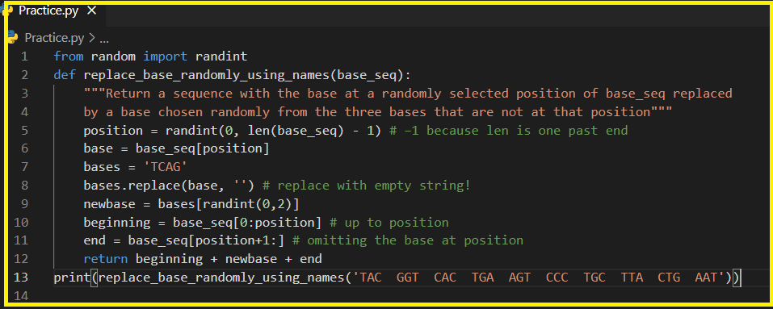
Some Outputs

Slide 17
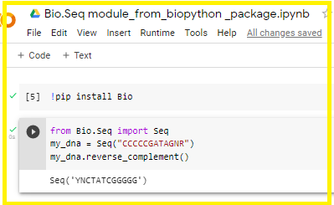
What is Python Packages?
A package, in essence, is like a directory holding subpackages and modules. While we can create our own packages, we can also use one from the Python Package Index (PyPI) to use for our projects.
Biopython is the largest and most popular bioinformatics package for Python. It contains a number of different sub-modules for common bioinformatics tasks.
Let assume that we have a DNA sequence and we would like to get reverse complement of it.
Module 1 package
module2
Class A
Function1()
Module 1
Module 2
…
Class B
Function2()

Slide 18
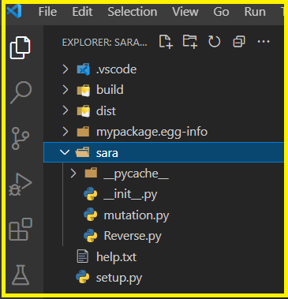


Differences Between Python Modules and Packages
A module is a file containing Python code. A package, however, is like a directory that holds sub-packages and modules.
A package must hold the file __init__.py. This does not apply to modules.
To import everything from a module, we use the wildcard *. But this does not work with packages.
Create Your Own Package
Now, We want to use our modules and package instead of using the Biopython package, I created a python package. It has two modules: one is mutation (the practice) and the other name is reverse (It accomplishes the same task as the previous biopython example).

Slide 19
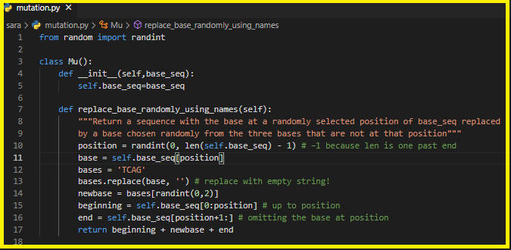
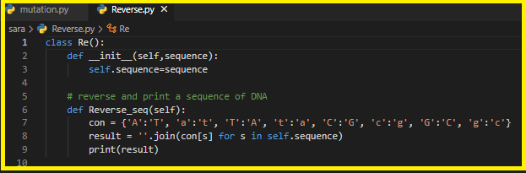

Slide 20
Python Library:
The Python library contains several different kinds of components.
It contains data types that would normally be considered part of the core of a language, such as numbers and lists. For these types, the Python language core defines the form of literals and places some constraints on their semantics, but does not fully define the semantics. (On the other hand, the language core does define syntactic properties like the spelling and priorities of operators.)
The library also contains built-in functions and exceptions-objects that can be used by all Python code without the need of an import statement.
The bulk of the library, however, consists of a collection of modules. There are many ways to dissect this collection. Some modules are written in C and built in to the Python interpreter; others are written in Python and imported in source form.
The Python Standard Library
The Python Standard Library is a collection of script modules accessible to a Python program to simplify the programming process and removing the need to rewrite commonly used commands.
Python’s standard library is very extensive, offering a wide range of facilities.
The following are descriptions of some standard libraries.
Module
Package
Library

Slide 21
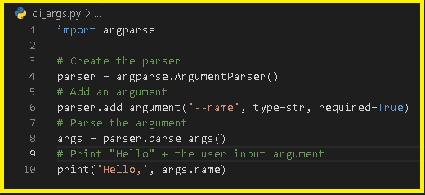
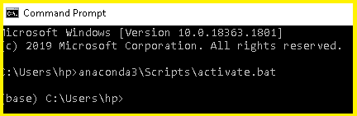
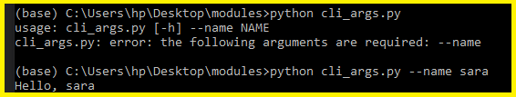
Command Line Arguments With ArgParse
The standard Python library argparse used to incorporate the parsing of command line arguments. Instead of having to manually set variables inside of the code, argparse can be used to add flexibility and reusability to your code by allowing user input values to be parsed and utilized.
Installation
Since argparse is part of the standard Python library, it should already be installed. However, if it’s not, you can install it using the follwing command:
If you do not have pip installed, follow the installation docs here.
Getting Started
Here is a file called cli_args.py to demonstrate a very basic example of the structure and usage of the argparse library:
pip install argparse

Slide 22
Some Python Libraries for Data Science You Should Know
Here's a line-up of the most important Python libraries for data science tasks, covering areas such as data processing, modeling, and visualization.
Data Mining
1. Scrapy One of the most popular Python data science libraries, Scrapy helps to build crawling programs (spider bots) that can retrieve structured data from the web – for example, URLs or contact info. It's a great tool for scraping data used in, for example, Python machine learning models.
Developers use it for gathering data from APIs. This full-fledged framework follows the Don't Repeat Yourself principle in the design of its interface. As a result, the tool inspires users to write universal code that can be reused for building and scaling large crawlers.
2. BeautifulSoup is another really popular library for web crawling and data scraping. If you want to collect data that’s available on some website but not via a proper CSV or API, BeautifulSoup can help you scrape it and arrange it into the format you need.

Slide 23
Data Processing and Modeling
3. NumPy
NumPy (Numerical Python) is a perfect tool for scientific computing and performing basic and advanced array operations.
The library offers many handy features performing operations on n-arrays and matrices in Python. It helps to process arrays that store values of the same data type and makes performing math operations on arrays (and their vectorization) easier.
4. SciPy
This useful library includes modules for linear algebra, integration, optimization, and statistics.
5. Pandas
Pandas is a library created to help developers work with "labeled" and "relational" data intuitively. It's based on two main data structures: "Series" (one-dimensional, like a list of items) and "Data Frames" (two-dimensional, like a table with multiple columns). Pandas allows converting data structures to DataFrame objects, handling missing data, and adding/deleting columns from DataFrame, imputing missing files, and plotting data with histogram or plot box. It’s a must-have for data wrangling, manipulation, and visualization.

Slide 24
6. Keras
Keras is a great library for building neural networks and modeling.
7. SciKit-Learn
This is an industry-standard for data science projects based in Python. Scikits is a group of packages in the SciPy Stack that were created for specific functionalities – for example, image processing. Scikit-learn uses the math operations of SciPy to expose a concise interface to the most common machine learning algorithms.
Data scientists use it for handling standard machine learning and data mining tasks such as clustering, regression, model selection, dimensionality reduction, and classification.
8. PyTorch
PyTorch is a framework that is perfect for data scientists who want to perform deep learning tasks easily.

Slide 25
Data Visualization
9. Matplotlib
This is a standard data science library that helps to generate data visualizations such as two-dimensional diagrams and graphs (histograms, scatterplots, non-Cartesian coordinates graphs.
10. Seaborn
Seaborn is based on Matplotlib and serves as a useful Python machine learning tool for visualizing statistical models – heatmaps and other types of visualizations that summarize data and depict the overall distributions. When using this library, you get to benefit from an extensive gallery of visualizations (including complex ones like time series, joint plots, and violin diagrams).
The list is by no means complete! The Python ecosystem offers many other tools that can be helpful for data science work.
Do you know other useful Python libraries for data science and Machine Learning projects? Let us know what other tools you find essential to the Python data ecosystem!

Slide 26
Supporting Materials: Please click on the topics to be directed to the websites that were used in this Powerpoint Function-definition Modules List of Some Useful Built-in Python Modules Random module, example Python Package Biopython package Python Library Some Python Libraries for Data Science You Should Know

