Slide 1
Brown University Project Solving forward and inverse problems in mathematical modeling of wave propagation
Abolfazl Khan Mohammadi
Sara Betancur Giraldo
Michele Battistoni

Slide 2



Accurate modeling
Numerical methods:
Computational cost
Limited generalization
*Scarce or noisy data*

Slide 3
Physics Informed Neural Networks
Forward: Predict evolution with Initial and Boundary Conditions
Inverse: Infer source terms or unknown parameters from observed data
Data efficiency
Physical consistency
Use of PDEs

Slide 4
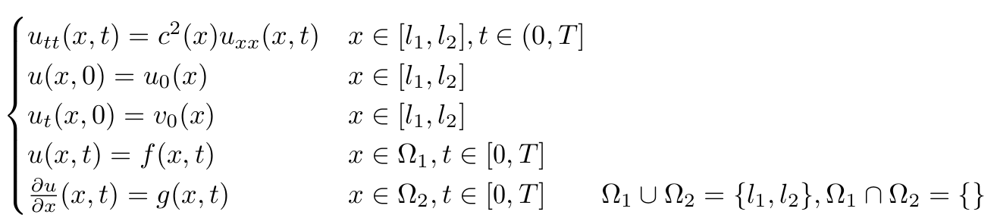
Problem statement
1D wave equation with given BCs and ICs
ICs
BCs
Task 1. Find an analytic solution, given ICs and BCs of our choice.
Task 2. Write a finite-difference (FD) solver → compare FD vs. analytical solution (AS)
Task 3. Implement a PINN to solve the forward problem of task 1 → compare accuracy
Task 4. Using 19 sensors, equally spaced, reconstruct the initial “input”: u(x,t=0)
Task 5. Reconstruct the “input” via a reduced number of randomly located sensors.
For FUN :)
Wave speed inversion in 1D
Forward problem in 2D

Slide 5
Method and Implementation
Tasks 1-2: Data constructed via analytical solution and FD
We formulated the analytical solution
We implement a FD scheme to get numerical data
We defined an initial condition (“source”) at t = 0
Tasks 3-5: Implementation of PINN using PyTorch
Task 3: Focus on network architecture, lambda weights, learning rate, number of collocation, IC and BC points
Task 4-5: Focus on sensors location, number and time resolution.

Slide 6
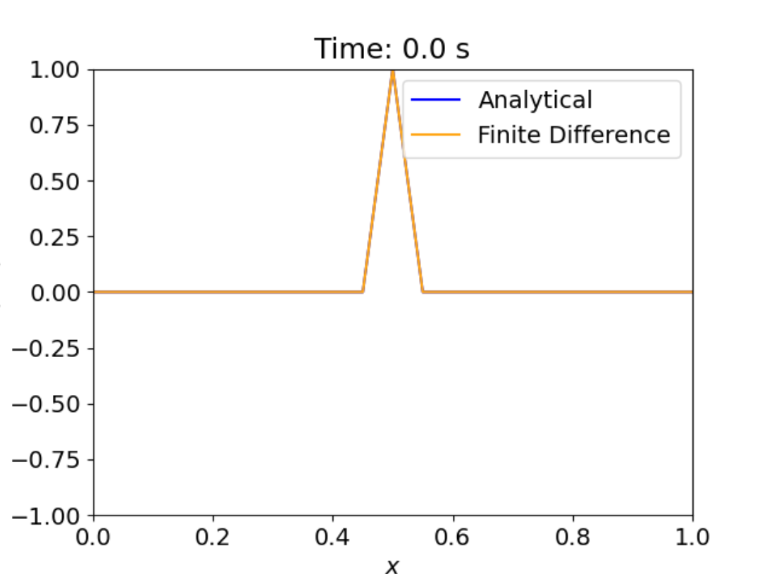
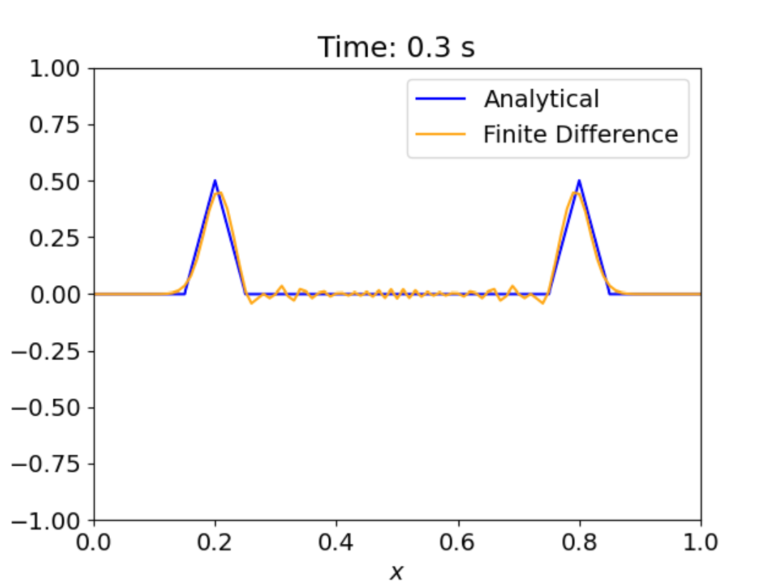
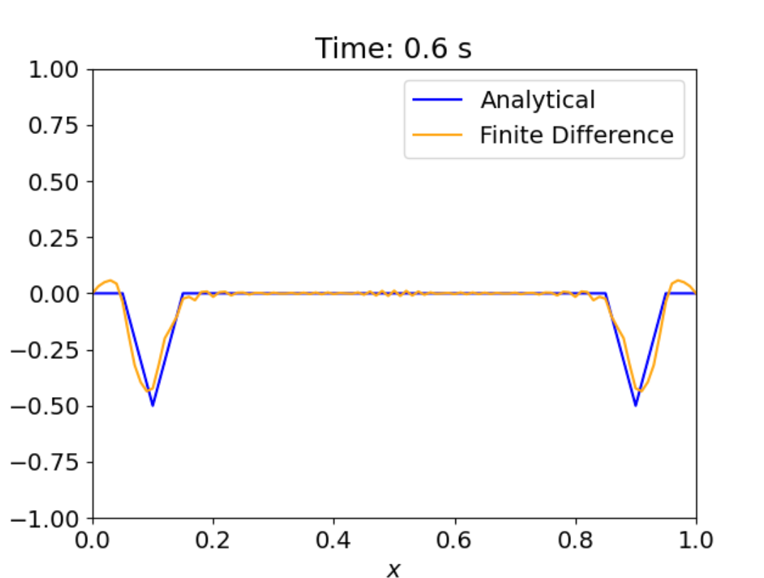
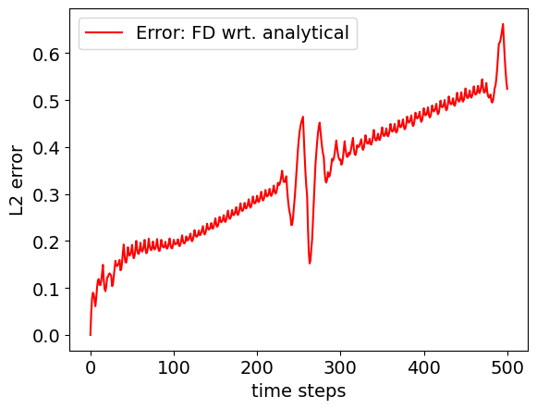
Task 1-2: Analytical vs FD solutions
Exact solution
Simulation Time: 1 Seconds

Slide 7
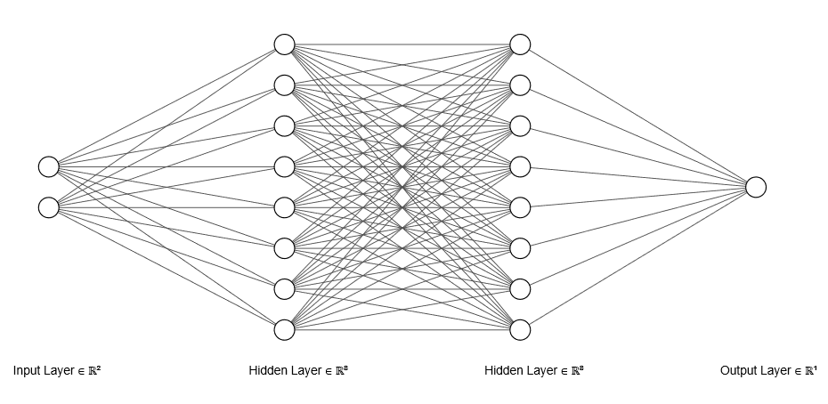
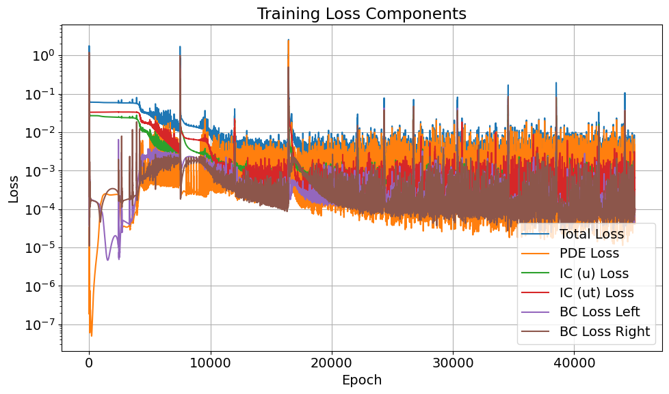
Task 3: PINNs Setup & Training
Feed Forward NN: [2, 64, 64, 1] with tanh ​
Xavier weights initialization​
PDE_residuals: u_{tt} – c² u_{xx}​
IC_residuals and BC_residuals​
Adam optimizer: LR = 1E-2
N_c = 5000
N_bc = 100

Slide 8
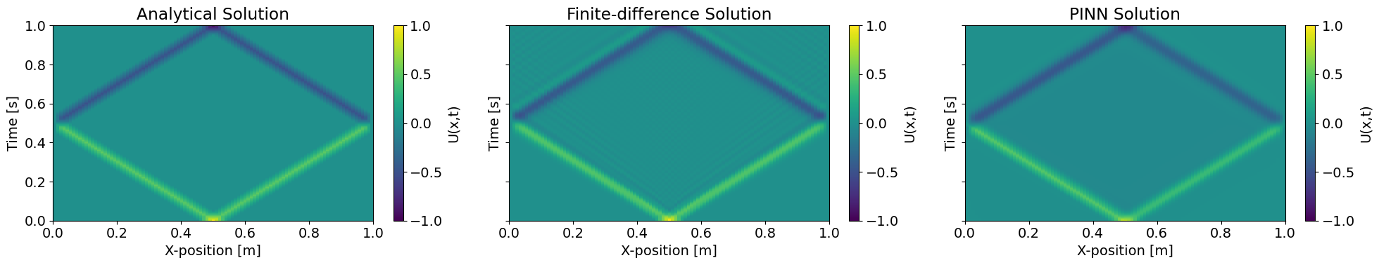
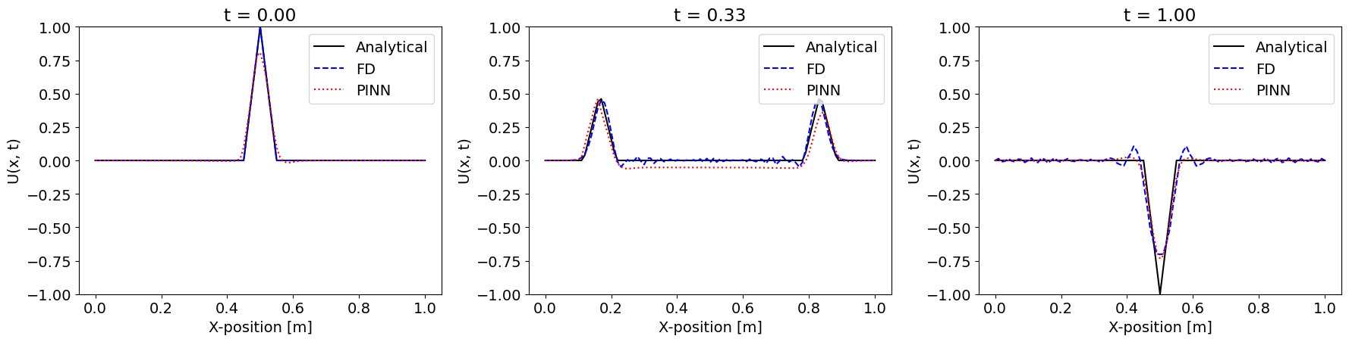
Task 3: PINNs Results

Slide 9
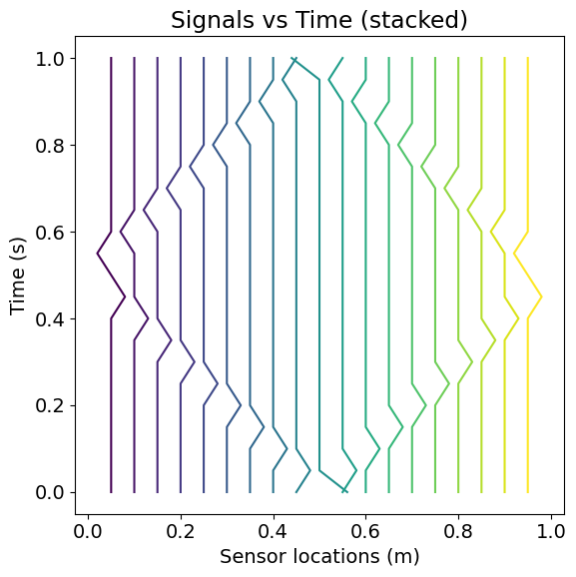
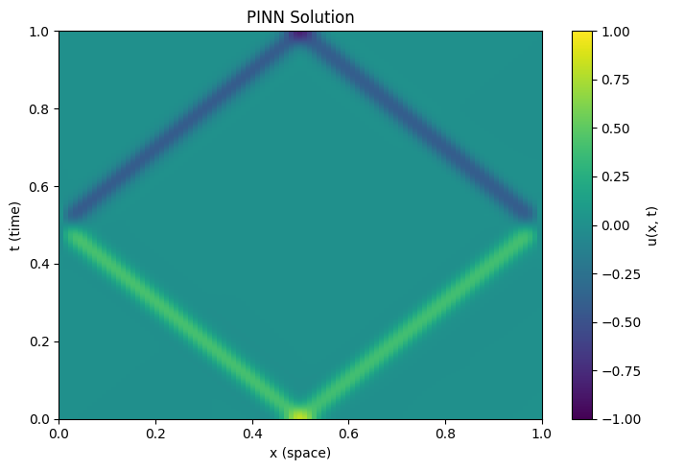
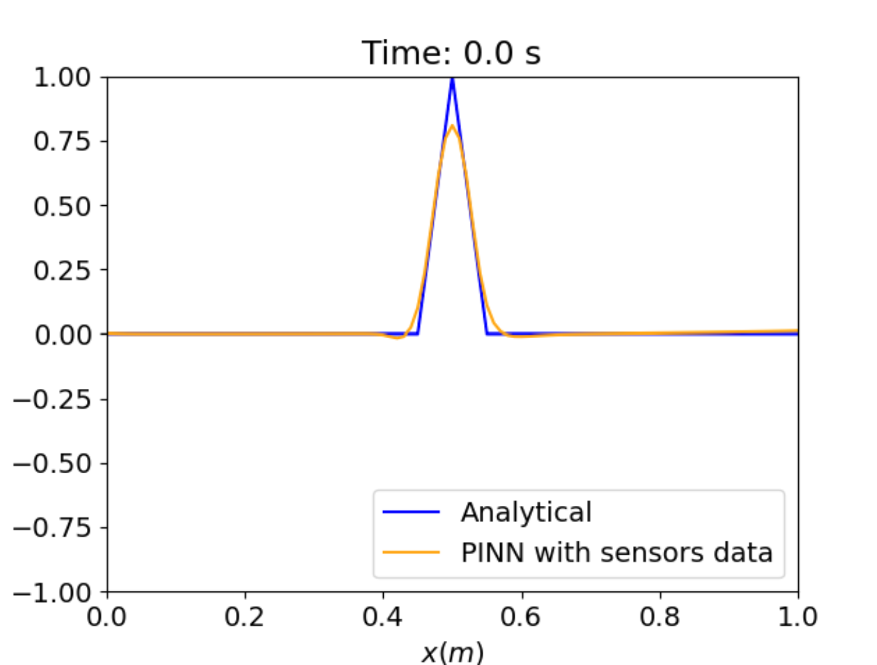
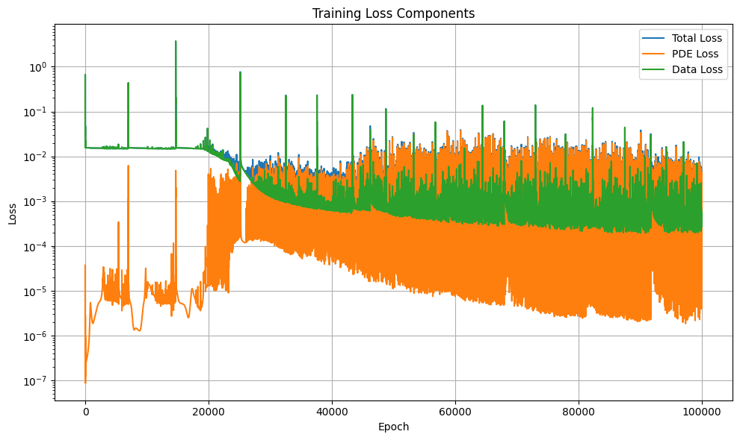
Task 4: PINN w/o IC and BC, with 19 sensors
uniformly spaced
“source” inversion

Slide 10
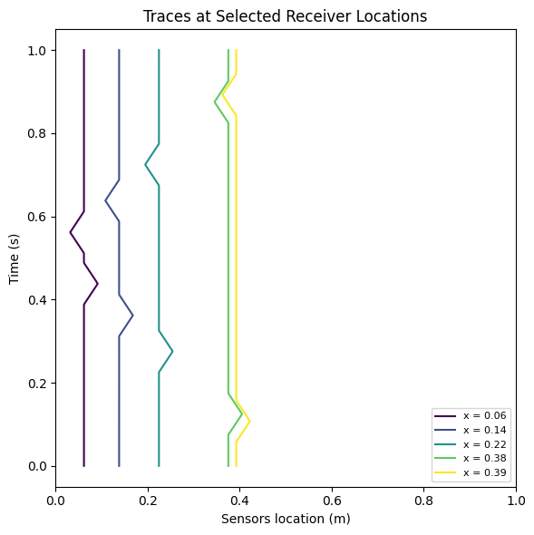
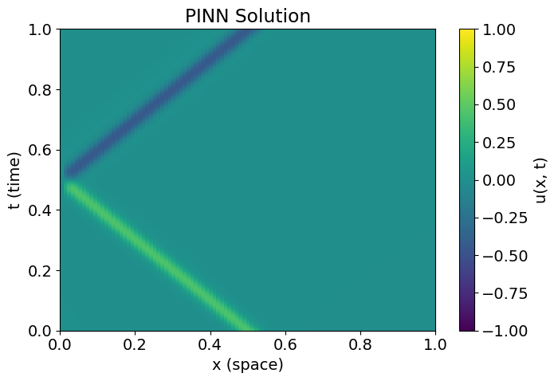
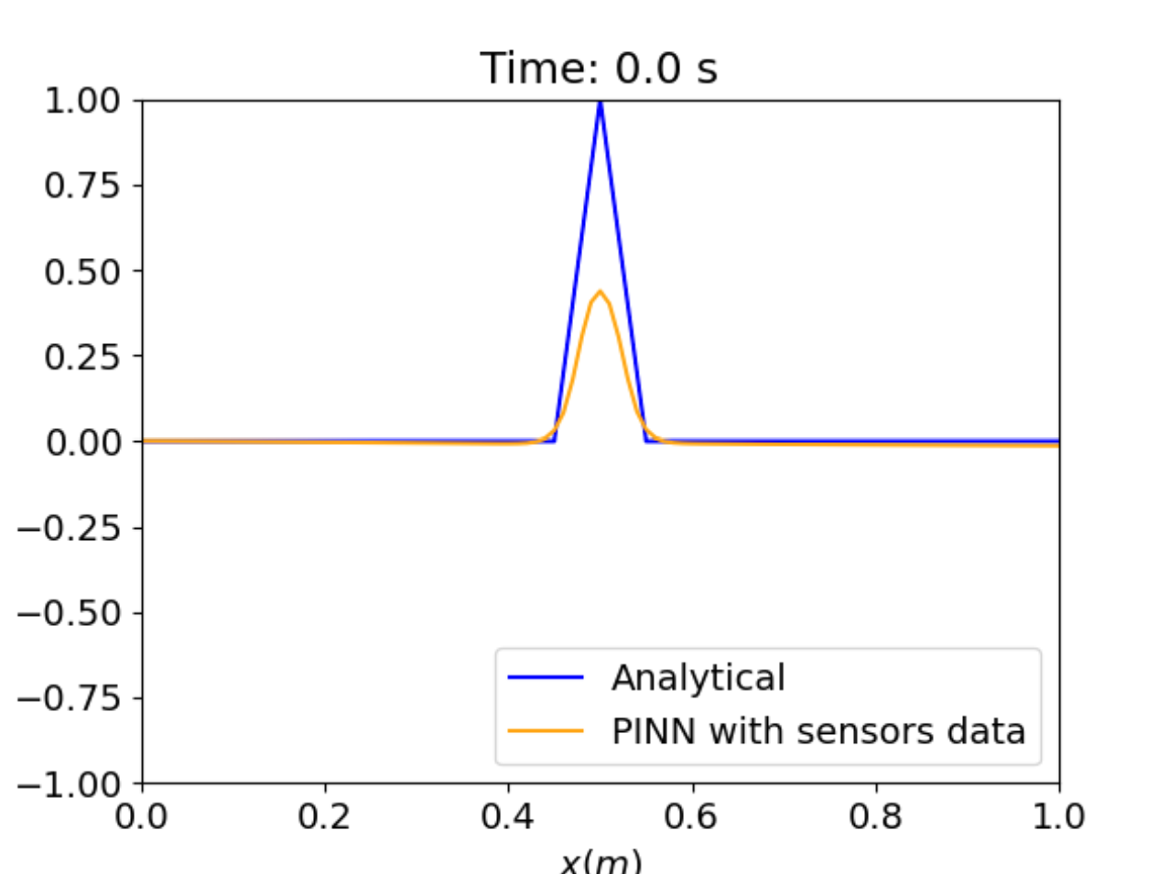
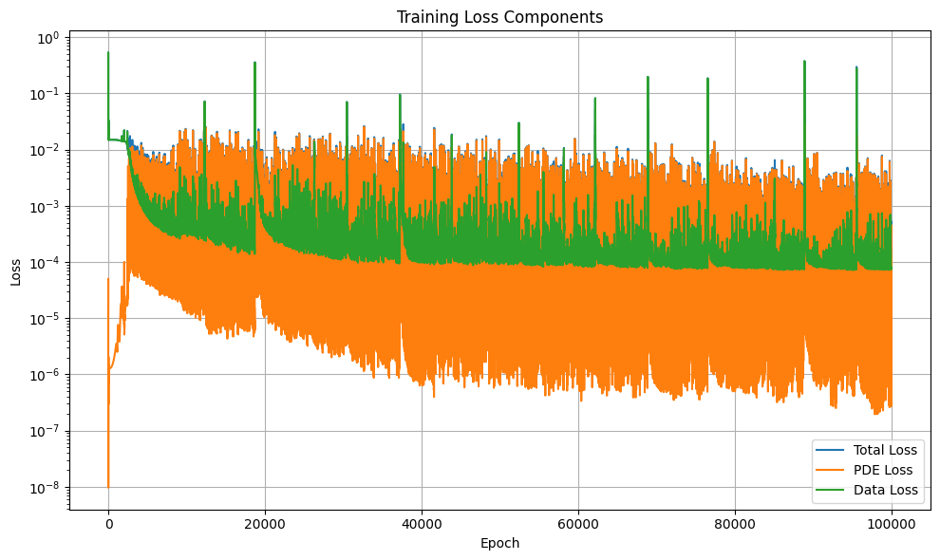
Task 5.a: PINN w/o IC and BC, with 5 sensors
randomly located
“source” inversion
Unfortunate
random pick!

Slide 11
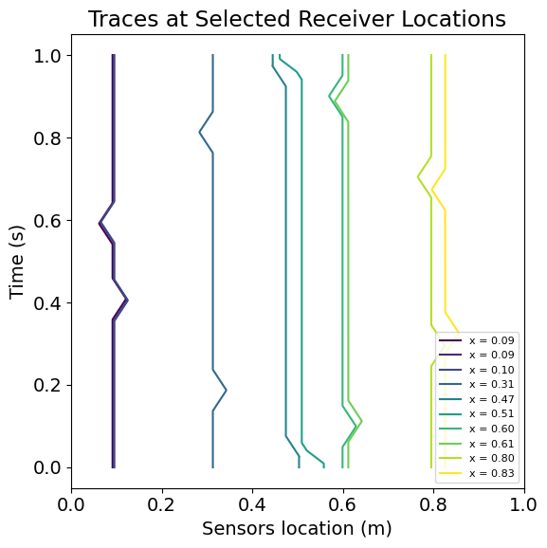
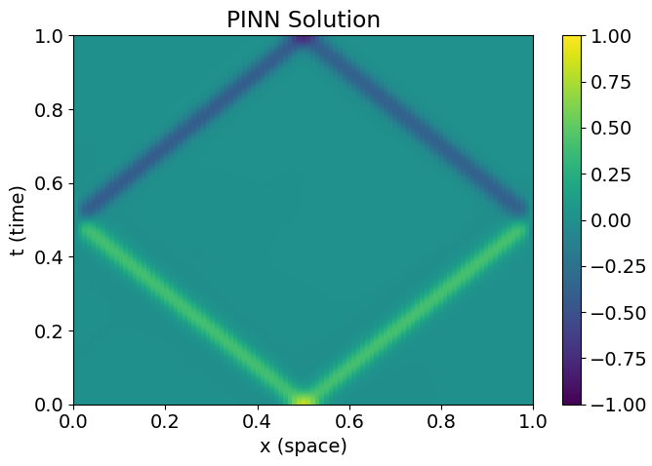
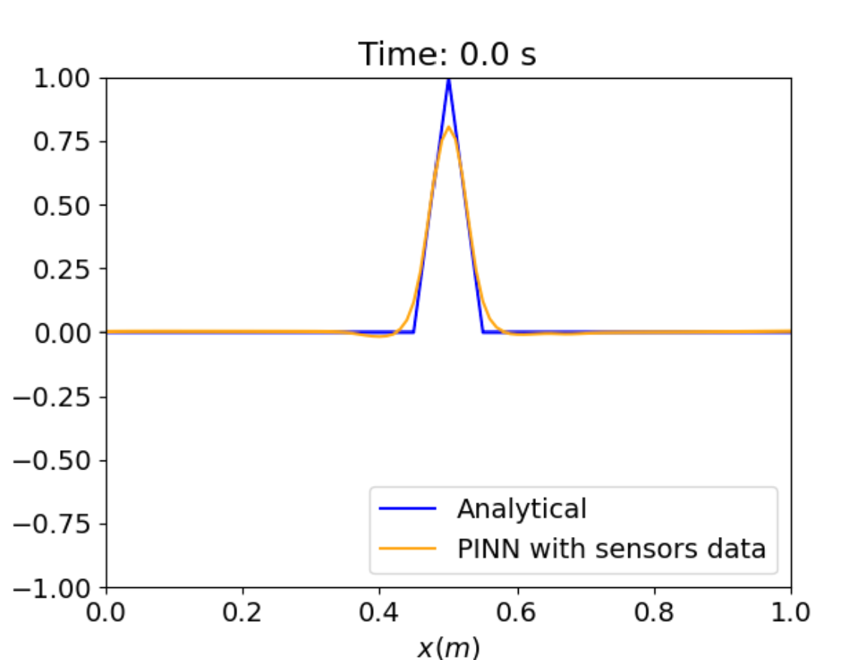
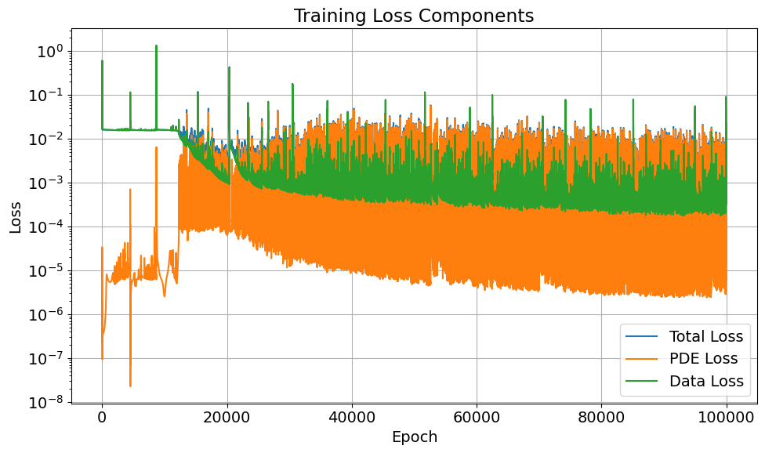
Task 5.b: PINN w/o IC and BC, with 10 sensors
randomly located
“source” inversion
Lucky
(better distribution)

Slide 12
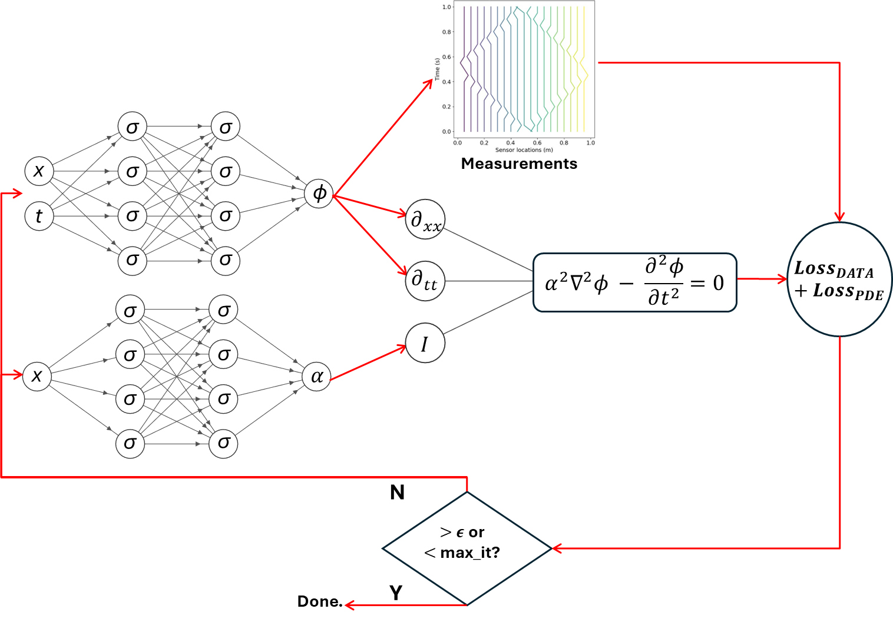
Extra Task 1: Wave Speed Inversion Setup
Forward NN: [2, 64, 64, 1]
Inverse NN : [1, 64, 64, 1]
19 Sensors

Slide 13
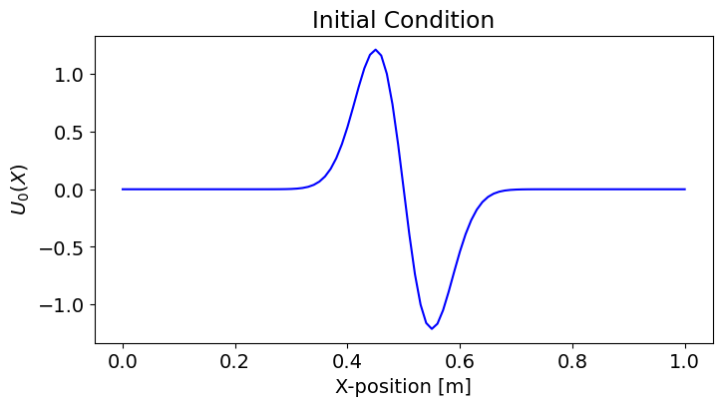
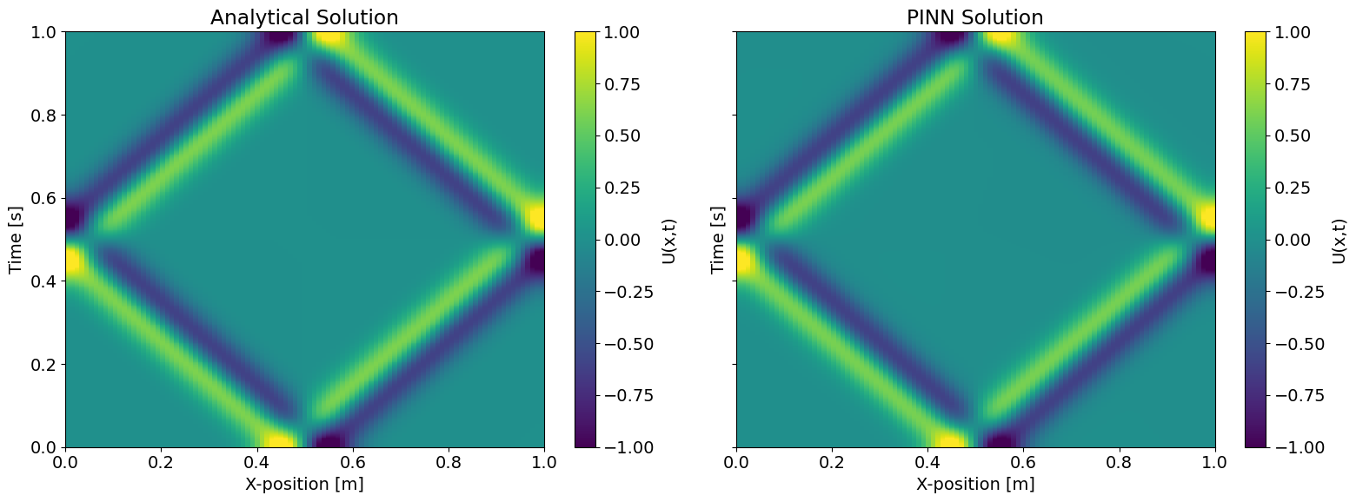
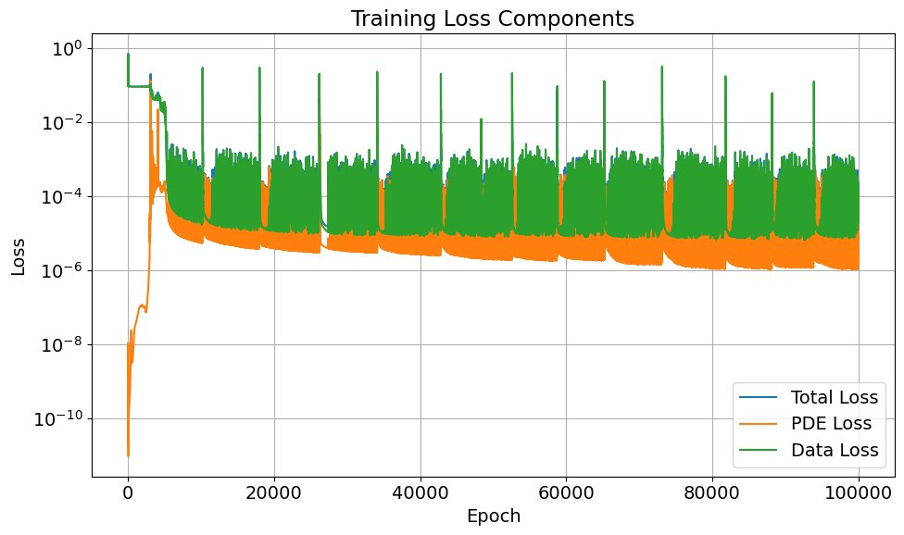
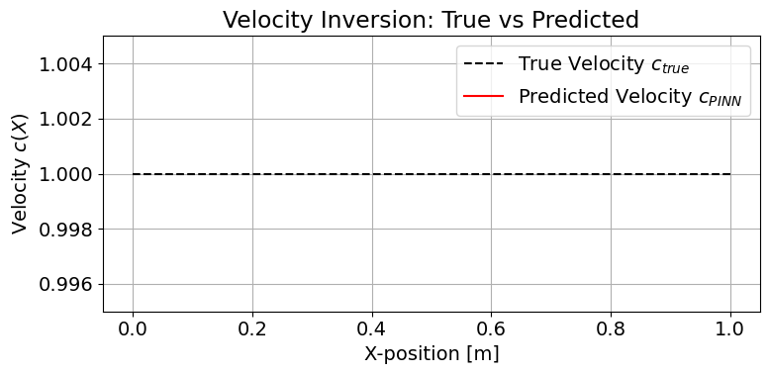
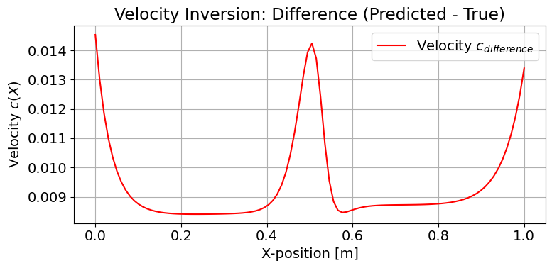
Extra Task 1: Wave Speed Inversion Results
First Derivative of Gaussian

Slide 14
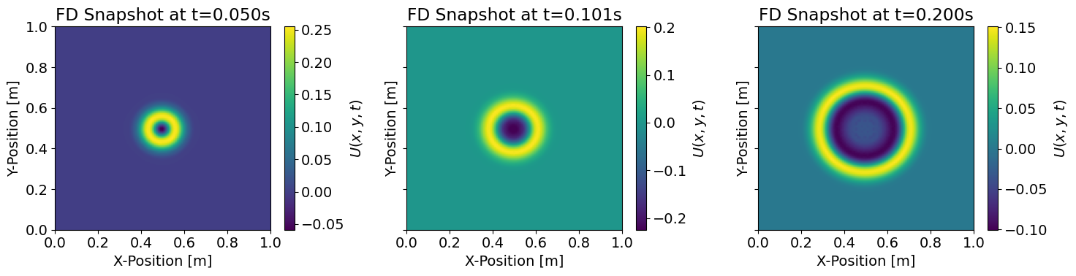
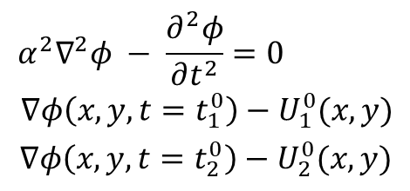
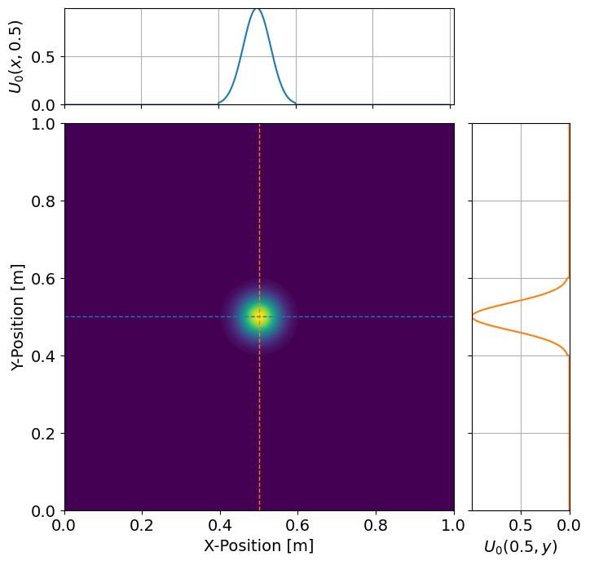
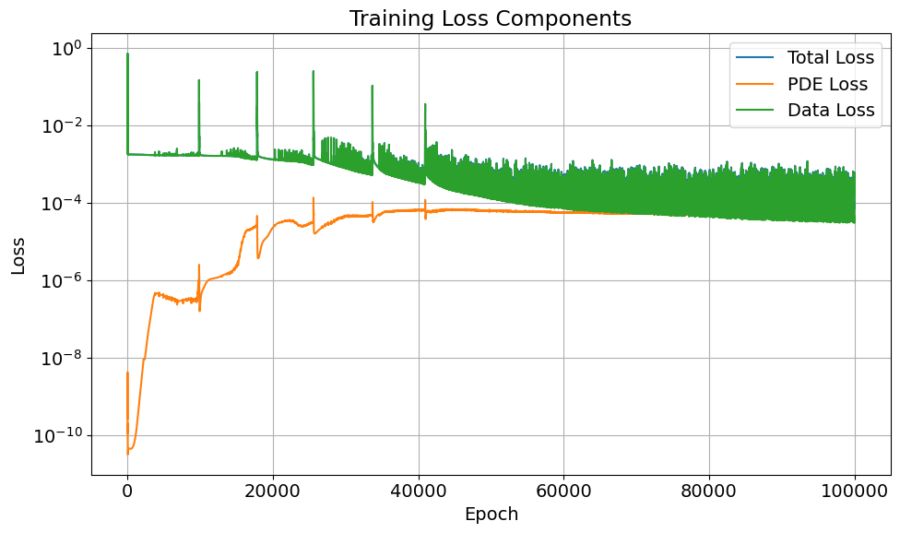
Extra Task 2: 2D Forward Problem Setup
We implemented a 2D Finite Difference solver to generate data, as there is no analytical solution in this case available

Slide 15
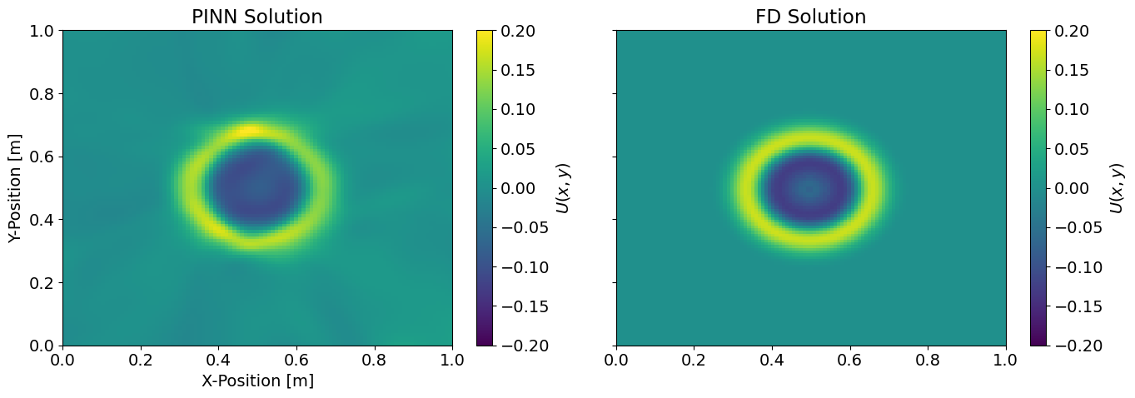
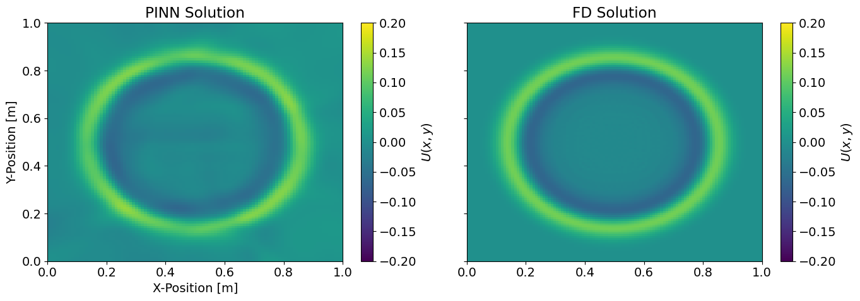
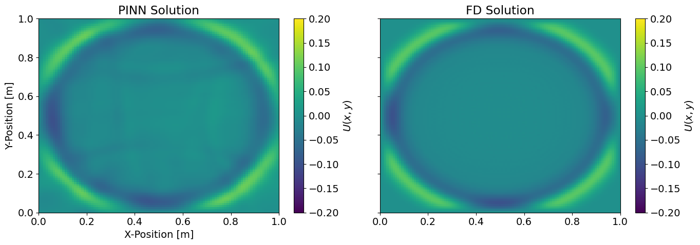
Extra Task 2: 2D Forward Problem Result

Slide 16
Conclusion & Future Thoughts
Successfully implemented classical and numerical solvers.
Implemented PINNs using PyTorch for the 1D forward problem
Solved initial condition (source) inversion via PINNs with sensor sensitivity analysis
Performed 1D wave speed (P-wave velocity) inversion
Extended the framework to 2D wave propagation
2D wave speed inversion
Robustness to realistic and noisy data
Multi-source and multi-frequency inversion
Extension to heterogeneous or complex media

Slide 17
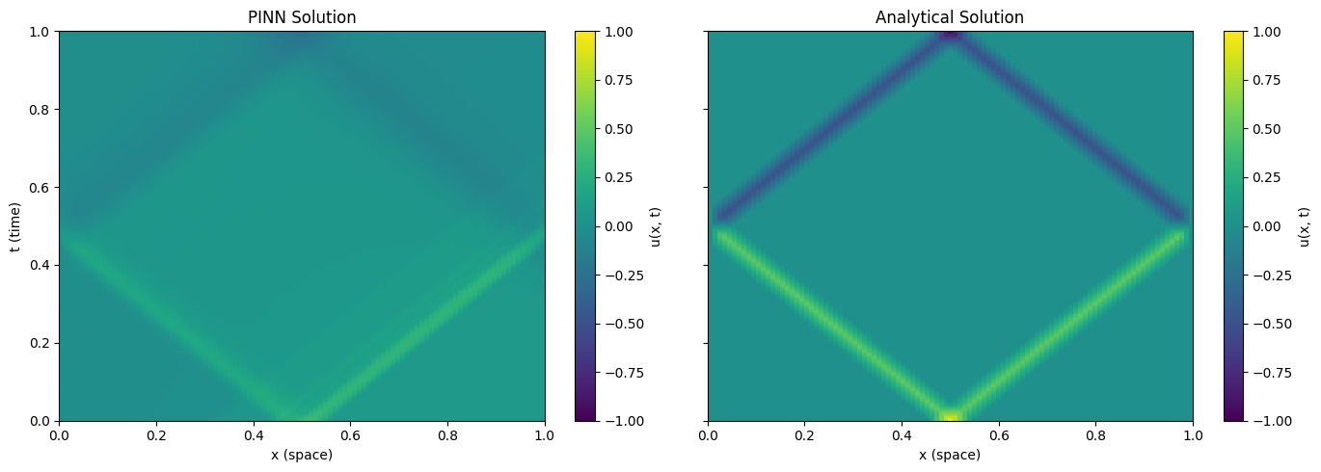
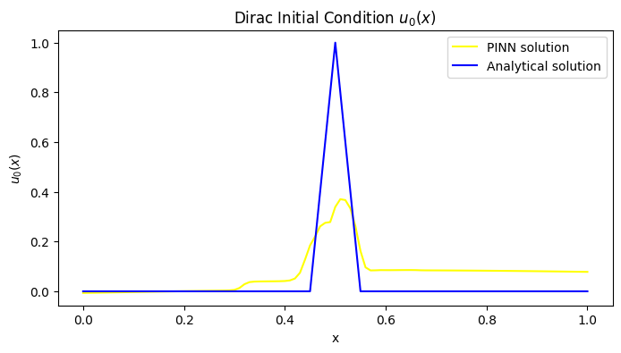
Dual problem: Self tunning weight losses

Slide 18
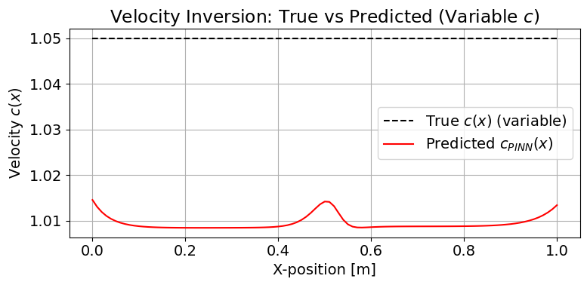
Extra Slide 1: Can we use this for inference?

