Slide 1

CAR POOL

Slide 2
Index
Problem Statement
Project Modules
Project DFD
JDBC

Slide 3
Problem Statement
This is a java based web project. It is based on the concept of car pooling. It provides various information about car owners and their cars so that people can pool with others going for same path or destination. Carpooling is also socially economical. Not only will you be saving, but you will also help reduce the costs we all pay towards the construction of new roads, road maintenance and air pollution related health costs. Having fewer cars on the road means reduced Greenhouse Gas (GHG) emissions and improved air quality.

Slide 4
Project Modules
This complete project has been divided into four sections with different features as follow:
Search Module
Login Module
Registration Process Module
Manage Information Module

Slide 5
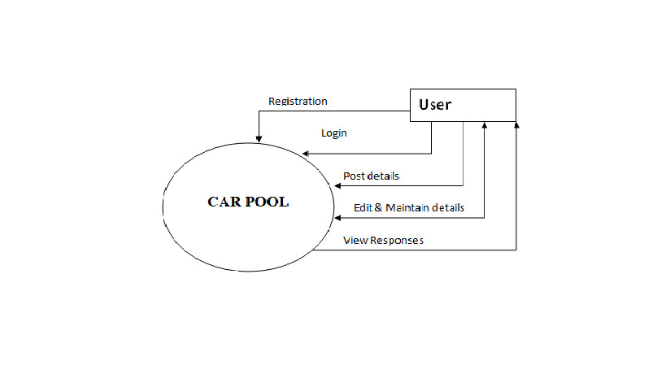
Project DFD

Slide 6
JDBC
JDBC stands for Java Database Connectivity. JDBC is a Java API to connect and execute the query with the database. JDBC API uses JDBC drivers to connect with the database. There are four types of JDBC drivers:
JDBC-ODBC Bridge Driver,
Native Driver,
Network Protocol Driver, and
Thin Driver

Slide 7
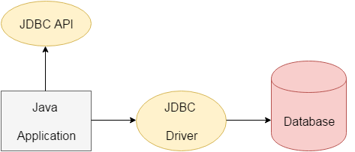
JDBC

Slide 8
Thank You

