Slide 1
Linux Kernel Source

Slide 2
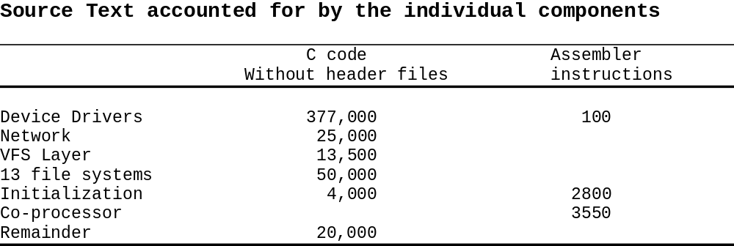

Slide 3
The Kernel Source
arch - This subdirectory contains all of the architecture specific code
for each supported architecture (MIPS, ARM, 386 and so on), there
is subdirectory under "arch". Each supported architecture subdirectory
has four major subdirectories:
kernel - which contains the architecture specific kernel code
mm - which contains the architecture specific memory mgmt code.
lib - which contains architecture specific library code (vsprintf...)
target platform directory - which contains platform specific code
Note: Linux ports to processors without memory management units
(MMU) are also available.

Slide 4
documentation - This subdirectory contains the documentation for
the kernel.
drivers - This subdirectory contains the code for the device drivers.
Each type of device has subdirectories, such as char, block, net...
fs - This directory contains the file system code. This has further sub
directories for each supported file system (ext2, proc, ...)
include - The include subdirectory contains the include files for the
kernel. It has further subdirectories for common include files for all
architectures), one for every architecture supported.
init - This directory contains the initialization code for the kernel.
kernel - This directory contains the main kernel code.
lib - This directory contains the library code of the kernel.
mm - This directory contains the memory management code.

Slide 5
The directory structure of the LINUX sources
/usr/src/linux
modules
mm
net
kernel
init
lib
include
ipc
unix
inet
linux
fs
arch
drivers
mips
asm-alpha
ext
nfs
net
alpha
asm-i386
ext2
proc
char
sparc
asm-m68k
xiafs
minix
ppc
block
asm-generic
isofs
msdos
i386
scsi
asm-mips
hpfs
sysv
sound
asm-sparc
kernel
boot
mm
Math-emu
umsdos

Slide 6
Kernel Development on x86 platform
The Linux kernel development requires following steps:
Selecting kernel
Configuring kernel
Compiling kernel
Installing the kernel

Slide 7
Access to the kernel sources
Download sources from http://kernel.org/:
http://kernel.org/pub/linux/kernel/v2.6/linux2.6.7.tar.bz2
http://kernel.org/pub/linux/kernel/v2.6/linux2.6.7.tar.bz2.sign
Or get a patch vs the x.y.<z1> version:
ftp://ftp.kernel.org/pub/linux/kernel/v2.6/patch2.6.7.bz2
ftp://ftp.kernel.org/pub/linux/kernel/v2.6/patch2.6.7.bz2.sign
Check the integrity of sources:
gpg –verify linux2.6.7.tar.bz2.sign linux2.6.7.tar.bz2
GnuPG details: http://www.gnupg.org/gph/en/manual.html
Kernel source signature details: http://www.kernel.org/signature.html

Slide 8
Using the Patch command
patch command: uses the output of the diff command to apply a set
of changes to a source tree.
patch basic usage:
patch -pn < diff_file
  n: number of directory levels to skip
Linux patches:
  Always to apply to the x.y.<z1> version
  Always produced for n=1
patch -p1 < linux_patch

Slide 9
Kernel Configuration
The Linux kernel configuration is usually found in the kernel source
in the file: /usr/src/linux/.config .
The kernel can be configured using text mode or graphical
configurator.
      make config - starts a character based questions and
      answer session
      make menuconfig - starts a terminal-oriented
      configuration tool (using ncurses)
      make xconfig - starts a X based configuration tool

Slide 10
Kernel Configuration…
Makefile edition
Setting the version and target architecture if needed
Kernel configuration: defining what features to include in the kernel:
  make xconfig
  or make menuconfig
  or make oldconfig
  Kernel configuration file (Makefile syntax) stored in the .config
file at the root of the kernel sources
  Distribution kernel config files usually released in /boot/

Slide 11
Makefile Changes
To identify your kernel image with others build from the same
sources, use the EXTRAVERSION variable:
  VERSION = 2
  PATCHLEVEL = 6
  SUBLEVEL = 7
  EXTRAVERSION = -acme1
  uname –r will return: 2.6.7-acme1

Slide 12
Kernel Configuration…
When the kernel configuration runs, it reads the main kernel
configuration file, located in arch/i386/Kconfig.
This configuration file also includes other configuration files as
needed.
For example arch/i386/Kconfig file includes
source “sound/core/Kconfig”
Which includes
source “sound/core/Kconfig”
source “sound/drivers/Kconfig”

Slide 13
Compiling and installing Kernel
make
make modules_install
make install

Slide 14
Building Kernel
The "make" command (with no arguments) now automatically
(and silently) generates dependency information, compiles the kernel,
and compiles any drivers that you have selected for installation as
modules.
Once you have configured your kernel, simply issuing the make
command, followed by the make modules_install and
make install commands, is the most common build and install
procedure for 2.6-based kernels.
Makes changes in the grub.conf file.
Copies modules to /lib/modules/<kernel version>/

