Slide 1
Network Throughput
NAPI

Slide 2
Network Throughput
TCP/IP Layer Issue
TCP Segmentation offloading
Network Driver Issue

Slide 3
TCP Performance
It is now common for off-the-shelf hardware (workstations and faster
personal computers) to deliver 800,000 bytes or more per second.
It is a worthwhile exercise to calculate the theoretical maximum
throughput we could see with TCP on a 10 Mbits/sec Ethernet.
The next slide shows the total number of bytes exchanged for a full-
sized data segment and an ACK.

Slide 4
Field sizes for Ethernet theoretical maximum throughput calculation.
Field | Data #bytes | ACK #bytes
Ethernet preamble Ethernet destination address Ethernet source address Ethernet type field IP header TCP header user data pad (to Ethernet minimum) Ethernet CRC interpacket gap (9.6 microsec) | 8 6 6 2 20 20 1460 0 4 12 | 8 6 6 2 20 20 0 6 4 12
total | 1538 | 84

Slide 5
We first assume the sender transmits two back-to-back full-sized data
segments, and then the receiver sends an ACK for these two segments.
The maximum throughput (user data) is then
throughput = 2 x 1460 bytes / (2 x 1538 + 84 bytes) x 10,000,000
bits/sec / 8 bits/byte
= 1,155,063 bytes/sec
If the TCP window is opened to its maximum size (65535, not using
the window scale option), this allows a window of 44 1460-byte
segments. If the receiver sends an ACK every 22nd segment the
calculation becomes
throughput = 22 x 1460 bytes / (22 x 1538 + 84 bytes) x 10,000,000
bits/sec / 8 buts/byte
= 1,183,667 bytes/sec

Slide 6
Moving to faster networks, such as FDDI (100 Mbits/sec),
indicates that three commercial vendors have demonstrated TCP over
FDDI between 80 and 98 Mbits/sec.

Slide 7
The following practical limits apply for any real-world scenario.
1. You can’t run any faster than the speed of the slowest link.
2. You can’t go any faster than the memory bandwidth of the slowest
machine. This assumes your implementation makes a single pass over
the data.
3. You can’t go any faster than the window size offered by the receiver,
divided by the round-trip time.
The bottom line in all these numbers is that the real upper limit on how
fast TCP can run is determined by the size of the TCP window and the
speed of light.

Slide 8
Introduction to NAPI NAPI is a proven (www.cyberus.ca/~hadi/usenix-paper.tgz) technique to improve network performance on Linux. NAPI provides a "inherent mitigation" which is bound by system
capacity as can be seen from the following data collected by Robert
on Gigabit ethernet (e1000): Psize Ipps Tput Rxint Txint Done Ndone --------------------------------------------------------------- 60 890000 409362 17 27622 7 6823 128 758150 464364 21 9301 10 7738 256 445632 774646 42 15507 21 12906 512 232666 994445 241292 19147 241192 1062 1024 119061 1000003 872519 19258 872511 0 1440 85193 1000003 946576 19505 946569 0

Slide 9
Legend: "Ipps" stands for input packets per second. "Tput" == packets out of total 1M that made it out. "txint" == transmit completion interrupts seen "Done" == The number of times that the poll() managed to pull all packets out of the rx ring. Note from this that the lower the load the more we could clean up the rxring "Ndone" == is the converse of "Done". Note again, that the higher the load the more times we couldn't clean up the rxring. Observe that: when the NIC receives 890Kpackets/sec only 17 rx interrupts are
generated. The system cant handle the processing at 1 interrupt/packet
at that load level. At lower rates on the other hand, rx interrupts go up and therefore the interrupt/packet ratio goes up. So there Is possibility that under low
enough input, you get one poll call for each input packet caused by a
single interrupt each time. And if the system cant handle interrupt per
packet ratio of 1, then it will just have to chug along ....

Slide 10
NAPI Prerequisites
NAPI, however, requires the following features to be available:
DMA ring or enough RAM to store packets in software devices.
Ability to turn off interrupts or maybe events that send packets up the stack.
NAPI processes packet events in what is known as dev->poll() method. Typically, only packet receive events are processed in dev->poll(). The rest of the events MAY be processed by the regular interrupt
handler to reduce processing latency (justified also because there
are not that many of them).

Slide 11
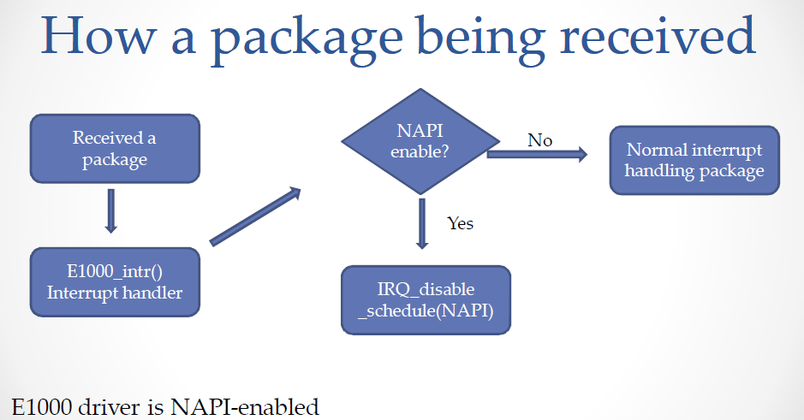

Slide 12
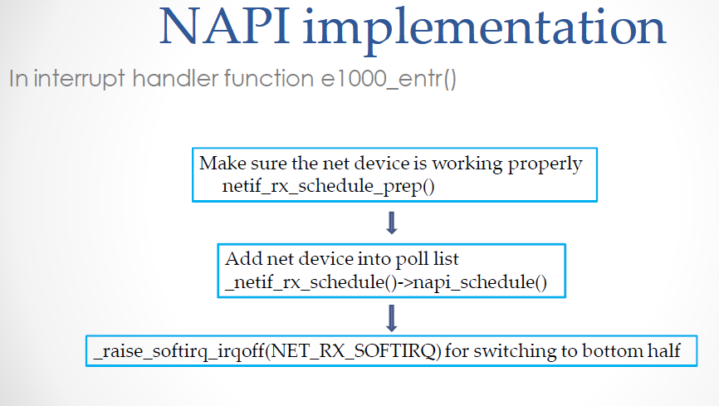

Slide 13
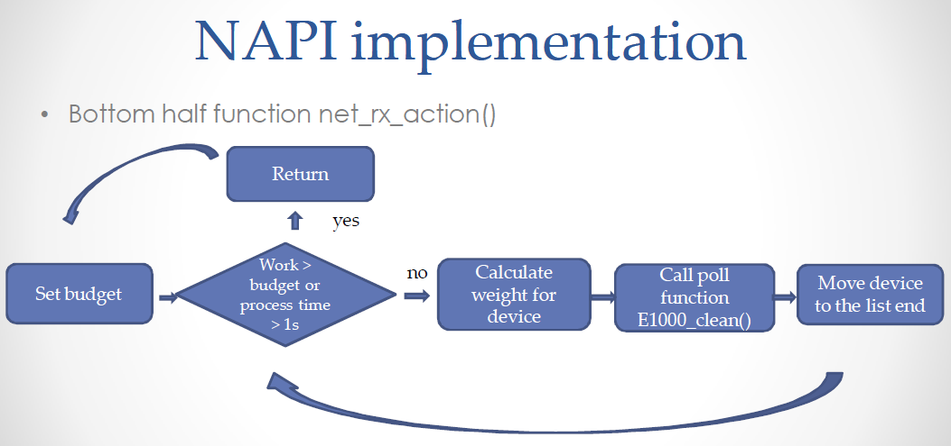

Slide 14
