Slide 1
PCI bus family
The following buses belong to the PCI family:
PCI
32 bit bus, 33 or 66 MHz
MiniPCI
Smaller slot in laptops
CardBus
External card slot in laptops
PCI Extended (PCI-X)
Wider slot than PCI, 64 bit, but can accept a standard PCI card
PCI Express (PCIe or PCIE)
Current generation of PCI. Serial instead of parallel.
PCI Express Mini Card
Replaces MiniPCI in recent laptops
Express Card
Replaces CardBus in recent Laptops

Slide 2
PCI Device Types
Main types of devices found on the PCI bus:
Network cards (wired or wireless)
SCSI adapters
Bus controllers: USB, PCMCIA, I2C, FireWire, IDE
Graphics and video cards
Sound cards

Slide 3
PCI Express Software and Configuration Model
PCI Compatibility
Legacy-free migration guidelines
PCI Express Topology
PCI Express to PCI Device Mapping
PCI Express Capability Structure
Hot-Plug
PME Delivery
Extended Configuration Model
Advanced Features
Advanced Error Reporting
Isochrony/QoS Support through Traffic Classes /Virtual Channels

Slide 4
PCIe Configuration Space
PCIe is completely compatible with existing deployed PCI software. PCIe devices
implement all registers required by the PCI specification as well as the power
management registers and capability pointers specified by the PCI power
management specification. In addition, PCIe defines a PCIe capability pointer to
indicate support for PCIe extensions and associated capabilities.
The PCIe devices contain the following regions of the PCI configuration space:
• Mandatory PCI configuration registers
• Power management capabilities
• MSI capabilities
• MSI-X capabilities
• PCIe extended capabilities

Slide 5
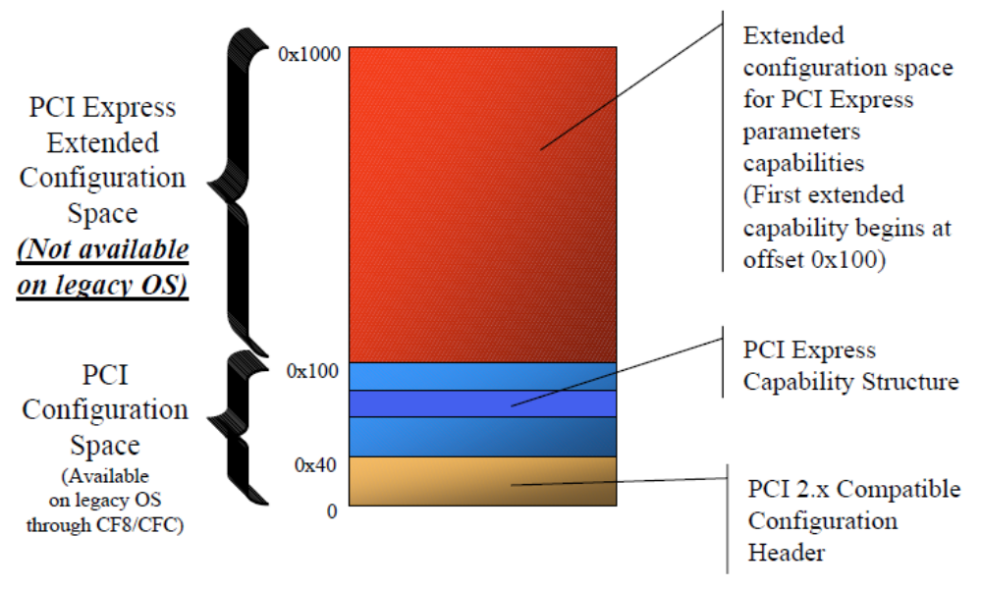
PCIe Configuration Space Layout

Slide 6
PCI Compatibility
PCI Configuration Mechanism #1 supported
PCI compatible configuration header
Configuration space locations at offsets 0x00 to 0x3F work as in PCI
PCI compatible device enumeration and resource allocation
Power management through PCI PM capability
PME supported using in-band messaging
PCI compatible in-band INTx legacy interrupt emulation
MSI support
MSI is the native interrupt mechanism in PCI Express

Slide 7
Legacy Free Migration Guidelines
Use MSI for device interrupts
MSI support is required for PCI Express
IO space permitted only for “Legacy Devices”
Alias I/O resources if required through MMIO
– Allows I/O decode to be turned off at run-time
Devices needing I/O at run-time MUST indicate “Legacy Device”
– “Legacy Devices” may not be supported in future versions of spec
Legacy I/O space support for option ROM boot
– Firmware assigns I/O BARs to required boot devices
– Operating system only assigns I/O space to devices that
indicate “Legacy Device” type
• I/O bars of other devices may be closed by OS

Slide 8
Message Signaled Interrupts
The ‘old’ way
In order to appreciate the benefits of using Message Signaled Interrupts, let’s first see how devices do interrupts in a legacy PC
I/O Device
Interrupt
Controller
main
memory
CPU
I/O Device
IRQ2
ISR
IRR
INTR
EFLAGS
ESP
stack
I/O Device
IRQ1
IMR
INTA
EIP
APP
I/O Device
IRQ0
ISR
IVT
system bus

Slide 9
Multi-step communication
A device signals that it needs CPU service
The Interrupt Controller signals the CPU
The CPU responds with two INTA cycles
  First INTA causes bit-changes in IRR and ISR
  Second INTA puts ID-number on system bus
CPU uses ID-number to lookup IVT entry
CPU saves minimum context on its stack, adjusts eflags, and jumps to specified ISR

Slide 10
Faster, cheaper, and more
Faster response to interrupts is possible if the old multi-step communication scheme can be replaced by a single-step protocol
Less expensive PCs can be manufactured if their total number of signal pins and the physical interconnections can be reduced
More devices can have their own ‘private’ interrupt(s) if signal lines aren’t required

Slide 11
The ‘new’ way
Message Signaling allows all the needed information to arrive in a single package, and go directly from a device to the CPU
main
memory
I/O Device
CPU
ISR
EFLAGS
I/O Device
I/O Device
ESP
stack
EIP
APP
IVT
system bus

Slide 12
Implementation
The customary PCI Configuration Space is modified to accommodate three additional registers, which collectively are known as the MSI Capability Register Set:
    An MSI Control Register (16 bits)
    An MSI Address Register (32 bits/64 bits)
    An MSI Data Register (32 bits)
(In fact these additions fit within a broader scheme of so-called “new capabilities”)

Slide 13
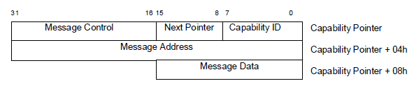
MSI Capability Structure
The capabilities mechanism is used to identify and configure an MSI or MSI-X
capable device.

Slide 14
Capability ID for MSI
7::0 CAP_ID The value of 05h in this field identifies the function as being MSI
capable. This field is read only.
Next Pointer for MSI
7::0 NXT_PTR Pointer to the next item in the capabilities list. Must be NULL for
the final item in the list. This field is read only.

Slide 15
PCI Command Register
15 10 9 8 7 6 5 4 3 2 1 0
Interrupt Disable
Fast Back-to-Back Enable
SERR# Enable
Stepping Control
Parity Error Response
VGA Palette Snoop Enable
Memory Write and Invalidate Enable
Special Cycles
Bus Master Enable
Memory Space Enable
I/O Space Enable

Slide 16
PCI Status Register
15 14 13 12 11 10 9 8 7 6 5 4 3 0
Interrupt Status
Capabilities List
Reserved
Reserved
Fast Back-to-Back Capable
Master Data Parity Error
DEVSEL Timing
Signaled Target-Abort
Received Target-Abort
Received Master-Abort
Signaled System Error
Detected Parity-Error

Slide 17
MSI Control Register
15 8 7 6 4 3 1 0
reserved
1
0 0 0
0 0 0
0
64-bit address capable (1=yes, 0=no)
multiple messages enable
multiple messages capable
000 = 1 message
001 = 2 messages
010 = 4 messages
011 = 8 messages
100 = 16 messages
101 = 32 messages
110 = reserved
111 = reserved
MSI Enable (1=yes, 0=no)

Slide 18
MSI Address Register
63 32
0 0 0 0 0 0 0 0 0 0 0 0 0 0 0 0 0 0 0 0 0 0 0 0 0 0 0 0 0 0 0 0
31 20 19 12 3 2 1 0
1 1 1 1 1 1 1 0 1 1 1 0
Destination
ID
reserved
R
H
D
M
0 0
0xFEE
Specifies which processor in the system will be
the recipient the Message Signaled Interrupt
RH = Redirection Hint (0=No redirection, 1=Utilize
destination mode to determine message recipient)
DM = Destination Mode (0=Physical,1=Logical)
Specifies how Destination ID will be interpreted

Slide 19
MSI Data Register
31 16
reserved
15 14 11 8 7 0
T
M
T
L
reserved
Delivery
Mode
vector
Delivery Mode
000=Fixed 001=Lowest Priority
010=SMI 011=Reserved
100=NMI 101=INIT
110=Reserved 111=ExtINT
Trigger Level (1=Assert, 0=Deassert)
Trigger Mode (0=Edge, 1=Level)

Slide 20
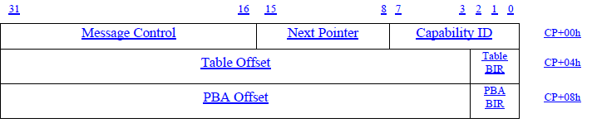
MSI-X Capability Structure
The MSI-X capability structure points to an MSI-X Table structure and a MSI-X
Pending Bit Array (PBA) structure, each residing in Memory Space. The Capability
ID is 11h.

Slide 21
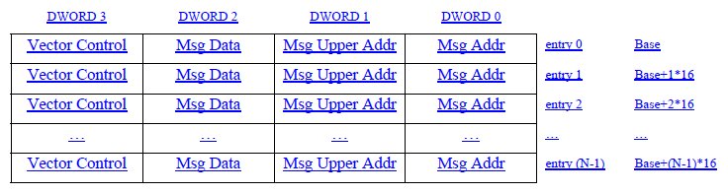
MSI-X Table Structure
The MSI-X Table structure, typically contains multiple entries, each consisting of
several fields: Message Address, Message Upper Address, Message Data, and
Vector Control. Each entry is capable of specifying a unique vector

Slide 22
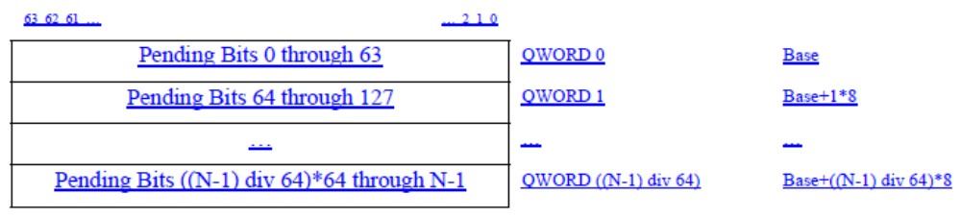
MSI-X PBA Structure
The Pending Bit Array (PBA) structure, contains the function’s Pending Bits, one per
Table entry, organized as a packed array of bits within QWORDs. The last QWORD
will not necessarily be fully populated.

Slide 23
Extended Configuration Mechanism
Extends device configuration space
Not accessible on Legacy operating systems
Flat memory mapped access for extended configuration
4096 bytes of memory mapped space per device
First 256 bytes alias traditional PCI index/data configuration space
No index/data access
Located by base address + offset (bus, device,function)
Firmware communicates base address to OS

Slide 24
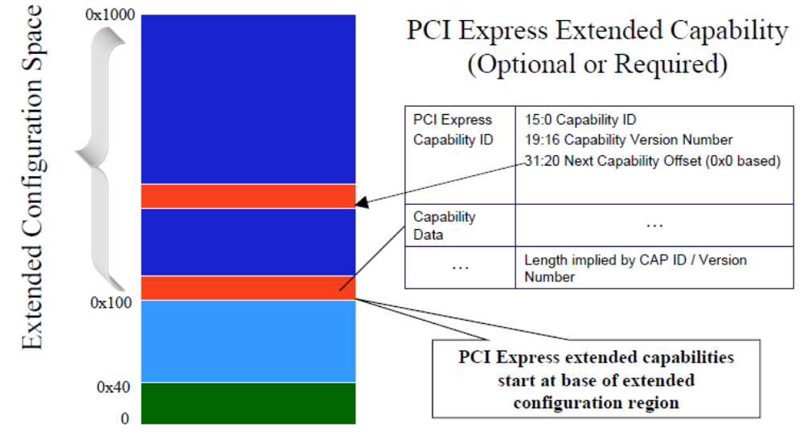
Extended Configuration Space Layout

